Slide 1


President Elect & Assistant Governor Learning Seminar 2026/2027
Rotary International President Olayinka Hakeem Babalola, member of the Rotary Club of Trans Amadi, Nigeria
District Governor 7070 Elizabeth (Liz) Compton, from the Rotary Club of Toronto Leaside.
Saturday, 7th of February 2026 Oshawa Golf Club

Slide 2
Governance – Bottom Line Up Front
Governance is a system
Avoids conflict
Ensures compliance with rules and regulations
Roles/Responsibilities need to be taken seriously
Make your year that much more rewarding

Slide 3
In a Rotary Context
The system by which an organization is directed and controlled

Slide 4
Governance Defined
...how does the Board ensure the proper running of the club so that it meet the needs of all interested parties.
Rotary International Members Community Government

Slide 5
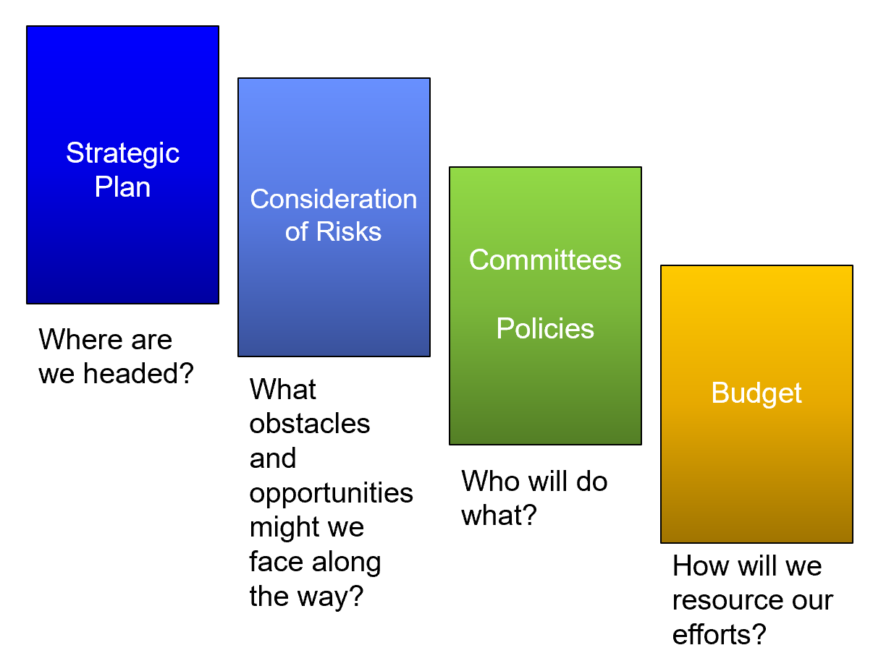
Sources of Direction

Slide 6
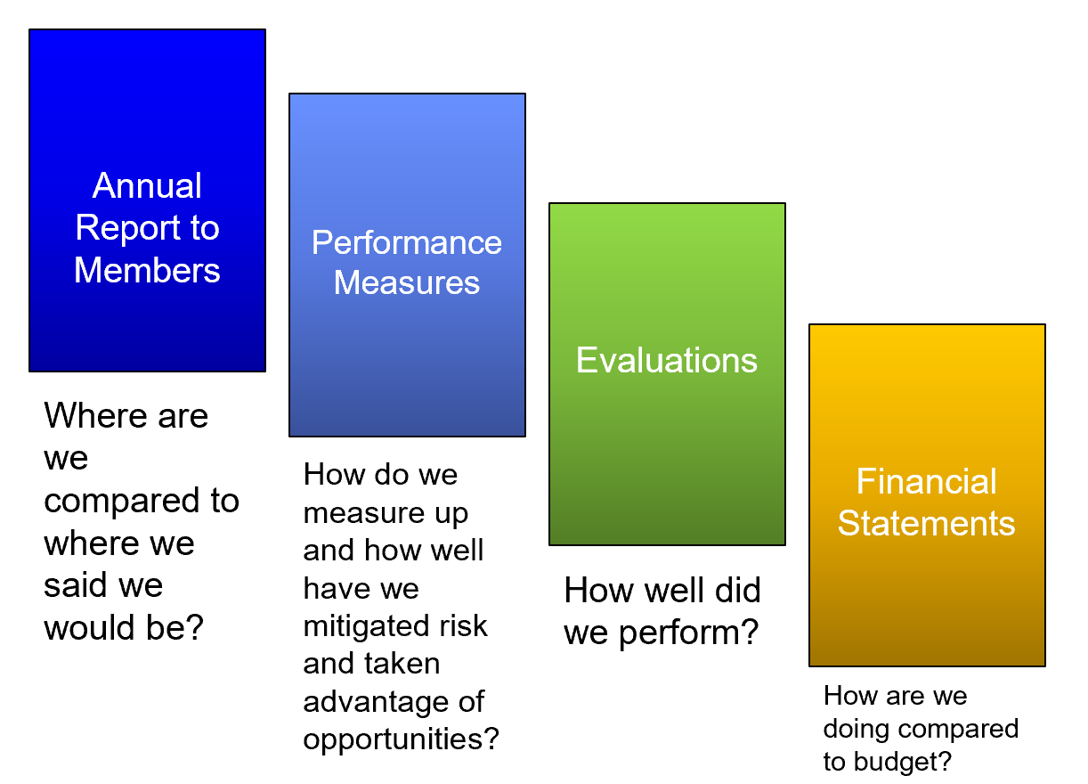
Sources of Control

Slide 7
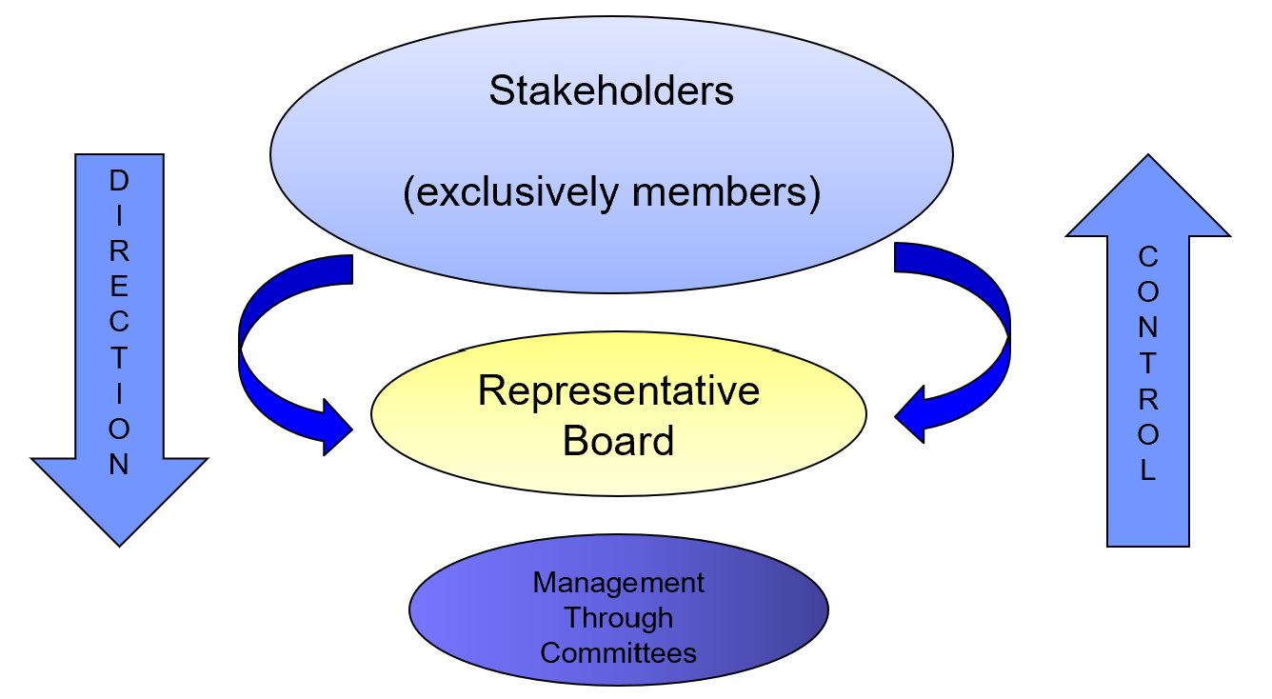
The Rotary Operational Board

Slide 8
Primary Role of the Board
Annual recommendation of the President to the Members?
Setting direction and making decisions on behalf of the members
Monitor performance and ensure compliance with governing documents and laws
Monitoring risk and club culture

Slide 9
Duties of a Director
Two primary duties:
Duty of care – informed and prepared decision making
Duty as a fiduciary – to act solely in the best interests of the member
Directors bear the legal responsibility for decision made by the Board

Slide 10
A Board is effective when…
Chair is objective and Directors are fully engaged
The right items are being discussed at meetings
Constantly communicating to members
Understands compliance documents (i.e. bylaws/policies)
Speaks as one voice

Slide 11
Enemies of Board Effectiveness
Lack of time/effort
Lack of information/knowledge
Group-decision making style
Lack of independence

Slide 12
Key Considerations
Do you have a culture of governance
Are the right people in the right Director roles
Are committees effective
Are you ONCA compliant

Slide 13
Key Considerations
Do you know your bylaws
Are your bylaws, policies and procedures up to date
Do you have a system for succession planning
Do you have a documentation and archiving system

Slide 14
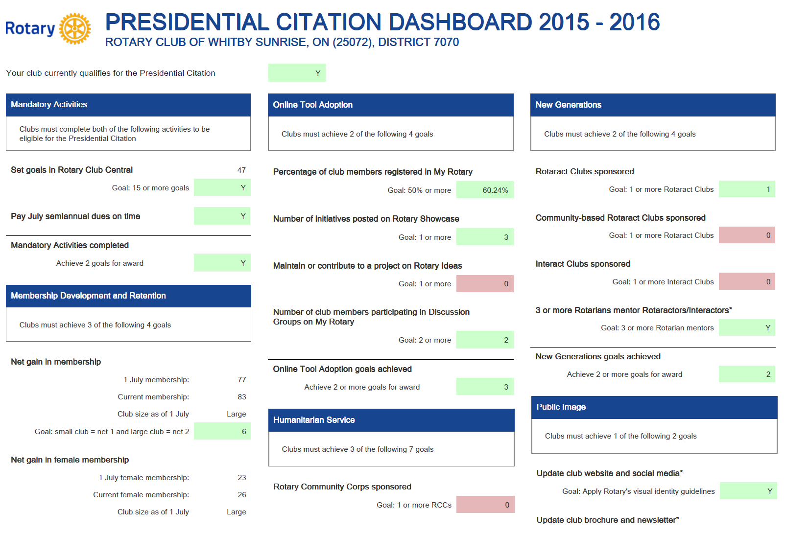
A Useful Tool - Dashboard

Slide 15
A Useful Tool - Agenda
Confirm quorum
Ensure no conflicts of interest
Approve minutes of last meeting
Use a consent agenda
Leave time for generative discussions on key decision items

Slide 16
Need Support?
Terry Caputo
Cell: 905-213-5925
Email: terrycaputo@outlook.com

