Slide 1


President Elect & Assistant Governor Learning Seminar 2026/2027
Rotary International President Olayinka Hakeem Babalola, member of the Rotary Club of Trans Amadi, Nigeria
District Governor 7070 Elizabeth (Liz) Compton, from the Rotary Club of Toronto Leaside.
Saturday, 7th of February 2026 Oshawa Golf Club

Slide 2
Public Image Committee
Presenters: Dave Andrews Joe Solway

Slide 3
Today’s Presentation
Why a positive public image for your club is so important
Resources
Check your Checklists: Public Image & Web Presence
What’s New for 2026-27

Slide 4
Rotary Public Relations
Public relations efforts are vital to Rotary’s continued growth and service.
Creating a positive image for Rotary is the responsibility of every Rotarian, both locally and globally
Everyone in your club is an ambassador for Rotary

Slide 5
Your Club Public Relations Plan for 2026-27
As Club President your role is to CREATE a Club Public Image committee (director, chair, and committee members)
The Committee Mandate is to:
to tell Rotary’s story to the public and
to promote your club’s projects and activities.

Slide 6
Why a Positive Public Image ? Here’s The Bottom Line
When your Rotary Club has a positive public image:
your current members are motivated to be active
AND
prospective members are eager to join your club.

Slide 7
This powerpoint presentation, in its entirety, will be seen on the ‘www.rotary7070.org’ District website
Go to the “About 7070” tab at the top of the page
Scroll down and click on the tab “PELS 2026-27 and you will find Public Relations For Your Club”
Slide 7
Notes:
Future Vision Plan Update, Nov 2008
7

Slide 8
A Public Relations checklist for your club
Check your PR Checklist:
Does your club have a Public Image Director and Chair and a Committee? Is there someone in your club designated to take photos, update your website and post on social media?
Do you know the media in your area?
Do you send out press releases & posts on Social media?
Are News media members of your club?
Who are your publics?
Are you using the Tools of the Trade – Resources?

Slide 9
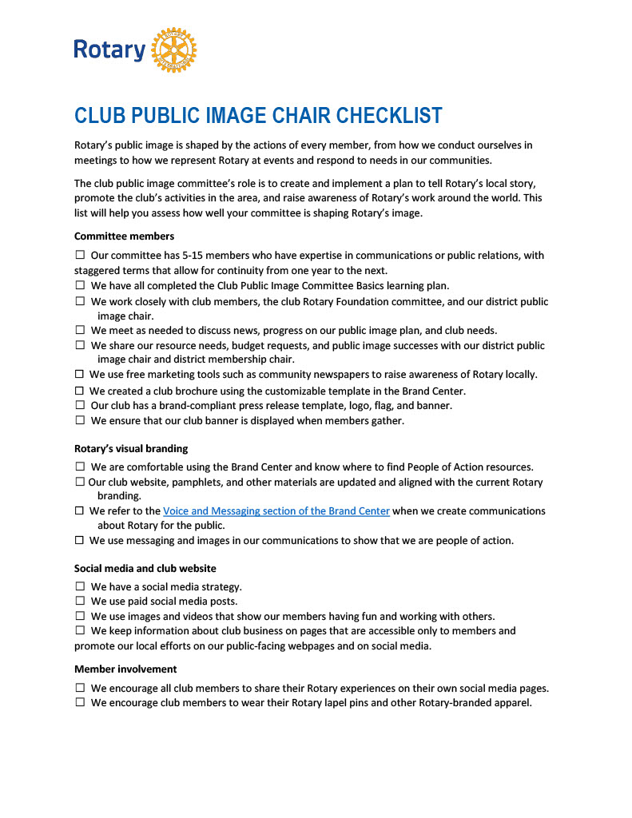
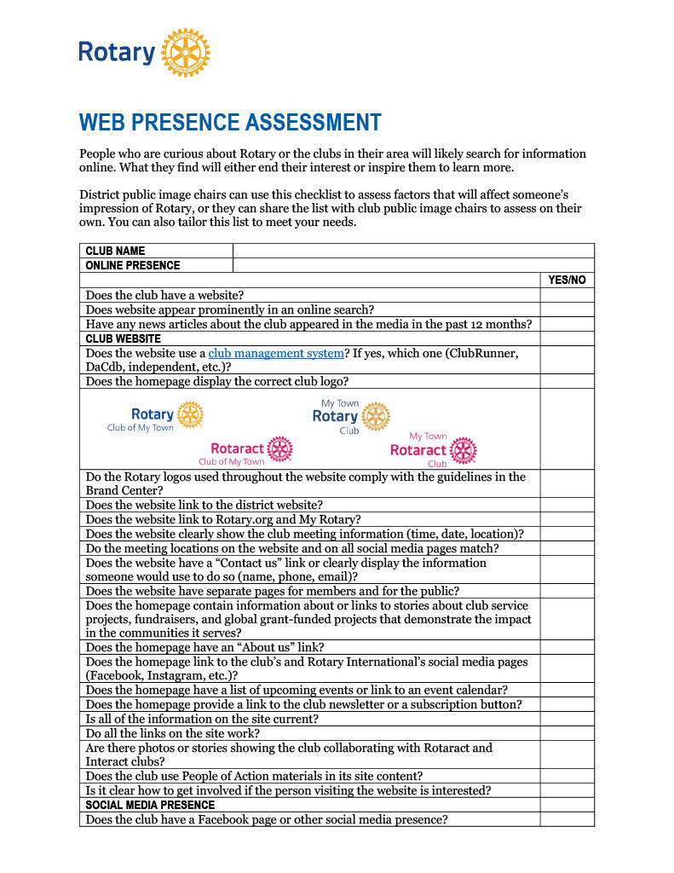
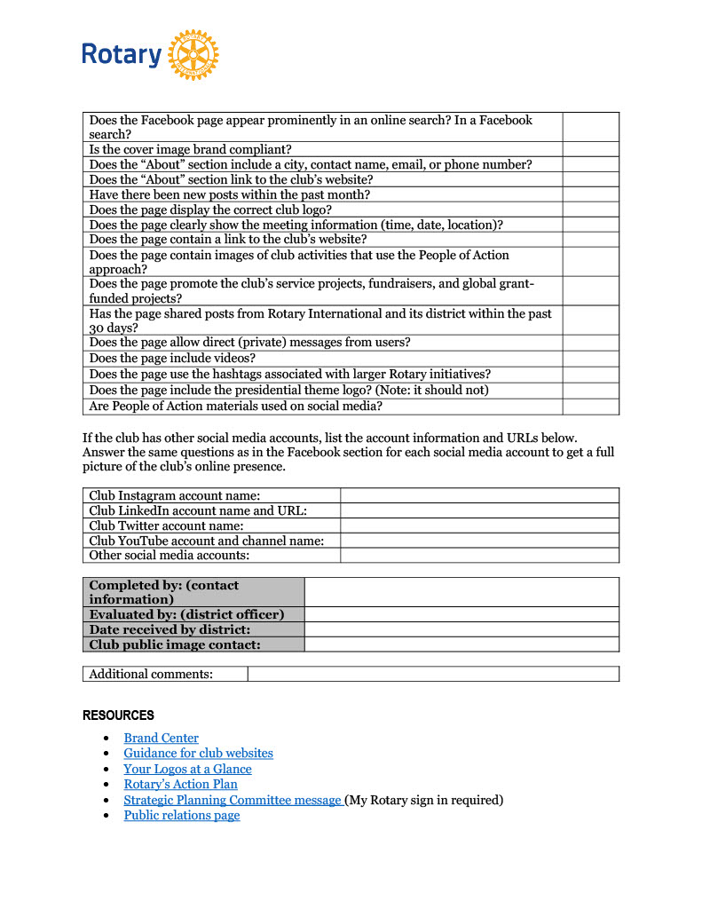
PUBLIC IMAGE CHECKLIST & WEB PRESENCE ASSESSMENT
SHARE THESE WITH YOUR BOARD OF DIRECTORS, YOUR PUBLIC IMAGE COMMITTEE, AND ALL OF YOUR CLUB MEMBERS
Club Public Image Checklist Club Web Presence Assessment

Slide 10
SOME KEY COMMITTEE RESPONSIBILITIES
1. Use social media to promote awareness of Rotary
and your club in your community
2. Share your club’s Rotary stories with the local media
(including social media)
3. Become familiar with Rotary’s public relations resources
Slide 10
Notes:
Future Vision Plan Update, Nov 2008
10

Slide 11
Know your media in your area
Print or ON LINE – Daily, Weekly, Monthly, Regional, SNAP / Neighbour Today
Radio – Local Stations
TV – Local, National, Cable
Social Media – Facebook, Twitter, Instagram, ETC !!!
Do you know the news editors and reporters at each media location?
The names, email addresses, phone numbers
Their deadlines for publishing

Slide 12
Know your media in your area
Do you reach out to the news editors at each media location?
Give them a call.
Invite them to a Rotary Meeting to see what Rotary is all about
Invite them to be a speaker

Slide 13
Press Releases and Social Media Posts
Do you currently do your own press releases?
Do you send out press releases?
Do you use the News Release templates in the Brand Center?
Do you use these sources: RI Brand Center, our District Website, District Newsletter, Rotary.org/My.Rotary for Rotary Information?
Your press releases are a basis for your social media posts
Are your press releases being published?

Slide 14
News media as club members
Do you have any News media as members of your club?
Are they on your PR Committee?
Are you actively searching for one (or more) to become a club member (or perhaps a friend of Rotary) ?

Slide 15
Joe Solway
Here’s Joe Solway
(Rotary Zone 28 & 32 Assistant Rotary Public Image Coordinator)
How to use the media to tell your story
And
How to Be The BRAND

Slide 16

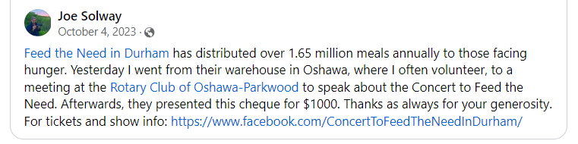
The Big Rotary Cheque

Slide 17
Who Are Your Publics / Audiences?
the media
local government officials
the business community
civic leaders and other organizations
prospective members
Your current members
people directly affected by Rotary service projects.
Notes:
Future Vision Plan Update, Nov 2008
17

Slide 18
Tools of the Trade - Resources
Rotary International News Releases
District 7070 Newsletter
Info from Websites:
Rotary International https://www.rotary.org/en
Rotary Zone 28 & 32 https://portal.clubrunner.ca/50077/
District 7070 https://rotary7070.org/
Your Club website
The Social Media
RI and District 7070 Facebook, Twitter, Linked In, Instagram, YouTube, etc

Slide 19
RESOURCES
1. Lead Your Club – Public Relations Committee manual: 2016-19 Edition 226c-EN https://clubrunner.blob.core.windows.net/00000050157/en-ca/files/sitepage/public-image/lead-the-way---public-relations-committee-man/Lead-The-Way---2016-19-PR-Committee-Manual--226c_en--14-.pdf
2. Tell Rotary’s Story - Voice & Visual Identity Guide For
Rotarians 547A-EN
https://clubrunner.blob.core.windows.net/00000050157/en-ca/files/sitepage/public-image/rotarys-voice-and-visual-identity-guide/Rotary-Voice-and-Visual-Identity-Guide---547Aen---Sept-2016.pdf
3. The Rotary Brand Center (My Rotary on the RI Website)
https://brandcenter.rotary.org
4. Our newest Public Image Campaign:
People of Action ( in the Rotary Brand Center)
https://rotary7070.org/stories/rotary-s-people-of-action-campaign
Slide 19
Notes:
Future Vision Plan Update, Nov 2008
19

Slide 20
RESOURCES
5. Media Crisis Handbook 515-EN
http://www.rlifiles.com/files/resource/mediacrisis515.pdf
6. “Enhancing Our Public Image” page (My Rotary/ Learning & reference/Learn by Topic) on the RI rotary.org website
https://my.rotary.org/en/learning-reference/learn-topic/enhancing-our-public-image
7. Club Public Image Checklist from the Rotary International PR Team
https://clubrunner.blob.core.windows.net/00000050157/en-ca/files/sitepage/public-image/club-public-image-checklist/Club-public-image-chair-checklist-en---Jan-16--2023.pdf
Slide 20
Notes:
Future Vision Plan Update, Nov 2008
20

Slide 21
RESOURCES
Club Web Presence Checklist from the Rotary International PR Team
https://clubrunner.blob.core.windows.net/00000050157/en-ca/files/sitepage/public-image/club-web-presence-assessment/Web_Presence_Assessment-en.pdf
9. Two Rotary Zones 28 & 32 Webinars:
“Rotary – What’s In A Name?” https://www.youtube.com/watch?v=J_JM_hiXNxg
“ Resonating Narratives – Crafting Stories That Inspire & Impact”
https://youtu.be/-4ls6KfyUuc?si=rGKkxvax_P7btjPE
Slide 21
Notes:
Future Vision Plan Update, Nov 2008
21

Slide 22
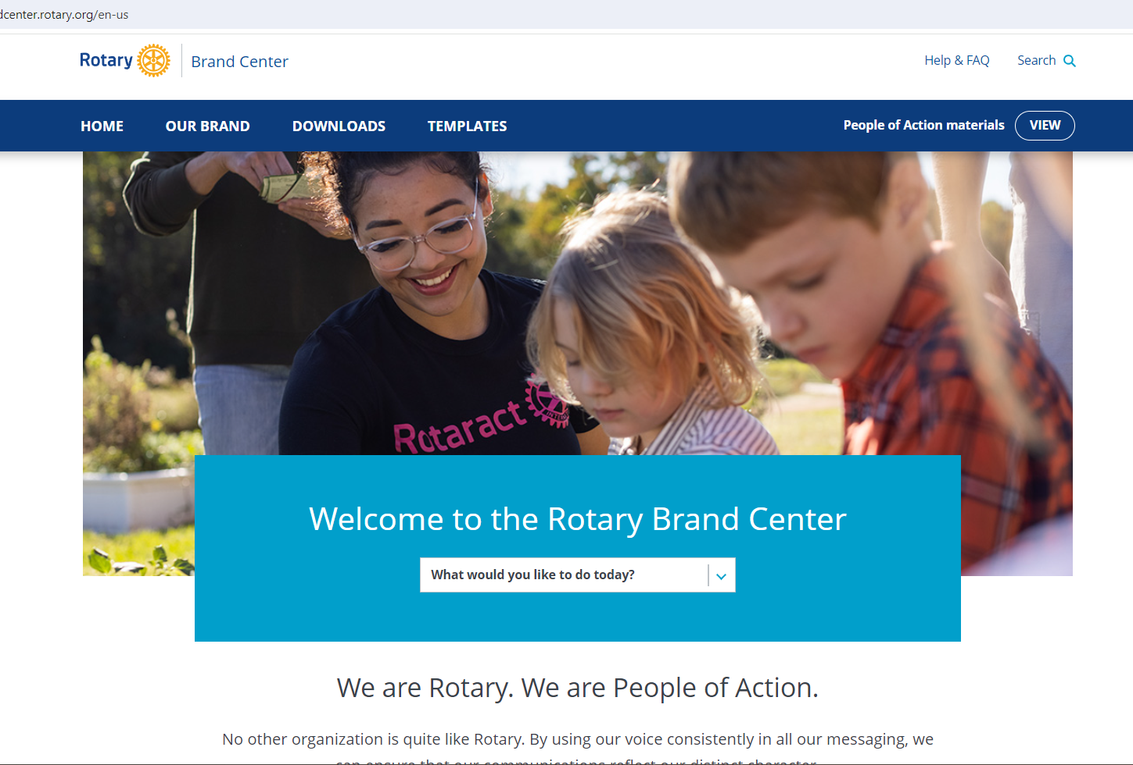
The Rotary Brand Center
Slide 22
Notes:
Future Vision Plan Update, Nov 2008
22

Slide 23
The Rotary Brand Center
The Rotary Brand Center:
- Brand Story - tell our story in ways that help people everywhere
understand what Rotary does, how we’re different, and why our work
matters
- People of Action – Sharing Rotary with New Audiences
- Brand Elements – Brining our Brand to Life
- Ways to Promote Rotary -Being consistent in our
communications
Slide 23
Notes:
Future Vision Plan Update, Nov 2008
23

Slide 24
The Rotary Brand Center
The Rotary Brand Center:
offers a simple and intuitive way to customize your club logo
create a marketing brochure for your Club
or give your newsletter (bulletin) AND WEBSITE a fresh look.
Slide 24
Notes:
Future Vision Plan Update, Nov 2008
24

Slide 25

The Rotary Brand Center
Our public image campaign: People of Action
Download ads and materials TODAY
This is the “next step” in our global brand strengthening initiative
It is a multi year campaign that narrows the gap between public awareness and public understanding of ROTARY
Slide 25
Notes:
Future Vision Plan Update, Nov 2008
25

Slide 26
“Enhancing Our Public Image” ON THE ROTARY.ORG WEBSITE
log in to “My Rotary” on the rotary.org website
Go to the “Learning & Reference” on the scroll bar
Go to “Learn By Topic” and Hit: “Enhancing our Public Image”
https://www.rotary.org/myrotary/en/learning- reference/learn-topic/enhancing-our-public-image
Slide 26
Notes:
Future Vision Plan Update, Nov 2008
26

Slide 27
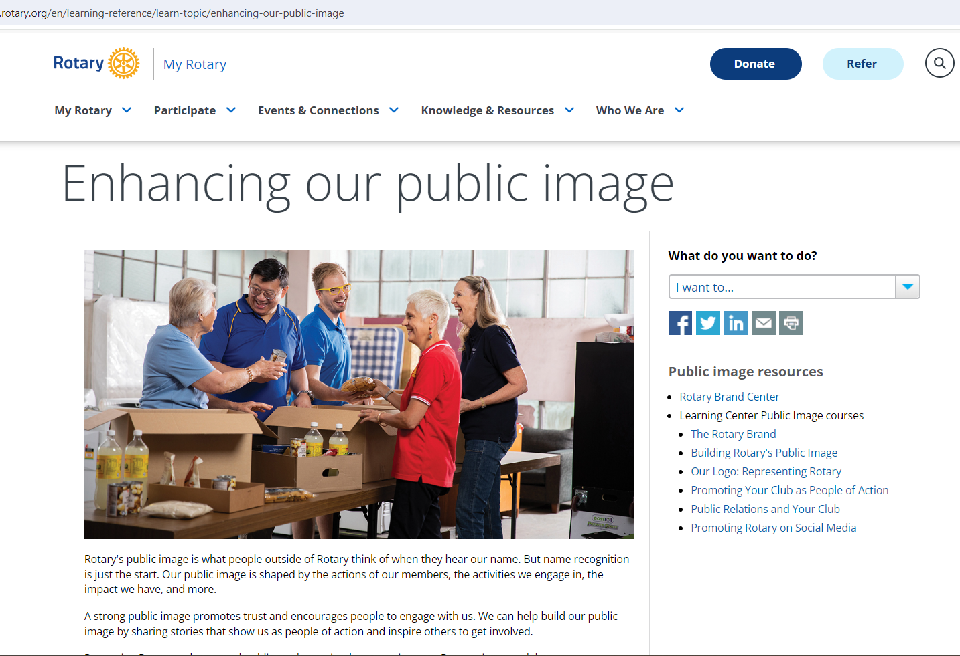
“Enhancing Our Public Image” ON THE ROTARY.ORG WEBSITE
Slide 27
Notes:
Future Vision Plan Update, Nov 2008
27

Slide 28
“Enhancing Our Public Image” ON THE ROTARY.ORG WEBSITE
This PR Website page is filled with ideas can help you create a successful campaign.
Know your local media
Write a press release that journalists want to read
More ideas for promoting Rotary
Excellent Resources and references
Tools
Slide 28
Notes:
Future Vision Plan Update, Nov 2008
28

Slide 29
“Enhancing Our Public Image” ON THE ROTARY.ORG WEBSITE
More ideas for promoting Rotary
hold a special event
start a Facebook page
place a billboard ad
Advertise on cable and public access TV
Slide 29
Notes:
Future Vision Plan Update, Nov 2008
29

Slide 30
“Enhancing Our Public Image” ON THE ROTARY.ORG WEBSITE
More ideas for promoting Rotary
Create a public service announcement
Write op-eds and letters to the editor
Distribute club brochures, media kits, and fact sheets
Post on your club website and social media outlets, including blogs, Facebook, Twitter, YouTube, Instagram
Slide 30
Notes:
Future Vision Plan Update, Nov 2008
30

Slide 31
“Enhancing Our Public Image” ON THE ROTARY.ORG WEBSITE
Promoting Rotary to the general public can be as simple as wearing your Rotary pin or as elaborate as organizing an integrated marketing campaign.
By increasing the public's understanding of Rotary, we're strengthening our ability to make an impact in communities around the world.
Slide 31
Notes:
Future Vision Plan Update, Nov 2008
31

Slide 32
“Enhancing Our Public Image” ON THE ROTARY.ORG WEBSITE
Include a public relations component in your club's service project plan:
It will help ensure your club’s projects and events get the attention and support they deserve.
Slide 32
Notes:
Future Vision Plan Update, Nov 2008
32

Slide 33
Rotary Merchandise
Promoting Rotary to the general public can also be as simple as wearing your Rotary T Shirt when doing service projects in your community
Does your club have Rotary T shirts?
Right logo?
Locally sourced or from a licensed Rotary vendor?
Slide 33
Notes:
Future Vision Plan Update, Nov 2008
33

Slide 34
Social Media
Does Your Club have a Facebook Page, Instagram and Twitter Accounts, Blogs? (Rotary does)
Do you send videos to You Tube (Rotary does)? Rotary does and be sure to Check out the District 7070 You Tube Channel
Is your Rotary Club LinkedIn? (Rotary is)
Slide 34
Notes:
Future Vision Plan Update, Nov 2008
34
.

Slide 35
District 7070 Social Media
Please follow District 7070 on their Facebook page, Twitter account , and Instagram Account (note : we are in the process of revising our LinkedIn account)
Share our posts on your Facebook page, Twitter account and Instagram account
Same for our District 7070 You Tube Channel videos (share them , show them and post them too)
Slide 35
Notes:
Future Vision Plan Update, Nov 2008
35
.

Slide 36
Why Social Media ?

Slide 37
Create Connections
A well-built media presence will help you create connections in your community and beyond, from building awareness of your club’s presence to showcasing its success.
Current members
Potential members
Community partners
Event sponsors
Attendees

Slide 38
Do You Want New Members in Your Club? YOU HAVE TO GET SOCIAL from Evan Burrell
“While it can seem overwhelming, social media is the best Rotary promotional tool for building strong relationships and engaging with your community.
If you set yourself some achievable goals this year, you and your club will reap the rewards.”
….. Evan Burrell

Slide 39
Pick Your Social Media Platform
With so many social media platforms available, getting started can be intimidating.
Choose one platform to focus on and grow from there.
We recommend starting with Facebook, which has the largest user base.

Slide 40

3 Primary Types
Facebook has nearly 3 billion monthly active users and reaches more than 50% of internet users worldwide.
Notes:
A Facebook page can establish your club's social media presence and reach members who are already using this platform.
Facebook lets you showcase content such as videos, photos, news, and events.
It's also useful for building relationships with prospective members and the local community.
Your page can have limited reach, however, if you don't pay for advertisements or boosted posts.

Slide 41

3 Primary Types
Instagram has about 2 billion active monthly users.
Notes:
It is best used for building relationships by using hashtags and keywords to search through topics.
Its Reels feature can also highlight short video content.
Instagram is a more visual platform and is better for pictures and short videos, because it doesn't support text-only content.

Slide 42

3 Primary Types
LinkedIn has more than 1 billion registered members from over 200 countries and territories.

Slide 43
What do I to Post

Slide 44
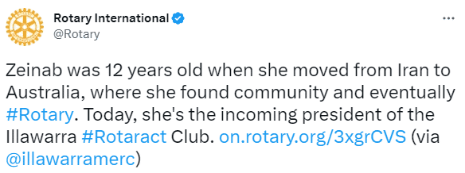
Written Content
This is the simplest content type, because you can share a status update, a link to an event, or a call to action.

Slide 45
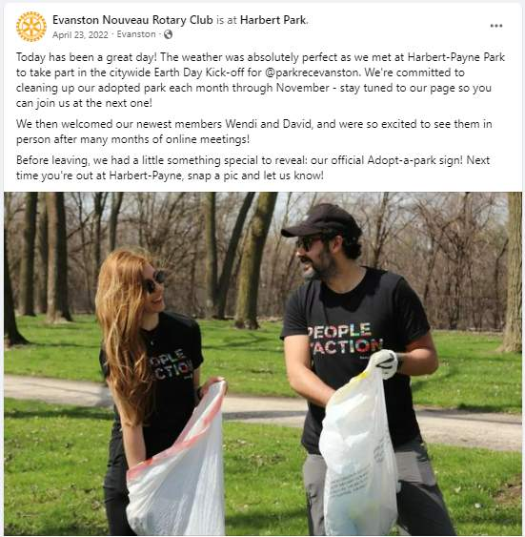
Visual Content
From photos to GIFs to infographics, visuals can bring your club's story to life. Add an image to tell your story visually or draw attention to your written message.

Slide 46
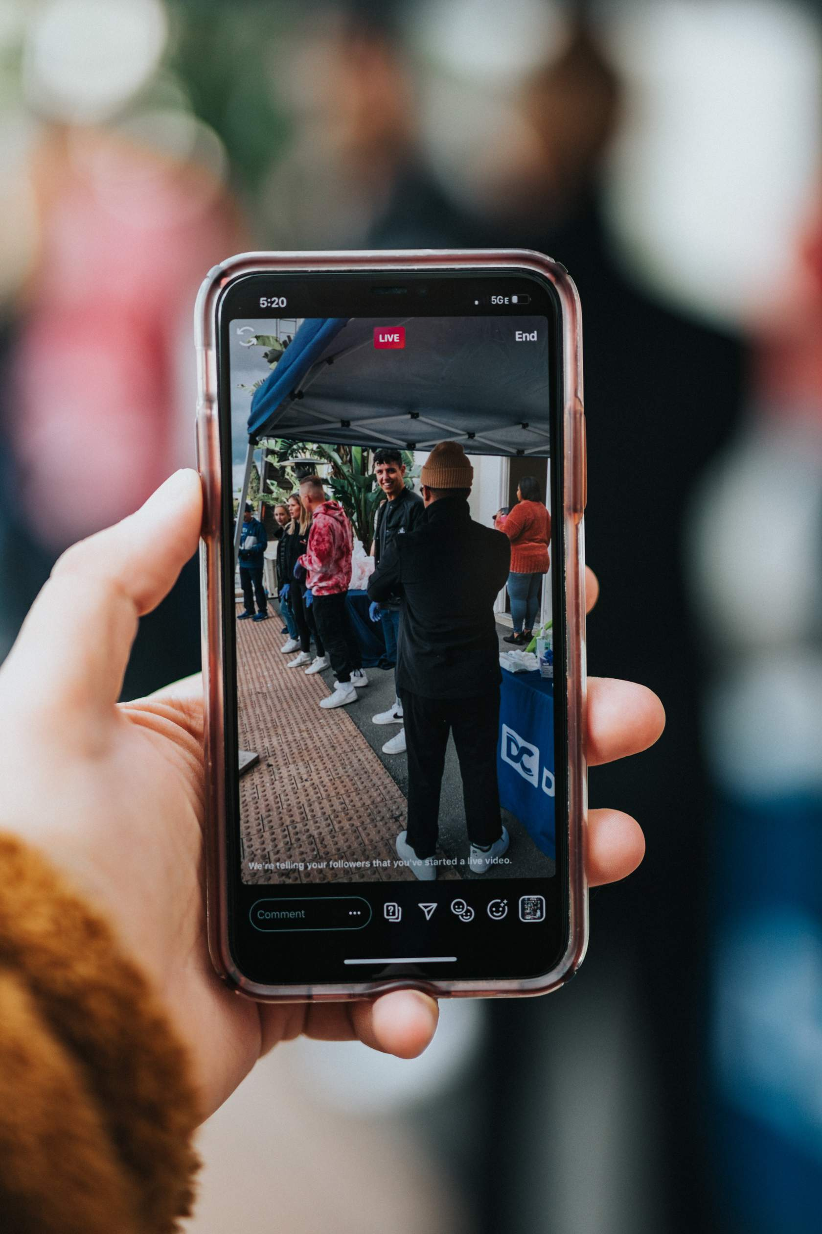
Video Content
Smartphones and editing apps make it easy to tell your story through video.
Take a behind-the-scenes video at your next event or record a series of interviews that feature club members and community partners.
Remember that short videos perform best on social media.

Slide 47
RI Board of Directors Decisions- Brand
in recognizing that consistent brand messaging and visual identity are critical to improving awareness and understanding of Rotary, The RI Board of Directors, in May 2023:
urged that “visual identity” be part of Rotary training for club presidents, district governors, and public image coordinators;
agreed that Rotary public image coordinators and district governors are responsible and accountable for maintaining brand fidelity in their districts/regions;
encouraged a culture of brand champions among club leaders;
Slide 47
Notes:
Future Vision Plan Update, Nov 2008
47
.

Slide 48
RI Board of Directors Decisions- Brand
added Rotary image and brand compliance goals to the Goal Center on Rotary Club Central to foster brand compliance accountability among Rotary club leaders;
requested that only those clubs (or Rotary-affiliated entities) that are brand compliant be featured in Rotary media outlets;
agreed that all Rotary events be “on brand” compliant and requested the general secretary to enforce this brand compliance.
Slide 48
Notes:
Future Vision Plan Update, Nov 2008
48
.

Slide 49
Rotary's Logo
The word “Rotary” always appears before our emblem in all of our signatures
This official logo is our masterbrand signature, which should be used wherever possible.
The mark of excellence (the Rotary wheel) should not appear alone
Slide 49
Notes:
Future Vision Plan Update, Nov 2008
49

Slide 50

Your Official Club Logo
Slide 50
Notes:
Future Vision Plan Update, Nov 2008
50

Slide 51
2026-27 Initiatives for Your Club
1. Club Website Refresh (& Rebate) Program
- 38 clubs completed in 2021-26
- 17 more clubs eligible for the refresh & rebate program
2. April 21, 2026 at 7 PM - Learning Tuesdays - Elevating Our Voice: Branding and Storytelling in Action: Joe Solway, our Rotary Zone 28 Assistant Public Image Coordinator has invited our Zones 28 and 32 Public Image Coordinators, Cheryl Metiva and Amy Schuller make this presentation and answer any questions you may have. Be sure to register on the District 7070 website event .
3. Speakers Corner
- updated and refreshed (on District Website – Our Work Tab)
– send us some speakers and use the ones that are there today
4. Club News in the Monthly District Newsletter
- highlight your clubs activities , ask / offer assistance to / from other
clubs (Deadline: 4 days before the first of the month)
Slide 51
Notes:
Future Vision Plan Update, Nov 2008
51
.

Slide 52
2026-27 Initiatives for Your Club
5. Rotary International Zone 28 and 32 Ignite Public Image Award
A new Public Image recognition designed to celebrate Zones 28 & 32 clubs and districts that shine a light on Rotary’s impact through consistent branding and storytelling.
This award honors those who not only share Rotary’s impact but do so with clarity, creativity, and brand excellence.
Step One: Conduct a brand audit. Ensure your club or district’s public image is brand compliant.
Step Two: fill out the Ignite Award Brand Audit Form to document your findings and take the first step toward recognition.
Every 2 months , there will be a series of new Public Image Challenges that will help your club create a lasting public image strategy, tell powerful stories, and celebrate the good you do in your community.
See the February District Newsletter for all of the details
Slide 52
Notes:
Future Vision Plan Update, Nov 2008
52
.

Slide 53
Need Help?
Go to the Public Image Tab on the District Website
Read the articles in the monthly District 7070 newsletter
Just ask us – Our Public Image Committee will be glad to Assist
Please send to Dave Andrews dave.f.andrews99@gmail.com
Or Joe Solway solwayjj@gmail.com

Slide 54
We need your help
Check your Checklist for 2026-27: Help Us Help You
Enter your club’s PR Chair’s name and email address on to your Committee List in Clubrunner

Slide 55
Questions
2026-27 Our Year Ahead Questions ??

