Slide 1


President Elect & Assistant Governor Learning Seminar 2026/2027
Rotary International President Olayinka Hakeem Babalola, member of the Rotary Club of Trans Amadi, Nigeria
District Governor 7070 Elizabeth (Liz) Compton, from the Rotary Club of Toronto Leaside.
Saturday, 7th of February 2026 Oshawa Golf Club

Slide 2
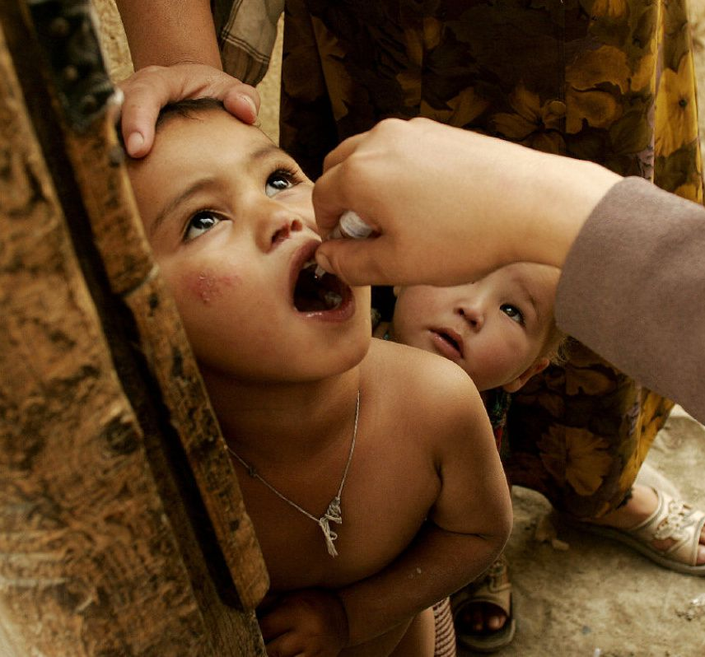
Area of Focus & Partnerships
The AOF and Partnerships Committee forms the base of the DRN
For District 7070 including;
Rotary International’s 7 Areas of Focus plus HIP
AOF Coordinators
  Maternal & Child Health: Janet Thorsteinson
  Economic & Community Development: Khalid Hasan
  Basic Education & Literacy: Joan Barrett
  Peacebuilding & Conflict Prevention: Haldene Alleyne
  Disease Prevention & Treatment: Sonya Chouljian
  Environmental Action: Nilam Bedi
  Water, Sanitation and Hygiene: Richard Mewhinney
  Honouring Indigenous People (HIP): Bill Empy

Slide 3
What do the AOF Committes Do?
The Chair of each committee should have direct knowledge pertaining to the Area of Focus
Generally, the Chair should be a member of the
RAG associated with their Area of Focus
The committee should be able to assist in
evaluating projects and Grant applications in
their Area of Focus and make suggestions on the
application
Assist with connecting to Resources to assist you in project Development

Slide 4
District International Service Chair
In District 7070 the DISC is Chair of the Area of Focus and Partnerships Committee
The DISC works with the District Foundation Chair and International Service Practitioners
The DISC helps identify experts/mentors for local and international service projects using a District Resource Network (DRN)
              A DRN is a List of Individuals with
                Subject knowledge
                Experience and
                A willingness to serve as Guides/Mentors
                445 of 535 Districts worldwide have a DISC

Slide 5
Key Points to Remember…
We want to encourage Clubs to provide details to the appropriate committee on projects dealing with their Area of Focus to ensure they are aware of all project activities in the district.
We are available to aid Rotarians and Clubs in the development and evaluation of projects employing best practices.
Help clubs with preliminary review of Grant applications as they pertain to a particular Area of Focus.
In addition, Area of Focus committees are here to provide education and would like to provide sessions/seminars leveraging outside speakers where appropriate for the district on each of their Area of Focus to enhance Rotarian engagement and their understanding of each Areas of Focus.
Key Points to Remember…

Slide 6
Resource Availability…
We have good contacts in other countries
10 of our club’s International Service Committees have done work in other countries either through Rotary or other charities. These include Kenya, Uganda, Cambodia, Dominican Republic, Haiti, Guatemala, India, Tanzania, El Salvador, Malawi and Laos.
Other active clubs with overseas visits include Eglinton, Alliston, Newmarket, Belleville and Whitby Sunrise.
This has allowed us to establish local connections with both Rotary Clubs and individuals to make best decisions.
Area of Focus Leaders are connected with Rotary Action Groups along with other experts in their Area of Focus as resources
Leverage the experience and relationships already developed.
Key Points to Remember…

Slide 7
Project Planning Resources…
If you are developing a project or evaluating a project proposal received from another source, club or District, leverage the resources available by first contacting the DISC;
Once contacted, it will activate the full list of resources available to assist you…
District International Service Committee <-> DRN <-> Cadre of Technical Advisors <-> Rotary Action Groups (RAGS)
…

Slide 8

Contact Details
Area of Focus | Focal Person | Email | Mobile
District International Service Chair | Richard Mewhinney | rmewhinney@rogers.com | 416-418-6646
Maternal & Child Health | Janet Thorsteinson | jthorsteinson5@gmail.com | 905-439-5247
Economic & Community Development | Khalid Hasan | khalid.hasan@resint.ca | 647-537-2444
Basic Education & Literacy | Joan Barrett | j-d-barrett@rogers.com | 647-284-4802
Peacebuilding & Conflict Prevention | Haldene Allenye | halleyne@bell.net | 416-846-6402
Disease Prevention & Treatment | Sonya Chouljian | rotarysonya3@gmail.com | 647-244-0890
Environmental Action | Nilam Bedi | nilam.bedi@gmail.com | 416-629-8907
Water, Sanitation and Hygiene | Richard Mewhinney | rmewhinney@rogers.com | 416-418-6646
Honoring Indigenous People (HIP) | Bill Empy | empy@prismeconomics.com | 416-482-4880
8

Slide 9
Promote your Project – Service Project Centre
If you’re using your projects to qualify for Presidential Citation or other awards, the project MUST be entered in the Service Project Centre
Uploading your project in the SPC will also allow other clubs to find and potentially support your project
All of, Global Grant, District Grant and non-grant projects can be entered
Let’s take a look
…

Slide 10
Summary
Action Items to consider:
Keep the Action and Partnership committee aware of all your projects or Area of Focus activities
Tap into the expertise of the Area of Focus Committees if you need assistance
Reach out to the Area of Focus Leaders to speak to your club
Contact a District Cadre Adviser about developing a robust project
Remember, we are here to help your Clubs understand the Areas of Focus. In District 7070 we have a wealth of experience to share.
Together, let’s
Create a Lasting Impact

