Slide 1

President Elect & Assistant Governor Learning Seminar 2026/2027
RI President Olayinka Hakeem Babalola, from Rotary Club of Trans Amadi, Nigeria
District Governor 7070 Elizabeth (Liz) Compton, from Rotary Club of Toronto Leaside.
Saturday, 7th of February 2026 Oshawa Golf Club

Slide 2

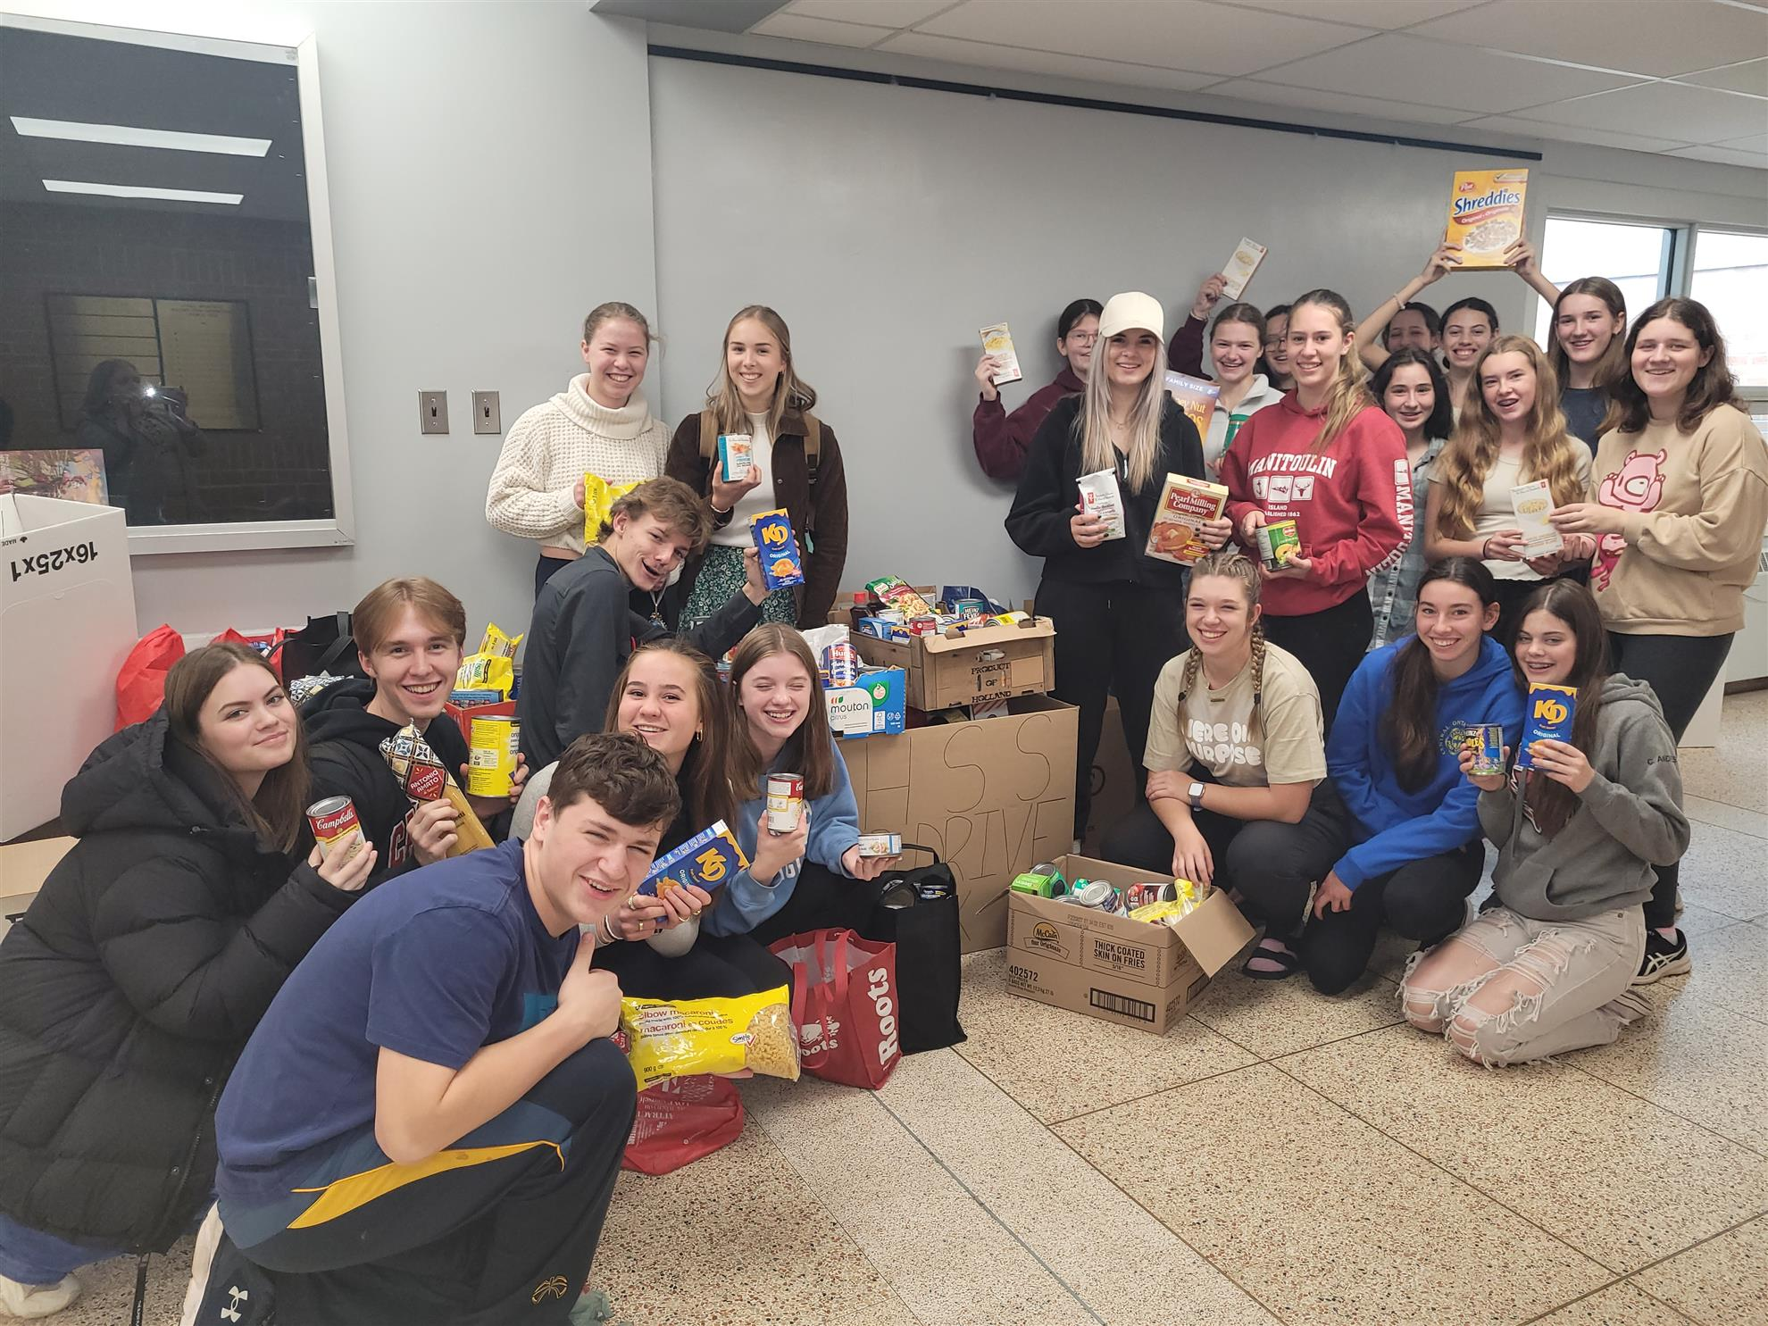
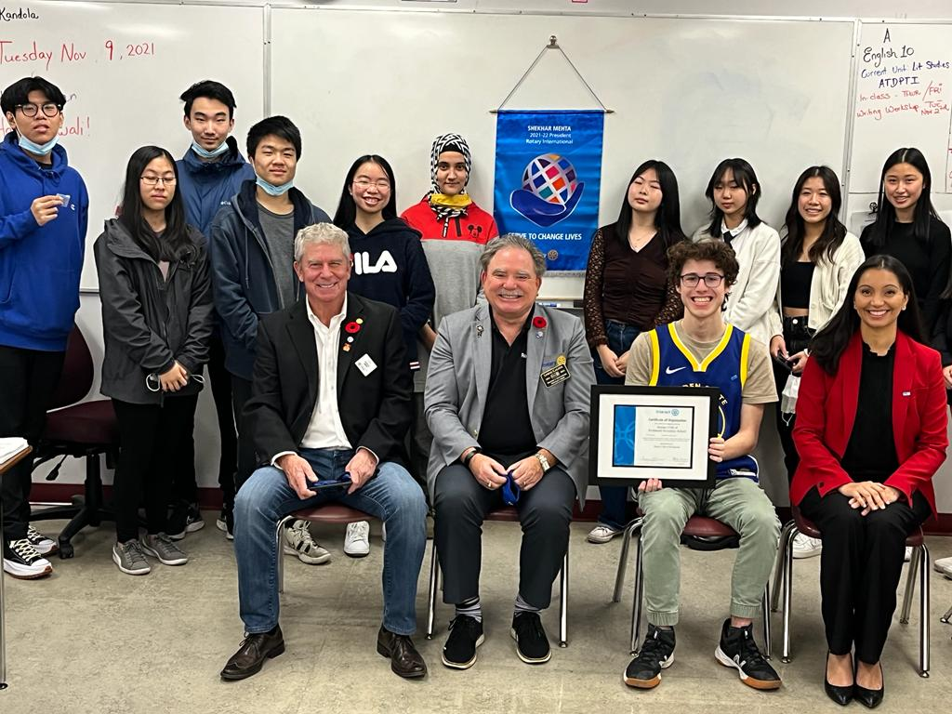

Youth Services in
Rotary District 7070

Slide 3

Agenda
Introduction & District 7070 overview
What opportunities exist for youth in District 7070?
RYLS
Youth Exchange
Rotaract
Interact
HIP Y2Y
District Events
Benefits for Youth
How you can help promote
Q&A

Slide 4
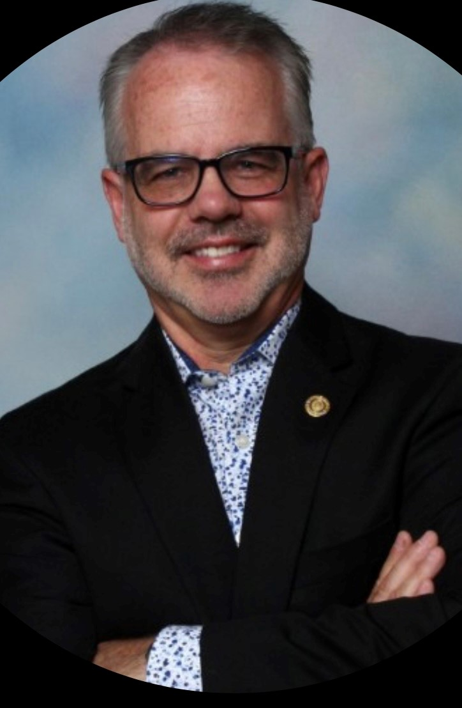
Mark Chipman
Who am I?
Rotarian since 2006
President, Whitby Sunrise, 2011-12
Rotaract Chair, 2018-21
District 7070 Governor, 2020-21
Youth Service Director, since 2021
RYLS Chair, since 2022
Past 25+ years working in IT at RBC/TD
Now retired
Die-hard Leafs Fan
Wife Leslie, 29 years married

Slide 5
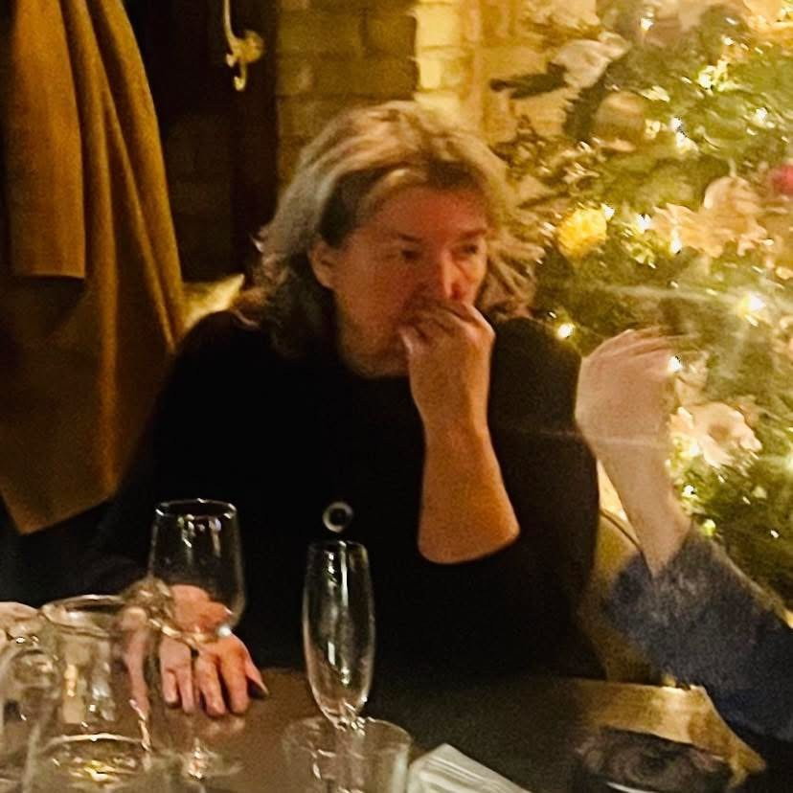
Laura Bradford
Who am I?
Rotarian since 2014
Newmarket Rotary Club
Past President
District Assistant Governor
Past RYLS Committee
Interactor Chair
Lover of all things Rotary

Slide 6
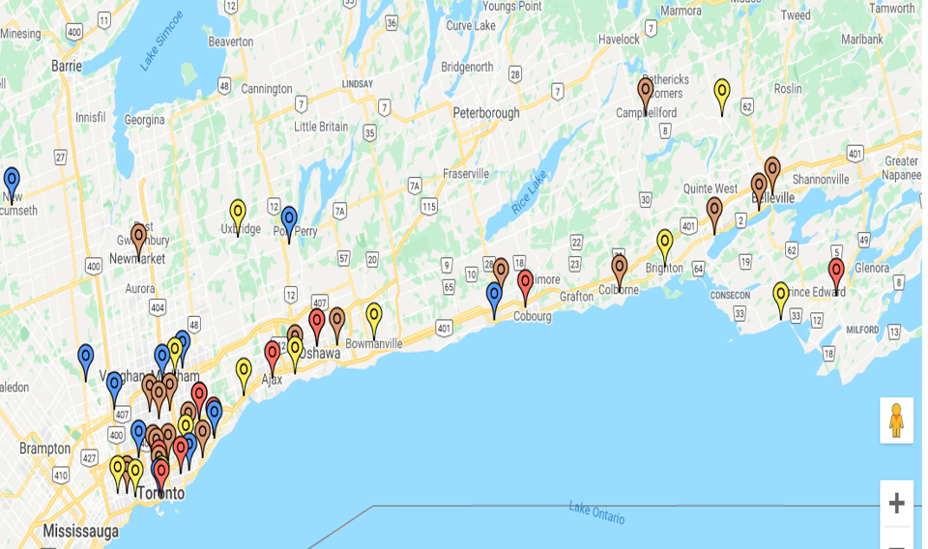
District 7070
535 Districts in world.
We are District 7070
From Etobicoke to Belleville to Newmarket
70+ Clubs:
55 Rotary
8 Rotaract
9 Interact
Members- approx 1,700
You pay dues for District services, including Youth Services
One of our 5 Avenues of Service

Slide 7
What we hear:
“No opportunities for youth!!”
My kids are always on their phones - there’s nothing for them to do!
Hard for young people to find a job without any connections!
My kids aren’t sure what they want to do for a career – no direction!
Wish there were more things in Rotary that are of interest to kids!
How can kids develop the skills that are in demand by employers!
Our club is old – we can’t attract younger members!
Young people don’t know anything about Rotary!
No activities for my kids to get their volunteer hours!
There’s nothing for youth to do in Rotary!
Sound familiar!!!
Rotary provides a wealth of opportunities for Youth

Slide 8

Interact
Interact = “international” & “action.”
For participants ages 12-18
14,911 Clubs, 342,953 members in 145 countries
Carry out the good work of Rotary
9 Interact Clubs, potentially 10
School and community based
School sponsor, President, Treasurer & Secretary, Host Rotary Club
District Interact Presidents meet on zoom monthly
Chair - Laura Bradford
Interact Club | Location
Newmarket Aurora | Newmarket
Newmarket / Sacred Heart | Newmarket
Richview | Toronto
Etobicoke Collegiate | Etobicoke
Scarborough | Scarborough
Father Bressani SS | Woodbridge
Alliston SS | Alliston
Father Leo J Austin | Whitby
Earl Haig SS | North York

Slide 9

RYLS
For students ages 16 to 20
April 9-12, 2026 at Ganaraska Forest Centre
Only 30 students accepted!
Registration closes Feb 28, 2026
The 3-night experience will offer an inspiring program:
Conflict Resolution, Goal Setting, Hands-on Activities, Team Building, Group Dynamics, Public Speaking, Outdoor Survival +++
Rotary friends and family most welcome!
Chair - Mark Chipman

Slide 10
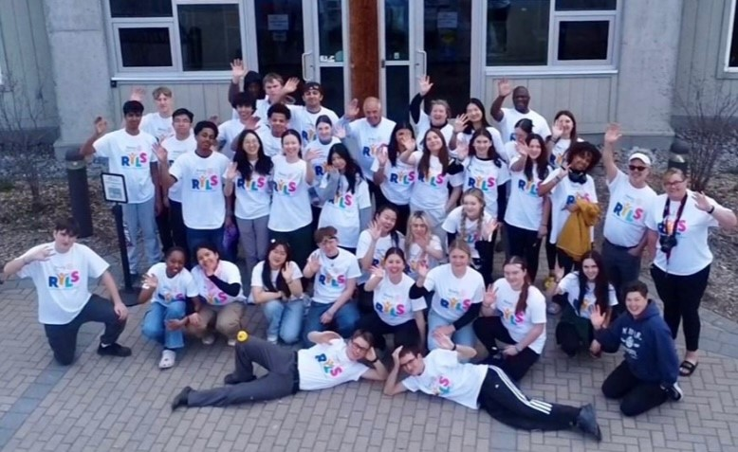
RYLS

Slide 11
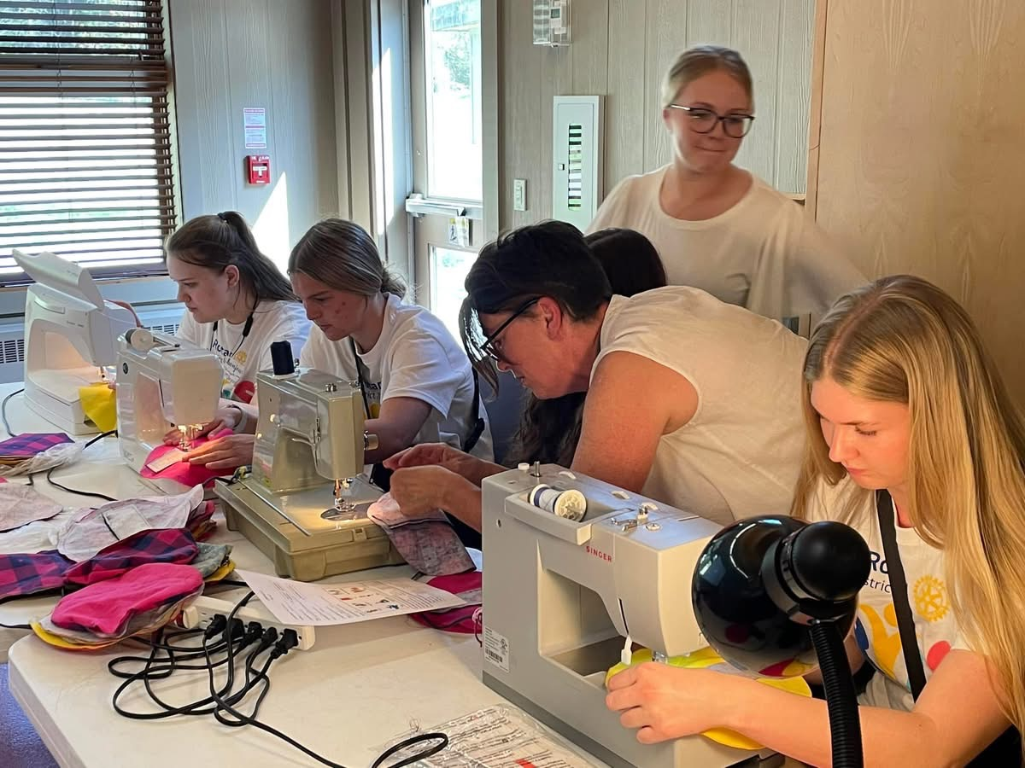
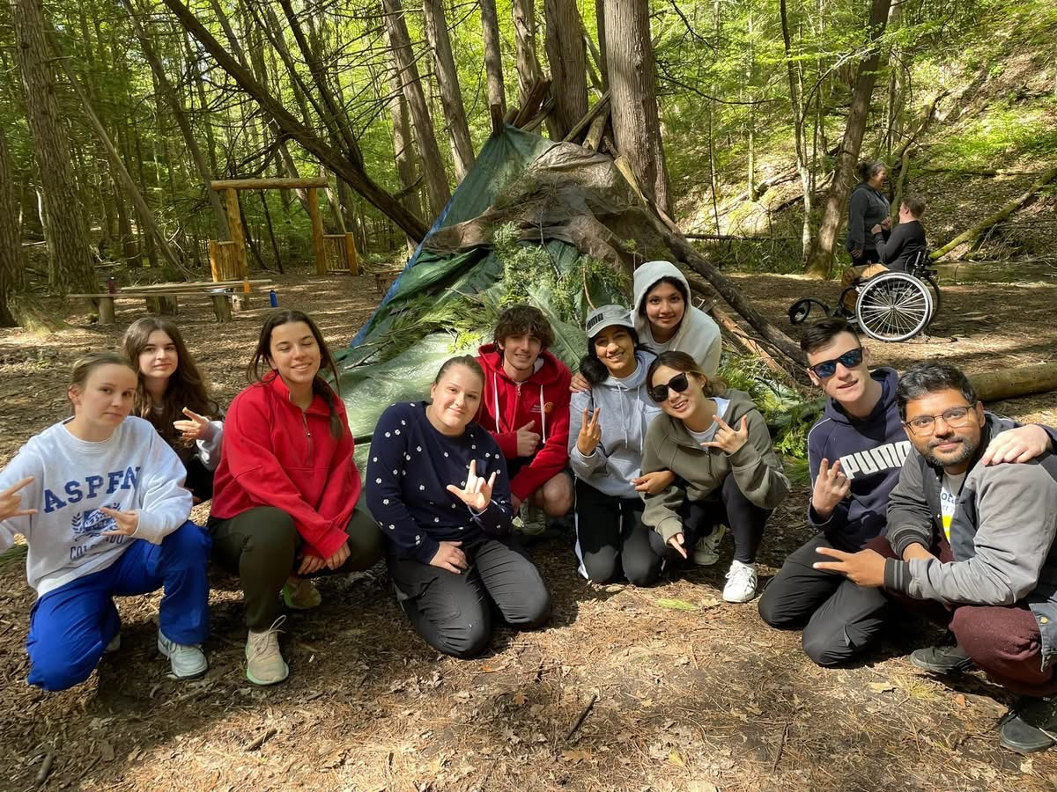
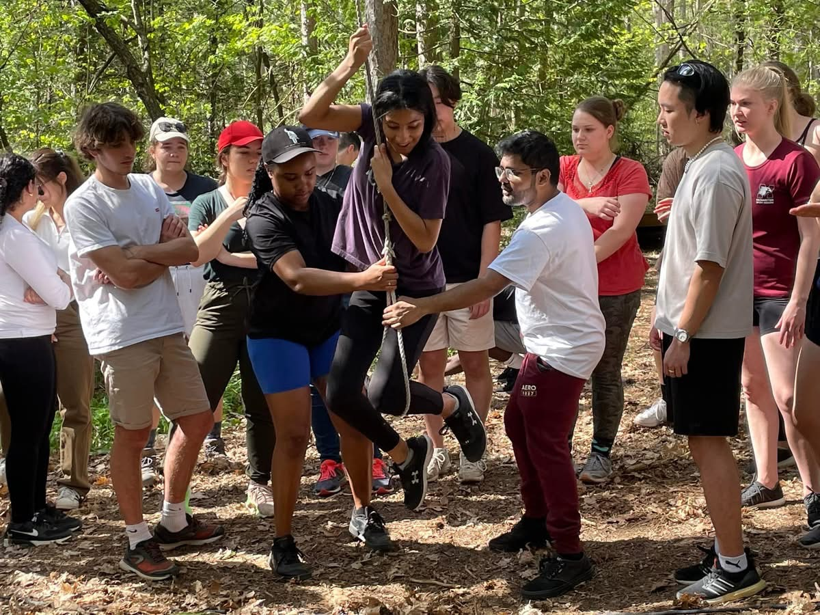
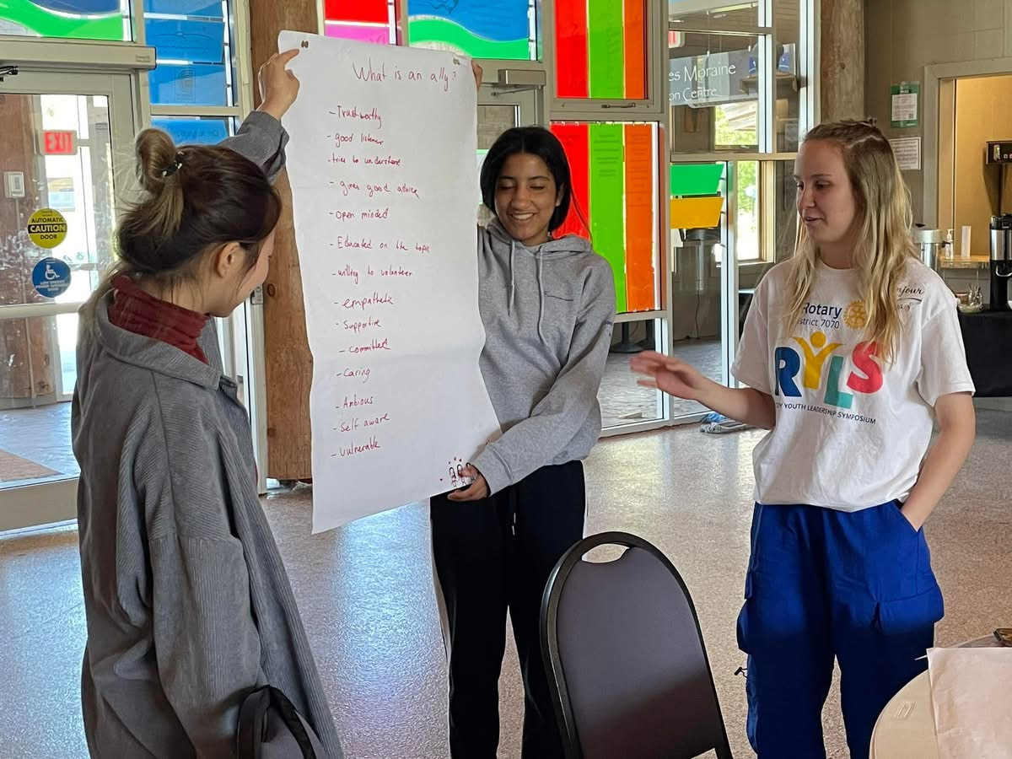
RYLS

Slide 12
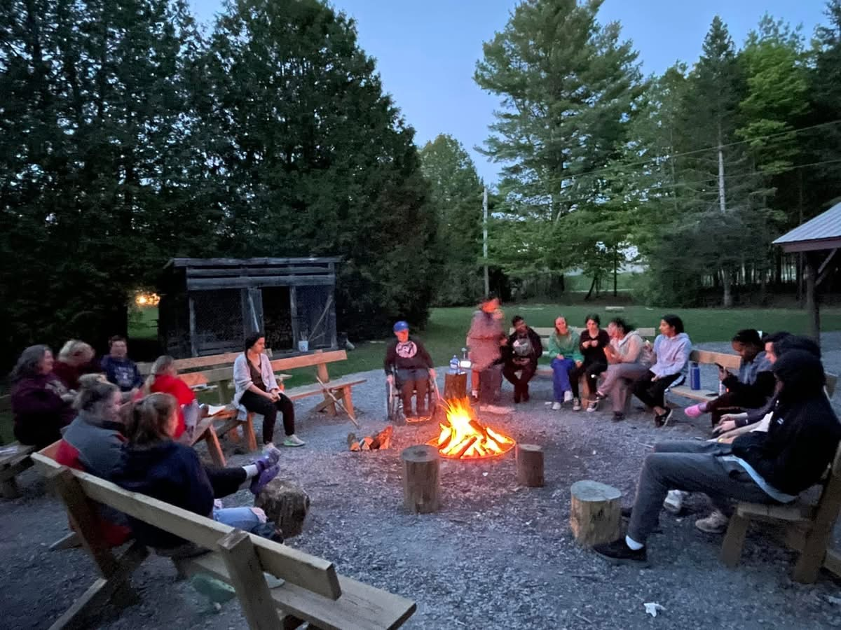
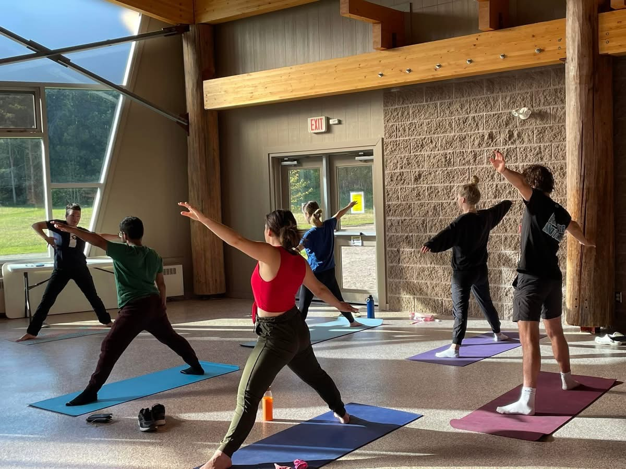
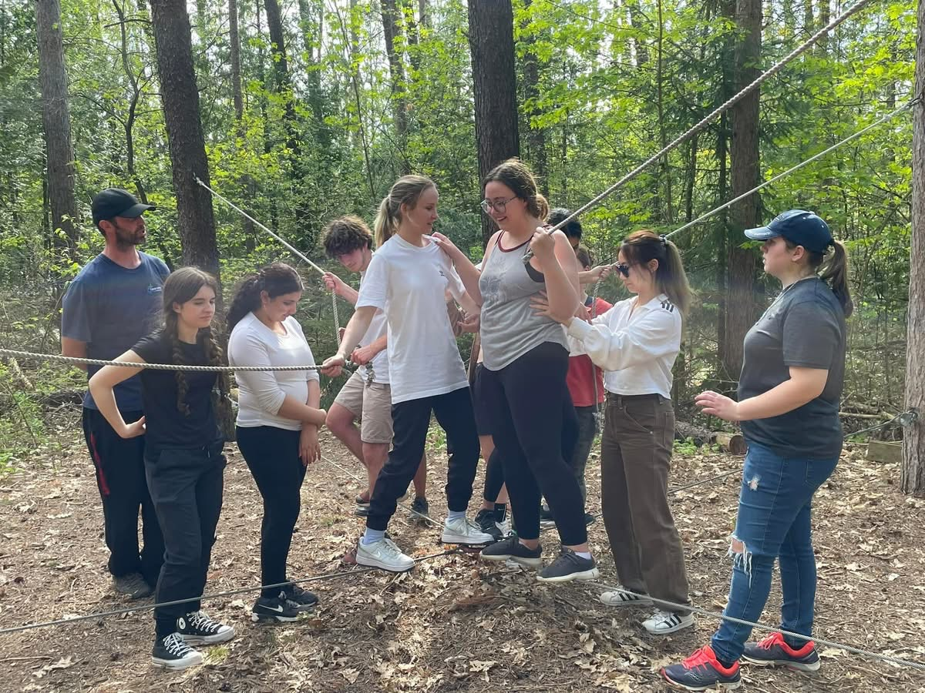
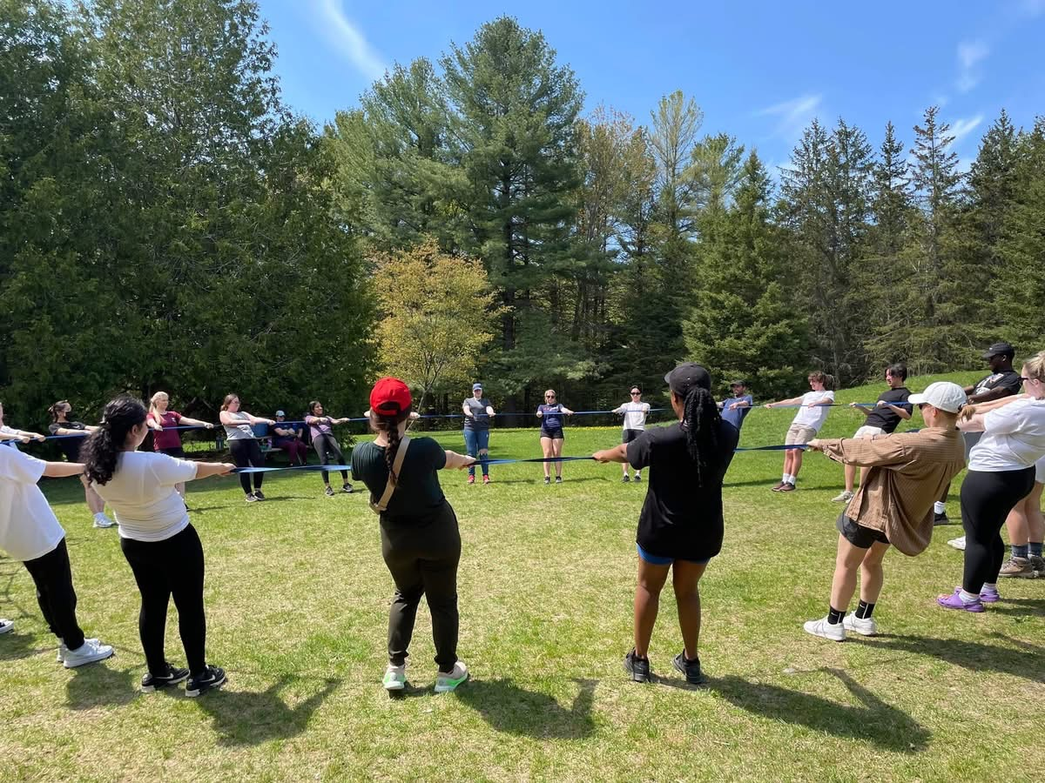
RYLS

Slide 13
TOP 10 Reasons why RYLS is awesome
#1 Solid Rotary leadership team and certified Ganaraska staff
#2 Ganaraska Centre is surrounded by forest/outdoors
#3 Learn Leadership skills
#4 Campfires
#5 Life altering experience for participants
#6 Delicious meals
#7 Life-long friendships!!
#8 RYLS Tshirt
#9 Easy application online!
#10 This incredible experience all for only $379 +HST
Apply online now (Feb 28, 2026 deadline) for the April 9-12 RYLS !!!!!
Spots still available!!

Slide 14

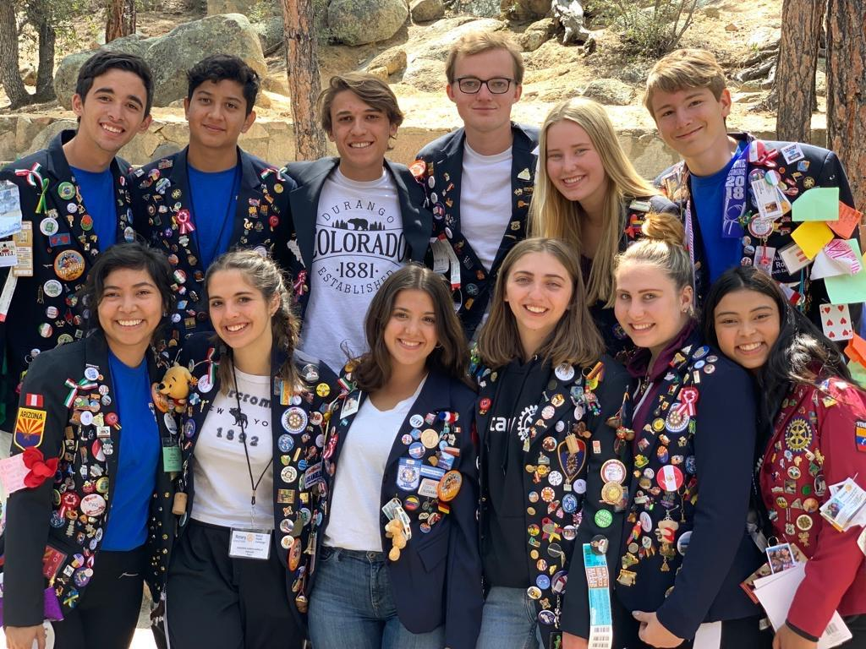
Youth Exchange
For students ages 15-17
Exchanges for one year
Countries - Italy, Sweden, Brazil, Finland, France, Belgium, Germany and others
Room and board, school fees provided by District
Students responsible for trip expenses, spending money
5 Exchange Students this year
Applications now for ‘27
Chairs – Rob Pope, Trevor Hagerman

Slide 15

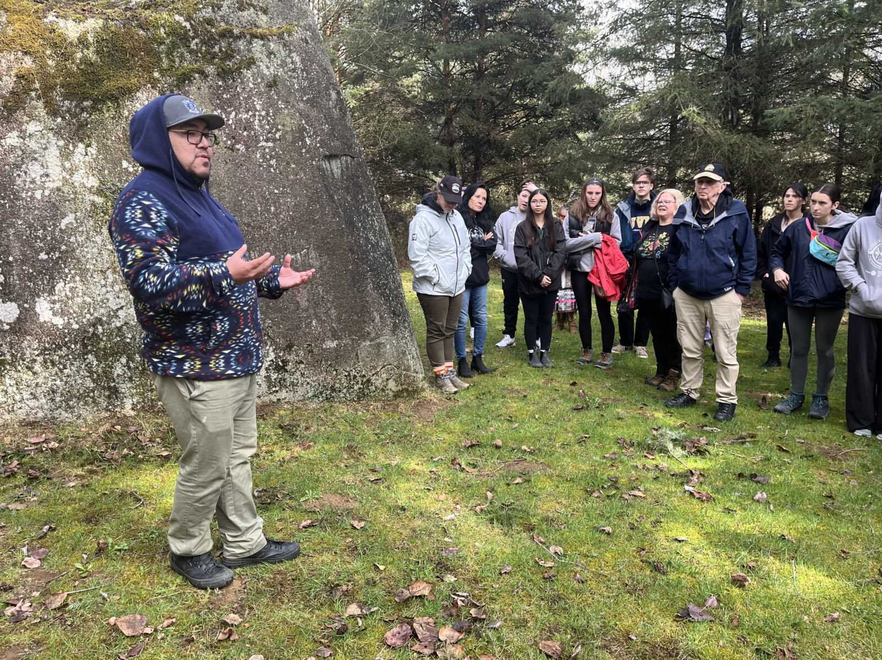
HIP Youth to Youth (Y2Y)
Sponsored by Honouring Indigenous People (HIP)
Indigenous & non-Indigenous students, 15-17 yrs
Winnipeg, BC, Nova Scotia
90% - profound impact
This year in Six Nations - March
Chair - John Currie

Slide 16

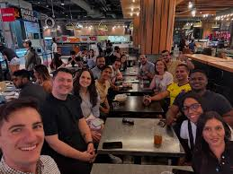
Rotaract
For people ages 18+
Fun, friendship and community service
10,000 Clubs, 200,000+ members worldwide
8 Clubs in D7070
Includes eClub
Mostly university/college based though a few community based
Chair - Malaravan Balachandran

Slide 17
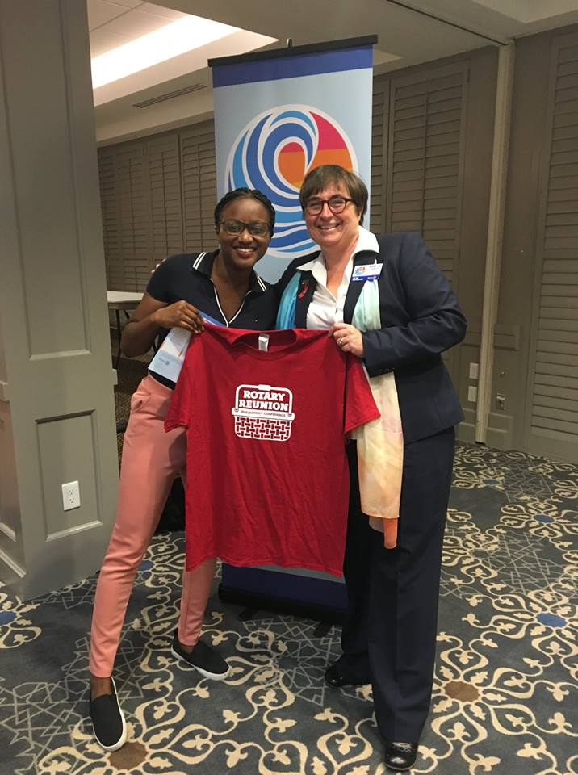
Youth at District Events
District Conference
District Assembly
Foundation Walk
Great Lakes Watershed Clean-up
Year-end District Celebrations
Etc. Etc. Etc.

Slide 18

Benefits to Youth?
Build leadership and key skills (e.g President, Board, Project Mngmt)
Serve/give back to your community
Connect with other young people, socialize, have fun
Develop network of Rotarians in all professions
References for school/job applications; build resume!
Annual awards & recognition
Attend Youth Service events - RYLS, Youth Exchange, HIP Y2Y
Attend annual District Conference, District Assembly, GLWC, etc
Volunteer for projects lead by sponsor Rotary Club

Slide 19
10 Things your Club can do to GROW Youth Services
Bring info back to your Club/help promote our District Youth programs
Reach out to Rotary Club members/friends – get their kids involved
Join the District Youth Services Committee
Ensure funding within your Club's budget is set aside for Youth Services
Ensure Youth Services Committee set up in your Club
Update Clubrunner with the Youth Services Director's name
Sponsor a Rotaract or Interactor Club
Sponsor a youth to attend a District event (i.e. Assembly, Conference)
Sponsor a youth from the community or Rotary family to join RYLS
Have us speak to your Club to get them excited about Youth Services!!
WE CAN HELP!

Slide 20

Thank you – Q&A

