Slide 1
Insurance is fun 101
An exciting review of the district 7070 Insurance program that will keep you on the edge of your seat
Presented by Rachel Boyd, February 20, 2025

Slide 2
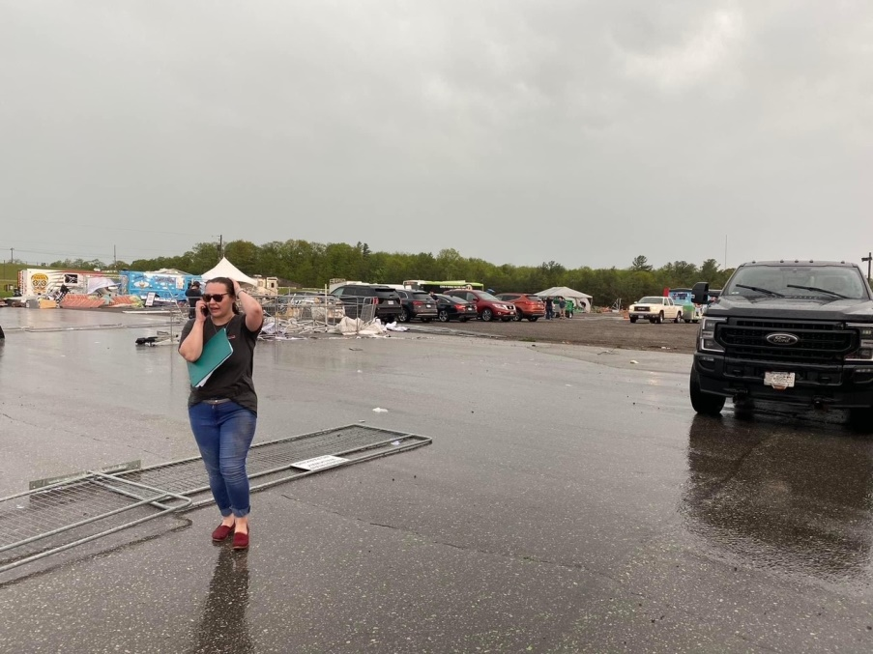
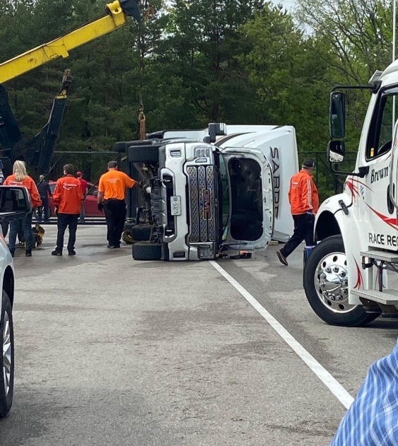
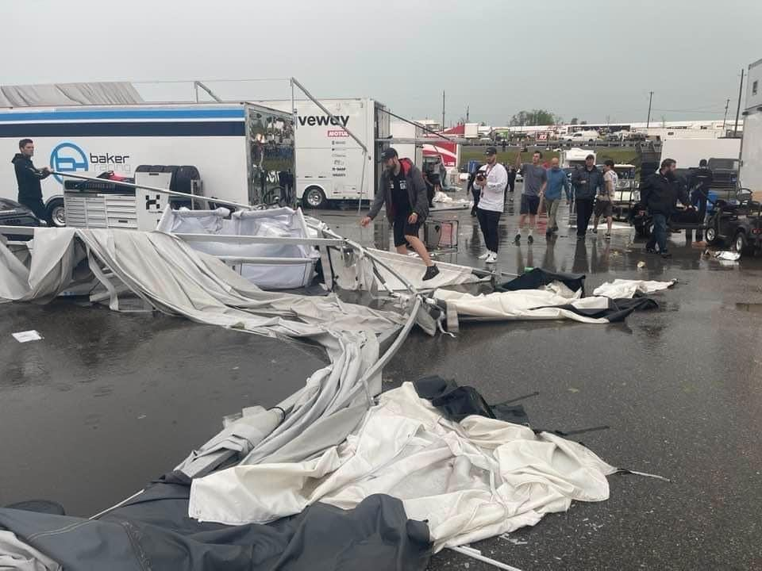
What could possibly go wrong?

Slide 3
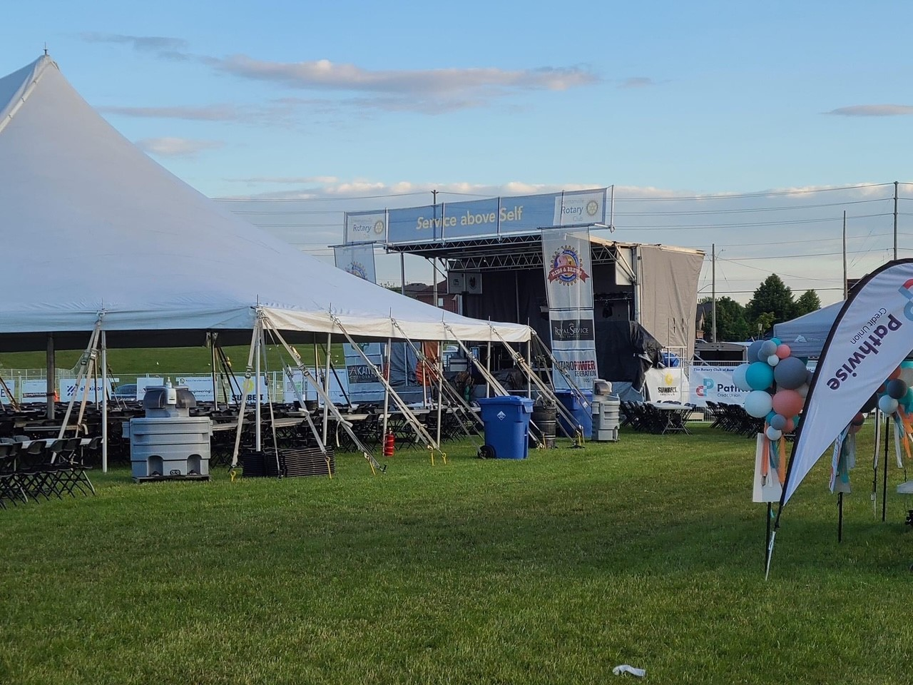
No activity is without risk. How do we protect ourselves?
2012 -17 people taken to hospital with non-life threatening injuries after lightning struck the main dinning tent at the Whitby Ribfest Sunday afternoon.
2017 – Teen viciously beaten at Bowmanville Ribfest; victim approached by group of teens and attacked
2017 - A Penticton woman filed a lawsuit against the City of Penticton, stemming from an incident on Canada Day during RibFest at Okanagan Lake Park. The plaintiff was walking down a set of stairs when she fell off the last step, allegedly suffering injuries to both ankles

Slide 4
How do we protect ourselves?
We transfer the risk through:
(1) Insurance (2) Certificates of Insurance and Additional Insured clauses
Loss Control (Security, First Aid Stations, Smart Serve, training)
Insurance from vendors (Rented Equipment, stages, fencing, Generators)

Slide 5
Who is an insured?
Definition of “insured” to include all members and volunteers

Slide 6
General Liability Insurance
$5m limit with a $10m Aggregate
Main coverages :
(A)Bodily Injury & Property Damage – PD Deductible $2,500
Abuse sub-limit $1,000,000 Aggregate
(B) Personal Injury & Advertising Injury
(C) Medical Payments $50,000 pp
(D) Tenants’ Legal Liability $1,000,000
Coverage extensions for Employers Liability ($1m), Non-owned Auto Liability ($5m), Damage to Hired Auto $50,000

Slide 7
General Liability Examples - Ribfest
Food/Alcohol poisoning
Trip/slip and fall
Damage to Property not in your care, custody and control

Slide 8
Key General liability Exclusions
Amusement Rides & inflatable (Bouncy Castles)
Tobogganing
Fireworks
Stage Rental unless a Certificate of Insurance naming the Rotary Club as “Additional Insured” with minimum Liability limits $2m is collected from the vendor
Watercraft with some exceptions (non motorized, less than 16m, use for safety purposes, not for hire coverage)

Slide 9
Directors and officers insurance
CLAIMS MADE POLICY
$3,000,000 Policy limit and aggregate, Deductible $2,500
Extension for Employment Practices $250,000
Insured person includes volunteers, spouses, past members, estates of deceased members

Slide 10
What is a wrongful act?
Wrongful Act means including, but not limited to:
1 - any Executive Wrongful Act (breach of Duty, negligence, misstatement)
2. any Employment Practices Wrongful Act (discrimination, wrongful discipline, invasion of privacy, harassment & humiliation)
3. any Third Party Employment Practices Wrongful Act (Claim brought on behalf of a customer, service provider or other business invitee of the Insured Organization against any)

Slide 11
THREE MAIN TYPES OF exclusions
Intentional dishonest, Fraudulent, criminal acts
Other Insurance (Bodily Injury)
Timing (prior to insurance bound/retro date)

Slide 12
Crime Insurance
Employee Dishonesty $50,000
Theft, Robbery or burglary $25,000
Fraud $25,000, including computer fraud (phishing, funds transfer fraud, forgery, counterfeit)
Expenses $10,000

Slide 13
Property Coverage
As per individual Member Certificates of Insurance.
If you have buildings, contents or equipment that requires insurance coverage, we need to know about it.
Property Deductible $1,000 (Replacement Cost)
Property Floater Deductible $2,500 (Actual Cash Value)

Slide 14
Gaps in coverage
Cyber – There currently in no Cyber coverage
Umbrella/Excess Insurance limits – The policy limits have not been increased with an umbrella a/o excess policy
There is no Pollution coverage

Slide 15

Questions?

