Slide 1
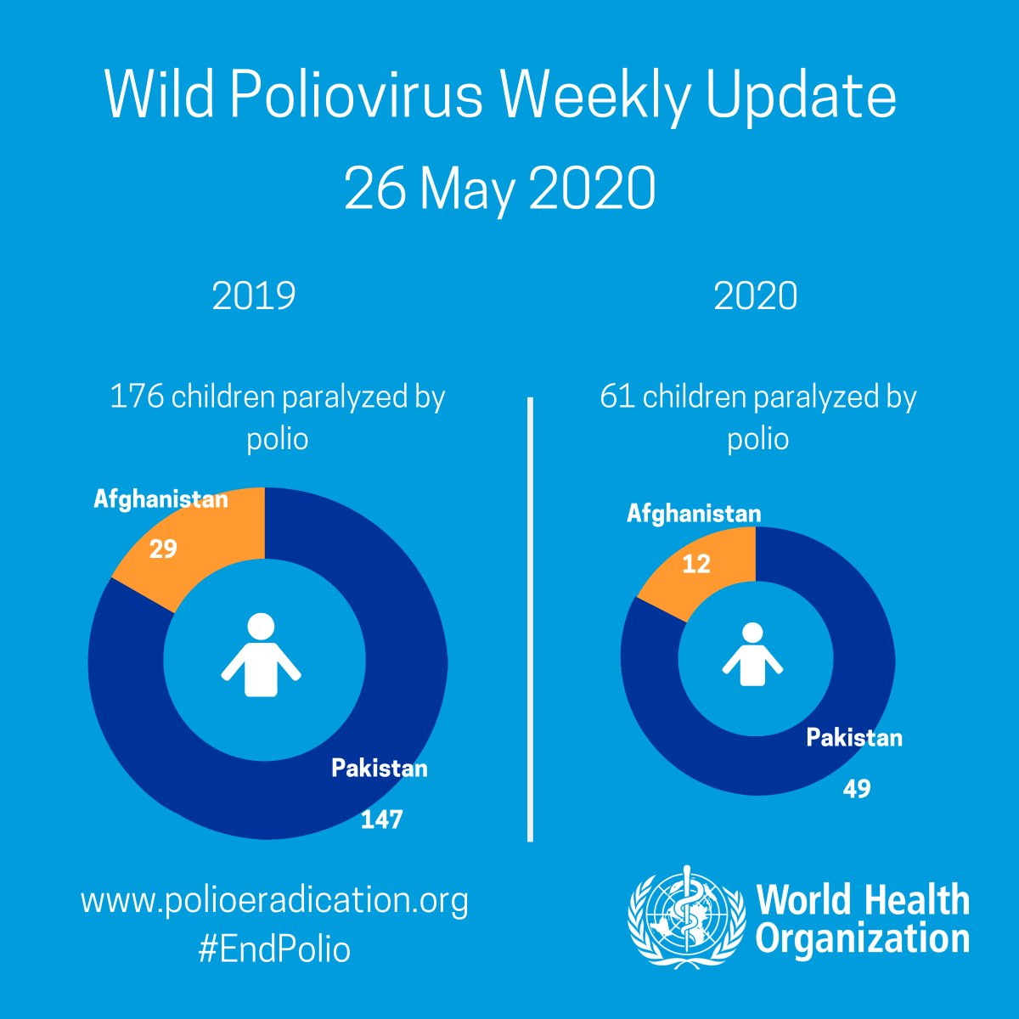
Wild poliovirus weekly case update from
@WHO
: Two new cases in Pakistan In 2020: #Afghanistan: 12, #Pakistan: 49 In 2019: #Afghanistan: 29, #Pakistan: 147 More: http://bit.ly/2n9YwWJ
2:08 PM · May 29, 2020·Twitter Web App

Slide 2

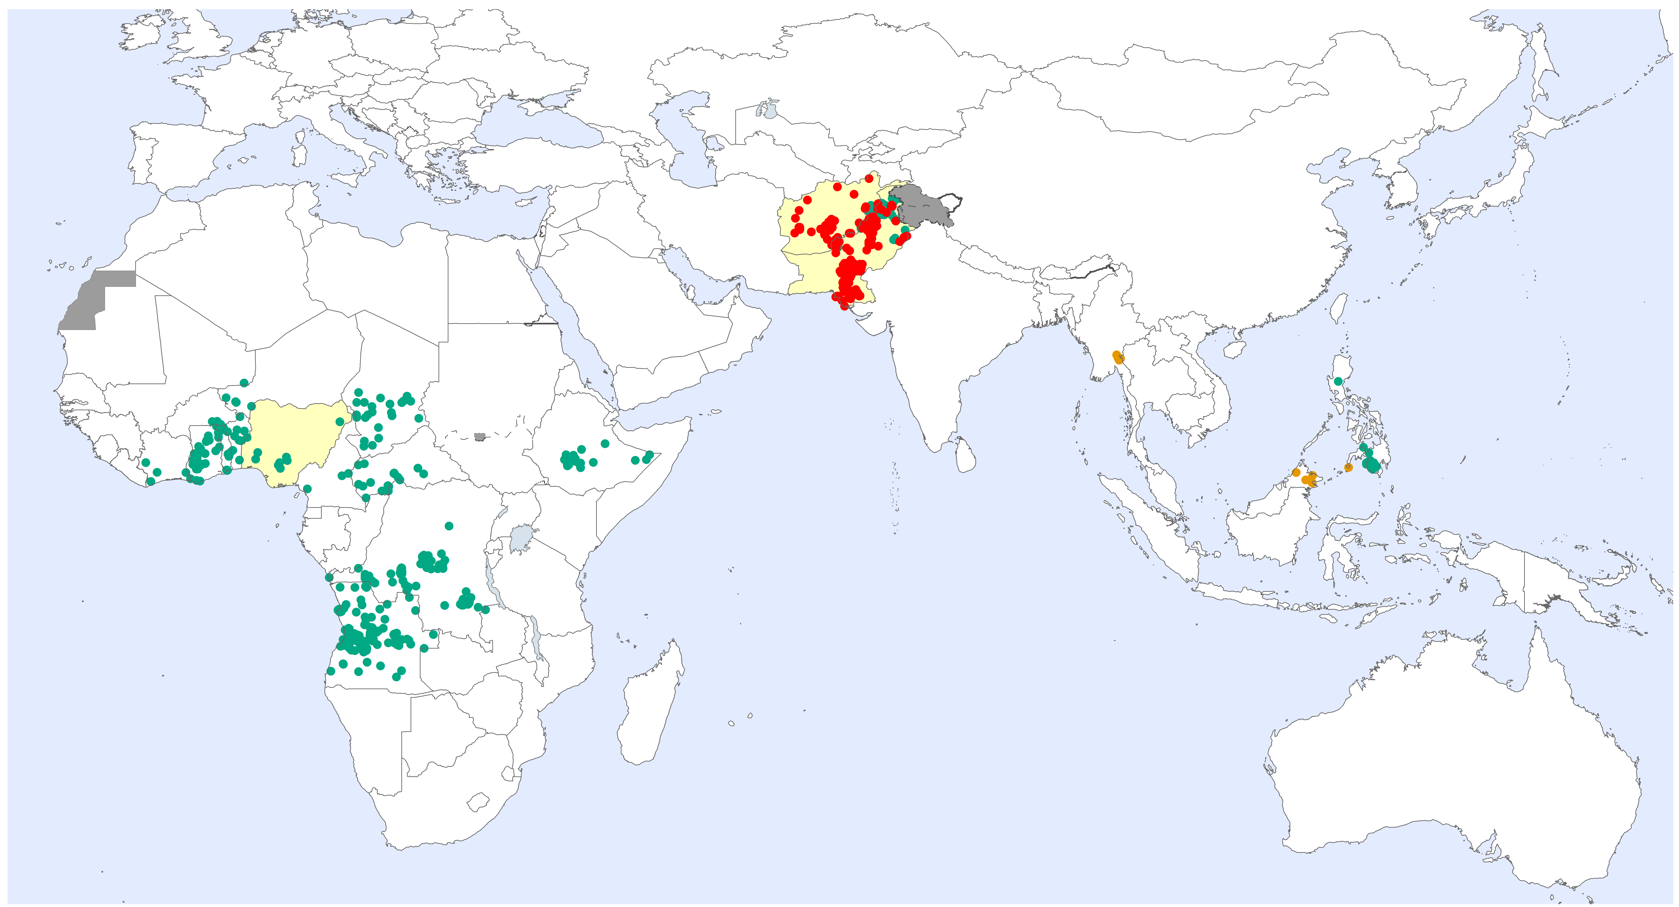
Global WPV1 & cVDPV Cases¹, Previous 12 Months²
Endemic country (WPV1)
¹Excludes viruses detected from environmental surveillance; ²Onset of paralysis 27 May 2019 – 26 May 2020
Notes:
Table in 05A.SummaryTablesPOLIS_SJ

Slide 3
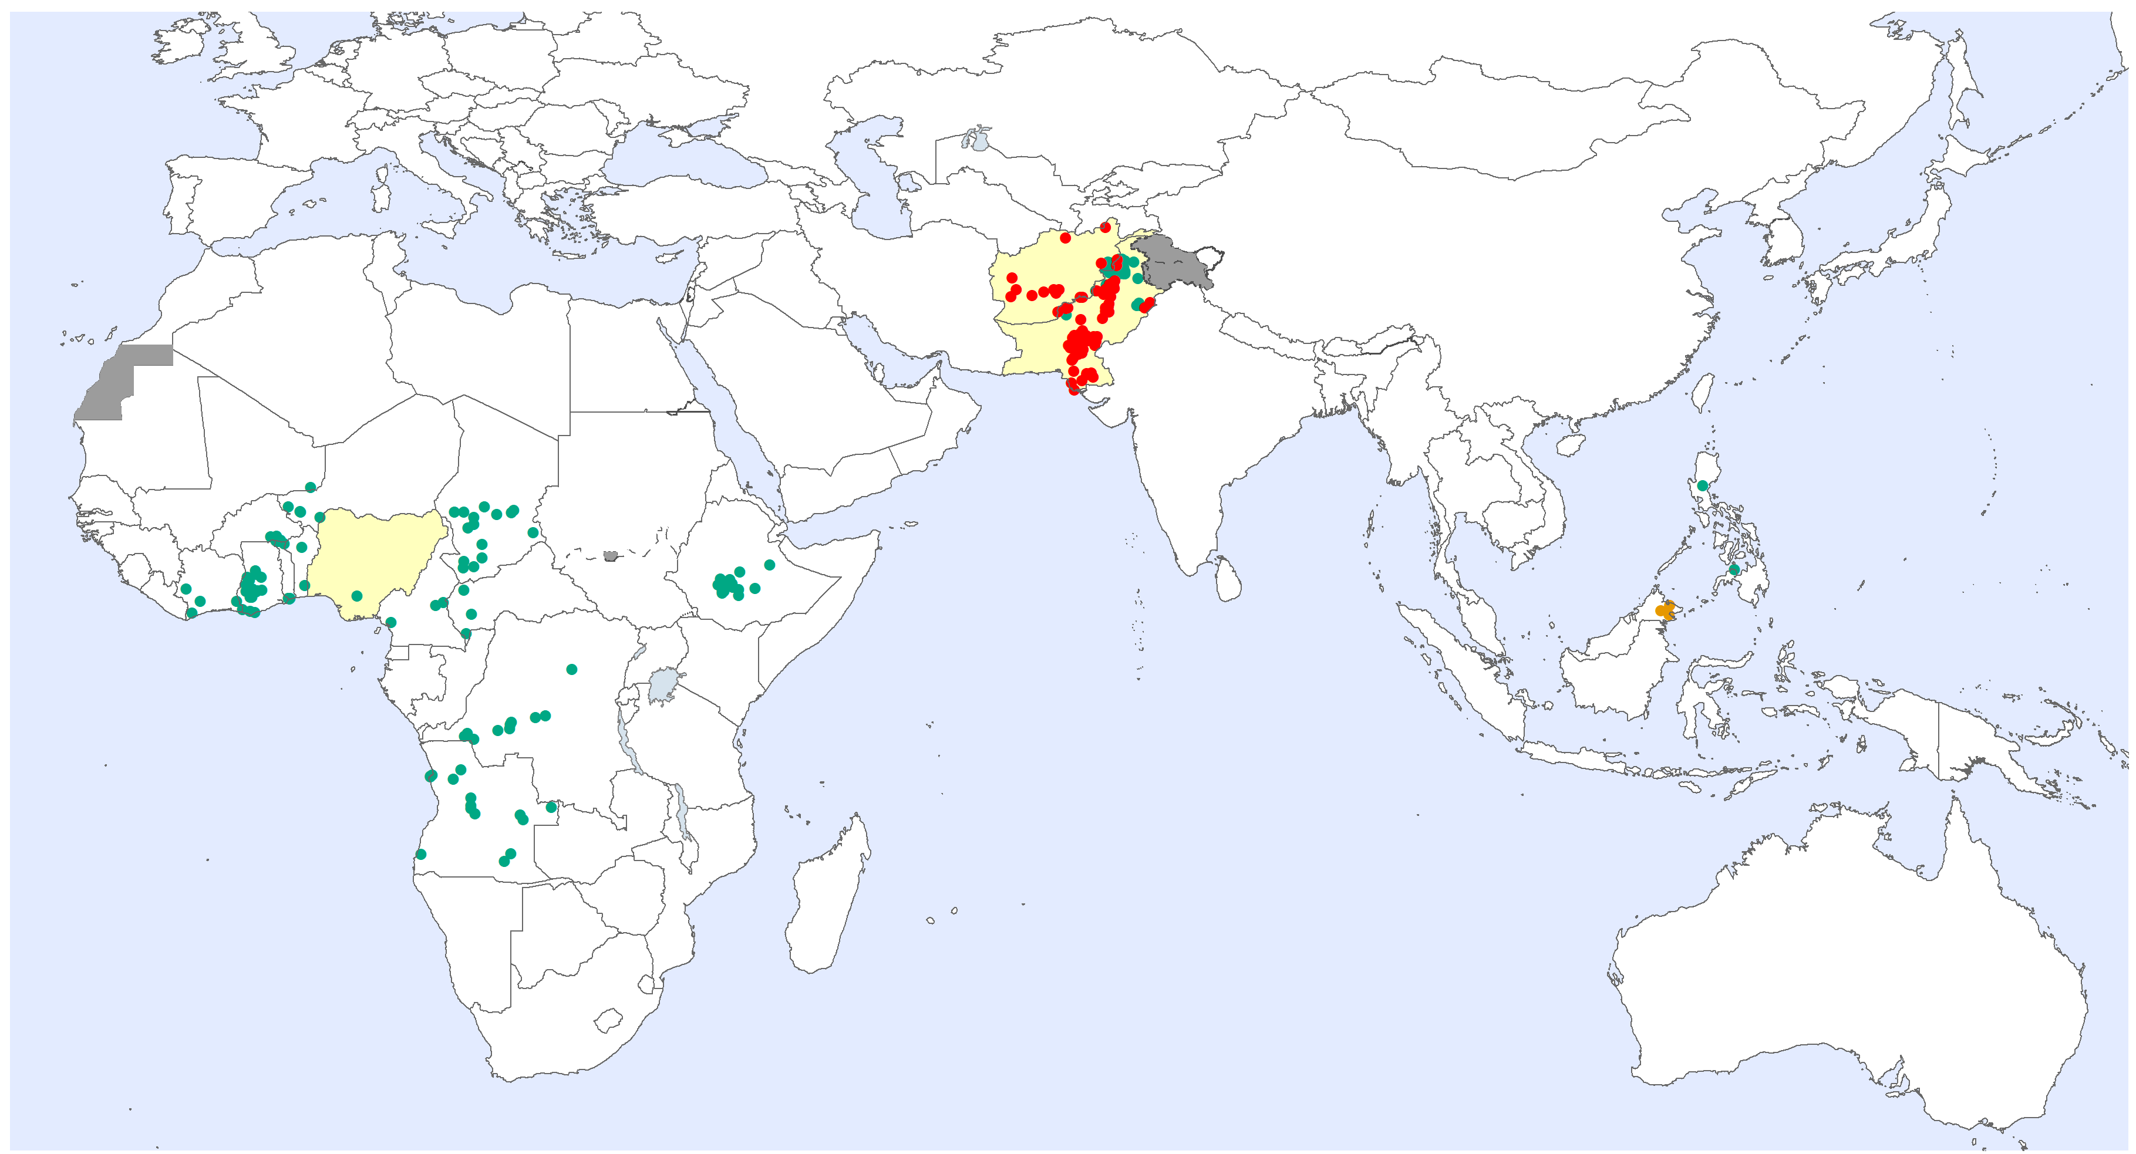
Global WPV1 & cVDPV Cases¹, Previous 6 Months²
Endemic country (WPV1)
¹Excludes viruses detected from environmental surveillance ; ²Onset of paralysis: 27 Nov. 2019 – 26 May 2020

Slide 4
Global Wild Poliovirus 2015 - 2020
Notes:
Table in 01.Global_Update_WildVirusSummary
POLISdata2018 sheet to be updated first

