Slide 1
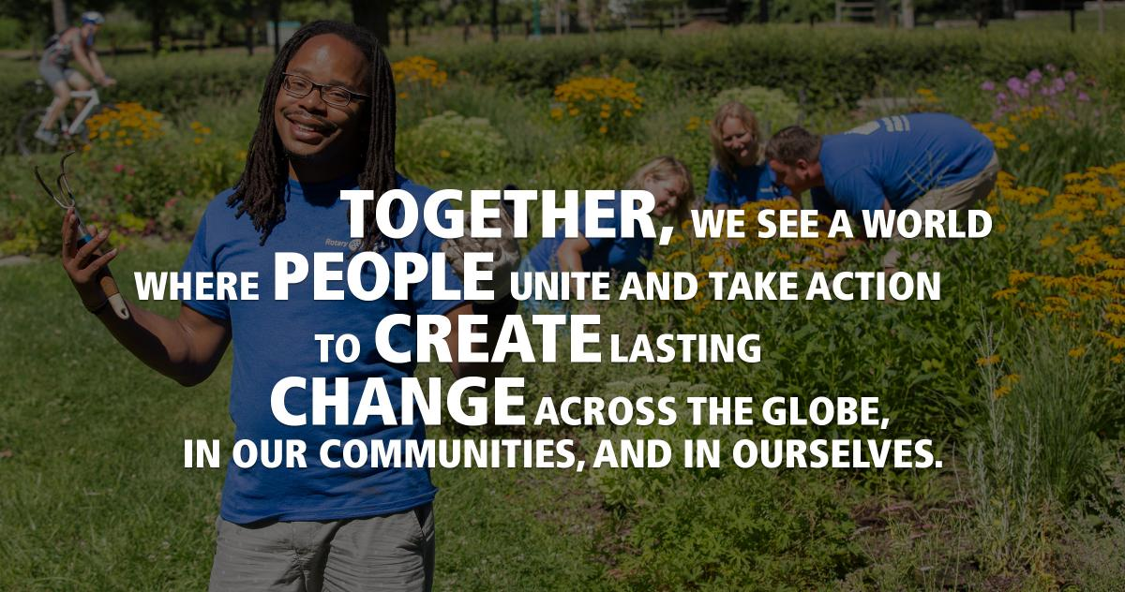

District Assembly, Saturday 1st of June 2024
Learning Committee
Who Are We?
Subcommittees
What are we responsible for?

Slide 2

BRINGING OUR ACTION PLAN TO LIFE
LESSONS FROM THE 2023 NORTH AMERICA GROWING CLUB STUDY.

Slide 3

ACTION PLAN PRIORITY 1:
INCREASE OUR IMPACT

Slide 4
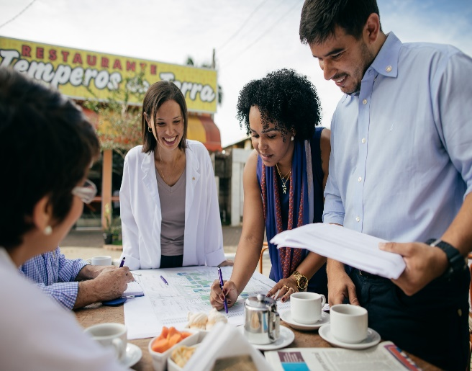
HOW WILL WE INCREASE OUR IMPACT?
Set realistic goals and track progress.
Strengthen club leadership & governance, especially succession planning.
Focus on our community (local and/or international).
Assess community needs and build meaningful partnerships.

Slide 5

ACTION PLAN PRIORITY 2:
EXPAND OUR REACH

Slide 6
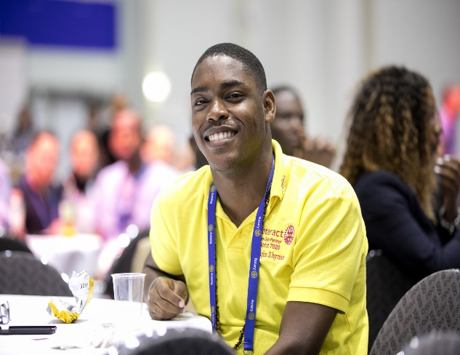
HOW WILL WE EXPAND OUR REACH?
Use multiple forms of media to tell our story.
Engage the whole club in attracting new members.
Invite others to our meetings and service projects.
Ensure membership reflects our community.

Slide 7

ACTION PLAN PRIORITY 3:
ENHANCE PARTICIPANT
ENGAGEMENT

Slide 8
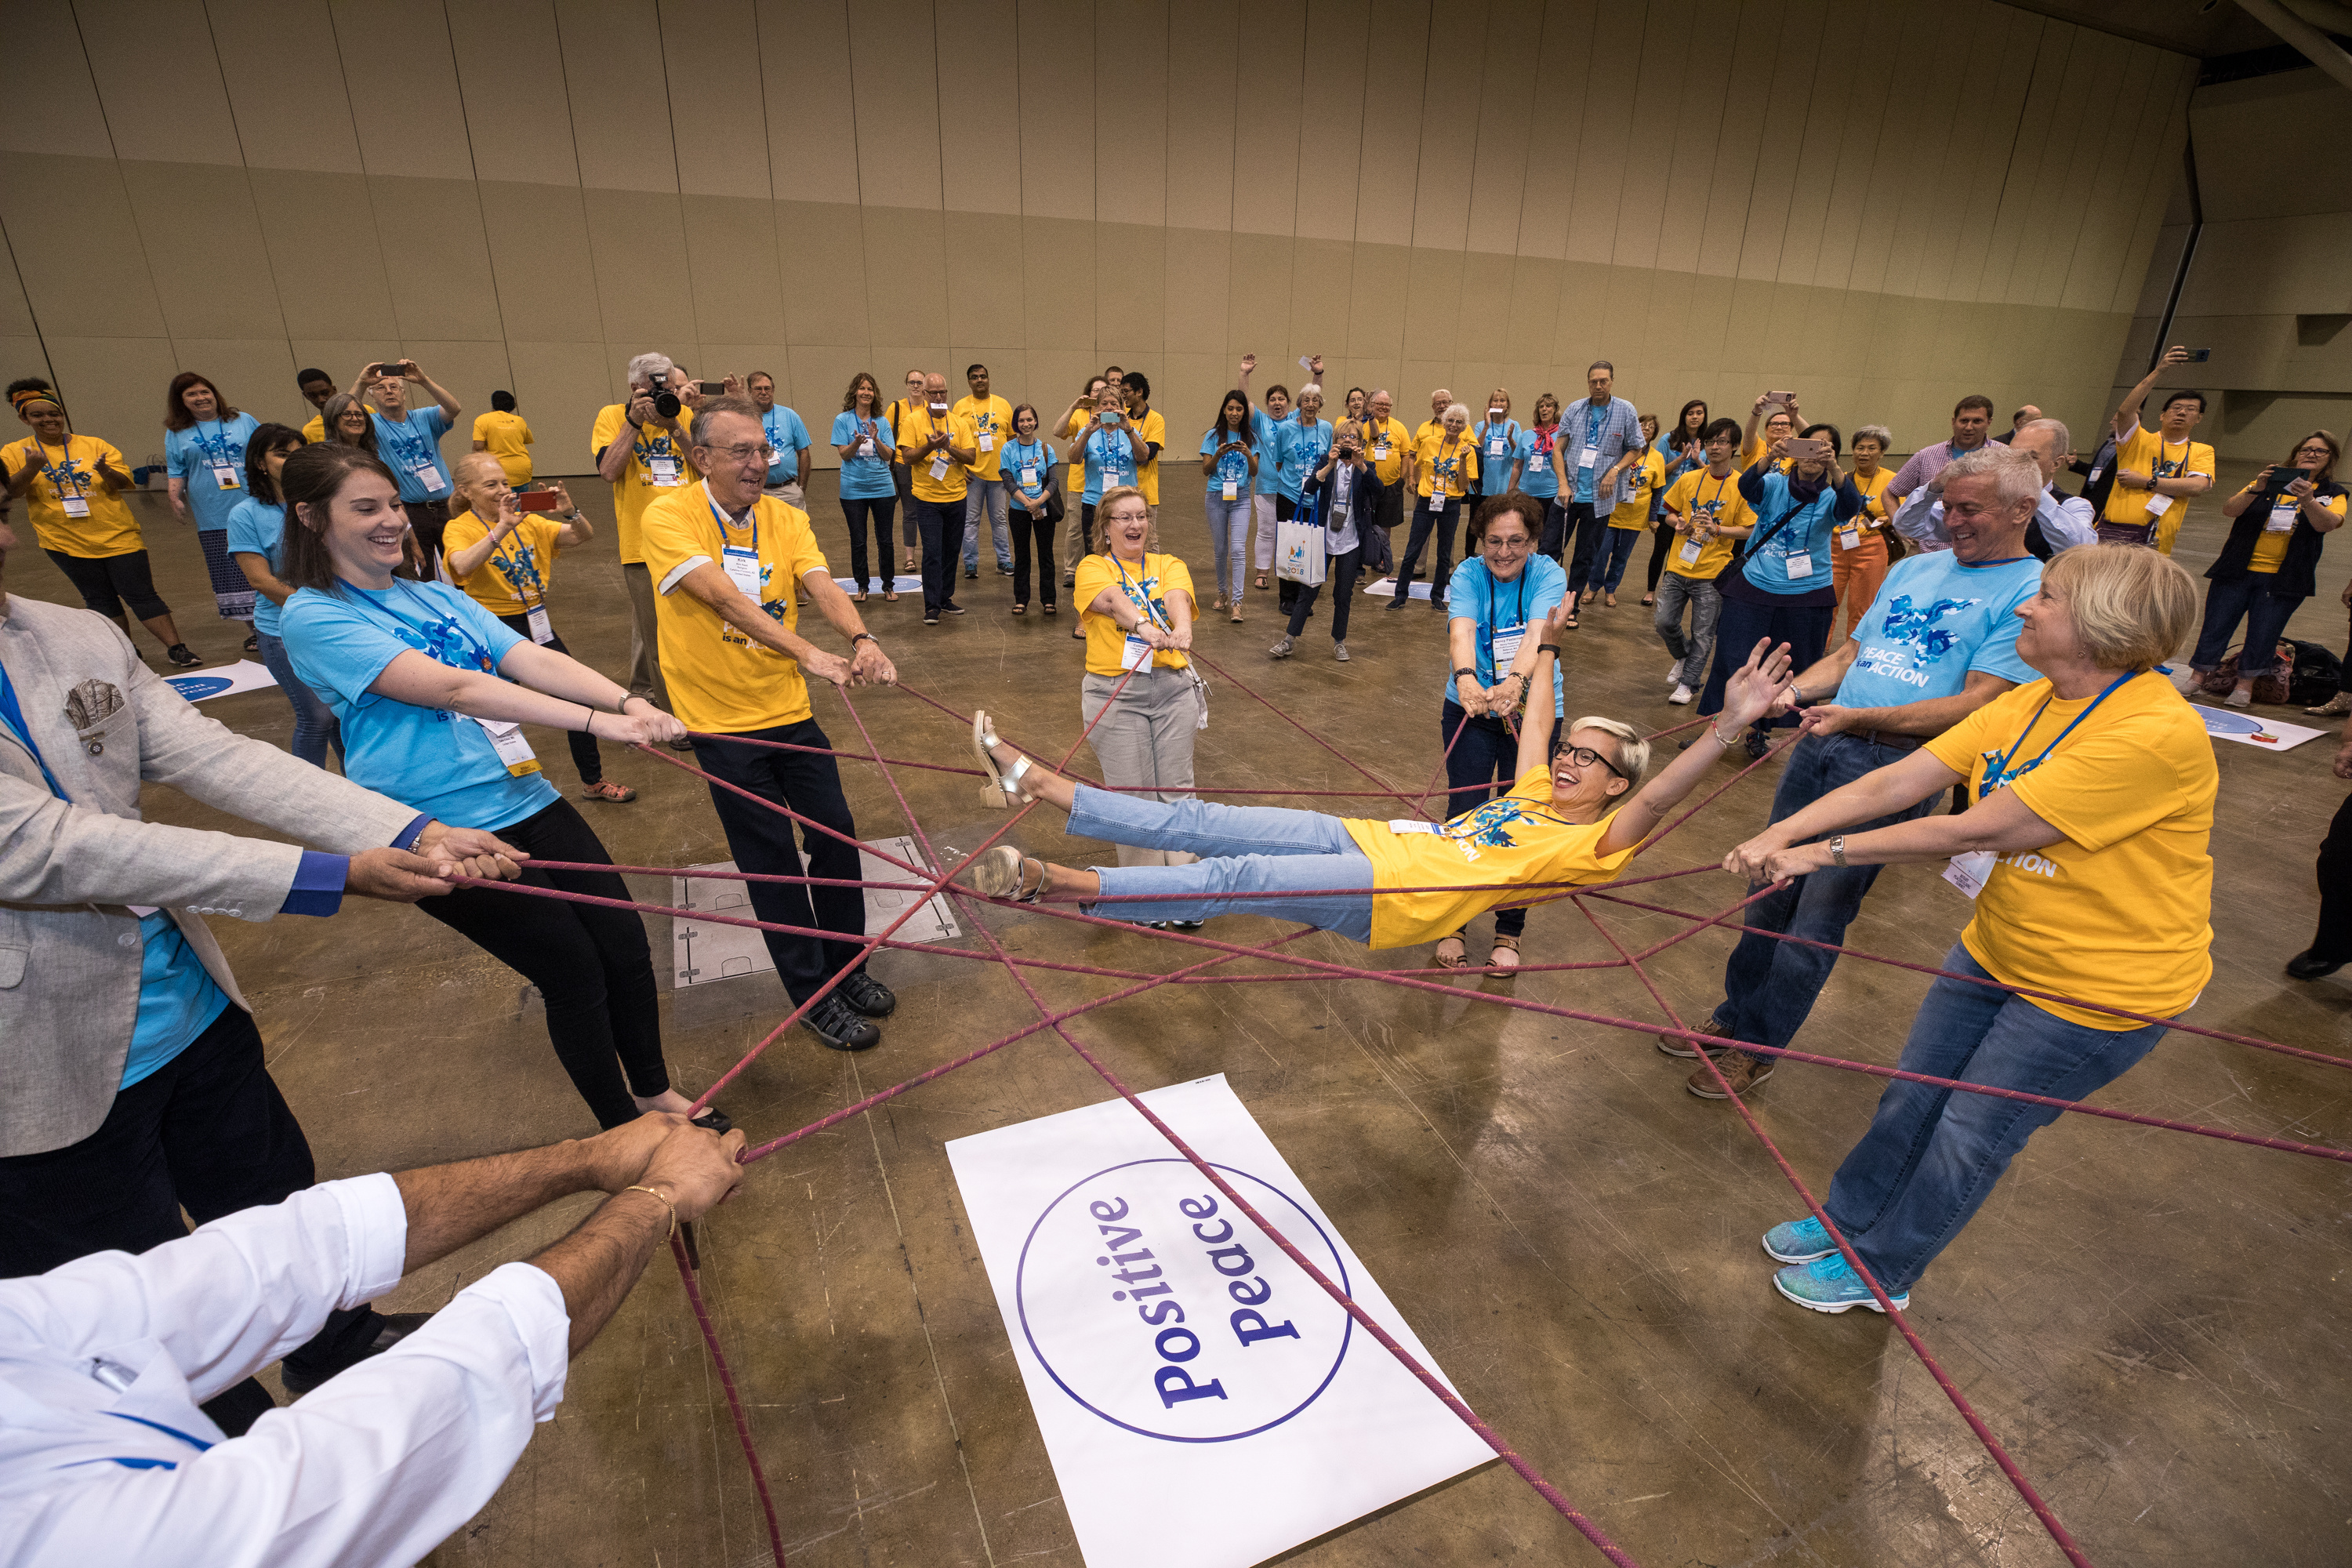
HOW WILL WE ENHANCE PARTICIPANT ENGAGEMENT?
Ensure a welcoming and ‘fun’ club culture.
Find new ways for people to be involved.
Respond to members’ interests and priorities.
Make member ‘care’ a top priority.
Consider the cost of participation.

Slide 9

ACTION PLAN PRIORITY 4:
INCREASE OUR ABILITY
TO ADAPT

Slide 10
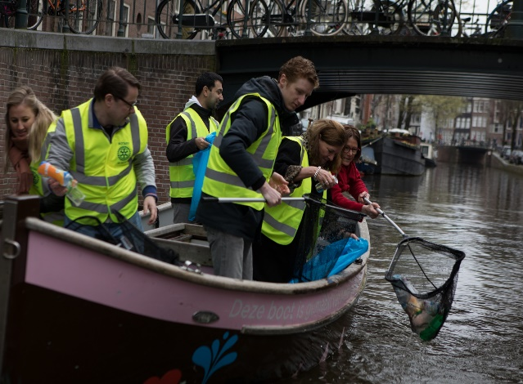
HOW WILL WE INCREASE OUR ABILITY TO ADAPT?
Ensure our club reflects our community.
Use our new members’ innovative ideas.
Try new approaches to meetings, service projects, fun events, etc.
Start a satellite or Impact, Rotaract, Passport club!

Slide 11
BRINGING OUR ACTION PLAN TO LIFE
LESSONS FROM THE 2023 NORTH AMERICA GROWING CLUB STUDY.
Doug Logan, Zone 28 Rotary Coordinator
Herb Klotz, Zone 32 Rotary Coordinator

Slide 12
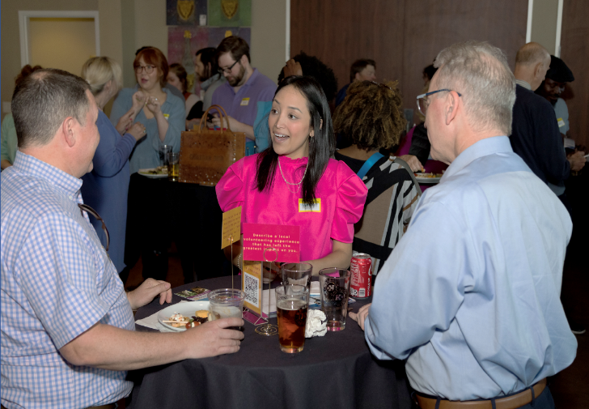
ATTRIBUTES OF GROWING CLUBS (2022 Study)
Active, intentional member engagement
Dynamic, meaningful service
Effective governance (intentional leadership,
succession planning)
Strong public image (well known in community)
Diversity (representative of community)

Slide 13

The Action Plan is our guide to creating experiences people don’t want to miss, that draw others in, and to being proud and loud in telling our story.

Slide 14

THANK YOU!

