Slide 1
How to run effective board meetings Presented by: Terry Caputo

Slide 2
Primary Role of the Board
Selection of the President (annual process that should be consistent)
Setting direction and making decision on behalf of the members (where you focus most of your time)
Monitoring performance and compliance with laws and regulations (make it efficient)
Notes:
Insert program name and photo.

Slide 3
Operational Board
Stakeholders
(exclusively members)
D
I
R
E
C
T
I
O
N
C
O
N
T
R
O
L
Representative
Board
Management
Through
Committees

Slide 4
Key Ingredients
Important considerations:
Inherent conflict in the President’s operational role vs Chair role
Agenda ownership
Director engagement
Information to exercise the duty of care
Use of member expertise to inform decisions
Time
Notes:
Insert program name and photo.

Slide 5
Effective Board Leadership
The Chair is the leader of Board and needs to:
Foster constructive culture/tone
Facilitate oversight
Promote independence
Guard responsibilities/boundaries
Define discussion parameters
Ensure Director engagement
Build consensus
Focus discussion/restrain Directors
Ensure the will of the Board prevails
Quickly handle and defer new business
Notes:
Insert program name and photo.

Slide 6
Meeting Effectiveness Principles
Disciplined process (not necessarily Roberts Rules)
Rules of engagement/decision-making known and respected
Awareness of Directors’ experience/biases
Board engagement and empowerment
Active participation
Decisions are their decisions
Able to do what needs doing
“Own” a strategically designed agenda
Notes:
Insert program name and photo.

Slide 7
Ownership of Agenda
Driven by the Chair with input of Directors
Include pre-read materials in advance
Clearly state the outcome of each item
Only deal with items that have back up information
Create a workplan in agenda form
Focus on “how agenda items will be handled
Notes:
Insert program name and photo.

Slide 8
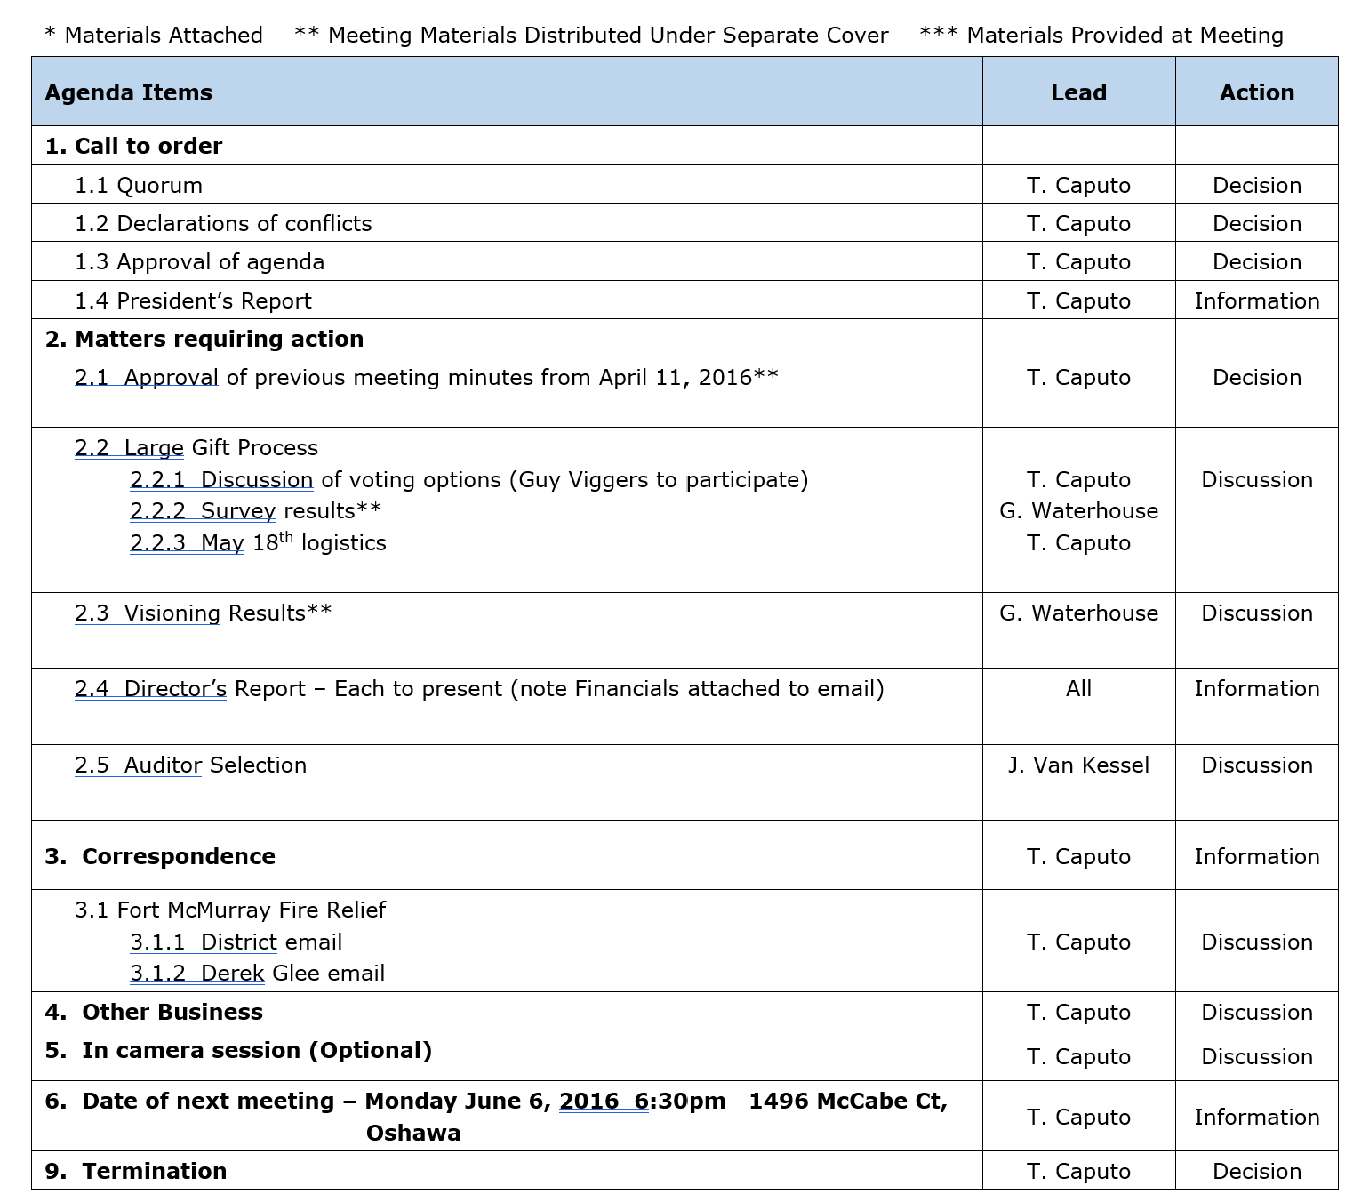
A Useful Tools - Agenda
Notes:
Insert program name and photo.

Slide 9
A Useful Tool - Dashboards
Notes:
Insert program name and photo.

Slide 10
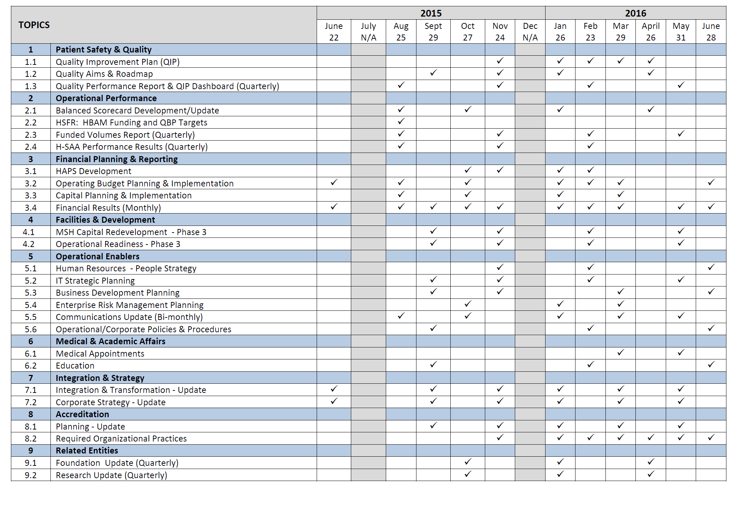
A Useful Tools – Work Plan
Notes:
Insert program name and photo.

Slide 11
Thank you
Terry Caputo
(905) 213-5925 (cell)
terrycaputo@outlook.com
Notes:
Insert program name and photo.

