Slide 1


HELLO!
Welcome Future Secretaries!

Slide 2

CLUB SECRETARY
Your Club’s Time Capsule

Slide 3
01.
WHAT DOES A SECRETARY DO?
ROLES, RESPONSIBILITIES and BEST PRACTICES
02.
GETTING ORGANIZED
THE KEY TO A SUCCESSFUL YEAR
03.
OPPORTUNITIES
HIDDEN BENEFITS
04.
MAKE IT YOUR OWN
TABLE OF
CONTENTS
IDEAS TO BECOME AN EFFECTIVE SECRETARY

Slide 4

01.
WHAT DOES A CLUB SECRETARY DO?
Where to start: In’s and Out’s

Slide 5
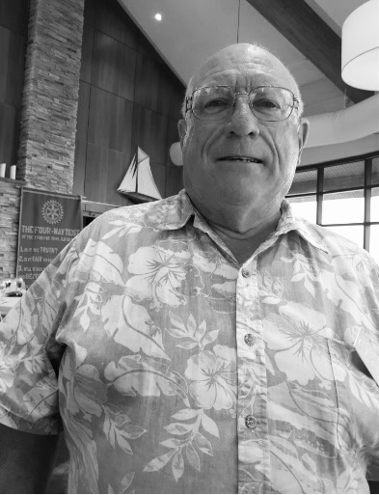

This is where I started...
Grant Southwell - 60 Year Rotarian and former Municipal Clerk

Slide 6

KEY RESPONSIBILITIES
  Record Information
  Update Information
  Share Information
  Store Information

Slide 7
01.
RECORDING INFORMATION
  Meeting Agendas: Weekly club and monthly board meetings
  Meeting Minutes: Accurate and detailed
  Correspondance: Ensure it is passed along to the appropriate member and/stored
02.
UPDATING INFORMATION
  Membership Data: Keeping membership data current in ClubRunner + the Ministry of Business and Public Service Delivery
  Club Service: Working with your Club Service Director to update the website
  Communication: Notifying club members about upcoming events and activities

Slide 8
03.
SHARING INFORMATION
  Communication Channels: Sharing minutes, newsletters, and social media updates
  Turnaround Time: Set realistic goals for yourself in turning around meeting minutes
  Reporting: Prepare board reports to the club and update your club goals in Rotary Club Central
04.
STORING INFORMATION
  Document Management: Updating the documents section of ClubRunner by scanning, creating documents, and important mail
  Historical Records: Preserving the club's historical records and important documents
  Backups: *Establish redundancies, outside of the ClubRunner ecosystem

Slide 9
02.
ORGANIZATION
Pull yourself together, man!

Slide 10

STEPS TO SUCCESS
  Meet with the current Secretary
  Understand the Scope
  Get to know ClubRunner
  Stay Informed
  Collaborate

Slide 11
TOOLS FOR ORGANIZATION
Digital Tools: ClubRunner, Rotary.org, dedicated Rotary email, and forwarding email
Templates: Creating reusable templates for agendas, minutes, newsletters
Checklists: used for routine tasks so nothing is overlooked.
IMPORTANCE OF
ORGANIZATION
Why organization is critical for a club secretary: Efficiency, accuracy, and effective communication. Improved club operations and member satisfaction.

Slide 12

MANAGING RECORDS
Record-Keeping: Best practices for maintaining accurate records;
Document Storage: Using ClubRunner and other tools for document management;
File Organization: Implementing a systematic approach to file organization for easy retrieval for yourself and future you

Slide 13

TIME MANAGEMENT
Prioritizing Tasks: Identifying urgent vs. important tasks;
Scheduling: Setting up a regular schedule for recurring tasks and events;
Delegating: Delegating tasks when appropriate to manage workload effectively

Slide 14
03.
OPPORTUNITIES
EXTRACTING VALUE FROM YOUR YEAR

Slide 15

LEVERAGING THE ROTARY NETWORK + PROFESSIONAL DEVELOPMENT
  Build relationships within and outside the club;
  Collaborate with other clubs on joint projects;
  Utilize Rotary’s Online Learning Centre;
  Attend online learning seminars, the District Conference, and other clubs

Slide 16


Community Impact
Identify and lead impactful service projects;
Enhancing the club’s presence in the community through effective communication and PR;
Building partnerships with local organizations to amplify impact
Enhancing Club Engagement
Organizing engaging events and activities;
Member Involvement: Encouraging active participation from all members;
Feedback: Regularly seeking and incorporating member feedback to improve club activities

Slide 17
04.
MAKE IT YOUR OWN!
A couple hacks I have picked up along the way

Slide 18
P
E
Utilize a Password Manager. 1Password is a paid option. Bitwarden is a FOSS project that works well. Both support 2FA and passkeys
Create a Rotary-specific email address for yourself and one for your club. Contact ClubRunner to set-up forwarding emails
Redundancies are paramount. Find a cloud-based system that works for you to back up critical data. Don’t trust software will always be there.
Train your membership, don’t let them off the hook, and learn to say NO! You have enough to do - show them how and stick to your guns.
R
T

Slide 19
“JUST KEEP MOVING FORWARD.”

Slide 20
THANK YOU
Have any questions?
Jeremy Taft
613-827-3470
admin@trentonrotary.ca

