Slide 1
THE CLUB TREASURER
In praise of the unsung hero!

Slide 2
Thank you for your service!
Important but often understated.
Only noticed when something goes wrong!
We tend to work alone.
We tend not to have mentorship.
RI training materials are weak.

Slide 3
There’s no single template for this job
One size does not fit all
Broad themes in common, but …
Different club sizes, governance cultures, revenue-generating activities
Foundation vs no foundation
Incorporated vs unincorporated
HST vs no HST
Therefore, RI training materials are at the lowest common denominator

Slide 4
How can the District help?
Club treasurers working group
Last year and the year before but on hiatus this year
To be resurrected next year
Online networking opportunity with a loose agenda
Conversation, sharing of experiences, asking for advice
Occasional guest speakers
Sometimes you are the expert, sometimes you are the learner

Slide 5
Here’s what we have talked about in the past.

Slide 6
Maintaining accounting records
Excel vs an accounting package
QuickBooks vs Sage
QuickBooks: online vs desktop version
How to help each other where guidance is needed

Slide 7
How we collect payments
Cash & cheque
E-transfer?
Credit card?
Canada Helps?
PayPal?
Square? (we had a presentation on this)
What works well and where are there limitations?

Slide 8
How we make payments
Cheque
E-transfer? (bank limitations)
EFT?
Managing internal control issues

Slide 9
Bank services and bank charges
What services does your club require?
How much do you pay?
Banks versus credit unions

Slide 10
Club admin costs vs fundraising costs
Rules of thumb for keeping them separate, where this is important
Separate bank accounts?
Special requirements for clubs that have their own foundations
Are there generally accepted guidelines about what costs should be covered by members and what shouldn’t be?
Are there CRA guidelines to consider?

Slide 11
Club admin budgets and membership dues
Dues range: seems to be $250 - $300. What does this pay for?
Small fundraisers to subsidize dues?
Managing minimum commitment to the restaurant
Financial implications of hybrid meetings

Slide 12
Charitable foundations
Pros and cons of having them
Applying for one
Tax receipting rules
Gifts-in-kind
Charity information return
HST and Public Sector Body rebates
How large can reserves be?
Can a loan be converted to a donation?
How are we allowed to use funds in the foundation?
Insurance coverage issues.

Slide 13
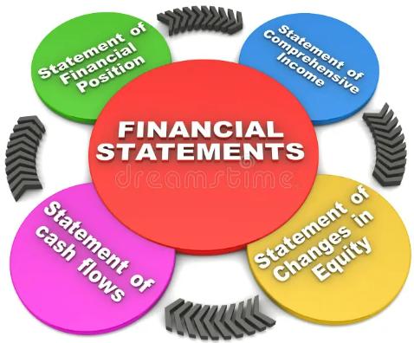
Year-end financial reporting options
Audits, review engagements, notice-to-reader statements
Internal financial statements only; no public accountant involvement

Slide 14
A template for making donation decisions
Financial and non-financial criteria for prioritizing requests:
Goodness of fit with the club’s passions
Impact in your local community
The impact of the donation relative to its size
How established the organization is
Your prior experience with the organization
How has the organization “stewarded” your previous donations?
Willingness of the organization to participate in your club’s activities and fundraising events

Slide 15
How can the District help our treasurers?
Training materials?
Internal control recommendations?
How to spread the work around while maintaining proper coordination and controls?

Slide 16
Succession planning for treasurers
How do we make the role less daunting?
An “assistant treasurer” with delegated tasks?
How much professional proficiency is needed and practical ways to overcome deficiencies
Hiring a part-time bookkeeper: does anybody do this?

Slide 17
Understanding our District insurance program
Property, commercial general liability, directors & officers liability
relationship with our insurance broker
presentations by Assistant Governor Rachel Boyd

Slide 18
Ontario Not-for-Profit Corporations Act
Applies to at least half of our clubs
Backgrounder and implementation requirements
presentations by Terry Caputo, Chair of the District Governance Committee

Slide 19
Care to be part of our club treasurers working group?

