Slide 1
Notes:
My name is Mary Lou Harrison, Rotary Public Image Co-Ordinator for Zone 28. And I believe.
I believe in the magic of Rotary, the incredible power of our connection (place hat on the podium) through Rotary.
This is my father’s hat. He was a Rotarian for over 60 years in this district. He died in June last year BUT through the magic of Rotary we are still connected.
Through the magic of Rotary, I am connected with you and with People of Action all around the world, most of whom I will never meet.
From our time together, I have 1 thing I want you to know and 1 thing I want you to do.

Slide 2
Your Club’s Public Image Matters
Notes:
I want you to know that your club’s public image matters.
Rotary has magical stories to share, BUT these stories are your stories. They come from your clubs, your action.
Your club’s public image matters.

Slide 3
Make it a priority
Notes:
And I want you to make it a priority..
Make sure someone has the lead on this essential task (ideally 2 someones!) in your club.

Slide 4
WHY?
Notes:
WHY? We have a lot of things to do? Why should we bother?
Membership Crisis in North America, unlike other parts of the world - good news re D7070, but not all - more People of Action, More magic!
But data from a survey of Rotary clubs in Zones 28 & 32 shows 3 attributes of Growing Clubs.
Here’s the magic

Slide 5
Growing Clubs:
Notes:
Here’s the magic…

Slide 6
Growing Clubs:
Great Meetings & Strong Friendships
Notes:
1. Growing Clubs have great meetings and people develop strong friendships

Slide 7
Growing Clubs:
Great Meetings & Strong Friendships
Meaningful Service Projects
Notes:
2. Growing Clubs have meaningful service projects.
Any guesses about #3?

Slide 8
Growing Clubs:
Great Meetings & Strong Friendships
Meaningful Service Projects
Strong Public Image
Notes:
3. Growing clubs have strong public image.
This means that they are well known in their communities.

Slide 9
How do you want your club to be known?
Notes:
How do you want your club to be known?
How do you want to position your club in your community.
How can you be “the bright shiny object in your community” that attracts people (JOE)

Slide 10
Notes:
Rotary regularly conducts research around the world to assess what people know and think about Rotary.
Here are some of the ways we are seen.
Not all are negative BUT is this how we see ourselves?

Slide 11
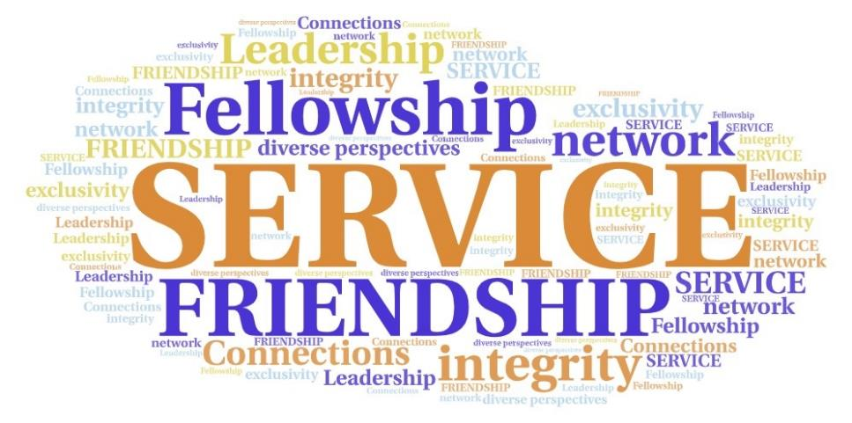
Notes:
Here are some of the ways we think about ourselves – taken from the RI 2018 Annual Membership Engagement Survey.
Much more positive, much more magical!
So this means we have a GAP to bridge.

Slide 12
Bridging the Gap!
Notes:
Not just any bridge.
This is the Ranney Gorge Suspension Bridge brought to life by the magic of the Rotary Club of Campbellford working with many community partners! It links a Rotary trail on one side and a park on the other. The Rotary Club of Campbellford is seen as a Go To organization in their community.

Slide 13
Notes:
The Rotary Club of Manila Magic is an actual club of young professionals in the Philippines, District 3810. They are passionate about effecting positive change in their community.
Their president is referred to as the PLP – Phenomenal Leader President!

Slide 14
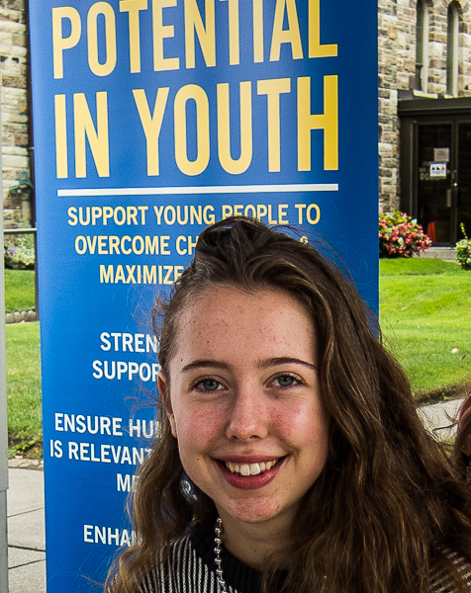
Notes:
Ignite the Potential in Youth - RCTW

Slide 15
Networking for Good

Slide 16
How do you want your club to be known?
Notes:
How do you want your club to to be known? Rotary Toronto Sunrise is in the process of deciding – food security, mental health, newcomer welcome – I do 2 of those!

Slide 17
Framing a Communications Plan
What I want my audience to know?
What I want them to do/feel?
Notes:
Now you can move to communicating with intent. 2 things BEFORE you do anything else!
What I want my audience to know
What I want them to do/feel?
You may have multiple audiences – potential members, current members (engagement for retention), community partners, donors, event attendees
What you want them to do feel may vary according to the audience - curious to know more/visit your website, join a service project, feel proud of accomplishments/share social media posts, come to you to partner on projects, give $/product, buy tickets/attend events

Slide 18
Your Club’s Public Image Matters
Notes:
KNOW - I want you to know that your club’s public image matters.
Rotary has magical stories to share, BUT these stories are your stories. They come from your clubs, your action.
Your club’s public image matters.

Slide 19
Make it a priority
Notes:
DO - And I want you to make it a priority.

Slide 20
Club Public Image Chair
District Public Image Chair
Zones 28 & 32 Public Image Teams
Rotary Brand Center
Rotary Learning Center
Notes:
Summary - As you focus on strengthening your club’s public image know that help is available.
Perhaps not a magic wand but certainly fairy godmothers (fathers)!

Slide 21
Notes:
Let’s get back to the magic.
Believe that you have something worth sharing.
Through Rotary, you offer hope of a better tomorrow, action for a better today, and the magic of our Rotary movement, locally and globally.
Thank you Thank you Thank you for stepping up to Rotary leadership. I think you’re magical!

