Slide 1

Oh No!
The “G” Word
A Governance Primer
Presented by: Terry Caputo

Slide 2
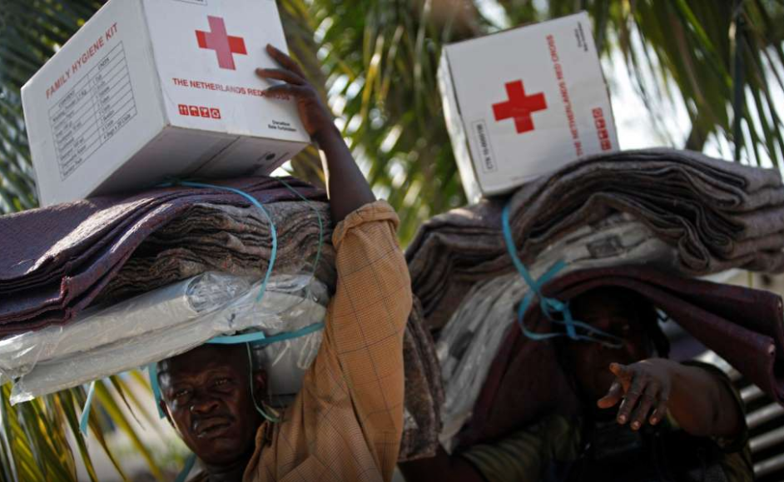
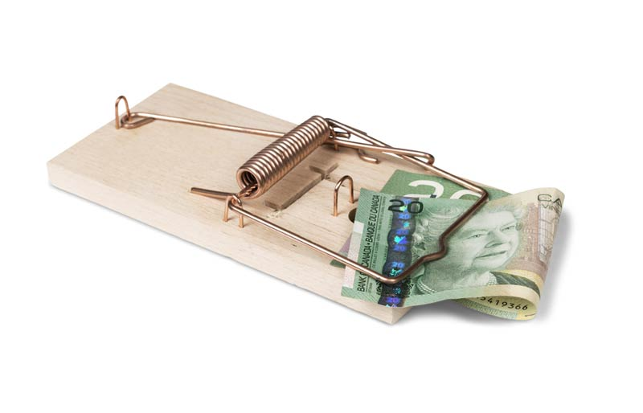
Why the need for governance
Avoid conflicts that erode the member trust
Ensure compliance with rules and regulations
Ensure the smooth operations of the club
Notes:
Insert program name and photo.

Slide 3
What is Governance
...the system by which an organization is directed and controlled
Notes:
Insert program name and photo.

Slide 4
In a Rotary Context
...how does the Board ensure the proper running of the club so that we meet the needs of our interested parties.
Notes:
Insert program name and photo.

Slide 5
Primary Role of the Board
Annual selection of the President?
Setting direction and making decision on behalf of the members
Monitoring performance and compliance with laws and regulations
Notes:
Insert program name and photo.

Slide 6
Duties as a Director
Two primary duties:
  Duty of Care – informed and prepared decision making
  Duty as a Fiduciary – to act solely in the best interests of the members
Directors bear the legal responsibility for decision made by the Board
Notes:
Insert program name and photo.

Slide 7
Who are the Interested Parties
Rotary International – allows us to use the name, brand and network
Members – pay dues, fundraise and provide human capital
Community – helps us raise the money to fund our initiatives
Government – for clubs incorporated/charities
Notes:
Insert program name and photo.

Slide 8

What Type of Board is Right?
Advisory
Collaborative
Governance
Intervening
Operating
Very Passive (Rubber Stamp)
Very Active (Micro-Managing)

Slide 9
Operational Board
Interested Party
(exclusively members)
Representative
Board
Management
Through
Committees
Who is providing oversight?

Slide 10
A Board is effective when?
The club is on track to achieve its goals
  Fundraising efforts are successful
  Annual goals are being met
  Value is recognized by your community
Directors are engaged and can have constructive dialogue at meetings prior to decisions being made
The sum of its parts are greater than the whole:
  President is a team leader
  Directors have a good mix of skills and experience
  Very supportive board culture
Notes:
Insert program name and photo.

Slide 11
Enemies of Board Effectiveness
Lack of time
Lack of information and knowledge
Group-decision making style
Lack of independence from the club culture

Slide 12
Governance System
Does your Club have a governance system?
What documents do you use to set the direction for the club?
What documents do you use to ensure the club is heading in the right direction?
How do you gain confidence that you are compliant with all policies/regulations/etc.
Notes:
Insert program name and photo.

Slide 13
Sources of Direction
Strategic Plan
Consideration of Risks
Committees
Policies
Budget
Where are we headed?
What obstacles and opportunities might we face along the way?
Who will do what?
How will we resource our efforts?

Slide 14
Sources of Control
Annual Report to Members
Performance Measures
Evaluations
Financial Statements
Where are we compared to where we said we would be?
How do we measure up and how well have we mitigated risk and taken advantage of opportunities?
How well did we perform?
How are we doing compared to budget?

Slide 15
Confidence in Compliance
Do you know the various sources of compliance that the club has to follow:
  From RI – constitution, bylaws, code of policies
  From Club – constitution (required by RI), bylaws, letters patent
  From Government – the legislation and regulations applicable to the jurisdiction where it is situated (i.e. Corporations Acts (Ontario/Federal)
Notes:
Insert program name and photo.

Slide 16
Operational Board
Stakeholders
(exclusively members)
D
I
R
E
C
T
I
O
N
C
O
N
T
R
O
L
Representative
Board
Management
Through
Committees
Who is providing oversight?

Slide 17
What’s Important
Build a culture of governance (take it seriously)
Take advantage of members with expertise (i.e. lawyers, accountants, professionals)
Evaluate the effectiveness of how the Club is run through the various committees
    Consider whether the Committees are resourced appropriately
Confirm if you have been incorporated and under what jurisdiction
Notes:
Insert program name and photo.

Slide 18
What’s Important
Read the appropriate Corporations Act
Ensure you have filed your tax returns
Review the RI Constitution and Bylaws and ensure the Club’s are consistent
Review the bylaws and refresh where required
    Ensure you note important procedures within the bylaws to ensure compliance
Do a refresh of your policies and procedures
Notes:
Insert program name and photo.

Slide 19
What’s Important
Ensure proper oversight
    Succession planning for the President and Board as a whole (normally done by a Governance and Nominating Committee)
    Are your policies and procedures up to date
    Are your financial results audited or reviewed (requirement under the business corporations act)
    Should you set up a separate Audit and Finance Committee made up of members with accounting/finance background)
    Build a compliance checklist and have the Treasurer attest to meeting the compliance
Notes:
Insert program name and photo.

Slide 20
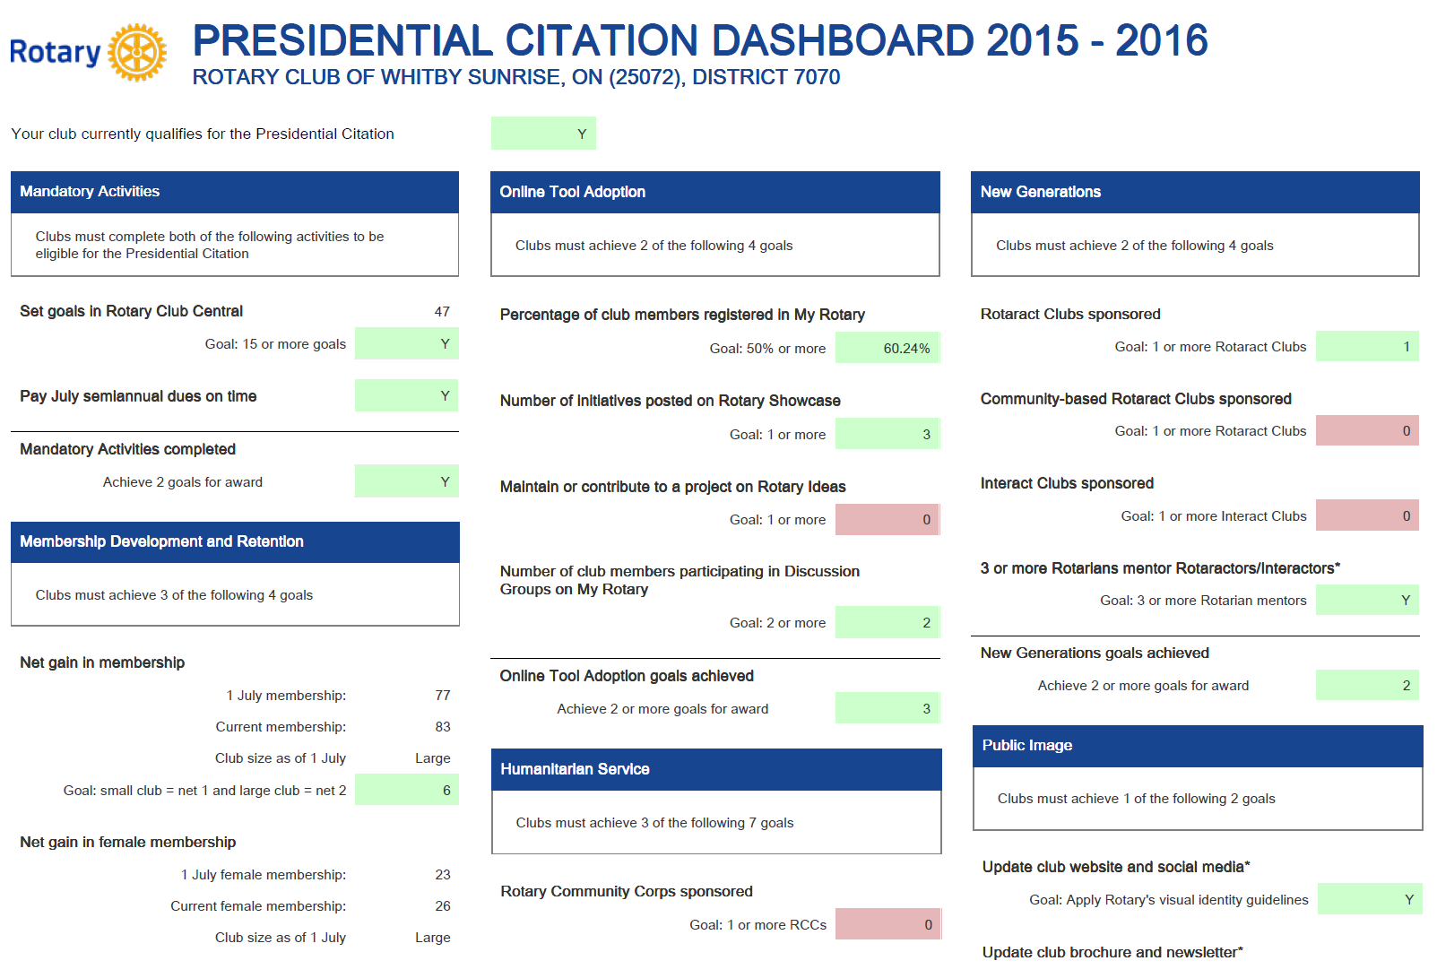
A Useful Tool - Reporting
Notes:
Insert program name and photo.

Slide 21
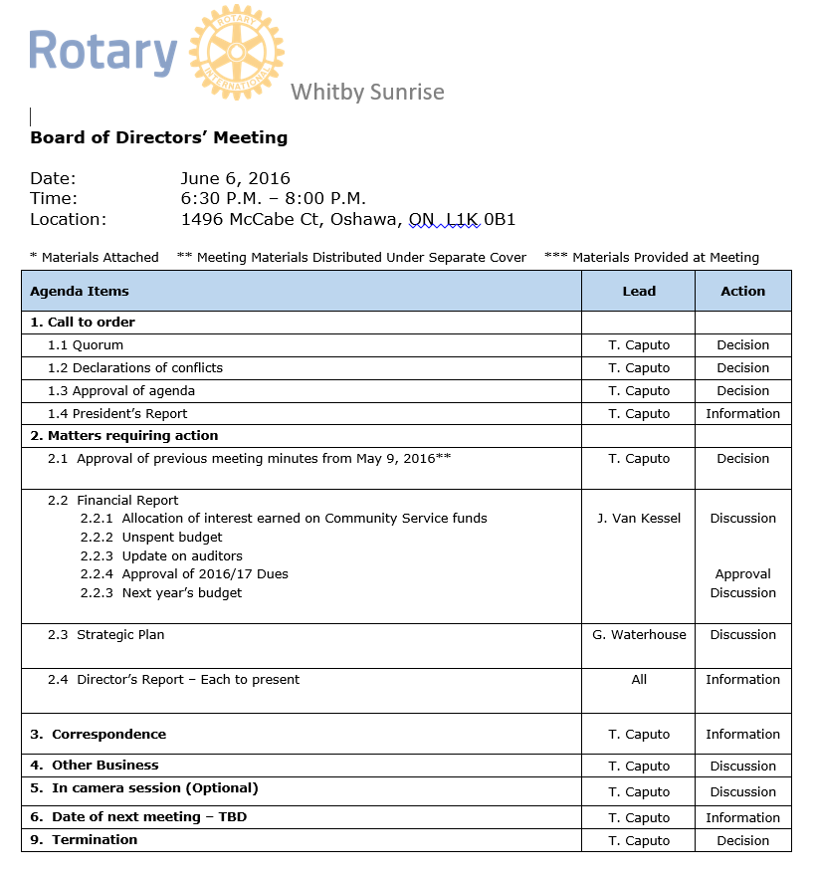
A Useful Tool - Agenda
Notes:
Insert program name and photo.

Slide 22
How You Run a Meeting
Ensure you run a proper meeting
    Confirm quorum
    Ensure there are no conflicts of interest
    Have proper minutes documenting decisions
    There should always be a financial report
    Any decisions that need to be made should have a briefing note written for Board members read prior to the meeting
    The Director responsible for the agenda item should write the briefing note and provide information
    Send out the meeting material well in advance
    President (Chair) ensures all voices are heard
Notes:
Insert program name and photo.

Slide 23
Thank you
  Terry Caputo
  (905) 213-5925 (cell)
  terrycaputo@outlook.com
Notes:
Insert program name and photo.

