Slide 1

DISTRICT ASSEMBLY
Breakout Session Name
DISTRICT ASSEMBLY 7070
District Governor 7070 Elizabeth (Liz) Compton, from the Rotary Club of Toronto Leaside.
Rotary International President Olayinka Hakeem Babalola, member of the Rotary Club of Trans Amadi, Nigeria
Saturday, 23rd of May 2026 Centennial College - Scarborough

Slide 2
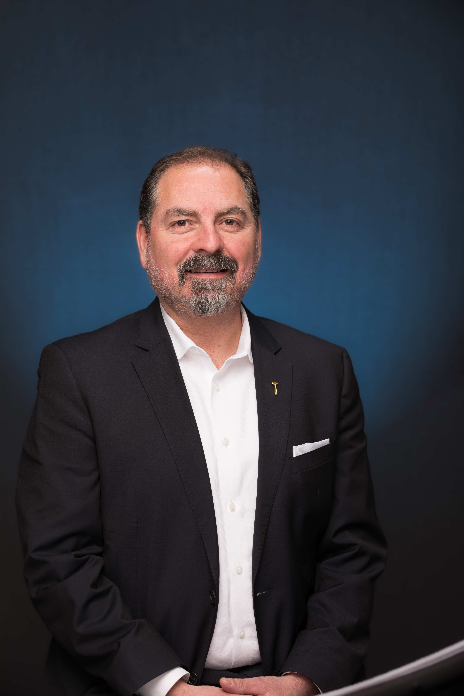
Goal Setting Break-out Session
Aligning with Rotary International
while Empowering Local Clubs
Hazzem Koudsi
  Rotary Club of Belleville
  Current CEO Habitat for Humanity
  Prince Edward Hastings
  Former Director CRA Tax Services Office

Slide 3
Session Objectives
What we will cover
Understand Rotary International priorities
Translate global goals into local action
Apply a structured goal-setting process
Measure outcomes and effectively adjust

Slide 4
Why Goal Setting Matters
From Activity to Impact
Drives focus and accountability
Aligns club efforts with broader mission
Improves member engagement and retention
Enable measurable community impact

Slide 5
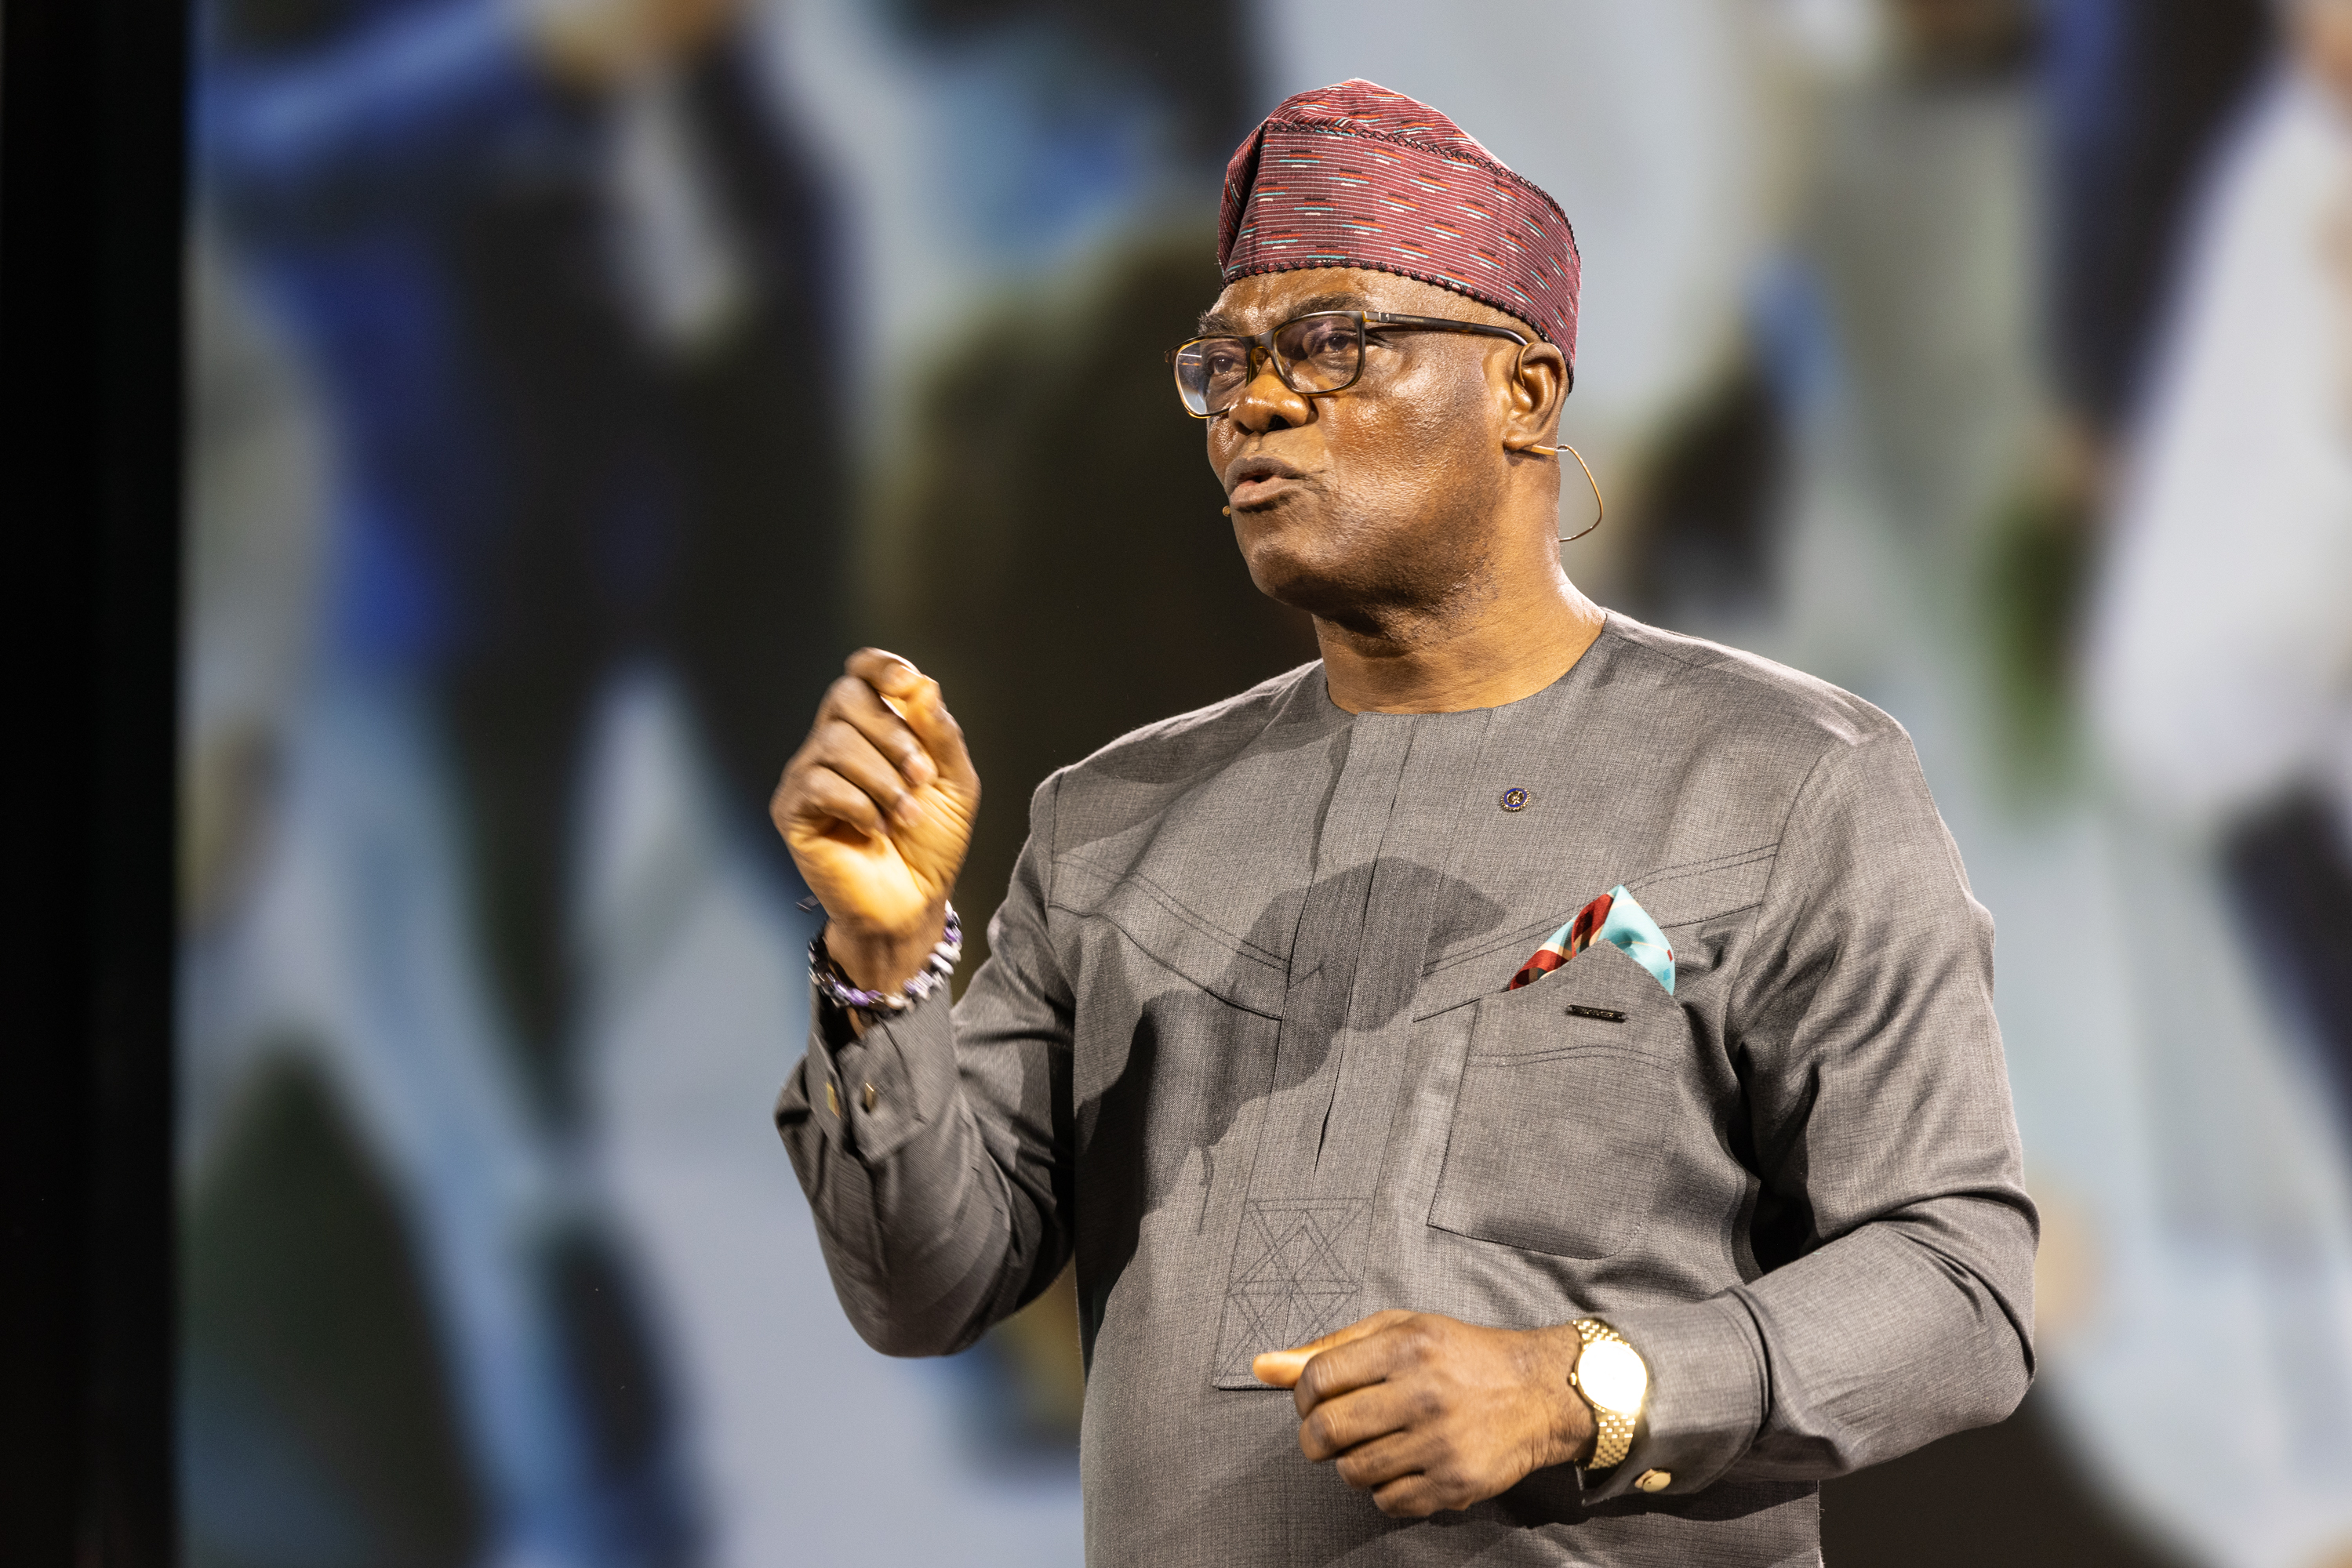
Rotary’s Strategic Priorities 2026/27
Rotary International Areas of Focus
Olayinka Hakeem Babalola “Create Lasting Impact”
Create Lasting impact (Expand Reach)
Synergy, Innovation, Positivity (SIP)
Internal Transformation
Empowering Women & Girls
Diversity, Equity and Inclusion (DEI)

Slide 6
Rotary’s Strategic “Rolling” Priorities
2025 to 2028
Rotary International three-year rolling strategy for
continuity and longer-term planning
Service Impact
- Seven Priority Goals
Foundation Focus
Polio Eradication
The Annual Fund
Endowment Fund

Slide 7
Local Club Challenge
Balancing Alignment & Remaining Flexible
Varying club sizes
Translate global goals into local action
  Keep International Focus while defining local relevance
Customization within a shared framework
Identifying achievable and meaningful otcomes

Slide 8
Goal Setting Framework
R & D
Assess the current state (SWOT)
Define Priorities
Set SMART Goals
Develop Action Plans
Assign Ownership
Track Progress and Adjust
Notes:
Membership trends
Club engagement
Financial health
Community needs

Slide 9
Defining Priorities
What Matters Most – Current/Next Year
Align with International strategic areas
Identify 2-4 key areas of focus
Consider club capacity and strengths
Notes:
Membership trends
Club engagement
Financial health
Community needs

Slide 10
Get SMART
Make Goals Clear & Actionable
Specific – clearly defined
Measurable – trackable outcomes
Achievable – realistic
Relevant – aligned with mission
Timebound – due dates
Example - “grow membership by 10% by June 30th”
Notes:
Measure – use dashboards or reporting
Have regular checkins especially at the start
Adjust as needed

Slide 11
Develop Action Plans
Turning Goals into Action
Define key activities
Set milestones
Identify required resources
Anticipate risks and how to mitigate

Slide 12
Own It
Accountability drives results
Assign goal leaders
Clarify roles and responsibilities
Provide leadership support

Slide 13
Example
Linking International Priority into Local Action
RI Priority: Expand Reach
Club Goal: increase membership by 10%
Actions:
  Host guest events
  Launch referral campaign
  Improving onboarding experience
Notes:
Inviting to meetings
Hosting membership recruitment info sessions

Slide 14
Common Pitfalls
Keep an eye out
Too many goals
Vague or unmeasurable targets
Lack of ownership
Ignoring member input

Slide 15
Keys to Success
What Works
Focus on a few priorities
Engage members in goal setting
Communicate progress regularly
Celebrate milestones
Stay flexible

Slide 16
Discussion / Breakout
Theory Application
What are your top 2-3 priorities?
What is one SMART goal you can define today?
How will you measure success?

Slide 17
Closing
From Goals to Impact
Alignment + Ownership = Results
Small, consistent progress wins
Every club can make a measurable difference.

