Slide 1

DISTRICT ASSEMBLY
How Your Club’s Web Presence
Impacts
Your Club’s Public Image
DISTRICT ASSEMBLY 7070
District Governor 7070 Elizabeth (Liz) Compton, from the Rotary Club of Toronto Leaside.
Rotary International President Olayinka Hakeem Babalola, member of the Rotary Club of Trans Amadi, Nigeria
Saturday, 23rd of May 2026 Centennial College - Scarborough

Slide 2
YOUR CLUB WEB PRESENCE
How Your Club’s Web Presence
Impacts
Your Club’s Public Image
Dave Andrews and Joe Solway
2026 District Assembly
Notes:
Welcome everyone to our Public Image presentation .
I am Dave Andrews, Chair of the
District 7070 Public Image Committee
and a member of the Rotary Club of Oshawa-Parkwood
I am very pleased to have with us today, my good friend
Joe Solway, our Rotary Zone 28 ARPIC –
Assistant Rotary Public Image Coordinator
from the Bowmanville Rotary Club
And producer of this week’s Unite For Peace – well done Joe

Slide 3
Why a Positive Public Image ?
…… Here’s The Bottom Line
When your Rotary Club has a positive public image:
your current members are motivated to be active
AND
prospective members are eager to join your club.
Notes:
Why a Positive Public Image ?
…… Here’s The Bottom Line
When your Rotary Club has a positive public image:
your current members are motivated to be active
AND
prospective members are eager to join your club

Slide 4
Don’t Forget The Mainstream Media
Although most of our presentation today is about social media, we think it is very important that you use the mainstream media too to tell your club’s story.
I can think of no one better to give you some tips on How to talk to the media , than Joe Solway….
Joe , the floor is yours
Notes:
Although most of our presentation today is about social
media and what is coming up in the new year,
we think it is very important that you also use
the mainstream media too, to tell your club’s story.
I can think of no one better to give you some tips on
How to talk to the media , than Joe Solway.
Joe, the floor is yours….. ,

Slide 5
Social Media
Why Social Media ?
Notes:
Why should we use Social media to tell your Rotary Story?

Slide 6
Why – To Create Connections
A well-built media presence will help you create connections in your community and beyond, from building awareness of your club’s presence to showcasing its success.
Current members
Potential members
Community partners
Event sponsors
Attendees
Notes:
WHY? To Create Connections
A well-built media presence will help you create
connections in your community and beyond,
from building awareness of your club’s presence
to showcasing its success.
Who are you Connecting with?
Current members
Potential members
Community partners
Event sponsors
Attendees

Slide 7
Do You Want New Members in Your Club?
YOU HAVE TO GET SOCIAL from Evan Burrell
“While it can seem overwhelming, social media is the best Rotary promotional tool for building strong relationships and engaging with your community.
If you set yourself some achievable goals this year, you and your club will reap the rewards.”
….. Evan Burrell
Notes:
Do You Want New Members in Your Club?
YOU HAVE TO GET SOCIAL from Evan Burrell
This year’ s District Governor for D9660 in Australia with a
huge International following on social media. Please check him out, follow him, become his friend. You won’t be disappointed.
“While it can seem overwhelming, social media is the
best Rotary promotional tool for building strong
relationships and engaging with your community.
If you set yourself some achievable goals this year,
you and your club will reap the rewards.”
….. Evan Burrell U HAVE TO GET SOCIAL

Slide 8
1. Pick Your Platform
With so many social media platforms available, getting started can be intimidating.
Choose one platform to focus on and grow from there.
We recommend starting with Facebook, which has the largest user base.
Notes:
Pick Your Platform
With so many social media platforms available,
getting started can be intimidating.
Choose one platform to focus on and grow from there.
We recommend starting with Facebook,
which has the largest user base.

Slide 9

3 Primary Types
Facebook has nearly 3 billion monthly active users and reaches more than 50% of internet users worldwide
Notes:
A Facebook page can establish your club's social media
presence and reach members who are already
using this platform. How about 3 billion monthly
active users
Facebook lets you showcase content such as
videos, photos, news, and events.
It's also useful for building relationships with
prospective members and the local community.
Your page can have limited reach, however,
if you don't pay for advertisements or boosted posts.
Almost all of our clubs in D7070 are on facebook - -
please keep the content and logos up to date

Slide 10

3 Primary Types
Instagram has about 2 billion active monthly users.
Notes:
Instagram has about 2 billion active monthly users.
It is best used for building relationships by using
hashtags and keywords to search through topics.
Its Reels feature can also highlight short video content.
Instagram is a more visual platform and is better for
pictures and short videos, because it doesn't support text-only content.
Currently 31 of 55 Rotary clubs are on Instagram
- 7 of 7 Rotaract Clubs are too

Slide 11
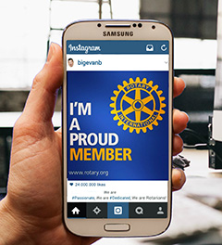
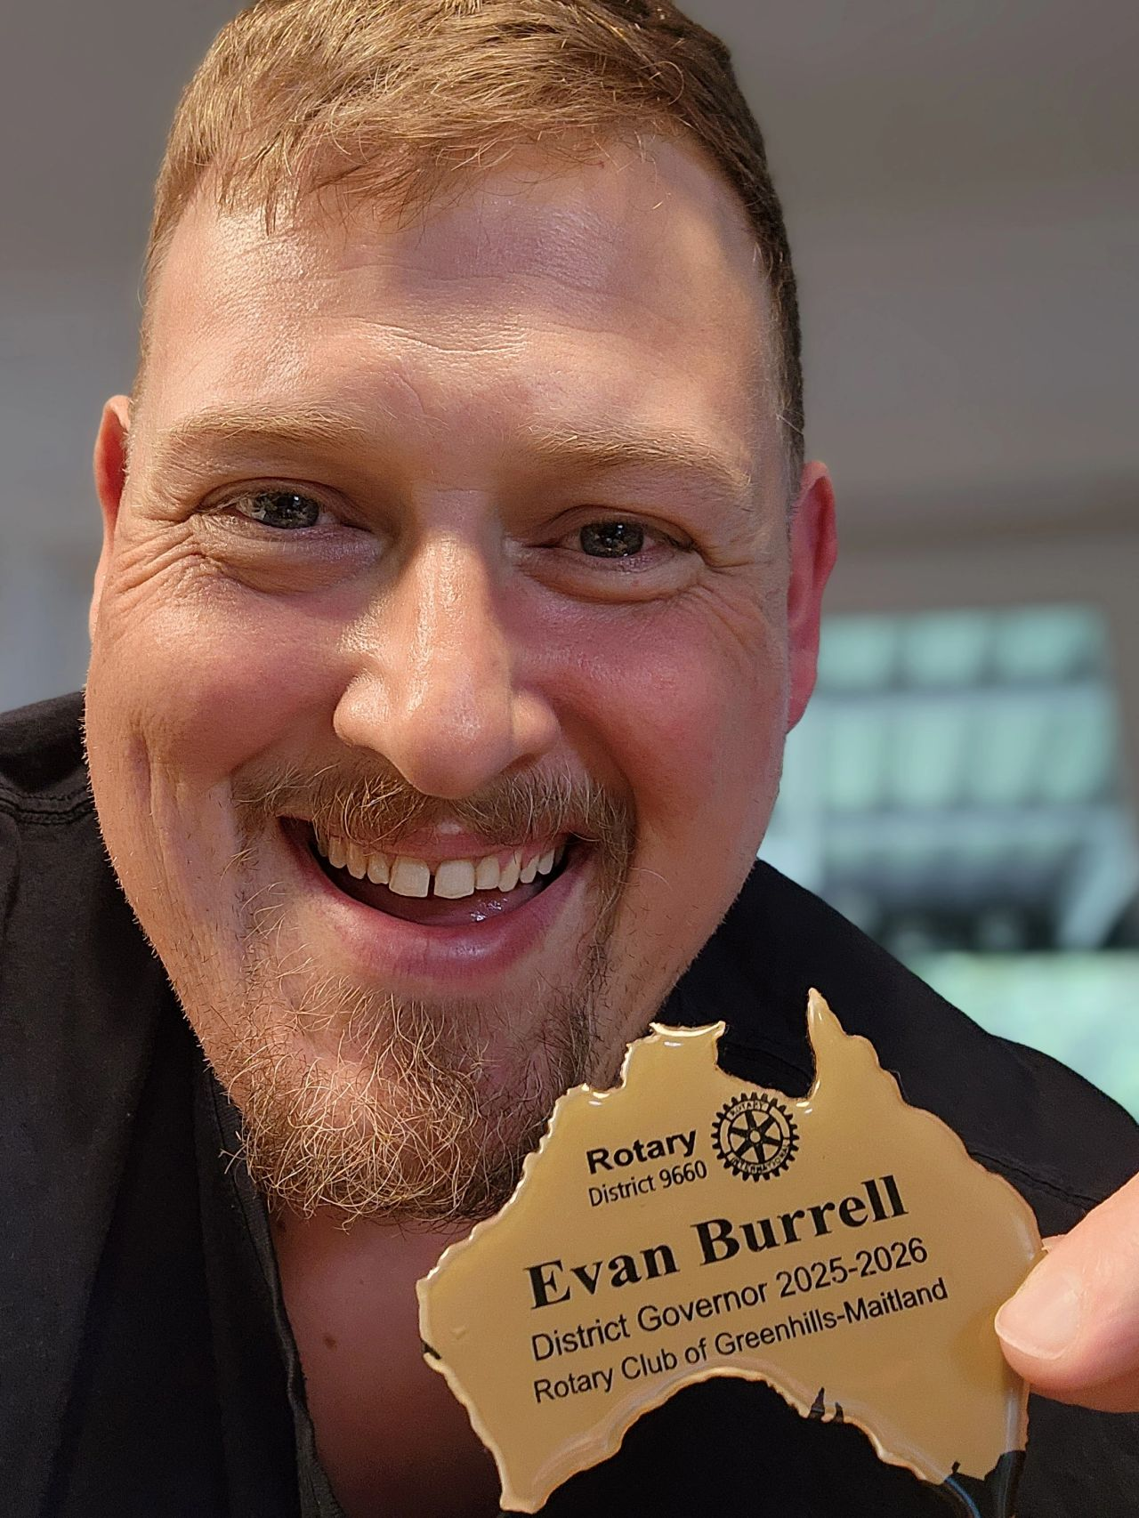
Why Instagram for Your Club?
The most engaging posts on social media are the ones that include images.
That isn’t a statement, it’s a fact!
Out of all of the social media networks, I have to say Instagram is my favorite. Why? Because photos equal fun!
So why should your club be on Instagram? Because “a picture is worth a thousand words.” There are so many things you can do with photos to showcase your vibrant club and promote Rotary.
Notes:
The most engaging posts on social media are the ones that
include images. That isn’t a statement, it’s a fact!
Out of all of the social media networks, I have to say
Instagram is my favorite. Why? Because photos equal fun!
Although Facebook is currently the most popular social network,
other platforms have been gaining ground, especially
visual platforms like Instagram, which allows users to
share photos, after applying edits and digital filters.
After uploading your photo, you can share it on your
club’s social networking sites like Twitter and Facebook.
So why should your club be on Instagram?
Because “a picture is worth a thousand words.”
There are so many things you can do with photos
to showcase your vibrant club and promote Rotary.
Evan Burrell - DG for D9660 in Australia

Slide 12
How To Use Instagram for your club?
Before your jump in:
Make sure you own a smartphone with a camera
Download the Instagram app
Use hashtags: Mix them up. Use some that are general (#barbecue or #ribfest), some that are trending, and some that are Rotary specific (#Rotary, #RotaryStory, #ricon26). But make sure they are relevant to what you are posting about.
Engage with your audience: Respond to comments you get on your photos. Follow others
Use captions: Keep text to a minimum, because it is a visual platform. Don’t just leave the caption field blank.
Plan your photos. Just like the old days of film photography, capturing good photos for Instagram with your smartphone requires planning. Experiment with different angles and plan around your source of light. Keep your eye out for that key moment or winning facial expression.
Take a lot of photos: Professional photographers shoot hundreds of images to get that one good shot. The same is true for Instagram. “There are no rules for good photographs, there are only good photographs.”
Notes:
Before your jump in:
Make sure you own a smartphone with a camera:
An Apple iPhone or Samsung Galaxy will suffice.
Download the Instagram app:
You can’t get started unless you start using it. Download the app from Google Play for Android or Apple App Store for iPhone and iPad.
Use hashtags: They are how you reach new audiences and gain more followers. Mix them up. Use some that are general (#barbecue or #ribfest), some that are trending (#environment), and some that are Rotary specific (#Rotary, #RotaryStory, #ricon26).
But make sure they are relevant to what you are posting about.
Engage with your audience: Respond to comments you get on your photos
Follow others who are passionate about Rotary or
about helping the community.
Like and comment on their photos. Use captions: Keep text to a minimum, because it is a visual platform.
But make sure you have some kind of caption for every post to give viewers context.
Don’t just leave the caption field blank.

Slide 13
How To Use Instagram for your club?
Before your jump in:
Make sure you own a smartphone with a camera
Download the Instagram app
Use hashtags: Mix them up. Use some that are general (#barbecue), some that are trending, and some that are Rotary specific (#Rotary, #RotaryStory, #ricon16). But make sure they are relevant to what you are posting about.
Engage with your audience: Respond to comments you get on your photos. Follow others
Use captions: Keep text to a minimum, because it is a visual platform. Don’t just leave the caption field blank.
Plan your photos. Just like the old days of film photography, capturing good photos for Instagram with your smartphone requires planning. Experiment with different angles and plan around your source of light. Keep your eye out for that key moment or winning facial expression.
Take a lot of photos: Professional photographers shoot hundreds of images to get that one good shot. The same is true for Instagram. “There are no rules for good photographs, there are only good photographs.”
Notes:
Before your jump in:
Plan your photos. Just like the old days of film photography, capturing good photos for Instagram with your smartphone requires planning.
Occasionally there are happy accidents, but it’s about putting yourself in a position to get a good photo.
Experiment with different angles and plan around your source of light.
Keep your eye out for that key moment or winning facial expression.
Take a lot of photos: Professional photographers shoot hundreds of images to get that one good shot.
The same is true for Instagram. And in the days of digital photography, this is easier than ever,
and you don’t have to blow a fortune on film. Take 10, 20, or more photos of the same subject and use the one that turns out best.
Remember, Ansel Adams said, “There are no rules for good photographs, there are only good photographs.”

Slide 14
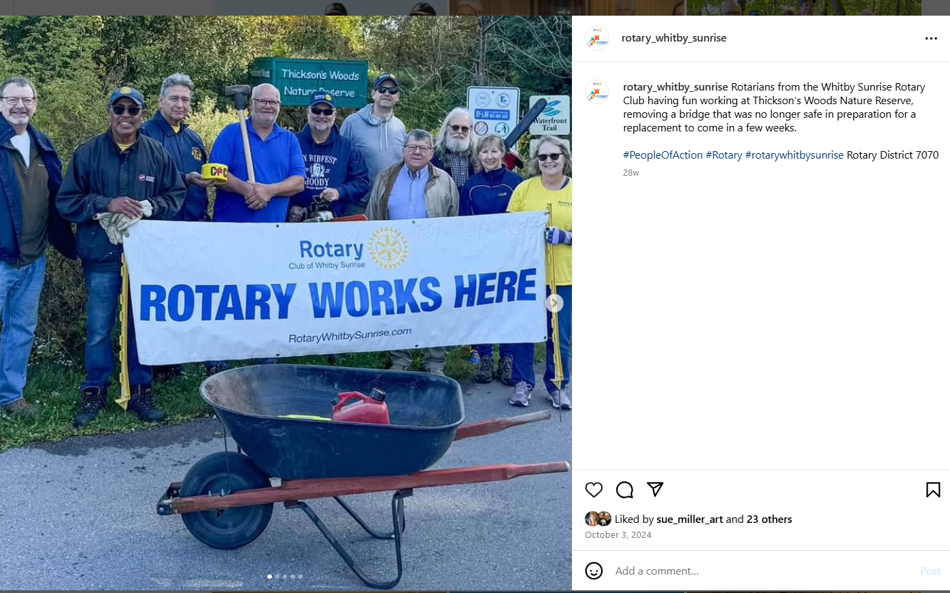
Instagram Example – Whitby Sunrise
Notes:
Remember - It is best used for building relationships by using hashtags and keywords to search through topics.
Here is one from Whitby Sunrise who have posted
over 1,700 posts on Instagram
One short sentence
- who what when where and why and lots of hashtags
Remember … Instagram is a more visual platform
and is better for pictures and short videos,
because it doesn't support text-only content.

Slide 15
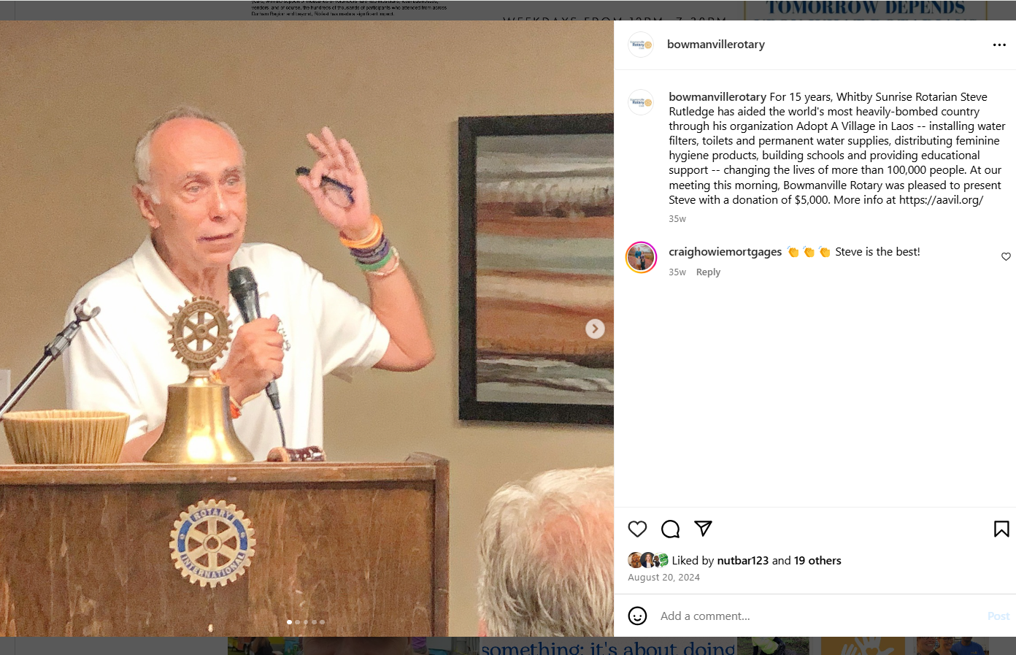
Instagram Example – Bowmanville
Notes:
Here’s one from Bowmanville
Steve Rutledge talking about Adopt A village Laos ,
talking about clean water to villages in Laos,
and Bowmanville made a sizeable donation
Again – who, what , when , where and why
And a comment from another club
Instagram really is a more visual platform.

Slide 16
Want Some Help With Instagram?
Beatrix Yip
President of the York Rotary Club
Member of the District 7070 Public Image Committee
Beatrix_yip@live.com
Watch for a District 7070 Public Image Webinar with Beatrix in 2026-27 featuring tips on Instagram for your club
Beatrix is willing to put on a presentation for your club
Notes:
Our District Public Image Committee is very pleased to have Beatrix as an esteemed member
Beatrix Yip
President of the York Rotary Club
Member of the District 7070 Public Image Committee
Beatrix_yip@live.com
Watch for a District 7070 Public Image Webinar with Beatrix in 2026-27 featuring tips on Instagram for your club
Beatrix is willing to put on a presentation for your club

Slide 17

The Third Primary Type
LinkedIn has more than 1 billion registered members from over 200 countries and territories.
Notes:
LinkedIn has more than 1 billion registered members
from over 200 countries and territories.
If Rotary is the original social network,
why not use this networking giant that reaches
1 billion people
We have a few Clubs in our District who are doing just that
We have now have a District 7070 Linkedin account

Slide 18
What Do I Post ?
Great Question

Slide 19
Don’t Forget The Impact in Your Posts
And when we talk about projects, fund raisers, donations in a post or story, stress the impact
fed xxx people, etc…
planted xxx trees,
impact on the environment …
Remember Rotary International President Yinka Babalola’s theme for 2026-27 is “create lasting impact”
Notes:
Don’t Forget The Impact in Your Posts
And when we talk about projects, fund raisers,
donations in a post or story, stress the impact
fed xxx people, etc…
planted xxx trees,
impact on the environment …
Remember Rotary International President Yinka Babalola’s
theme for 2026-27 is “create lasting impact”

Slide 20
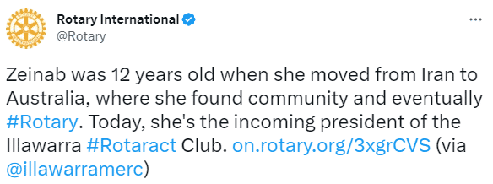
Written Content
This is the simplest content type, because you can share a status update, a link to an event, or a call to action.
Notes:
There is written content
This is the simplest content type,
because you can share a status update,
a link to an event, or a call to action.

Slide 21
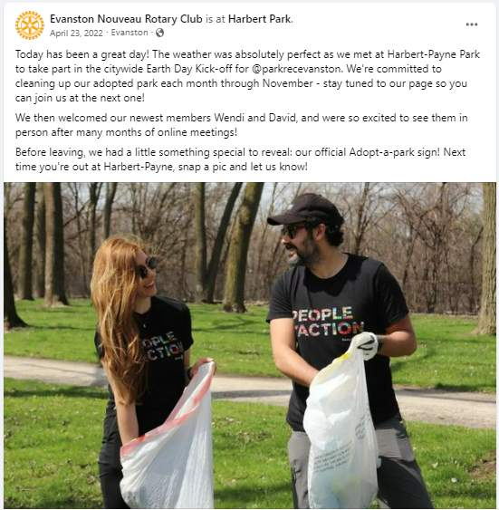
Visual Content
From photos to GIFs to infographics,
visuals can bring your club's story to life.
Add an image to tell your story visually or draw attention to your written message.
Notes:
Then there is visual content
From photos to GIFs to infographics,
visuals can bring your club's story to life.
Add an image to tell your story visually
or draw attention to your written message

Slide 22
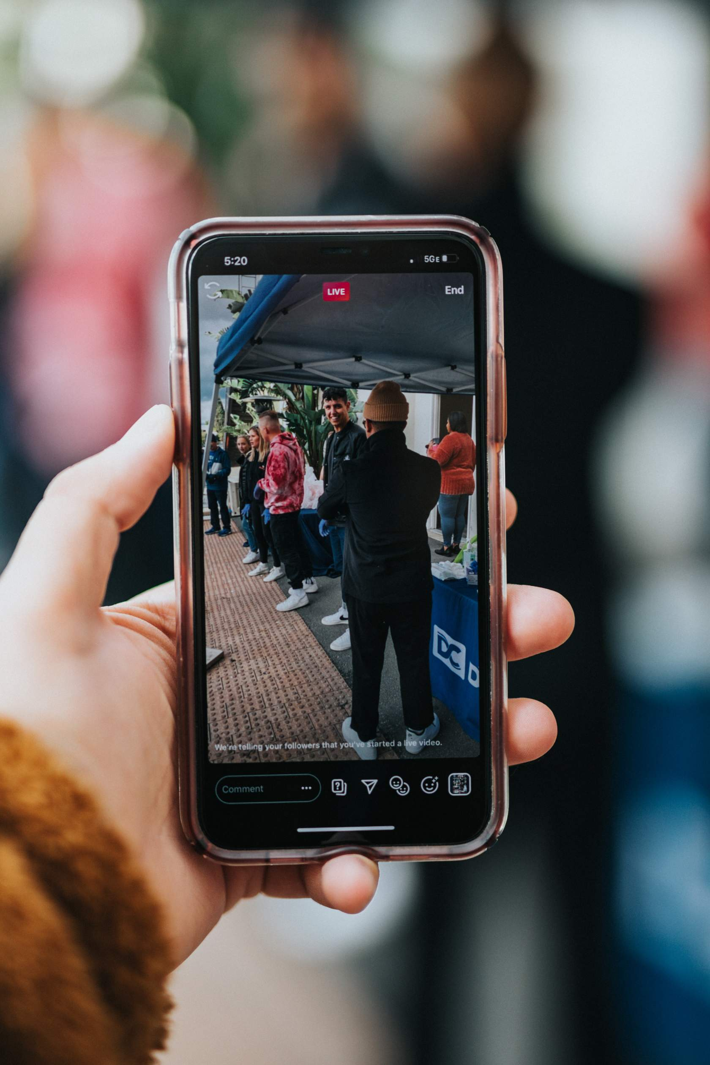
Video Content
Smartphones and editing apps make it easy to tell your story through video.
Take a behind-the-scenes video at your next event or record a series of interviews that feature club members and community partners.
Remember that short videos perform best on social media.
Invite people to your event, project, etc in a video. Preferably a personal invite… people respond to that…
Notes:
Then there is video content.
This is where you will see reels .
Smartphones and editing apps make it easy
to tell your story through video.
Take a behind-the-scenes video at your next event
or record a series of interviews that feature club members
and community partners.
Remember that short videos perform best on social media.
Invite people to your event, project, etc in a video.
Preferably a personal invite… people respond to that…

Slide 23
Video Content
Here is a good example of
a video that you can post –
from Joe Solway
Notes:
Here’s a great example that Joe did when he was on the Dominican Republic service project this year with the Whitby Sunrise Rotary Club
Joe, tell us about the video

Slide 24
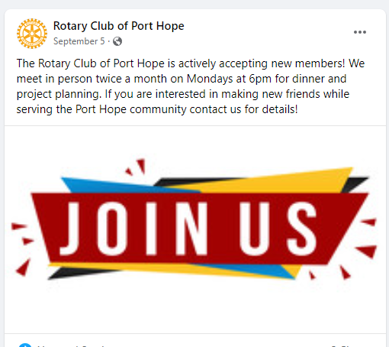

Don’t be Afraid to ASK
From The Rotary Club of Port Hope Rotary
Notes:
DON’T BE AFRAID TO ASK PEOPLE TO JOIN YOUR CLUB.
Here are a few examples from the Port hope Rotary Club.
ABOUT EVERY FIFTH POST
ASK EVERYONE TO JOIN YOUR CLUB
The Rotary Club of Port Hope is actively
accepting new members !
If you are interested in meeting new friends
and serving the Port Hope community,
contact us for details !

Slide 25
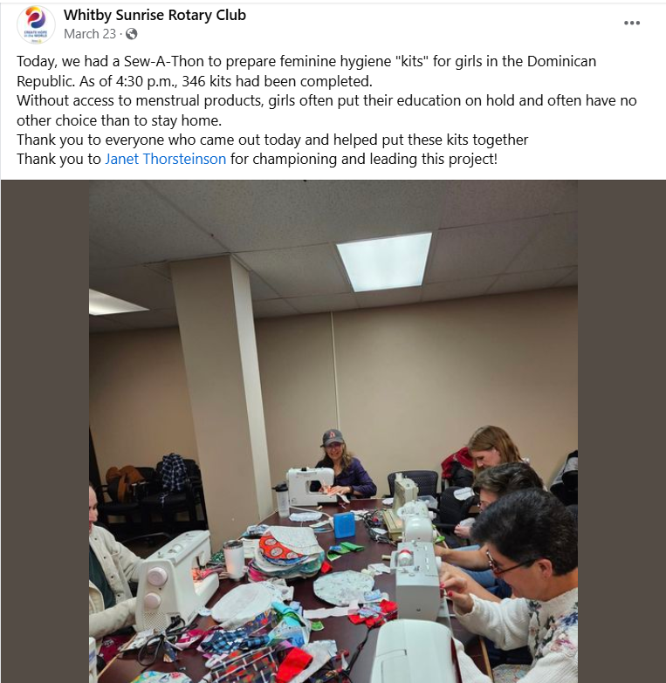
Another Example – Whitby-Sunrise
Notes:
Here is a great facebook example from the Whitby Sunrise
Look at everyone at the Sew Girls Can Go To School program and the event is for girls in the Dominican Republic
Again – who, what, when, where and why

Slide 26
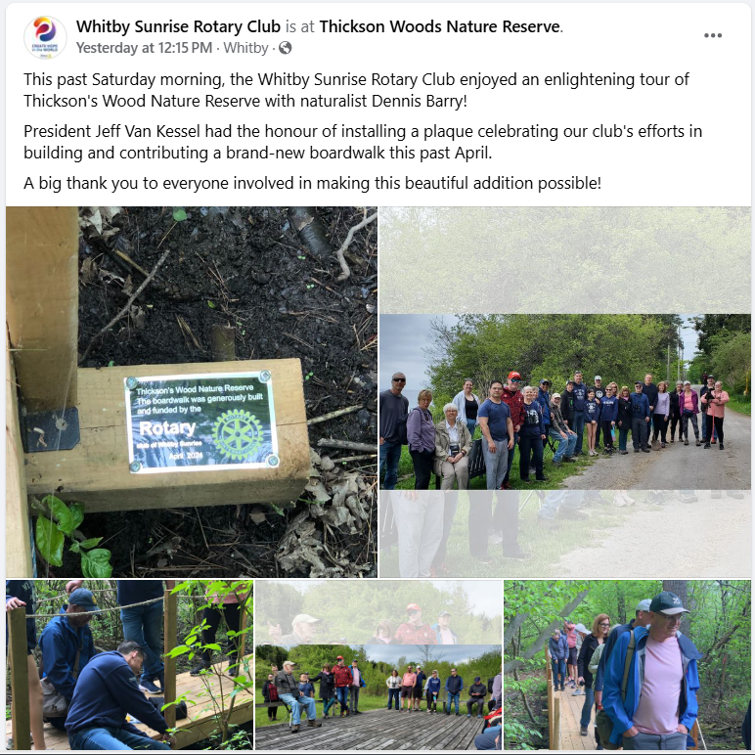
Another Example – Whitby-Sunrise
Notes:
Lots of photos here in the Thickson’s Woods nature preserve , getting fixed up thanks to the RC of Whitby Sunrise
Wow - these people are people of action
Again , the 5 W’s

Slide 27
2026-27 Club Website Refresh
& Rebate Program
Club Website Refresh (& Rebate) Program
- 36 clubs completed in 2021-26
- 20 more clubs eligible for the refresh & rebate program
Web Design Professional, Rotarian and ClubRunner expert, Melissa Wells (Rotary Club of Welland) , Ex Nihilo Website Designs (www.exnihilodesigns.com), manages the ClubRunner Website refresh program for each Club
Your Cost: $300.00 + HST
Rebate: $150.00 + HST
1. All Rotary logos current and correctly used
2. Following the training session the addition of 3 upcoming meetings or events
3. Following the training session the addition of 3 Club Stories
Notes:
The ClubRunner website refresh program is still here for 2026-27. It will include :
A Homepage re-design with a visually engaging layout with simultaneous visitor and Rotarian user focus.
The Creation of a membership join page with email form.
The Creation of additional content pages as required (contact, causes/programs, about us, youth programs, Paul Harris, Rotary Foundation, as required).
The Integration of social media account links and Facebook feed.
The Creation of Google Analytics account if required for website statistics.
Information on e-Commerce ClubRunner capabilities and the creation of a Donate page if the club adopts this program.
The Current and correct usage of the Rotary and Rotary Theme logos .
Your website will display better on a mobile device.
Your training video to keep your website fresh and current

Slide 28
2026-27 Club Website Refresh
& Rebate Program
Club Website Refresh (& Rebate) Program
- 36 clubs completed in 2021-26
- 20 more clubs eligible for the refresh & rebate program
Web Design Professional, Rotarian and ClubRunner expert, Melissa Wells (Rotary Club of Welland) , Ex Nihilo Website Designs (www.exnihilodesigns.com), manages the ClubRunner Website refresh program for each Club
Your Cost: $300.00 + HST
Rebate: $150.00 + HST
1. All Rotary logos current and correctly used
2. Following the training session the addition of 3 upcoming meetings or events
3. Following the training session the addition of 3 Club Stories
Notes:
Melissa Wells, (Rotary Club of Welland in D7090) will contact your Rotary Club to arrange a Zoom kick-off meeting to discuss design and content goals.
Each Rotary Club will have a minimum of the same two Rotarians participate in both the Kick Off and Training Meetings.
There is no limit of Rotarians to participate in either or both meetings.
Following the Kickoff meeting, Melissa will complete the redesign work and you will immediately see the fresh new results in your Club Website.
Part of the website redesign is to ensure your Club Website
works on mobile devices as an important factor in younger potential members to view your website.

Slide 29
2026-27 Club Website Refresh
& Rebate Program
Club Website Refresh (& Rebate) Program
- 36 clubs completed in 2021-26
- 20 more clubs eligible for the refresh & rebate program
Web Design Professional, Rotarian and ClubRunner expert, Melissa Wells (Rotary Club of Welland) , Ex Nihilo Website Designs (www.exnihilodesigns.com), manages the ClubRunner Website refresh program for each Club
Your Cost: $300.00 + HST
Rebate: $150.00 + HST
1. All Rotary logos current and correctly used
2. Following the training session the addition of 3 upcoming meetings or events
3. Following the training session the addition of 3 Club Stories
Notes:
Once the redesign work is complete, Melissa will provide a one-hour Zoom training meeting that will be recorded as an ongoing resource for your Club. The Training meeting will provide the information and
helpful tips for you to keep your website fresh and up to date. 6 hours of Melissa’s time is allotted to the 2 meetings and redesign time.
Cost- $300 plus HST.
Special Co-op incentive- Upon completion of your Training meeting
and follow up work on your website , all you have to do is:
1. Ensure All Rotary logos are current and correctly used
2. Following the training session , add 3 upcoming meetings or events
3. Following the training session, add 3 Club Stories
Once the District Public Relations Chair has been contacted and confirmed that all of these steps are completed,
the District will reimburse you for 50% of the Program fee ($150 plus HST) for your club.

Slide 30
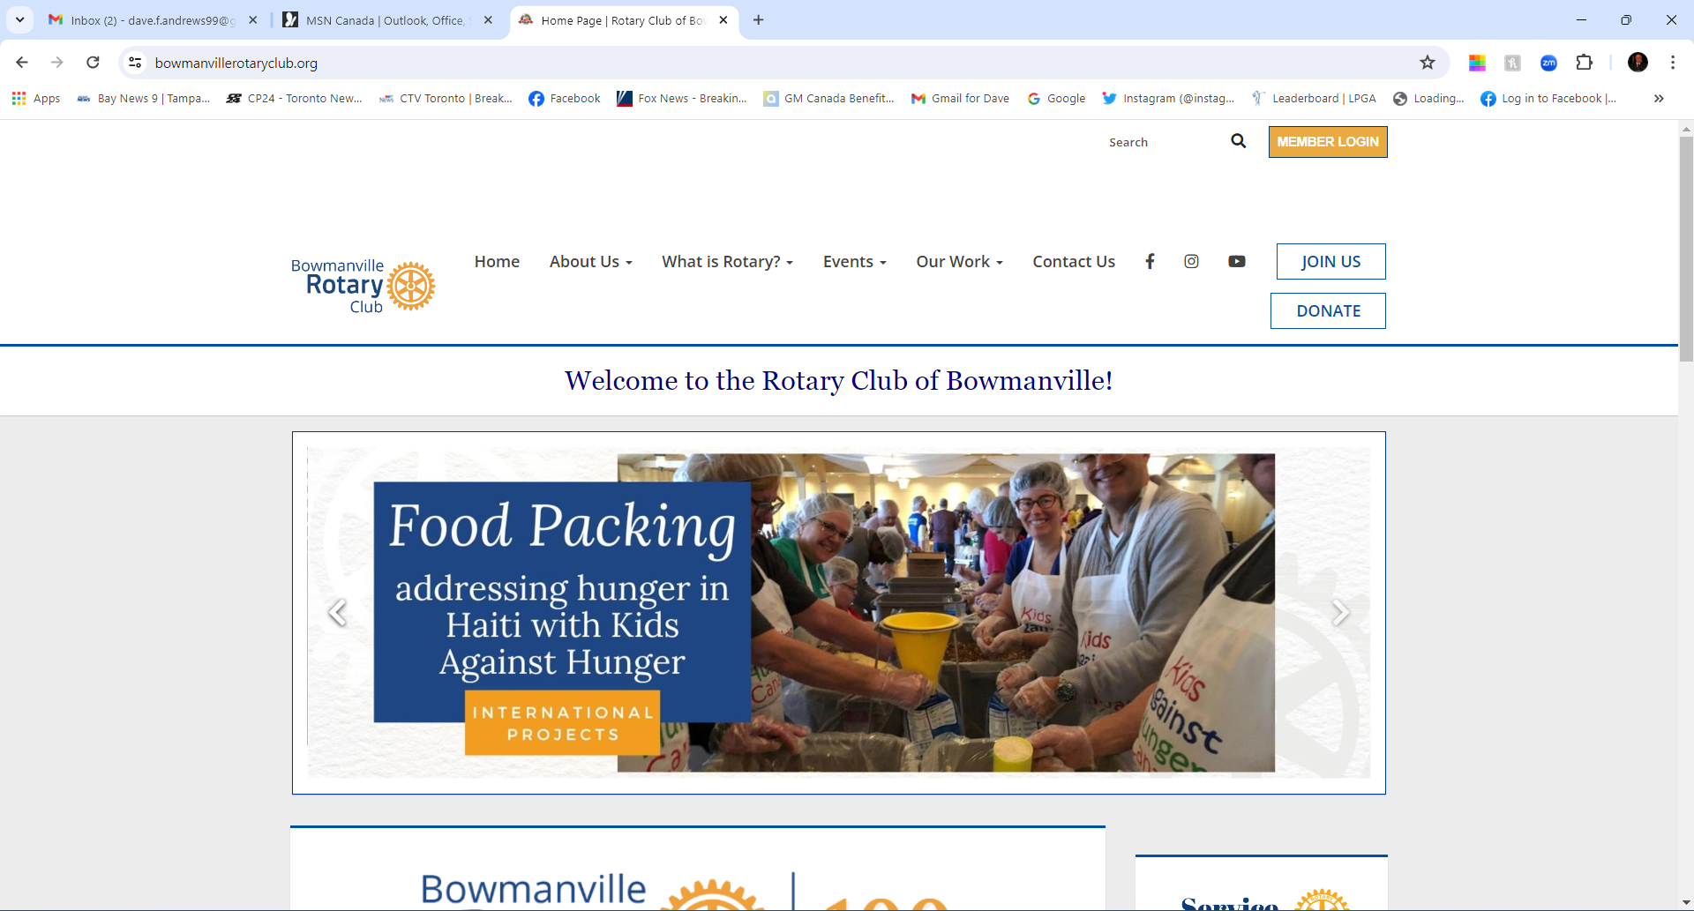
Club Website Refresh - Bowmanville
Notes:
Just one example:
We are looking at Bowmanville here - top of the page

Slide 31
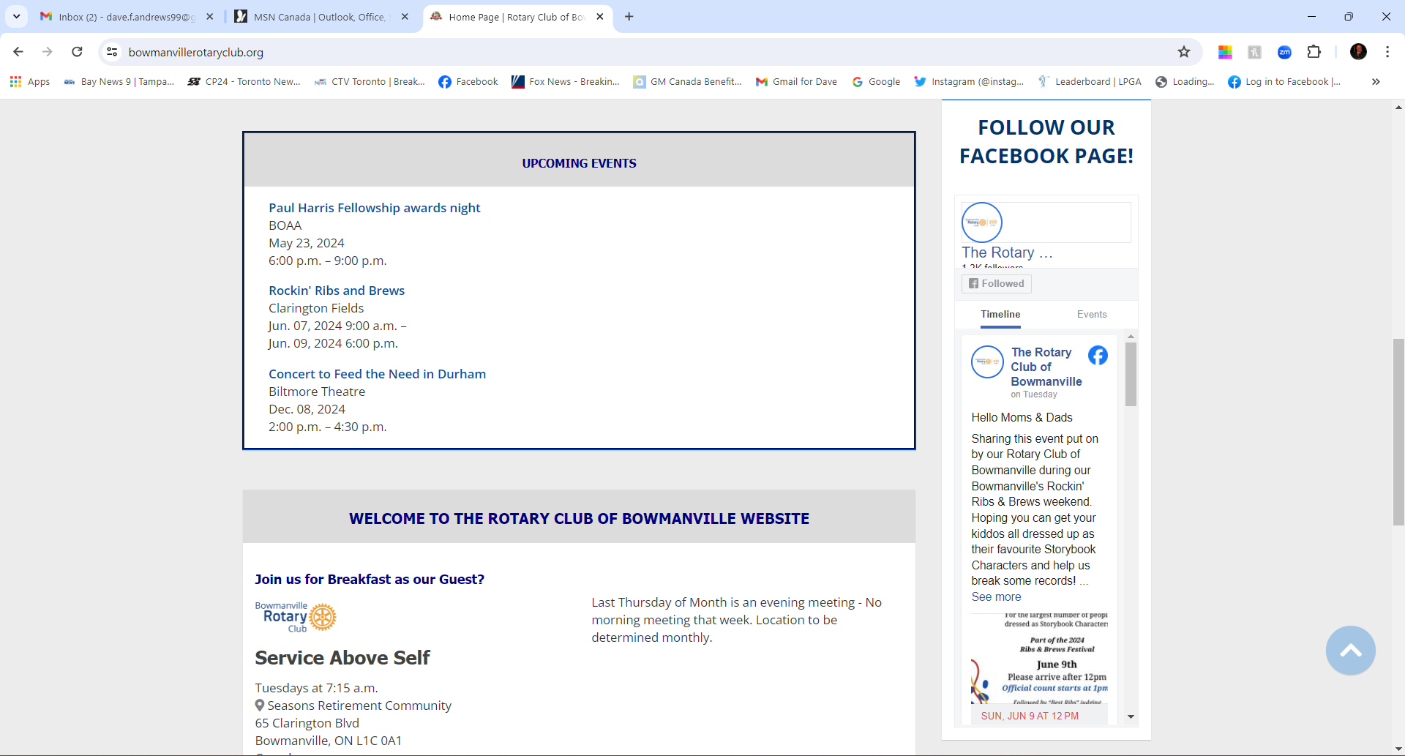
Club Website Refresh - Bowmanville
Notes:
Just one example:
We are looking at Bowmanville here - middle of the page

Slide 32
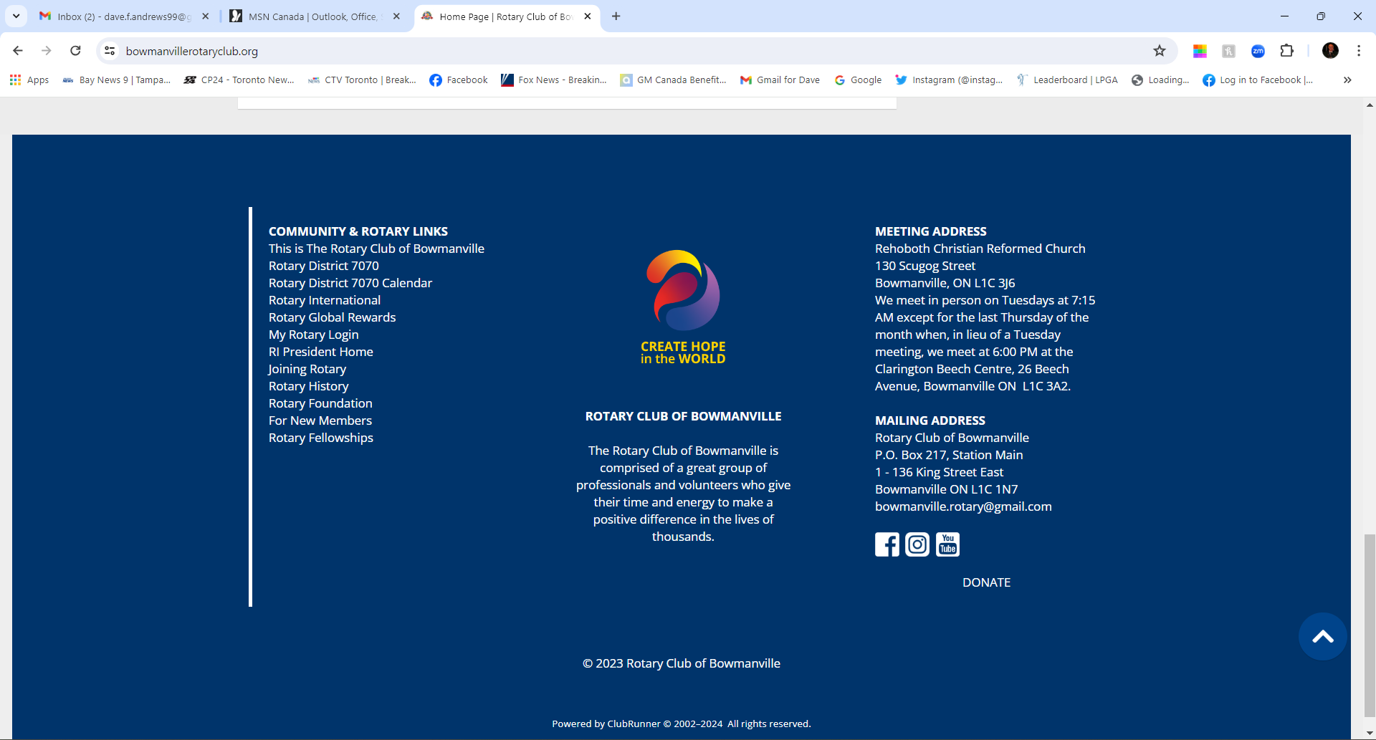
Club Website Refresh - Bowmanville
Notes:
Just one example:
We are looking at Bowmanville here - bottom of the page
NOTE: Last year’s page . They have changed the theme if you look at their page this year

Slide 33
Questions ????
Send us your questions to
David Andrews
dave.f.andrews99@gmail.com
Joe and I will get you the answers and we will put them into the next District Newsletter

