Slide 1
Ontario’s Not-for-Profit Corporation’s Act: Transition / Tools Governance Committee Chair: Terry Caputo February 2023

Slide 2
Objective
What’s new in ONCA
What steps do clubs need to take
Resources available
Project Plan for Clubs
Notes:
Insert program name and photo.

Slide 3
What is ONCA?
...legislation that most not-for-profits incorporated under provincial law will need to follow that replaces Ontario’s Corporations Act
Notes:
Insert program name and photo.

Slide 4
Key Terms
Letters Patent
Now called “articles”
The document the government gave you when you incorporated
It includes your purposes, address, and other special rules
Members
The people who are called members in your bylaws
Have governance powers like electing the directors or appointing the auditor
Notes:
Insert program name and photo.

Slide 5
Why is this important
Opportunity to revisit your governance and align your bylaws with your policies and procedures
Opportunity to simplify your bylaws and take out unnecessary detail
Move detail procedures outside of bylaws to be able to change easily
Some new things are possible
Avoid confusion later on
Notes:
Insert program name and photo.

Slide 6
What’s new
Public Benefit Corporations
Financial Review Standards
Member Rights/Remedies
Changes for Directors/Officers
Ontario Business Registry
Notes:
Insert program name and photo.

Slide 7
Public Benefit Corporation (PBC)
A not-for-profit is a PBC if it:
Is a registered charity (i.e. foundation), or
Receives more than $10,000 in:
Grants or financial assistance from the government
Gifts or donations from sources other than members, directors, officers, or employees
Events revenue not counted
Measured annually in arears and starts after the AGM
Notes:
Insert program name and photo.

Slide 8
Public Benefit Corporation
Face a higher standard of financial review
Can distribute their property only to the government or a similar PBC if they dissolve
Can’t have more than a third of its directors be employees
Notes:
Insert program name and photo.

Slide 9
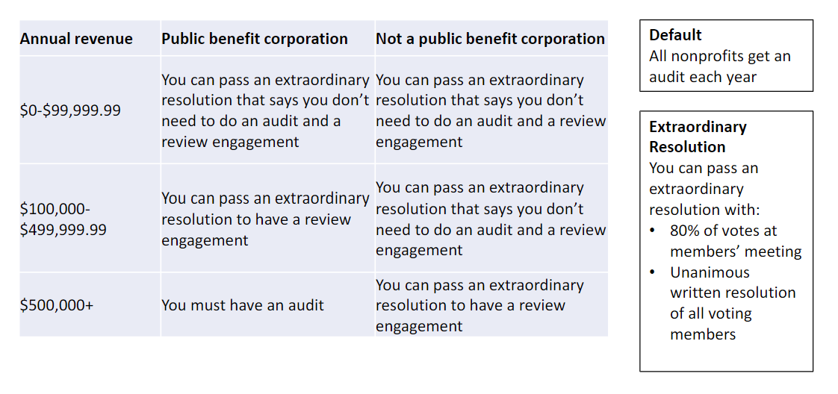
Financial Review Standards
Important Note: The default is an audit, therefore, ensure you pass the extraordinary resolution at the AGM.
Notes:
Insert program name and photo.

Slide 10
Member vs. Director
As a reminder…
Members and directors have distinct roles within a corporation – even if members and directors are one and the same
Members are similar to shareholders of a for-profit corporation (but are not “owners”)
Directors are responsible for the management the corporation’s activities
Directors have fiduciary obligations; members do not
Notes:
Insert program name and photo.

Slide 11
Member Rights/Remedies
Members can remove directors by ordinary resolution (51% vote)…vs 2/3 vote
Can not remove directors appointed by virtue of their role (ex-officio,i.e. President) using an ordinary resolution
Right to remove auditors or person conducting a review by ordinary resolution
Notice of meeting – 10 days to 50 days
Notice of special business meetings – ensure members have enough information to decide
Notes:
Insert program name and photo.

Slide 12
Member Rights/Remedies
Proxy voting needs to be permitted by article or bylaw…recommend requirement that proxy holder has to be a member
Voting normally by hand…consider adding to bylaw ballot, mail, telephonic and electronic means
Must be able to verify identity of member
Use voting function that does not show how member voted
Right to examine various records, except minutes of directors meeting and board resolutions
Notes:
Insert program name and photo.

Slide 13
Member Rights/Remedies
Members holding 10% of votes (can be lower level if bylaw) can call a meeting
Meeting to be called in 21 days or can be held by members requisitioning
Exceptions…no obligation to call meeting for personal issues
Right to make a proposal…must be submitted 60 days before meeting
Notes:
Insert program name and photo.

Slide 14
Member Rights/Remedies
Members can now bring lawsuits on behalf of the corporation against even the directors, if:
they have provided notice to the director and
the Court has found it is in the interest of the corporation for the member to carry on the action.
Notes:
Insert program name and photo.

Slide 15
Changes for Directors/Officers
Composition
Min 3, ex officio allowed, one-time special resolution to fix directors
Term of Directors
4 years that has unlimited renewals
Important Note: Directors must consent to take office within 10 days of being elected. Recommend creating a form and have them sign at the AGM
Notes:
Insert program name and photo.

Slide 16
Changes for Directors/Officers
Standard of Care for Directors
ONCA allows for indemnification
Reasonable diligence defense
Directors’ Deemed Assent
Have consented to decisions unless dissent is registered (i.e. minutes)
Have 7 days to dissent when you become aware of a decision (i.e. if missed meeting)
Notes:
Insert program name and photo.

Slide 17
Changes for Directors/Officers
Directors’ Conflicts of Interest - broadened
Cannot attend portion of meeting
Cannot vote
Changes in Required Officers
Directors can serve as officers
Directors must appoint a chair (i.e. customary that President is chair)
Notes:
Insert program name and photo.

Slide 18
Ontario Business Registry
Benefits of the new online registry:
Look up Ontario corporations online
Make your annual filings and change your articles online
Response to changes in real time
Automatically share information with the Public Guardian and Trustee, but not Canada Revenue Agency
Notes:
Insert program name and photo.

Slide 19
What steps to take
Step 1: Does ONCA applies to you
Step 2: When you need to act
Step 3: Get your books in order
Step 4: Update your bylaw
Step 5: Update and file articles of amendment
Notes:
Insert program name and photo.

Slide 20
Step 1: Does ONCA apply
Applies to not-for-profits incorporated under:
Ontario’s Corporations Act
Most special Acts -in case of conflict, special Act applies
Does not apply to not-for-profits incorporated under:
Canada Not-for-Profit Corporations Act
Co-operative Corporations Acts
Business Corporation Acts
Unincorporated Association
Notes:
Insert program name and photo.

Slide 21
Incorporating a Club
District 7070 is using Nonprofit Law Ontario as a reference site for both incorporation and transition to ONCA processes
Resources provided by Community Legal Education Ontario (CLEO)
Develop clear, accurate and practical legal education and information
Website: https://nonprofitlaw.cleo.on.ca/
Notes:
Insert program name and photo.

Slide 22
What is your status?
Are you incorporated or not under:
Provincial - Ontario Business Registry
Federally - Corporations Canada
Registered charity - CRA Charity Database?
Not incorporated
Considered an unincorporated association

Slide 23
Why incorporate?
Corporations:
Are legally independent from its members; any liability is limited to corporation’s insurance/assets
Have stronger governance – legally required through bylaws
Required to keep records and file returns
Can enter into contracts, sue and be sued and hold property
Unincorporated associations:
Are not independent from the members; exposes members to personal liability
No simple legal mechanism to enforce governance
Notes:
Unincorporated Associations
Collection of individuals acting together for a common purpose – members are not separate from the organization
Not established and governed under a statute which offers more flexibility on structure (Rotary recommends a structure)
No reporting requirements
Individuals carry on the actions of the organization
No independent power and does not contract, sue or be sued and can not hold property…it is all on the individuals
Must go to court to get power to sue

Slide 24
Incorporate as a charity?
Charities use resources for charitable activities and have charitable purposes that must fall into:
The relief of poverty
The advancement of education
The advancement of religion (not apply to Rotary)
Other purposes that benefit the community
Approved by CRA and follow stringent rules on tax receipting and disbursement of funds
Enforce a higher level of fiduciary responsibility
Question: Is a tax receipt worth all the additional trouble?

Slide 25
Step 2: When you need to act
October 19, 2021: ONCA took effect
Until October 18, 2024: Old (valid) letters patent and bylaws continue to be valid
After October 19, 2024: Letters patent and bylaws automatically changed to comply with ONCA, except key provisions:
number of directors
member classes and voting rights
dissolution clauses
Notes:
Insert program name and photo.

Slide 26
Step 3: Get books in order
Collect the following documents:
Letters patent and supplementary letters patent
Bylaw
Minute books
Special resolutions
Directors and officers register
Director consent forms
Members register
Financial statements
Governance documents
Notes:
Insert program name and photo.

Slide 27
Step 4: Update your bylaws
Some examples of changes required:
You must appoint a chair
Allow corporation to be eligible for membership?
Class of member – recommend one class
What % of members can a members’ meeting
Whether to allow proxy voting
Notes:
Insert program name and photo.

Slide 28
Step 5: Update file articles
What might need to change:
Purposes: reflect your club’s goals?
Number of Directors: minimum 3
Membership classes and voting rights
Restrictions on powers: borrowing, selling key assets
To file articles of amendment, you need a:
CompanyKey: Ask for it
ONe-Key: Sign up online
Services Ontario Account: Sign up online
Notes:
Insert program name and photo.

Slide 29
Completing application
Need to insert a company key – mailed to registered office
Company email address
Requested date of articles
Confirmation of Authorization- warning re penalties
Name: 4 options for English and French
Number of Directors – fixed or min/max
North American Industry Classification System (“NAICS”) code
Is the corporation a charity? Does the corporation have consent from PGT not to use the “After Acquired Property clause”
Notes:
Insert program name and photo.

Slide 30
Resources
Various law firm websites
Ontario.ca website
Nonprofit Law Ontario
Look under Resources menu for CLEO’s bylaw builder
Various tools collected by committee that accompany this presentation
Notes:
Insert program name and photo.

Slide 31
ONCA Transition Plan
Set governance
Obtain company key
Complete documents review
Amend by-laws
Align policies and terms of reference
AGM approval
Update corporate register
Completion – submit to CRA if charity
Notes:
Insert program name and photo.

Slide 32
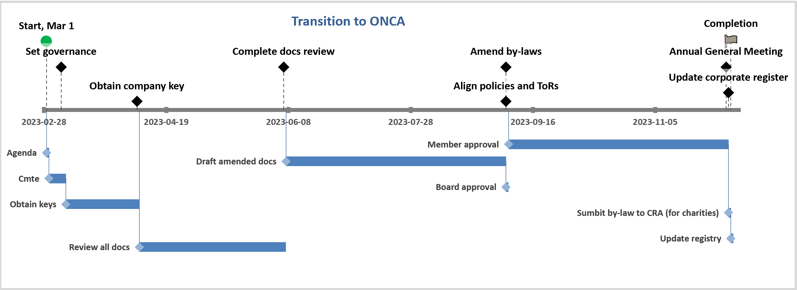
Example Project Plan
See Excel file that accompanies this presentation
Notes:
Insert program name and photo.

Slide 33
Set governance
Recuring board agenda item
Establish ONCA Committee vs Secretary role
Committee should be small and focused
Secretary should be chair
Create project plan
Monthly progress reports
Notes:
Insert program name and photo.

Slide 34
Set governance
Recuring board agenda item
Establish ONCA Committee vs Secretary role
Committee should be small and focused
Secretary should be chair
Create project plan
Monthly progress reports
Notes:
Insert program name and photo.

Slide 35
Obtain company key
Secretary sign up for ONe-Key
ONe-Key Login
Review Ontario Business Registry Instructions for Not-For-Profit
Obtain Company Key
Sign up with One-Key
Review your account
Make necessary changes
Notes:
Insert program name and photo.

Slide 36
Complete Documents Review
Letters patent
Articles of incorporation
By-law
Club governance document
Policies
Procedures
Terms of reference
Minute book
Notes:
Insert program name and photo.

Slide 37
Amend bylaw
Review recommended Rotary Club bylaws
Review current Club bylaw
Use Nonprofit Law Ontario tools
Sample by-law with options
CELO By-law builder
Consider scaling down bylaw to allow for flexibility
Consider legal review
Notes:
Insert program name and photo.

Slide 38
Align policies and ToRs
Review policies to ensure consistency with bylaw
Consider adding items removed from bylaw
Create system to ensure compliance with bylaw
Review / establish terms of reference for board and committees
Notes:
Insert program name and photo.

Slide 39
Approvals
Board approves articles and bylaw and provides adequate time for members to review
Members approve articles and bylaw at the AGM
Notes:
Insert program name and photo.

Slide 40
Completion
Submit bylaw to CRA if you are a charity
Update information
Notes:
Insert program name and photo.

Slide 41
Questions?
Feel free to contact me with any follow up questions
Terry Caputo
(905) 213-5925
terrycaputo@outlook.com
Notes:
Insert program name and photo.

