Slide 1

PETS 2014 Membership

Slide 2
WHY IS THERE CONCERN?
Notes:
Open with general comments about Rotary membership

Slide 3
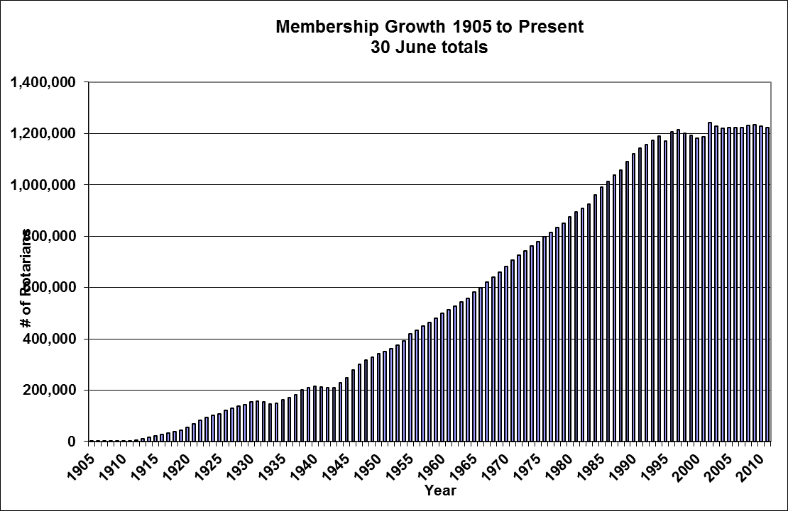
Rotary Membership Trends
Notes:
Highlight trends

Slide 4
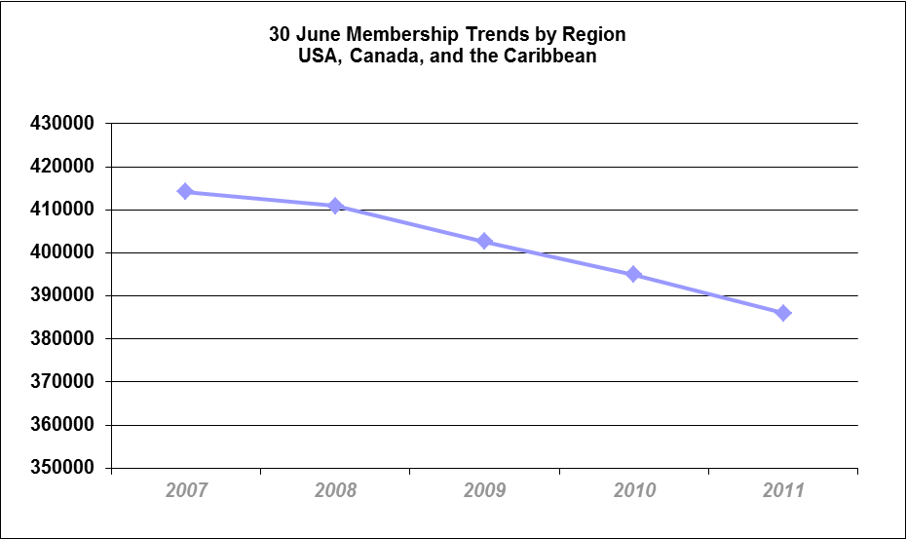
Regional Membership Trends
Notes:
Highlight trends

Slide 5
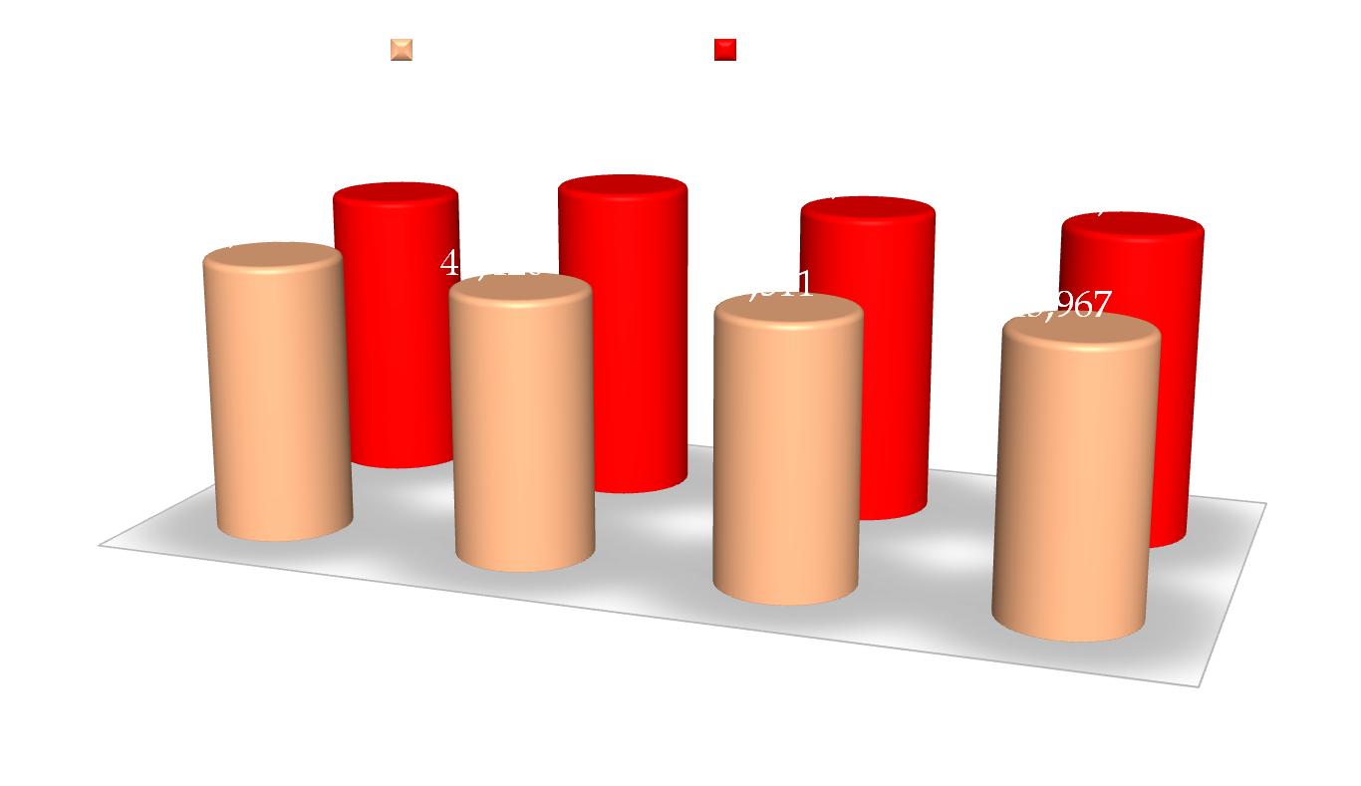
New Vs. Lost Members
Notes:
Highlight Trends

Slide 6
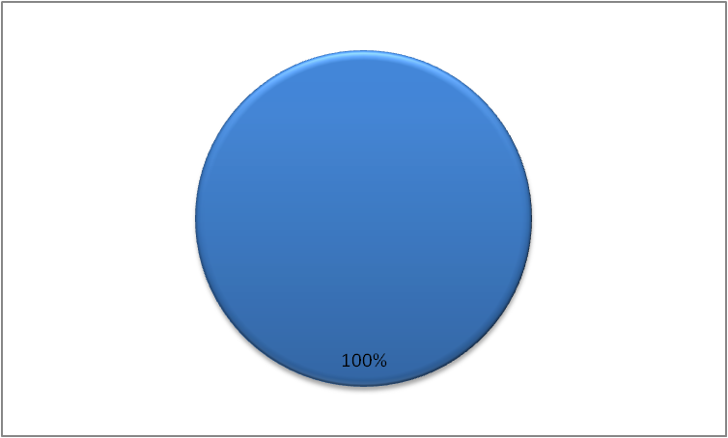
Concerned About Membership

Slide 7
What should you be doing as Club President to address this trend?
Make sure your club has a compelling answer to the WHY ROTARY question
Consider engaging club in VISIONING exercise to get club united on why, what and how
Ensure club has a membership RECRUITMENT STRATEGY with action plan and committee to execute it
Address RETENTION by having activities that speak to the eight motivation factors

Slide 8

Tell me about your Rotary club?
Notes:
Get them to talk about their Rotary club. I suspect we will hear about the great things clubs are doing. The “WHAT” and possible the “HOW” not the “WHY”. Encourage discussion about the “WHY”

Slide 9
WHY?
HOW?
WHAT?
Notes:
Highlight the “WHY” Rotarians do things and how this will engage members.

Slide 10
What is the Vision of your Rotary club?
Create a vision. Decide what your club is going to be about in the future. What is your purpose in your community? Use a consensus-building process to create your club's inspiring and challenging future vision.
Notes:
Encourage discussion to try and develop a vision. Break into table groups to come up with some vision statements.

Slide 11
PAIRS DISCUSSION
Would your club and club members benefit from strengthening the WHY statement?
What might be some ideas that you would like to see expressed in your club vision?

Slide 12
Will it motivate you to join (or remain a part of) this organization and continue to motivate you once you are there?
Does it provide an anchor point for the kinds of changes needed to keep your club vital and strong?
Does it describe a future that is more attractive than the present?
Does it challenge you?
Can you use it to develop a strategic action plan that you and fellow club members can act on?
Can it serve as a framework to keep decision making on track?
Notes:
Encourage discussion to try and develop a vision. Break into table groups to come up with some vision statements.

Slide 13
Rotary Club of Somewhere is a service club of community leaders who work within the local and world community to make a difference.
The Rotary Club of Somewhere aims to be the premier Rotary Club in District 70XX. It will be a leading proactive and dynamic organization that provides services which enhance the lives of others in the local and international community. It will be a respected deliverer of philanthropic and corporate largesse.
By supporting Rotary Foundation and Rotary ideals, we are recognized in the Community as enthusiastic men and women who get things done - at home and abroad - for youth and our communities, while enjoying fellowship and friendship.
Notes:
Samples

Slide 14
Key Points to Date
Membership recruitment and retention needs to be a focus for all presidents and their boards
A starting point is to get a common answer developed as to WHY
Consider club visioning or strategic planning as a means to achieve this

Slide 15
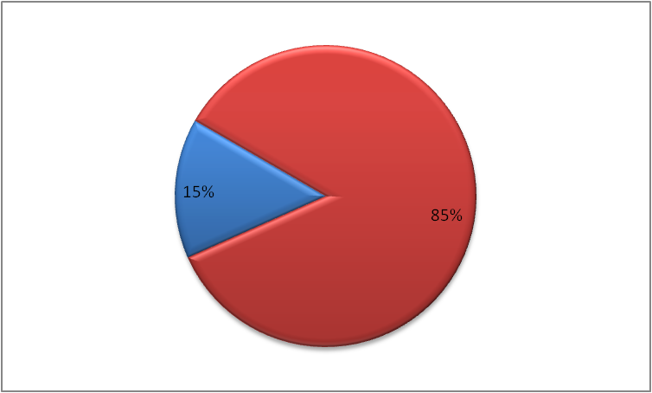
Rotarians Who Ask

Slide 16
Membership Recruitment
Needs a plan
Includes identifying types of new Rotarians sought
Needs committee to action
Needs board to monitor and support with a monthly review of numbers

Slide 17
Recruitment alone is not enough!
RETENTION is critical
Need to make your meetings fun
Need to use people’s time well
Resolve conflict
Give everyone a common focus
And APPEAL to what motivators individuals

Slide 18
Motivation Factors
Achievement:
Desire to accomplish something difficult
Need to get results
High standard of success
Respond to challenging goals
Want to be highly competent
Like to see things completed
Affiliation:
Desire to form close personal relationships
Need to belong
Value being engaged and included
Want to be associated and accepted by the group

Slide 19
Motivation Factors
Autonomy:
Value being allowed to be independent
Independent and self-reliant
Enjoy working with others that are the same
Tend to avoid being governed by rules and systems
Creativity:
Finding novel ways to approach/see issue
Like to be asked to find a new or different way to address issue
Enjoy expressing themselves through pictures, ideas or often non-traditional ways

Slide 20
Motivation Factors
Responsibility:
Feel accountable for task, process and people
Feel motivated by the responsibility others have placed in them to complete the task or support the people
Recognition:
Need work
acknowledged
Want appreciation and praise – can be given individually or in public

Slide 21
Motivation Factors
Status:
Focus on position
Like titles and symbols of authority
Enjoy sense of power and influence
Security:
Want stability and predictability
Like consistency and sameness
Want to know that job is safe
Don’t like surprises

Slide 22
Other Examples From Your Clubs?
What other actions do you as a club take to ensure your club retains members by speaking to their motivations:
  Achievement
  Affiliation
  Autonomy
  Creativity
  Responsibility
  Recognition
  Status
  Security

Slide 23
What is your role as President of your club?
To ensure your club has a good answer to the WHY question
To develop a vision and strategic plan
To ensure it has a membership recruitment plan and committee
To develop a retention plan that speaks to the various motivators
Notes:
Ask for their input

Slide 24
What tools are available?
District Membership Committee
New Member Information Packages
Mentoring
Member Satisfaction Surveys
Club Visioning
Rotary Leadership Institute
Club Membership Committee manual
Be a Vibrant Club: Your Club Leadership Plan
Strategies for Attracting and Engaging Members Guide
Club Assessment Tools
New Member Orientation: A How-to-Guide for Clubs
Notes:
Ask for their input to see how many they are aware of.

Slide 25
Thank you!

