Slide 1
President Elect Training
Club Goal Setting in My Rotary

Slide 2
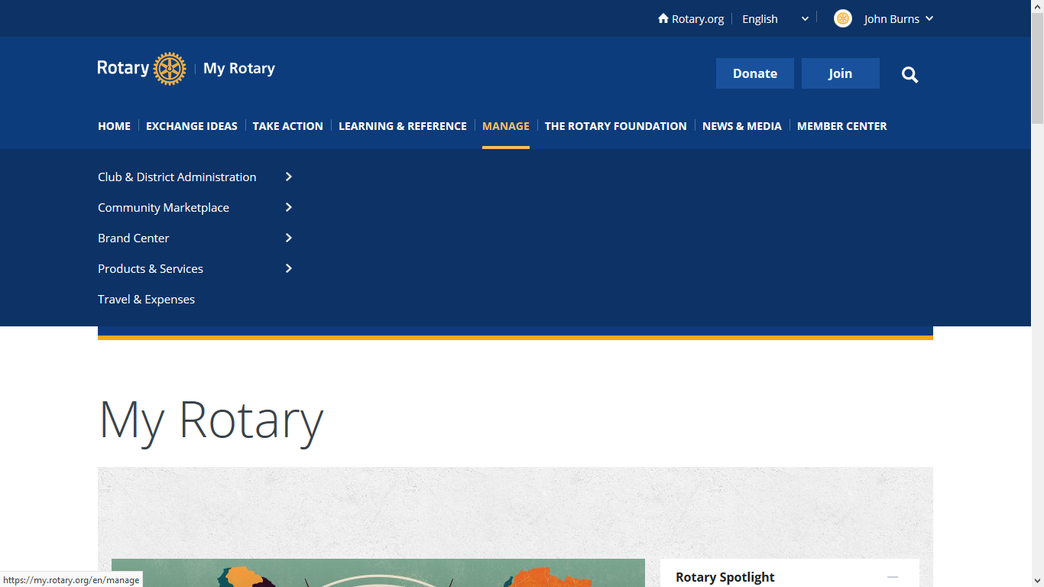
Log in to My Rotary and select “MANAGE”

Slide 3
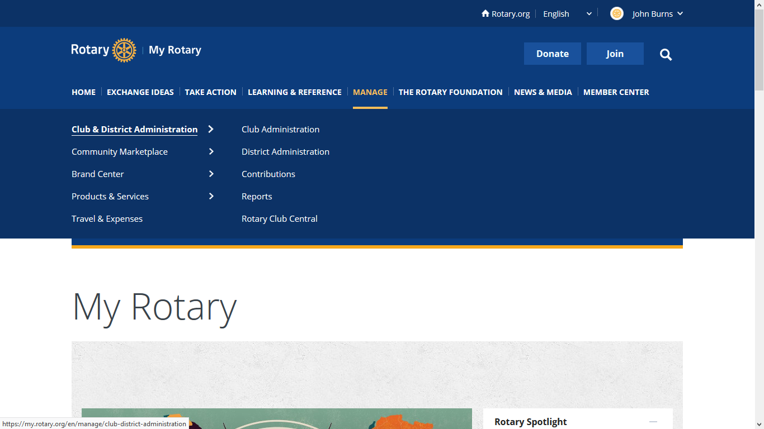
Select “CLUB & DISTRICT ADMINISTRATION”

Slide 4
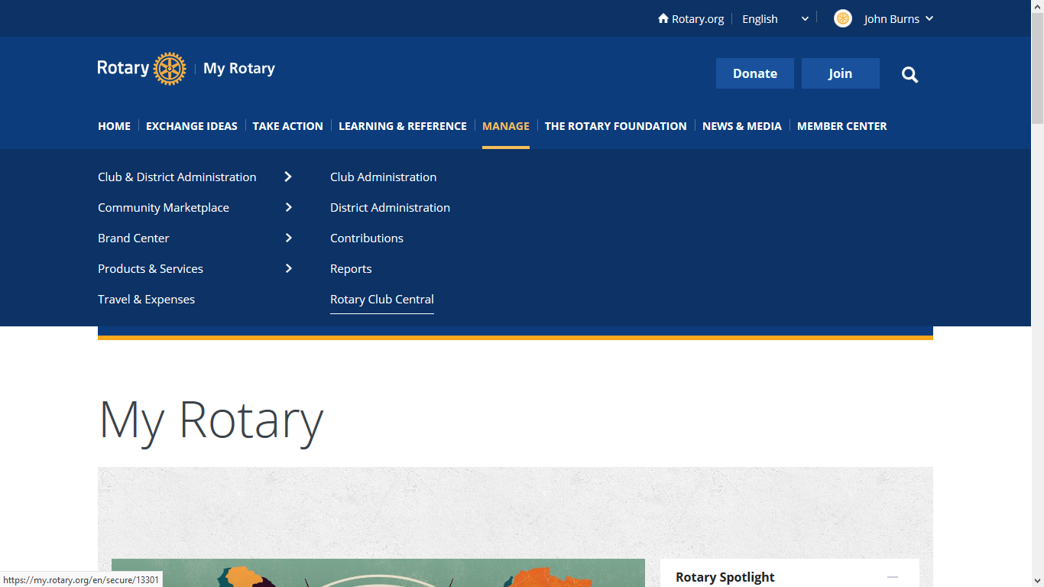
Select “ROTARY CLUB CENTRAL”

Slide 5
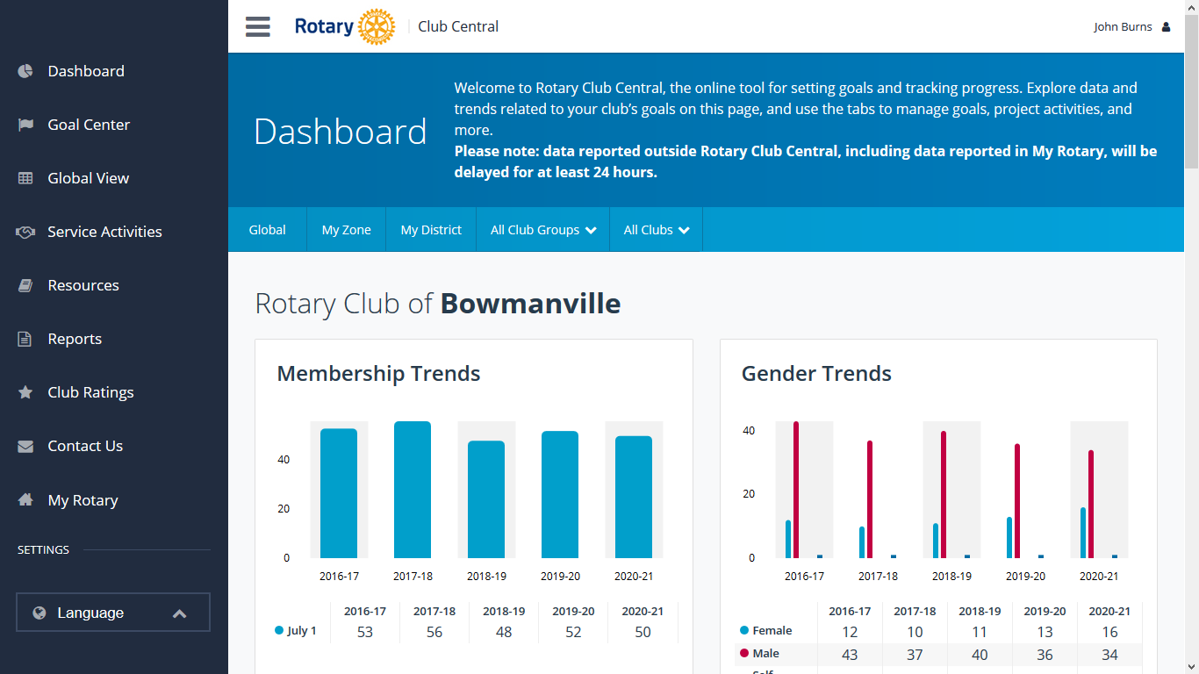
When you do this your club name will show

Slide 6
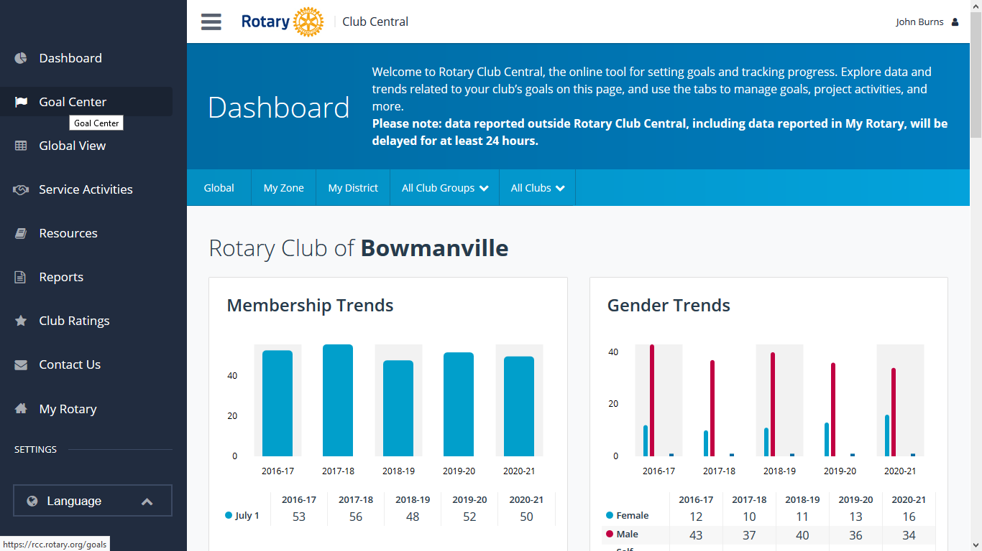
Select “GOAL CENTRE” from the list on the left

Slide 7
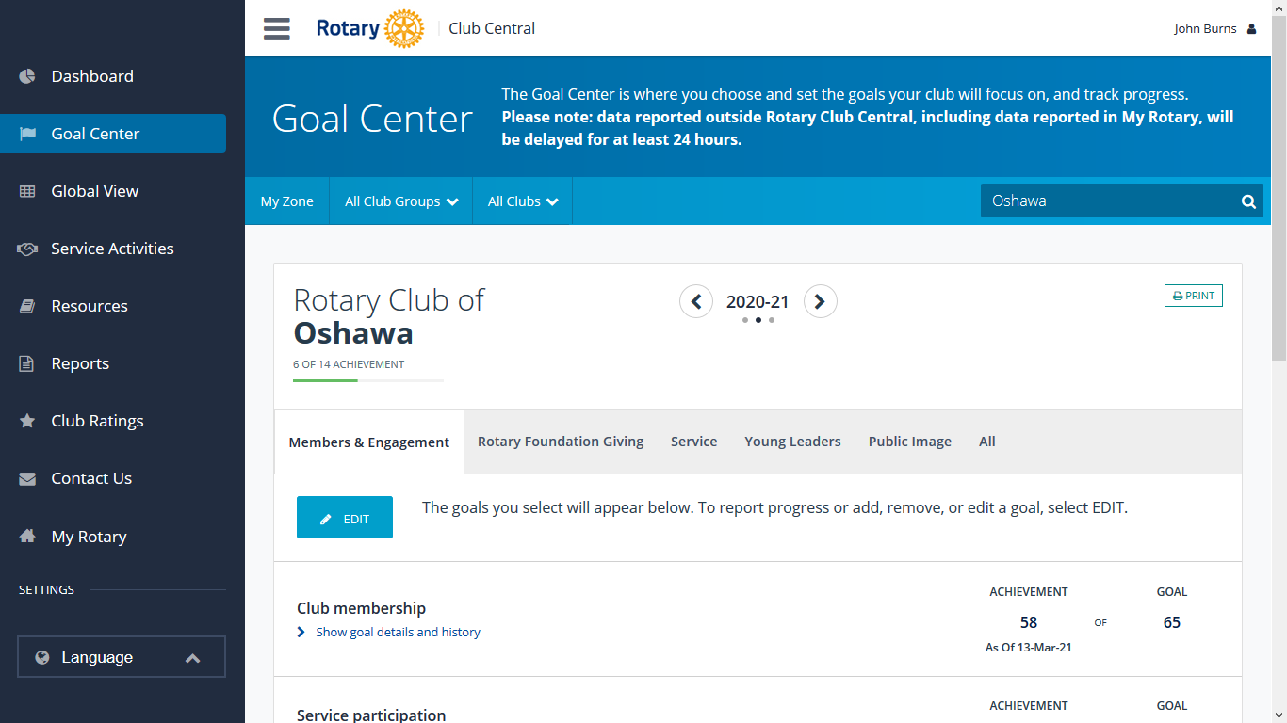
First check “WHAT YEAR IS SELECTED”

Slide 8
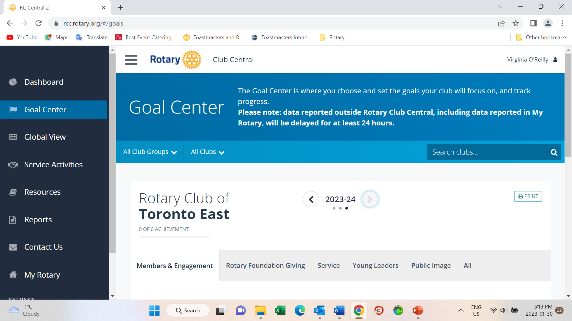
Change the year to “2023-24”

Slide 9
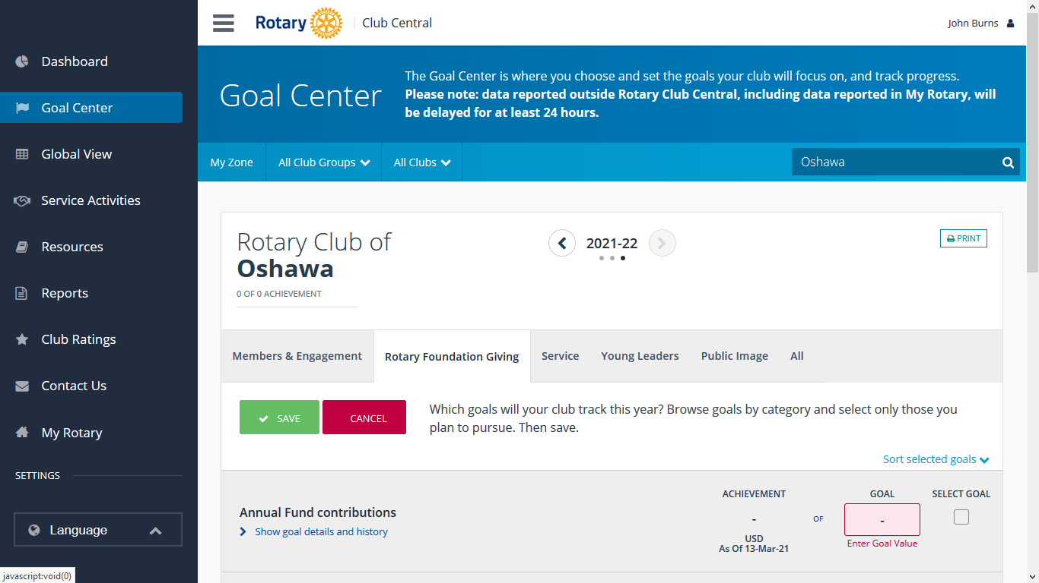
Notice the various tabs – Members & Engagement, Service, Public Image etc.

Slide 10
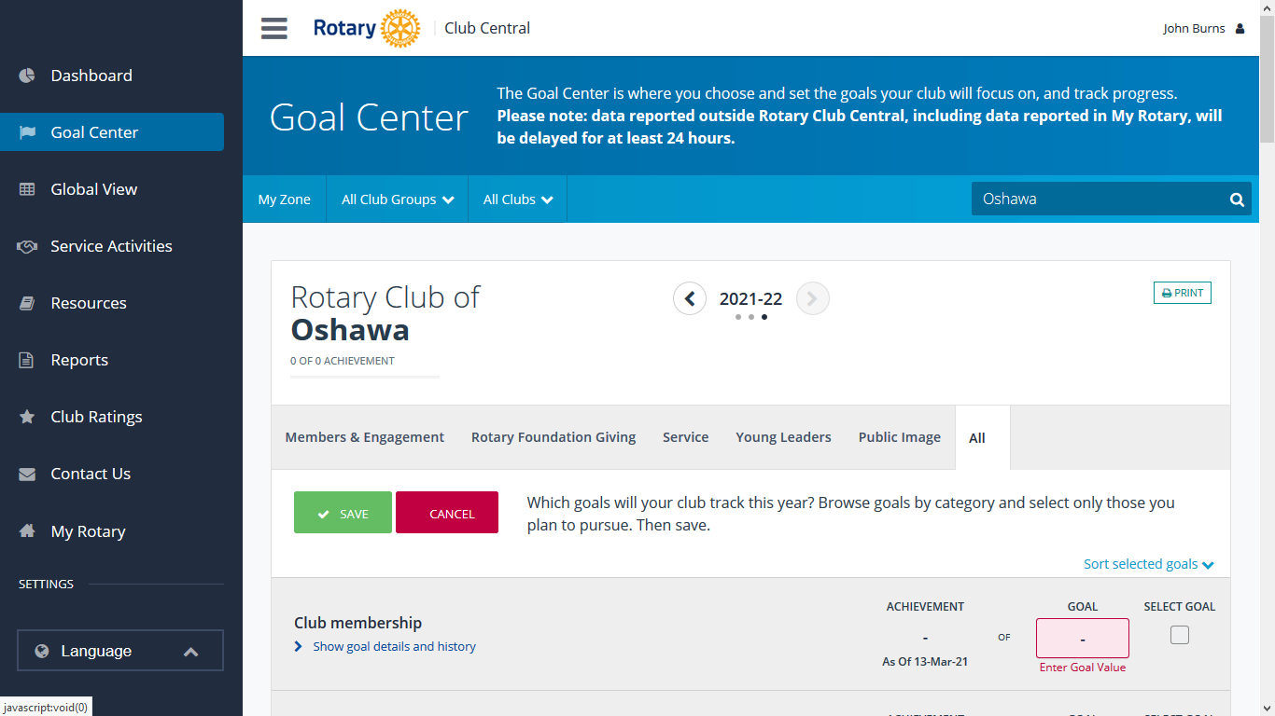
You can work on any tab you want, I will use the “ALL” tab which has all 25 of the possible goals.

Slide 11
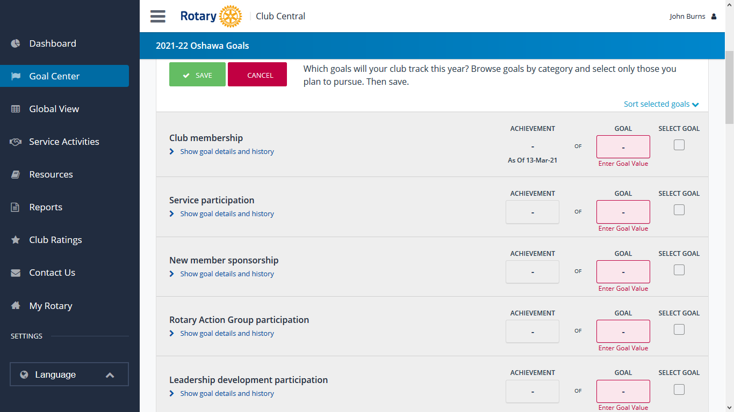
By scrolling down the page you can access all the categories. Under each goal category you will see in blue, “Show goal details and history”

Slide 12
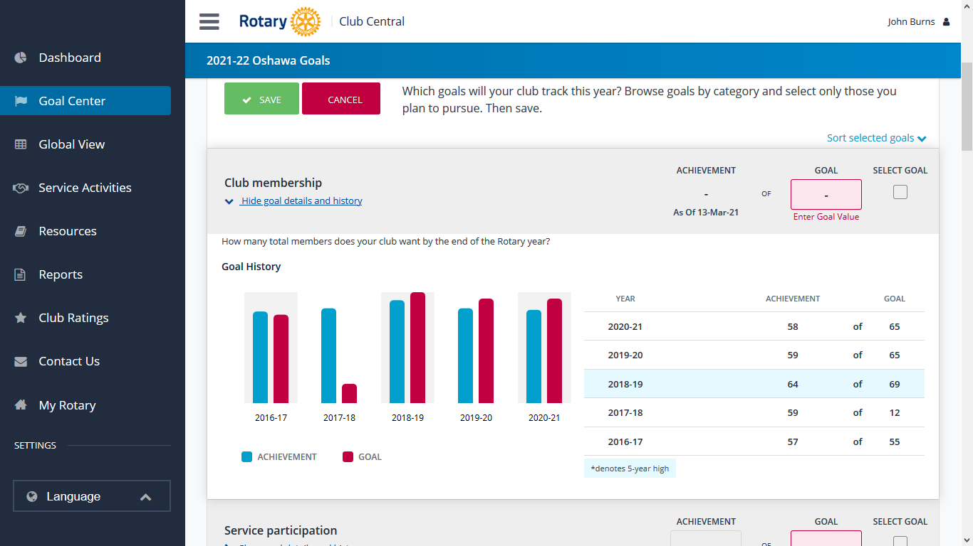
By clicking on the blue print you can view your clubs history over a few previous years on that particular subject. You will see the goal that was set and the achievement. You may find this to be a useful guide.

Slide 13

To enter a goal for a particular category, click on the “SELECT GOAL” box on the right of the category. It will turn green and show a tick.

Slide 14

You can then enter in the selected goal a value in the pink box marked “GOAL”

Slide 15
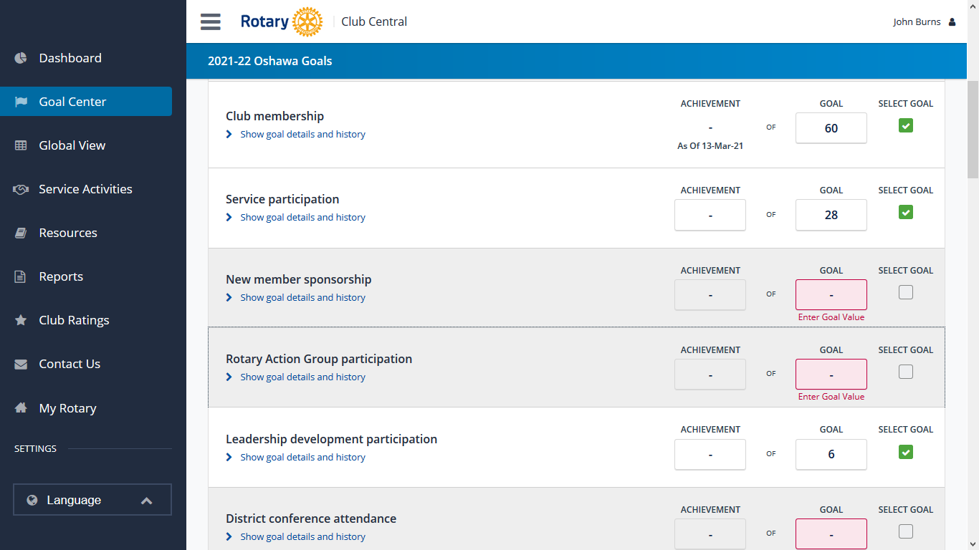
You can then continue to select and enter as many goals as you wish, by repeating the same process of “SELECT GOAL” and “ENTER GOAL VALUE”

Slide 16
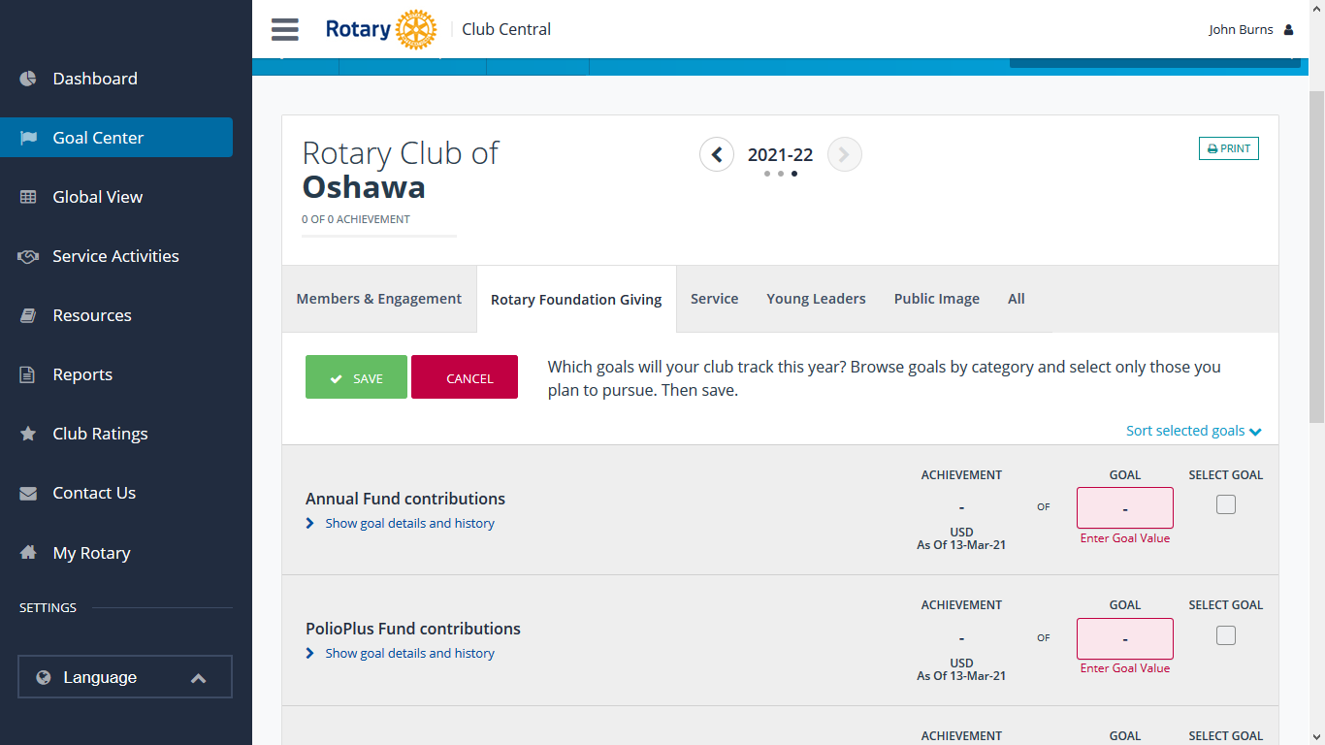
If you are entering goals in the section “ROTARY FOUNDATION GIVING”, when you have clicked in the “SELECT GOAL” box you will be given the option to select the “CURRENCY” you wish to use.

Slide 17
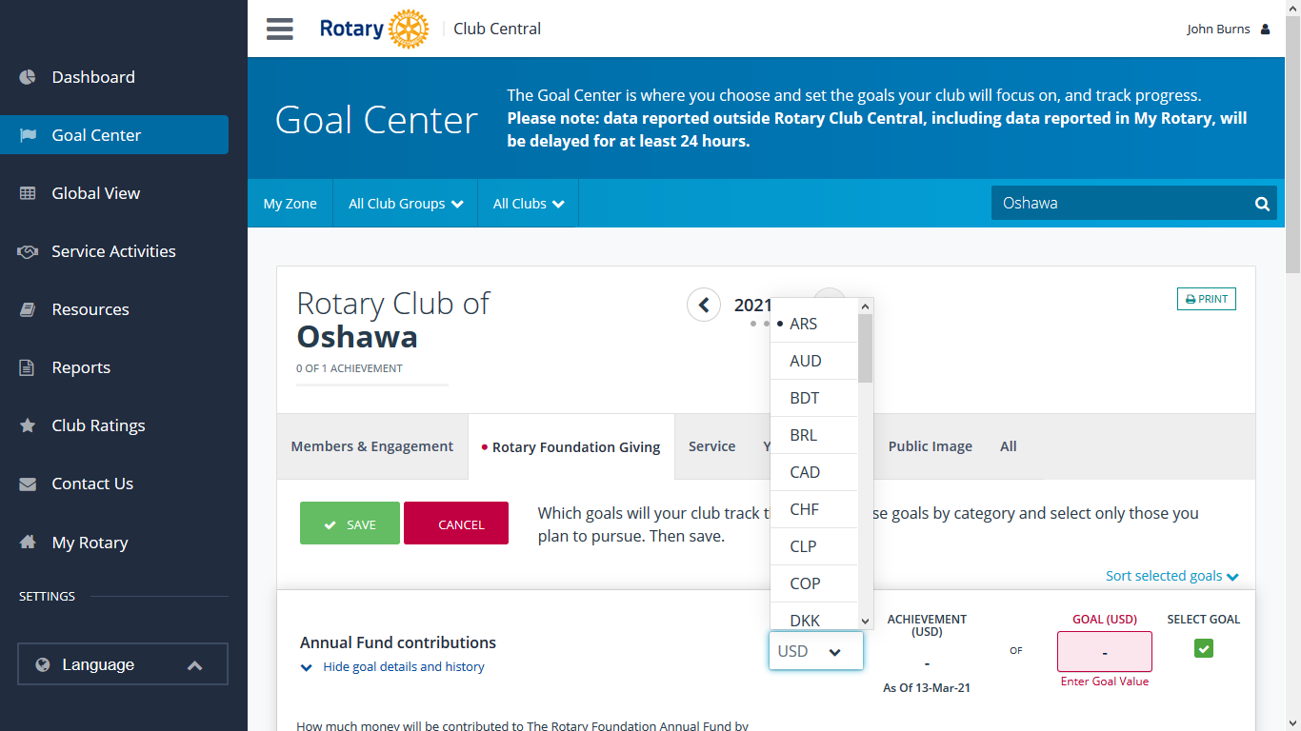
Select the “CURRENCY” first, then “ENTER GOAL VALUE”.

Slide 18
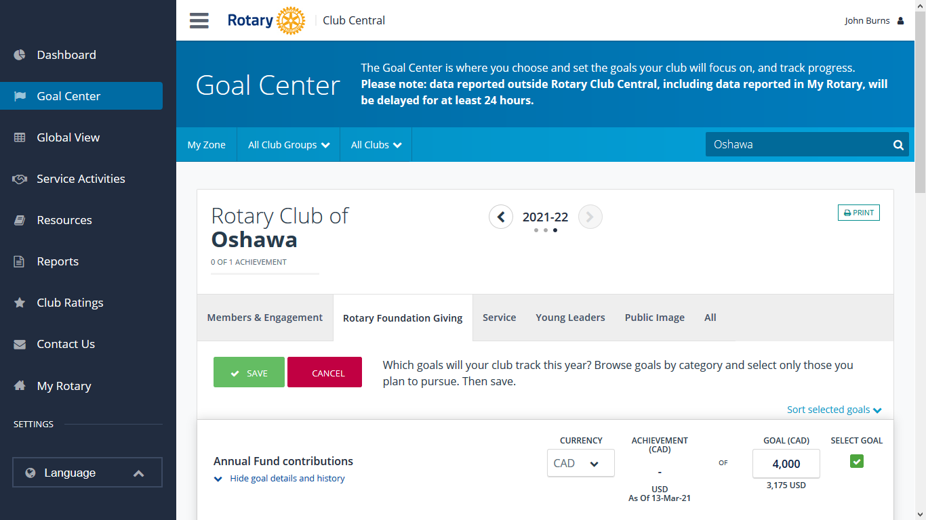
You can see the result shows your value in your currency and below it, the value in US$

Slide 19
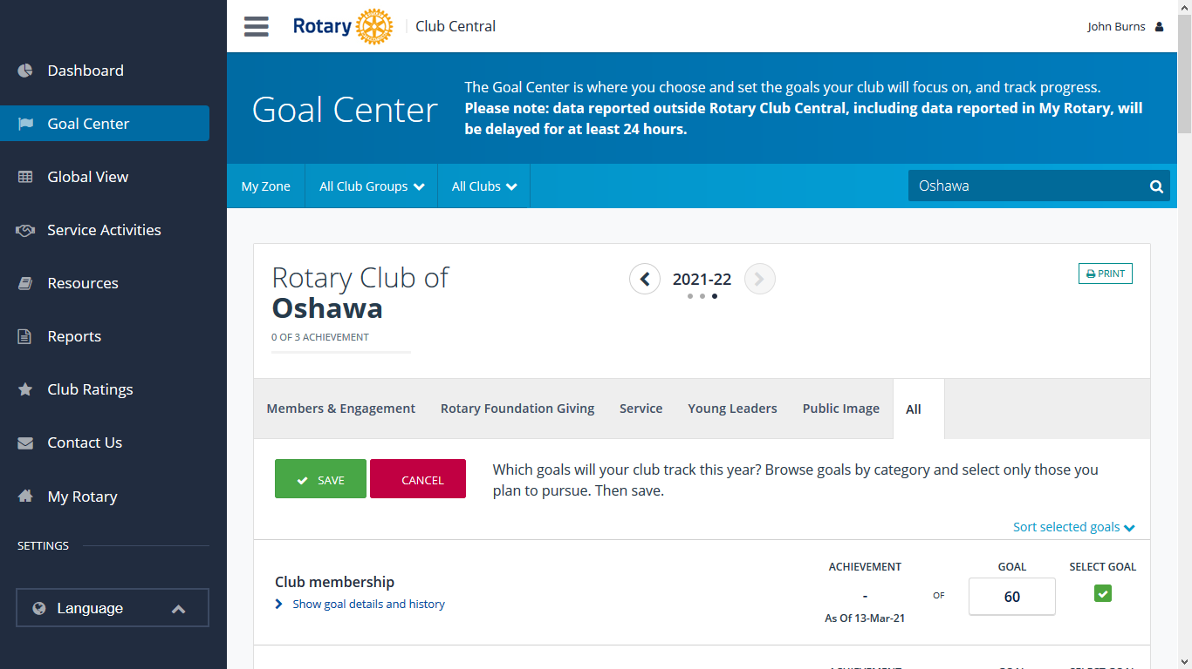
When you have completed all your entries or if you wish to leave the goal center, you must first scroll to the top of the page and select “SAVE”. If you don’t do this , “ALL YOUR ENTRIES WILL BE LOST”

Slide 20
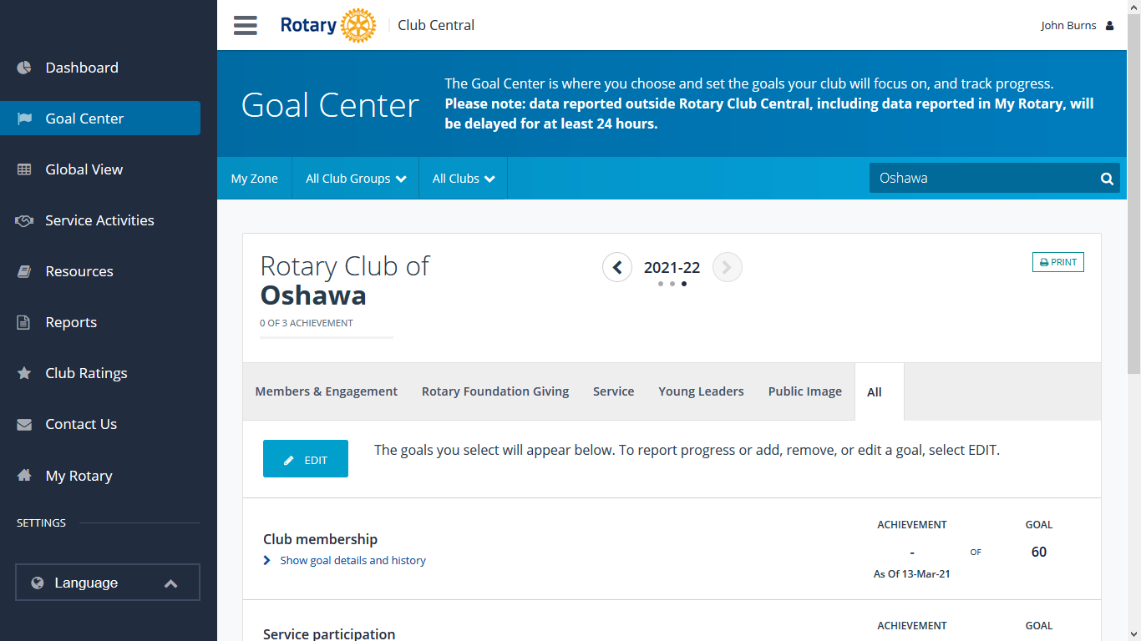
You can return to the Goal Centre as many times as you wish. When you return you will see a blue box on the left “EDIT”. When you click on this, you can “ADD, REMOVE or EDIT” your goals, you can also enter an “ACHIEVEMENT” value

Slide 21
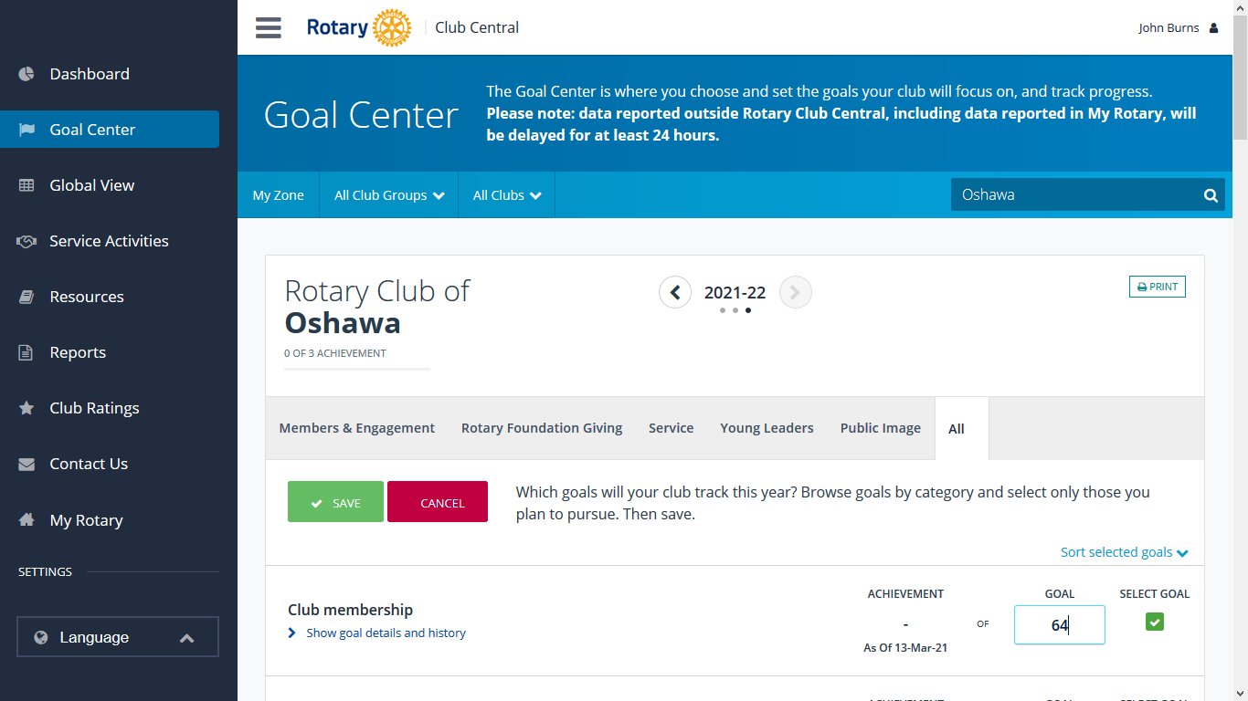
To “EDIT” a goal value, simply place the cursor in the “GOAL” box and enter the new value.

Slide 22
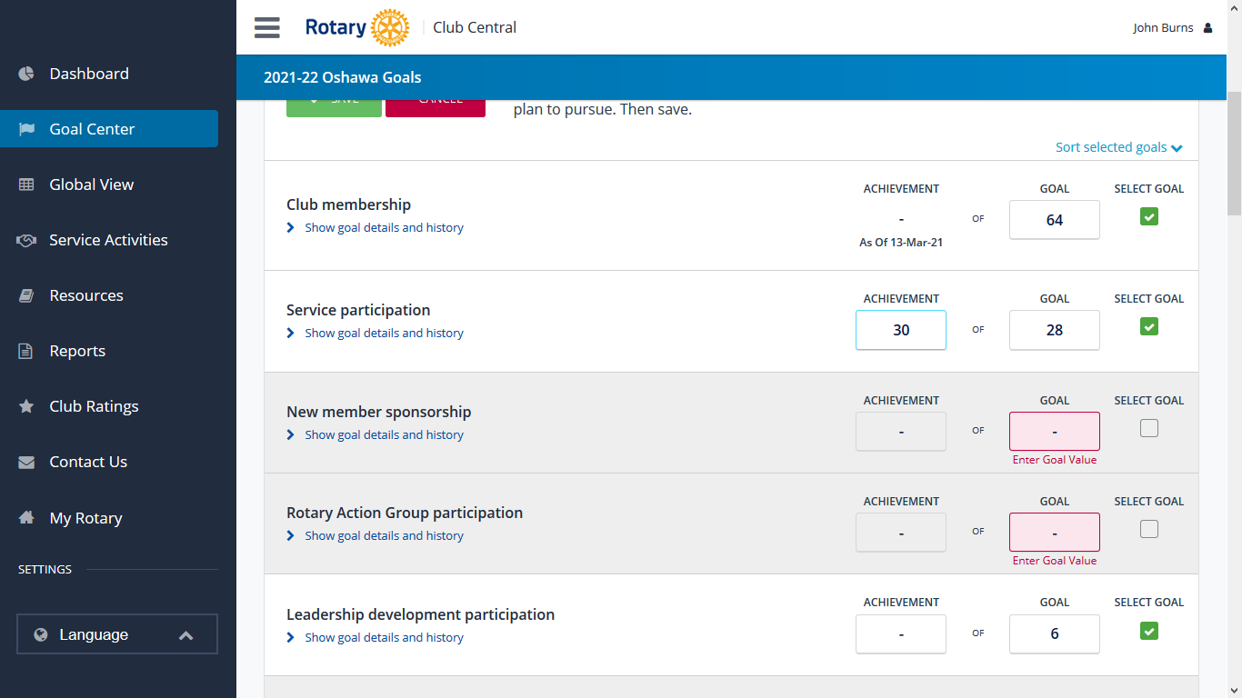
If you wish to enter an “ACHIEVEMENT”, place the cursor in the “ACHIEVEMENT” box and enter a value

Slide 23
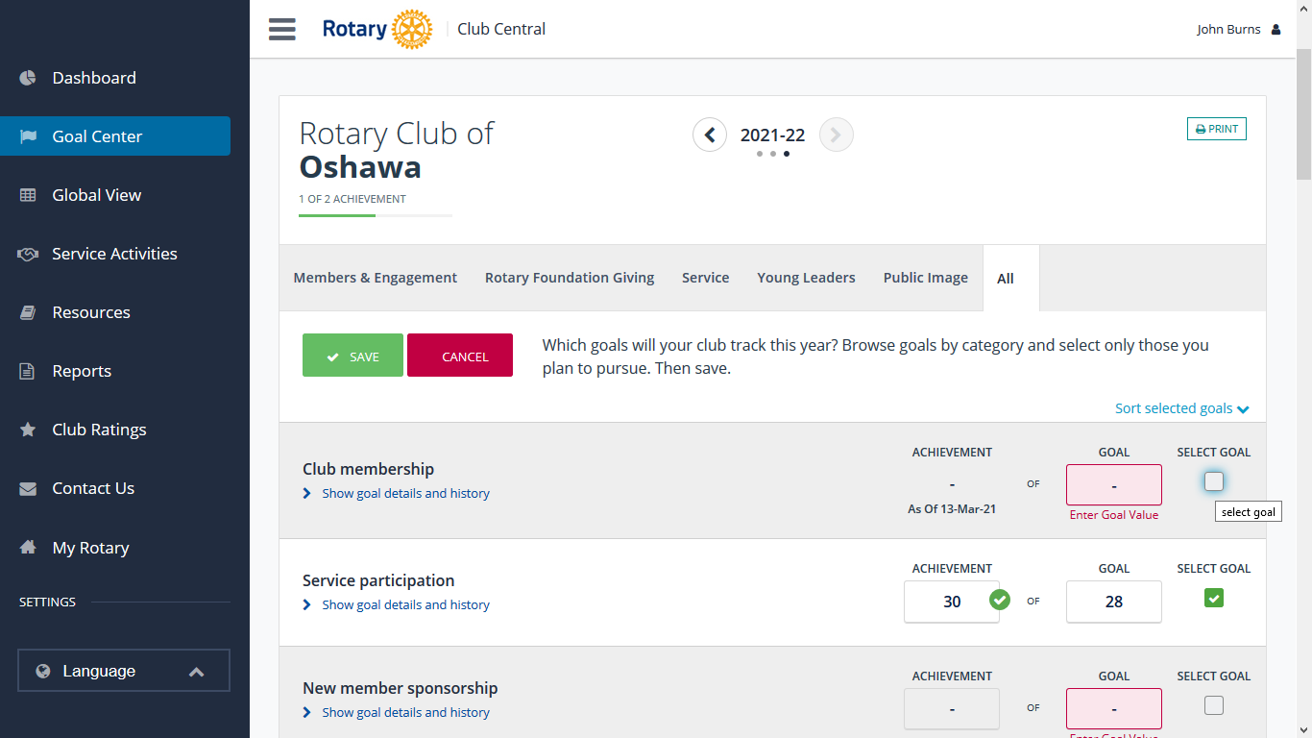
If you wish to “REMOVE” a goal, place the cursor on the “SELECT GOAL” box and left click

Slide 24
You can “ADD, REMOVE and EDIT” goals in the “ROTARY FOUNDATION GIVING” section, but you can not “ENTER an ACHIEVEMENT”. This action is carried out by “RI”.

Slide 25
Remember every time you leave The “GOAL CENTRE”
SAVE

Slide 26
Goals For Club Citation Achievement

Slide 27
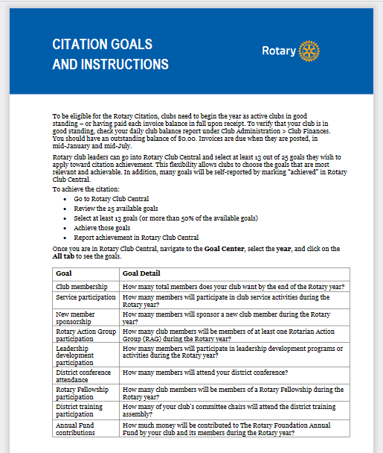

Slide 28
