Slide 1
MY ROTARY and CLUBRUNNER
Title Page Option

Slide 2
MY ROTARY
Rotary International Website
  Home page for the public
  Log into MY ROTARY

Slide 3
FOR TEXT/BULLET POINTS
PUT SUBHEAD HERE. DELETE IF NONE.
Use this space for longer text. Keep in mind that it’s not as interesting to have long blocks of text. Try not to use more than the amount of text shown here. Split content between slides, or…
Just use
Bullet points
You could also make a list
With numbers

Slide 4
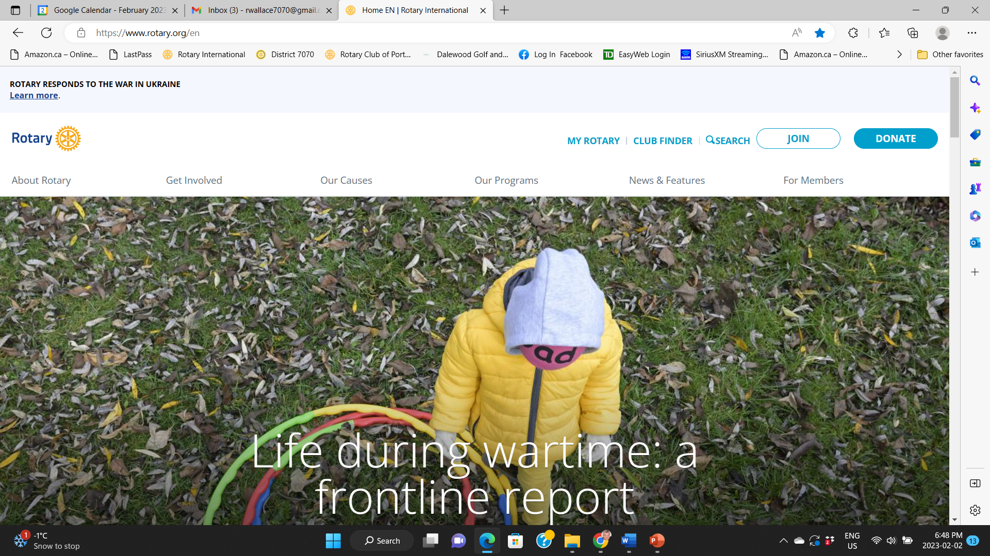



Slide 5
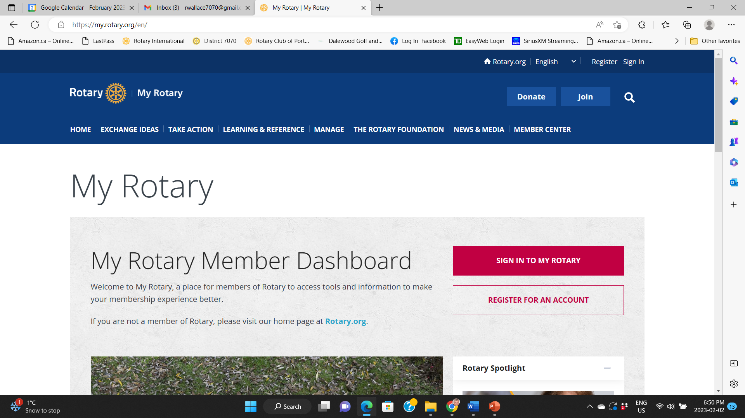



Slide 6
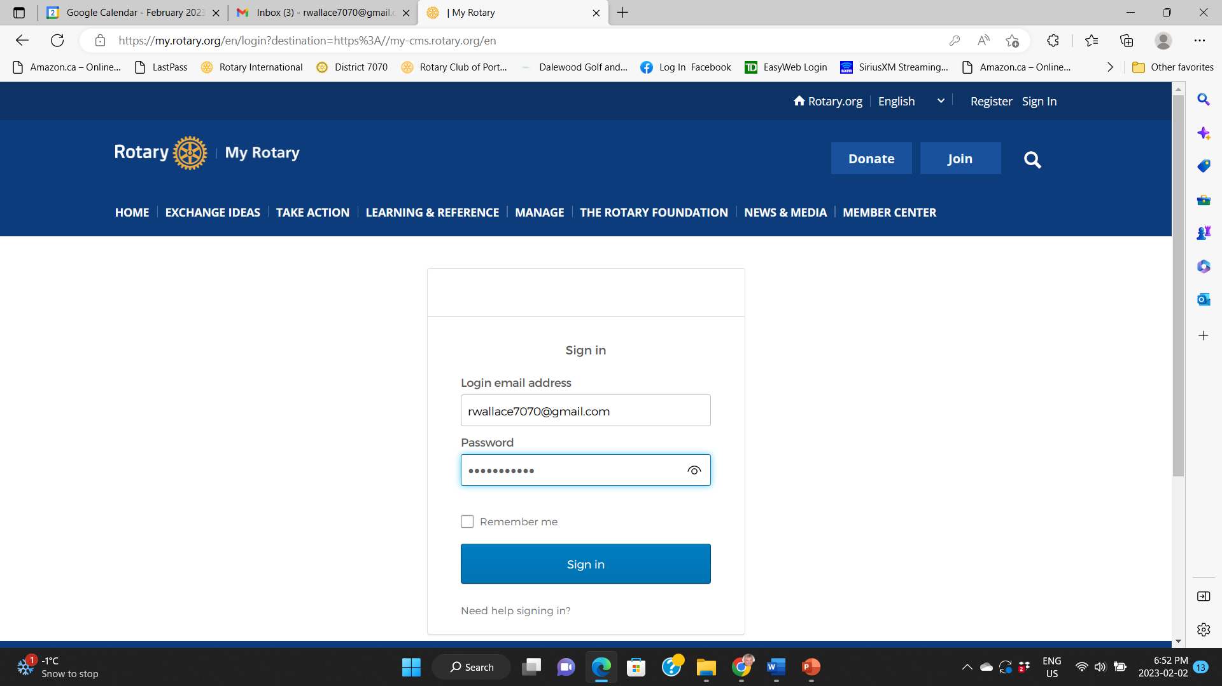



Slide 7
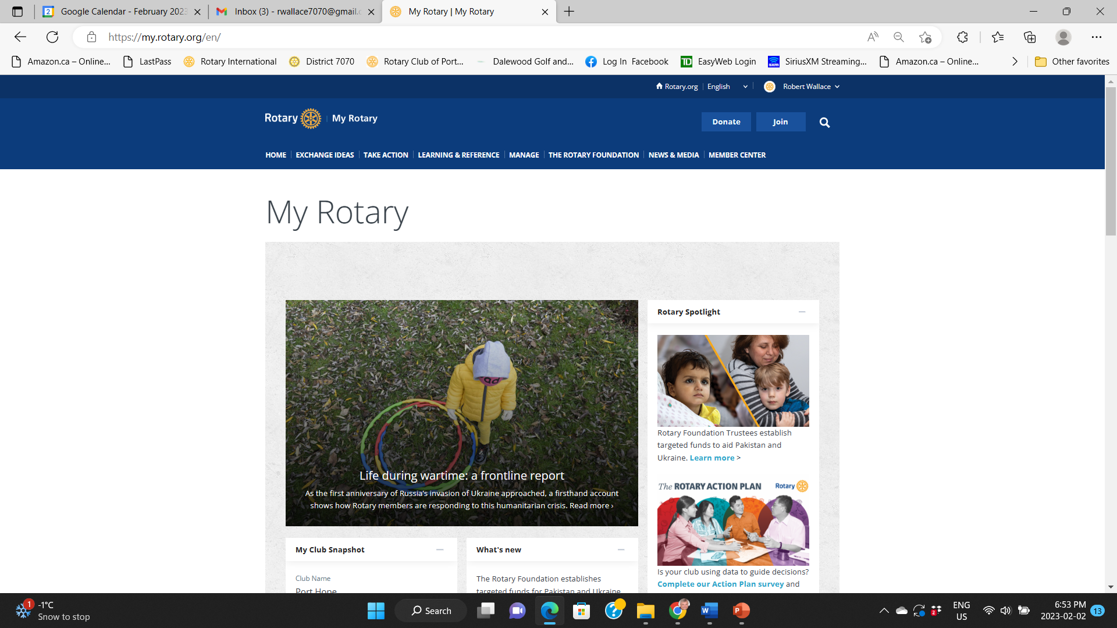

Slide 8
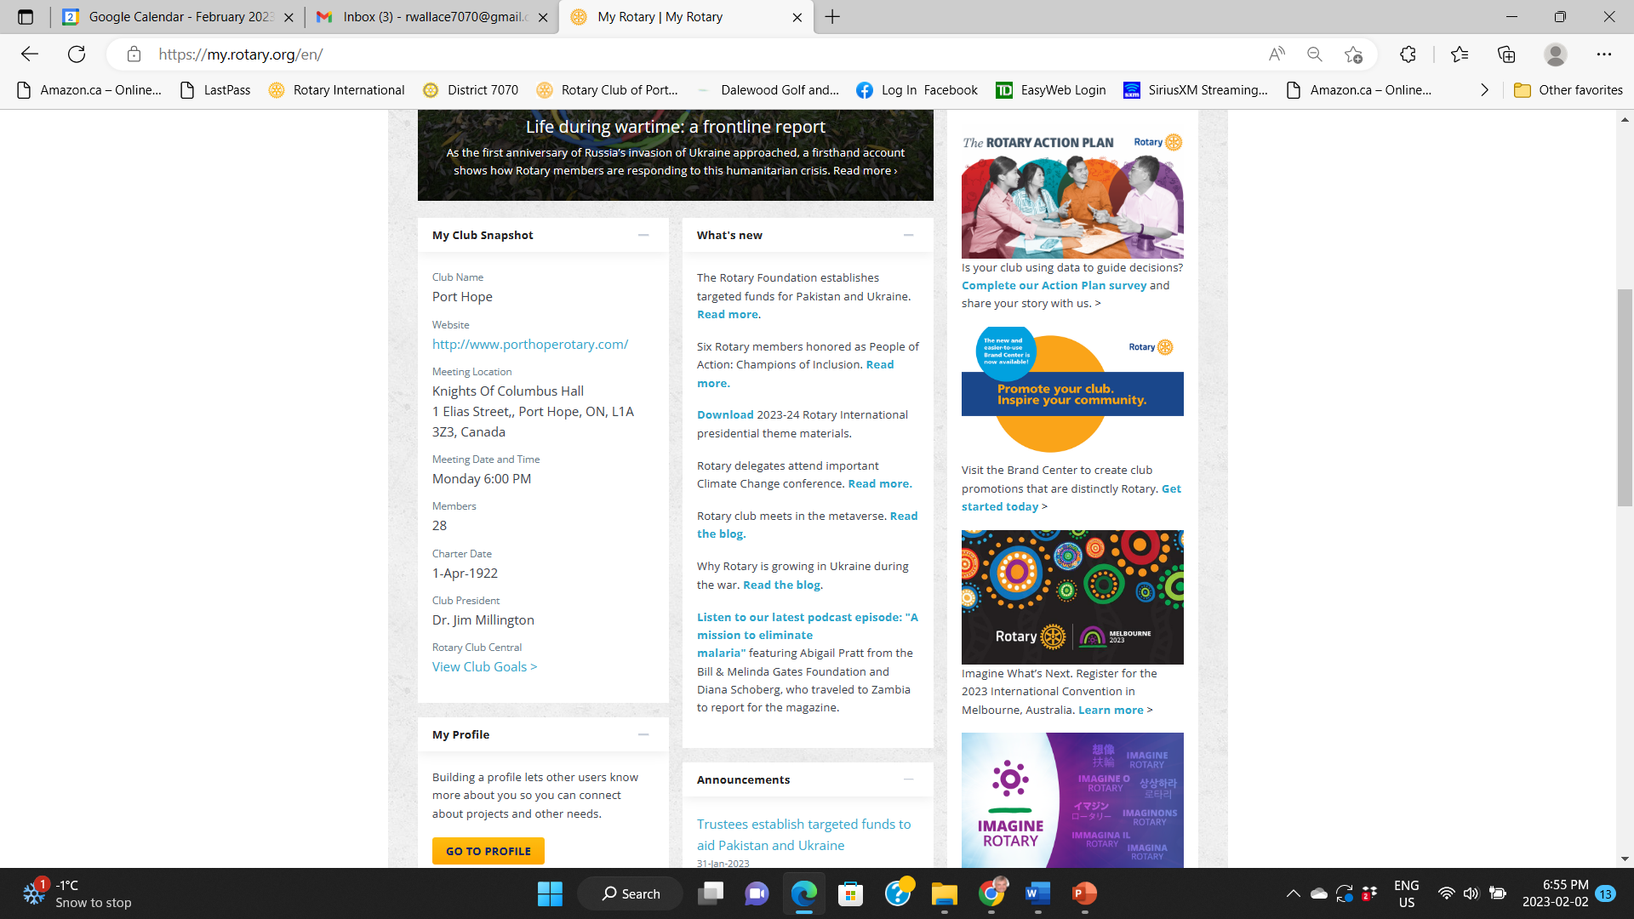



Slide 9
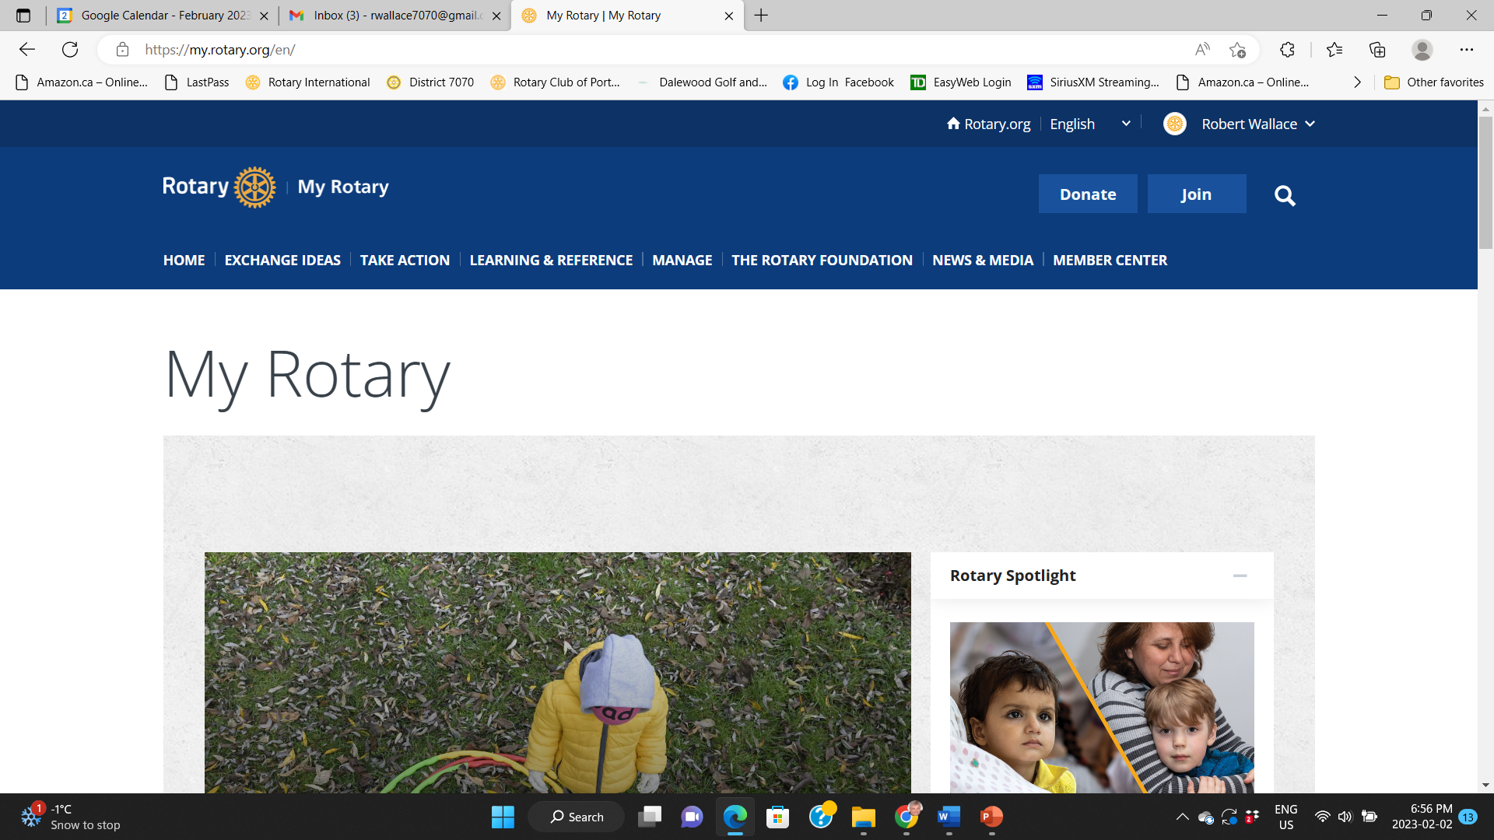





Slide 10
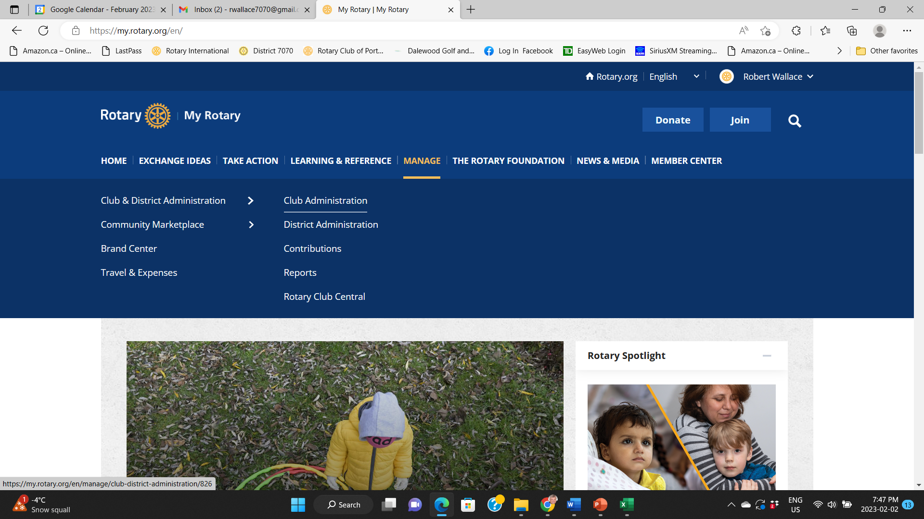



Slide 11
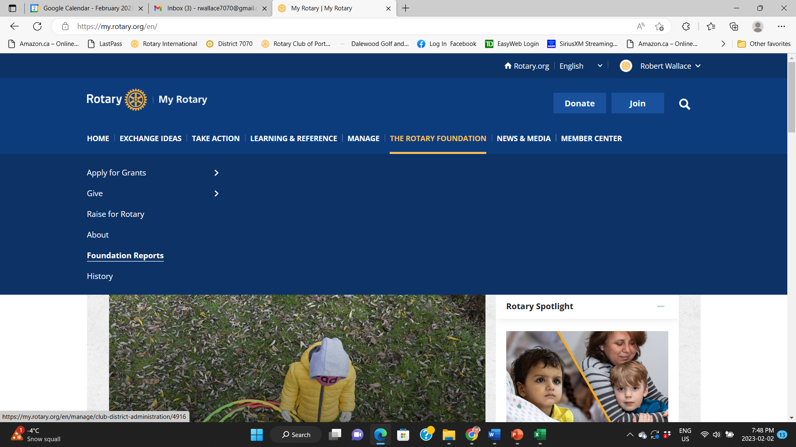



Slide 12
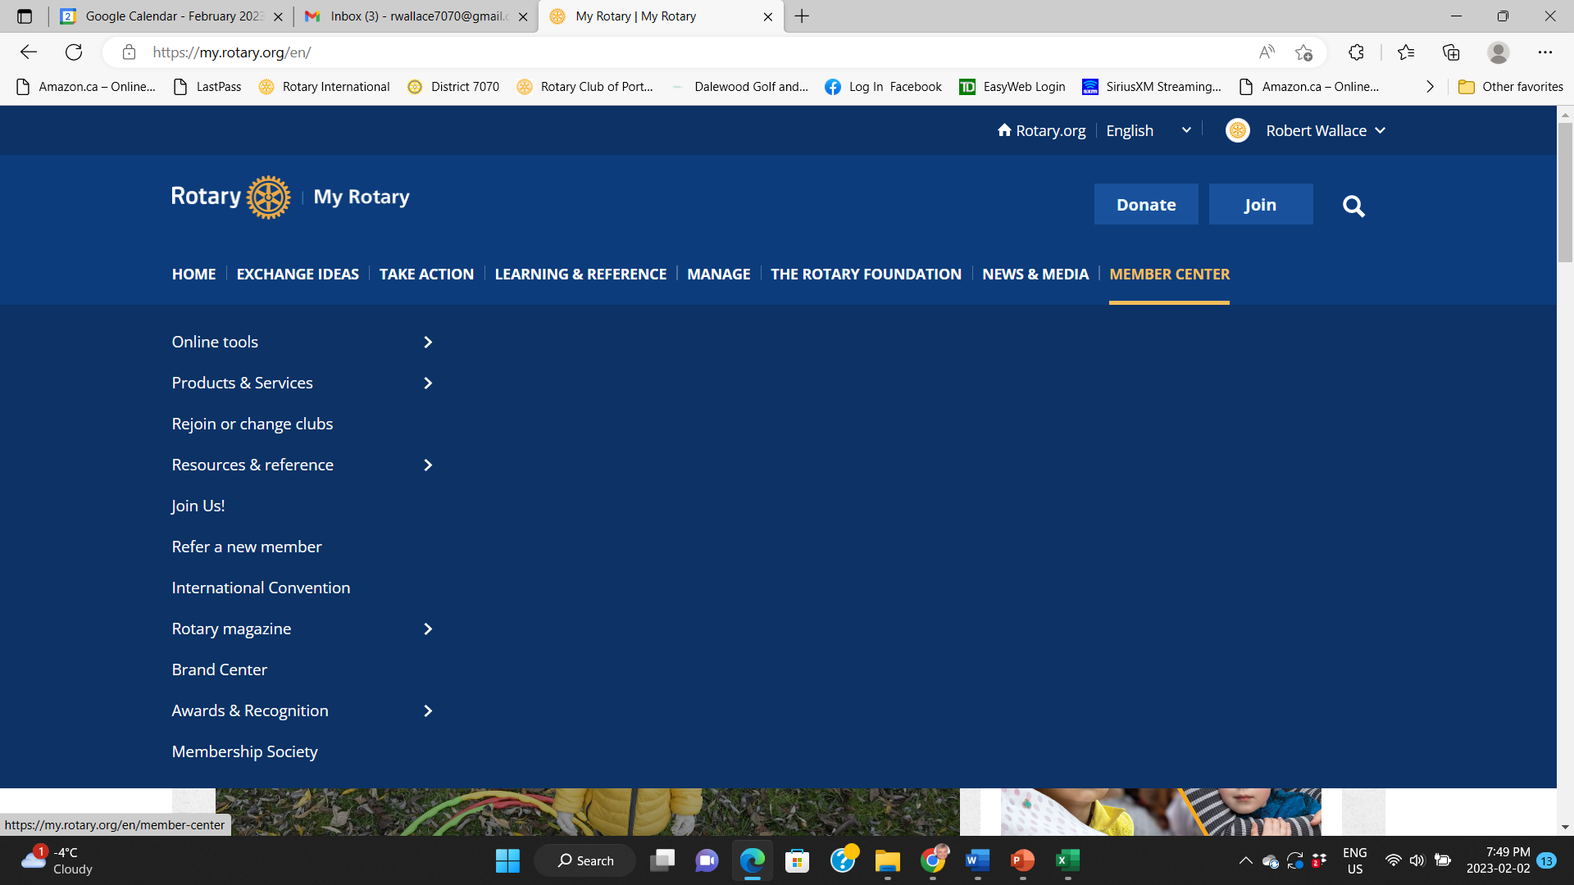

Slide 13
QUESTIONS

Slide 14
CLUBRUNNER
Club website
Club data base
Club event planner
Club Calendar

Slide 15
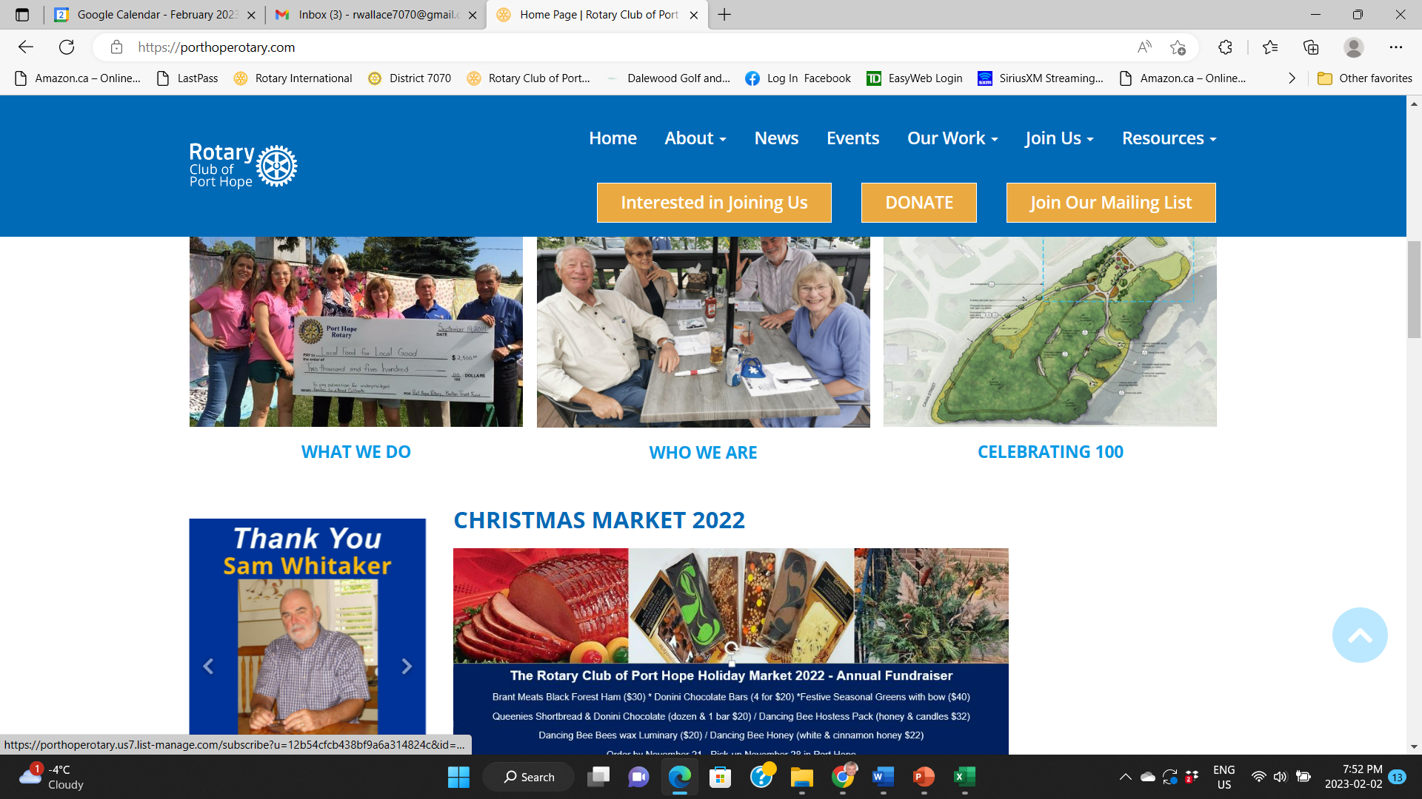

Slide 16
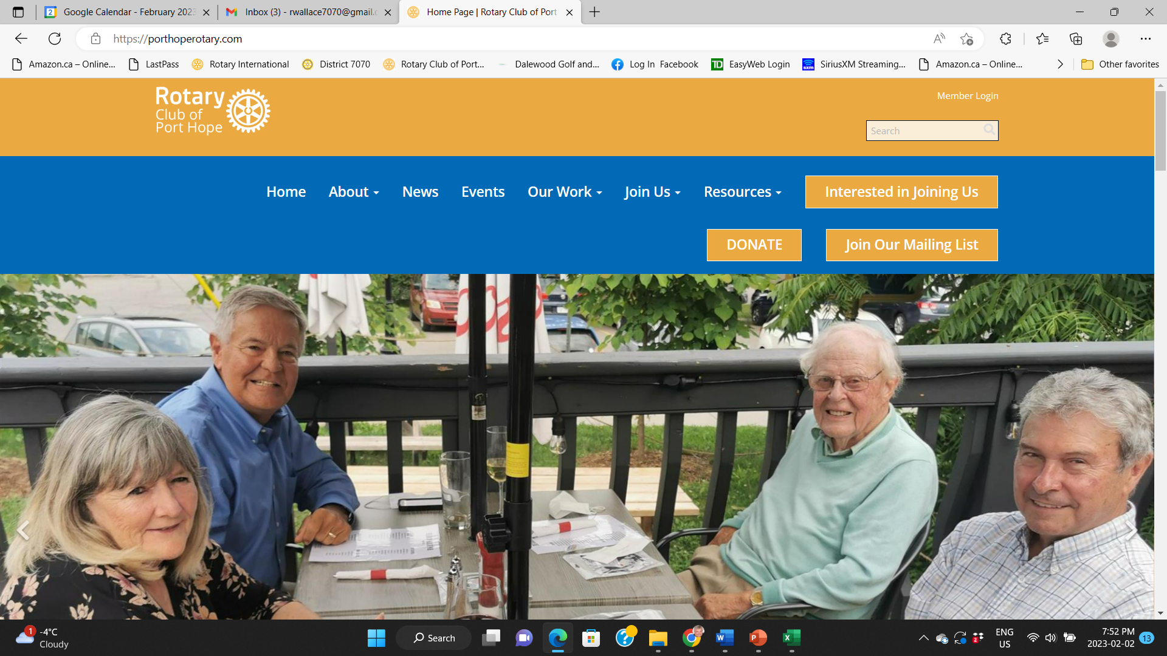


Slide 17
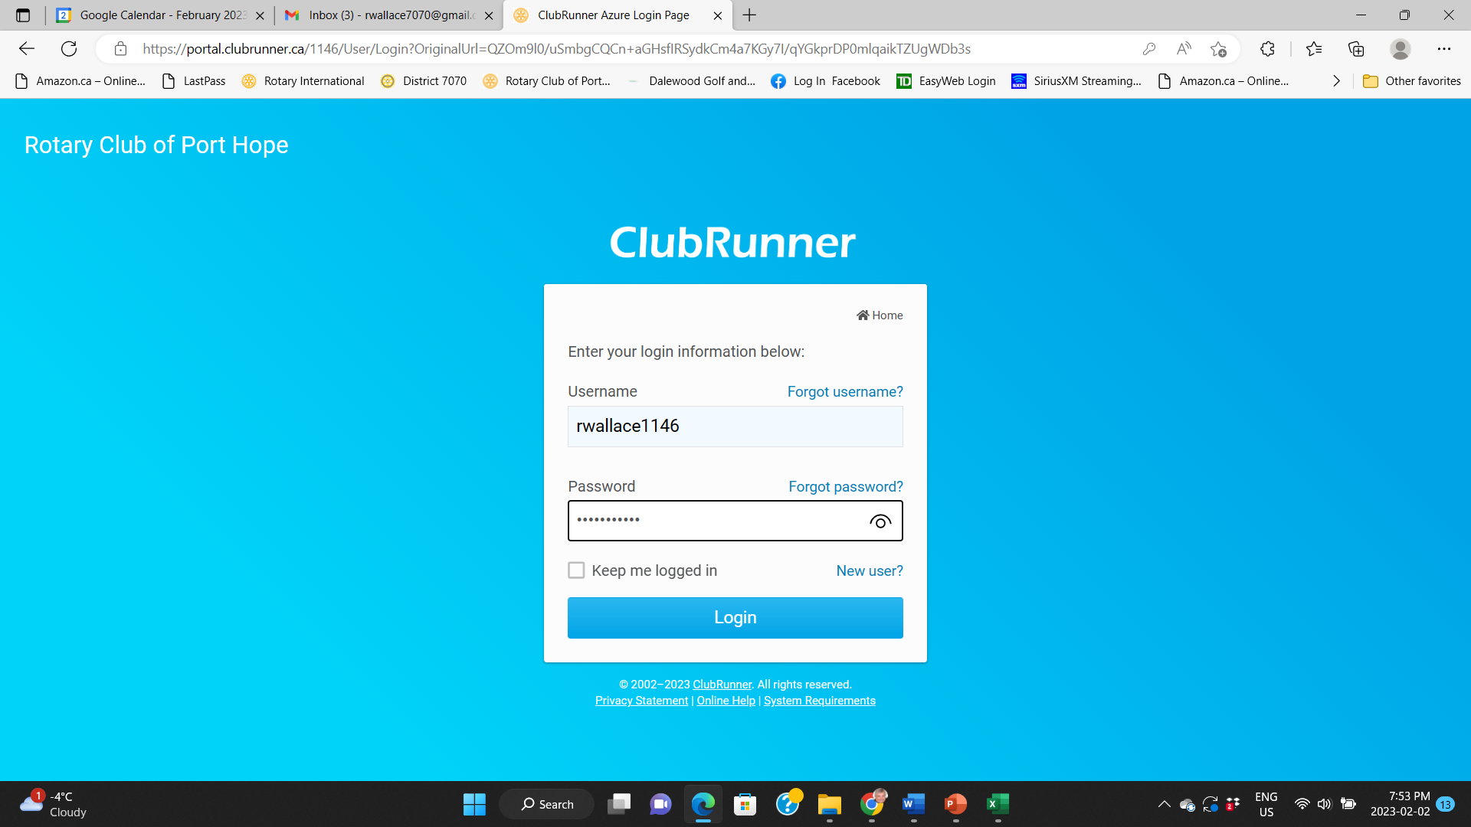

Slide 18
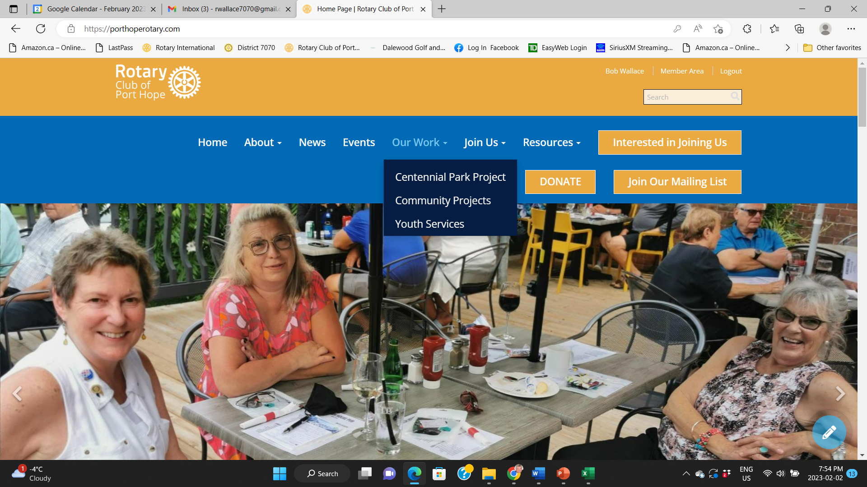


Slide 19
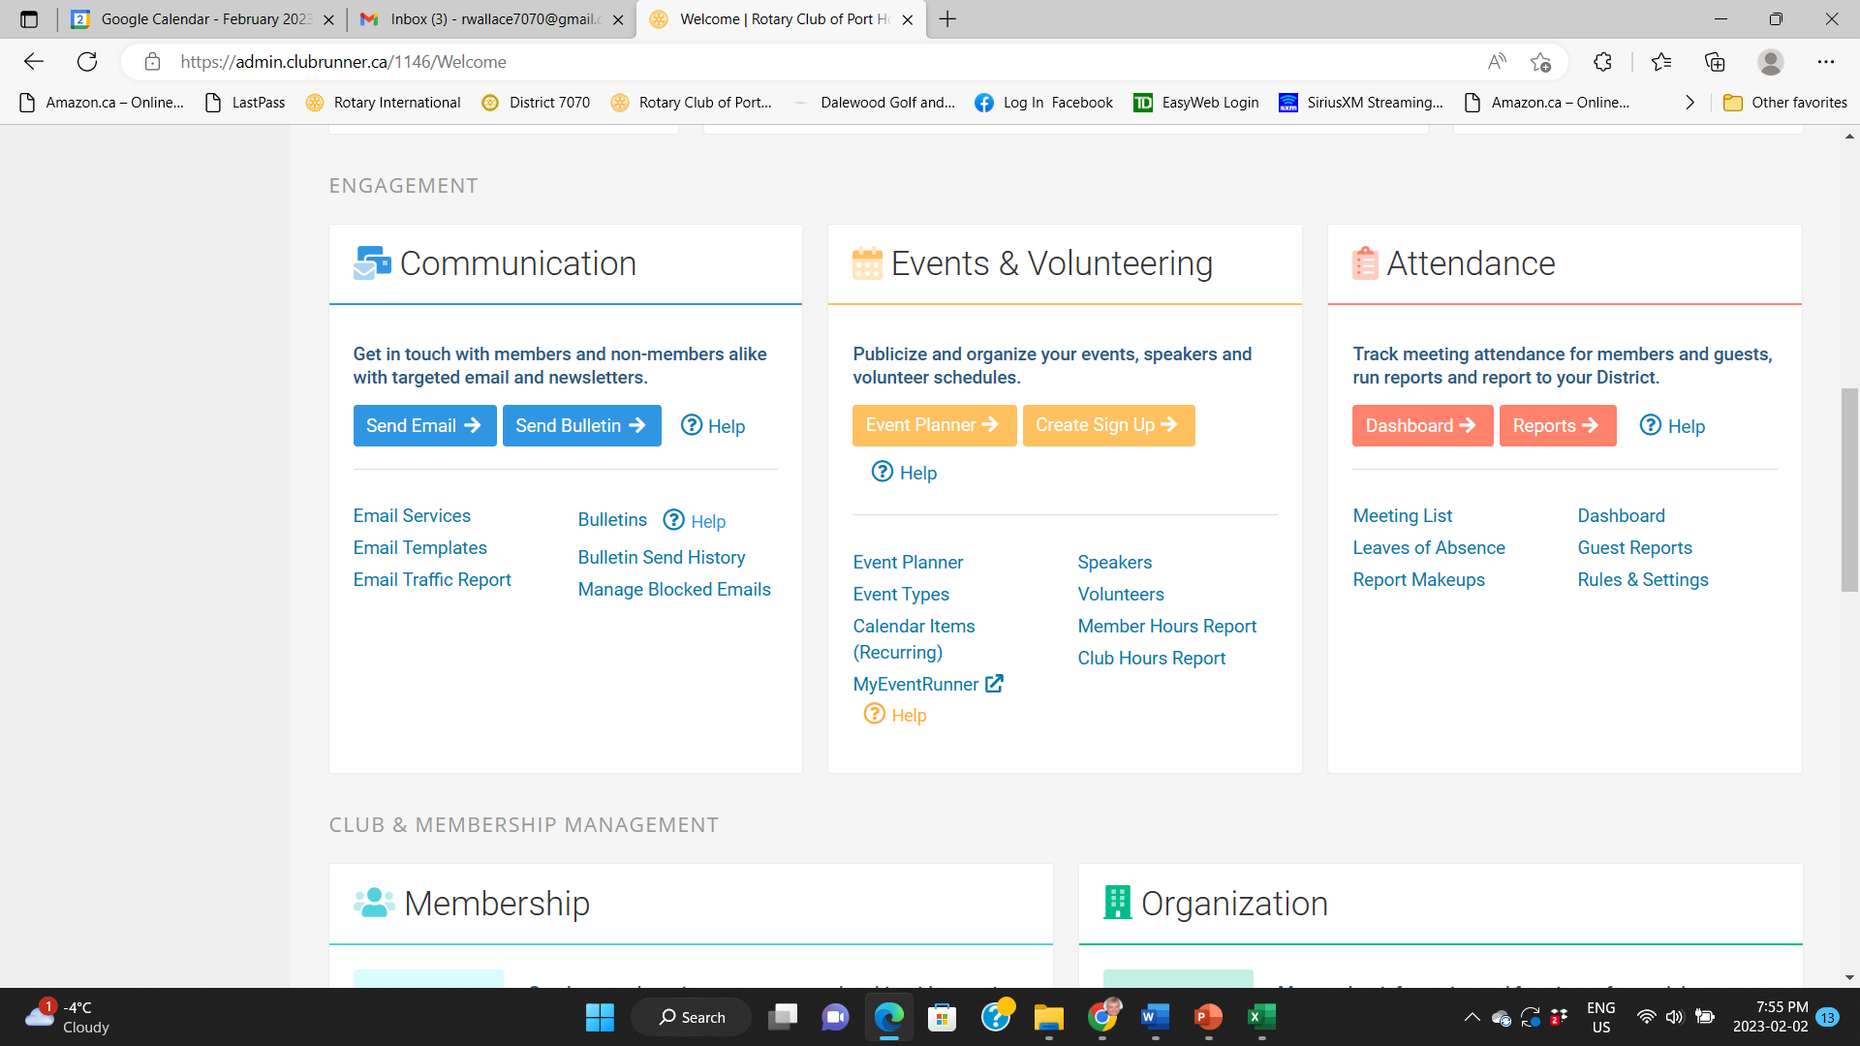

Slide 20
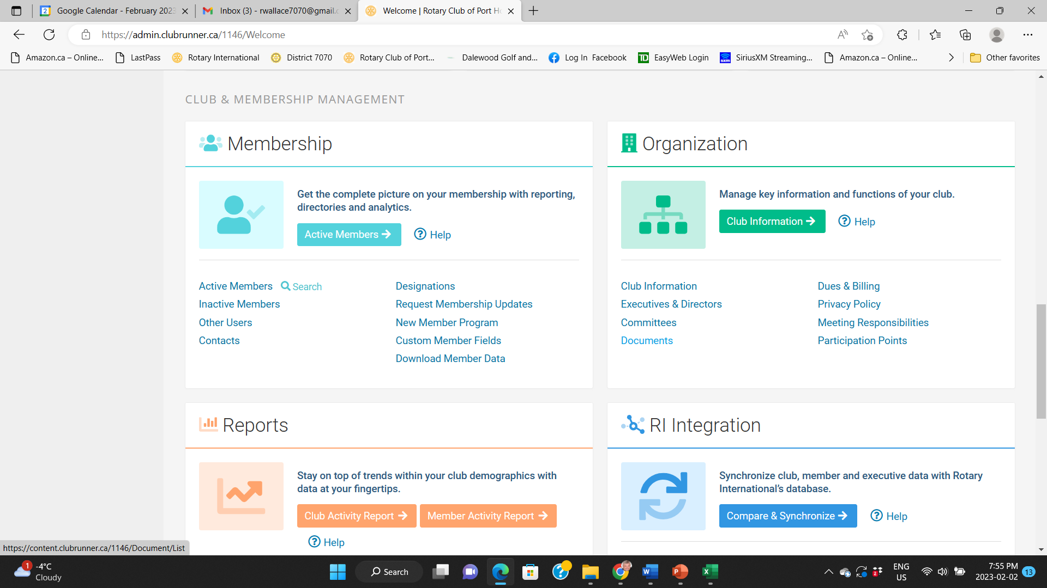

Slide 21
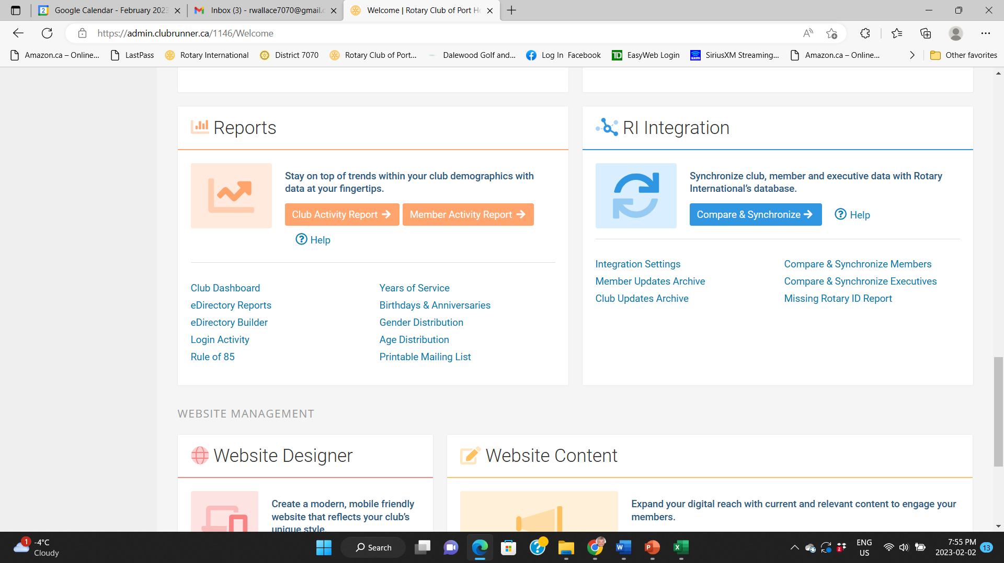

Slide 22
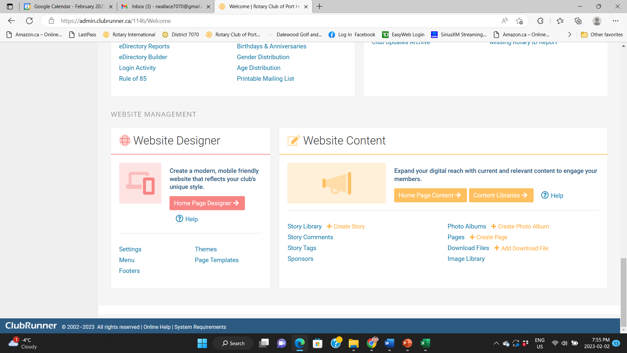

Slide 23
QUESTIONS

