Slide 1
Presentation by
Area of Focus
District 7070
At the PETS Training Session
February 4, 2023

Slide 2
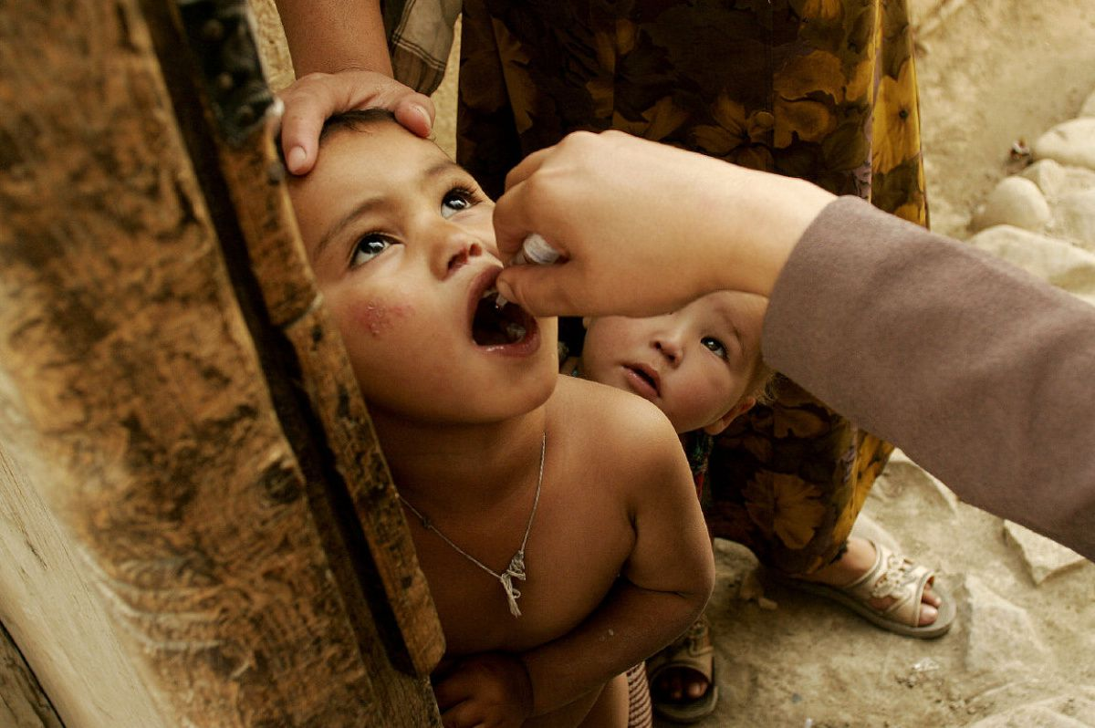
District 7070 –Area of Focus and Partnership Committee
Rotary International’s 7 Areas of Focus plus HIP
AoF Coordinators
Maternal & Child Health: Maureen Bird
Economic & Community Development: Khalid Hasan
Basic Education & Literacy: Joan Barrett
Peacebuilding & Conflict Prevention: Nevine Yassa
Disease Prevention & Treatment: TBA (Maureen Bird)
Environmental Action: Nilam Bedi
Water, Sanitation and Hygiene: Richard Mewhinney
Honouring Indigenous People (HIP): Bill Empy

Slide 3
Introduction
We want to encourage Clubs to provide details to the appropriate committee on projects dealing with their Area of Focus to ensure they are aware of all project activities in the district.
The Area of Focus committees are here to provide education and would like to provide sessions/seminars leveraging outside speakers where appropriate for the district on each of their Area of Focus to enhance Rotarian engagement and their understanding of each Areas of Focus.
We are available to aid Rotarians and Clubs in the development of projects employing best practices.
Help clubs with preliminary review of Grant applications as they pertain to a particular Area of Focus.

Slide 4
What you (Club President) can do
Communication is Essential
Sharing of information is essential to create coordination of projects
The Areas of Focus Team needs a list of committee chairs and contact info. We can do more together.
District Project Board – Under Development

Slide 5
For International Projects…
Have good contacts in other countries
10 of our club’s International Service Committee have done work in other countries either through Rotary or other charities. These include Kenya, Uganda, Cambodia, Dominican Republic, Haiti, Guatemala, India, Tanzania, El Salvador, Malawi and Laos.
Other active clubs with overseas visits include Eglinton, Alliston, Newmarket, Belleville and Whitby Sunrise.
This has allowed us to establish local connections with both Rotary Clubs and individuals to make best decisions.
Leverage the experience and relationships already developed.

Slide 6
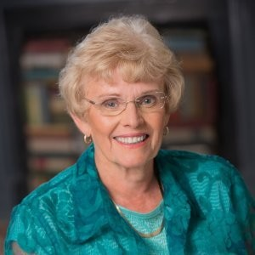
Maternal & Child Health
Coordinator:
Maureen Bird
RC Toronto

Slide 7
Did we know?
We are fortunate to live in a country with good access to health care
Most births in Canada are in hospital or at home with midwife assistance. Our maternal death rate is a small fraction of that in developing countries.
Death rates of children under two are again a fraction of those in developing countries.
But we can’t be complacent as some of these problems still exist for our First Nations

Slide 8
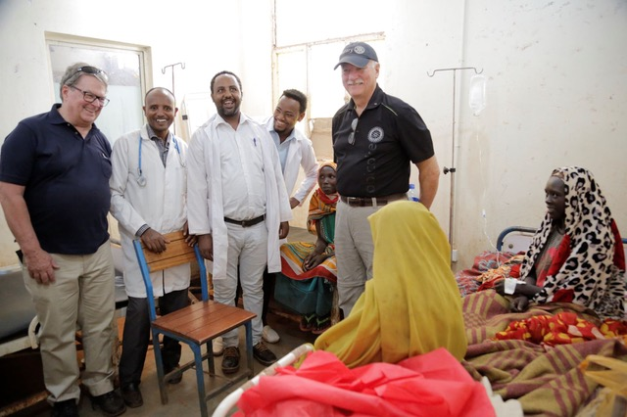
Best Practice
Best Practice by Finding the Right Partners
Ethiopia Birthing Kits – in partnership with CUSO
Led by Michael Bell, Etobicoke
The World Health Organization has reported that Ethiopia has
one of the world’s highest maternal mortality rate ratios with
an average of 675 maternal health deaths per 100,000 live
births. In comparison, the Canadian maternal mortality rate
ratio is 7.2 deaths per 100,000 live births.
We had 25 clubs from our district supporting this project along with a handful of individual donors bringing our total fundraising to over $45,000.00 CDN. While the CUSO project timeline did not allow us to achieve a Global Grant, we were able to get our $45,000.00 CDN matched by the Canadian Government at 13 to 1 or an additional $585,000.00 for this project. More than half the clubs in 7070 contributed to this project.

Slide 9
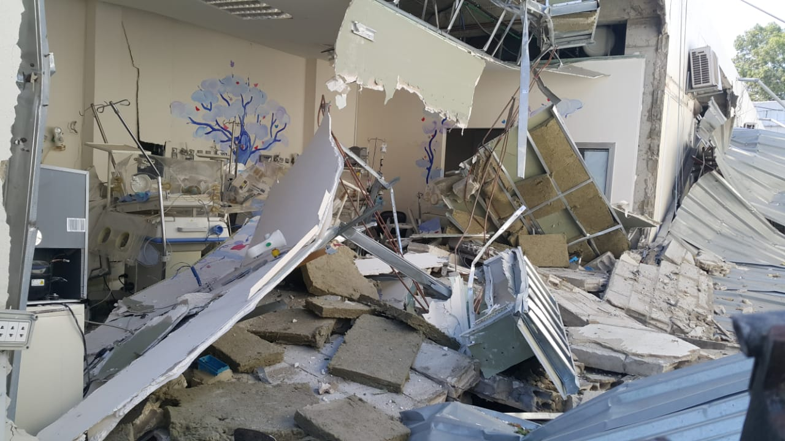
Best Practice
Best Practice by Working with our own District Clubs
Global Grants give us access to district and TRF funds
Beirut Paediatric Hospital Equipment
In the summer of 2020 a devastating explosion in the port area of Beirut Lebanon caused millions of dollars of damage in the city. In the paediatric wing of the hospital the surgery and recovery areas were destroyed
- A global grant led by Whitby Sunrise
- Value – almost US$400,000
- Supported by 22 clubs from 7070 and clubs and DDF from 7 districts

Slide 10
Best Practice
Look for Sustainability
From inception we worked with Dignitas International in Malawi in the fight against AIDS.
In partnership with the Ministry of Health they set up a program for testing, treating and education.
Their most successful project was the Prevention of Mother-to-Child transmission at birth.
The training of the local components has made this a successful project still continuing today.

Slide 11
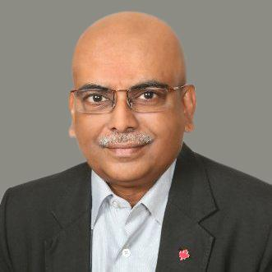
Economic & Community Development
Coordinator:
Khalid Hasan
RC North York
11

Slide 12
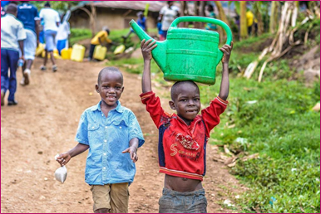
Did we know?
Nearly 1 billion people will go bed hungry tonight
1.3 billion people live on $1.25 a day – extreme poverty
45 million children in Africa remain out of school
I billion people still defecate in the open, absence of a toilet
More than 775 million people over the age of 15 are illiterate (17% of world’s adult population)
Today, over 70 million people are displaced as a result of conflict, violence, persecution, and human rights violations. Half of them are children.
12

Slide 13
Economic & Community Development
Eliminate Poverty and Empowerment: Ultimate Mantra!
Unemployment, underemployment, lack of economic opportunity, and the absence of social safety nets lie at the core of poverty.
Creating productive employment opportunities is essential for reducing poverty and achieving sustainable economic and social development
Providing income security and empowerment especially for women, people with disabilities, youth, and the extremely poor (focusing Diversity, Inclusion and Equity - DEI)
13

Slide 14
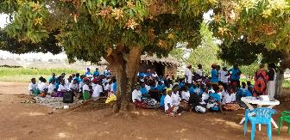
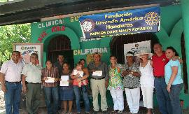
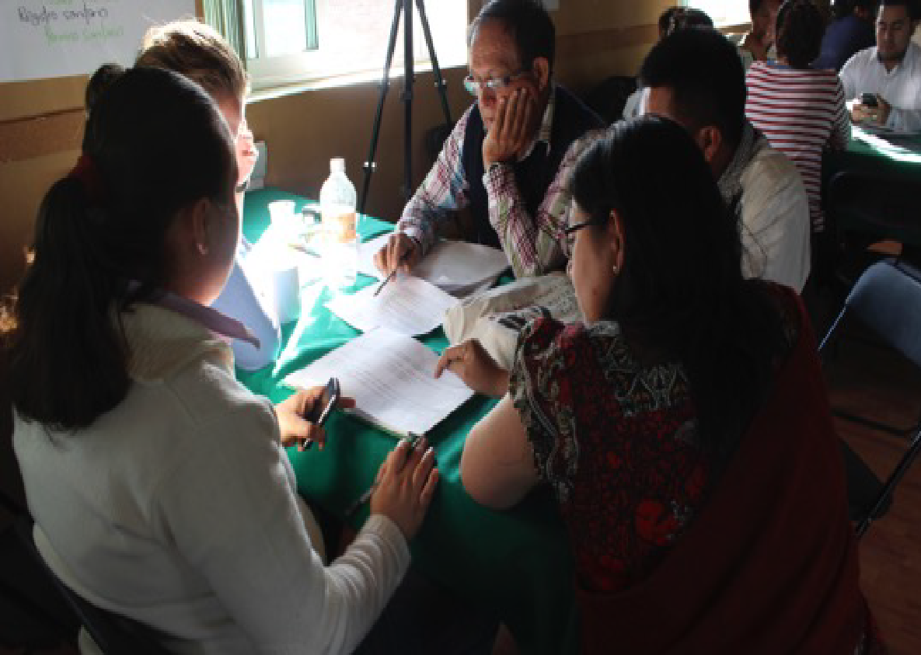
Elements of Economic & Community Development
Needs Assessment
Education
Loan capital
Mentoring
Networking
Evaluation
14

Slide 15
What you (President Elect) can do
What can you do for your CLUB and MEMBERS?
Raising club profile in the corporate sector of the city
Increasing ownership of club members
Project bringing in mentors and volunteers from other clubs in the area
International entrepreneurs applying for the program/project
For the COMMUNITY
Share the reality of ECD
Share your success stories (best practice)
Promote and create Awareness, Interest, Desire and Action (AIDA)
Invite successful entrepreneurs in our club meeting (ownership)
Attract new members – both young and successful entrepreneurs
Changing lives!
Let us BRAND ourselves!
15

Slide 16
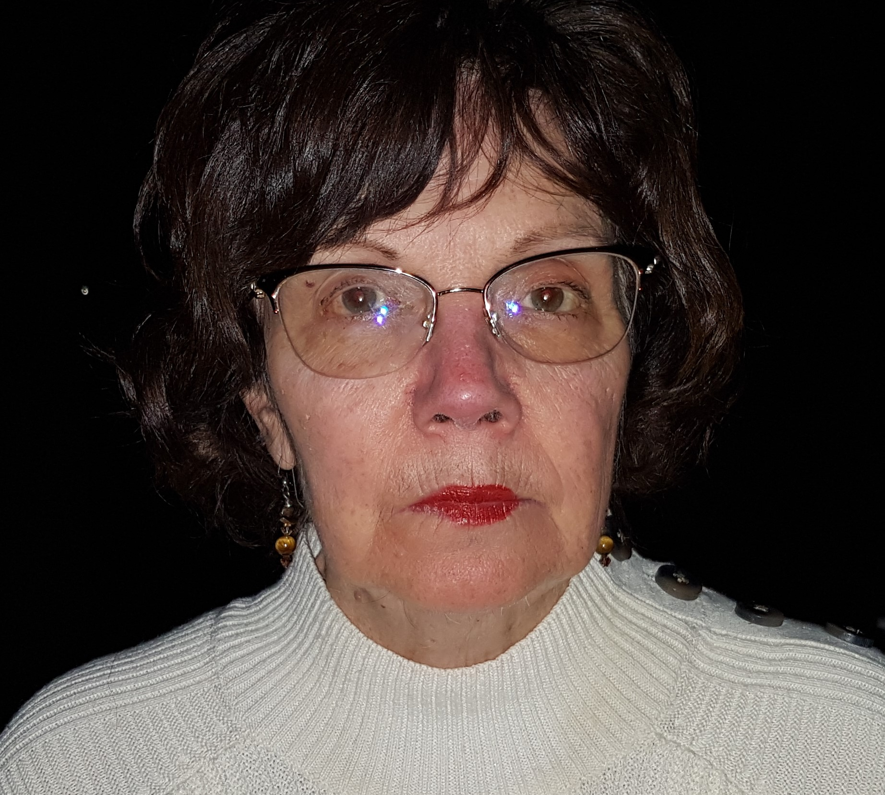
Basic Education & Literacy
Coordinator:
Joan Barrett
RC Scarborough
16

Slide 17
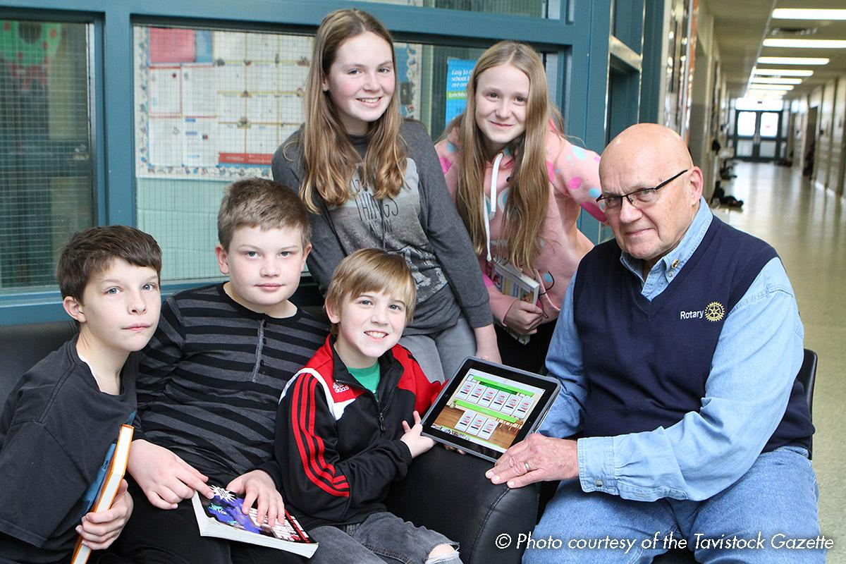
Introduction
Many clubs engage in projects related to literacy both locally and internationally.
Most clubs do not contact the Area of Focus - Basic Education & Literacy Committee – for guidance in project selection, or for knowledge of projects other clubs are doing.
When clubs keep us informed of projects, we can offer support and perhaps link other clubs that would like to join an education project that is ready to go.
17

Slide 18
Did we know?
Local Projects:
Backpack projects in August /September (filled with required school supplies)
Purchasing books for local schools, drop-in centres, school libraries, children’s Book Bank,…
Supporting nutrition programmes in schools (breakfast, snacks, hot lunches)
Supporting literacy learning in Refugee Centres, Family Residences (purchasing of materials such as laptops/iPads, books, paper etc)
Funding to local agencies who run summer literacy camps
Scholarships to high school students to allow them to pursue higher education (Whitby Clubs, Scarborough Clubs)
Free Reading Programme supplied to After School Centres, libraries
18

Slide 19
Did we know?
International Projects:
Free Reading Programme sponsored by the North York Rotary Club to schools in the Philippines (English language instruction)
Free Reading Programme sponsored by the Rotary Club of Scarborough to a large orphanage in Ukraine as well as the laptops to support the programme
Kenya High School Scholarships, through the Bidi foundation, to both boys and girls; sponsored by the Rotary Club of Whitby
Clubs support schools in developing countries with funds for the construction of schools, safe water and sanitation facilities. Many of these include education in safe hygiene as well.
19

Slide 20
Best Practice
Emergence of zoom during this pandemic! Lessons to learn!
Involvement in literacy discussions around the world on a regular basis – really getting to know issues almost ‘firsthand’(ICC, BELRAG connections to other like-minded clubs)
Next step(s): To formulate a workable plan to coordinate and work together, both with other clubs and the BELRAG relationship being initiated
SUCCESS STORY
Free Reading – online learning
Struggling readers or English as a second language
Endorsement of rotary clubs around the world – many here in Canada as well as the united states
Testimonials to show effectiveness
Research has begun to further show its impact
20

Slide 21
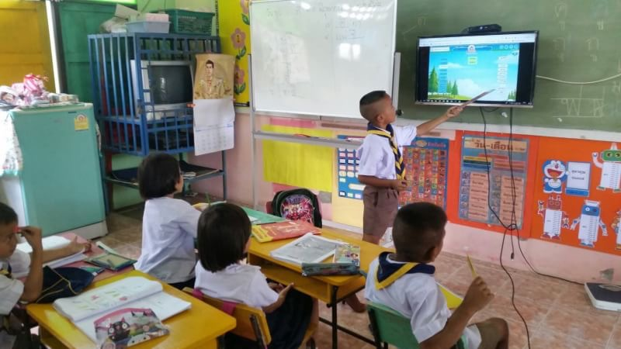
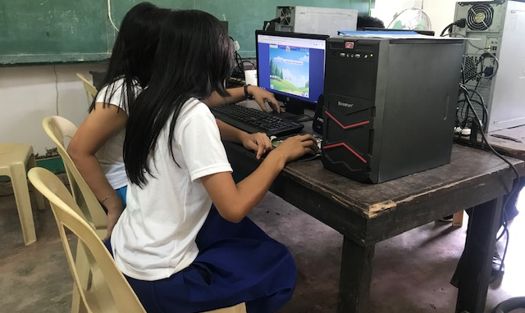
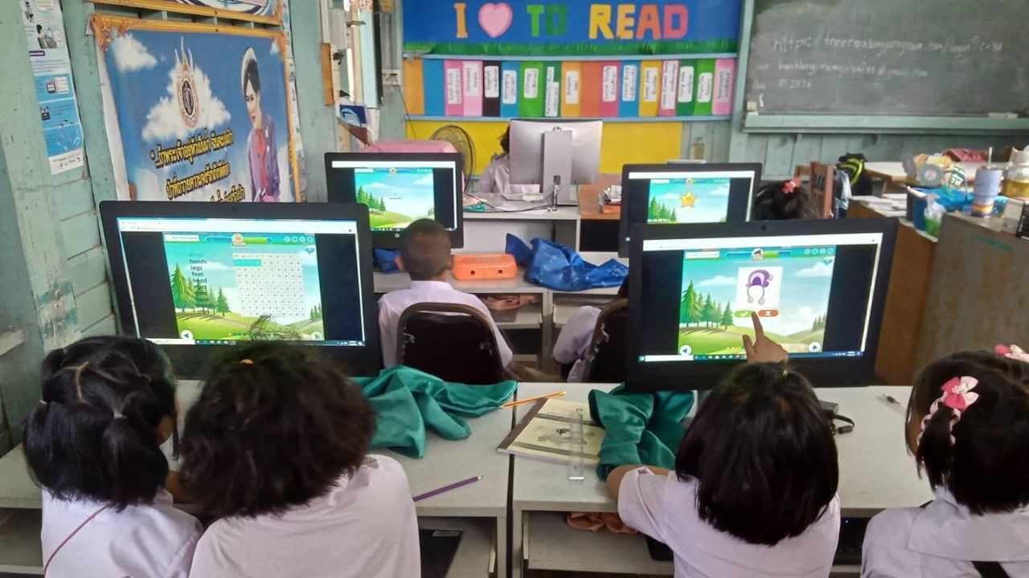
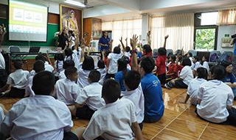
Literacy in Action
21

Slide 22
What you (President Elect) can do
Know your community and its needs – Education is CRITICAL for ALL
Are there people in your club interested in education? Give them opportunities to go forth!
Tips (Local & International):
do you have schools with low EQAO scores?
are your schools in need of materials (devices, books,…)
can you provide reading/writing volunteers? Guest readers,…
join with other clubs for an international project
Set a goal for educational project(s)! This year, over next 2 or 3 years
22

Slide 23
Peacebuilding & Conflict Prevention
Coordinator:
Nevine Yassa
RC Scaborough
23

Slide 24
Introduction
Peacebuilding and Conflict Prevention Area of Focus
We as Rotarians refuse to accept conflict as a way of life. All Rotary projects provide training that fosters understanding and provides communities with the skills to resolve conflicts.
Rotary creates environments of peace
As a humanitarian organization, peace is a cornerstone of our mission. We believe when people work to create peace in their communities, that change can have a global effect.
By carrying out service projects and supporting peace fellowships and scholarships, our members take action to address the underlying causes of conflict, including poverty, discrimination, ethnic tension, lack of access to education, and unequal distribution of resources.
Our commitment to peacebuilding today answers new challenges: how we can make the greatest possible impact and how we can achieve our vision of lasting change. We are approaching the concept of peace with greater cohesion and inclusivity, broadening the scope of what we mean by peacebuilding, and finding more ways for people to get involved.
Rotary creates environments where peace can happen.
24

Slide 25
Did you know?
Rotary’s Four Roles in Promoting Peace
Rotary and its members are:
Practitioners: Our work fighting disease, providing clean water and sanitation, improving the health of mothers and children, supporting education, and growing local economies directly builds the optimal conditions for peaceful societies.
Educators: Our Rotary Peace Centres have trained over 1,300 peace fellows to become effective catalysts for peace through careers in government, education, and international organizations.
Mediators: Our members have negotiated humanitarian ceasefires in areas of conflict to allow polio vaccinators to reach children who are at risk.
Advocates: Our members have an integral role as respected, impartial participants during peace processes and in post-conflict reconstruction. We focus on creating communities and convening groups that are connected, inclusive and resilient.
25

Slide 26
Upcoming Event
WORLD UNDERSTANDING AND PEACE DAY SYMPOSIUM
You are cordially invited to an incredible Peace Symposium with music, art and incredible speakers on Thursday Febraury 23, 2023 at 7:00p.m. where you will hear Nobel Prize Winner Ouided Bouchamaoui who will join us all the way from Tunis, different entities that Rotary International is collaborating with to promote peace such as Mediators without Borders, The Peace and Economic Peace Centre, Rotary Inter-Country Committees (RotaryICC) and learn about how Rotary is collaborating with these different entities to extend peace and understanding around the world.
Register today:
https://rotary7070.org/event/world-understanding-and-peace-day-conference/
26

Slide 27
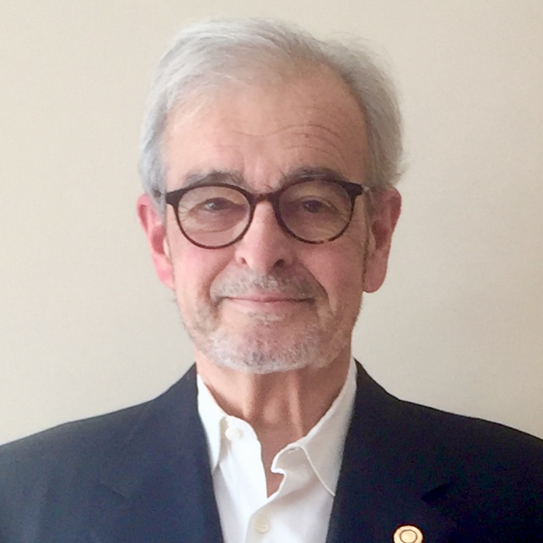
Disease Prevention & Treatment
Interim Coordinator:
Maureen Bird
RC Toronto
27

Slide 28
The Goal
United Nations Sustainable Development Goal #3:
“Ensure Healthy Lives and promote well being for all at all ages”
Essential to sustainable development
In 2017 less than half of the Global population were covered by essential health services
Focus on immunization, HIV, Tuberculosis and Malaria
progress has been good but has been disrupted by COVID
28

Slide 29
Rotary’s Role in Disease Prevention & Treatment
Rotary’s Role
Dozens of programs world-wide funded by Global and District Grants
Bed nets
Medical equipment
Education
The Global Polio Eradication Initiative
Rotary’s signature accomplishment
From 185,000 cases to 140, 1 YTD in 2021
Rotary donations to date (including Gates Foundation match) $2.4 Billion
29

Slide 30
Our District Initiatives
WHAT OUR DISTRICT IS DOING?
District Grants:
Portable anaesthetic units for Tanzania - Rotary Club of Belleville
Seniors garden - RC Willowdale
Global Grant:
GG-2119172 Project Karantina Hospital, Beirut, Lebanon Update – Paediatric ward and operating theatre equipment. RC Whitby Sunrise and 21 other clubs.
This unit will officially be opened soon and all equipment and training has been completed.
30

Slide 31
How You Can Help!
GET INVOLVED!
Promote support of Polio initiative in your club
Support other clubs through District & Global Grants
31

Slide 32
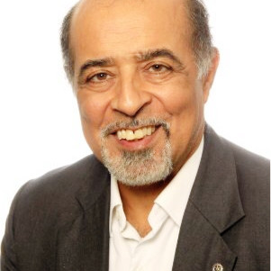
Environmental Action
Coordinator:
Nilam Bedi
RC Eglinton
32

Slide 33
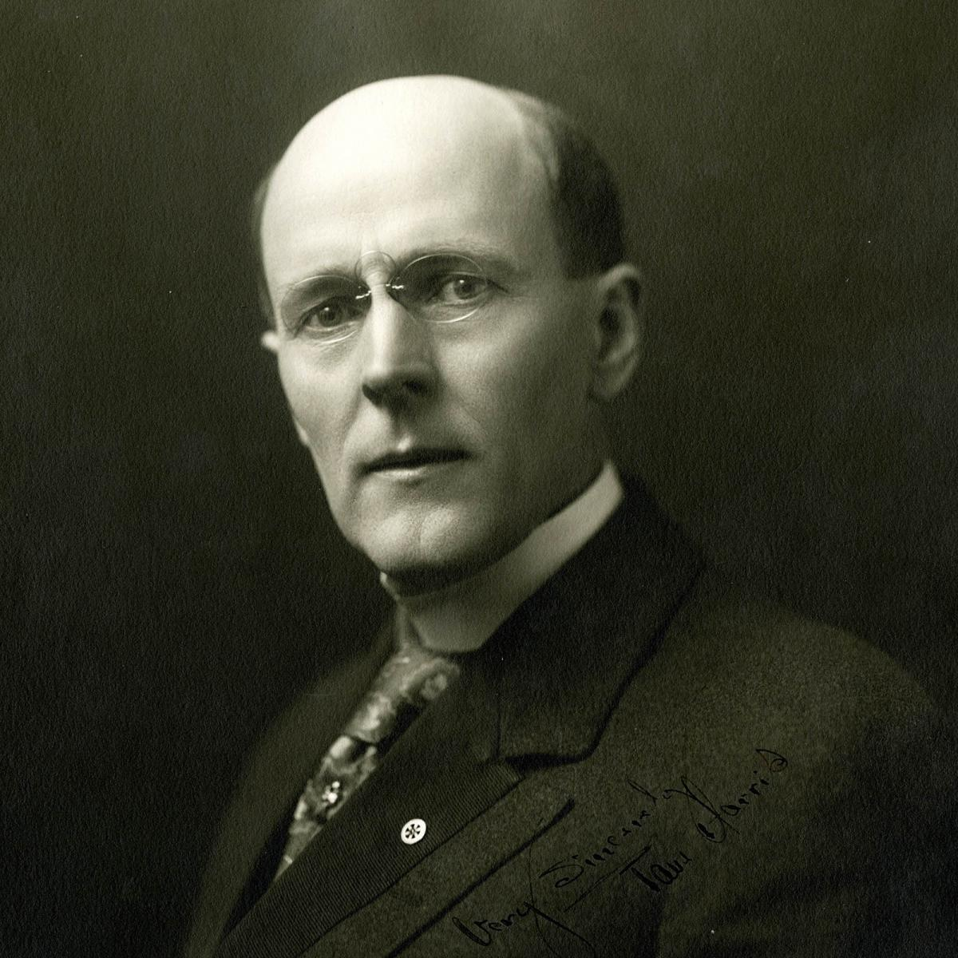
Rotary’s Roots in Conservation and the Environment
Paul Harris founded Rotary in 1905.
Did you know that he was a nature lover, joining a group in 1908 dedicated to outdoor recreation and conservation activities?
He met his wife on a Prairie Club outing and served as a Director in 1911.
33

Slide 34
Rotary Context for Environmental Action
Policy Statement regarding this Area of Focus:
Protecting land, marine, coastal and freshwater resources
Enhancing capacity of communities to support natural resource management
Support agroecology and sustainable agriculture, fishing and aquaculture
Address climate change through solutions to reduce GHG emissions
Strengthen resilience of ecosystems and communities affected by climate change
Support education to protect the environment
Advocate sustainable consumption
Address environmental justice issues and environmental health concerns
34

Slide 35
District 7070 Rotary Environmental Action Committee
District 7070 created an Environmental Action Committee (EAC) in July 2020
In approaching our mandate systematically, we started with an examination of what the term “Environment” means.
“Environment” – very broad and can be seen through different lenses:
Media: air, water, land; other frameworks to understand and act on the environment
Issues: energy, pollution, habitat, plastics, waste, climate change, land-use, biodiversity, food waste
Actors: individuals, community groups, government, academia, industry
Actions: advocacy, research, regulation, awareness/education, global vs. local, remediation, prevention
35

Slide 36
D 7070 Rotary Environmental Action Committee, Cont’d.
The focus of D7070 EAC is a practical one:
Plan & implement service projects relevant to our clubs
Build on what is already happening within clubs
Coordinate cleanups across the District
Scanning global developments, working with ESRAG (Environmental Sustainability Rotarian Action Group)
Create awareness about environmental issues
Two Tuesday talks (still available on the District YouTube channel)
Earth Day events
Plenary and breakout sessions at District Conference
Help clubs with speakers
Share ideas on projects, fundraising, etc.
Build global and local networks and partnerships
Inspire local action for sustainable solutions
Number of clubs with environmental committees grown several-fold
Toolkit on starting and environmental committee is available
Help interested clubs on projects worldwide – e.g. Global Grants
36

Slide 37
Examples of What Clubs Are Doing
Learning about environmental issues
Community gardens
Nature walks
River and shoreline cleanups (upcoming event April 22nd – Great Lakes Watershed Cleanup)
Environmental competition for high schools
Native tree and shrub planting
Waste reduction and recycling projects
Food waste reduction initiatives
Plastic free challenges within clubs
Supporting projects by grassroots environmental groups
Greening of club activities
37

Slide 38
Some Opportunities for Your Club
Contact D7070 EAC for
Learning about specific environmental issues
Participating in planned pilot initiatives:
Ecological Footprint Tracker
Carbon Footprint Tracker
Solutions Forums
Collaborate with other clubs on activities such as tree planting, cleanups, larger environmental projects
Use and promote environmental resources from ESRAG, UNEP, national and local governments, issue-specific action groups
38

Slide 39
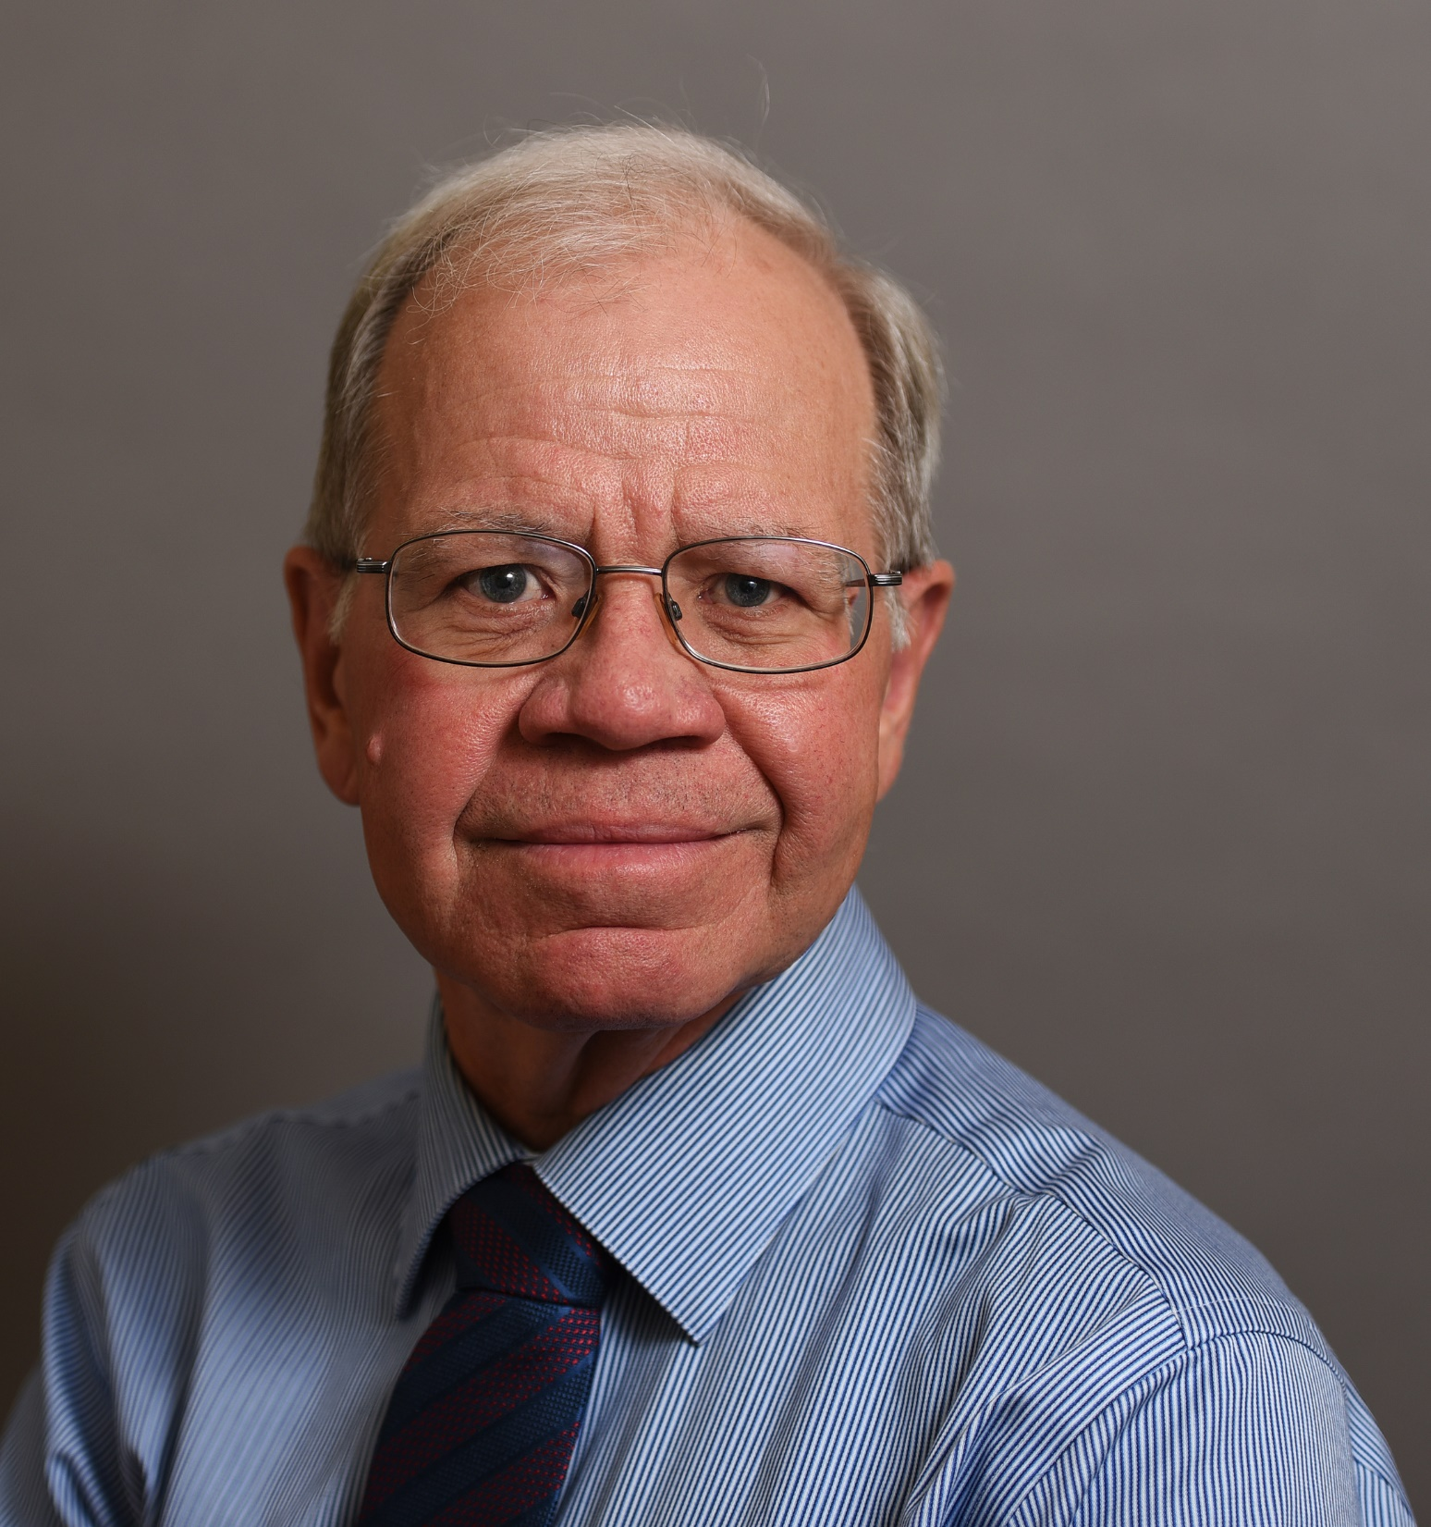
Water, Sanitation & Hygiene
Coordinator:
Richard Mewhinney
RC Newmarket
39

Slide 40
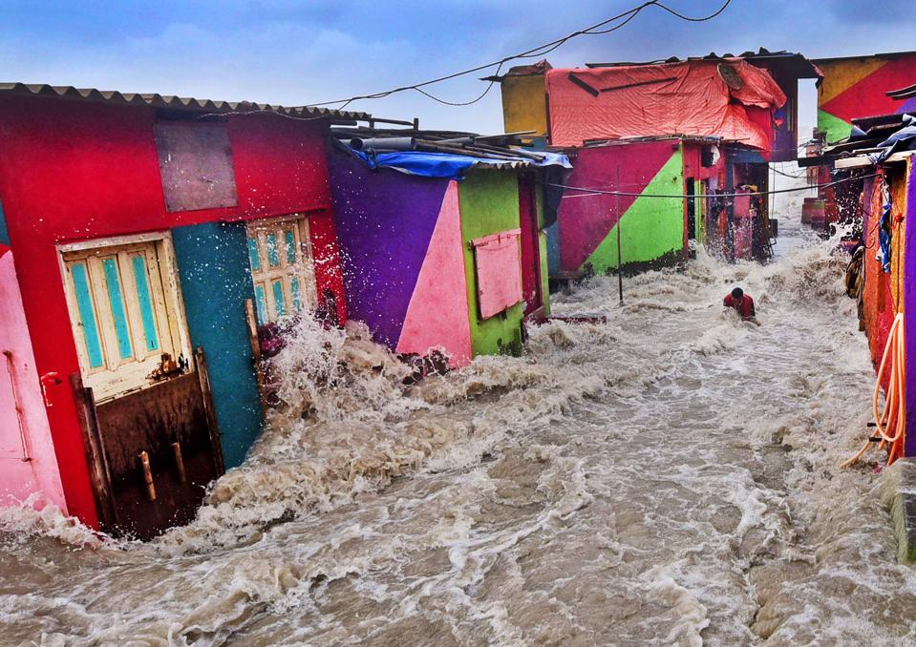
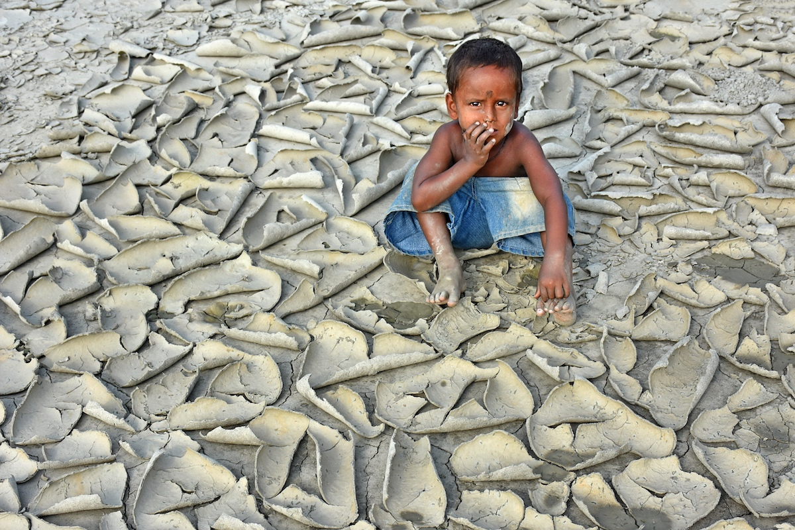
Issues: Water Scarcity, Floods, Waste, Drought, Toxics....
Source: CIWEM Photographer of the Year, 2019 et. al

Slide 41
Our Mission and Purpose
Our Mission is to be an available resource on topics related to Water Sanitation and Hygiene through one-on-one consultations, providing speakers to clubs.
We are available to consult with Rotary Clubs and Rotarians on questions of WASH.
We are available to review projects and proposals and provide feedback on best practices
In the past year, our committee has had the opportunity to review grant applications prior to submission to provide input and guidance to assist in a successful grant submission.
41

Slide 42
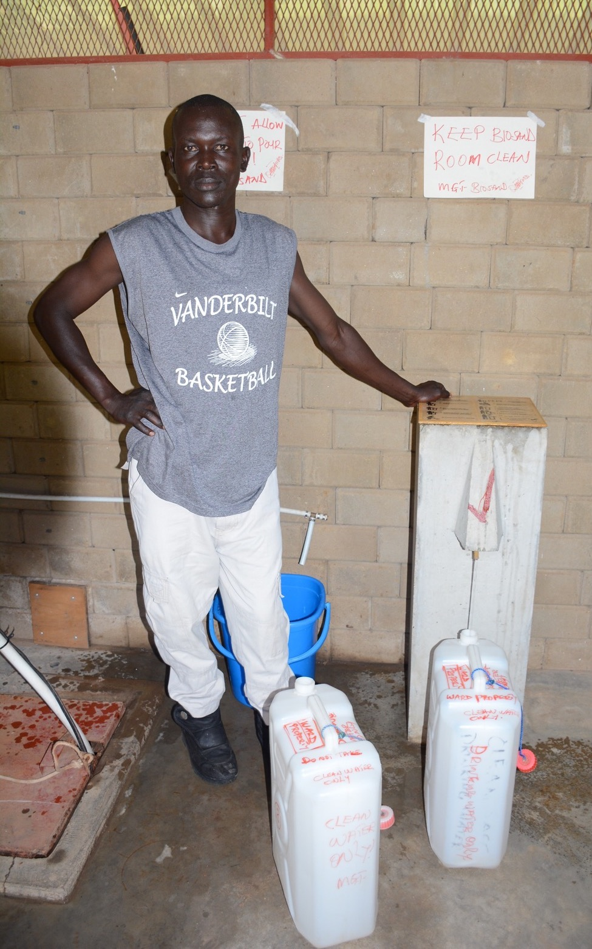
Our Mission and Purpose
Clean water, sanitation, and hygiene education are basic necessities for a healthy environment and a productive life.
When people have access to clean water and sanitation, waterborne diseases decrease, children stay healthier and attend school more regularly, and mothers and young girls can spend less time carrying water and more time helping their families and staying in school.
42

Slide 43
Water Projects within the District
Water projects we are aware of taking place in the district
Global Grant – Bugiri Water Project Uganda – RC Toronto Eglinton
Global Grant – Ghana Water Project – RC Oshawa Parkwood
District Grant – Adopt a Village in Laos - Clean Water access – RC Whitby Sunrise
Pending Global Grant – Ongutoi Uganda - Water Collection for Sustainability – RC Newmarket
District Grant – School Water Project Burundi
- RC Markham Sunrise
43

Slide 44
Water and Sanitation - Get Involved
If you’re interested in water:
Join Water, Sanitation and Hygiene Rotary Action Group www.wasrag.org
Your club has a water project, let us know and we can assist
If you don’t know where to start, support anther water project in the district. There are opportunities to help financially and active participation.
Plan an event for World Water Day, March 22, 2023
44

Slide 45
HIP (Honoring Indigenous Peoples)
Coordinator:
Bill Empy
RC Toronto
45

Slide 46
Introduction
2020
Revised Mission
50% Indigenous & 50% Non-Indigenous
Geographically Dispersed
HIP publishes its revised Vision, Mission & Shared Values
VISION
Our vision is that all Indigenous and Non-Indigenous Peoples work together, interconnected and interdependent, for the benefit of future generations.
2019
Board Expansion
HIP Board expands from coast-to-coast & hosts first in-person strategic planning session.
MISSION
Our mission is to catalyze societal change by inspiring Indigenous & Non-Indigenous relationship building, strengthening community well-being and advancing the next generation of leaders.
2016
Discovery Results
Results from a lengthy discovery & assessment phase.highlighted education as the number one way Rotarians can work with Indigenous People. .
50% Rotarian
50% Women & 50% Men
2014
Founded
Founded by Rotarians in Southern Ontario.

Slide 47
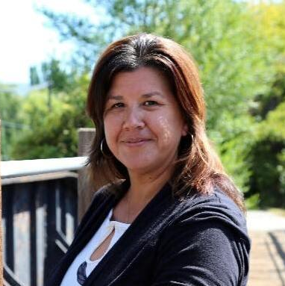
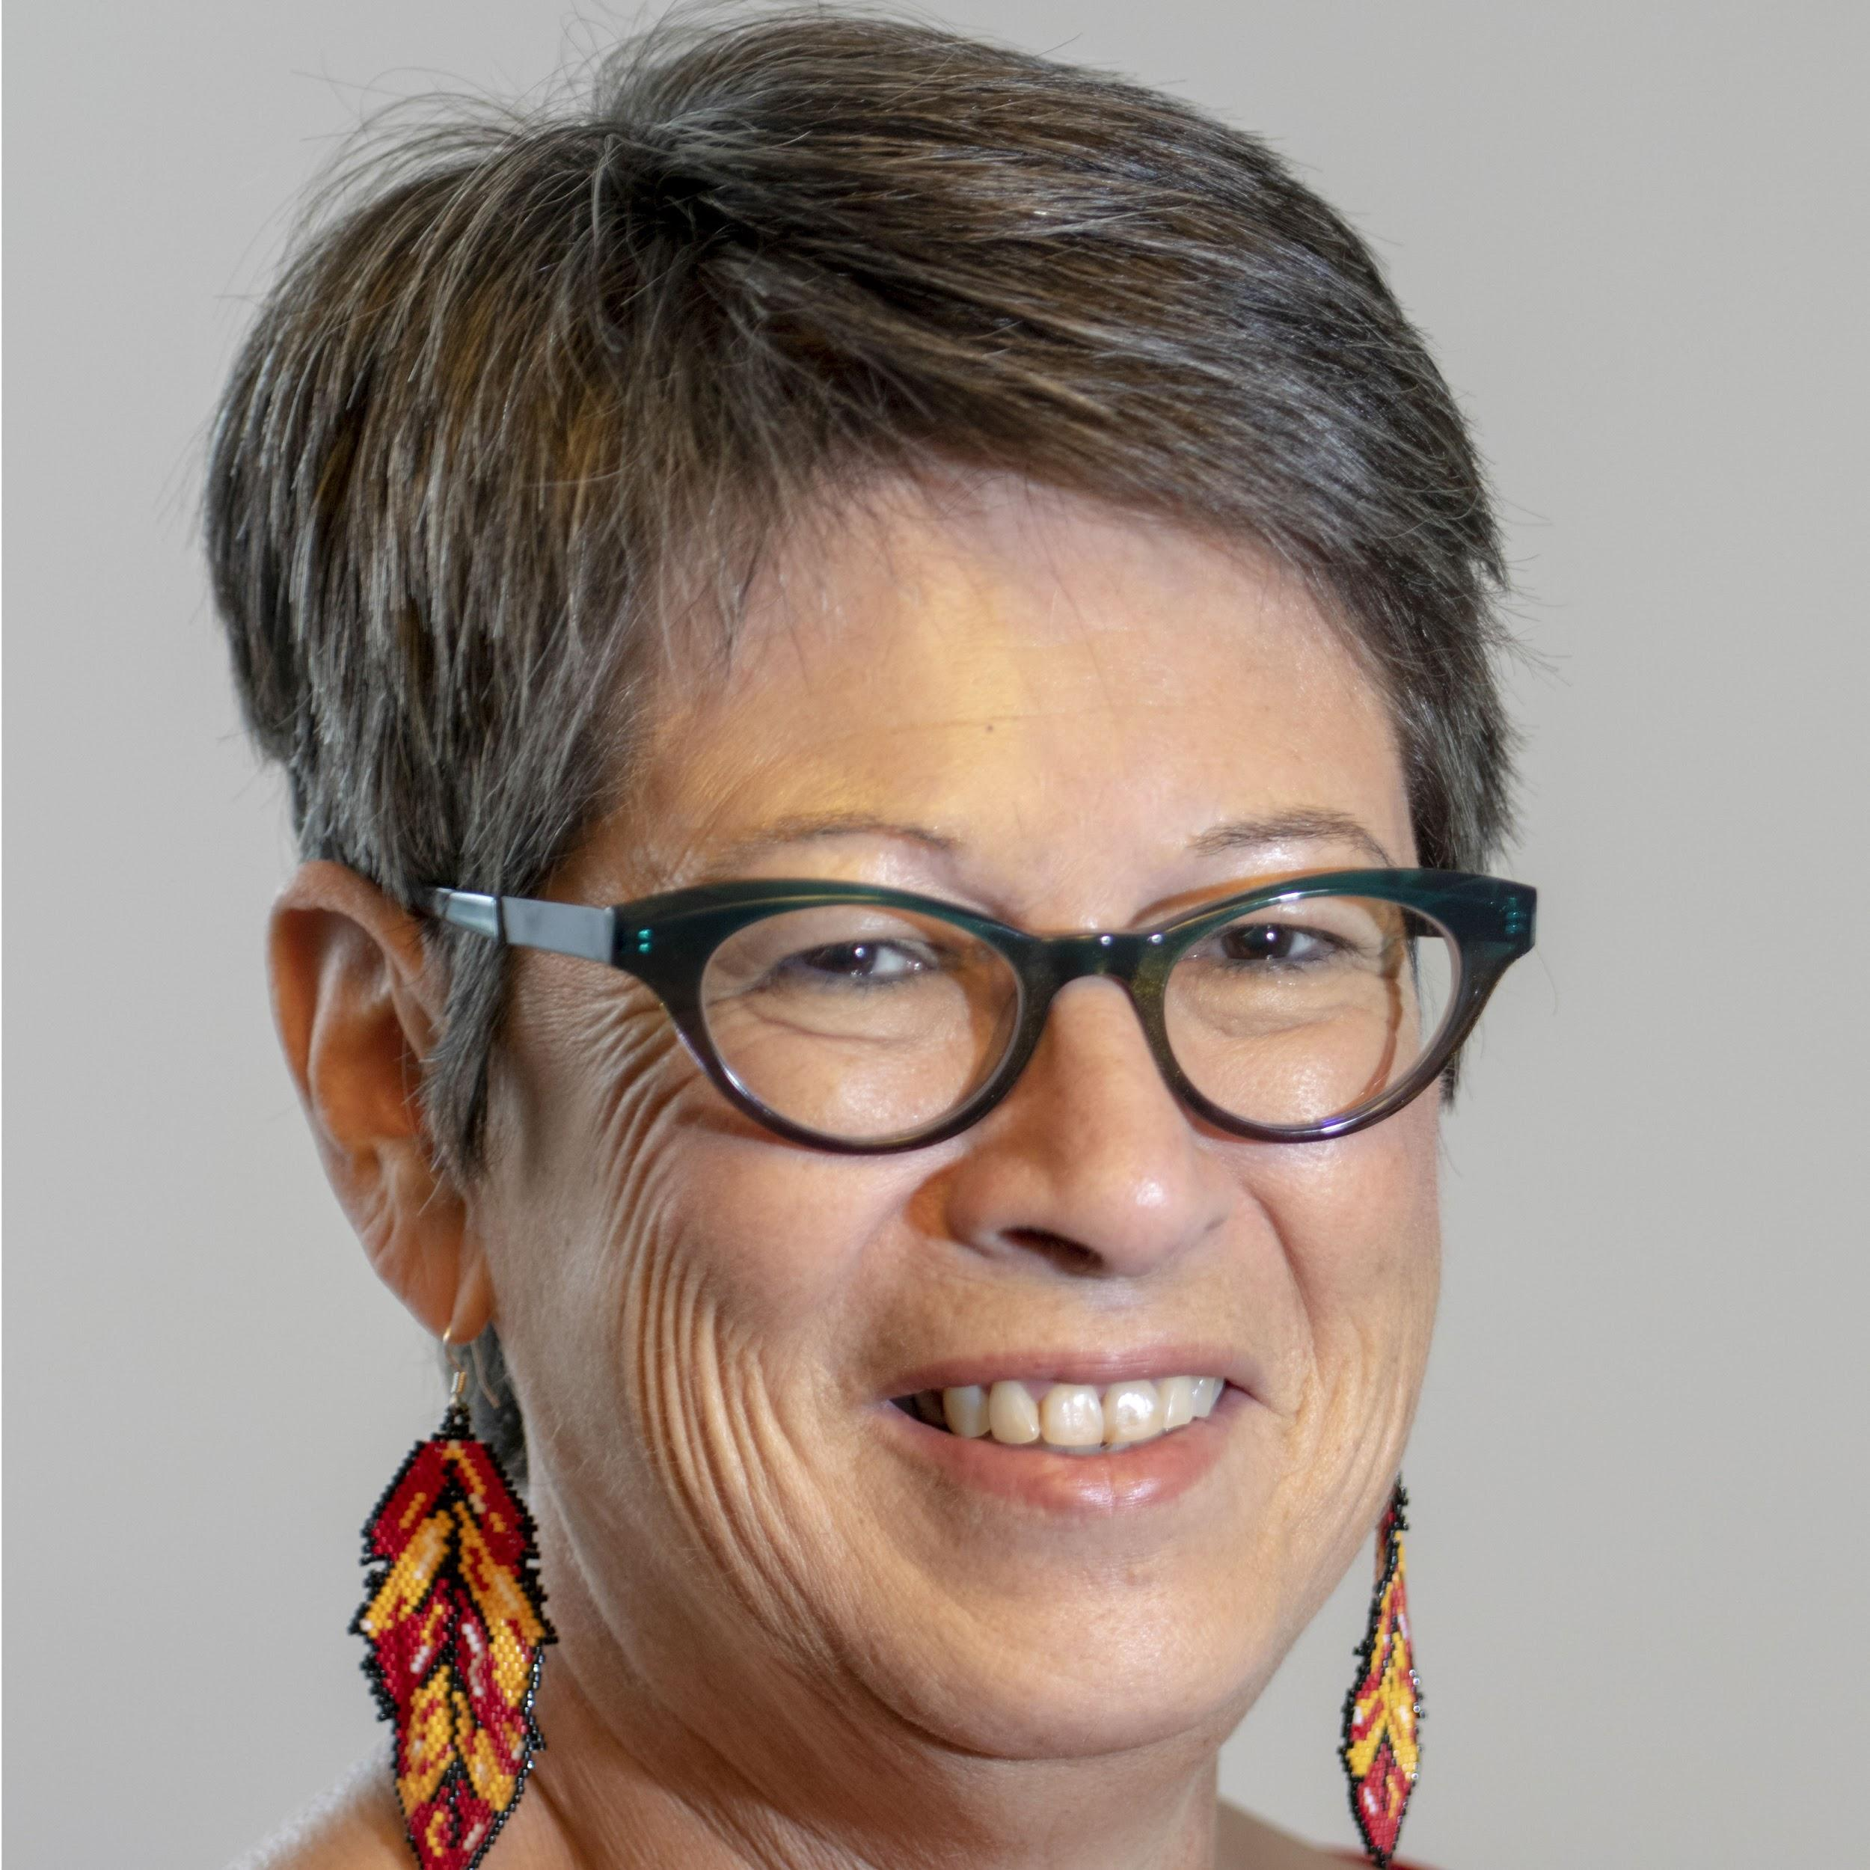
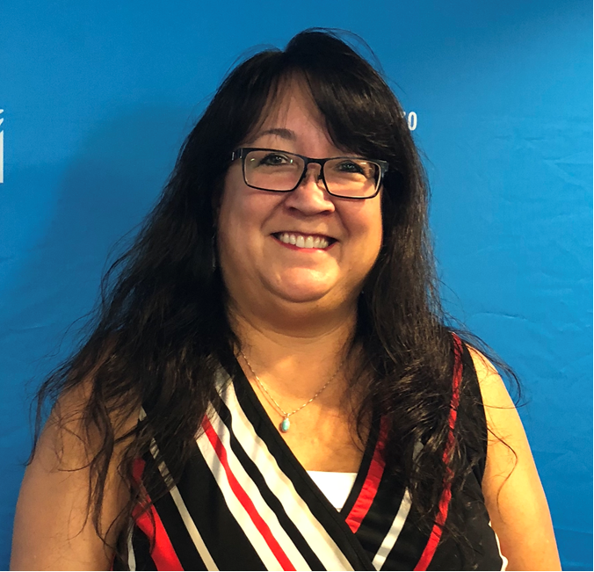
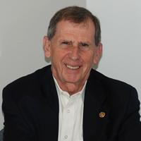
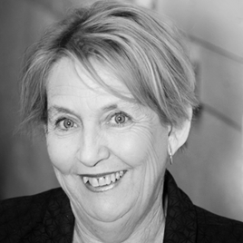
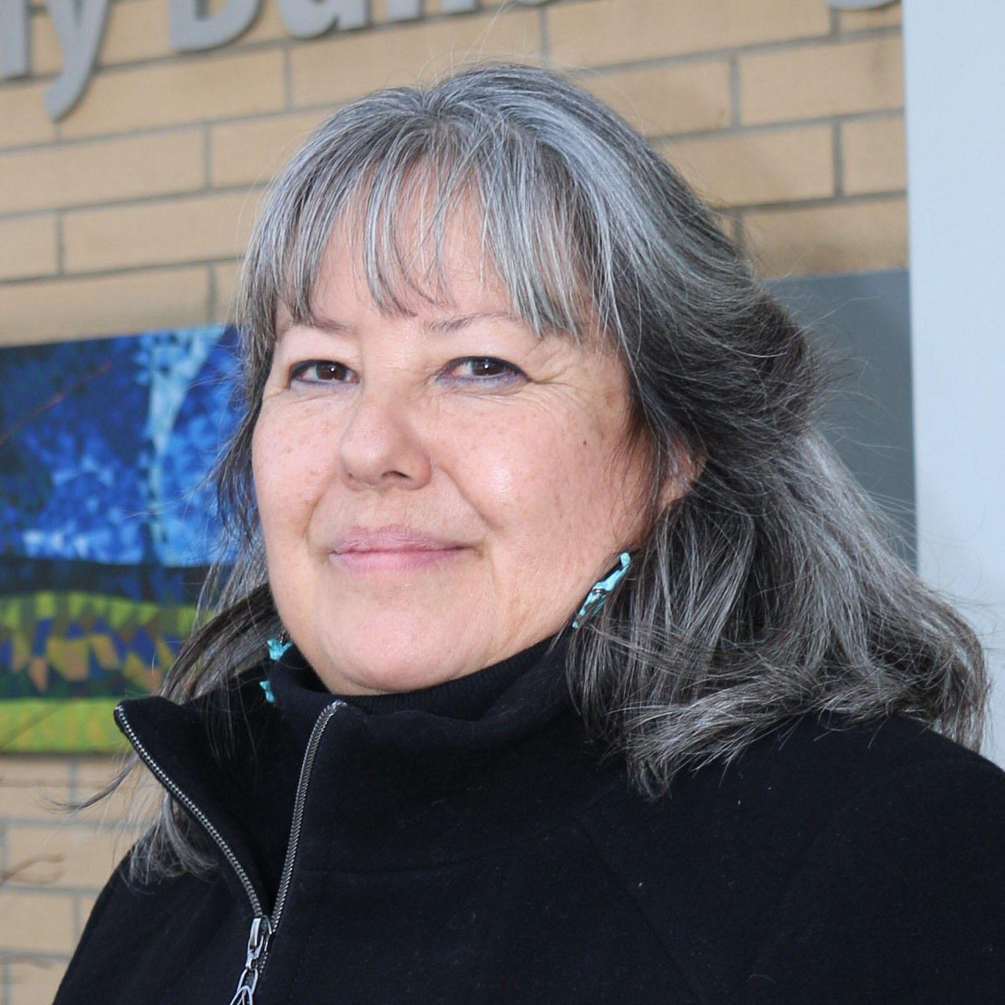
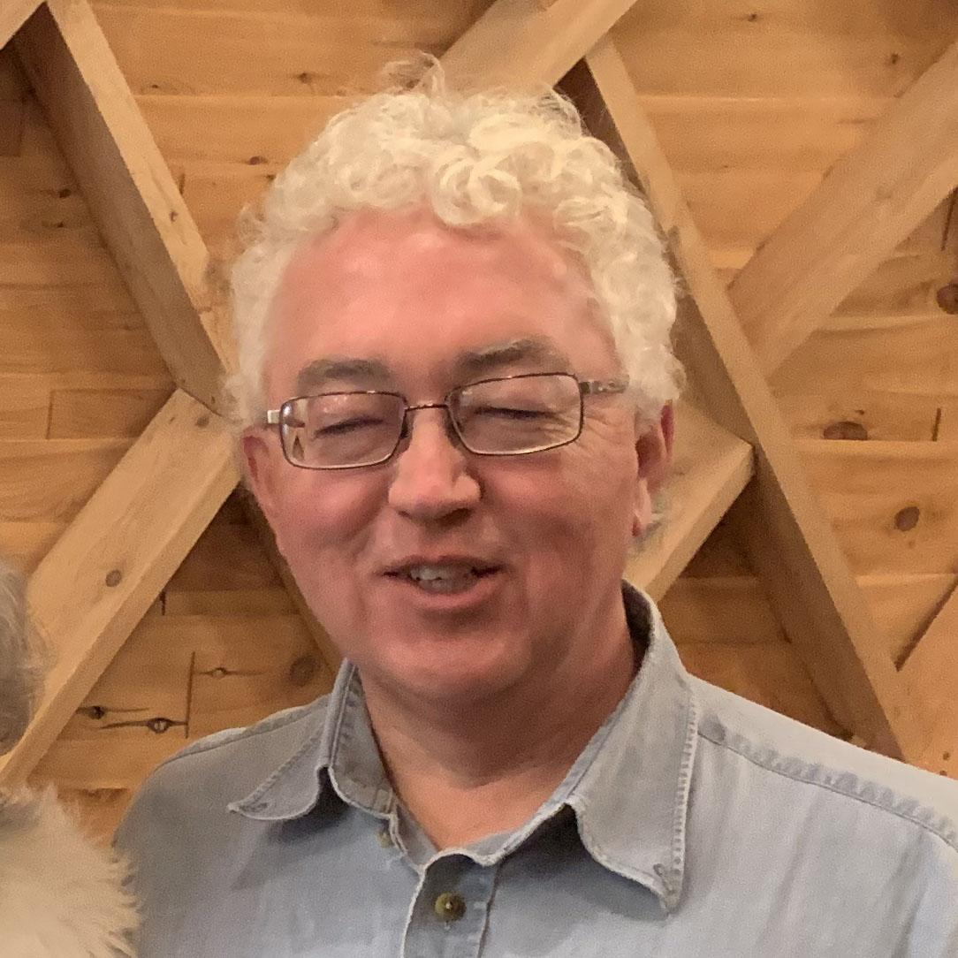
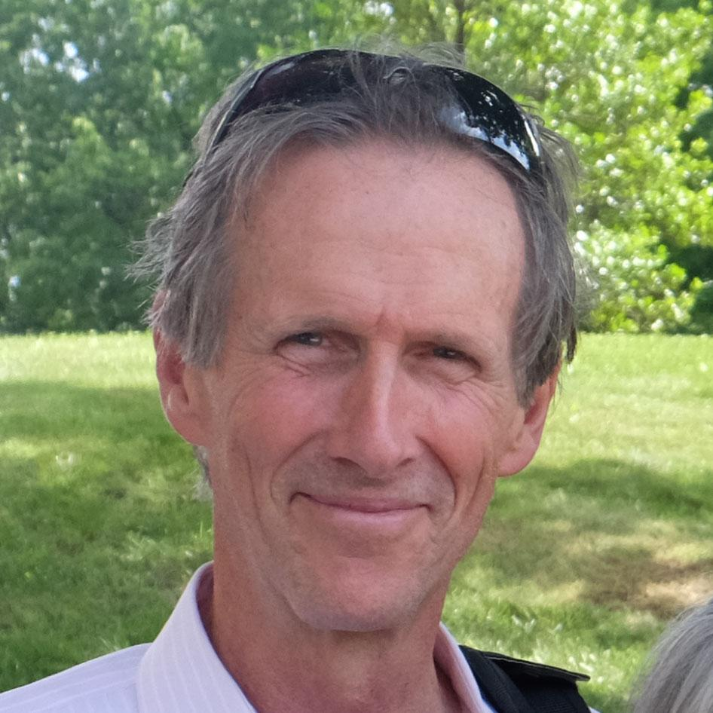
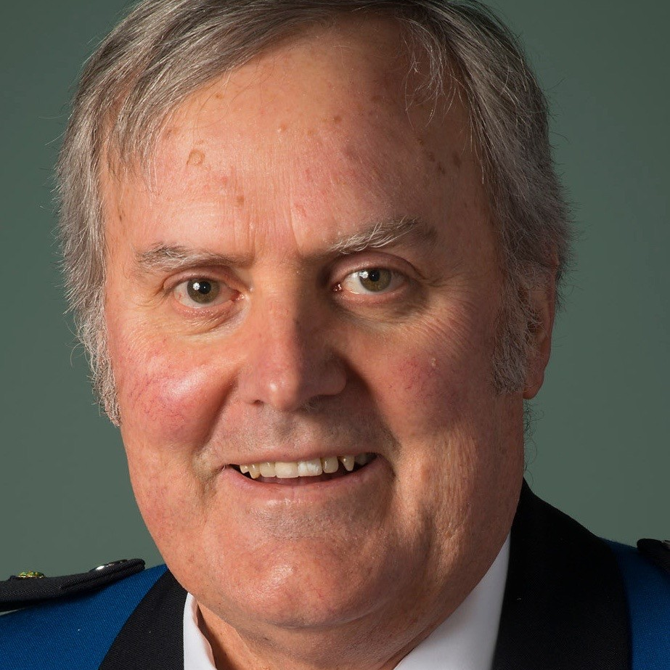
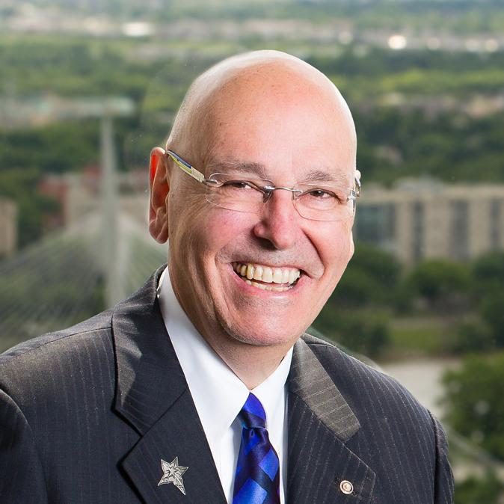
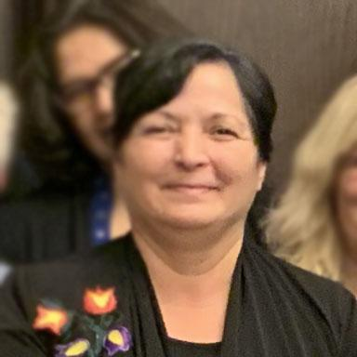
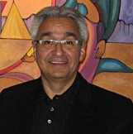
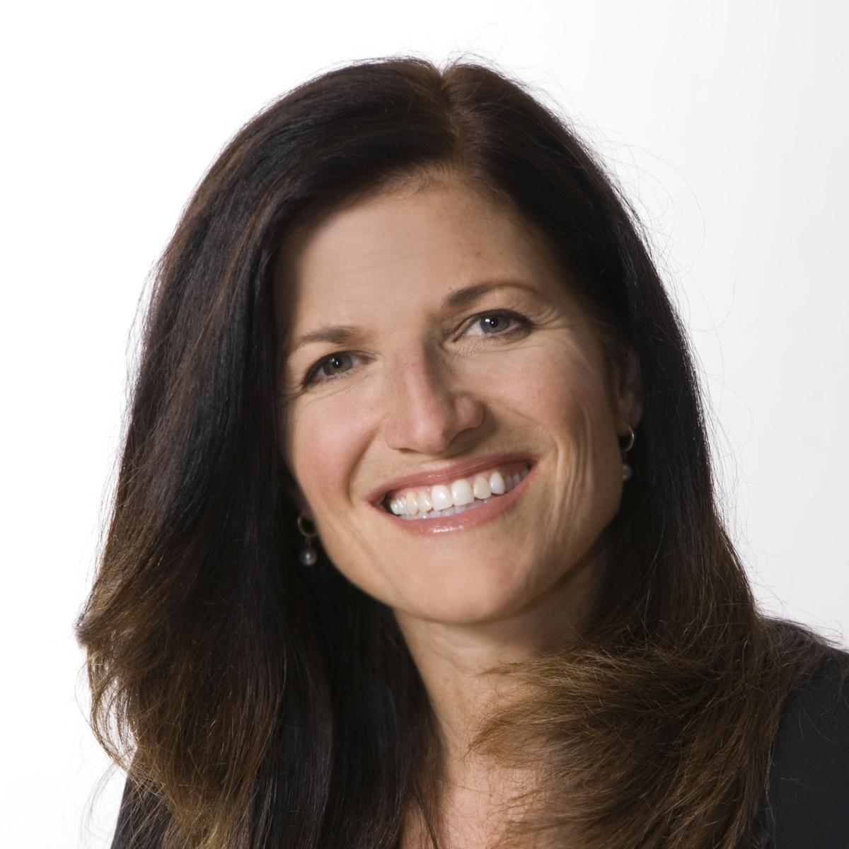
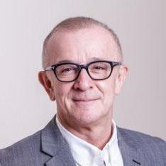
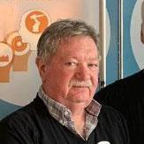
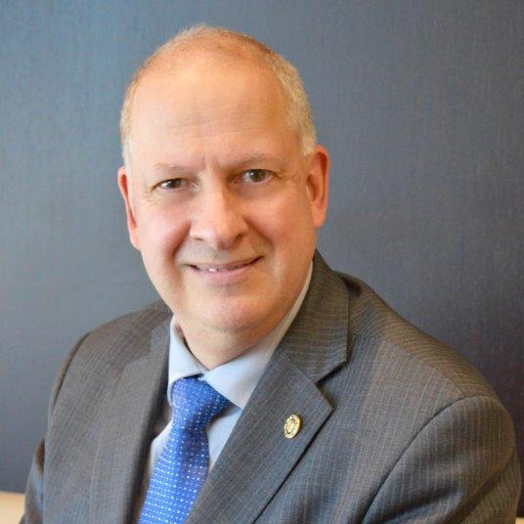
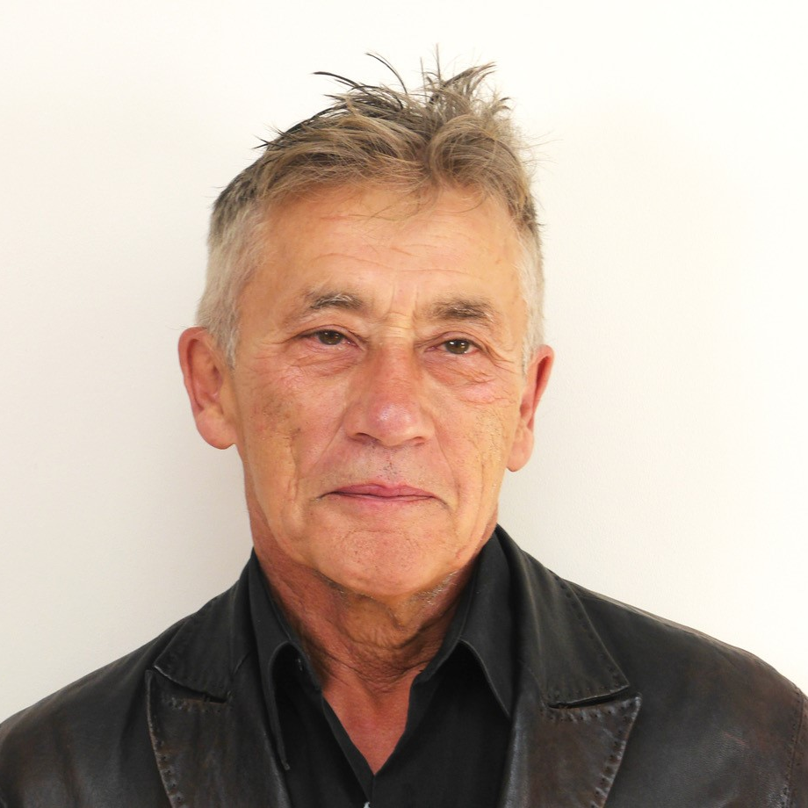
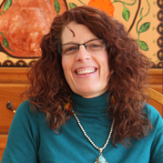
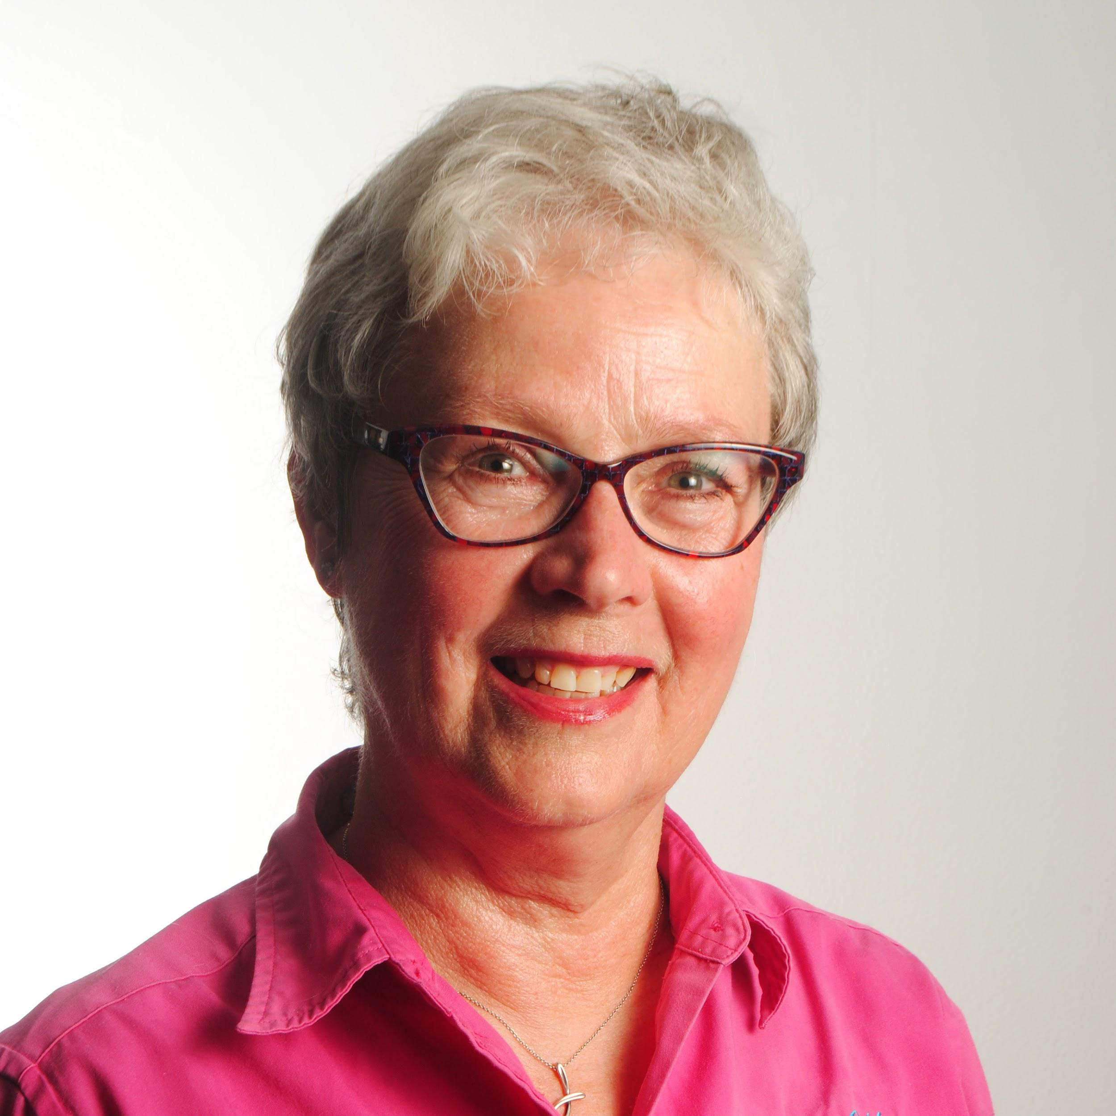
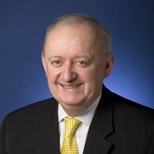
Working Together Coast-to-Coast
HIP’s BOARD OF DIRECTORS
50% Indigenous, 50% Non-Indigenous, 50% Women, 50% Men & 50% Rotarian
LEONA ANTOINE
Nlka’pamux/Sylix Nation, Lower Nicola Valley, BC
KAREN MACKENZIE Cree-Métis, Edmonton, AB
DIANE REDSKY Ojibway, Shoal Lake #40 First Nation, MB
CHRIS SNYDER RC of Toronto, ON Chairperson
JAN FOX RC of Edmonton, AB
KAHONTAKWAS DIANE LONGBOAT Mohawk Nation Turtle Clan, Six Nations Grand River Territory, ON
KARIHWAKERON TIM THOMPSON Mohawk Wahta Mohawk Territory, ON
TOM HERMAN RC of Wolfville, NS
ROBERT BLACKER RC of Steveston, BC
DAVID G. NEWMAN RC of Winnipeg, MB
ELEANOR BERNARD Eskasoni, NS
LARRY FROST Ojibway, Serpent River First Nation, Toronto, ON
LISA FARANO Rotary E Club of Social Innovation, ON
ANDRE MORRISEAU Ojibway, Fort William First Nation, ON
JOHN LOMAX RC of Brampton, ON
JOHN ANDRAS RC of Toronto, ON
KENN RICHARD | Métis, St Francis Xavier, ON
KATSI'TSIARIHSHION SUZANNE BRANT Mohawk, Tyendinaga Mohawk Territory, ON
JANET MCLEOD RC of Peterborough Kawartha, ON
FRED LAWLOR RC of Mississauga, ON

Slide 48
Shared Passion & Goals
Peacebuilding & Conflict Prevention
Maternal & Child Health
Basic Education & Literacy
Economic & Community
Disease Prevention & Treatment
Environmental Action
Water, Sanitation & Hygiene
ROTARIANS
INDIGENOUS PEOPLES
48

Slide 49
HIP in Action
National Youth 2 Youth Engagement program:
Turtle Lodge and the National Museum of Human Rights in Winnipeg from March 25 to 31
March 25th Arrive in Winnipeg – Ma Mawi Wi Chi Itata (Introductions)
March 26th – Ma Mawi Wi Chi Itata (Urban Indigenous Learning)
March 27th to 30th - Turtle Lodge Teachings
March 31st – Activities with Canadian Museum for Human Rights
We are excited to have the Government of Canada ($109000) and Canadian Museum for Human Rights ($15,000 approx) as partners.
How can you help?
Our big focus right now is to secure the remainder of the funds. We have raised $160,000 of the $280,000 needed for the event.
For more info on the event visit HIPY2Y.COM
49

Slide 50
Support the Movement
Get Started!
Book a HIP Talk
Join HIP, its FREE!
Attend or Host Indigenous Cultural Safety Education
Form a HIP Indigenous Relations Committee
Support the Student-to-Student engagement program
Support National Indigenous day
Commemorate Residential Schools by supporting Orange Shirt Day
Visit www.HonouringIndigenousPeoples.com for more information!
50

Slide 51
Area of Focus Sum Up
Coordinator:
Richard Mewhinney
RC Newmarket
51

Slide 52
Sum-Up
Action Items to consider:
For larger clubs, name a coordinator for each Area of Focus
As a smaller club, Name a single Area of Focus Coordinator to be a point of contact for the Area of Focus Committees. Perhaps this can engage a New member to help with their involvement and understanding of Rotary
Keep the Action and Partnership committee aware of all your projects or Area of Focus activities
Tap into the expertise of the Area of Focus Committees
Reach out to the Area of Focus Leaders to speak to your club
Remember, we are here to help your Clubs understand the Areas of Focus. In District 7070 we have a wealth of experience to share.
52

Slide 53
Contact Details
Area of Focus | Focal Person | Email | Mobile
Chair, AoF | Richard Mewhinney | rmewhinney@rogers.com | 416-418-6646
Maternal & Child Health | Maureen Bird | maureen.bird@rotarytoronto.com | 416-804-3726
Economic & Community Development | Khalid Hasan | khalid.hasan@resint.ca | 647-537-2444
Basic Education & Literacy | Joan Barrett | j-d-barrett@rogers.com | 647-284-4802
Peacebuilding & Conflict Prevention | Nevine Yassa | rotaryicccanada@gmail.com | 416-283-7924
Disease Prevention & Treatment | Maureen Bird | maureen.bird@rotarytoronto.com | 416-804-3726
Environmental Action | Nilam Bedi | nilam.bedi@gmail.com | 416-629-8907
Water, Sanitation and Hygiene | Richard Mewhinney | rmewhinney@rogers.com | 416-418-6646
Honoring Indigenous People (HIP) | Bill Empy | empy@prismeconomics.com | 416-482-4880
53

Slide 54
Thank you!

