Slide 1
Club Administration
PP Dave Taylor

Slide 2
Club Admin Summary
President Elects
Training Seminar 2017

Slide 3
Objectives
Overview the administration required for an effective club.
Provide leadership to those club officers responsible for administration.
Identify challenges and solve problems that your club may face.

Slide 4
Key Admin Responsibilities
Maintain membership records.
a) Club records
b) District records
c) RI records
Record attendance? ?
Send out notices of Board meetings.
Record and maintain minutes.
Legal requirement for Incorporation

Slide 5
Key Admin Responsibilities(2)
Handling Club Mail & Email
Snail mail – Mailboxes
Generic email addresses
Maintain a Log of All mail.
Distribute mail.
Backup when on holidays
Make required reports to RI & District.
Collect membership dues and submit subscriptions.
Miscellaneous

Slide 6
Communications with District:
From 1st July 2017 – email addresses:
District Governor: dg@rotarydistrict9455.org
Dist Governor Elect: dge@rotarydistrict9455.org
Dist Governor Nominee: dgn@rotarydistrict9455.org
District Secretary: secretary@rotarydistrict9455.org
From District:
Emails:
Newsletters

Slide 7
OnLine Data Management
RI & D9455
Update and review membership data
Club, District, RI & RDU
Update club data
Report new club officer information.
View the club’s Rotary Foundation contribution reports.
Pay club dues – RI & District

Slide 8
Web Concept
Event Organisers
District Committee Members
Club Secretaries
District Newsletter Editor(s)
Club Bulletin Editors
District Web
Database
ClubRunner
www.rotarydistrict9455.org
Club Members
District Chairs
Web Newsletter
Mobile Phone
Dist. Directory
Club Newsletters
Meetings and Event Registration
Reports
Club Web Databases

Slide 9
What you need to do?
For the District Directory 2017-18
Ensure Club Details correct by 30 May:
Review and edit Club Details – this affects the contact info’ on the Club Listing page,
Ensure Club Member Details correct by 30 May:
Review and make sure that your Club Member Details are correct – this affects the ability for your own club members to contact each other and District to contact your key members

Slide 10
What you need to do?
For the District Directory 2017-18
Ensure Club Profile is added and correct by 30 May:
Upload your President photo
Check that all upcoming key leadership positions are correctly added:
President Foundation
President Elect Club Service
Secretary Community
Treasurer International
Membership Vocational
Youth
Ensure Club & Member Info is updated at least monthly:

Slide 11
What we will do?
Club Profile => District Directory
Your Club Profile will be compiled for use in the printed District Directory & on the PDF version on the Website
1 July 2017:
Your Club Profile President/Secretary/President Elect info’ will appear on the District Website
& in the 2017-18 District Directory

Slide 12
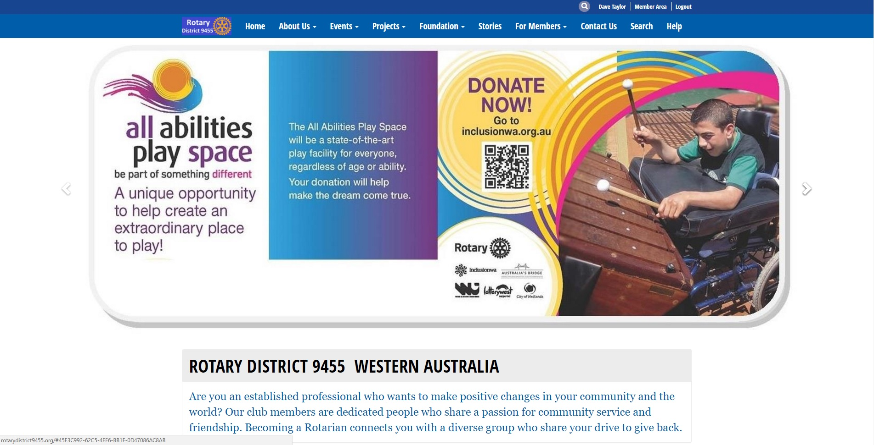

Slide 13
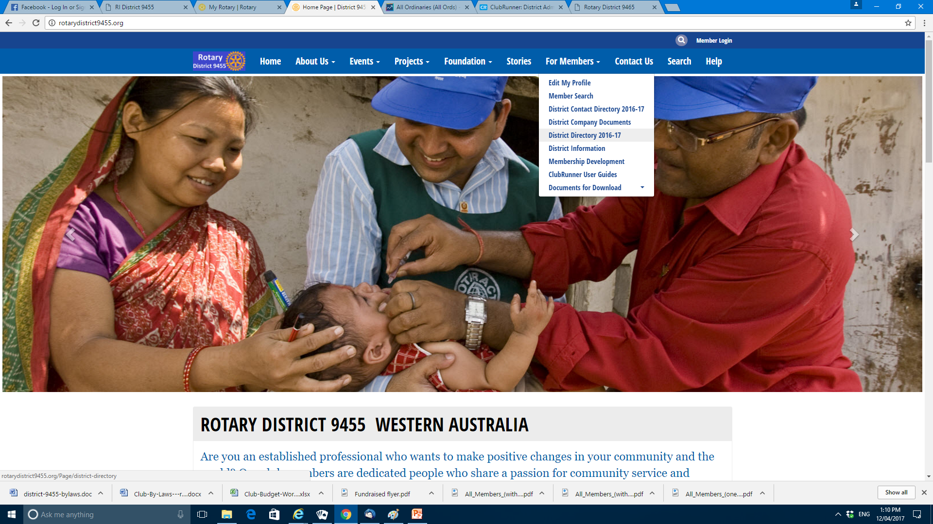

Slide 14
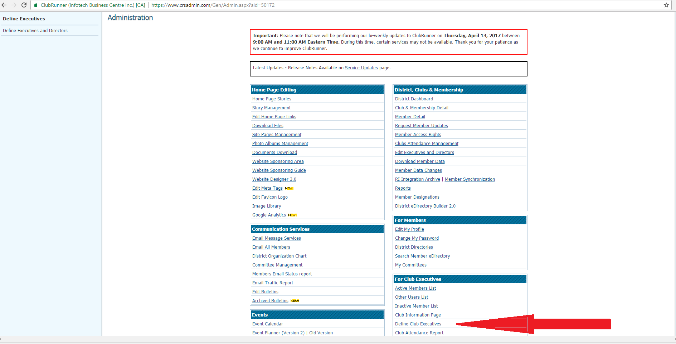

Slide 15
Objectives
3. Identify challenges and solve problems that your club may face.

Slide 16
Using the RI Website
Rotary Club Central

Slide 17
RI Club Administration Software
Track Goals Club Central.
Resources

Slide 18
Reports
Semiannual report*
Membership Data Form*
Rotarian Relocation Form
Changes to club data*
Official Directory Data Form*
*Can be reported through Member Access.

Slide 19
Resources
Club constitution and bylaws
Manual of Procedure
RI Catalog
Rotary Down Under
Club Secretary’s Manual

Slide 20
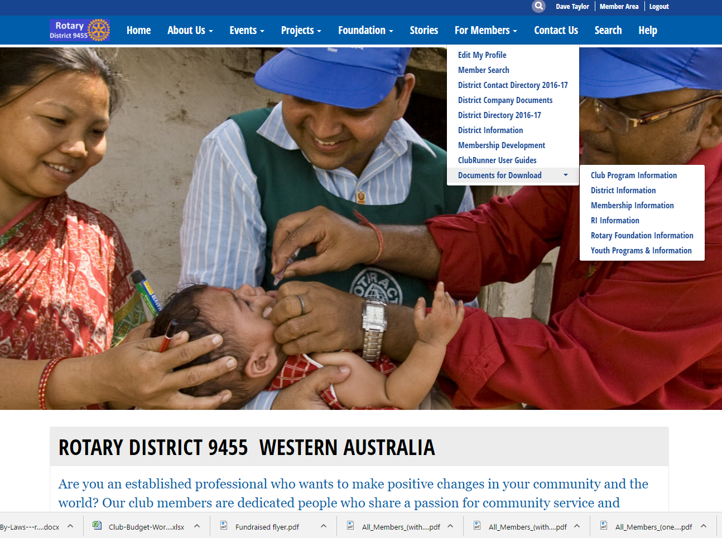

Slide 21
Club Officer Functions
With Rotary Club Central, club presidents and secretaries can
  View and change club membership data.
  Pay club dues.
  Search club and district data.
  Update club data.
  View reports of Rotary Foundation contributions.

Slide 22
ROTARY CLUB CENTRAL
Club presidents elect & club officers can set goals 5 months prior to taking office.
They have access from 1st February
(if they are registered for Member Access)
All goals & achievements fall in 3 broad categories
Your Club, Service, and Foundation Giving.

Slide 23
ROTARY CLUB CENTRAL
Below the Trends section in each category, are
"Goals and Progress.“
Next to each goal, you can either EDIT or VIEW.
Club leaders including:
Club President
Club Secretary
Club Treasurer
Club Foundation chair and
Membership chair
can EDIT goals and achievements
All club members can VIEW club goals and achievements.

Slide 24
Treasurer
Construct a Budget
Calculate the Club Dues
Pay District, RI & RDU Dues
Have Accounts Audited
Send a copy of Audit to District by 31st Oct
Charitable Collection Licence

Slide 25
District Website
After 30th June: Streamscape site
http://rotarydistrict9455.org.au/
I will delete All District info from that site on 29th June.
From 1st July: The ClubRunner Site
http://rotarydistrict9455.org/

Slide 26
REMEMBER: District Exec Emails
After 1st July 2017:
DG…….dg@rotarydistrict9455.org
DGE….dge@rotarydistrict9455.org
DGN….dgn@rotarydistrict9455.org
District Secretary:
secretary@rotarydistrict9455.org
THAT IS no “au”

