Slide 1
3.
DEVELOP
NEW CLUBS
GROW ROTARY
2.
RETAIN
MEMBERS
1.
ATTRACT
MEMBERS
NEW CLUB CREATION
Date
Audience
Notes:
There are really only three ways to grow Rotary:
Add members to your existing clubs – unless you are an already thriving and vibrant club, this will take a change in club culture, which means you may have to change peoples’ behaviors and habits which can be difficult.
Retain members in existing clubs – we know this may also take a change in culture and will require listening to your members and not being afraid to try. This too can also be difficult depending on your current club makeup.
Start new clubs – members then accept a culture as they develop it, which is much easier.

Slide 2
We are not poaching!
Myth debunked!
An analysis of all new clubs formed in the last five years found that 88% of charter members were actually new to Rotary!
88%
of Charter Members are new to Rotary
Brian King, RI Director of
Membership Development

Slide 3





CLUB FLEXIBILITY –
TRY SOMETHING NEW!
TIME & PLACE
FORMAT
DELIVERY
CLUB MODELS
MEMBERSHIP TYPES
Notes:
To have impact, you can change your meetings’:
Time Was: Monday – Friday; at Breakfast or Lunch
Now: Tuesday Night & Saturday Mornings
Place Was: Nearby where members lived or Worked/Country Clubs & Hotels
Now: Corporate Clubs meet at work; Young Professionals meeting at Bars; and, places of worship – Vets traveled over 1 ½ hours to go
Format Was: 4 Business Meetings a month
Now: 2 Business Meetings with a social or service project
Example: Maidenhead Bridge
Delivery Was: In-person
Now: Hybrid & Virtual
Example: Voice of Siri

Slide 4
Rotary Club
Rotaract Club
Satellite Club
ROTARY
CLUB
TYPES
Notes:
All Rotary and Rotaract clubs share similar values and a passion for service, but each offers a unique experience. When you start a club, you’ll need to choose a club type, a meeting format, and a club model. Look at the needs of your community and the club’s prospective members to decide which kind of club would be best.
Rotary International captures three different types of clubs: Rotary, Rotaract, and satellite.
Please keep in mind, a satellite club is not a fully chartered club – they’re a formally recognized group within a Rotary club.

Slide 5
DIFFERENT
CLUB MODELS
to meet member needs
NEW CLUB
DEVELOPMENT
Notes:
There is so much potential for new club development. Often, prospective members’ and even current members’ needs are not being met by existing clubs in their area. A new club offers a home to those who want to make the Rotary experience their own!

Slide 6
Traditional
Passport
Corporate
Cause-based
Alumni-based
Interest-based
International
ROTARY
CLUB
MODELS
Notes:
Next, determine the approach or elements your club will offer. You can choose one of these models or even design your own!
These are just the models that we’re aware of. The sky is the limit!

Slide 7

PASSPORT
Difference: Engagement with other clubs’ meetings, projects & fundraisers
Strengths: Flexibility, variety, affordability & building connections across the district
For: Frequent travelers & those who enjoy a variety of club experiences
Notes:
Passport Clubs are usually the first type of new club a district starts. Why? Because it is easy to find members for it, as you can start by pulling names of past Rotarians off of DAKDB or ClubRunner. Many individuals have left simply because the meetings were happening at an inconvenient time for them. Passport clubs usually meet at nights and weekends, as opposed to the workday, so Rotary can work for more individuals.

Slide 8

CORPORATE
Difference: Most members work for same employer
For: Employees of an organization who want to give back to their community
Limitations:
  Consider company’s in-person meeting rules
  Club name cannot include company’s name
Notes:
Sometimes people do not want to come early to work or stay late afterwork, so you may want to consider a lunch meeting, since the members are already there.
Some offices, especially banks, do not want their employees having meeting at the office during non-office-hours/when the office is not typically open.
In speaking recently with the Morrisville Yardley Area Rotary Club, they let me know that they are going to start a Corporate Club at the headquarters of Toll Brothers, a national homebuilder. This is a great idea – this allows members to network with others in other departments that they would not have otherwise been able to do so.

Slide 9

CAUSE-BASED
Difference: Focuses on a particular cause/issue
For: People who want to connect with others while focusing on a particular issue
Activities: Service projects & speakers are related to cause
Fueled: By members’ passions & community’s needs
Notes:
This is my favorite type of club because you can add it to an existing club or a new club and people passionate about a cause are highly motivated to make things happen. Also, a cause makes people stay members!
The most common are:
- Eco Clubs
- Veterans Clubs
- End Human Trafficking Clubs
It is about the service. Not required to be a member of the group being served. Inclusive in terms of membership. Only Exclusive in terms of service. You do not have to be a vet to be in the veterans club – you just have to want to serve vets and/or their families.

Slide 10

ALUMNI-BASED
For:
- Former Rotary Global Friendship Exchange Participants, Peace Fellows, Rotaractors, Rotex & Rotary Program Participants
- Rotary Youth Leadership Awards
- Rotary Youth Exchange
- Rotary Scholars
- Rotary Community Corps
Notes:
Global Horizons Fellows NOT allowed

Slide 11

FORMING AN ALUMNI CLUB
Rotary eClub of Global Travelers
Notes:
Rotary Program Participants
- Rotary Youth Leadership Awards
- Rotary Youth Exchange
- Rotary Scholars
- Rotary Community Corps

Slide 12

INTEREST-BASED
Difference: Focuses on a particular interest or hobby
For: Those who want to enjoy Rotary in a specific way or focus on shared interest/activity
Activities: Projects aligned with interest
Fueled: By members’ passions
Notes:
An interest club is like a cause-based club; but, instead of focusing on a cause, they focus on an interest or hobby. existing club can adopt this model
The sky is the limit!
My DG Classmate in Australia is starting a club focused on Kola Bears.

Slide 13
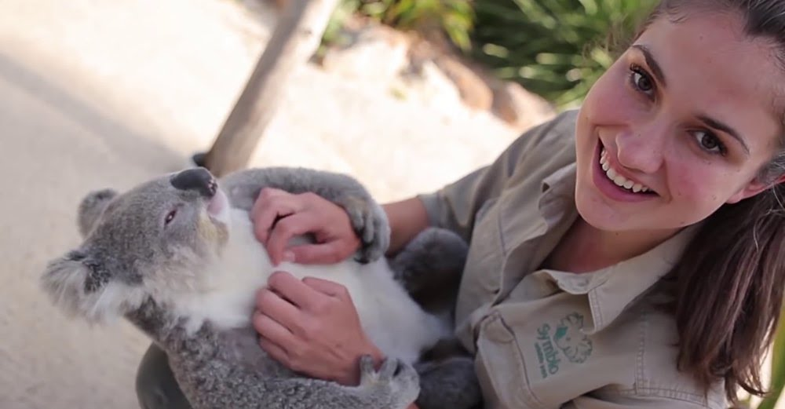
FORMING AN INTEREST BASED CLUB
Australia - Rotary Club
of Koala Lovers
Notes:
Interest based clubs. These already exist in the Rotary world!
An interest club is like a cause-based club; but, instead of focusing on a cause, they focus on an interest or hobby. existing club can adopt this model
The sky is the limit!
My DG Classmate in Australia is starting a club focused on Kola Bears.
Okay, maybe we can’t compete with a Rotary club centered around Koala bears…

Slide 14

FORMING AN INTEREST BASED CLUB
DXXXX - Rotary Club
of NFL Team Fans
Food drives?
Vocational Training?
Environment?
Notes:
…but maybe Club of XXX Fans who support a clean environment and help with recycling after games, or they do a food drive at the games, or support vocational training initiatives.

Slide 15

INTERNATIONAL
For:
  - Expats & those who want international experiences
  - Those who speak a common language
Members: From all over the world/meet online
Focus: International service, activities & connection
Opportunity: Learn about other cultures
Notes:
The Chicago area has set up two Spanish speaking clubs.

Slide 16
LESSONS LEARNed
Examples of Clubs Started &
One Lesson Learned from each
Duluth & Twin Cities Eco Club
Rotary Club of Minnesota Veterans
Rotary Club to End Human Trafficking
Rotary Club of Network to Empower Women

Slide 17
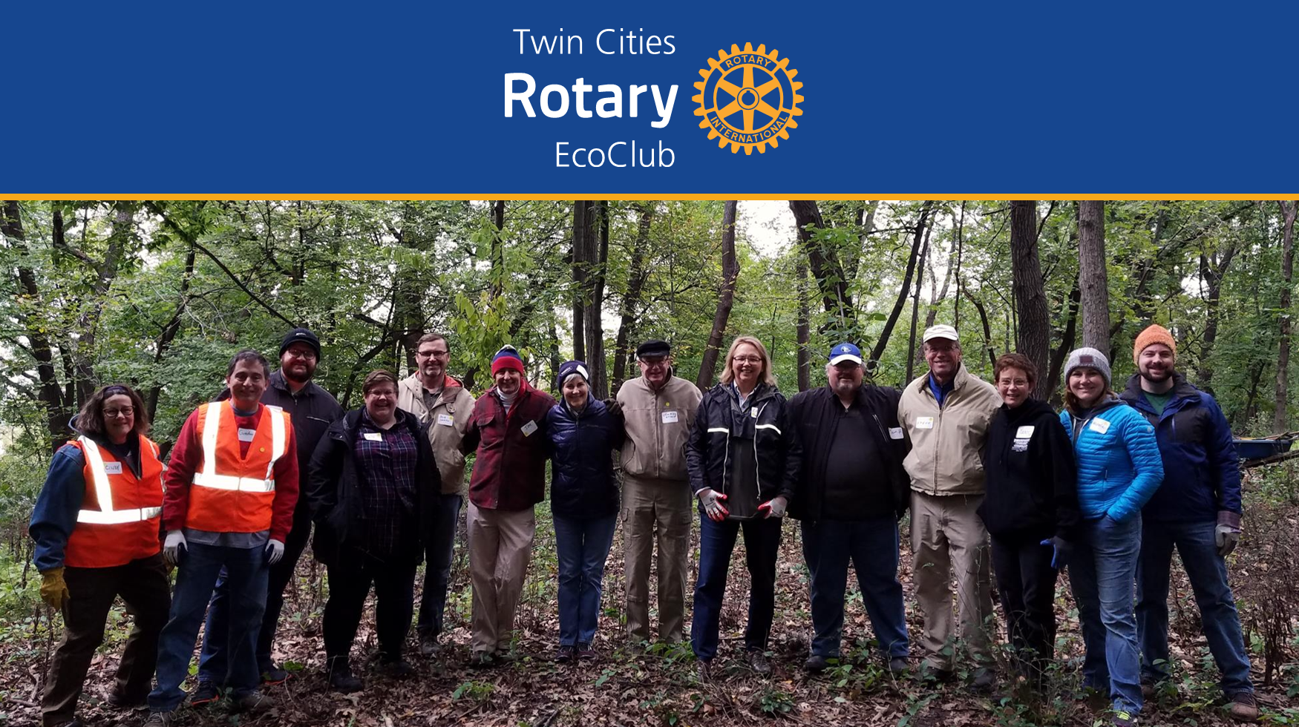
Notes:
The forming of this club taught us that it is important to move quickly when starting a club. If wait too long in between bringing in new members the former members may change their minds about joining before you reach the 20 members required to join a club. However, if you move quickly, the momentum will carry you forward and you potential members will stay excited and you won’t lose them along the way.

Slide 18
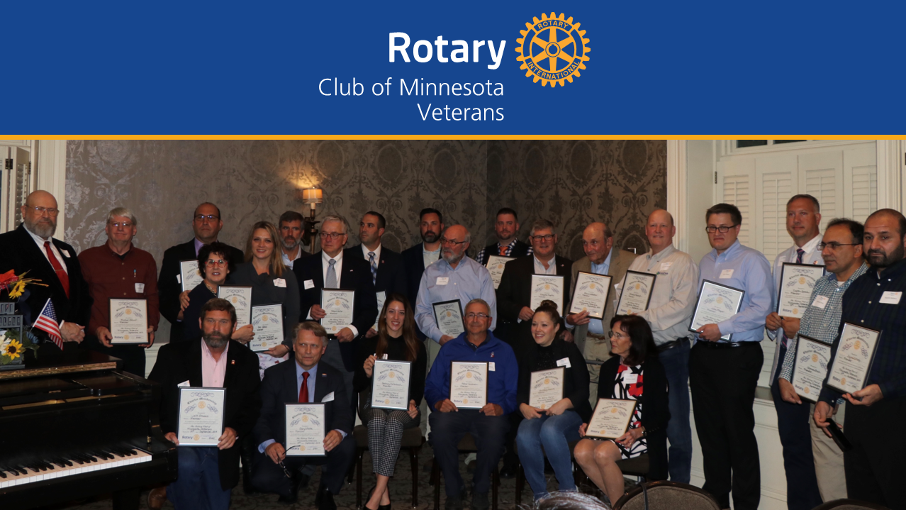
Notes:
This club taught us the most important lesson of all – it is not hard to start a new club. If I can start the world’s first ever Rotary Club for Veterans in a state that doesn’t have a single military base in and I am not even a veteran – than you can do it to.
JUST REMBEMBER – IF WE CAN DO IT, YOU CAN TOO!

Slide 19

Notes:
This club taught us that new clubs can really reach out into the community and bring in new members into Rotary. Shortly after this club started, at one of the club’s virtual meetings there was a new member from Turkey. Shortly after the meeting I received an email from Rotary International Immediate Past President Mark Maloney contacted Tom Gump to let him know that the new member was his sister and that he had been trying to get her to join Rotary for more than 40 years, we just didn’t have the right club for her until this one was started.

Slide 20
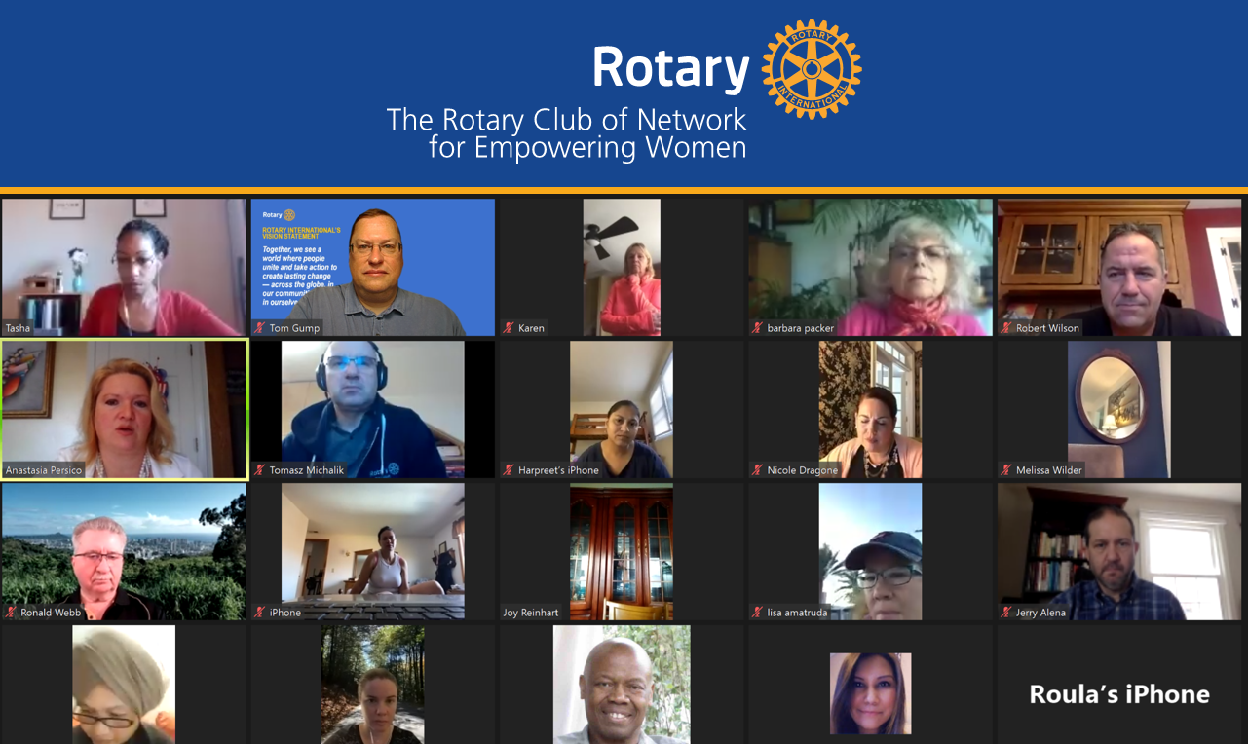
Notes:
Forming this club taught me that it is all about the member’s wishes and not ours. It is always best to let members decide about when they meet, where they meet and how they want to meet. We should not try to impose our traditional clubs rules upon them; but rather, we should accept their culture. After all, it is their club not ours!

Slide 21

FOR HELP CONTACT:
List your District New Club Champion contact info here
Event/Audience
New Club Creation
Date

