Slide 2
District Trainers 2022-23
Welcome!

Slide 3
Housekeeping Reminders
Facility locations
Timeline
Breaks

Slide 4
Course Overview
Purpose of this District Trainer Seminar:
Consistent training for District Trainers
- to ensure -
Consistent training for districts and clubs

Slide 5
Course Overview
How does this event support Rotary’s Action Plan?
IMPACT As People of Action we make decisions grounded in evidence
REACH As People of Action we are inclusive, engaging, compassionate, and ambitious on behalf of the world
ENGAGEMENT As People of Action we create meaningful relationships across decades and continents
ADAPT As People of Action we seek new perspectives and new ideas that can strengthen Rotary and create lasting change

Slide 6
Course Overview
Learning Objectives: Class participants will
Gain understanding of your role and typical Rotary training events
Learn to plan your curriculum & your training events
Prepare the training team

Slide 7
What to Expect
Our agenda
Facilitator role
Your role

Slide 8
Introductions – 1 minute!
Name, city, club
How many years in Rotary?
How many years as district trainer?
Why did you accept this assignment?
What was your most unusual vacation?

Slide 9
Part 1: Understand Your Role as District Trainer

Slide 10
Part 1: Understand Your Role
Learning objectives:
Understand the role and responsibilities of the district trainer
Identify the role and responsibilities of the district training committee

Slide 11
Part 1: Understand Your Role
District trainers manage training throughout the district.
Work closely with the governor or governor-elect to develop a training plan for the year, defining event goals, identifying speakers and facilitators.
District trainers chair the district training committee and assign responsibilities for planning and conducting training events to committee members.
Above all: District trainers build relationships.
Notes:
What duties does your district assign the district trainer?
Do you have a committee already or need to build one?
How has your district found speakers and facilitators in the past?
What part of your role are you most concerned about?

Slide 12
Part 1: Understand Your Role
Activity 1: Full-Group Discussion Delegating Tasks
Discuss how your district does/could define the big picture for training
Discuss training team makeup and responsibilities

Slide 13
Part 1: Understand Your Role
Activity 2: Breakouts Handling Challenges
♥ Making tech cooperate
♦ Dealing with “uncooperative” participants
♣ Handling presenter no-show
♠ Handling facility challenges

Slide 14
Part 1: Understand Your Role
Part 1 Wrap-up:
Key take-aways

Slide 15
Part 2: Understand Rotary Training Events

Slide 16
Part 2: Understand Training Events
Learning objectives:
Understand Rotary’s training cycle
Identify resources for developing a training program

Slide 17
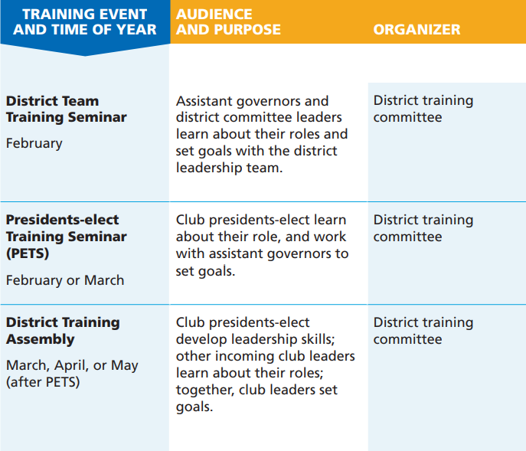
Part 2: Understand Training Events
Role-Based Training Events
Convened by the Governor-elect
Notes:
Rotary’s role-based training events are designed to prepare incoming officers for their year.

Slide 18
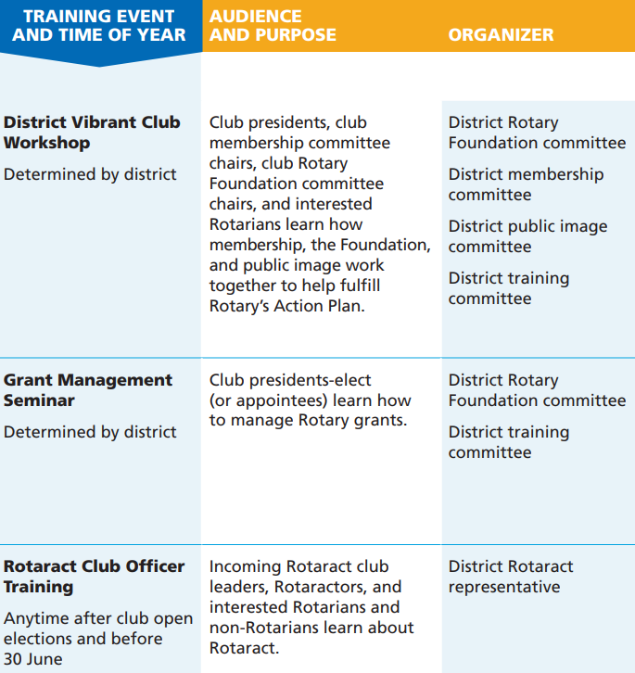
Part 2: Understand Training Events
Topic-Based Training Events
Convened by the Governor
Notes:
Rotary’s topic-based training events provide information about Rotary and The Rotary Foundation for all members.

Slide 19
Part 2: Understand Training Events
Activity 1: Full Group Discussion
Tips for training Rotary leaders
Promoting training events
Using Rotary Learning Center
Other learning resources
Motivating attendees intra-event
Making things fun
Encouraging follow-through post-event

Slide 20
Part 2: Understand Training Events
Activity 2: Breakouts District Training Events
♥ What are different ways to organize training events, and who attends?
♦ What timing (month, day of week, time of day) works?
♣ Successes and challenges in using online training
♠ Promotion and attendance

Slide 21
Part 2: Understand Training Events
Part 2 Wrap-up:
Key take-aways

Slide 22
Mid-day Checkpoint

Slide 23
Part 3: Plan Your Curriculum

Slide 24
Part 3: Plan Your Curriculum
Learning objectives:
Assess participants’ needs to help plan a curriculum
Use a variety of training approaches

Slide 25
Part 3: Plan Your Curriculum
Activity 1: Full group discussion Assessing participant needs
Use past evaluations, questionnaires, online surveys, and informal feedback.
Focus on recurring themes, concerns, or requests for specific content
What else?

Slide 26
Part 3: Plan Your Curriculum
Activity 3: Breakout
Changing Existing Event’s Agenda
Alter the agenda for a grant management event to suit your attendee’s current needs

Slide 27
Part 3: Plan Your Curriculum
Activity 3: Breakout Discussion
Changing Existing Event’s Agenda

Slide 28
Part 3: Plan Your Curriculum
Leader’s Guide Full-Group Discussion
Have you used Rotary leader’s guides (now in the Learning Center?
What have you learned when tailoring these guides to your audience?

Slide 29
Part 3: Plan Your Curriculum
Part 3 Wrap-up:
Key take-aways

Slide 30
Part 4: Plan Your Training Event

Slide 31
Part 4: Plan Your Training Event
Learning objectives:
Identify important qualities in an event venue
Develop an event budget
Recognize when to use virtual options
Notes:
Because club and district leaders change annually, Rotary offers in-person training events to prepare incoming leaders for their new roles.

Slide 32
Part 4: Plan Your Event
Event Planning Key Messages:
Planning should start 6-12 months before the training event, depending on its size.
Event planning tools and templates can be modified for various events.
Event budgeting tools and template can be modified for various events.
Notes:
Because club and district leaders change annually, Rotary offers in-person training events to prepare incoming leaders for their new roles.

Slide 33
Part 4: Plan Your Event
Event Planning: warm-up questions
What is the most challenging part of planning a training event?
How far in advance do you start planning your training events?
What factors do you consider when selecting a venue?
What are some possible training topics that you could cover in a virtual format?

Slide 34
Part 4: Plan Your Event
Training Event Case Study Exercise:
10 minutes to prep
15 minutes to share

Slide 35
Case #1
You want to demonstrate using My Rotary and Rotary Club Central but providing Wi-Fi in all meeting rooms will be cost prohibitive.
What training methods could you consider to cover this topic?
What resources could you share before or after the event to help participants with this topic?
Case #2
At your district training assembly, participants will attend role-based session in the morning. Then all participants will come together in a for a group closing session.
What pre-event assignments will ensure participants are familiar with the topics you will cover?
What specialized post-event training could you provide to each group?

Slide 36
Part 4: Plan Your Event
Part 4 Wrap-up:
Resources
Key take-aways

Slide 37
Part 5: Prepare the Trainers

Slide 38
Part 5: Prepare the Trainers
Learning objectives:
Identify ways to select and prepare facilitators
Discuss best practices for holding train the trainer events
Notes:
Because club and district leaders change annually, Rotary offers in-person training events to prepare incoming leaders for their new roles.

Slide 39
Part 5: Prepare the Trainers
Key factors in selecting facilitators:
Training experience and past evaluations
Specialized Rotary knowledge for information-heavy sessions
Professional experience related to the session topics such as public relations or club budgeting
Notes:
Because club and district leaders change annually, Rotary offers in-person training events to prepare incoming leaders for their new roles.

Slide 40
Part 5: Prepare the Trainers
Trainer Preparation warm-up questions
How do you determine the number of facilitators you’ll need for an event?
What qualities do you look for in your facilitators?
How do you prepare your facilitators? Do you conduct a train the trainer event?

Slide 41
Part 5: Prepare the Trainers
Prepare the Trainers Exercise:
5 minutes to prep
10 minutes to share

Slide 42
Case Study
Think about trainers / facilitators from your past (work, school, other) who have been effective and engaging.
Think about trainers from your past who were not effective.
Document the top five traits of effective and ineffective facilitators.
How can you prepare your district facilitators to foster effective traits and prevent ineffective ones ?

Slide 43
Part 5: Prepare the Trainers
Part 5 Wrap-up:
Resources
Key take-aways

Slide 44
EVALUATIONS!

