Slide 1
News Media
Rotary Public Image Webinar Series
Districts 6450 and 6440

Slide 2
Richard Brill
District 6440 Public Image Chair
richard.brill.rotary@gmail.com

Slide 3
Social Media Examples
Facebook, Twitter/X, Instagram, LinkedIn
Important and Great for All Rotary Clubs
Reaches Your Followers and Friends
Plus More With Shares and Tags

Slide 4
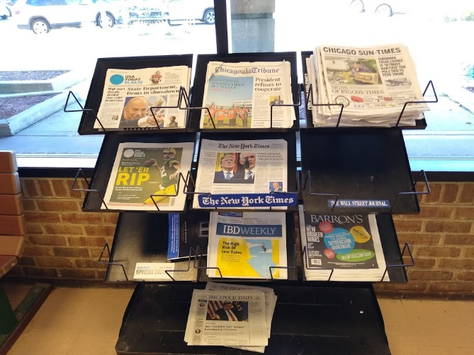
News Media Examples
Suburban Weekly Newspapers
Suburban Daily Newspapers
Online News Sources
Suburban Business Magazines
Downtown News Media ?
Reaches Thousands to
Hundreds of Thousands of Neighbors

Slide 5
News Media Roles
Club Public Image Chair
Enter Name on ClubRunner Executives and Directors Tab
Club Public Image Team
Expertise Valuable if Available

Slide 6
News Media Steps -- 1
Create a Plan

Slide 7
News Media Steps – 1a
Recognize Event or Program with News Potential
Major Fundraiser
Valuable Service Project
Installation of Officers
Contributions to Local Organizations
College Scholarships
Vocational Scholarships

Slide 8
News Media Steps – 1a
Recognize Event or Program with News Potential
Food Drives
Random Acts of Kindness Week
RYLA
Great Speaker at Breakfast or Lunch
District Project Localized

Slide 9
News Media Steps -- 2
Gather Information
Gather Photos or Poster or Other Visuals
Review Any Template News Release from District

Slide 10
News Media Steps -- 3
Write News Release/Social Media Post
Headline
Dateline
Who, What, When, Where, Why
First Paragraph Critical
Media Cuts from End
No Rotary Abbreviations
Contact Information Vital
Include Way to Register or Get More Information
Keep to 1 or 2 Pages Maximum

Slide 11
News Media Steps – 3a

Slide 12
News Media Steps -- 4
Add Photo or Poster or Visual
Action, Movement, People, Local Setting
All Ages and Genders
Caption with Description and Key Names
Color
Maybe Video Clip
Use for Both News Media and Social Media

Slide 13
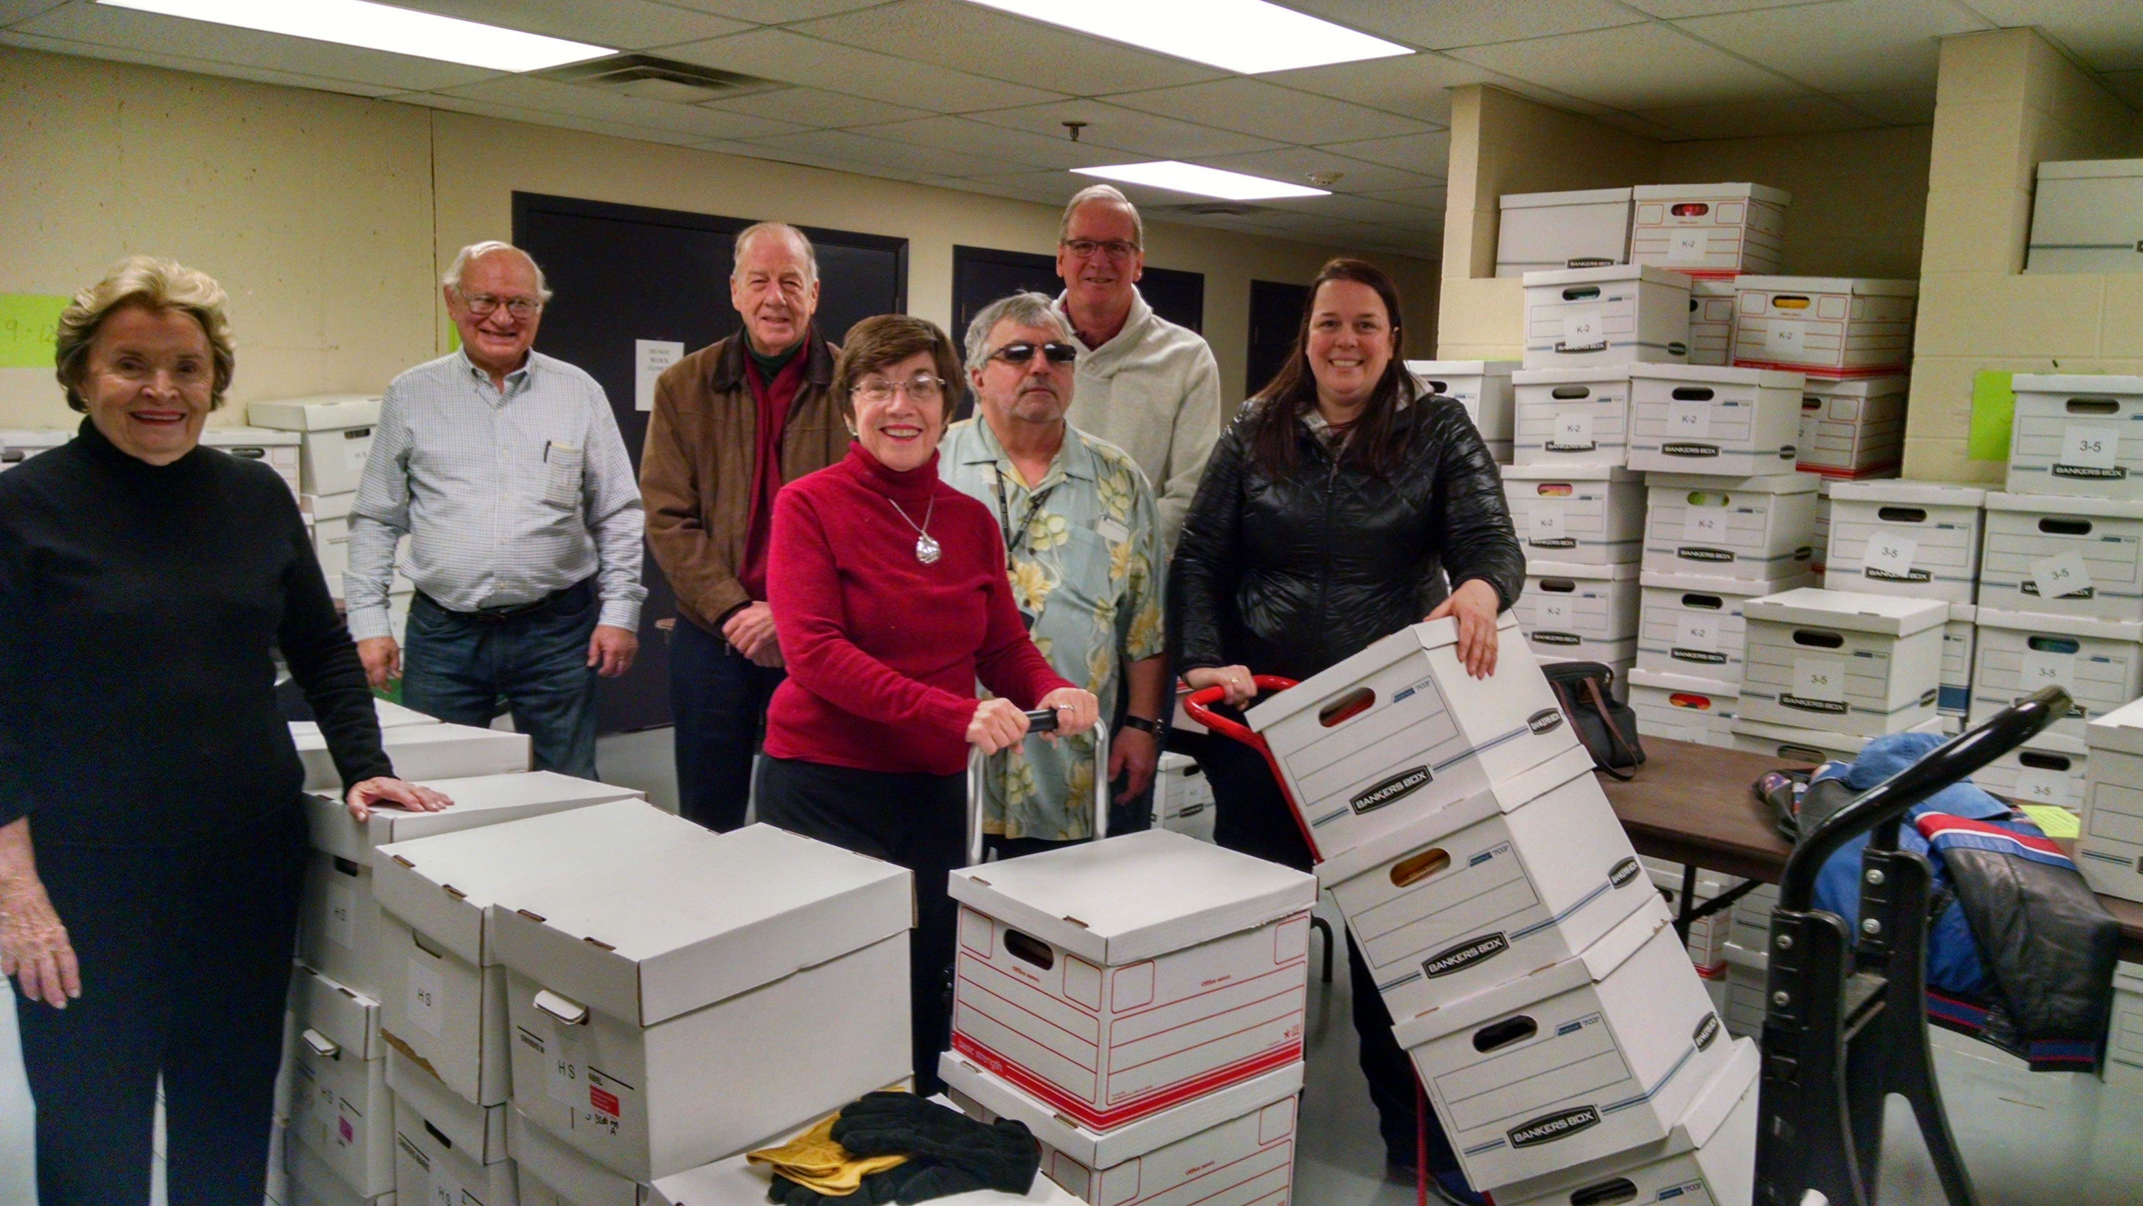
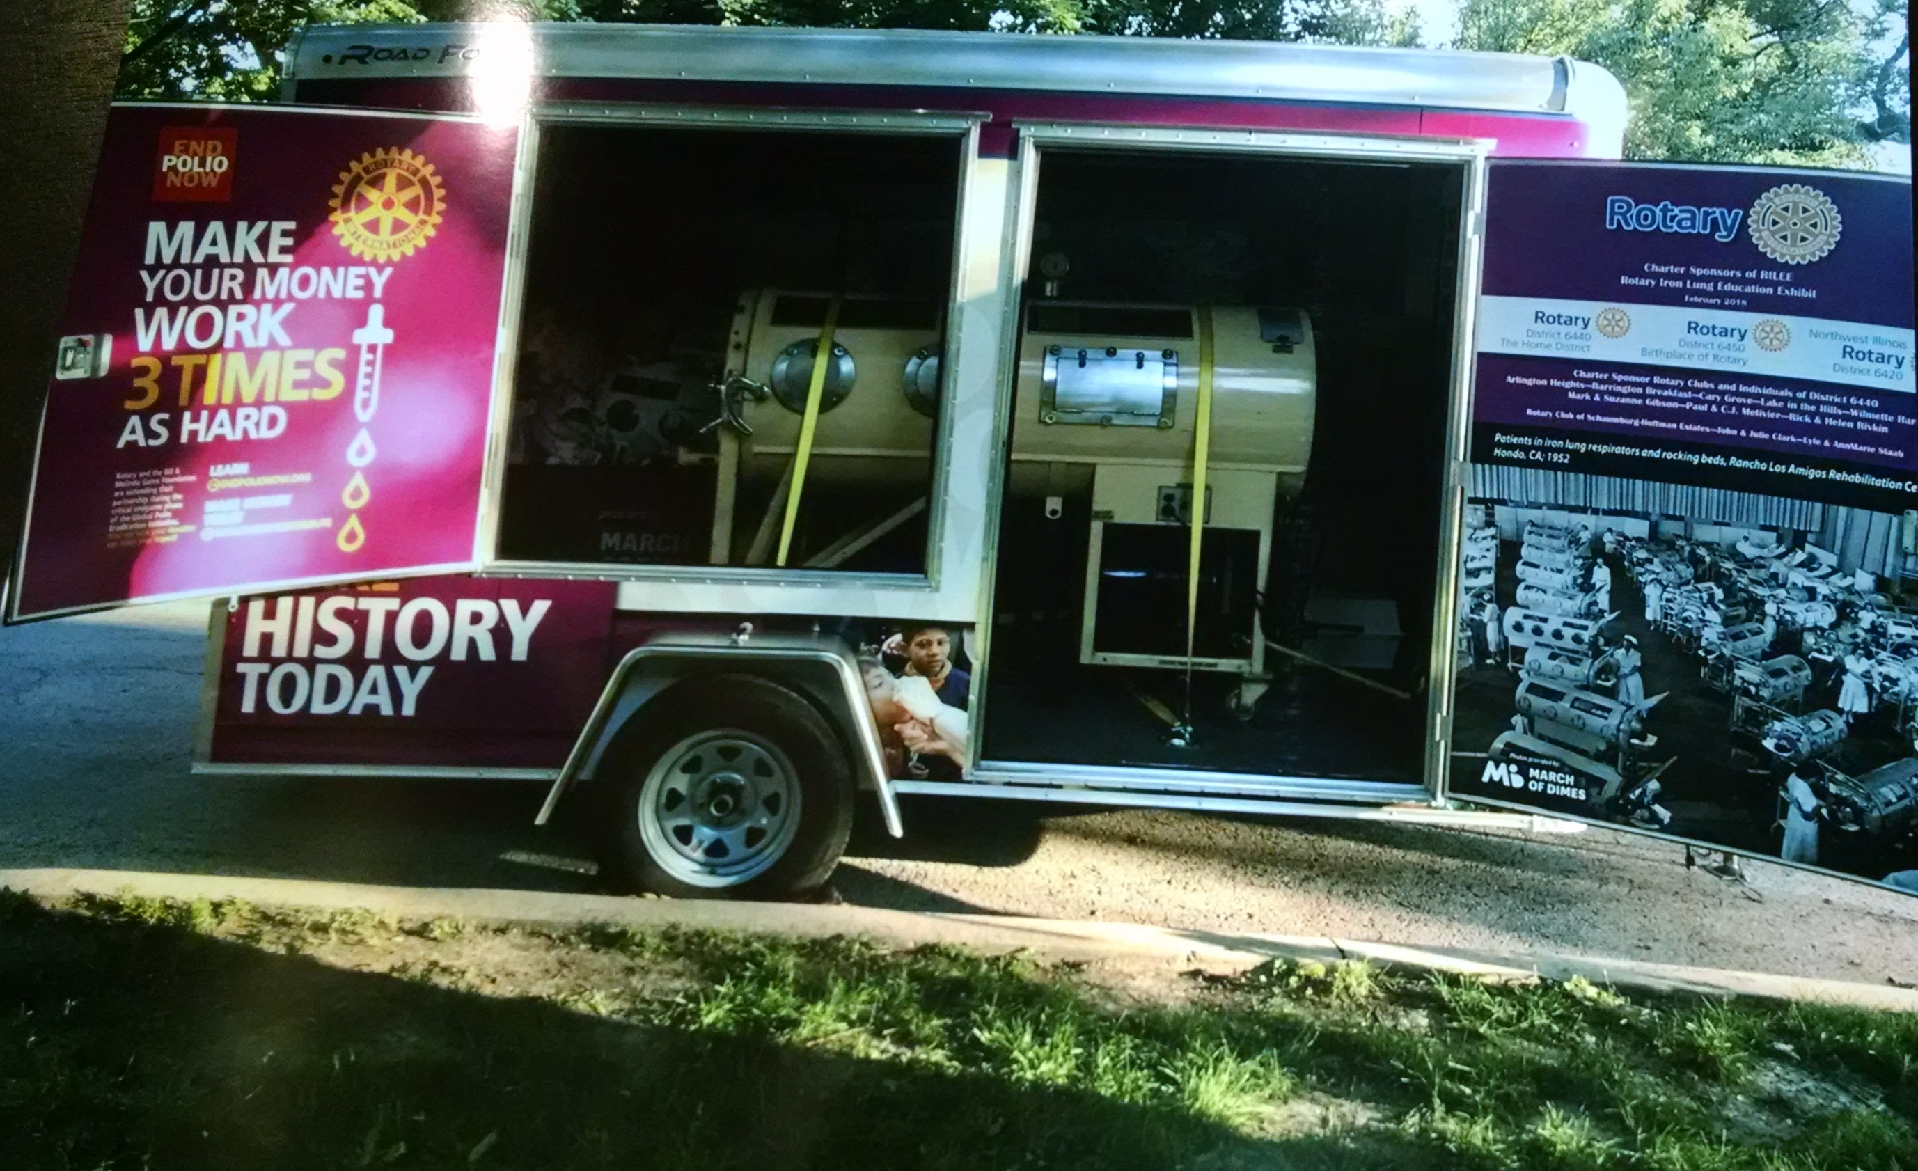
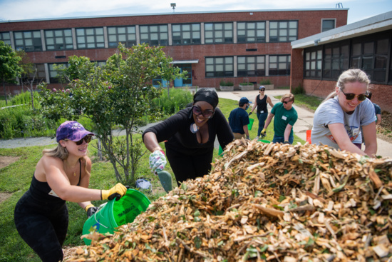
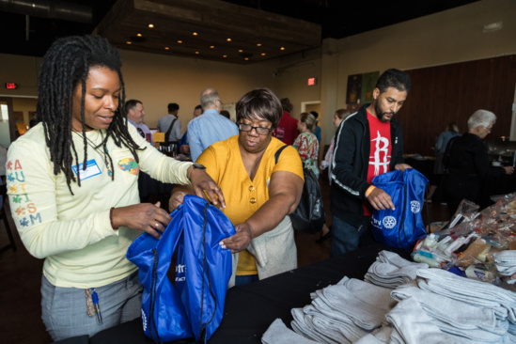
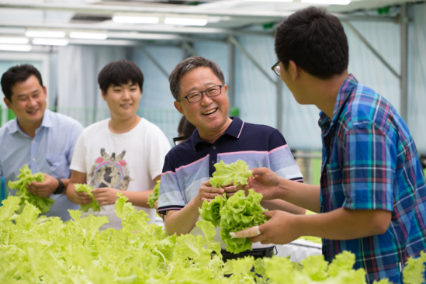
News Media Steps – 4a

Slide 14
News Media Steps -- 5
Find Local News Media
Internet Database like Mondo Times
Your Suburb’s Newspapers
Go to Walgreens, CVS, Jewel, etc. and Scan Newspaper Rack
Your Online News Sources
Your Local Networks including Patch and NextDoor

Slide 15
News Media Steps – 5a

Slide 16
News Media Steps -- 6
Open Each News Media Website
Find Editor Email or Send News Button – Sometimes at Bottom
Save Any Email Addresses in Your Media List
Copy News Release into Email or Boxes
Send Photo or Visual or Poster –in Body of Email or Browse Button
Monitor News Media for Any Articles or Briefs

Slide 17
News Media Steps – 6a

Slide 18
News Media Steps -- 7
Post News Release and Visual on Club Website and Newsletter
Remember to Post on Your Social Media Platforms

Slide 19
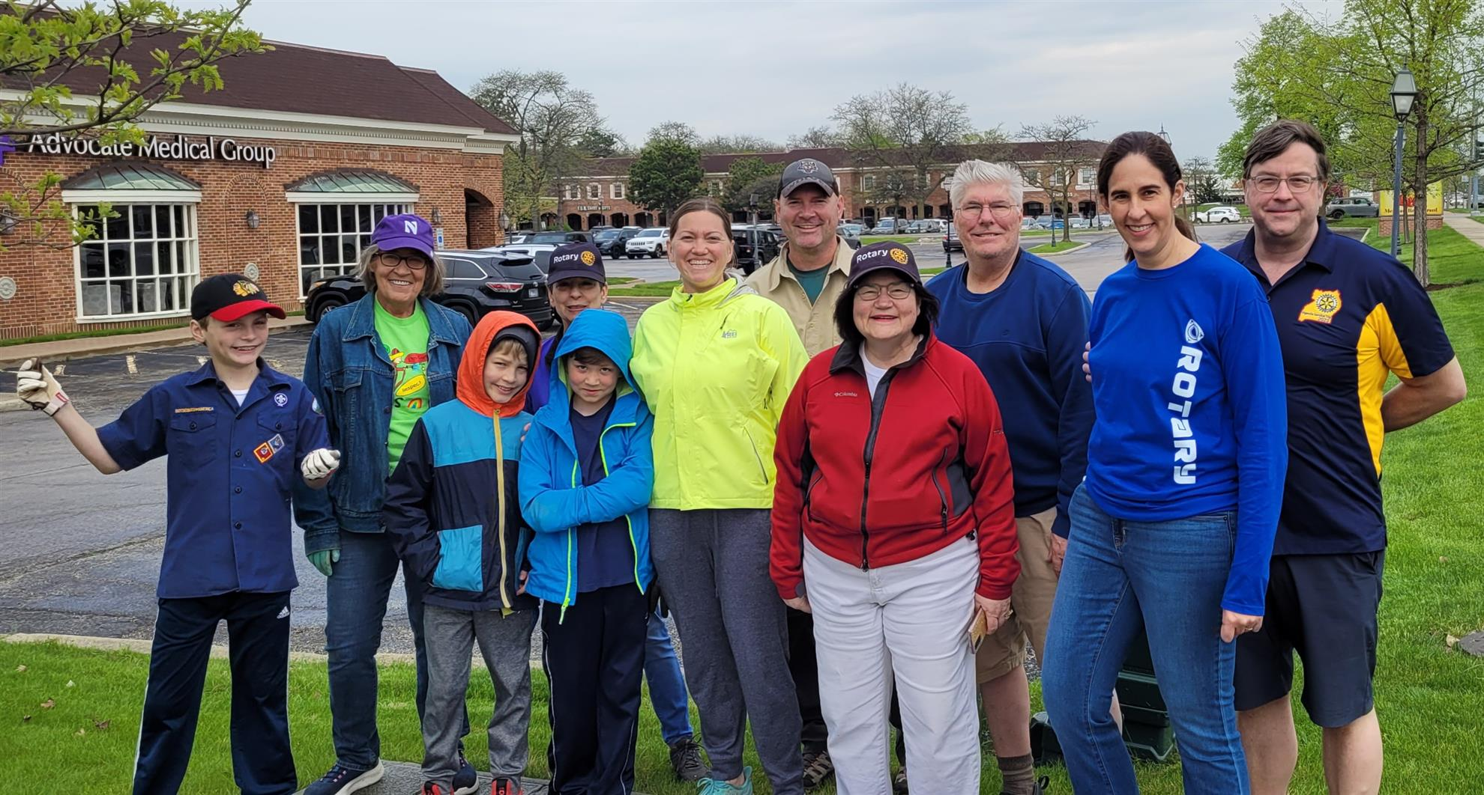
News Media Steps – 7a
Waukegan Road Cleanup
A little rain wasn't enough to keep a group of intrepid Rotarians, Scouts and friends from gathering trash along Waukegan Road as part of the club's Adopt-a-Highway project. All are welcome to join us by helping out with this semiannual program.

Slide 20
How News Media Benefits Your Club
Much Greater Public Awareness
Greater Support for Service Projects and Club Activities
Increase Member Participation
Attract More Members
Attract More Young, Female and Diverse Members
Raise More Money
Make Club Recognized Part of Your Community

Slide 21
Richard Brill
District 6440 Public Image Chair
richard.brill.rotary@gmail.com

