Slide 1
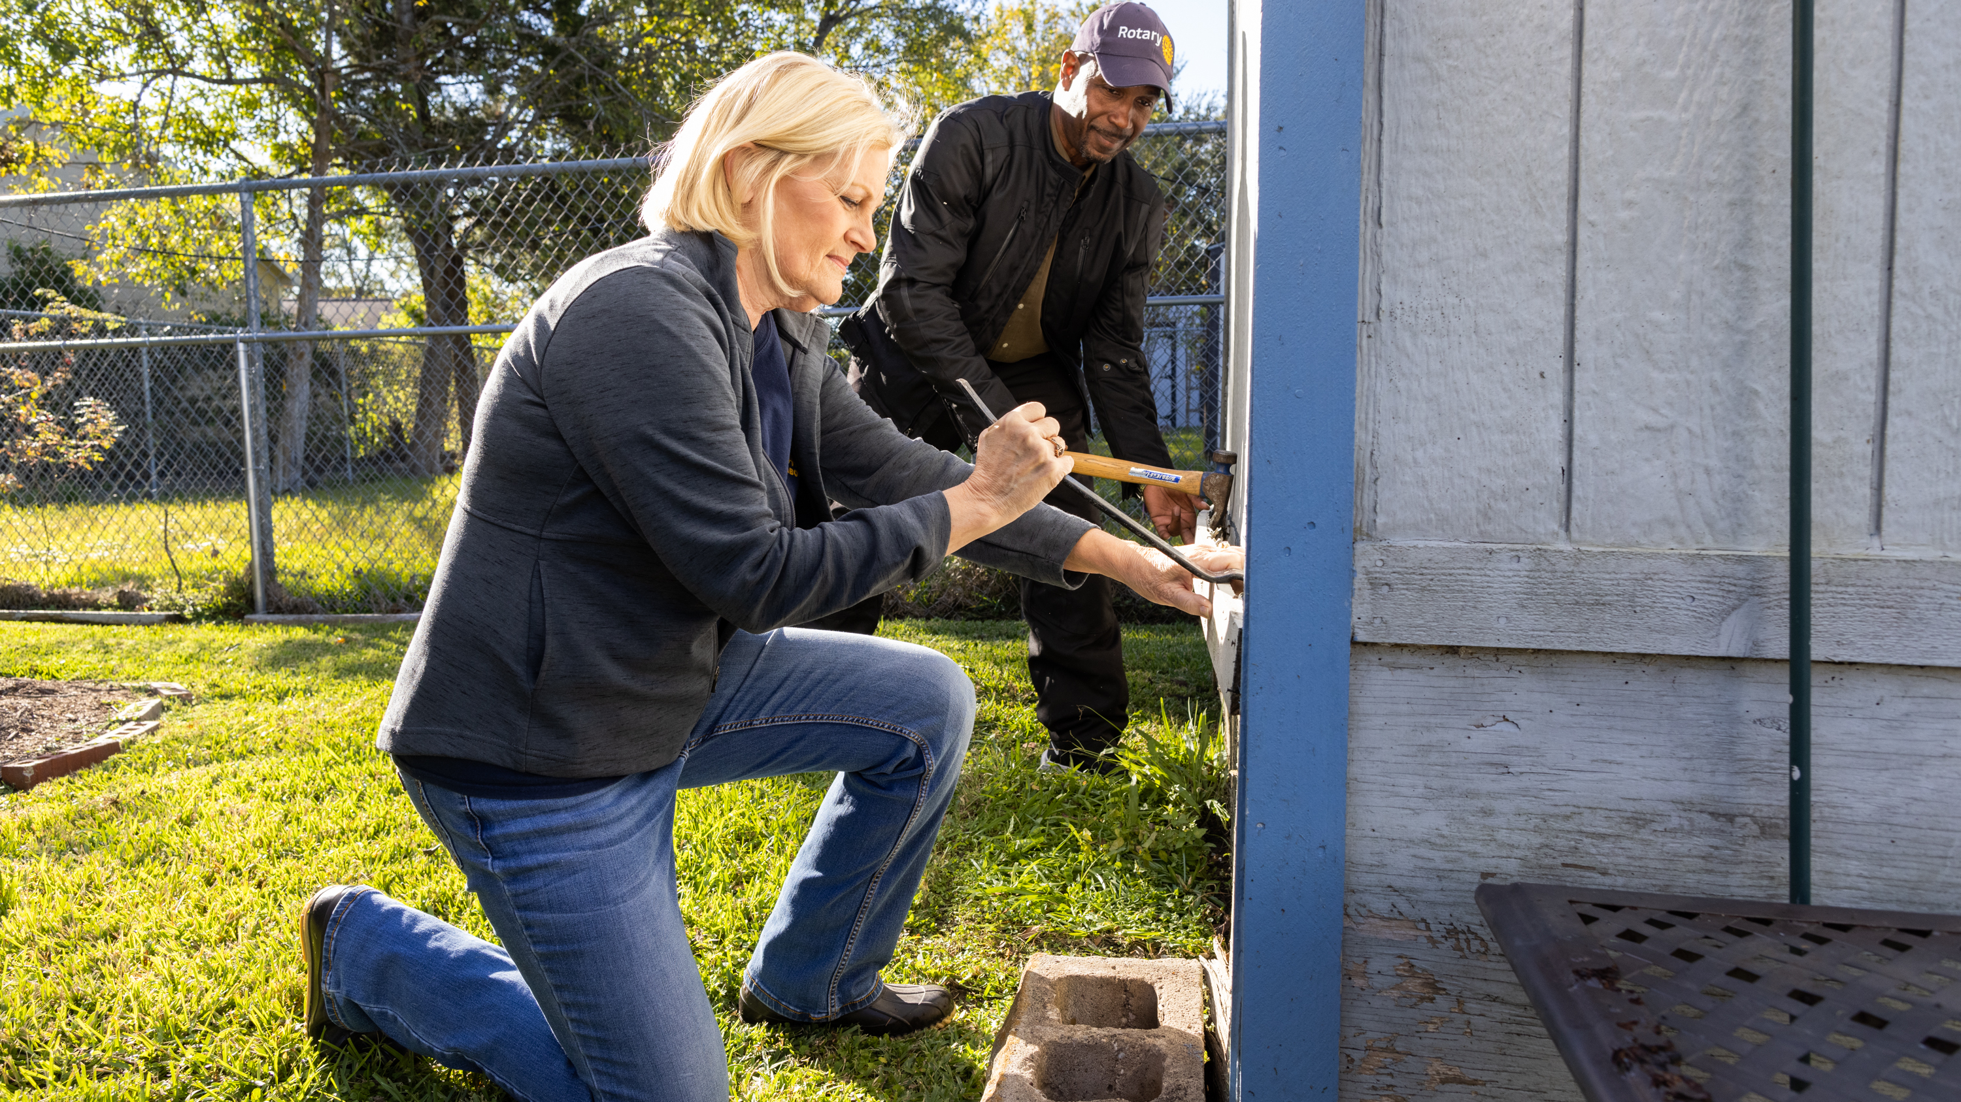
US Public service announcement campaign update
Notes:
Link to video

Slide 2
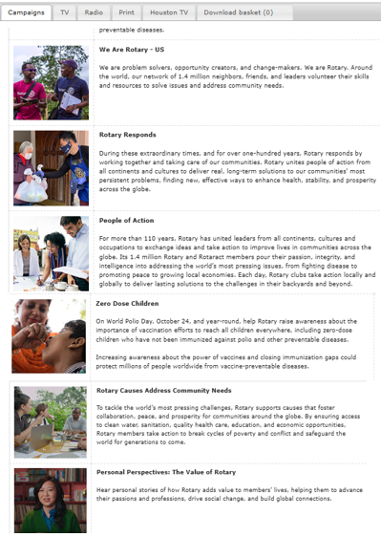
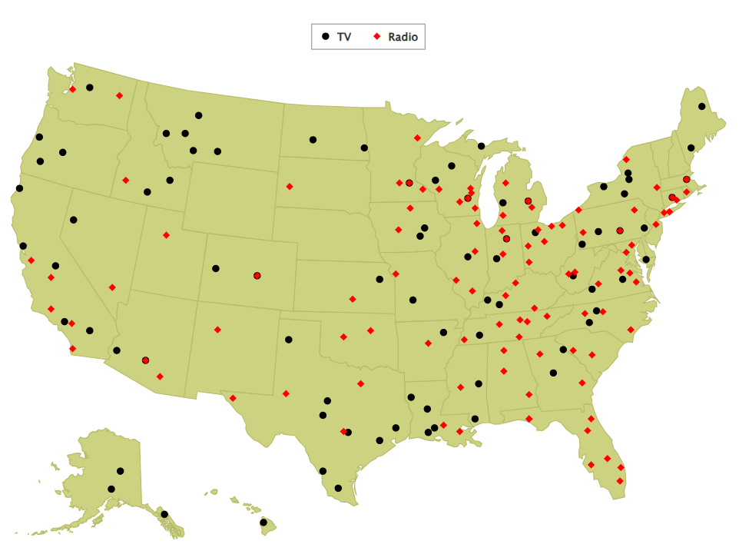
Us Psa Results
15 March 2020 – February 2026
Donated media value to-date
Over $49M

Slide 3
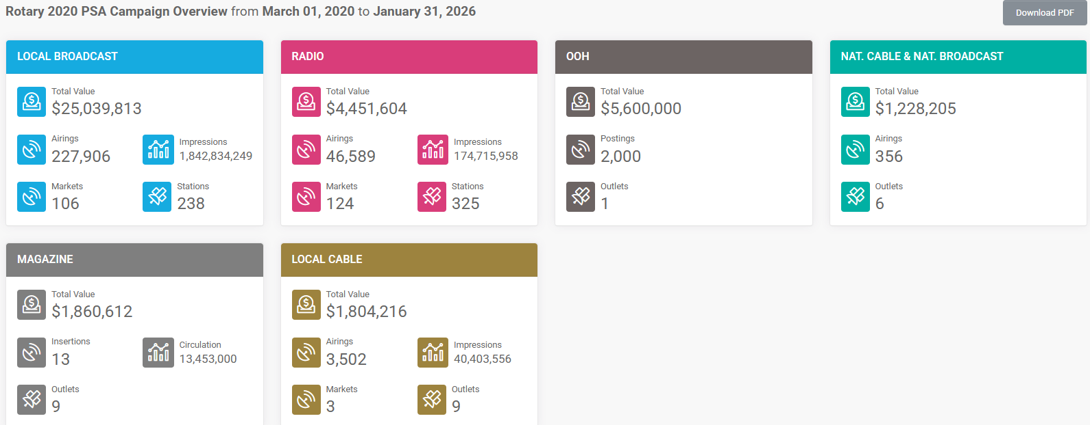
Psa campaign overview
March 2020 – February 2026
Donated Media Value to Date
$49,108,973.00
+ $48,593,310.00
(donated revenue gained)
$67:1
Media values can fluctuate based on market conditions, time of year, number of solicitations, and the specific media outlets involved.
This variability makes it difficult to forecast values consistently from month-to-month and year-to-year.

Slide 4
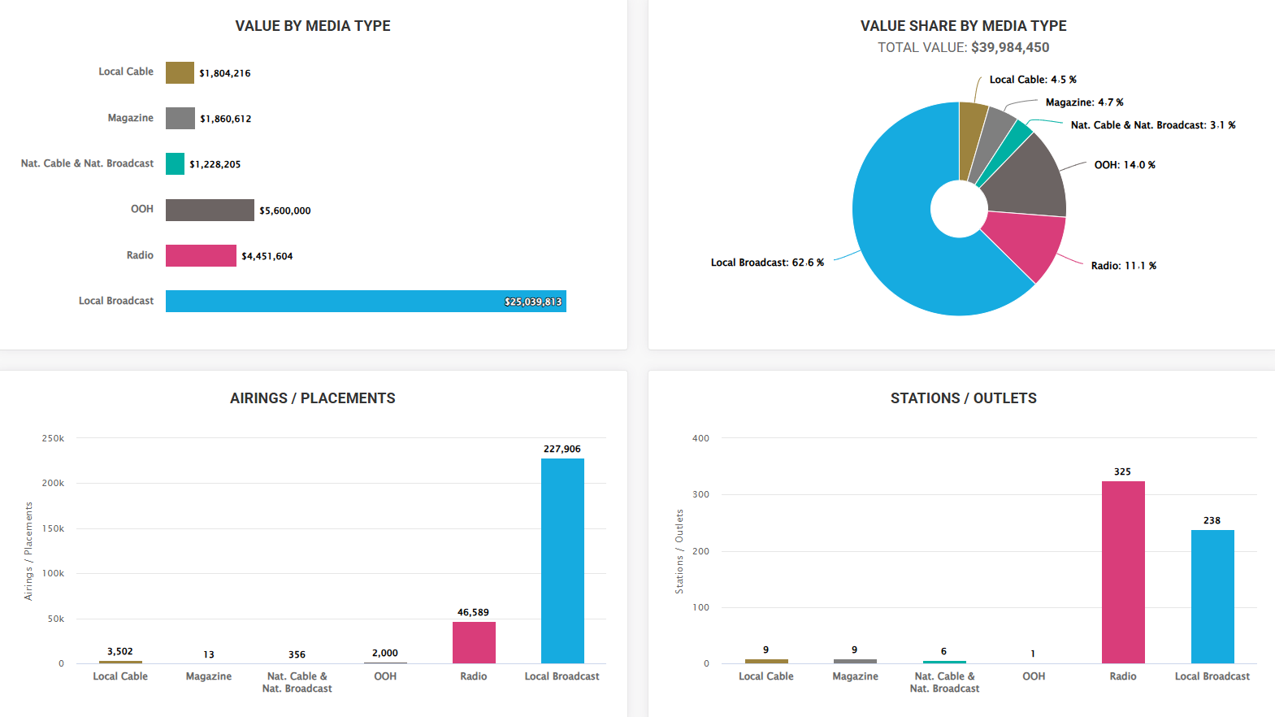
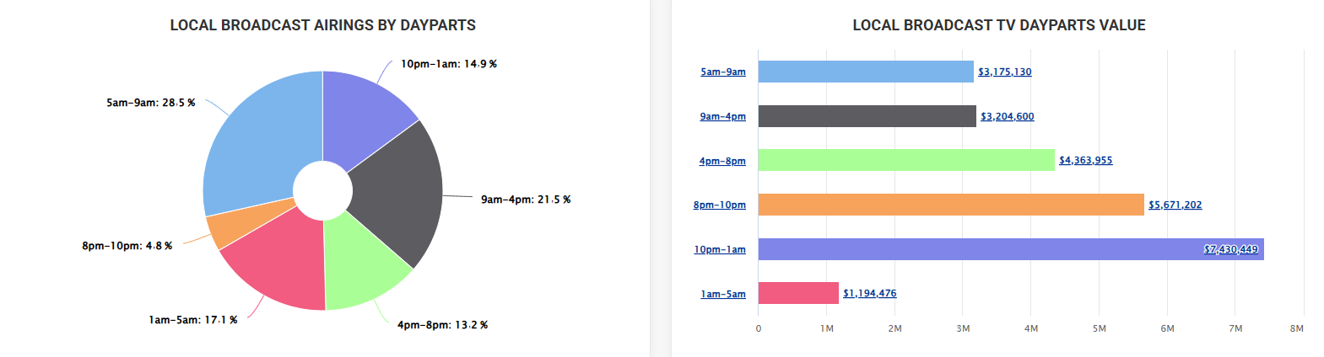
Psa campaign overview
March 2020 – February 2026
Local Broadcast | 2,304,963,016
Radio | 176,984,960
Magazine | 13,453,000
Local Cable | 40,419,413
TOTAL IMPRESSIONS | 2,535,820,389

Slide 5
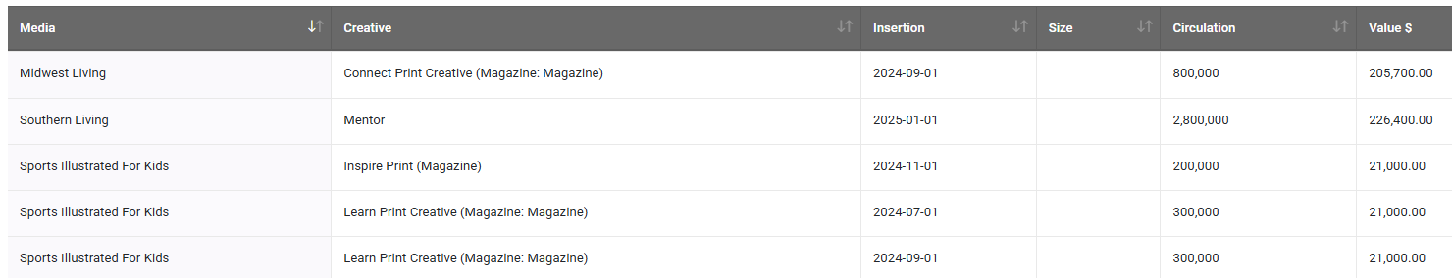




Magazine placements
July 2024 – February 2026

Slide 6

PSA 1 pager
Monthly reports
Sample outreach letter
Plowshare Download Center
Brand Center
Regional RPIC team, Rotary Marketing team
Resources
For your teams who want to engage with the PSA program

