Slide 1

District 9790 Assembly 2021 -22
International Service
May 23, 2021
Kerry Kirk
International Service Chair
Title Page Option

Slide 2
Agenda – 9790 International Service
00.04
New to International Service? Introductions
  Recap the basics – our Vision, our roles, our progress against plan 15m
New District Resource Network Demonstration - your input required 15m
Sustaining our current International Project Portfolio 10m
Identifying new project opportunities - The Global scenario 10m
Opportunities to serve – partner (mini shark tank) 30m
Going for a Global Grant 5m
Your next steps and Q&A 10m
00.05

Slide 3
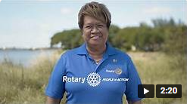
International Service putting Rotary’s vision* into practice
00.05
“Together, we see a world where people unite and take action to create lasting change – across the globe, in our communities, and in ourselves. ”
We are Rotary 2021 Video
Serve to change Lives
00:09

Slide 4
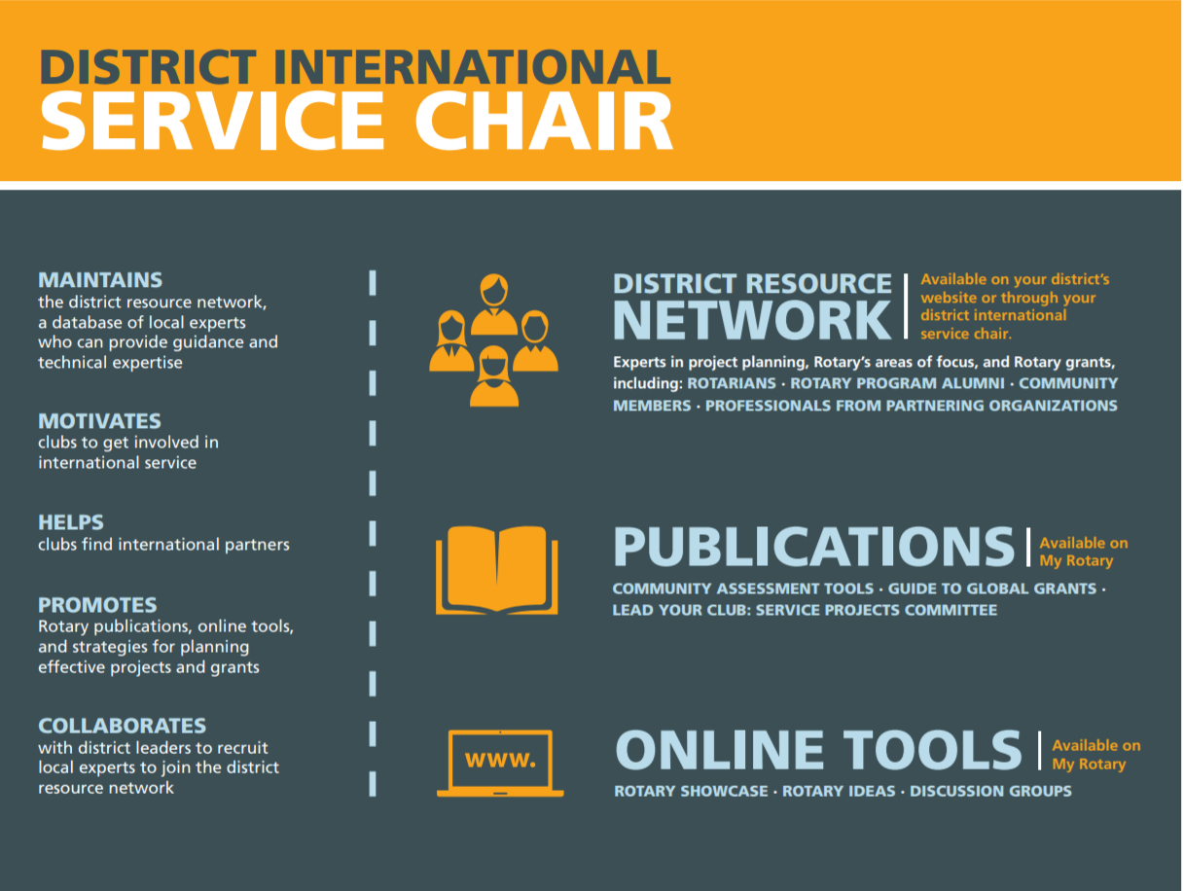
00.09
District International Service Chair DISC (my) ROLE
Kerry Kirk PP, Rotary Club of Sunbury, PHF
RAWCS International Project Manager (12-2020-21 Beds to Sri Lanka RAOAF) & 3 2019-20 local projects (scrub caps & Counselling qualifications)
Designer of the 9790 DRN system
MMgt (Tech) Melb, MAICD, MAIPM
Cyber Security & IT Project/Program Manager
Mother of 2 Jamieson (also a Rotarian) and Zac
Daughter of Henry (Dec bicycle mechanic) & Eileen (90 year old, Past Rotarian and Australian Unity Company Director)
00:11

Slide 5
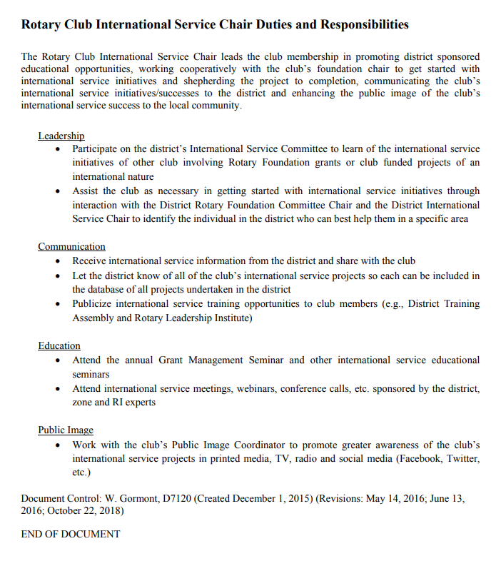
00.11
Introductions ISC Role (Yours)
00:13

Slide 6
9790 International – Progress against 3Y plan (2019-22)
00.13
Work
Collaboratively
Focus Connections
Rotary UN, &
Other 3rd party connections
Actions
Data collection, Build /publish
9790 District Resource Network
Sustainable
9790
Existing
Initiatives
Focus Existing Projects
Club giving budgets
Sustainability needs
Standards & Governance
Actions
Review Current Projects
- Intentions / Goals
- Resource needs
- Project Management
- Standards & Promotion
COVID-19
New 9790
International
Projects
Focus New initiatives
UN SDG’s
Wicked Problems
Actions
1 new project per AG Group
9790 Peace Fellowship
Ocean Project
Conservation Projects
Now
5th highest District
For Registered
Intn’l Projects
(RAWCS
as at 19/5/21)
b
00.15
Notes:
Progress/Status as at 16/05/21
Work collaboratively
DRN designed 2019/20
Funded 2020/21 and developed
Expect to enter data in 2021/22
Focus Area coordinators approved 2020/21
Hope to have them appointed in 2021/22
Sustainable 9790 Existing initiatives
International projects workshop 2019/20 proposed all clubs consider balance of local vs international projects budget
Treasurers surveyed said their clubs typically spent
60-80% local and 20-40% International, I am happy so long as it isn’t 100% Local and 0% International, if it is I ask clubs why is your club a Rotary INTERNATIONAL Club and not a local branch of the CWA.
I have asked each club to consider spending at least 10-15% of their annual budget on International projects, be it supporting one or more of our District supported International projects, like ROMAC or RAM or their own International project(s) they start/maintain or helping another club in their or another cluster get their project off the ground.
Each year I request a report from the ISC’s of their International projects and ask if they need anything
New 9790 International Projects – only 30% known to be achieved, checking with AG’s if more exist but are not known at this stage (email sent 16/5/21)
1 New project per AG group
Cluster 1 Eltham, Rosanna and Greensborough central have each registered at least 1 new RAOF project since 2019-20. (Eltham, 1-2020-21: Training facility for Global Action Nepal (RAOAF); Rosanna 9-2020-21: The Apex School, Sanghori Sarwar Shaheed, Pakistan (RAOAF); Greensborough Central 25-2019-20: Women's Maternity ward Kongar Southern Sudan (RAOAF) and 25-2019-20: Women's Maternity ward Kongar Southern Sudan (RAOAF))
Cluster 2 – no new International projects registered
Cluster 3 – Sunbury Cambodia Cows, maternal and child health packs and school in Batambong. (also managed the District project for 12-2020-21: Container and transportation for beds to Kandy National Hospital, Sri Lanka (RAOAF)
Cluster 4 – no new International projects registered
Cluster 5 – no new International projects registered
Cluster 6 – no new International projects registered
Cluster 7 - no new International projects registered
Cluster 8 - no new International projects registered
Cluster 9 - no new International projects registered
Cluster 10 – Albury 134-2019-20: Nepal - Covid 19 Community Relief Fund (RAOAF)
9790 Peace Fellowship
Cluster 2, Moreland achieved – Michael Chew in 2019-20
9790 Ocean Project / Conservation Projects
No Ocean project known,
Cluster 1, Greensborough Central have however commenced a project, 24-2019-20: Agricultural Training Centre in Panygor Kongar (RAOAF) which promotes education for the local community About Farming giving them knowledge and practical experience to growth sustainable crops in the region to eliminate poverty and hunger
Cluster 9, Wodonga Central has a Nepalese project to install 200 biogas systems to communities in Ghodaghodi, Joshipur, and Pratappur Lamki Chuha Municipalities, Nepal. which they are going for a global grant for (GG 1986208).
21 Rotary Districts 16 of those are running less International Projects than us
Only Districts 9675 (28), 9685 (60), 9800 (46) and 9705 (29) running more than us (Syd X 2) ACT and Central Melbourne/Dandenong) – we have 24 registered, run more but not all registered

Slide 7
00.15
Introducing….
The 9790 District Resource Network (DRN)
DRN is like an enhanced directory of our experienced resources, you, your fellow (9790) Rotarians, your collaborators
A database of local expertise – people who can provide guidance and technical expertise in
  project management,
  global grants or
  have specific knowledge relating to one or more Rotary key focus areas
Opt-in only
00:16

Slide 8

00.16
Why? Who do you turn to…
When you need to know the protocols for a certain country?
When you want to for example give a community fresh water,
but you haven’t done a WASH project before?
When you are struggling with a global grant application?
Your new to Rotary / our District, have some expertise and
want to work with others to use it?
00:17

Slide 9
00.17
New District Resource Network Demonstration
Beta Version
How to find a knowledgeable resource (not a volunteer)
How to enter your information
Key Focus Area Coordinators
Success will rely on us all participating
Brief Demonstration – Merv Minett
How you will access the DRN
00:30

Slide 10
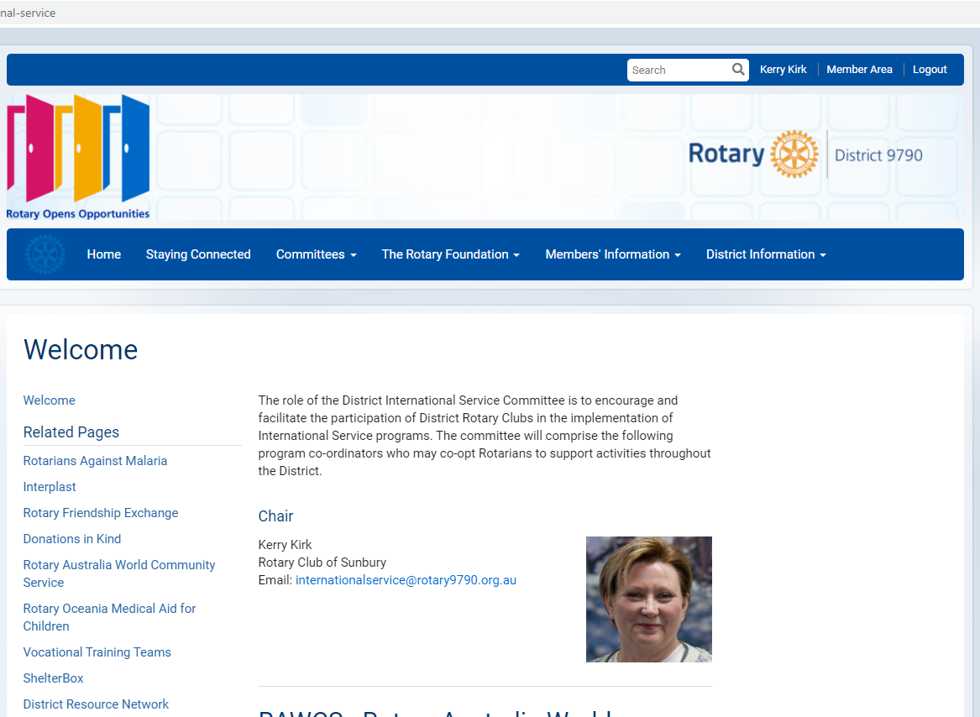
How to access it and when
00.30
00:32

Slide 11
00.32
Regarding you…
Do you Work in a health or allied health field?
Do you have a Mental Health or St Johns First Aid qualification?
Are you a peace fellow, past exchange student, RYLArian?
Have you run a project or lived in a country of interest?
Have you run one or more KFA projects?
Are you qualified/experienced in
something that could benefit another project?
Would you be prepared to take a phone call?
00:33

Slide 12
Sustainability of existing initiatives
00.33
00:34
Notes:
12

Slide 13






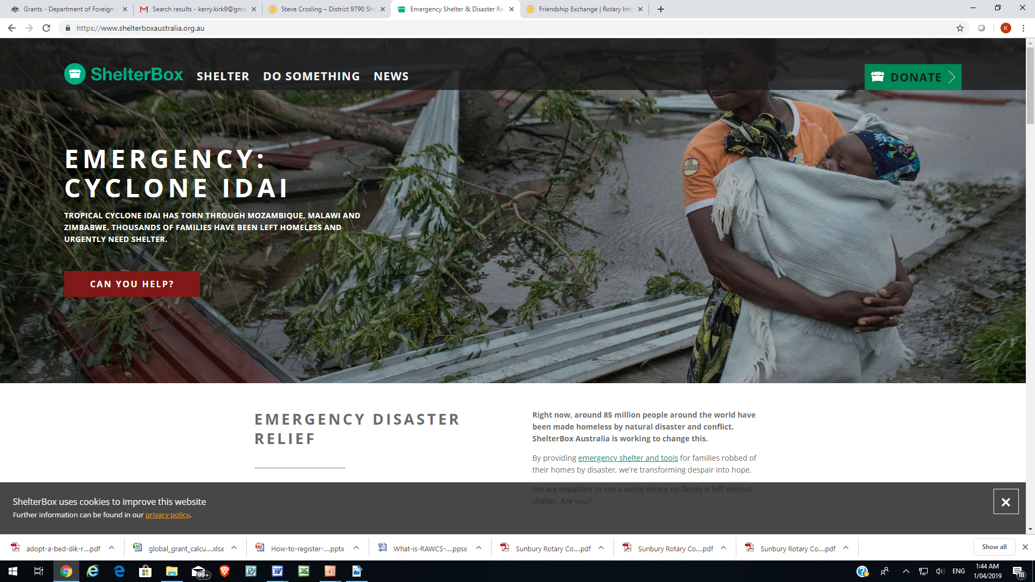

International Service 9790 Representatives at National Committees
00.34
9790 Role 2021-2022 | 9790 Representative/Club
RAWCS | (new) David Earle – Shepparton Central
ROMAC | Bruce Walker – Benalla
Interplast | Chris Sutton – Numurkah
RAM | (new) Bryce McNair - Albury Hamish Jones – Strathmore
Operation Cleft | (new) Trevor Moyle, Moreland
Shelterbox | Steve Crosling – Diamond Creek
Rotary Friends Exchange | Ann Kimberley – Benalla
DIK | TBA
rawcs.org.au
romac.org.au
interplast.org.au
International
Team
Committee
Vacancies
ram.rawcs.com.au
operationcleft.org.au
shelterboxaustralia.org.au
rotarydik.org
00:37

Slide 14
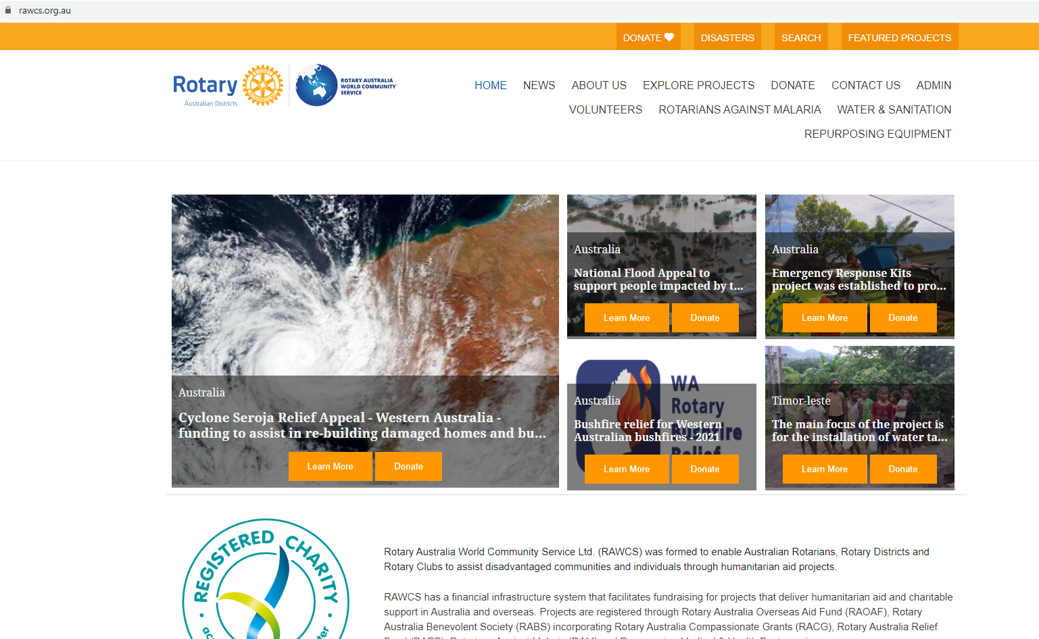
00.37
RAWCS – Rotary Australia World Community Service
https://rawcs.org.au/
30 Current 9790 Club sponsored Projects registered (up from 24 last year)
(24 RAOAF (up from 19 last year)
Thank you to the 25 clubs and others that went online and supported our most recent District 9790 International project last year to send beds to Sri Lanka for COVID-19.
Read through the many excellent projects here and see if your club can provide any financial assistance to one of more of them and when creating a new International project, enter it into RAWCS and let other clubs find and donate to yours.
Thank you Mani Seneviratne for your service to RAWCS and
Welcome David Earle the new 9790 RAWCS coordinator for 2021-22
…
00:39
Notes:
1-Aug-2020CC219149Rotary Club of Yea Inc.$389.00
2-Aug-2020CC219196Rotary Club of Corowa$97.25
3-Aug-2020DC219191Rotary Club of Albury North$97.25
3-Aug-2020DC219198Rotary Club of Tallangatta$486.25
3-Aug-2020DC219227Rotary Club of Preston Inc$97.25
3-Aug-2020DC219229John Strang$97.25
3-Aug-2020DC219250Rotary Club of Diamond Creek Inc$291.75
5-Aug-2020DC219341Rotary Club of Greensborough$97.25
7-Aug-2020DC219340Rotary Club Tocumwal$97.25
7-Aug-2020DC219439Rotary Club Of Rosanna Inc$97.25
8-Aug-2020DC219391Rotary Club of Benalla Inc$97.25
8-Aug-2020DC219436Rotary Club$97.25
10-Aug-2020CC219527Rose King$97.25
10-Aug-2020CC219528Tony Cozzolino$97.25
10-Aug-2020CC219529Kit Holland$19.45
10-Aug-2020CC219530Rotary Club of Southern Mitchell$97.25
10-Aug-2020CC219531Steve Ansell$77.80
11-Aug-2020CC219582Rutherglen Rotary Club$97.25
12-Aug-2020CC219617David D'Silva$97.25
12-Aug-2020DC219615Rotary Club of Pascoe Vale$97.25
13-Aug-2020CH219228Rotary Club of Albury Wodonga Sunrise$97.25
15-Aug-2020DC219765Rotary Club of Sunbury Incorporated$486.25
18-Aug-2020DC219915Rotary$194.50
21-Aug-2020DC220009Rotary Club of Albury$97.25
21-Aug-2020CH219521Rotary Club of Greenvale$97.25
27-Aug-2020CH219913Rotary Club of Lavington$97.25
27-Aug-2020CH219949Rotary Club of Mansfield$97.25
14-Sep-2020DC220977Rotary Club of Kinglake Ranges$97.25
16-Sep-2020DC221118Rotary Club Albury West$194.50
29-Sep-2020DC219580Rotary Club of Seymour$194.50
27-Oct-2020DC232925Rotary Club of Yarrawonga/Mulwala$194.50

Slide 15
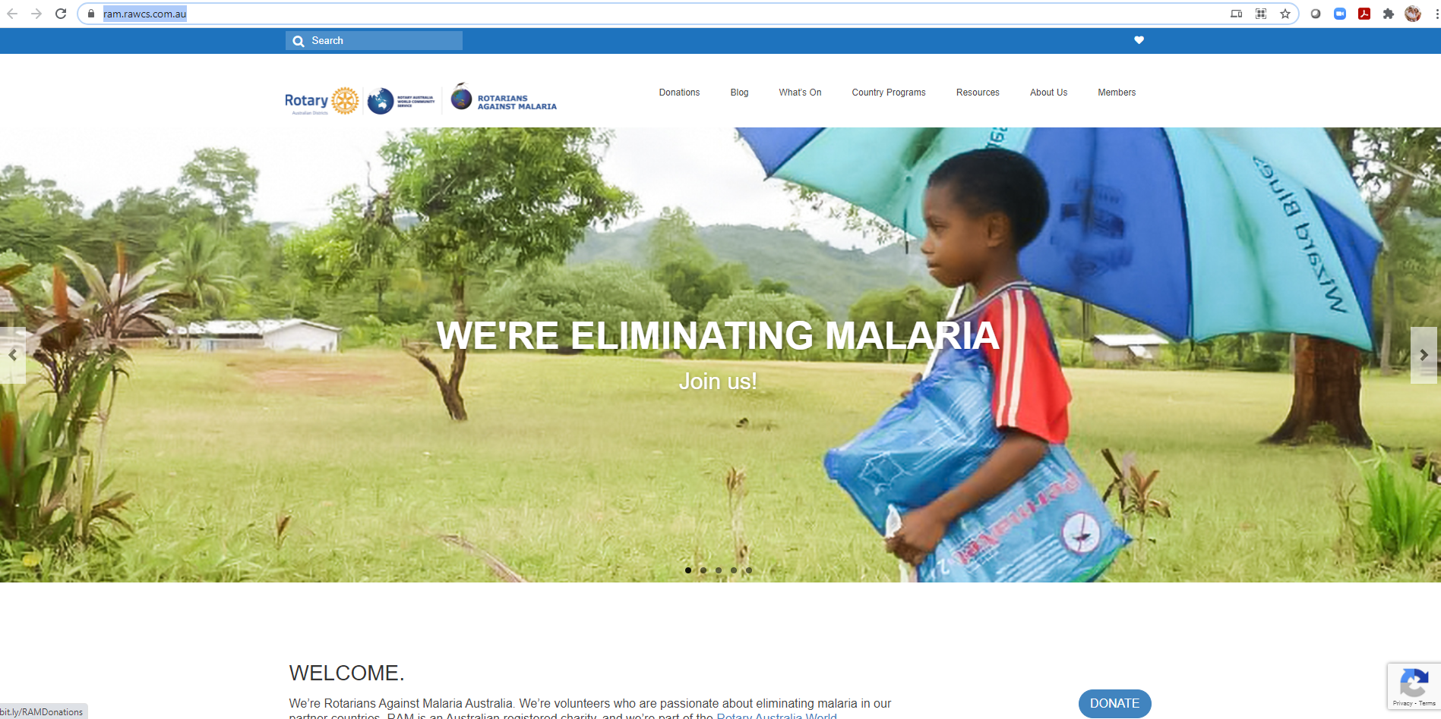
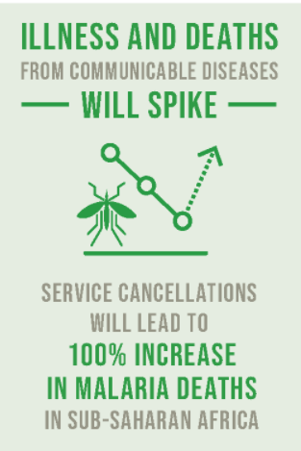
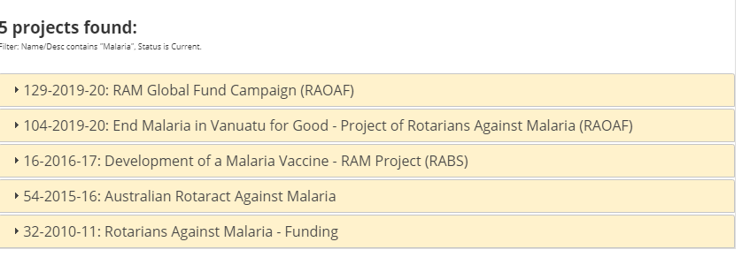
00.39
Rotarians against Malaria - RAM
https://ram.rawcs.com.au/
https://sdgs.un.org/goals/goal3
Our thanks to Jen Parer Holbrook who is handing over RAM coordinator responsibilities
to a new coordinator this year Bryce McNair from Albury Wodonga Sunrise club
00:40
Notes:
This infographic on the left is a snippit from the United Nations SDG 3 “Ensure healthy lives and promote well-being for all at all ages“ progress update and refers to the impact of COVID-19 on other communicable diseases.
“The incidence rate of malaria had plateaued, staying around 57 cases per 1,000 people at risk from 2015 to 2019.
The WHO 2020 target for reductions in malaria case incidence will be missed by 37%.
In 2019, the global tally of malaria cases was 229 million and the disease claimed some 409,000 lives.
Gaps in funding and in access to life-saving tools are undermining global efforts to curb the disease, and the COVID-19 pandemic is expected to set back the fight even further.”
Many of the lives lost are children from our region, including Vanuatu. District 9800, 9810 and 9790 in the RAWCS Southern Region are bandying together and going for a global grant to end malaria in Vanuatu for good. Other regions are tackling different countries and we hope this concentrated effort by region will significantly help the cause.
Please consider donating to this cause and helping to eradicate Malaria in Vanuatu.

Slide 16
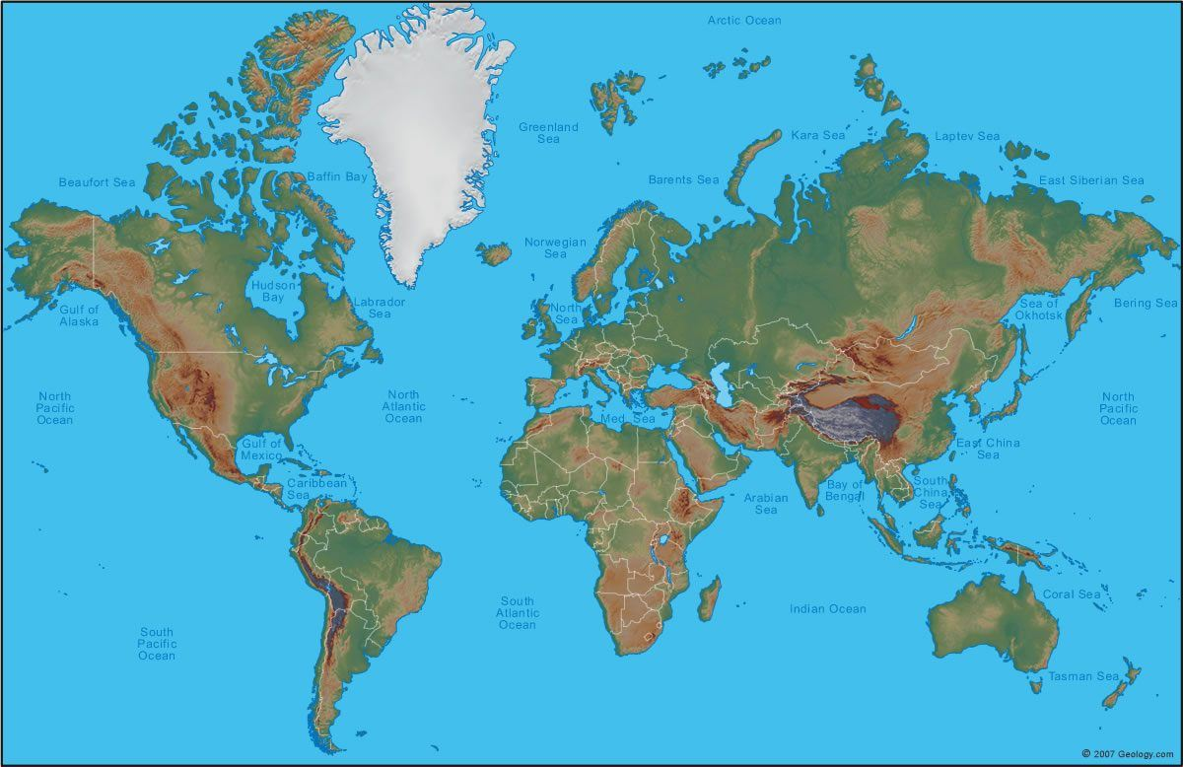
00.40
9790 International Project Portfolio
Cambodia (78)
Indonesia (49)
Nepal (73)
Sri Lanka (77)
Vietnam (64)
Philippines (129)
Ghana (43*)
Kenya (125)
Uganda (109)
Tanzania (52)
Somalia (158)
South Sudan (160)
South Africa (123)
1
4
2
PNG (101)
Fiji (Not Rated)
4
# of 9790 Projects
* Global Peace Index Rating (By Comparison Aus 13, NZ 2, Iceland 1 and USA 121)
00:41

Slide 17

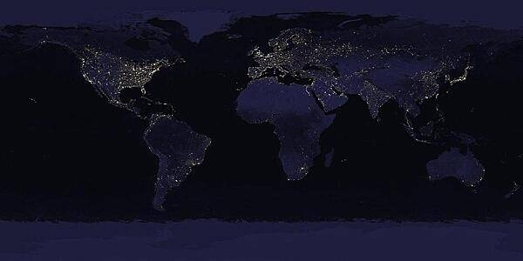
00.41
World Snapshot – What we are responding too
2021-2
7.7 Billion people growing rapidly*
~70% water, 30% land – 195 Countries
~60% urbanization
Environmental Issues - large areas subject to overpopulation, industrial disasters, pollution (air, water, acid rain, toxic substances), loss of vegetation (overgrazing, deforestation, desertification)…
Global Avg life expectancy is increasing – currently 70 yrs
10% of GDP spent on Health (Military 2%)
Threats:
  Maritime Privacy | Resource competition | border issues | Ethnic and culture clashes | Stateless armed entities
  Refugee Crisis 2020 ~80M displaced persons **
  20.9 million people in 2012 were victims of forced labor, representing the full range of human trafficking (also referred to as 'modern-day slavery’)
  As at 18/5/21 164M COVID-19 cases world wide , 17.8M Active (101K serious or critical), 3.4 Million deaths and only 7% pop had 1st vaccine***
  Other natural disasters not abating
*from 1 b in 1820 to 2 b in 1930, 3 b in 1960, 4 b in 1974, 5 b in 1987, 6 b in 1999, and 7 b in 2012. (110, 30, ~12)
** 45.7 million conflict IDPs, 26.3 million refugees, 4.2 million asylum seekers, and 3.6 million Venezuelans displaced abroad
*** Source https://www.worldometers.info/coronavirus/ & UN Reports on COVID vaccine rollout
00:44

Slide 18
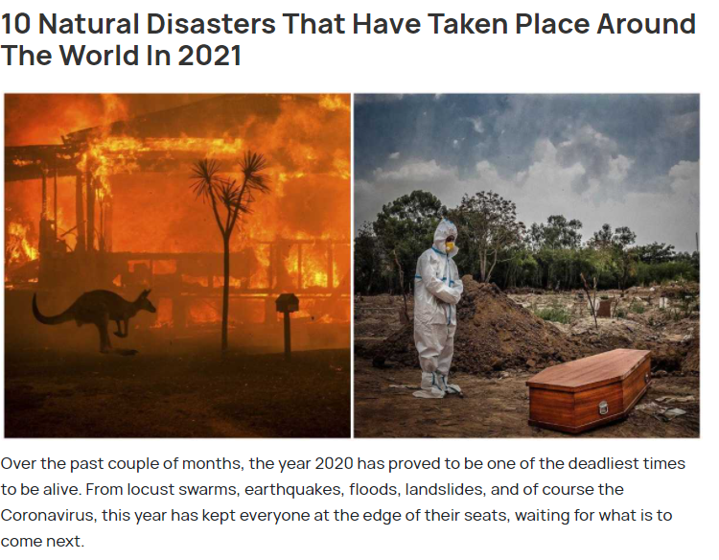
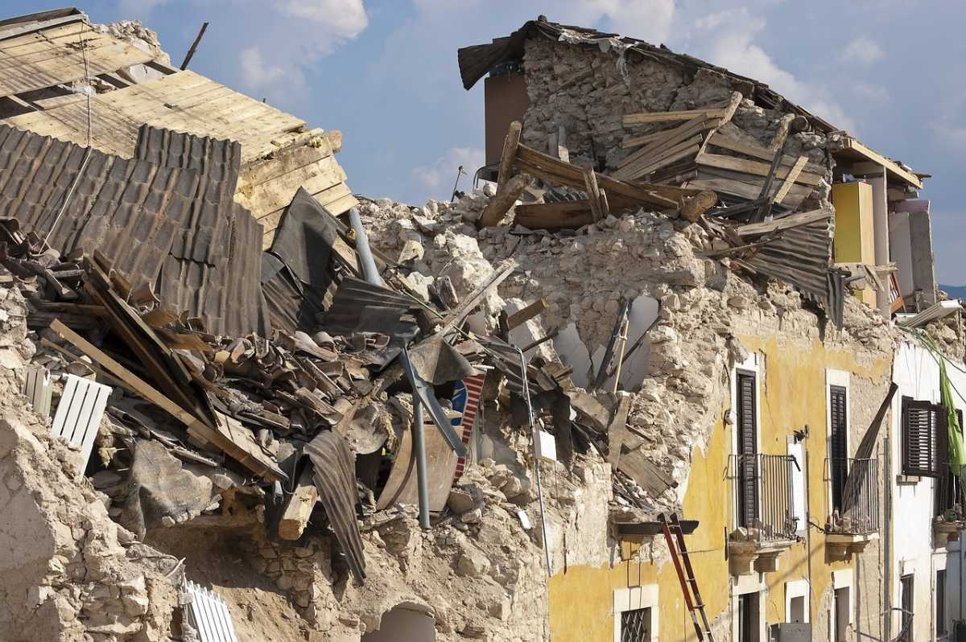
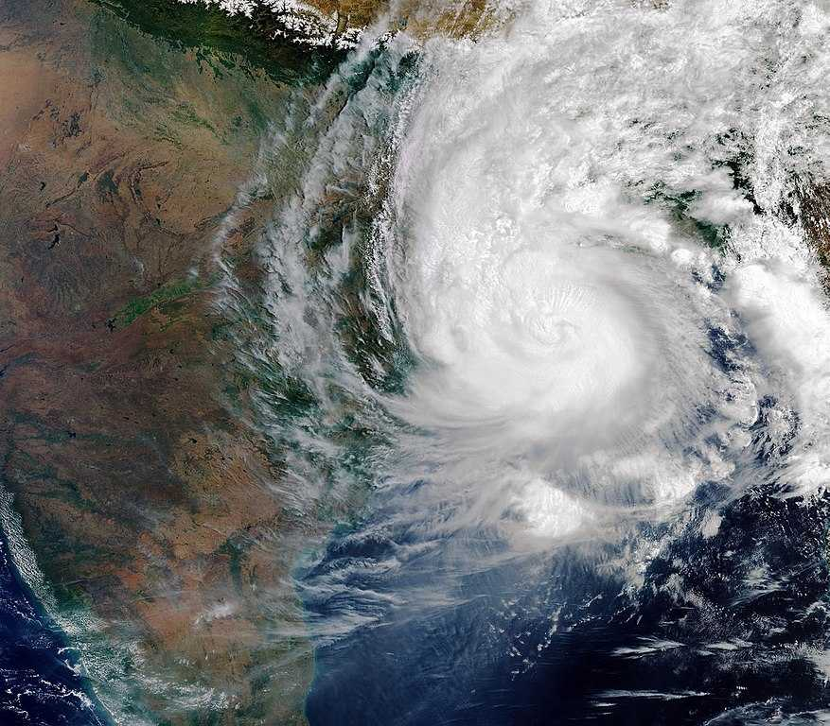
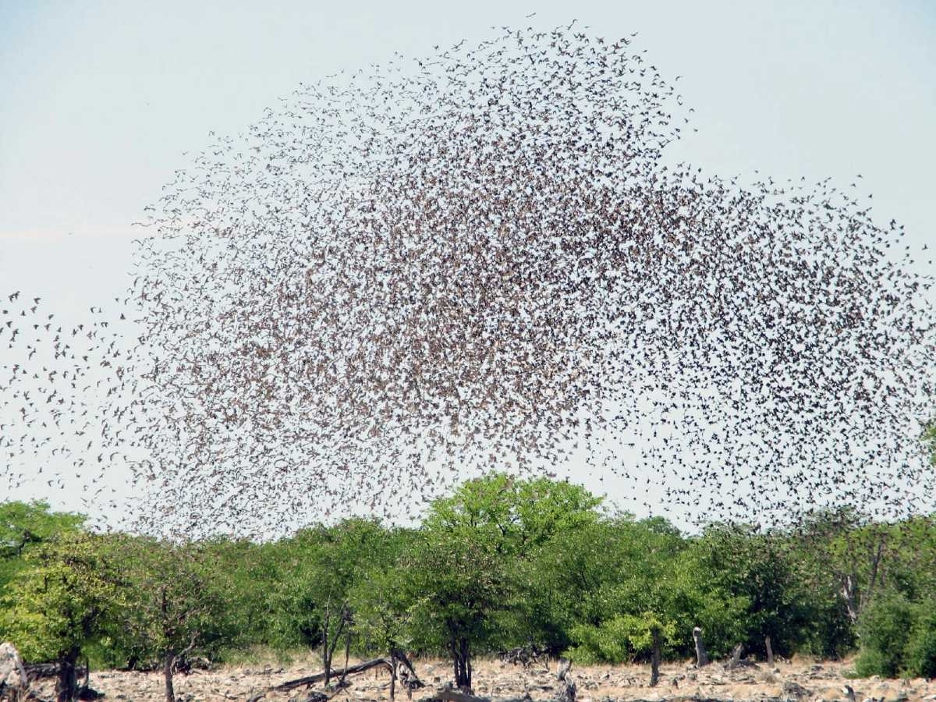
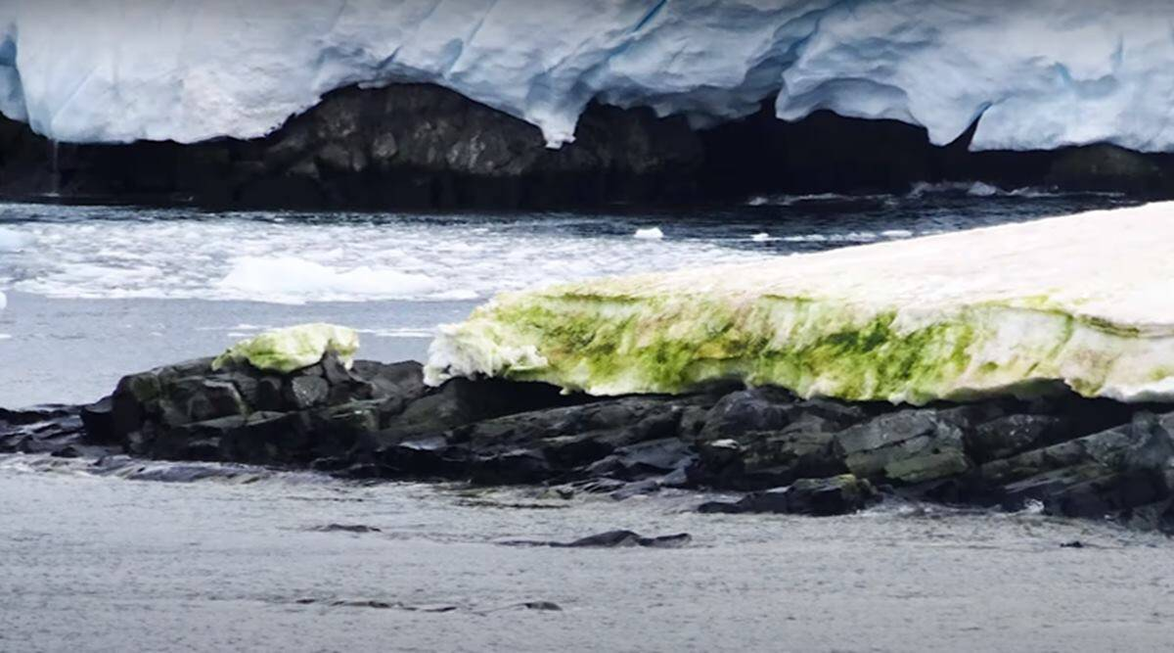
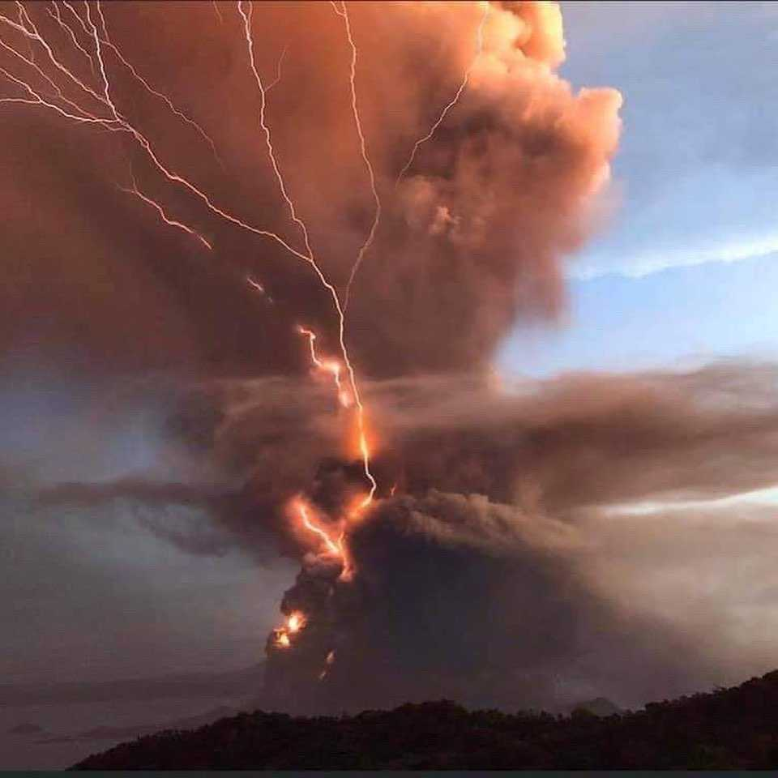
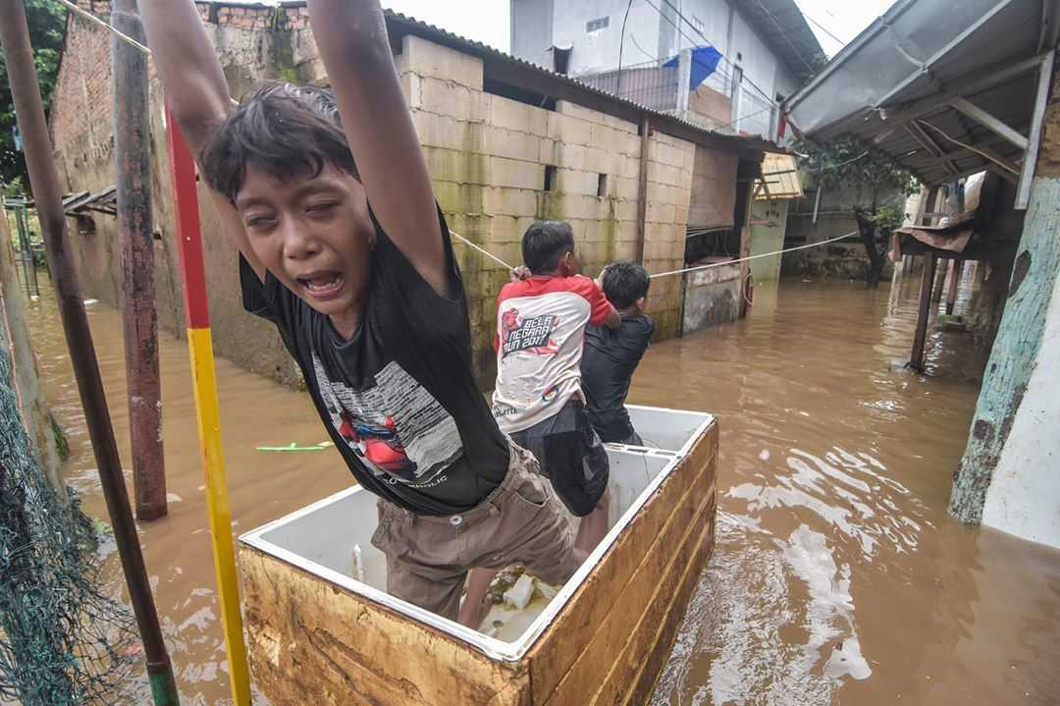
00.44
Next..
Earthquakes China-India-Iran-Philippines-
Russia-Turkey-The Caribbean
Cyclones, Amphan, Bangladesh, India
COVID-19
Flash floods Indonesia
Volcanic Eruption - Phillipinnes
Locusts: Asia, East Africa, India, Middle East
Green snow in Antarctica
00:46

Slide 19

Looking for a project opportunity
00.46
Rotary’s 7 Areas of Focus
UN SDGs –list/link to global problems to solve
UN 17 goals to target poverty, inequality, injustice and climate change by 2030.
169 Objectives - Each goal is broken down into a number of objectives/Targets.
00:50

Slide 20

2020/21 Shark Tank
00.50
Name | Club/Cause | Country/Project / KFA
PP Janine Reinking | Sunbury | Cambodia/Maternal and Child Health
PP Trevor Moyle | Moreland | Nepal / Ghyangphedi Comm Dev Project
PP Bryce McNair | Albury Wodonga Sunrise - RAM | Vanuatu / End Malaria in Vanuatu for Good (RAM)
Peter Elias | Albury | Nepal/Covid-19 Community relief Fund
Pam Woods | Bundoora | Uganda – The Amasiko Partnership
01:15

Slide 21

Thank you to our Project Managers and Sharks
01.15
01:16

Slide 22
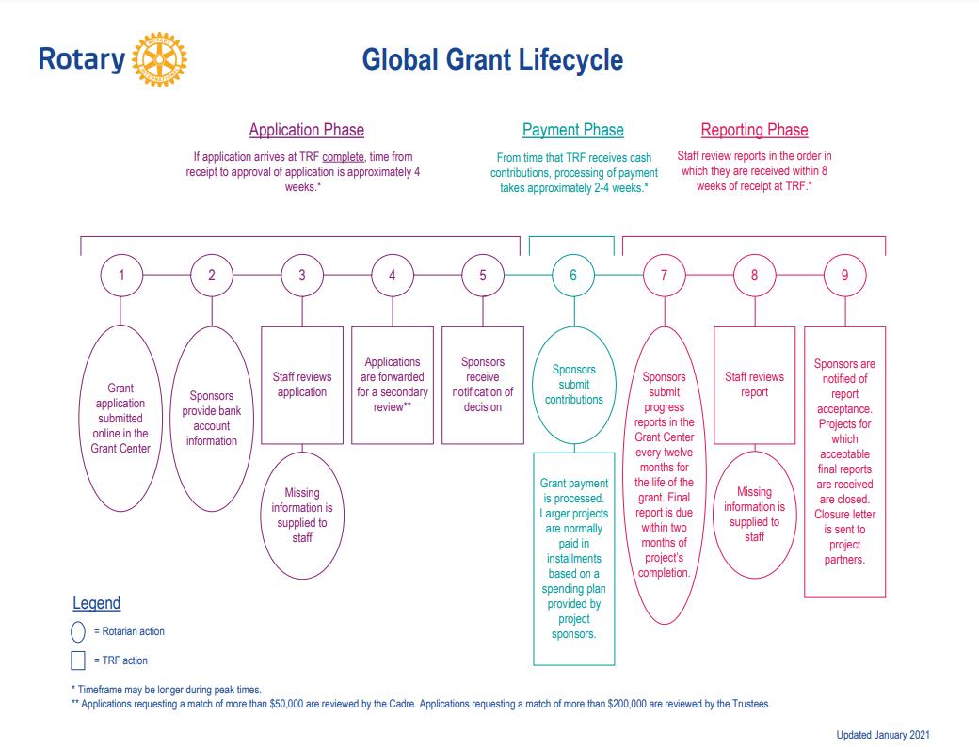
01.16
Global Grant Applications
Support large international activities with sustainable, measurable outcomes in Rotary’s areas of focus.
$30K - $400K USD
By working together to respond to real community needs, clubs and districts strengthen their global partnerships.
Lots of Rules and traps for new players incl Community Assessment
Sample of a D 9600 successful global grant application for a water project in PNG and their application process map
https://my.rotary.org/en/take-action/apply-grants/global-grants
01:19

Slide 23
01.19
My final asks of you when you return to your clubs
Know the % of your Club spend on International projects
Donate each year to sustain the key District Sponsored International Projects
(ROMAC, RAM, Interplast, Operation Cleft & ShelterBox)
Tell your Club about the DRN,
Watch out for a communication for the DRN to be released,
likely be a training session and enter your data/expertise into it.
Consider Registering all new International projects in RAWCS –
(Transparency, Registered Charity Tick & Donations)
Keep me updated on your new International Projects, so I can promote them
and try and get you extra support
01:22

Slide 24
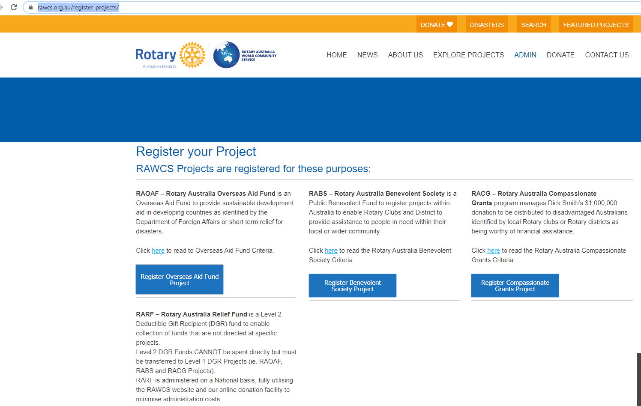

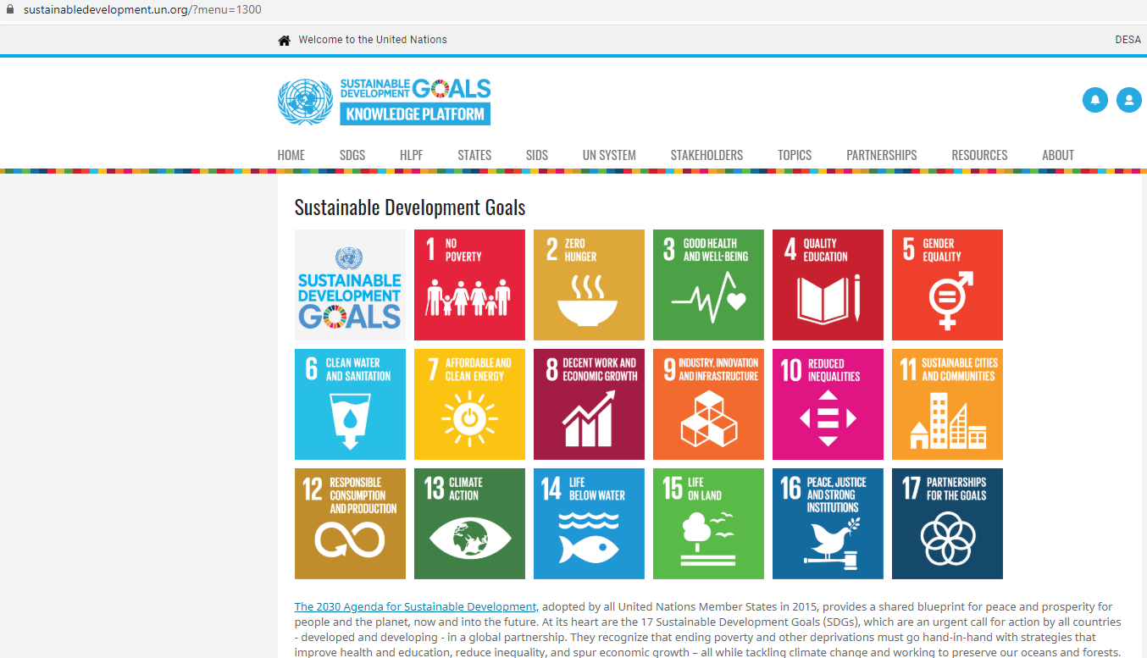


More Links / Resources
01:22
What | Where
Where to create a new project in RAWCS | https://rawcs.org.au/register-projects/
Where to get information on the United Nations Sustainable Development Goals | https://sustainabledevelopment.un.org/?menu=1300 Click on each Goal for further details on progress towards achieving the goal and targets and KPI’s
Where to get information on the Global Peace Index | https://www.economicsandpeace.org/wp-content/uploads/2020/08/GPI_2020_web-1.pdf
Where to get reliable relative statistics on a country for your project | https://www.cia.gov/the-world-factbook
01:23

Slide 25



Summary, Thank you
Questions?
01:23
1. Progress
(Mostly) On Track
2. District Resource Network
Online, Please enter your expertise
3. Healthy International Portfolio
5th highest District for # of Registered projects in the District, across 3 Continents
4. Shark tank
Thank you to all participants
01:30

