Slide 1
THE ROTARY FOUNDATION
District Grants Management Seminar
23 April 2023

Slide 2
CONTENT OF THE SEMINAR
ABOUT THE ROTARY FOUNDATION
FUNDING
GRANTS AVAILABLE
GLOBAL GRANTS
DISTRICT GRANTS
RESOURCES

Slide 3
Rotary Foundation Mission and Motto
Mission:
To enable Rotarians to advance world understanding, goodwill, and peace through the improvement of health, the support of education, and the alleviation of poverty
Motto:
Do Good in the World

Slide 4
AREAS OF FOCUS
Peace and Conflict Resolution and Prevention
Disease Prevention and Treatment
Water, Sanitation and Hygiene
Maternal and Child Health
Basic Education and Literacy
Community and Economic Development
Supporting the Environment
Notes:
We have identified specific causes to target to maximize our local and global impact. Through global grants we help clubs focus their service efforts in the following areas:
Peace and conflict prevention/resolution
Disease prevention and treatment
Water and sanitation
Maternal and child health
Basic education and literacy
Economic and community development
Supporting the Environment

Slide 5
Funding
How funds are generated to finance Global and District Grants?
5
Notes:
Before we get started on the nuts and bolts of Grant management, I want to spend a few minutes discussing how money flows into and out of TRF.

Slide 6
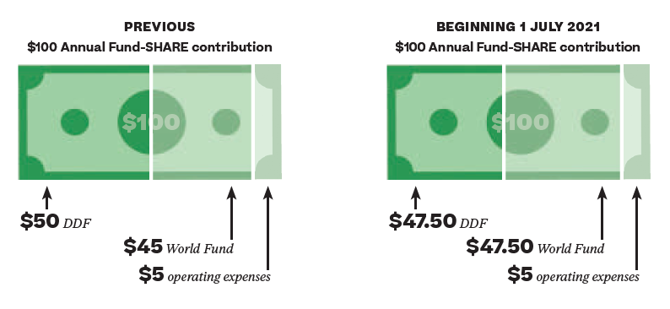
Notes:
Next Rotary year (2023-24) is the last year operating under the previous SHARE scheme of 50% to DDF. From 1 July 2024, the DDF will be 47.5% of Annual Fund contributions in 2021-22. For the 2023-24 Rotary year, our DDF is from contributions made in 2020-21.

Slide 8
SHARE CONTRIBUTION DETAIL (2023-24)
(Rotary Year 2020-21)
TOTAL to Annual Fund: USD $124,903.24
50% share to World Fund: 62,451.62
50% share to DDF: 62,451.62
Half DDF to District Grants $31,225.81
(approx. AUD $46,525.25)

Slide 9
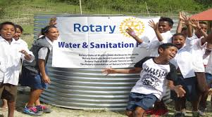
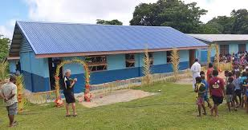
ROTARY GRANTS
District grants
Global grants
Disaster grants
Notes:
The Rotary Foundation offers grants that support a wide variety of projects, scholarships, and training that Rotarians are doing around the world. There are two main types of grants available: district grants and global grants.

Slide 10
Differences between District and Global Grants
District Grant | Global Grant
Supports the mission of the Rotary Foundation | Aligns with an area of focus
No minimum budget | Large scale projects and activities. Minimum budget of US$30,000
Short term impact | Long term, sustainable impact
District Involvement | The Rotary Foundation Involvement
Clubs must contribute an equal or greater amount | Measurable outcomes
 | International Partnership

Slide 11
DISTRICT QUALIFICATION
District leaders complete qualification process online annually
Agree to implement Memorandum of Understanding (MOU)
Conduct grant management seminars for clubs
Notes:
Districts must become qualified in order to receive grant funding from The Rotary Foundation. The online qualification process helps ensure that your district understands your financial responsibilities, including stewardship, and is prepared to take them on. Qualification must be completed each year.
Becoming qualified is simple. Your district governor, governor-elect, and Rotary Foundation chair should:
Read through the district qualification memorandum of understanding (MOU) on the grants application tool, answer a series of questions, and agree to the MOU
Conduct grant management seminars for clubs

Slide 12
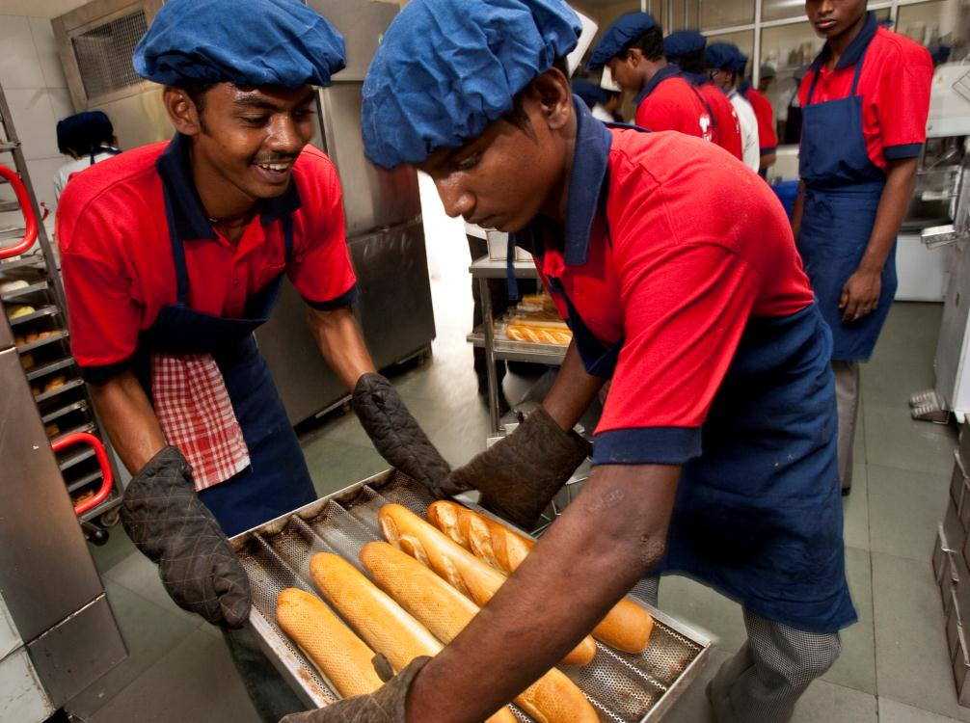
DISTRICT GRANTS
Small-scale, short-term
Local or international activities
Aligned with the Foundation’s mission
TRF awards a grant to Districts for use by Clubs
Districts determine rules for allocation
Notes:
District grants fund small-scale, short-term activities that address needs in your community and communities abroad. Each district chooses which activities it will fund with these grants. You can use district grants to fund a variety of district and club projects and activities.
You have a lot of freedom to customize your service projects. There aren’t many restrictions, as long as your district grant supports the mission of The Rotary Foundation, which is to enable Rotarians to advance world understanding, goodwill, and peace through the improvement of health, the support of education, and the alleviation of poverty. Districts must be qualified before they can administer district grants.
Districts may use up to 50 percent of their District Designated Fund to receive one district grant annually. This percentage is calculated based on the amount of DDF generated from a district’s Annual Fund giving three years prior, including Endowment Fund earnings. You aren’t required to request the full amount available.
Districts receive this funding as a lump sum and then distribute it to their clubs.

Slide 13
Obtaining a District Grant
District must be qualified
District must submit a spending plan
That is the clubs must have made an application
Up to 50% of the DDF can be applied for
Local rules apply on how the grant is administered
All clubs that receive a grant must report on outcome
Grants Seminar
DG, DGE & DRFC complete online MOU.
All previous grants reported on

Slide 14
APPLYING FOR DISTRICT GRANTS
Each District has its own rules
Your club must be qualified
Read District newsletters and announcements
Meet the deadlines
Submit application & MOU to District
Meet reporting requirements as required
14
Notes:
Each District decides on the rules.
NO MONEY SPENT UNTIL THE GRANT IS APPROVED BY TRF

Slide 15
The Application
Available on the District website
Project Description – outline its purpose, objectives and how it will meet the needs of the community
Estimated start and completion date
Detail Primary partner (Rotary Club) and co-operating organisations - Project Committee
Project Budget
Proposed Financing

Slide 16
Qualification
Clubs must become qualified in order to receive grant funding from The Rotary Foundation.
Global Grant applicant clubs will receive additional grant management training
The qualification process helps ensure that your club understands your financial responsibilities, including stewardship, and is prepared to take them on.
Qualification/re-certification must be completed each year.

Slide 17
Qualify your club
Becoming qualified for a District Grant is simple. Your President, President-elect, and Rotary Foundation chair should:
Read through the club qualification memorandum of understanding (MOU) sign and return to the District Grants Subcommittee Chair
Attend the Grant Management Seminar for clubs
Notes:
Any Club member can attend the Grant Management Seminar – preferably a member of the Club’s Foundation Committee. Alternatively, it can be completed online through the RI Learning Center and, once completed, the member completing the course online should download the Certificate of Completion and send a copy to the District Foundation Chair for filing.

Slide 18
Memorandum of Understanding
Available from the District website
Club Officer Responsibilities
Financial Management Plan
Conflicts of Interest
Itemised Budget
Bank Account Requirements
Able to account for funds separate from Club activities

Slide 19
MOU (Cont)
4. Report on use of Grant Funds
5. Document retention
TRF audits
Provide access to documents for transparency
Make copies or backup
Retain for a minimum of 5 years
6. Report misuse of Grant Funds

Slide 20
Objective Selection process includes:
Sustainability
Short / Long term impact
Aligned with mission / Fit within an area of focus
Percentage of Club members with hands on involvement
Number of persons who will benefit
Club history on grant reporting and history of prior reporting
Completeness of application
Prior year/s per capita support for Rotary’s Annual Fund
Notes:
Sustainability – necessary requirement for GG (demonstrate in the GG application)
Long-term impact – necessary for GG application

Slide 21
A few points to remember
This a competitive process
Give your application the best chance of success during
the assessment process
Submit by the due date……31 July 2023
Limit the number of applications per Club and rank
them in preferred order
Use the form on the District website
No hand written applications on old forms

Slide 22
Timetable:
Include full timetable, including deadlines
Submit timely application
Submit final report.
Funds need to be expended within the agreed program and timeframe
Signatures:
Club President must sign the application and co-sign with
President elect the MOU
Notes:
If a Club at the time of submission of the DG application does not have a PE, it should be co-signed by either the IPP or the Club Foundation Chair and their designation given

Slide 23
Grants are awarded to enable completion of an
approved project :
When a grant is approved to deliver ‘X’ don’t
presume those funds can be used to deliver ‘Y’
Prior approval for a change in the Project is required
from TRF.
A project can be started before approval is received –
BUT simple submission is not evidence of approval

Slide 24
No guarantee that a successful application in one year will mean that a similar application will be successful in following years
Grant awards to any one Club on any one project will not exceed AUD $2,500 (approx.)
District grants are matching in with Club expenditure commitment – BUT not more than AUD $2,500
Separate grants from the same Club cannot fund the same project

Slide 25
District Grant Timeline 2023/24
31 July 2023
Submit application
Complete MOU
30 June 2024
Spend funds
Prior to funds transfer
30 June 2024
Final report on completion of project
No later than 30 June 2024
Return unspent monies to District /TRF
No later than 30 June 2024
Advise Club grant bank account
Prior to transfer of grant funds
Notes:
If project is not complete within the year, an interim or progress report MUST be provided and show expenditure of TRF funds (invoices, payments etc) for the year on the project

Slide 26
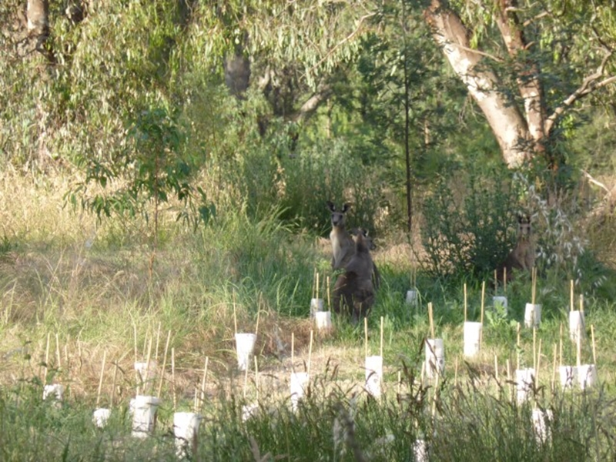

Slide 27
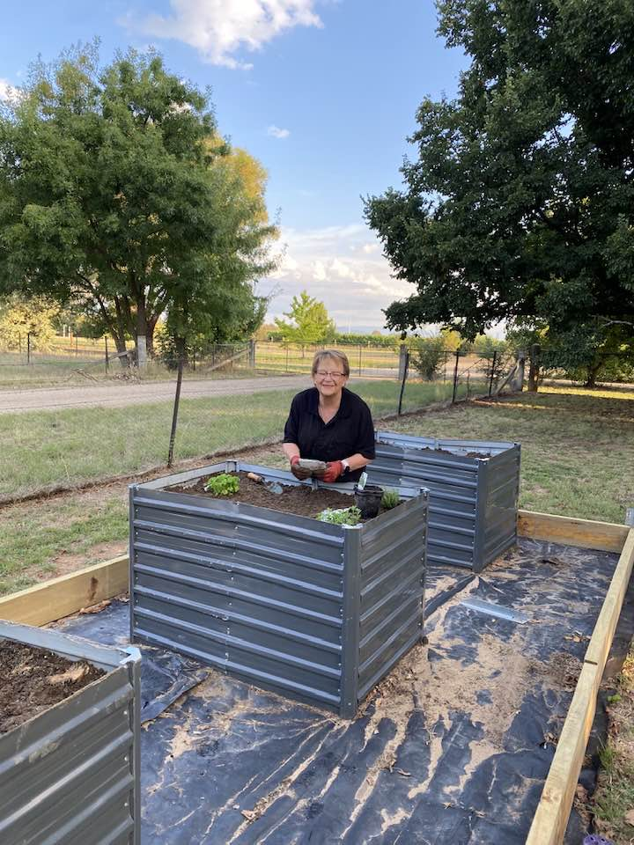
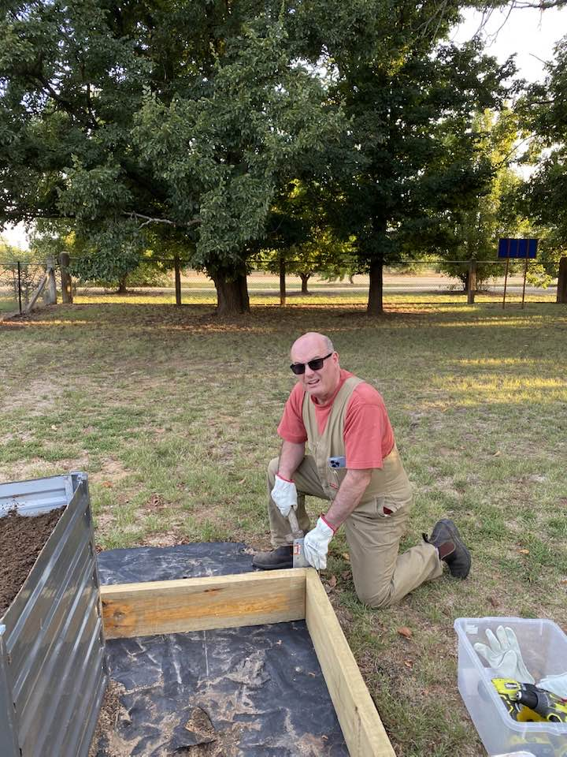

Slide 28
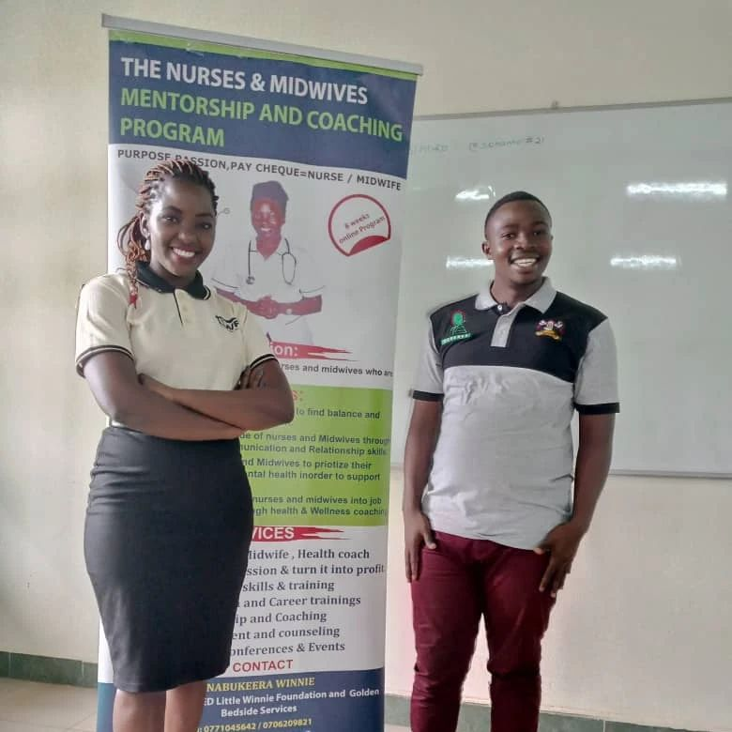

Slide 29
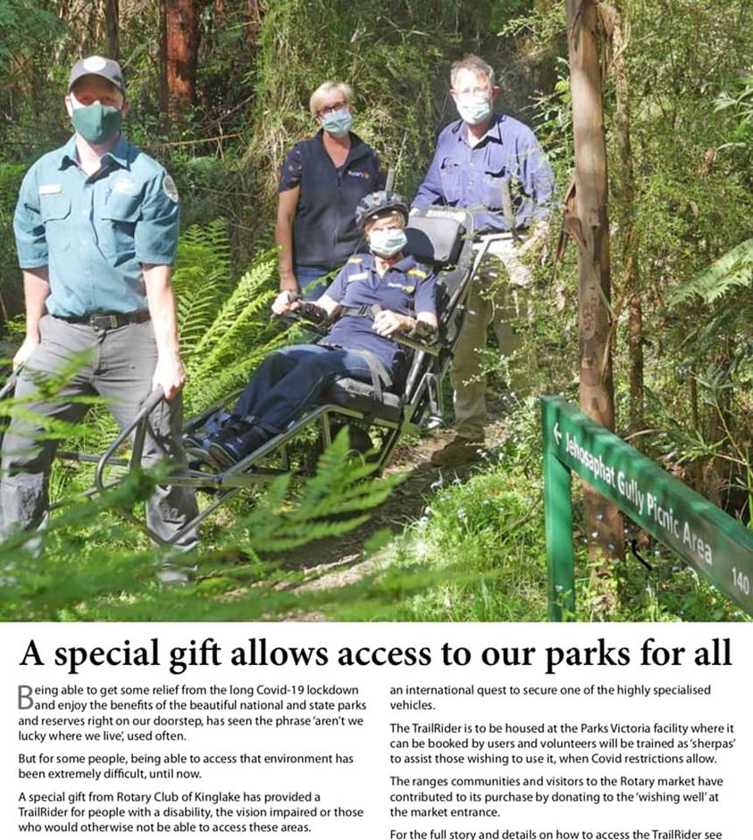
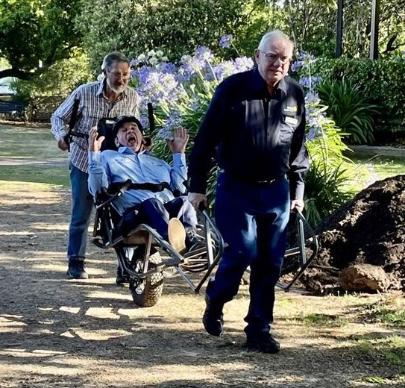

Slide 30
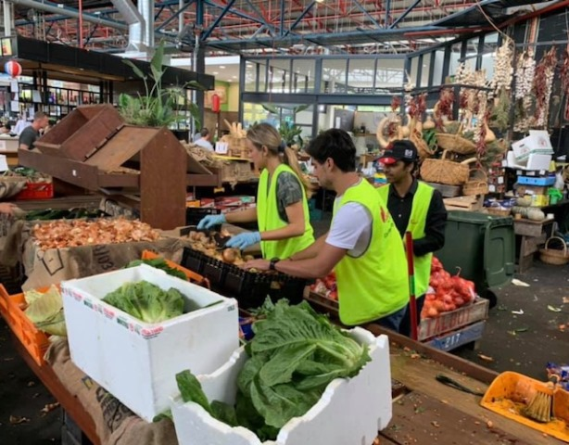

Slide 31
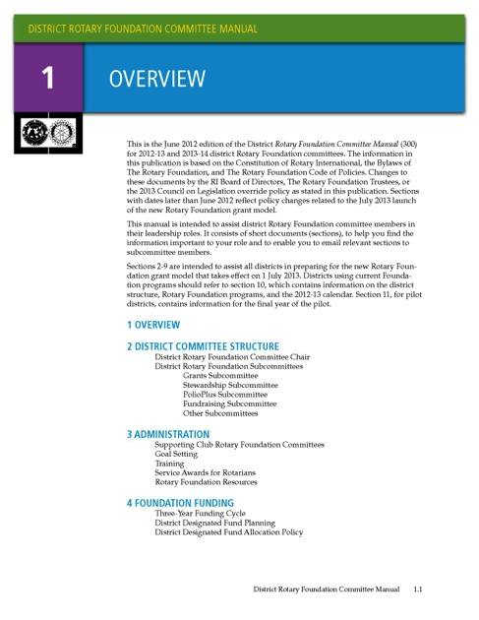
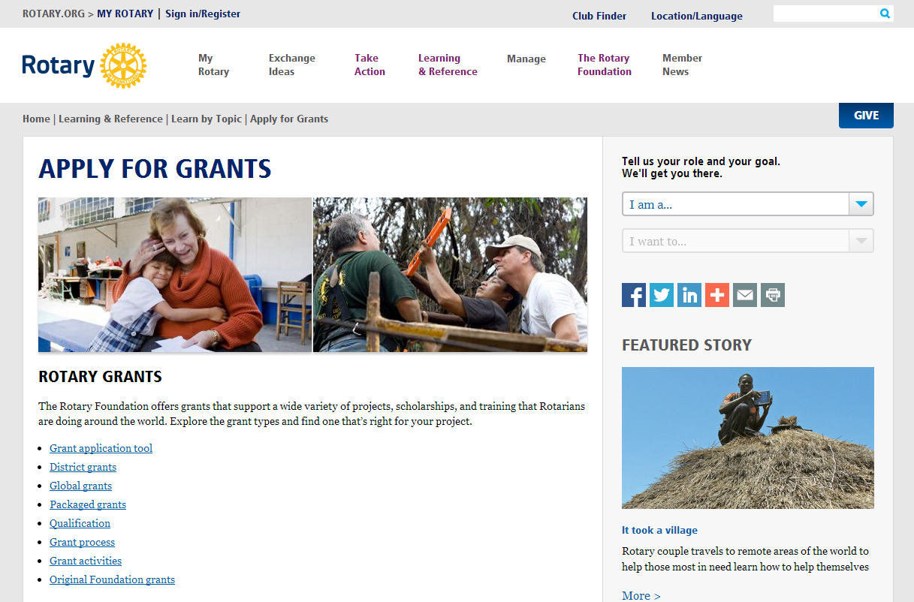
RESOURCES
www.rotary.org/myrotary/grants
Guide to Global Grants
Learning center
District 9790 website
www.rotaryfoundationaustralia.org.au
Notes:
We have a number of resources available to help you take full advantage of grant opportunities.
Rotary’s website has a wealth of general and detailed information about grants.
The learning center offers training resources to help you apply for Foundation grants.
Our training manuals can help you successfully participate in grants, especially:
District Rotary Foundation Committee Manual
District Rotary Foundation Seminar Manual
Guide to Global Grants

