Slide 1
Vocational Service projects from D9790

Slide 2
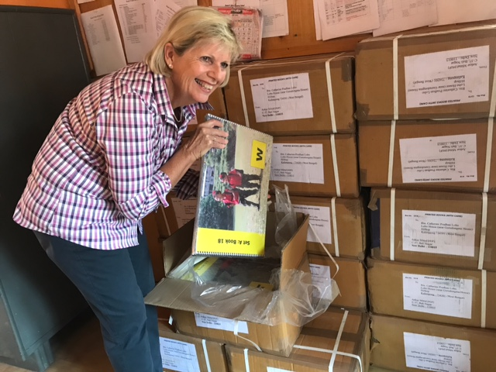
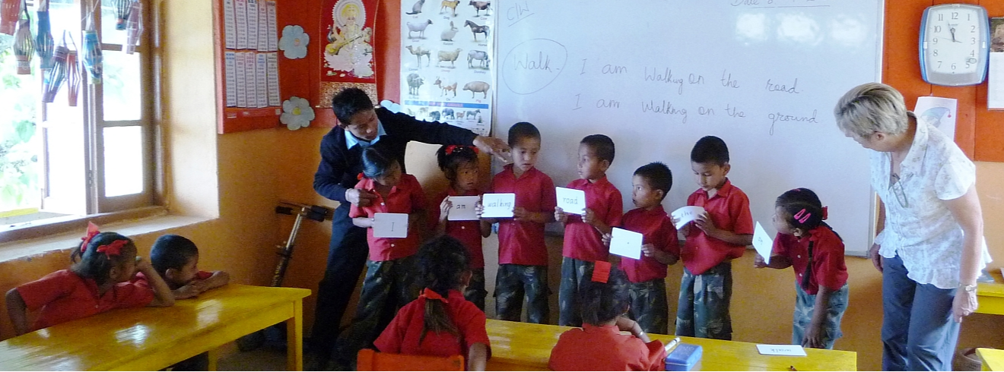
MARGOT SHERWILL ROTARY CLUB OF BENALLA
Margot is a former Primary school principal, literacy consultant and literacy & numeracy program author.
She has written, photographed and published sets of books given to schools in northern India and Nepal
145 small readers – eight of each type
145 teacher books

Slide 3
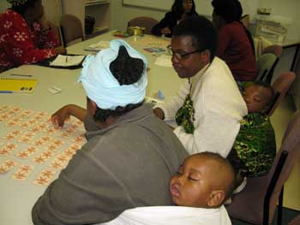
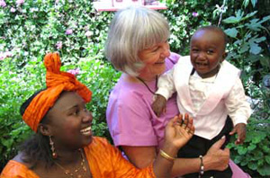
WORKING WITH REFUGEES IN ACTION
Rotary Clubs of Bundoora and Ivanhoe
Homework and Study Skills program for children with an African background

Slide 4
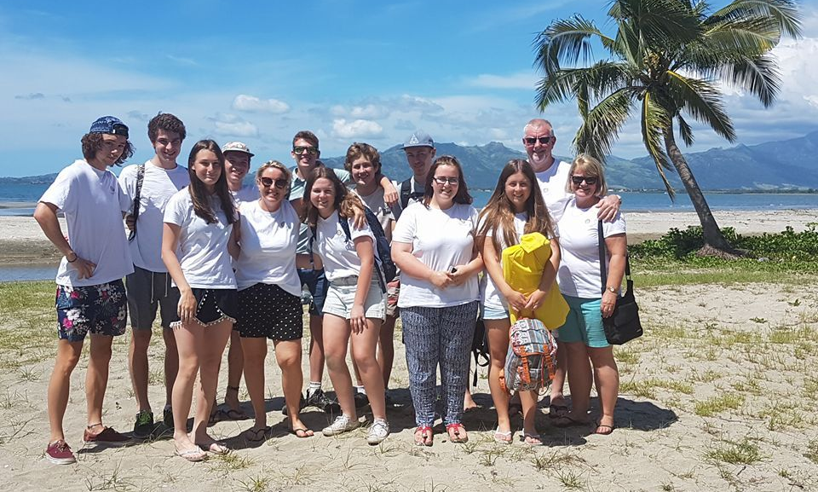
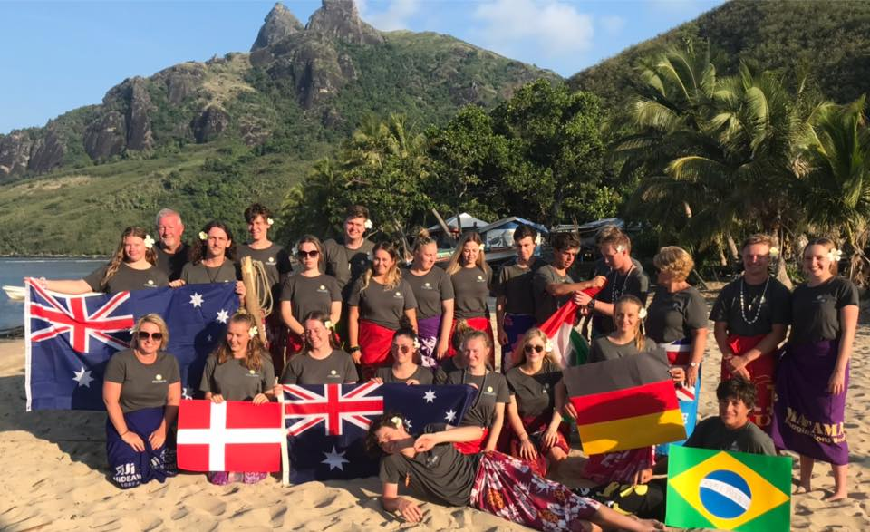
‘PAYING IT FORWARD’ STUDENT IMMERSION TRIPS
Kellie Kadaoui & Rod Bramich
Rotary Club of Albury Hume

Slide 5
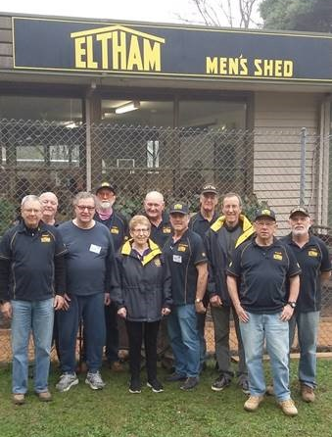
MENS’ SHED ROTARY CLUB OF ELTHAM
Nillumbik Shire Council
Rotary District 9790 Grant

