Slide 1
Rotary Falls Prevention Initiative
Introduction for Clubs/District 9640

Slide 2
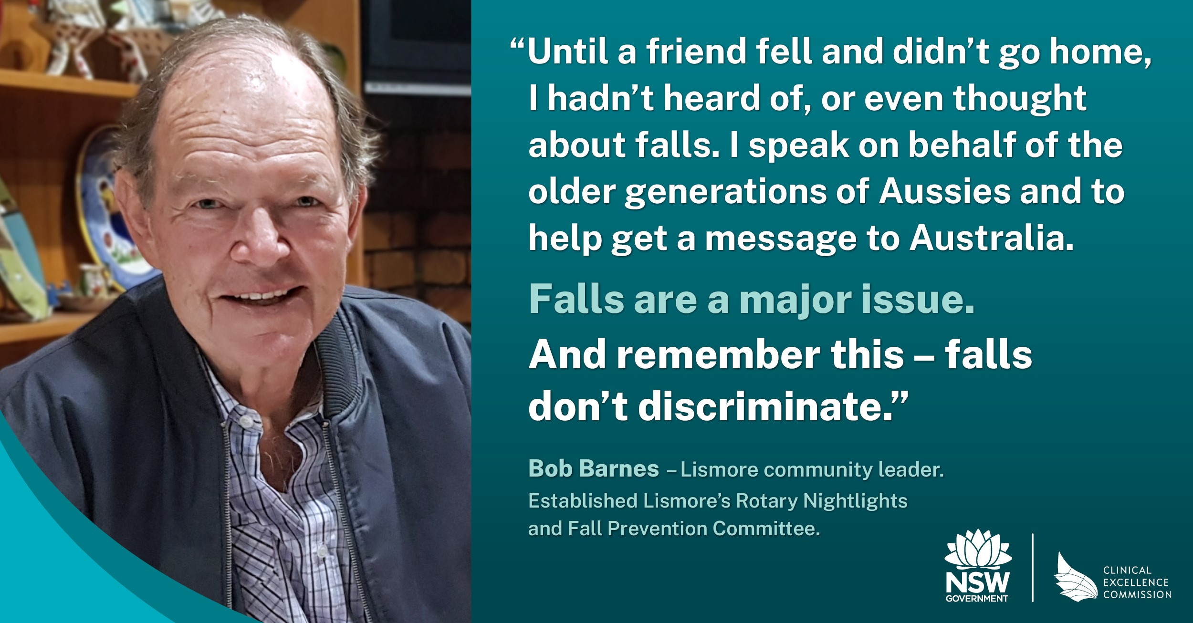

Slide 3
Falls by Australians aged 65+ are a
(little known) daily national tragedy

Slide 4
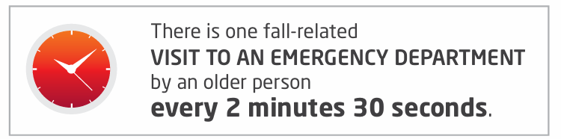

Slide 5
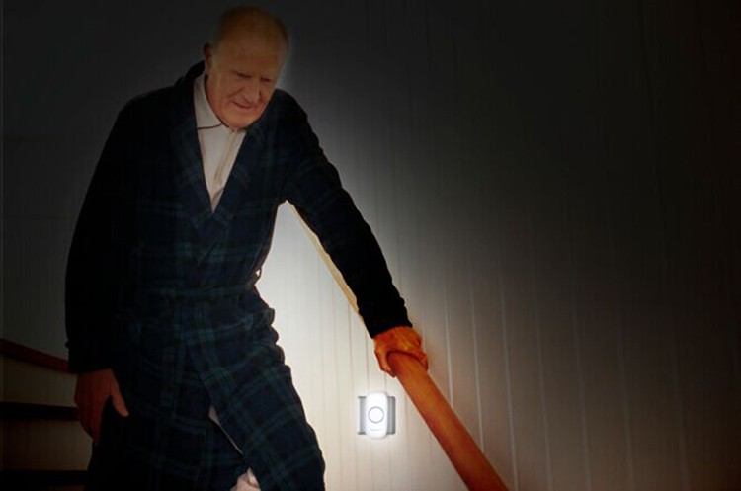

Slide 6
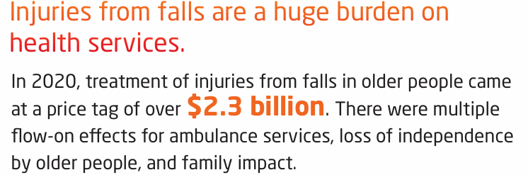

Slide 7
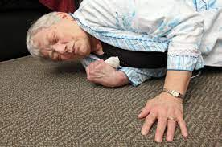

Slide 8


Slide 9
But research is now definitive:
FALLS CAN BE PREVENTED
So Rotary, with help from
NSW Health & the Australia New Zealand Falls Prevention Society
are preparing a campaign to show people the size of the problem.
And, more importantly,
WHAT WE CAN DO ABOUT IT.

Slide 10
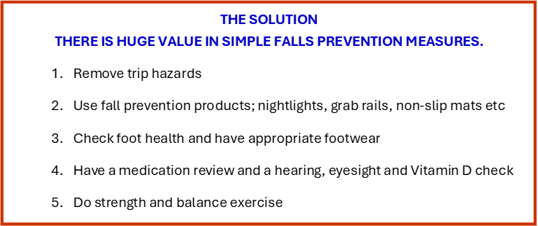

Slide 11
We would like to share this message nationally through Rotary Clubs.
But first, we would like to test the campaign we are developing.

Slide 12

As part of “April Falls Month”
Our Rotary Falls Prevention Committee are asking Rotary District 9640 Clubs to host an information table about falls prevention in their local community.
April Falls Month

Slide 13
We will provide you, or help you to organise:
Help with how to run a falls prevention information table
Helpful things such as signage, brochures and media release
We will check in with you afterwards to gain your feedback and any ideas for improvement.

Slide 14
What would you need to do?
  Contact a venue to host your information stand
  Get samples of falls prevention products to display

Slide 15
We encourage you to send our media release
  We want to bring the falls problem - and solutions – not just to the public, but, significantly, to the attention of each community’s Federal, State and Local politicians.
  In due course, we want to lobby Federal and State politicians to commit funds for a national falls awareness and prevention campaign, similar to “Slip, slop, slap”.

Slide 16
Extra ingredients, should you wish, include:
  Presence of Local Health Staff, Health professionals and/or Ambulance officer (they may offer the public a balance test etc)
  Send the media release
  A free raffle of the falls prevention products on display

Slide 17
YOU ARE IMPORTANT
A large component of your information table is
simply taking falls awareness and prevention to the public
and
providing a space for falls conversations to be shared
- every conversation counts.

Slide 18
Rotary is uniquely placed to share this message:
  We have credibility with our community
  We have a track record of success with other health issues, such as polio, bowel screening and preventing domestic violence
  Our membership is an older population, we ourselves could benefit from the message and a peer- to-peer message is a proven successful approach

Slide 19
Thank you!
We appreciate we have asked for your support and help at short notice!
Our plan is to test this approach in our local District, before refining it further in the hopes of creating a national Rotary initiative.
We are grateful for your consideration – Rotarians have a reputation for making things happen and this is no exception!

