Slide 1
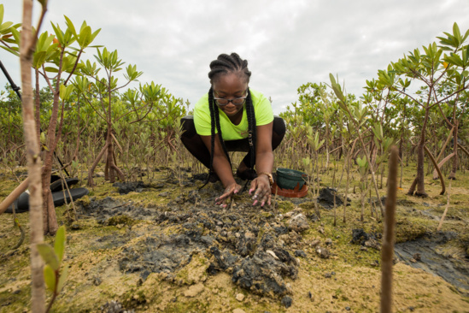
Quarterly
Foundation
Meeting
February 2025
THE ROTARY FOUNDATION
Doing Good in the World

Slide 2
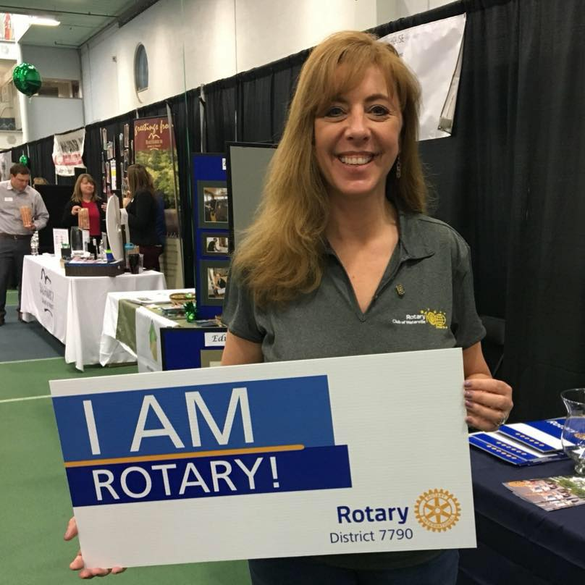
Assistant Regional Rotary Foundation Coordinator
WELCOME
PDG Tina Chapman D 7790
Zone 28PEL ARRFC Districts 7040, 7790, 7815
Immediate Past District Governor Rotary District 7790
Rotary District 7790 Mental Health Action Team Chair
Waterville (Maine) Noon Rotary Club Secretary

Slide 3
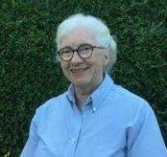
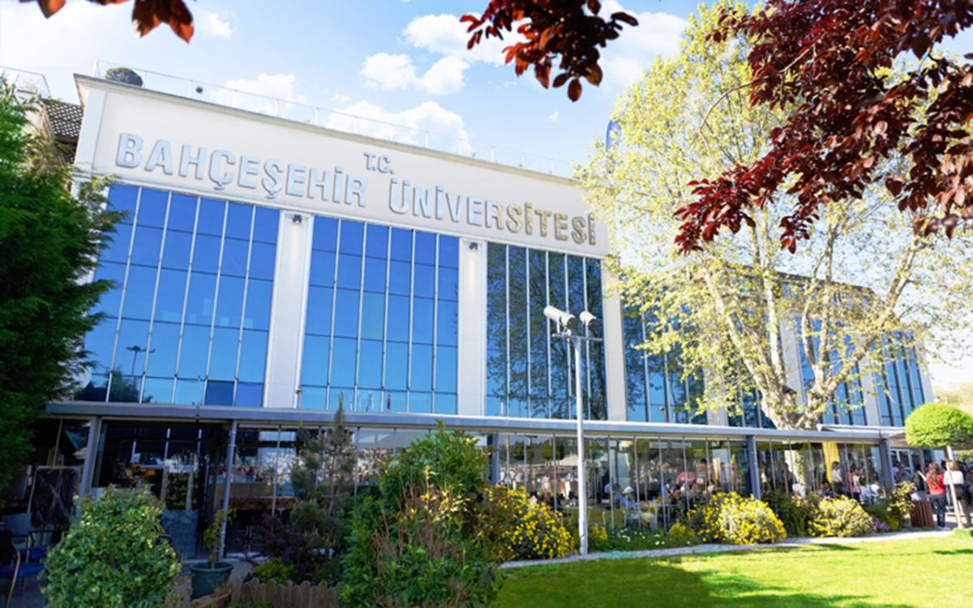
District Gg – scholarship & peace fellows
PDG Katie Burke – Chair – Scholarships
District GG Scholarship - $35,000 USD – 1st year/1st masters
District Applications open NOW
Due by – April 15
In-Person Interviews – May 3
All details on District Website - https://www.rotary7040.com/page/scholarships
Peace Centers
New one in Istanbul – JUST opened February
The Rotary Peace Fellowship is designed for leaders with work experience in peace and development. Fellows are committed to community and international service and the pursuit of peace. Each year, The Rotary Foundation awards up to 50 fellowships for master’s degrees and up to 80 for certificate studies at premier universities.

Slide 4
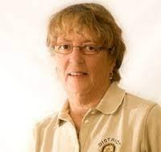
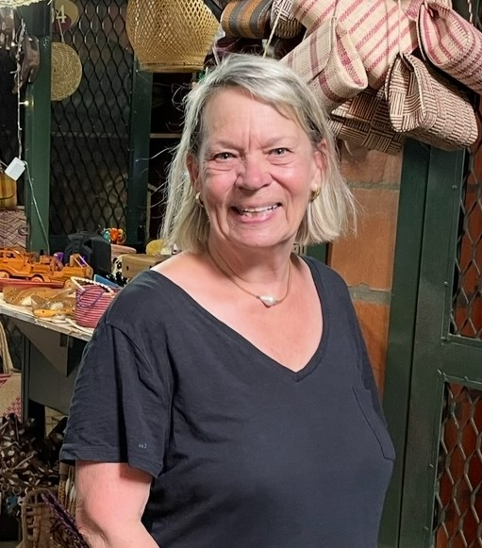
Grants – Co-Chairs, Dawn Straka/carol cartier
ALL Information is on:
https://www.rotary7040.com/page/grants-management
District Simplified Grants
Small, local projects
Max $2,500 USD DDF match
District Matching Grants
Larger, local or int’l projects
Not yet big enough for a Global Grant
Max $8,000 USD DDF match
Requested only ONCE per year
App’l deadline April 30
Completed within the Rotary year
Report deadline May 31
Global Grants –7040 Lead Host/Sponsor
Large, int’l projects - $30,000 +
Done overseas OR here!
Max $10,000 USD DDF match
Global Grants – non 7040 Lead/sponsor
Large, int’l projects $30,000 +
Done overseas OR here!
Max $5,000 USD DDF match
Rolling timelines
Generally last up to 3 years

Slide 5
2023-2024 Grant summary/current district
485 District Grants $30 million USD
106 Disaster Response Grants $4 million USD
1287 Global Grants $72 million USD
1 Program of Scale Grant $2 million USD
1 District Grant (8 projects) $20,079 USD
1 Disaster Response Grant $25,000 USD
12 Global Grants $95,931 USD

Slide 6

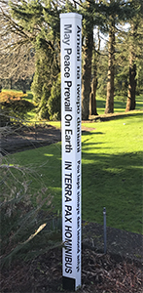

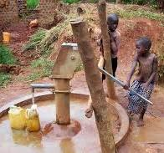
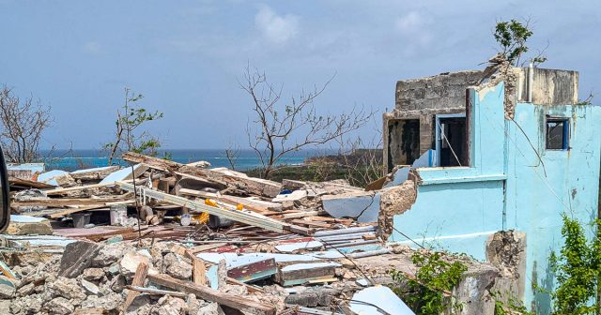
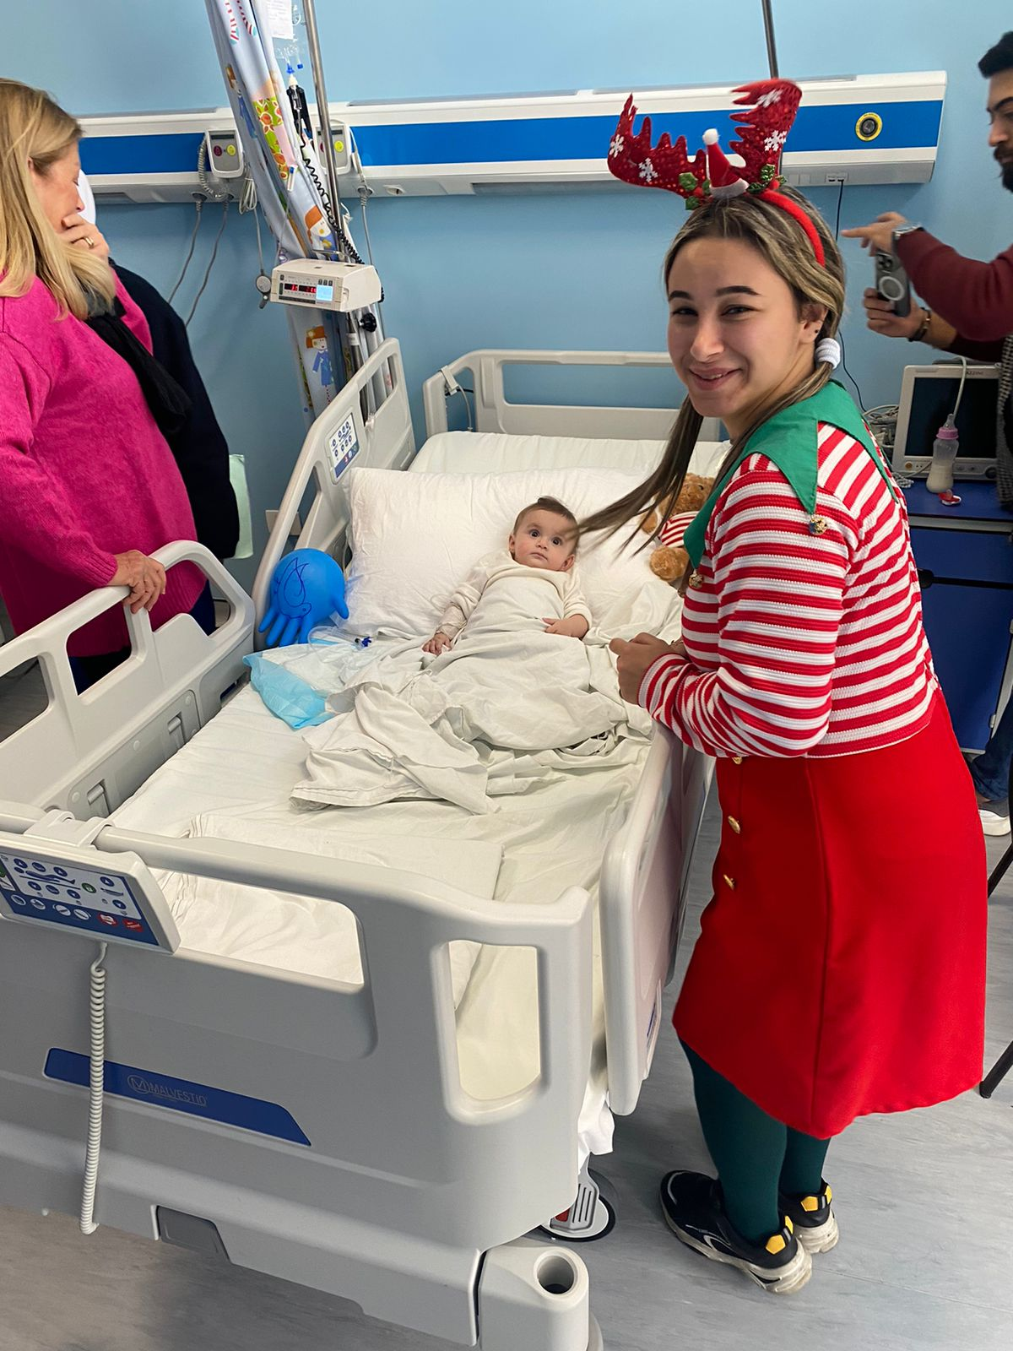
Discussion time
What community project went well last year? Why?
What community project is your club doing now/planning?
What partners do you have?
What funding do you need?
What bigger projects are you wanting to do?
Who have you shared these ideas with?
When do you want to do them?
What partners to you have/need?
What funding do you have/need?
Take one of the above and work on an application – district or global

Slide 7
applications

Slide 8

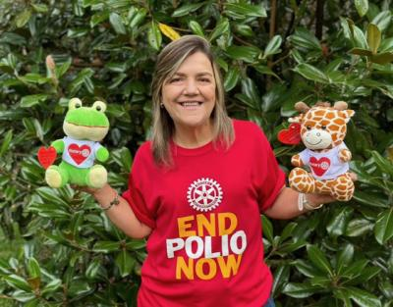
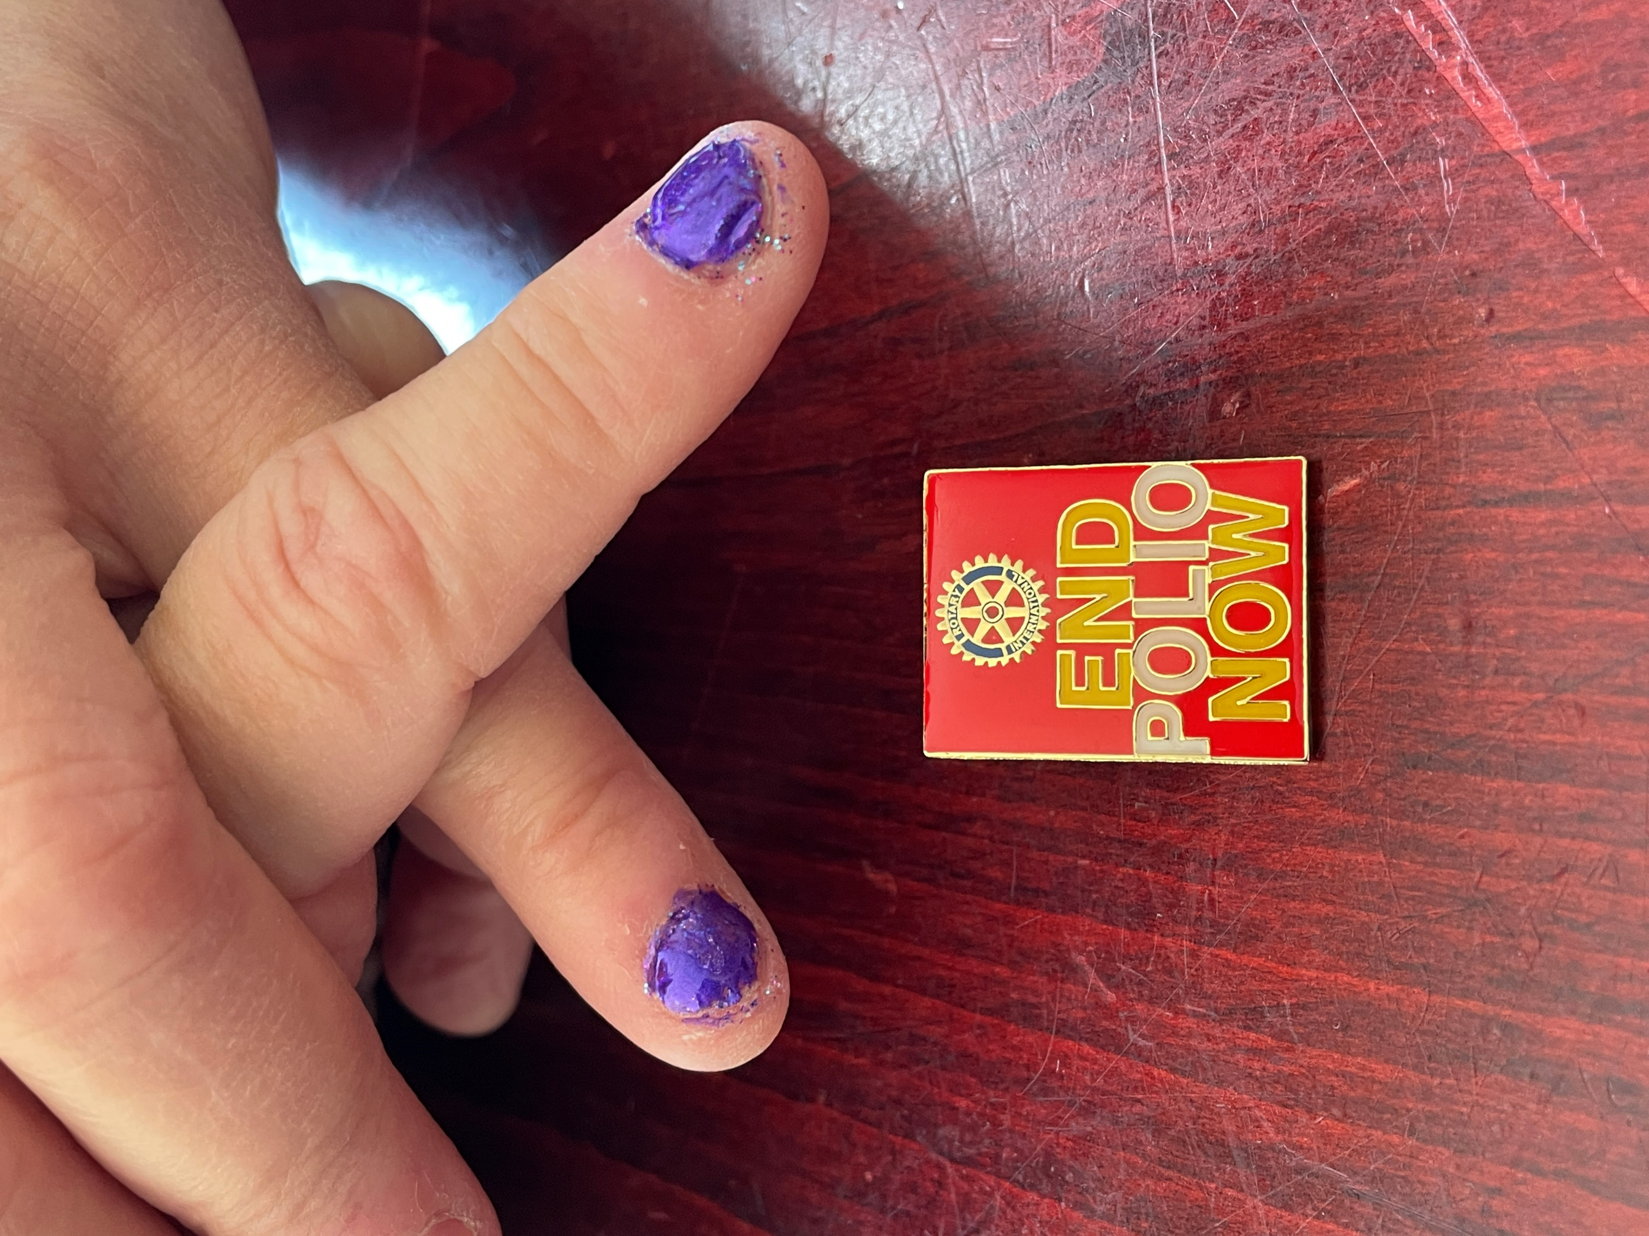

Polio plus
Gaza polio outbreak response continuing – emergency outbreak response in the Gaza Strip is continuing, with a mass vaccination campaign scheduled from 22-26 February, to reach more than 571,000 children. The campaign will aim to address residual immunity gaps, with a subsequent round being planned in April, after Ramadan. Recent detection from environmental samples, including from January, confirms that the strain is still circulating and continues to pose a threat to children with low or no immunity, both in Gaza and throughout the region.
Needle-free syringes for Polio immunization campaigns
The widely known IPV polio vaccine is administered using an intramuscular delivery with a needle and syringe. Now needle-free syringes have been introduced. This syringe — introduced in 2019 by the WHO during its polio eradication campaign in Pakistan — drives the vaccine through a nozzle orifice that delivers the dose into the skin without the penetration of a needle.
The results from using these needle-free syringes were outstanding. This method of vaccine administration helped increase campaign coverage by 18.4% compared to the traditional needle and syringe method. In a survey of caregiver and vaccinator acceptability in Karachi, Pakistan, 97.6% of vaccinators and 99.6% of caretakers preferred jet injectors to needle and syringe. This is because of its speed of use and less discomfort associated. These needle-free injectors also reduce the risk of accidental needlestick injuries both during injection and while managing waste. Additionally, they produce minimal waste.

Slide 9
Polio plus
Notes:
Our most recent member is Don Klug from Watertown. Please update me any time!!

Slide 10
District Fundraising Analysis
Notes:
No one likes numbers, but at the end of the day – the role of the Foundation team is to express BOTH – the spending side of the equation (grants) AND the income side of it (donations). Goals are STILL not being set and our Non-giving clubs remain unchanged.
We DO HAVE THREE NEW PAUL HARRIS SOCIETY members in the last 3 weeks! Thank you to Victor Budz (Kemptville), Michael Griffin (Potsdam), and Peter Labelle (Cornwall Sunrise) – present Chevrons if they are attending.

Slide 11
Rotary direct
Remember…..
Your Amount
Your Timeline
Your Program
Your Currency
YOUR CHOICE!
Notes:
Just ask me for any forms you might need/want!

Slide 12
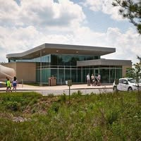
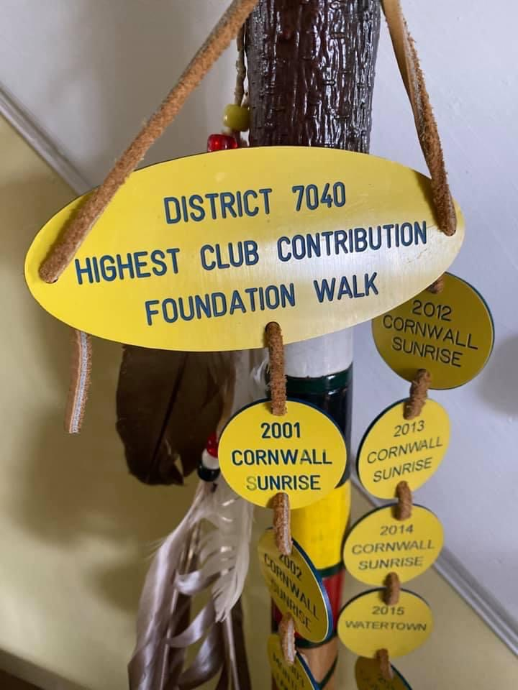
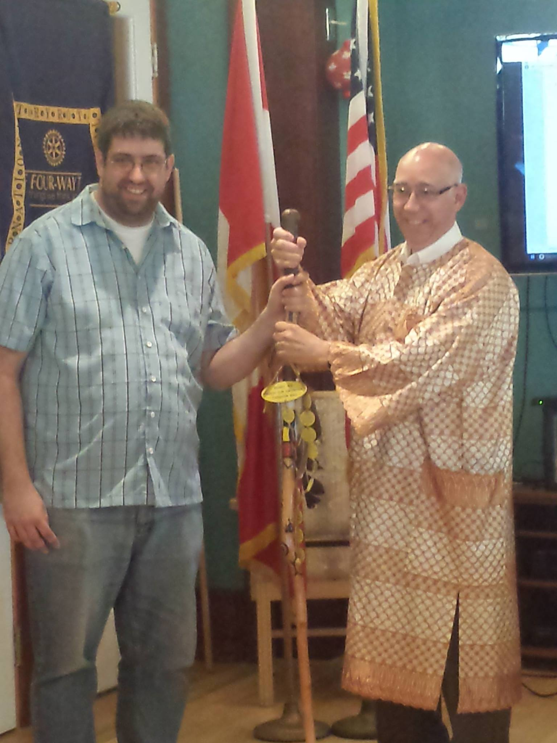
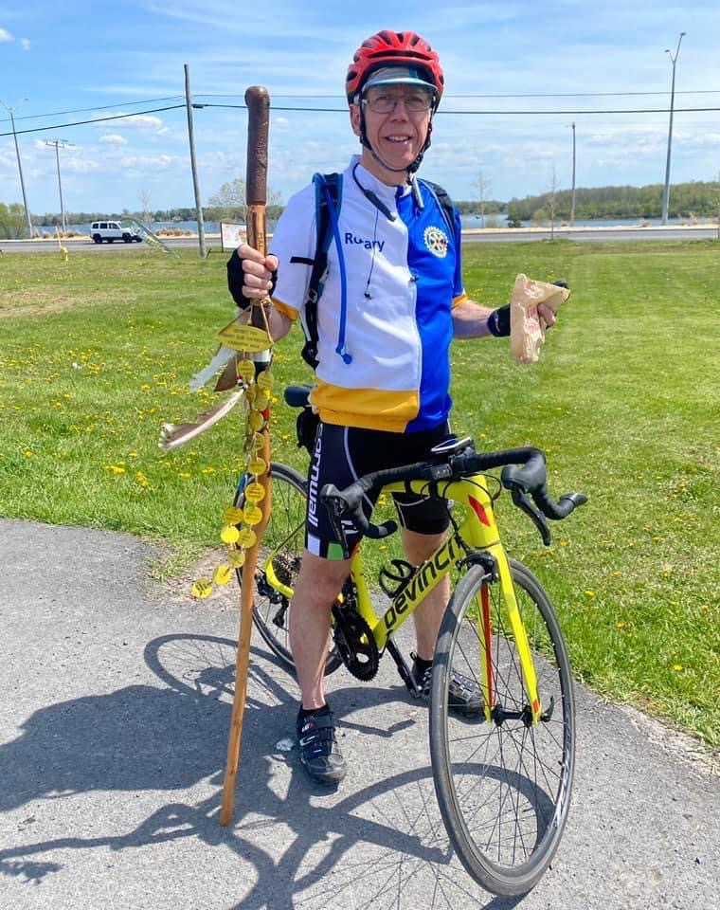
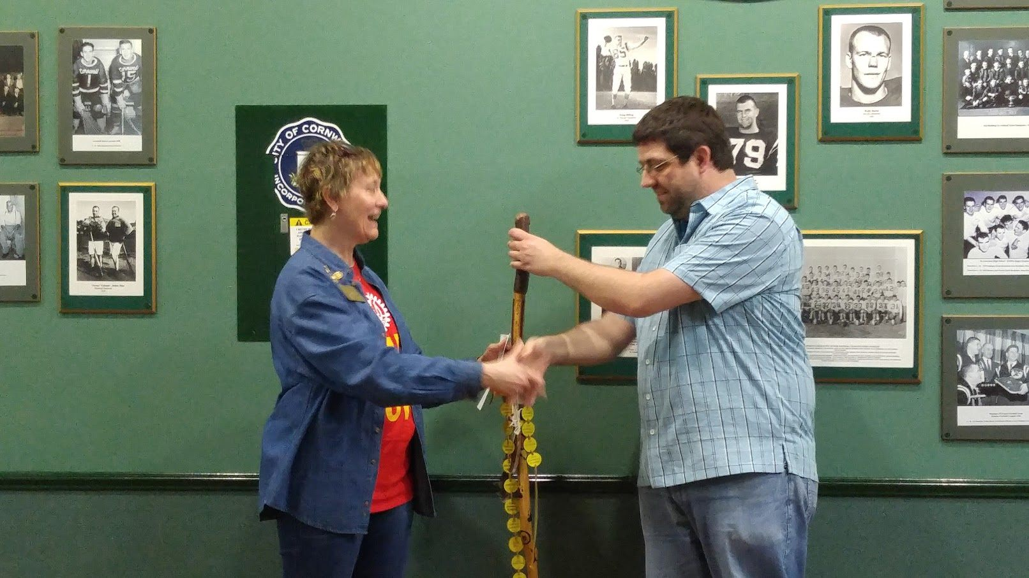
District annual fund walk
May 10, 2025 – Cornwall – Ontario Power Generation – 8:30 AM!
Contact PDG Bette Miller for details!
Bette.miller@cornwallsunriserotary.com

Slide 13

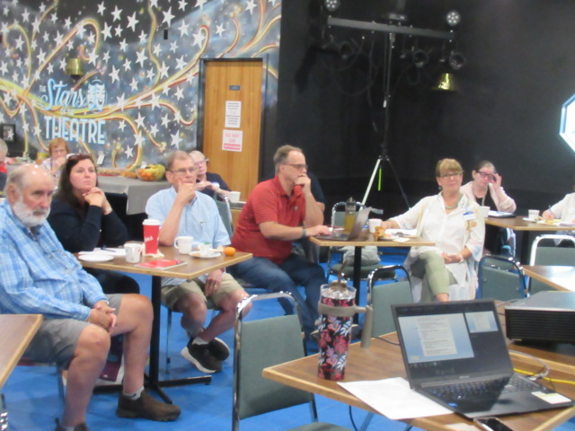
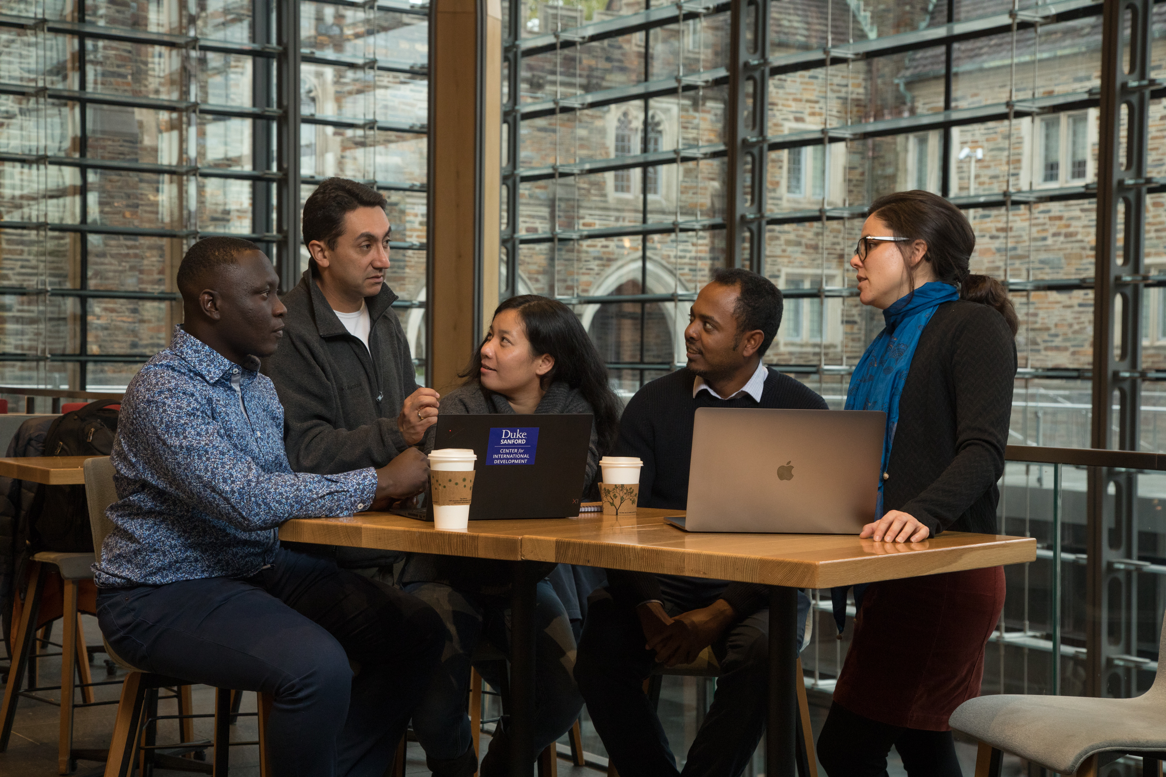

Discussion time
What does YOUR club do to help build the SHARE Annual Fund?
Has this been effective?
What could you do differently to make a true IMPACT?
Does it have to be a big Fundraiser?
What programs does The Rotary Foundation have to help?
Share your ideas…..
Remember – the role of Foundation is TWO SIDED –
1 - Generating donations – fundraising 2 – Spending donations – grants, scholarships
Notes:
Share ideas – record on chart paper

Slide 14
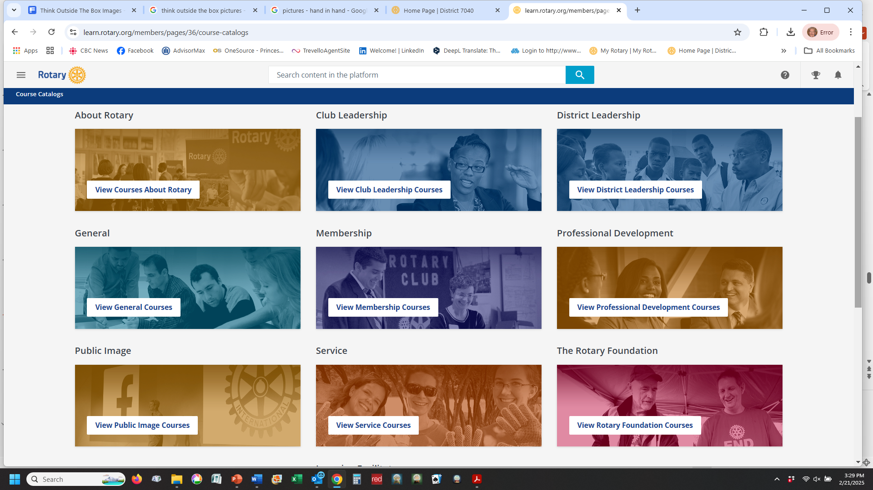
Club qualification
www.rotary7040.com
LEARNING CENTER https://my.rotary.org/en/login
https://learn.rotary.org/members/pages/36/course-catalogs
Notes:
Lots of content to choose from

Slide 15
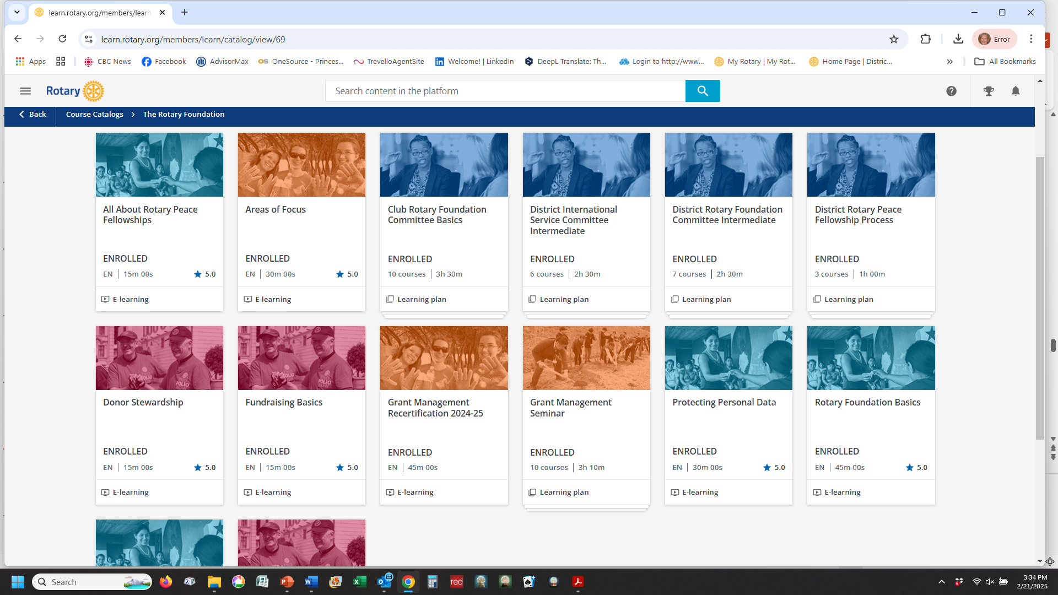
Club qualification
LEARNING CENTER – FOUNDATION COURSES
www.rotary7040.com
LEARNING CENTER https://my.rotary.org/en/login
Notes:
E-Learning – are short 15 minute (usually) modules Learning Plans – are longer and comprised of several short courses.

Slide 16
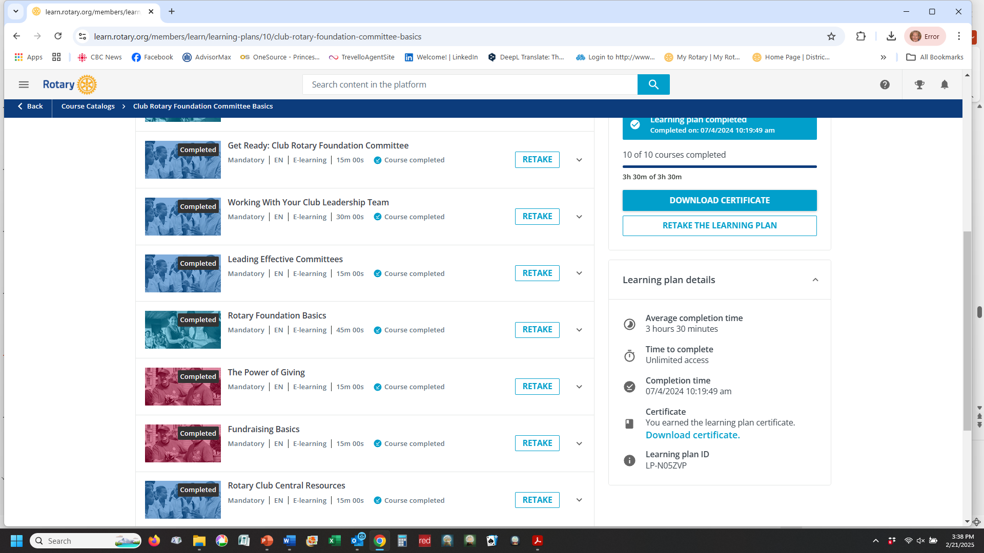
Club qualification
Club Foundation Committee Basics (LP)
www.rotary7040.com
LEARNING CENTER https://my.rotary.org/en/login
Notes:
Some excellent introductory courses for Foundation people – some also overlap with the Grants Management Seminar.

Slide 17
Club qualification
DISTRICT FOUNDATION MODULES – WWW.ROTARY7040.COM
www.rotary7040.com
LEARNING CENTER https://my.rotary.org/en/login
There are ONLY Two District Modules to complete for the 2025-2026 year. All members involved with grants must complete BOTH District modules.
1 - Club Information and
2 - Memoranda of Understanding
Click on the links below to get to the District Modules.
NOTE: These are videos, so you may wish to PAUSE every so often, if you find the information is going too fast.
Club Grant Qualification 2024-2025
https://vimeo.com/1007130653/297b0a4748?share=copy
Memoranda of Understanding 2024-2025
https://vimeo.com/1004604807/2abe498805?share=copy

