Slide 1
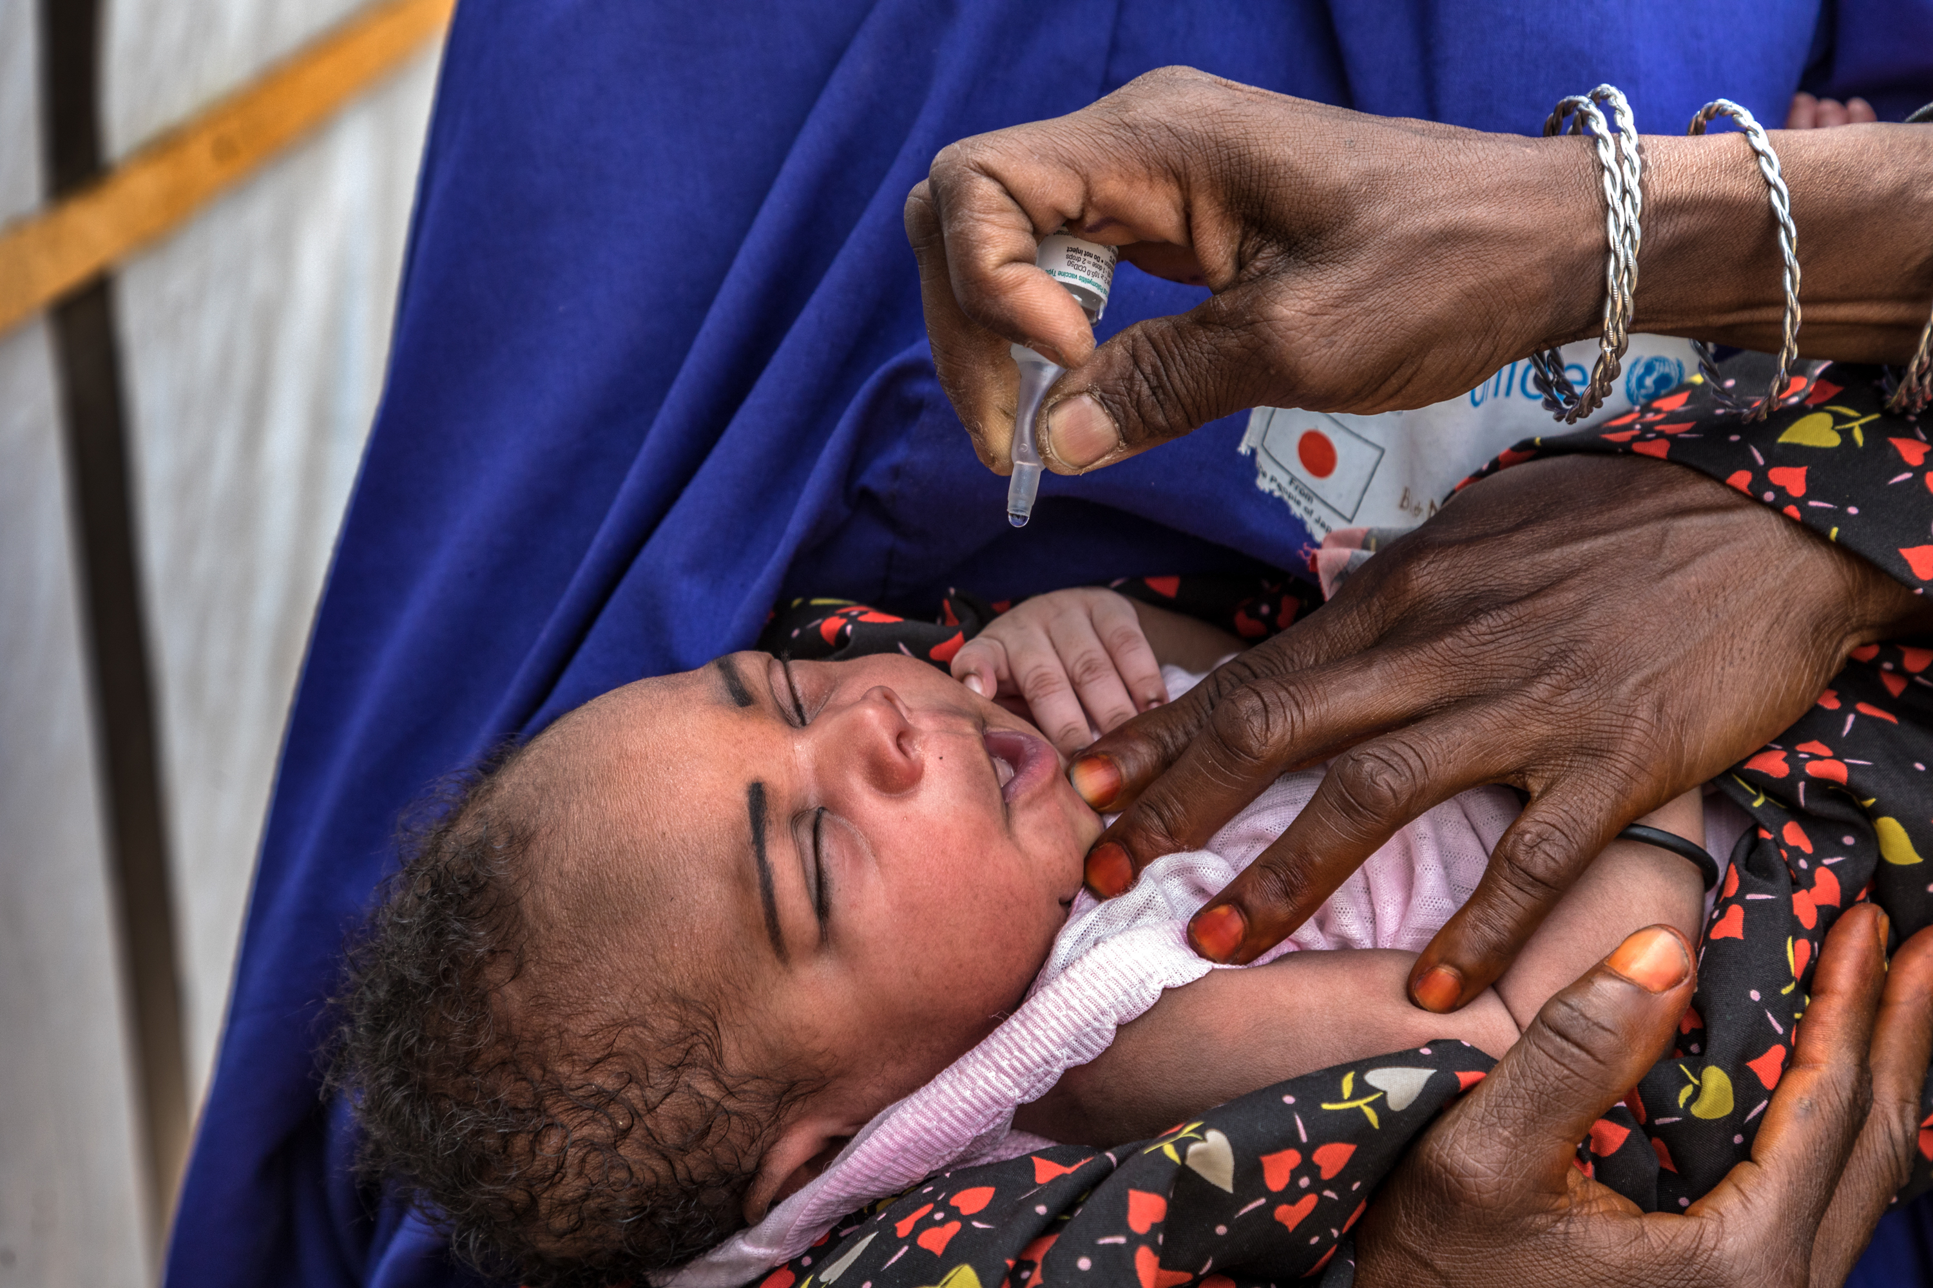
Quarterly
Joint Meeting
Foundation & International
October 2024
THE ROTARY FOUNDATION
Doing Good in the World

Slide 2
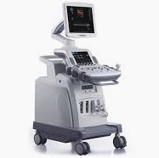
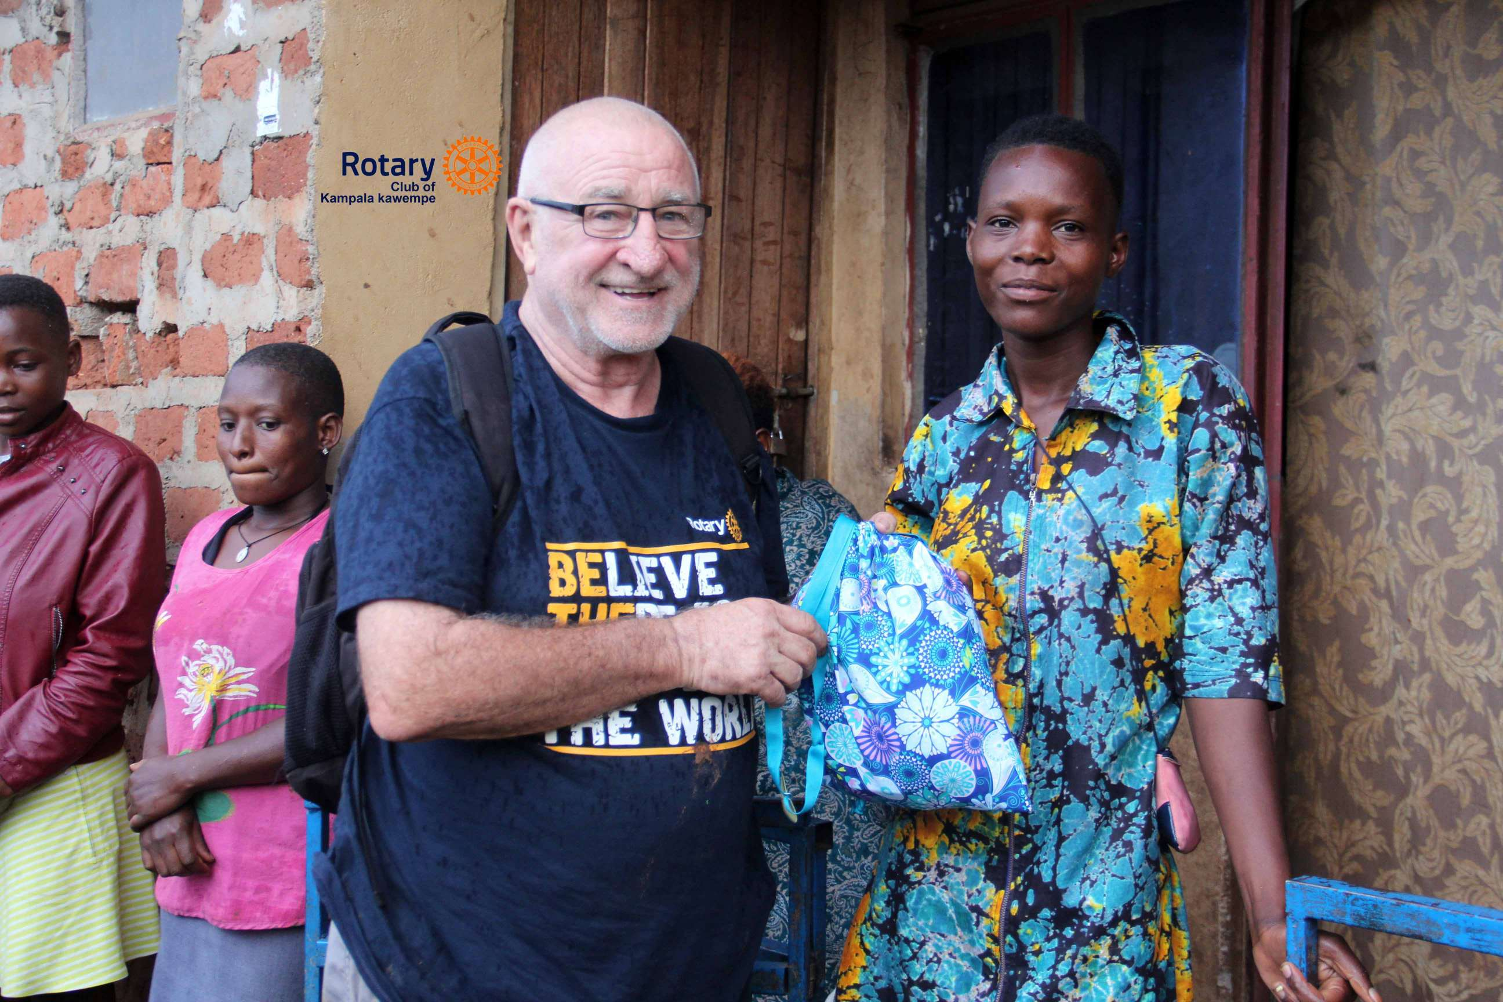
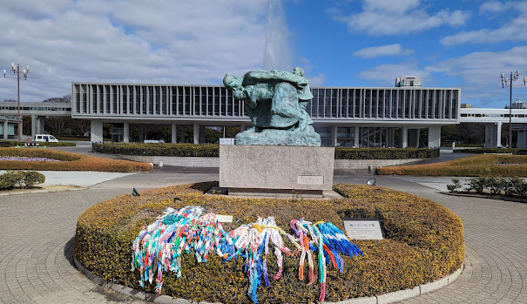
Club projects & special reports
Global Grants – Drafts
Cornwall Sunrise Ghana - WASH project
Montreal Cedars Beirut - Psychiatric Hospital project
Cataraqui Kingston Uganda - Xray machine project
Cornwall Sunrise Fort Myers - Career Tech project
Orleans Colombia - Tennis project
Global Grants – Underway
Ottawa Guatemala - Literacy project
Kingston Colombia - Hearing Screening project
Kingston Colombia - Spina Bifida project
Gananoque Colombia - Empowering Woman/Productive Beauty project
Cataraqui/Sunrise/Petawawa El Salvador - Toileton Phase 5
Cataraqui/Sunrise/
Lakeshore/Kingston Kenya Maternal, Vision, Primary Care project
Alexandra Bay France – Bifida project
Kingston Ukraine – Film School project
Cataraqui Pakistan – Differently Able Children Rehab project
Special Report
Kingston-Pete Burrell Hiroshima – ITHF Peace Trip
Notes:
These are projects currently on the TRF Grant Site – clubs may be heavily involved as lead clubs, or simply supporting initiatives from other clubs. They serve as “idea starters” for all clubs.

Slide 3
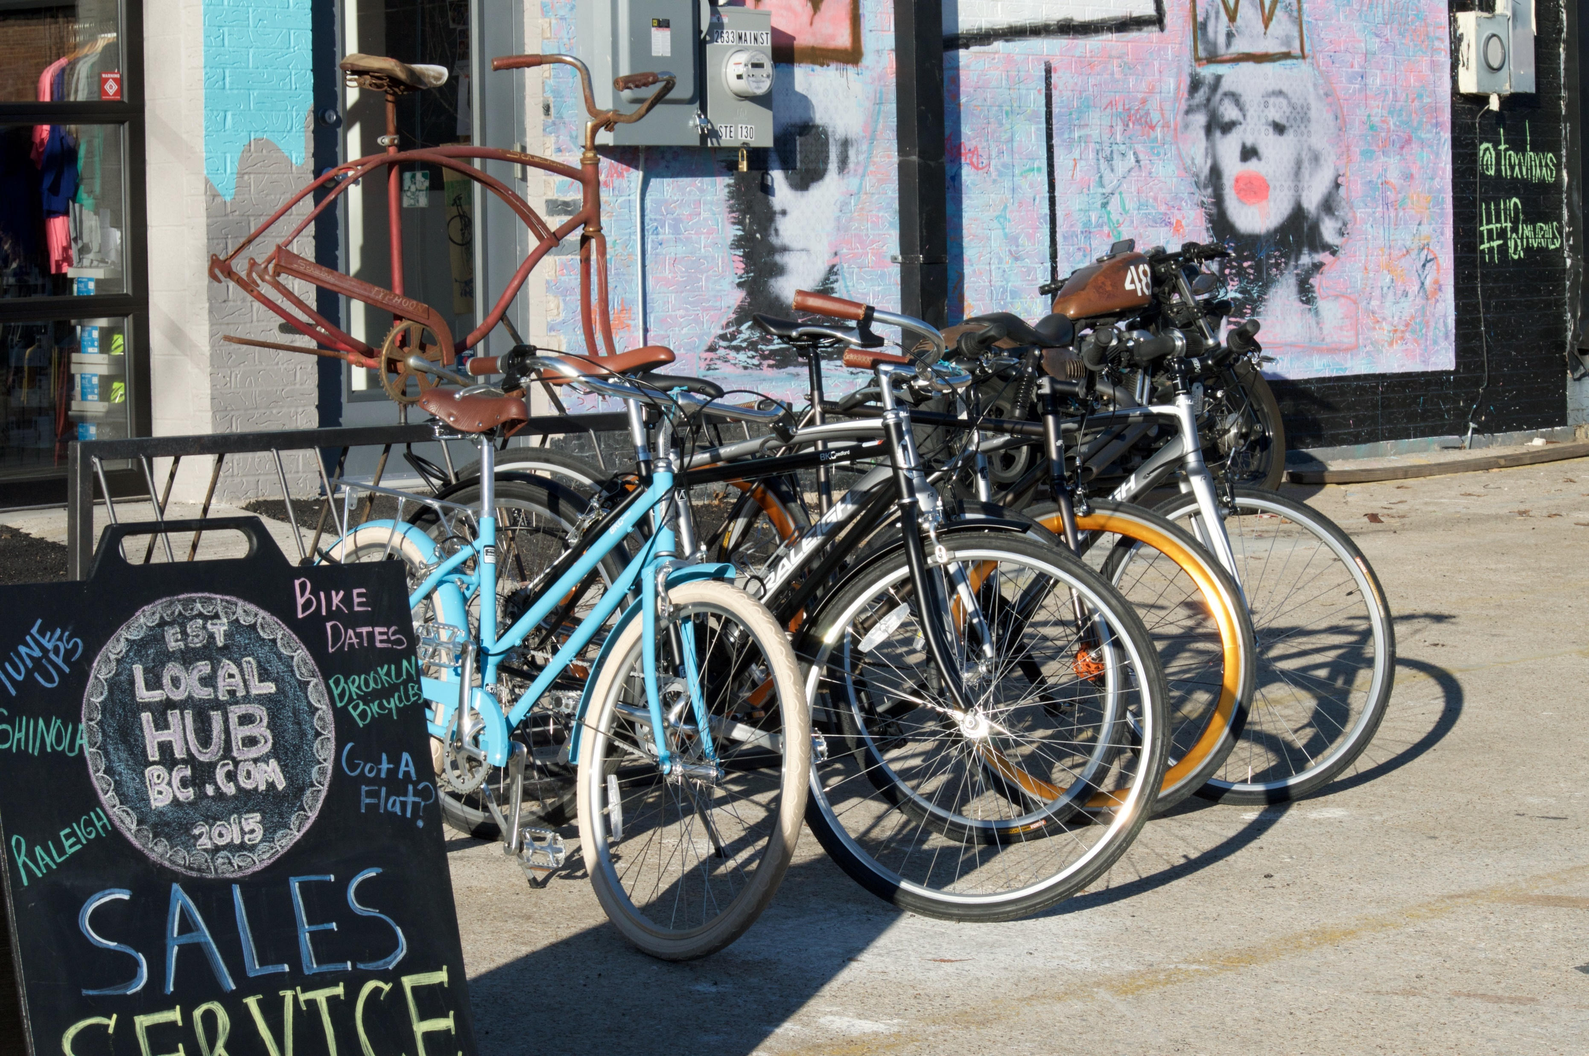
Club projects & special reports
District Grant Projects-2024-2025
West Ottawa Dictionaries for Life
Arnprior Clay Bank Nature Park Outdoor Learning
Arnprior Bicycle Repair Station
ePremier Food Hunger, Pallet Trick
C. Sunrise/Watertown Kampala Skills training
Montreal Cedars Cervical Cancer prevention campaign
Montreal West NDG Kitchen Appliances/Homeless Shelter
Potsdam Dodge Pond Camp
Any other Community projects/events to share??????
West Ottawa ePremier
Kanata Petawawa
Kingston Montreal
John Abbott Rotaract Hawkesbury
Cornwall Sunrise Arnprior
Orleans D7040 Passport
Plattsburgh Massena
Other clubs?
WHAT’S HAPPENING IN YOUR CLUB????
Now & for November Foundation Month?!
Notes:
Clubs share their current activities

Slide 4
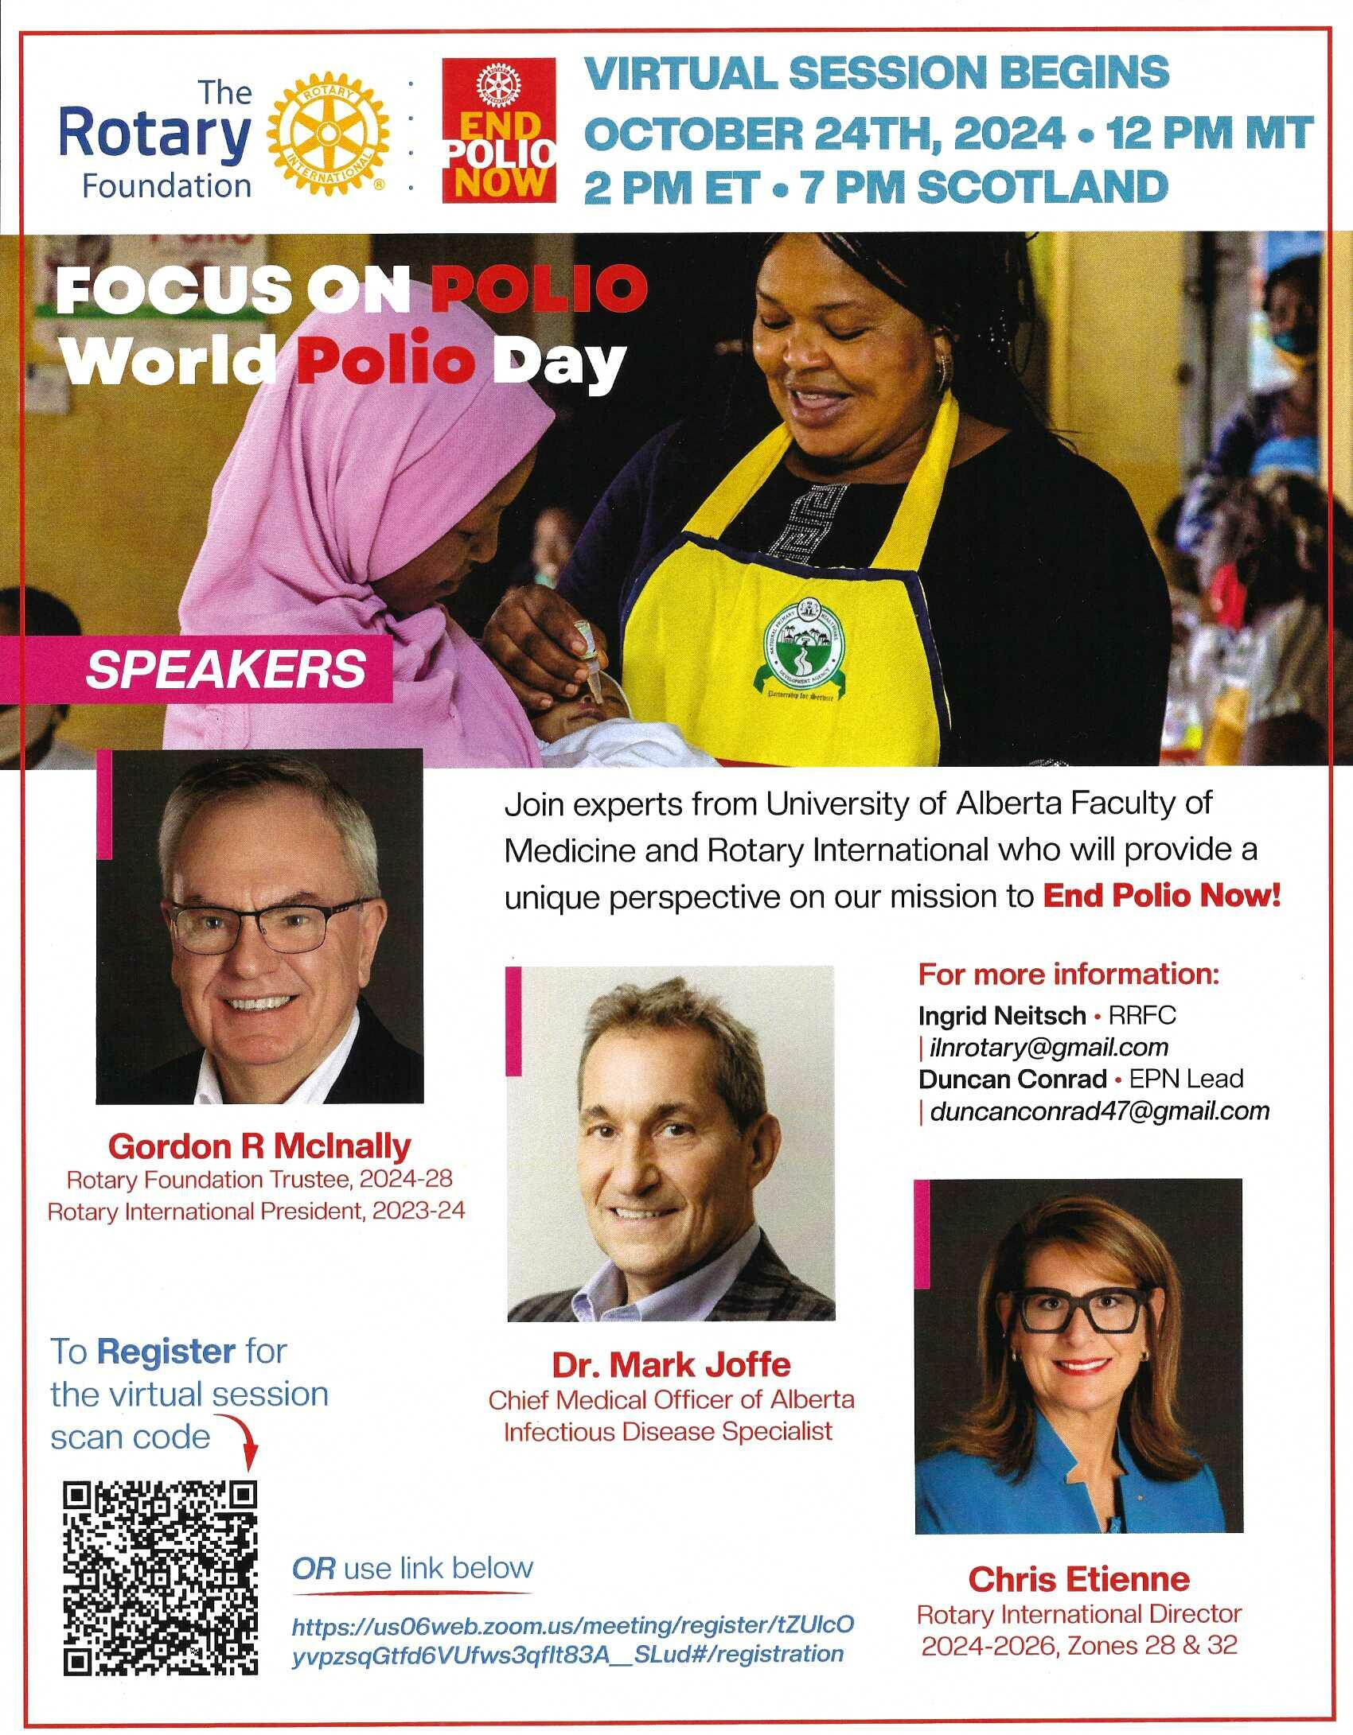
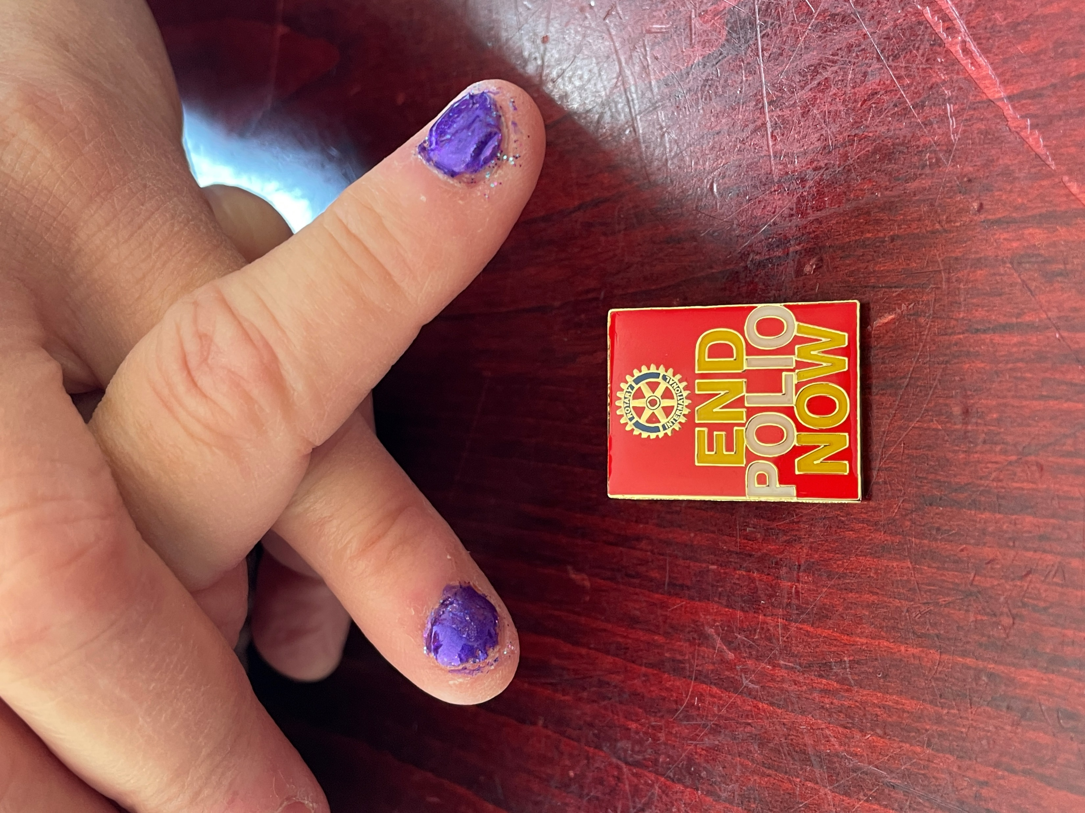
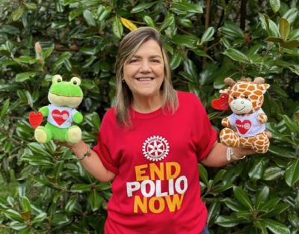
Polio plus – events/presentations
What is YOUR club doing for World Polio Day??
https://us06web.zoom.us/meeting/register/tZUlcOyvpzsqGtfd6VUfws3qfIt83A__SLud#/registration
Notes:
Don’t forget the District Action Plan Challenge of a special event to raise $1500 USD for polio!

Slide 5
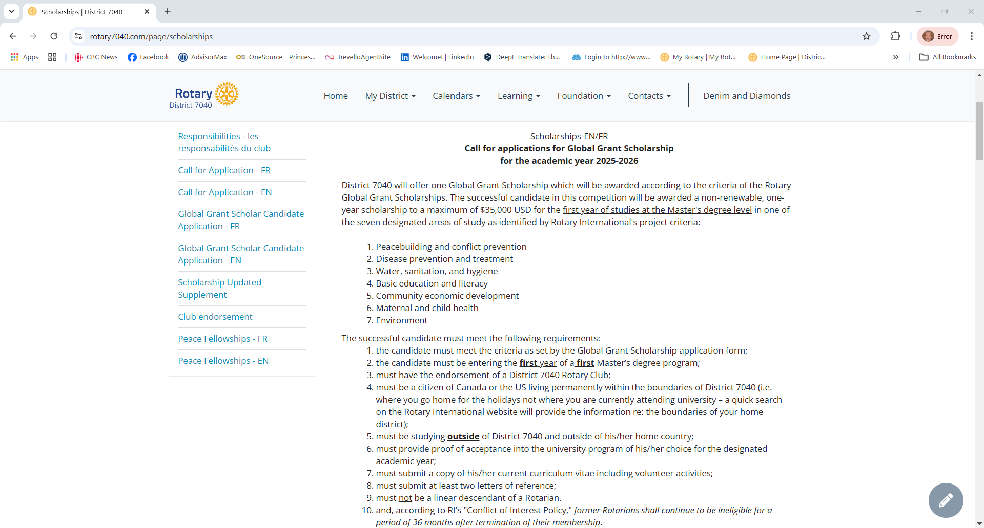
District Gg – scholarship & peace fellows

Slide 6
District Fundraising Analysis
* Goals are being set, but the levels are much less than last year. We encourage ALL clubs to set goals and work to achieve them. Still very concerning, is the number of “non-giving” clubs.
* Rotary Direct participants are UP, which is great!
* We have 2 new/changed Major Donors so far this year, and 1 additional Major Gift. Super!

Slide 7
District Designated Funds - DDF
(39500.00)
District Polio Plus Contribution - $10K becomes $45000 K with World Fund and Gates Matching
(10000.00)
28570.98

Slide 8
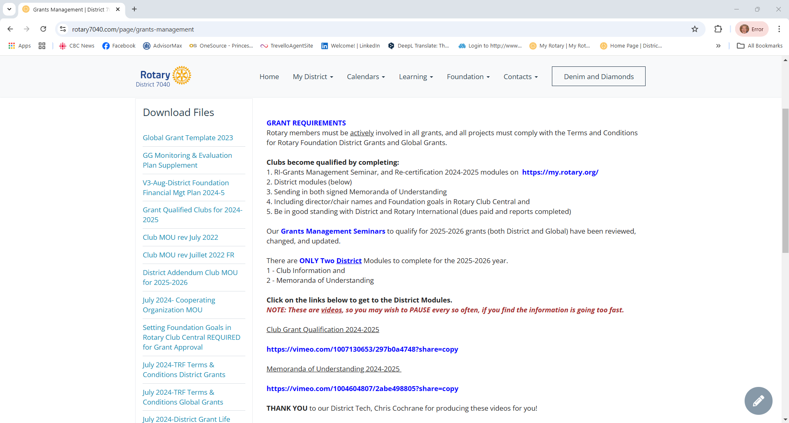
Club qualification
www.rotary7040.com
CLUB QUALIFICATION www.7040ROTARY.ORG
All details for grants, this year and last, are located in the Download Files section
DO scroll down to be sure you have the right document!
French versions of the two District modules are almost ready!! Newly translated and produced!
Les versions françaises des deux modules du District sont presque prêtes ! Nouvellement traduits et produits !

Slide 9
Annual Qualification Courses
Basic Courses
For those responsible, but not directly involved with grants
In Depth Courses
For those working directly with grants
Complete (or top-up new material for) the Grant Management Seminar from RI Learning Center
Complete the Grant Management Recertification 2024-2025 from RI Learning Center
Complete the Grant Management Recertification 2024-2025 from RI Learning Center
Complete this D7040 Club Qualification Course
Complete this D7040 Club Qualification Course
Complete the D7040 MOU Course
Complete the D7040 MOU Course
Send in TWO Signed MOU’s
Notes:
Foundation Qualification must be renewed annually (a Rotary Foundation requirement) for clubs wishing to pursue Global or District Grants.
Club Qualification Requirements
Signed Memorandum of Understanding [MOU] – signed annually by the President and President-Elect and emailed to foundation@rotary7080.org. If a President will be repeating a term, the second signature should be the club secretary.
Qualification by TWO or more club members.
Agree to any additional qualification requirements set by your district.
Be in good standing – current with all RI and District dues and project reports(?)
Member Qualification - Only a member who has completed the following is eligible to be the primary contact on a Global or District Grant application.
Complete the Grant Management Seminar on the Rotary Learning Center in My Rotary https://my.rotary.org/en/. If you have completed it in a previous Rotary year, complete the Grant Management Recertification 2021-22.
Attend the 7080 Foundation Qualification Webinar for its entire duration (approximately 90 minutes including questions). See below for the link.
Agree to any additional qualification requirements set by your district.
Be in good standing – current with all RI and District dues and project reports(?)
Qualification will be effective immediately on completion of the above steps. Qualification will expire on June 30th of each Rotary year.

Slide 10
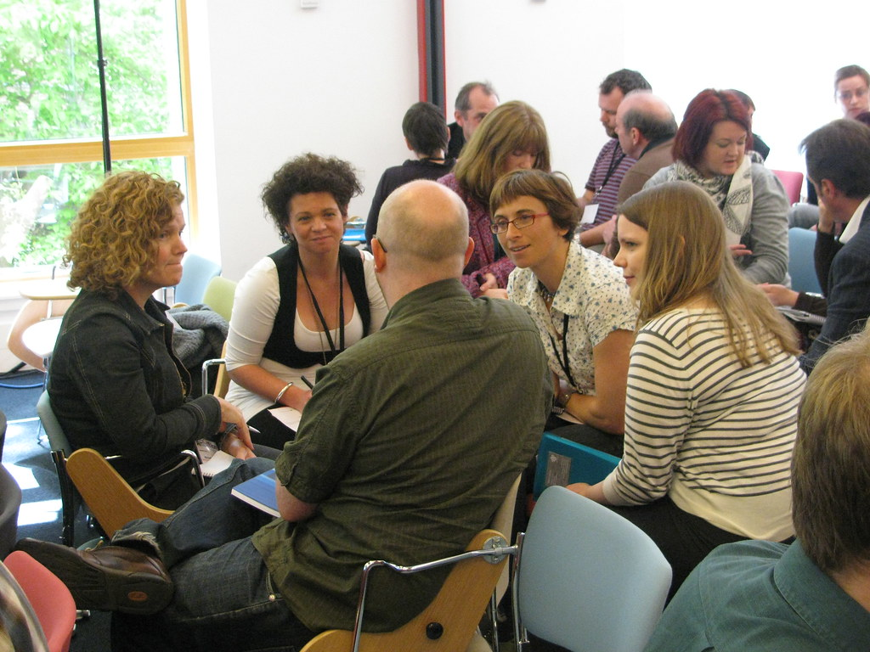
Training completed
Carol Cartier, Grants Co-chair (Kingston) is keeping the training report tally this year
4 Reports
a) TRF Learning Plan (Grants Management Seminar)
b) TRF Learning Center (Recertification 2024-2025)
c) District Club Qualification Module
d) District MOU Module (Declaration)
2 Signed MOUs
a) World MOU
b) District MOU Addendum
All reports are updated on MONDAYS each week. If you have done training in the course of a week, please wait until the NEXT week to ask any questions.
All training should be completed AS SOON AS POSSIBLE to avoid last minute issues and enable clubs to apply for grants right away.

Slide 11
District grant application
Use this SAMPLE to start working with your committee and other clubs.
Copy/move the information over to the MyRotaryProjects.org site – our DISTRICT APPLICATION SITE
The Stewardship committee will review the grant and may have questions to clarify intent or funding
If approved, the project will be included in the next District Spend Plan
All reports must also be completed on the MyRotaryProjects.org site
Notes:
Work together to plan activities or projects. Share best practices. See what is required for an application AND for a report.

Slide 12
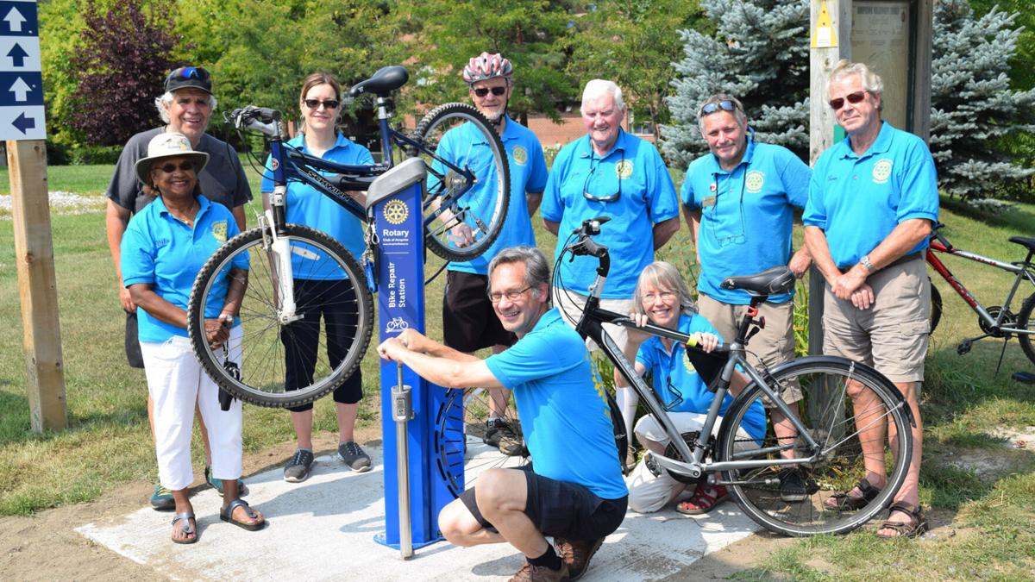
MyRotaryprojects.org – District Site!!!
DISTRICT PROJECT SITE
All Simplified and Matching Grant applications must be submitted on this site for consideration for any DDF Funding
Login as Club Admin
(anyone in the club can register as Club Admin!)
Upload project details
Seek funding
Find partners
Share photos
Find ideas for new projects
Copy replicable projects
Complete reports
Celebrate success!
Global Grants may be uploaded here to assist with visibility and funding requests however, formal applications must be entered in the Rotary International Grants Center
Peter Labelle is the webmaster, but many our team can admit you to the site for the 1st time!
NOTE - NOT THE SAME SITE AS ROTARY INTERNATIONAL’S SERVICE PROJECT CENTER!!

Slide 13
Upcoming dates
EVERYONE WELCOME!!!!!
October 20 – 7-8:30 pm Zoom - DG Dino Marzaro – Experiences with Polio
October 24 – 2-3 pm Zoom – World Presentation, Past RI Pres Gordon McInally, Dr. Mark Joffe, Christ Etienne Zone 28/32
November 9 – 9-9:45 am Zoom – PDG Sue Bellor – Mini Info Session on Endowment
November 13 – 6 pm – Kingston - JENNIFER JONES CELEBRATION FOUNDATION DINNER – Past RIP Jones is receiving an honourary degree from Queen’s on Nov 14th
December 7 – 9-10 am Zoom – Barbara Fisk and Peter Labelle – Global Grant Live Application Walk-through

