Slide 1


Third Quarterly Meeting 25-26
District International Service & Foundation Committees
February 21, 2026

Slide 2
Increasing Our Impact
Expand Our Reach
Enhance Participant Engagement
Increase Our Ability to Adapt

Slide 3
Increasing Our Capacity by Learning More
Goals for our District International Service Committee
  Club ISC/Foundation Chairs
    using Service Project Center 24-25 = 2 25-26 =
    joining Rotary Action Groups/Fellowships 24-25 = 3 25-26 =
    completing more Learning Center courses 24-25 = 12 25-26 =
  Attendance at Project Fairs 24-25 = 3 25-26 =
  Club articles in District Newsletters with photos 24-25 = 1 25-26 =
  Develop capacity to understand INCREASE OUR IMPACT & Building Blocks of a Project 24-25 = 9 25-26 =

Slide 4
Increase Club Knowledge
Anyone ending their term as Club International Club Chair in April?
Who could come with you on April 18th?
What more are you looking for from our International Service meetings?

Slide 5
Enhance Participant Engagement
Rank these in priority order for your club:
A. Grant writing guidance & training
B. Clear information on existing projects
C. Help finding partners
D. Flexible ways to participate in grants
E. District-level coordination without additional admin

Slide 6

Learning Center Updates
Who has taken the 4 Service Project Essentials courses in the Learning Center?
The courses include:
  General advice on planning projects
  A guide to creating a budget
  Tips for evaluating your project.
Each course can be completed in about 15 minutes.

Slide 7
Expand Our Reach
How might you accomplish this doing projects?
  Which of your upcoming projects will be with other clubs?
  Which community organizations will be engaged (not only $)?
  Who in your club will develop a social media plan for all stages of project?
  Bigger, better, bolder projects!

Slide 8
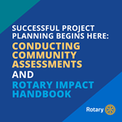
Enhance Participant Engagement
More than Global Grant use!!
What have you found useful in the handbook?
Truly connecting with your beneficiaries
“We’ve been heard”

Slide 9
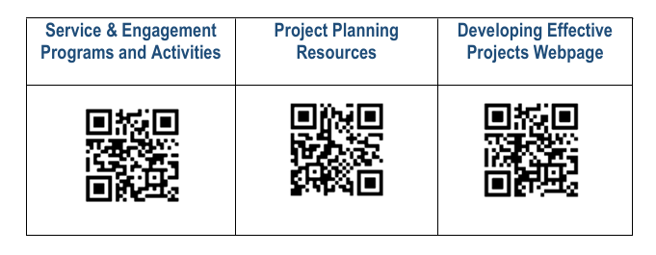
International Service: QR Codes

Slide 10

Increase Our Ability to Adapt
Who has placed their project(s) on spc.rotary.org?
Who has already used the Grant Center to apply for a grant, track its progress, report on it, and search for other grants in our district and beyond?
Let’s look at it!

Slide 11
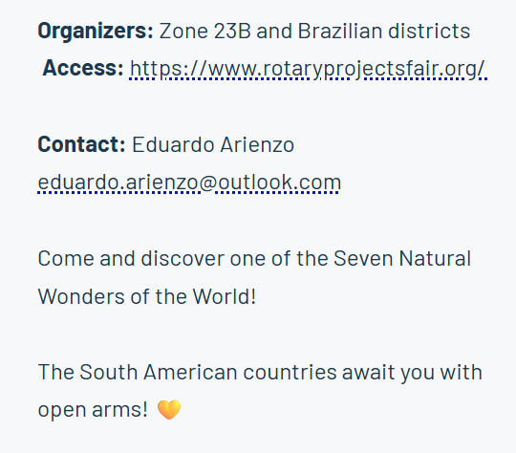

International Service:
2025-2026 Project Fairs

Slide 12
Hands-On Service Project Center
How many D7040 clubs have projects listed?
What’s the difference between Rotary Campaigns and Service Projects?
What’s listed under My Club Projects (if you’re signed in)?
What’s stands out to you in the Grant Center?
  How could you use this?
Check Resources
  What are you going to spend some time exploring?

Slide 13
Hands-On Service Project Center
Test Your Knowledge About IMPACT
Play Kahoot - Planning Projects to Make an IMPACT

Slide 14
Next Meeting - April 18th
L U N C H !!

Slide 15

District Resource Networks
District Resource Network
Rotarians Rotaractors
Alumni & Peace Fellows including Youth Exchange
Peace Activators, UN Representatives Network
RCC members, community members, and partners
Cadre of Technical Advisers
Action Group members
Fellowships & ICC members
Project Fairs &
Friendship Exchange
Notes:
Through your District International Service Chair, you can access your District Resource Network with some of the best experts to contribute their skills, expertise, and resources to help solve some of the world’s toughest issues.
DISCs work closely with district and clubs to identify and recruit mentors to build a resource base that helps clubs develop higher quality, sustainable projects and grants.
They include:
Rotary members & Rotaractors with project and grant experience;
The Cadre of Technical Advisers and Rotary Action Group members, two of our best project planning resources and you’ll be hearing more about the Cadre and Action Groups in this session
They have the professional expertise in the areas of focus, project design and implementation, grant writing and TRF grants to help clubs plan more sustainable and impactful projects.
Project Fairs
Fellowships, Friendship Exchanges
Also:
Rotary Alumni, such as Global Grants scholars and Peace Fellows;
Non-Rotarian experts: Rotary Community Corps, InterCountry Committees, local business and community organizations (schools, government, religious groups)
And our partner organizations, like Peace Activators and the United Nations Representatives Network

Slide 16
District Resource Network for D7040
Intercountry committee members
Project Fairs
Cadre of Technical Advisors
  Bette, Peter, Bonnie
Rotary Action Groups
  Raise hands, if you are ENGAGED
Rotary discussion groups/forums on Action Group websites
District Conferences
RI Convention
Zone Institutes
Rotary Alumni, incl. YE
District Rotary Foundation Chair, Pardeep
District Grants Chair, Carol
District Internat’l Svce Chair, Bonnie
Regional Grants Officer, Renee Reiling, RI Evanston
Area of Focus Managers at RI
Other District clubs/Rotarians having completed successful grants similar to what your club wants to do…

Slide 17
Learning by Query
x

Slide 18
Building Blocks to Impact Activity
Please break into 4 larger tables (push 2 tables together)
Discuss the Building Blocks diagram first
THEN place the headers (Input, Output, Outcome & Impact)
B E G I N by reading the scenario…

Slide 19
Any Ponderables??
Let’s discuss related to the Answers…
  How could have the project been:
    Stronger?
    Easier to implement?
    Involved more Rotarians?

