Slide 1


BRINGING OUR ACTION PLAN TO LIFE
LESSONS FROM THE 2023 NORTH AMERICA GROWING CLUB STUDY.
Doug Logan, Zone 28 Rotary Coordinator
Herb Klotz, Zone 32 Rotary Coordinator

Slide 2
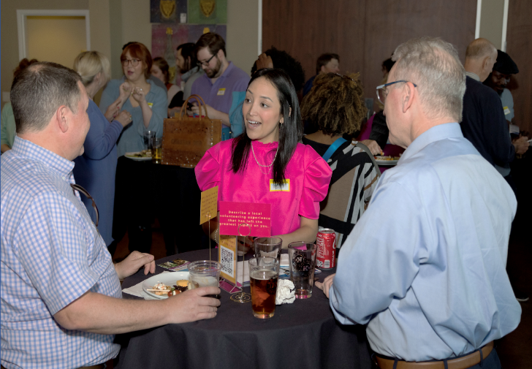
ATTRIBUTES OF GROWING CLUBS (2022 Study)
Active, intentional member engagement
Dynamic, meaningful service
Effective governance (intentional leadership)
Strong public image (well known in community)
Diversity (representative of community)

Slide 3

SURVEY (2023)
ROTARY CLUBS IN USA, CANADA & CARIBBEAN
(Zones 25B-34)
~350 clubs that showed consistent growth between 2018-2023
Top 4% to 5% of ~8,200 clubs
121 responded (35%)

Slide 4
SURVEY CRITERIA
10+ Net Members in 5 years
Growth in at least 3 of last 5 years
Club Sizes Surveyed
35% < 20 members
50% 21 – 59 members
11% 60 – 100 members
4% 101+ members

Slide 5

Survey Overview
Included 10 action statements linked to Action Plan priorities.
Plus, two open-ended questions focused on top reasons for growth in their club.
Example: Increase Our Impact
We set club goals (membership, foundation, service, etc.), track our progress and adjust our actions according to how well we’re doing.
(Check One: Never(1), Rarely(2), Sometimes(3), Often(4), Always(5))

Slide 6

ACTION PLAN PRIORITY 1:
INCREASE OUR IMPACT

Slide 7
INCREASE OUR IMPACT (AVERAGE RATING)
We have strong governance and leadership continuity. 4.3
We actively partner with other organizations. 4.2
We periodically conduct a community assessment. 2.8
We set club goals and track our progress. 4.0

Slide 8

HOW WILL WE INCREASE OUR IMPACT?
Set realistic goals and track progress.
Strengthen club leadership & governance, especially succession planning.
Focus on our community (local and/or international).
Assess community needs and build meaningful partnerships.

Slide 9

ACTION PLAN PRIORITY 2:
EXPAND OUR REACH

Slide 10
EXPAND OUR REACH (AVERAGE RATING)
We use multiple media to tell our story. 4.3
We actively partner with other organizations. 4.2
We strive to ensure our members reflect our community. 4.0

Slide 11
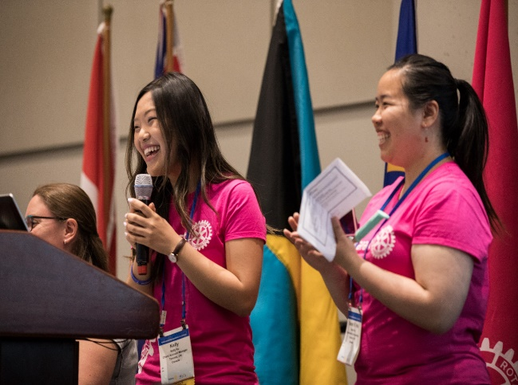


EXPAND OUR REACH
Average attraction
Growing clubs
25%/year
All N.Am. clubs
12%/year
~15%/year
Average attrition

Slide 12
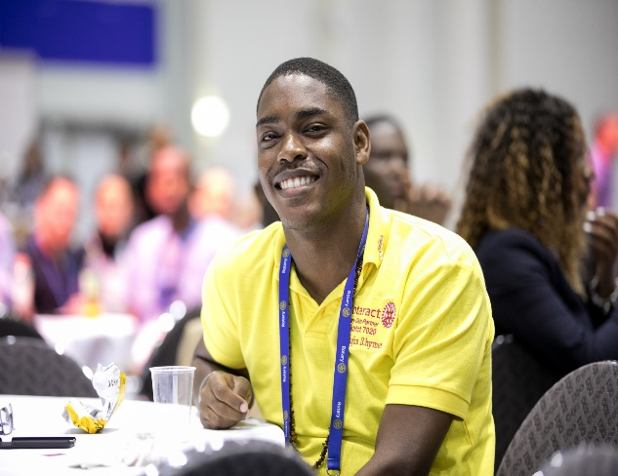
HOW WILL WE EXPAND OUR REACH?
Use multiple forms of media to tell our story.
Engage the whole club in attracting new members.
Invite others to our meetings and service projects.
Ensure membership reflects our community.

Slide 13

ACTION PLAN PRIORITY 3:
ENHANCE PARTICIPANT
ENGAGEMENT

Slide 14
ENHANCE PARTICIPANT ENGAGEMENT
(AVERAGE RATING)
We celebrate our successes and have fun together. 4.6
Members and others are keen to participate. 4.1
We seek out and support member’s priorities. 4.1

Slide 15
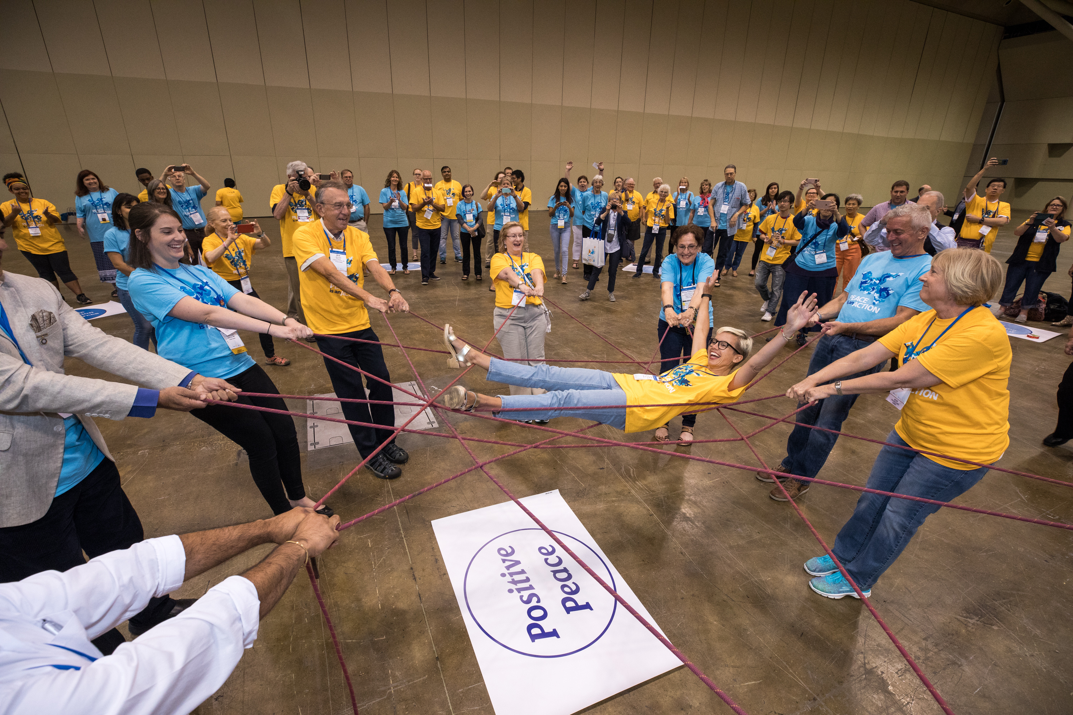
HOW WILL WE ENHANCE PARTICIPANT ENGAGEMENT?
Ensure a welcoming and ‘fun’ club culture.
Find new ways for people to be involved.
Respond to members’ interests and priorities.
Make member ‘care’ a top priority.
Consider the cost of participation.

Slide 16

ACTION PLAN PRIORITY 4:
INCREASE OUR ABILITY
TO ADAPT

Slide 17
INCREASE OUR ABILITY TO ADAPT (AVERAGE RATING)
We are open to new ideas & willing to try new things. 4.3
We have strong governance and leadership continuity. 4.3
We seek and support member’s priorities. 4.1
We strive to ensure our members reflect our community. 4.0

Slide 18
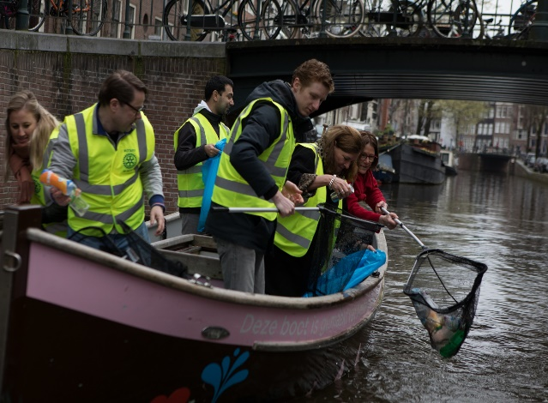
HOW WILL WE INCREASE OUR ABILITY TO ADAPT?
Ensure our club reflects our community.
Use our new members’ innovative ideas.
Try new approaches to meetings, service projects, fun events, etc.
Start a satellite or Impact, Rotaract, Passport club!

Slide 19

TWO LESSONS

Slide 20

LESSON 1
Growing clubs’ attraction rates are 10% higher than their attrition rates because they focus on creating an irresistible experience.
Retention is an outcome, not a target.

Slide 21

LESSON 2
The Action Plan is our guide to creating experiences people don’t want to miss, that draw others in, and to being proud and loud in telling our story.

Slide 22
THANK YOU!

