Slide 1
PolioPlus & Rotary
Presentation to Rotarians in District 7040
September 14, 2024

Slide 2
The District Polio Team: Joan Hunter (Rotary Club of Ottawa South) Susan Diening (Rotary Club of West Ottawa) Akmal Samsor (Rotary Club of Barrhaven)
Joan became a Rotarian in 2012
Susan became a Rotarian in 1995
Akmal became a Rotarian in 2024
Many of us, of a certain age, have childhood memories of pictures with children in iron lungs
Some of us have had a close friend or family member in their life, who had had polio as a child and have lived with a disability as a result

Slide 3
October 24, 2024 World Polio Day
We need to ramp up our effort to eradicate polio to protect children from this devastating and disabling disease
Note the outbreak of polio in Gaza where the conflict between Hamas and Israel has prevented children from being vaccinated and note the efforts currently underway to vaccinate 640,000 children
What can we do to engage Clubs in planning for World Polio Day Action?
What can we do to increase donations to the PolioPlus Fund?

Slide 4
Current Data
As of September 4, 2024 the number of wild polio cases is 34: 16 in Pakistan and 18 in Afghanistan
In 2023 the number of cases was 12: 6 in Pakistan and 6 in Afghanistan
In 2022 the number of cases was 30: 2 in Afghanistan, 20 in Pakistan and 8 in Mozambique
In 2021 there were 6 cases: 1 in Pakistan, 1 in Malawi and 4 in Afghanistan
In 2020 there were 140 cases: 84 in Pakistan and 56 in
Afghanistan

Slide 5
Club Engagement
Fundraising goals
Actions needed
Measurement and Recognition of Success

Slide 6
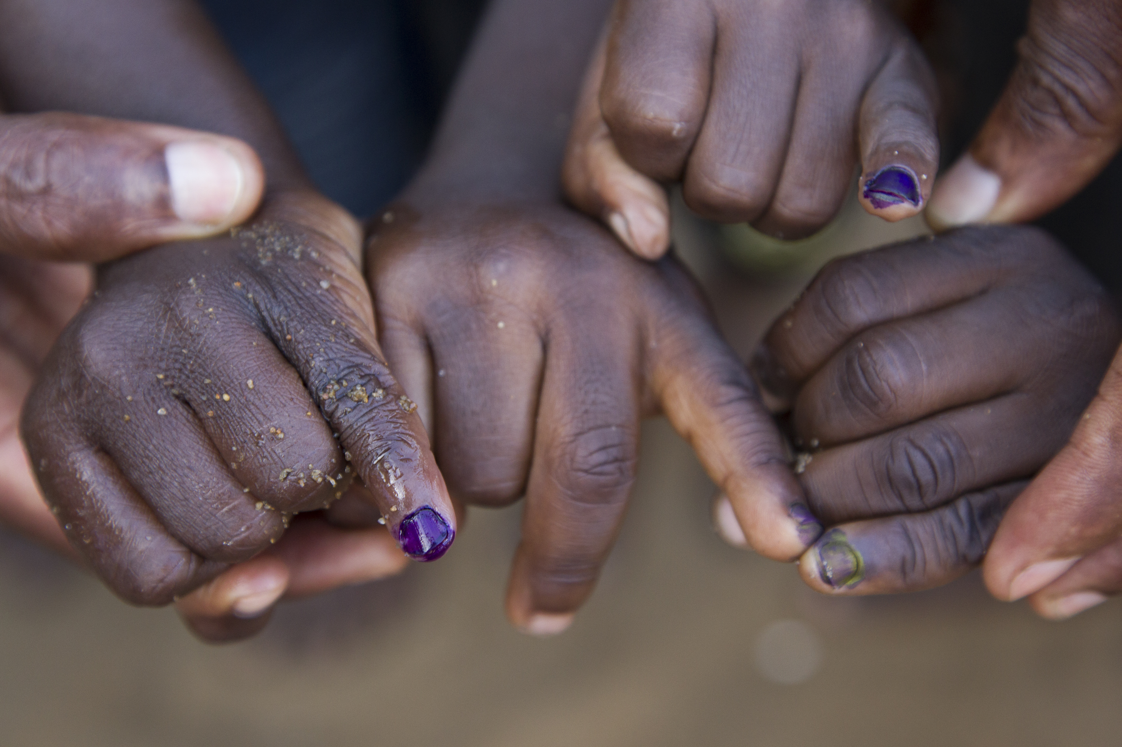
Fundraising
Races (Run for PolioPlus, Walk for PolioPlus
Money Jars (for Club meetings, family & friends, local businesses)
Wine and Cheese events
Small dinner parties
Bake sales
PolioPlus Society ($100 USD per year) for individual donations

Slide 7
Recognition of Clubs in District 7040 for which donations to the PolioPlus Fund exceeded US$1,500 in 2023-2024
Arnprior
Cataraqui-Kingston
Cornwall-Sunrise
Massena

Slide 8
Education and Learning
Learn - need to be informed
Share – need to spread the word making polio a subject of conversation within the community
Donate – need to seek donations (note matching 2:1 by the Gates Foundation: as an example, if your Club or your members donate $2,000 with the matching this becomes $6,000 but Rotary needs to raise 50,000,000 annually for the Gates Foundation to provide the matching money)
It is most important to ensure PolioPlus donations arrive at
TRF(Canada) or TRF early in our Rotary year so they are
matched with 2-1 from the Gates Foundation.

Slide 9
History of Rotary and Polio
Rotary is a partner in the Global Polio Eradication Initiative along with: WHO, CDC, UNICEF, the Bill and Melinda Gates Foundation and Gavi (a global vaccine alliance to protect people’s health by increasing equity in immunization)
PolioPlus campaign was launched in 1985
Rotary has helped reduce polio cases by 99.9%
But eradication does not mean elimination; vaccinations will always be required around the globe.

Slide 10
Eradication remains the goal
But we are not over the finish line yet
We cannot give up
As we know, polio is only a plane ride away!
Anti-vaxxers affect our ability to immunize children
World events (climate, conflict, etc) also interfere with vaccination efforts.

Slide 11
Next steps
What can we do as champions in our Clubs?
What can we do to assist you?

