Slide 1
Why should we eradicated Cervical cancer?
dalene barnard

Slide 2
Why eradicate cervical cancer?
1. Eradicate all cancer

Slide 6
Why eradicate cervical cancer?
1. Eradicate all cancer
2. Common

Slide 7
Breast cancer
Causes
Types
Lifestyle
Genetics
Bad luck
Pregnancy
Breastfeeding
Family history
Smoking
Alcohol
Unknown
Ductal Carcinoma In Situ (DCIS)
Invasive Breast Cancer (IDC/ILC)
Angiosarcoma of the Breast
Inflammatory Breast Cancer
Paget Disease of the Nipple
ER positive
PR positive
HER2 positive
Tripple negative

Slide 8
HPV
99,7% Ca Cervix

Slide 9
Why eradicate cervical cancer?
1. Eradicate all cancer
2. Common
3. The ideal cancer to eradicate

Slide 10
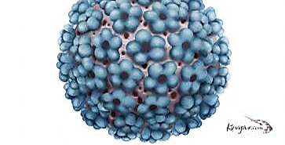
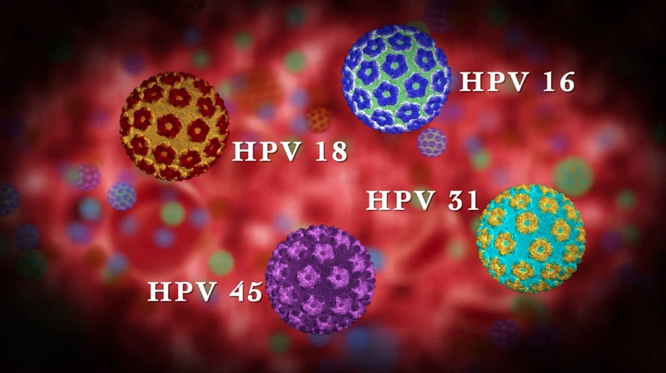
HPV
STI
Sexual contact
2 types: hr & lr
Infection:
Asymptomatic
Warts
Cancer

Slide 11
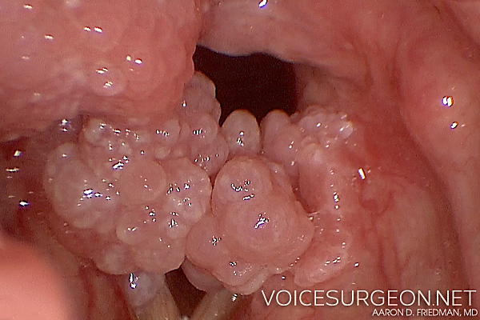
Warts
Physical impairment
Functional impairment
Cosmetic
Painful
Difficult to treat
Freeze
Surgical removal
Radiotherapy

Slide 12
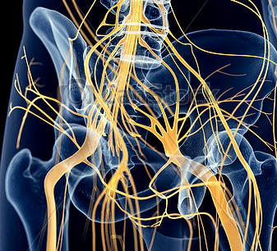
Pain

Slide 13
Incontinence

Slide 14
Why eradicate cervical cancer?
1. Eradicate all cancer
2. The ideal cancer to eradicate
3. Common
4. It causes significant suffering

Slide 15
Young women
Age 20-49
SEC
Mothers
Grief
Emotional suffering of children and family

Slide 16
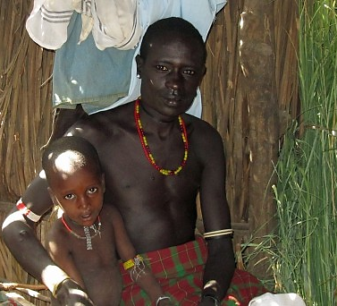
Family
Income
Education
Early motherhood
Childhood mortality
Household
Children raised by others
Pixabay

Slide 17
Why eradicate cervical cancer?
1. Eradicate all cancer
2. The ideal cancer to eradicate
3. Common
4. It causes suffering and death of young women
5. Loss of young women impact society severely.

Slide 18
Cervical cancer eradication
Cure
Prevention
Eliminate the cause

Slide 19
HPV Vaccine
Young girls (&boys)
9-13 year old girls
2 types – LR & HR / HR
R450 x2

Slide 20
Why eradicate cervical cancer?
1. Eradicate all cancer
2. The ideal cancer to eradicate
3. Common
4. It causes suffering and death of young women
5. Loss of young women impact society severely.
6. IT IS POSSIBLE!

Slide 21
Eradicated Cervical cancer?

