Slide 1
Buying and selling people: the illegal trade in persons in South Africa
Anja Visser
North-West University, Faculty of Education, Curriculum Studies
Anja.Visser@nwu.ac.za
018 299 4753

Slide 2
!!!Warning!!!
This presentation contains sensitive information, which might trigger memories of abuse. Some video material might also upset you.

Slide 3
Human trafficking ≠
only sex slavery

Slide 4
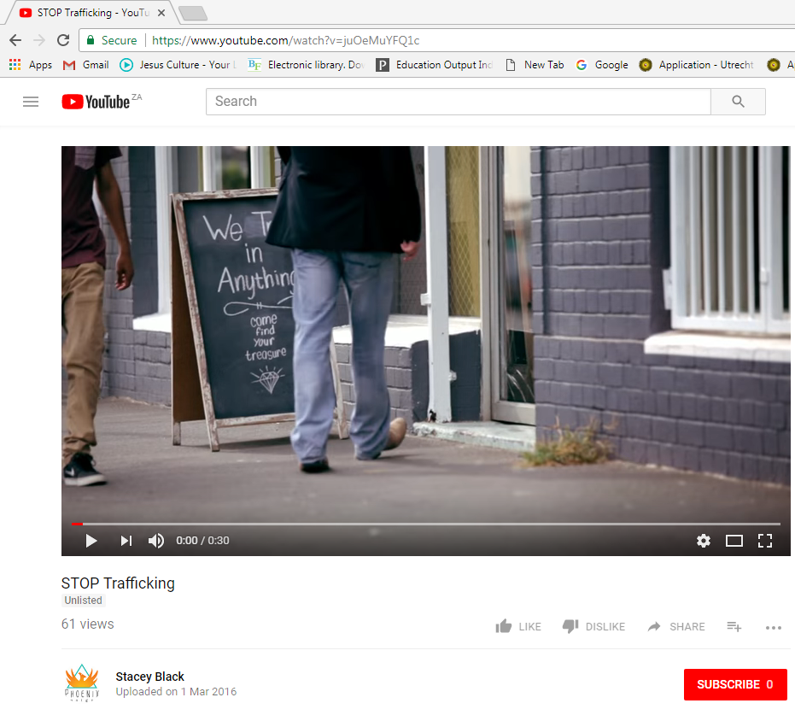
Video watch
https://youtu.be/juOeMuYFQ1c

Slide 5
What is human trafficking?

Slide 6
Prevention and Combatting of Trafficking in Persons Act 7 of 2013 (South Africa 2013)
© Anja Visser 2018
Notes:
Short history of human trafficking
What does the three elements mean
Difference between human trafficking and child trafficking

Slide 7
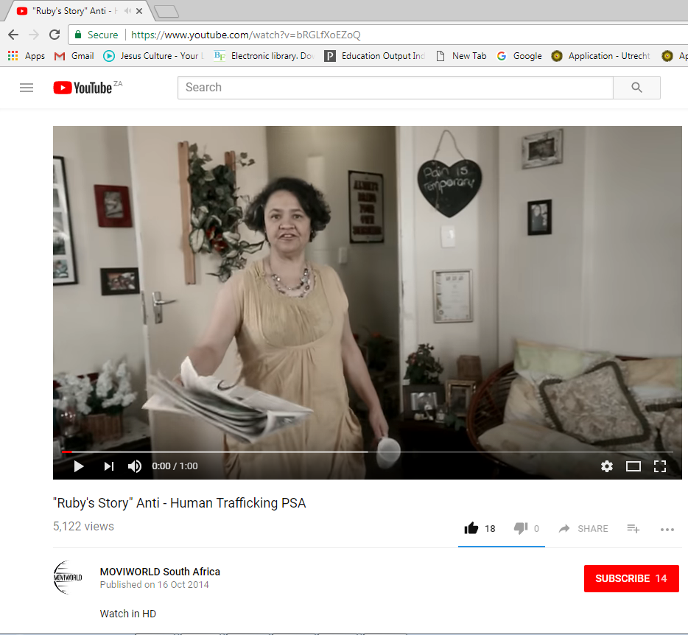
Video watch
Warning: content might upset you
https://youtu.be/bRGLfXoEZoQ

Slide 8
Human trafficking in South Africa
Source, transit and destination country.
South Africans trafficked from rural areas to city areas.

Slide 9
Human trafficking in South Africa
Prevention and Combatting of Trafficking in Persons Act 7 of 2013 promulgated in August 2015.
Statistical dilemma

Slide 10
Trafficking survivor’s story
Elanie Kruger

Slide 11
Combat trafficking
Prevention
Prosecution
Protection
Partnership

Slide 12
Prevention
Education
Demand
Supply

Slide 13
Prosecution
Traffickers
Legislation

Slide 14
Protection
Rescue
Rehabilitation
Reintegration

Slide 15
Partnership
Forming networks between different organisations:
Prevention
Prosecution
Protection

Slide 16
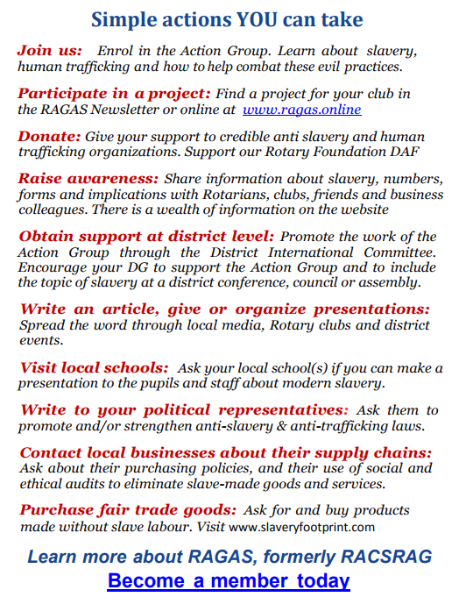
What does Rotary do?

Slide 17
Resources
0800222777.org.za
Nationalfreedomnetwork.co.za

Slide 18
For more information come join me in the
break away session
15:05-16:00 in Ondini

Slide 19
References
South Africa. 2013. Prevention and Combatting of Trafficking in Persons Act 7 of 2013.

Slide 20
Question time
???

