Slide 1
Integration of Different Roots and Cultures for Growth and Inclusion
Patrick G. Coleman
Regional Rotary Foundation Coordinator
Zone 20 A South
Notes:
Integration of Different Roots and Cultures for Growth and Inclusion

Slide 2
Integration of Different Roots and Cultures for Growth and Inclusion
Rotary is defined as a secular organisation open to all persons regardless of race, colour, creed, religion, gender, or political preference.
Notes:
Rotary is defined as a secular organisation open to all persons regardless of race, colour, creed, religion, gender, or political preference.

Slide 3
Integration of Different Roots and Cultures for Growth and Inclusion
We are, by definition, Culturally Diverse!
The question remains…
Are we, by PRACTICE, Culturally Diverse?
Notes:
We are, by definition, Culturally Diverse!
The question remains…
Are we by PRACTICE Culturally Diverse?

Slide 4
Integration of Different Roots and Cultures for Growth and Inclusion
Rotary’s beginnings were as diversified as the business culture of Chicago… in 1905!
Four men of varied businesses and religions
The “Fifth” Rotarian was similar to them
As Rotary grew so did our cultural diversity
It took over 75 years to cross the gender line
As well as many lawyers and a court decision!
Notes:
Rotary’s beginnings were as diversified as the business culture of the city
Four men of varied businesses and religions
The “Fifth” Rotarian was similar to them
As Rotary grew so did our cultural diversity
It took over 75 years to cross the gender line
As well as many lawyers and a court decision!

Slide 5
Integration of Different Roots and Cultures for Growth and Inclusion
The use of racial labels in Rotary does not demonstrate cultural diversity.
It demonstrates racial identifications.
As What Race Do You Identify Yourself?
Asian / Oriental
White / Caucasian
Black / “African”
Hispanic / Latino
“Native American”
Human
Notes:
The use of racial labels in Rotary does not demonstrate cultural diversity.
It demonstrates racial identifications.
What Race Do You Identify Yourself As?
Asian / Oriental
White / Caucasian
Black / “African”
Hispanic / Latino
“Native American”
* HUMAN

Slide 6
Integration of Different Roots and Cultures for Growth and Inclusion
In order to
We must have
Notes:
In order to coexist;
We must have respect

Slide 7
Integration of Different Roots and Cultures for Growth and Inclusion
Does Not Require
Complete Agreement
On Every Issue
Notes:
Coexistence Does Not Require Complete Agreement On Every Issue

Slide 8
Integration of Different Roots and Cultures for Growth and Inclusion
Does Require
Complete Cooperation
On Mutual Issues
Notes:
Coexistence Does Require Complete Cooperation On Mutual Issues

Slide 9
Integration of Different Roots and Cultures for Growth and Inclusion
“Mutual Issues” = the Six Areas of Focus
Peace and conflict prevention/resolution
Disease prevention and treatment
Water and sanitation
Maternal and child health
Basic education and literacy
Economic and community development
Notes:
“Mutual Issues” = the Six Areas of Focus
Peace and conflict prevention/resolution
Disease prevention and treatment
Water and sanitation
Maternal and child health
Basic education and literacy
Economic and community development

Slide 10
Integration of Different Roots and Cultures for Growth and Inclusion
Notes:
Coexstence Equals Peace!

Slide 11
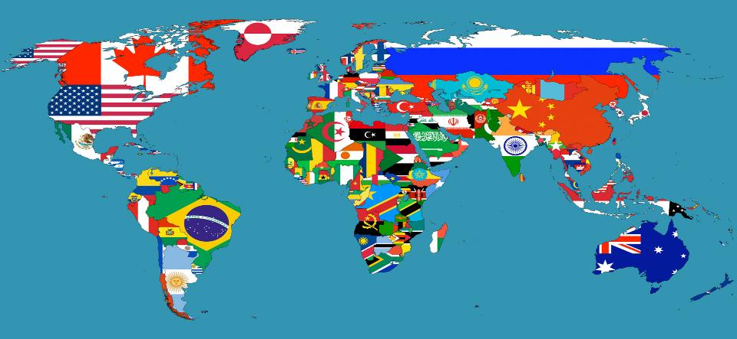
Integration of Different Roots and Cultures for Growth and Inclusion
Notes:
There is room under the “Big Tent” of Rotary if:
We welcome everyone in and
Everyone helps to hold up the tent!

Slide 12
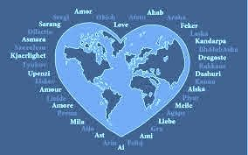
Integration of Different Roots and Cultures for Growth and Inclusion
The best way to
“Make A Difference”
is to honour the commandment to
“Love our neighbour”
Not condemn
Not judge
Not try to change
Just Do Good in the World!
Notes:
The best way to “Light Up Rotary” is to honour the commandment to “Love our neighbour”
Not condemn
Not judge
Not try to change

