Slide 1
ROTARY FOUNDATION UPDATE
Espen Malmberg
17 November 2017
Drakensburg, South Africa

Slide 2
2016-17 HIGHLIGHTS & RESULTS

Slide 3
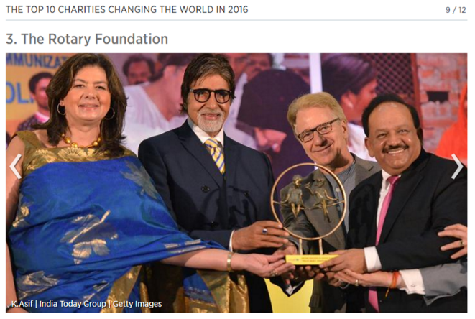
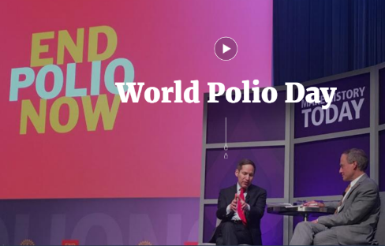
2016-17 HIGHLIGHTS
Notes:
TRF Centennial [CLICK]
World Polio Day 2016 [CLICK]
AFP Outstanding Foundation of the Year Award [CLICK]
TRF named a top charity changing the world [CLICK]
RPC*MGI achieves $150 million goal [CLICK]
$1.2 billion pledging moment [CLICK]
Additional:
Record-setting year for the Annual Fund ($140.2 million!)
Corporate Social Responsibility India successfully launched

Slide 4
FUNDRAISING RESULTS BREAKDOWN
TOTAL CONTRIBUTIONS
$304.4 million
*other includes contributions to the Donor Advised Fund, Global Grant Cash and term gifts
Notes:
We had a record setting year in giving to the Foundation. Rotarians and friends of the Foundation contributed over $304.4 million, surpassing the $300 million fundraising goal set to celebrate the foundation’s 100th birthday. Not only was it an incredible year for giving overall, but the Annual Fund reached an all-time high.

Slide 5
AREAS OF FOCUS MAJOR GIFTS INITIATIVES
Notes:
Inspired by the RPCMGI, the areas of focus major gifts initiatives each have major gift and commitment goals of $25 million except for the Peace MGI, which combines the area of focus with the ongoing Rotary Peace Centers efforts. These were launched with the WAS MGI, then this year Basic Education and Literacy and the new Peace MGI. On July 1st we will launch the Health MGI and possibly also the Economic and Community Development effort.
Occasionally we hear “Why all these different initiatives? Why not just give to Rotary?” The answer is that Rotary takes a donor centric approach that enables Rotarians and others to give where their heart leads them. An informal analysis indicates that Rotarians tend to give to multiple areas, and often a gift to, say, Peace, may inspire an additional gift to Polio. The more Rotarians work with us on their major gifts and bequest commitments, the more they understand the many strengths that Rotary has in putting their support to good use.

Slide 6
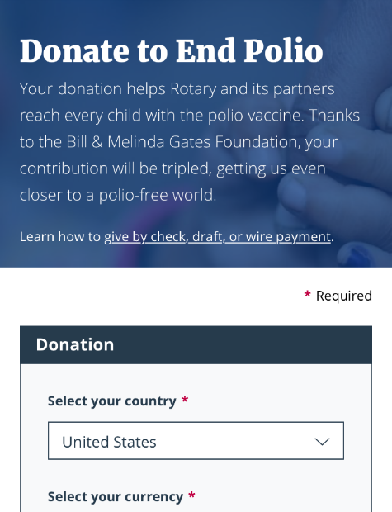
ONLINE GIVING PROJECT
Notes:
A way that we hope will help us achieve our fundraising goals is through the launch of a new online giving platform. We have been working on a a new online giving platform that will allow donors to have a more enhanced experience when making a contributions online. A few things that the new interface would allow for include improved recurring giving functionality including self-service options, automatic notification when a card expires or is rejected, improved memorial and tribute giving options. You may have seen that we have launched the first phase of this project on the End Polio Now donate page.

Slide 7
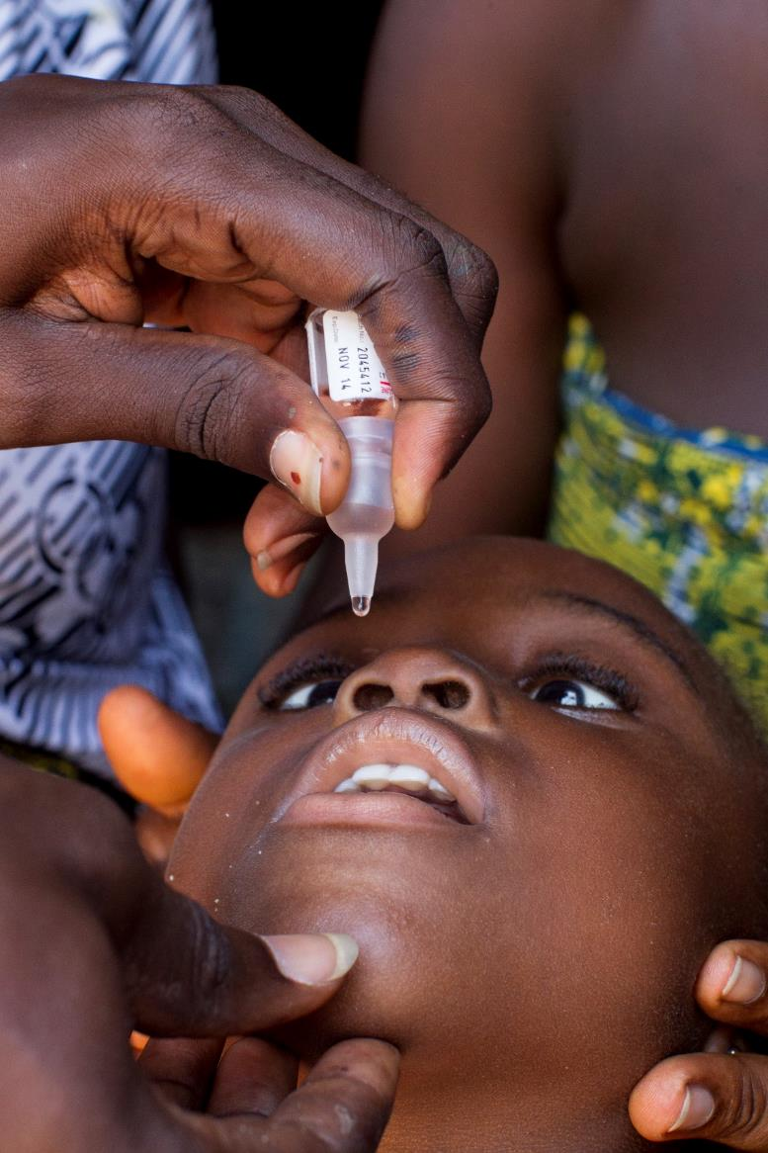
GRANTS OVERVIEW

Slide 8
GLOBAL GRANT TRENDS
$73k avg. award
Notes:
Seeing a steady increase in global grants over the past 4 years

Slide 9
RY17 GLOBAL GRANTS BY AREA OF FOCUS

Slide 10
GLOBAL GRANT PARTICIPATION TRENDS
 | 2013-14 | 2014-15 | 2015-16 | 2016-17
Percentage of districts participating in global grants | 80% | 89% | 91% | 92%
Percentage of clubs participating in global grants | 11% | 14% | 13% | 14%
Notes:
Not only have the total number of approved grants gone up, but we also see that the number of participating districts as well as clubs has risen in this same time frame. Last year clubs nine out of ten districts participated in at least one grant, up from 8 in ten in the first year of the new program. Additionally, we see a slight rise in the total number of Rotary clubs which participate in the grants. Perhaps this is something worth noting to see compare with how many clubs in your districts participated in a grant last year?

Slide 11
TOTAL NUMBER OF DISTRICT GRANTS APPROVED
$52,000 avg. award
Notes:
DG

Slide 12
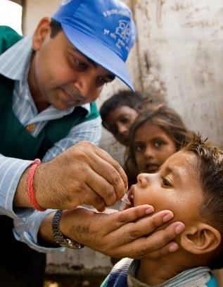
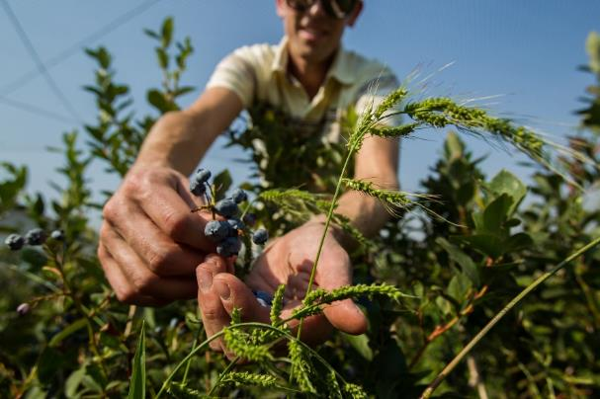
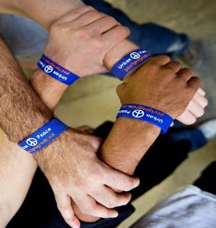
UPCOMING TRF SESSIONS
Notes:
More TRF Sessions during conference:
Your Rotary Legacy through Rotary’s Endowment on Saturday
The Rotary Foundation – ask the experts!

