Slide 2
23rd to 27th June 2018
AIR CANADA CENTRE

Slide 3
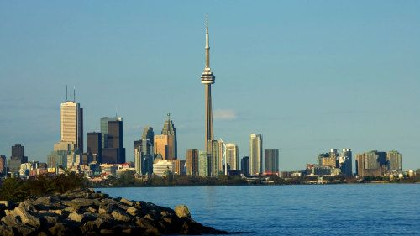

Slide 4
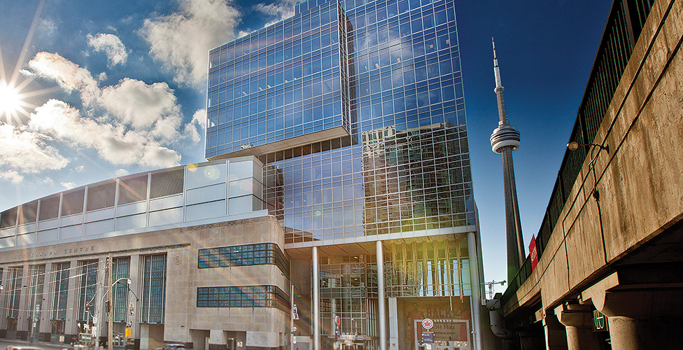

Slide 5
Registration fees
Date | Fees payable
Up to and incl. 18th December | $ 340
18th Dec 2017– 31 March 2018 | $ 415
From 1 April 2018 | $ 490

Slide 6
Flight options
Route | Fees payable
Durban-Jhb-Munich-Toronto Toronto-New York-Jhb-Durban | R 14 500
Johannesburg-Munich-Toronto Toronto-New York-Johannesburg | R 11 750
Port Elizabeth-Jhb-London-Toronto Toronto-London-Cape Town-PE | R 16 700

Slide 7
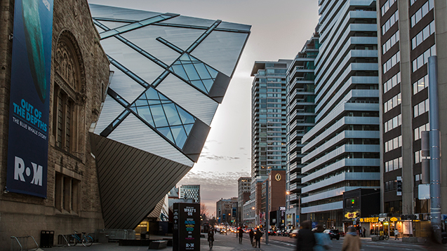

Slide 8
Hotel options
4-5 star hotels with breakfast | Rates
4 star hotels | $ 160 - $175
5 star hotels | $ 190 - $220
Single/Double rates usually the same Includes daily breakfast

Slide 9
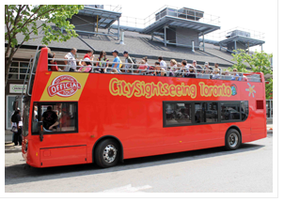
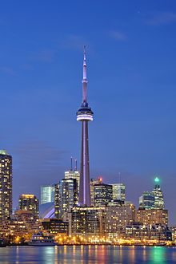
Tour options
Hop on-Hop off bus
CNN Tower
Toronto City Tour
Helicopter flips (day and night)
Niagara Falls
Walking tours

Slide 10
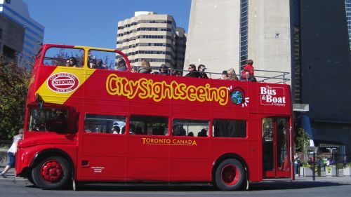
$32
2 day pass

Slide 11
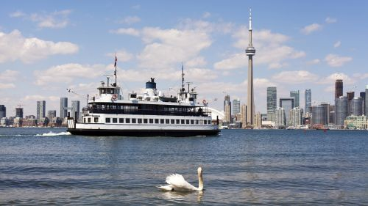
City tour
$36

Slide 12
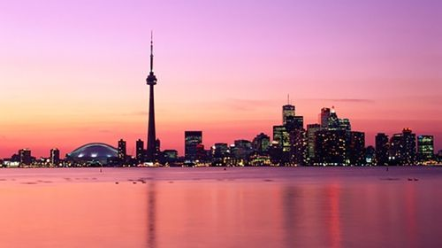

Slide 13
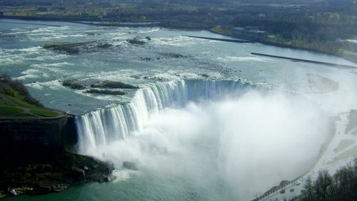
R 1 500

Slide 17
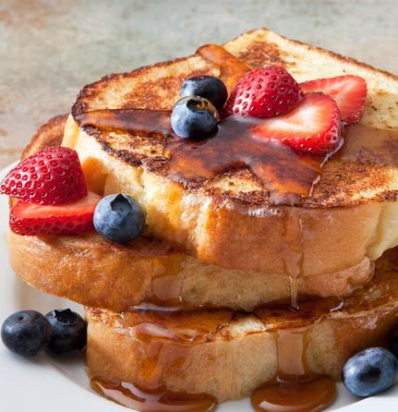

Slide 18
Visa Requirements
Options |  | Fees payable
www.canadianeasyvisa.net | ONLINE 24 HOURS | R 900.00
VISAREQUEST.CO.ZA | ONLINE | R 1800.00
Canadian Embassy – Arcadia Pretoria | 012 422 3090

