Slide 1
POLIOPLUS
POETS
2018
Zone 20a South : EPN Coordinator Richard Brooks

Slide 2
Dr. Albert Sabin (left) and 1984-85 Rotary President Carlos Canseco at a press conference to announce the PolioPlus program. © Rotary International.
1985 - PolioPlus

Slide 3
125 Nations
1985 - PolioPlus

Slide 4
Country
2018 - PolioPlus
1

Slide 5
Contributions from Rotarians since 1985
US$ 1.6 Billion

Slide 6
Contributions from
+US$ 600 Million

Slide 7
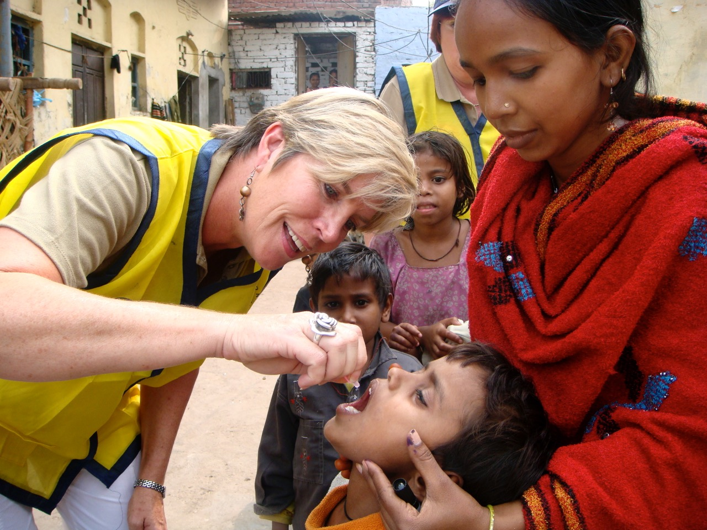
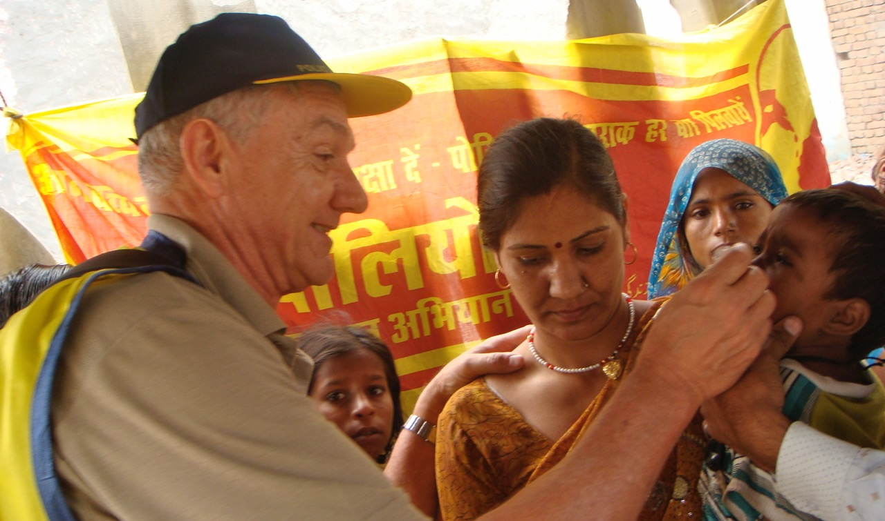
2.5 Billion children innoculated

Slide 8
99.9% decrease

Slide 9
THE GLOBAL CHALLENGE 2016-2019
A further US $1.5 billion
needed

Slide 10
ROTARY’s CHALLENGE – 2016-2017
US$ 50 Million over the next 3 years

Slide 11
ROTARY GOAL FOR POLIOPLUS 2017-2018
District to give 20% of its DDF to PolioPlus
Each Club to US$1500.00 to PolioPlus

Slide 12
US$2.00 for US$1.00
Up to US$ 35 million per annum

Slide 13
US$1000. PHF + US$2000 Gates Foundation = US$3000.

Slide 14
POLIOPLUS GIVING BY DISTRICT 9370
DISTRICT CONTRIBUTIONS FROM THE DISTRICT DDF
R I President, John Germ set a target for 2016-2017 for every District around the world to contribute at least 20% from their DDF to PolioPlus.
2016-2017
The 20% target for our District was $9838. The amount our District contributed was $20000! The Rotary Foundation would have added a further 50% ($20000 + 50% = $30000 ). Then the Bill & Melinda Gates Foundation trebled this amount through their 2 for 1 contribution bringing the figure up to $90000.00.

Slide 15
DISTRICT 9370 : DDF CONTRIBUTIONS : 2017-2018
The 20% goal for 2017 – 2018 is R10171.00
The amount given is $10120.00 . Add the 50% from the Foundation = $15130.00. Add the Gates Foundation 2 for 1 contribution total given to PolioPlus = $45390.00

Slide 16
CASH CONTRIBUTIONS BY DISTRICT 9370 TO POLIOPLUS AS AT 16th FEBRUARY 2017
2016 to 2017 . . . . . . . $9088.00
2017 to 2018 . . . . . . . $35655.40
Thanks must be given to Dries Lotter for his generous contributions this Rotary year to PolioPlus

Slide 17
EXTRACT FROM THE BILL AND MELINDA GATES 2017 ANNUAL LETTER DATED FEBRUARY 14, 2017
The Magic Number : 0
We want to end our letter with the most magical number we know. It’s zero. This is the number we’re striving for every day at the foundation . . . . . . . . .
Polio is closest to reaching this magic number. You ( Melinda) and I have talked about polio a lot. When you were growing up, you saw things kids never see today : children with polio on crutches and leg braces, photos of kids in iron lungs. By the late 1970s, with the help of vaccines the United States eliminated polio, but it still raged around the world. In 1988, when the global campaign was launched to end polio, there were 350,000 new cases each year.
( in 2017 there were 22 cases. 2018 only 3 )

Slide 18
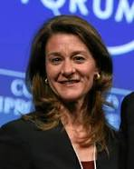
EXTRACT FROM THE BILL AND MELINDA GATES 2017 ANNUAL LETTER DATED FEBRUARY 14, 2017
Those 37 cases were confined to northern Nigeria and parts of Afghanistan and Pakistan. Honestly, we thought polio would be over by now. But immunizing children in conflict areas is hard – and dangerous.. We’re awed by the teams of vaccinators who take risks to reach each child. And we’re inspired by the infinite persistence of Rotary International. They were leading this fight long before we joined it, and they just kept moving forward. They know that going from 350,000 cases to 37 is amazing, but success is zero.

Slide 19
EXTRACT FROM THE BILL AND MELINDA GATES 2017 ANNUAL LETTER DATED FEBRUARY 14, 2017
It’s thrilling to be nearing the day when no children will be crippled by polio. But we’re often asked why we’re making such a big effort on polio if our priority is to save lives. The answer is , ending polio will save lives – through the magic of zero. When polio is eradicated , the world can dedicate polio funds to improving child health, and the lessons from polio will lead to better immunization systems for other diseases . . .. .

Slide 20
CONCLUSION …
We are so close. We’ve got a 99.9 percent reduction in polio. But we’re not there yet,” says John Sever, a vice chair of Rotary’s International PolioPlus Committee, who has been part of the eradication effort since the beginning. “Rotarians and others have to keep working. People will naturally say, ‘Well, it seems to be basically gone so let’s move on to other things,’ but the fact is it isn’t gone, and if we move on and don’t complete the job, we set ourselves up for having the disease come right back.”

Slide 21
CONCLUSION ….
“Rotary was there at the beginning,” “It would be unfortunate if Rotary isn’t there at the finish line. We’ve done too much, we’ve made too much progress to walk away before we finish.”
Michael McGovern .. International PolioPlus Committee chair

Slide 22
THE LAST WORD ….
“ We started this more than 30 years ago and we’ve stuck with it all this time.
And soon , we’re going to finish it “
Past RI President, John Germ

Slide 23
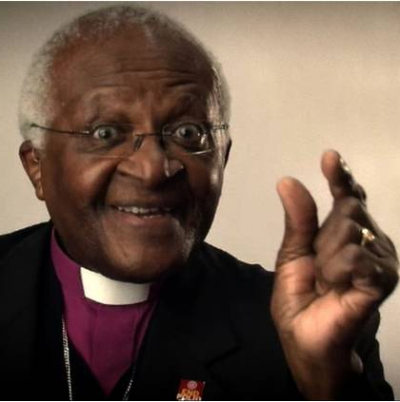
We’re “This” Close
Let’s do this!!

