Slide 1
DRFC Greg Cryer
Notes:
Pleasure to be here and congrats to all incoming Presiidents and officers.
Projects survive and thrive through our good works and the financial assistance from the Foundation.
How much we receive id directly related to how much we as a District give.
Make this year the year you pledge to give more to your favourite Foundation.
We should be proud of belonging to a Foundation that is recognised world wide as being one of the very best.

Slide 2
The Foundation’s Mission
The mission of The Rotary Foundation is to enable Rotarians to advance world understanding, goodwill, and peace through the improvement of health, the support of education, and the alleviation of poverty.
Notes:
We can very proud of what we have achieved in the past and there is absolutely no reason why we cannot replicate our successes through the next 100 years.

Slide 3
Notes:
Our Performance and Governance ratings by the Charity Navigator organisation are a testament to the world that Rotary's ethics are beyond question.
Our overhead cost of 9% is lower than most competing Foundations worldwide.

Slide 4
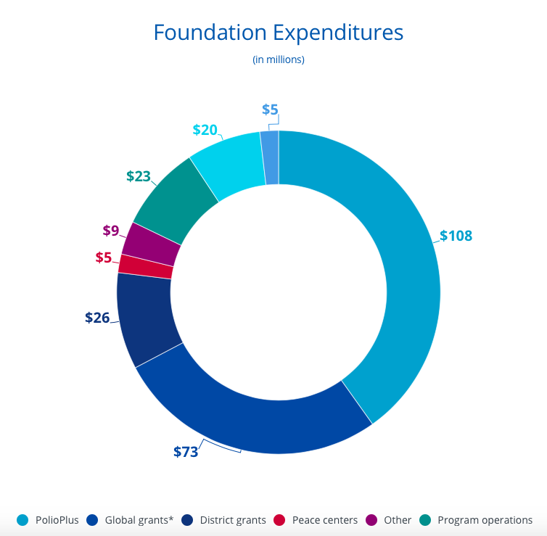
Notes:
Foundation spend over the past century $3b
Your donations do make a difference
Your donations ensure that 35000 clubs gets the opportunity to support local communities in the six areas of focus
We have all but eliminated polio from the world - ask the 16m survivors walking today because we are 99,9% close to ridding the world of the polio scourge
Remember for every $1 you give to Polio the Gates Foundation matches it with a further $2

Slide 5
Notes:
We are very proud of one of our very own BOOitjies who features on pg 17 in the Rotary Annual Report for 2016/17.

Slide 6
Rotary Annual report 16/17
Notes:
Dries is a man that lives, breathes and dreams about the Foundation - his financial support and his named legacy project will live forever as a testimony to his dedication to improving the lives of others less fortunate than ourselves.

Slide 8
The SHARE fund
Notes:
How and when do our EREY donations get back to the District - as we know the challenge from Foundation is for each and every Rotarian worldwide to donate $100 per annum.
We receive funds via the SHARE programme and its 3 year investment policy

Slide 9
Rotary’s unique 3 year investment cycle

Slide 10
2015 -16
EREY FUNDS
RAISED & INVESED
$81 481,84
2016 -17
FUNDS
INVESTED
2017-18
FUNDS
INVESTED
2018-19
50%
DDF FUNDS recd. - D9370
$40 740,92

Slide 11
EREY raised in 2015/16
$81 481,84
50%
DDF
2018/19
$40 740,92
50%
WORLD FUND
2018/19
$40 740,92

Slide 12
DDF -50% received in 2018
$40 740,92
25%
25%
$20 740,92
District Grants shared by all clubs in the district
$ 20 740,92
DDF allocated to assist
Global Grant
applications

Slide 13
Thank you all again for participating in POETS I now hand over to our Zone polio coordinator PDG Richard Brooks who will be followed by our Grant fundi Rob Campbell

Slide 14
Raising funds for the Rotary Foundation
POLIO
PLUS
FUND
ANNUAL
FUND
PERMANENT
FUND

Slide 15
Polio Plus Fund
All funds recd. used solely to achieve the Eradication of Polio worldwide.
Programme will continue until the goal is achieved.
Rotarians are encouraged to support the programme until worldwide certification is achieved.

Slide 16
Annual Fund
The Foundations primary source of funding.
Enables Rotarians to carry out local & International activities.
Contributions encouraged via the EREY programme.
EREY asks Rotarians to participate in a Foundation project and donate to the Annual Fund.
Contributions can be designated to SHARE, the WORLD FUND or one of Foundations 6 Areas of focus.
Contributions to the 6 areas of focus will not be include in the SHARE calculation.

Slide 17
Permanent Fund
Secures the future of Foundation through Endowments.
Principal untouched – earnings provide additional funds.
Donations could be – outright gifts,
endowment funds, bequests, or Life-income agreements.

Slide 18
WORLD FUND
PAYS FOR THE WORLDWIDE PROGRAMS
THESE PROGRAMS ARE AVAILABLE TO ALL DISTRICTS
NOT RELATED TO SPECIFIC CONTRIBUTIONS

Slide 19
DISTRICT GRANTS
DDF FUNDS CAN BE USED TO PAY FOR ANY FOUNDATION ACTIVITY
D9370 WILL DIVIDE THE 25% DDF RECD BY THE NUMBER OF CLUBS IN THE DISTRICT
EACH CLUB MUST MAKE APPLICATION TO THE DISTRICT FOUNDATION COMMITTEE
THE CLUB WILL NEED TO BE QUALIFIED IN TERMS OF THE FUTURE VISION CRITERIA

Slide 20
GLOBAL GRANTS
D9370 WILL ALLOCATE THE 25% DDF RECD TO ASSIST CLUBS APPLYING FOR GG’s
EACH CLUB MUST MOTIVATE THEIR FUNDING REQUIREMENT TO THE DISTRICT FOUNDATION COMMITTEE
DDF WILL BE ALLOCATED PENDING FOUNDATION APPROVAL
DDF ALLOCATED WILL BE MATCHED 1:1

