Slide 1
STRENGTHENING ROTARY
Jennifer Jones
Paul Hydzik
25 June 2013
Notes:
JENNIFER
Thank you for joining us for today’s workshop, Strengthening Rotary.
I’m Jennifer Jones [BRIEF INTRO].
PAUL
And I’m Paul Hydzik [BRIEF INTRO].
Together…we’re going to help you Strengthen your club…and Strengthen Rotary…worldwide.

Slide 2
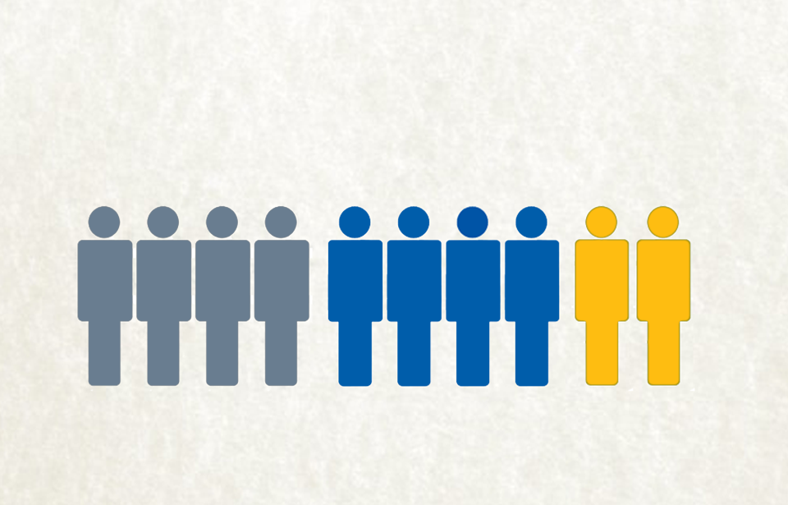
PUBLIC IMAGE SURVEY
Never Heard
of Rotary
Know
Name Only
Some
Familiarity
Notes:
JENNIFER
The fact is…people do not know Rotary.
Rotary’s own Public Image Surveys* that reached a wide cross section of the globe…we surveyed prospective members in 2006 and again in 2010…people much like you, except they just don’t happen to be Rotarians, yet…and we found:
Four in 10 have never heard of us.
Another four in 10 have heard of our “name only.”
Only two in 10 claim to have “some familiarity” with Rotary. Unfortunately what much of this group knows is often colored by misperceptions and half-truths. Let me ask you this…are enjoying the opportunity here at Convention to connect with other Rotarians?...are your clubs great places to exchange ideas with fellow Rotarians…and take action for your local community? These misperceptions would have you believe otherwise!
[FOR REFERENCE ONLY.]
*Research: Rotary Public Image Surveys completed 2006 and 2010. Responses received from six nations: Argentina, Australia, Germany, Japan, South Africa, United States. Surveyed approximately 1,000 individuals in each of six nations by phone and online. Survey has a +/- 4% margin of error.

Slide 3
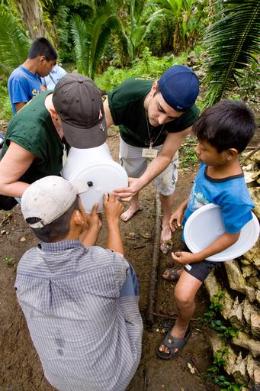
OPPORTUNITY
NOT EARNING
FULL CREDIT FOR
OUR GOOD WORK
Harder to reach our full potential
Notes:
JENNIFER
As a result…Rotary is not earning full credit for the good work you do in your home town and in communities around the world.
This is important…not because we all want credit. It’s important because it makes it harder for every Rotarian…harder for you…to attract new members and volunteers to your club. It makes harder for Rotary overall to attract partners and major contributors. In short it makes it harder for us all to achieve our full potential.
Our combined boards saw this information as an OPPORTUNITY to ASSOCIATE our STRENGTHS and the good works you do WITH ROTARY. In support of the Strategic Plan they launched an initiative to Strengthen Rotary.
TODAY WE BEGIN!

Slide 4





Conducted
160+ interviews
Analyzed 20,162 surveys
Visited
20 clubs
and attended the 2012 International
Convention
Participated in
5
Zone Institutes
Reviewed
400+
documents
Obtained comprehensive feedback from
Rotarians & prospects in 167 countries
Notes:
JENNIFER
We obtained responses from…over 20,000 Rotarians, Rotaractors, prospects and staff in 167 countries on six continents.
We reviewed macro trends in social and business sectors
And our first-ever research to explore the underlying motivators of giving time…and money—globally
Conducted 160+ interviews, club visits and visits to Rotary Institutes and our 2012 convention.
The findings provide a wealth of practical, actionable information you can put to work starting the day you return to your districts and clubs.

Slide 5
OUR STRENGTHS DIFFERENTIATE US
A multidisciplinary perspective allows us to see challenges in ways others can’t
The ability to apply leadership and expertise to social issues
The passion and perseverance necessary for lasting change
Community impact on
a global scale
See
differently
Think
differently
Act
responsibly
Impact communities globally
Notes:
JENNIFER
Research determined that Rotary has four core strengths that truly differentiate us from other nonprofits.
First, we see differently. Our multidisciplinary perspective enables us to see challenges in ways others can’t.
Second, we think differently because we apply our leadership and expertise to social issues.
Third, we act responsibly, with the passion and perseverance necessary for lasting change. There is no better example than polio.
Fourth, Rotary is a grass roots organization that impacts communities globally.

Slide 6
PRIMARY REASONS PEOPLE JOIN ROTARY…
Why did you initially join Rotary?
To positively impact my community
Friendship and fellowship
30%
Professional networking/
business development opportunities
To have a positive impact globally
20%
Potential for personal/professional recognition
Development and training opportunities
10%
0%
Notes:
JENNIFER
One of the most important findings from our research. We found out the top two reasons people join Rotary…
To positively impact our communities.
And for the friendships…and connections we enjoy.

Slide 7
…ARE THE SAME REASONS THEY STAY ROTARIANS
Why do you stay with Rotary?
To positively impact my community
Friendship and fellowship
30%
Professional networking/
business development opportunities
To have a positive impact globally
20%
Potential for personal/professional recognition
Development and training opportunities
10%
0%
Notes:
JENNIFER
What makes this even more essential is that these are also the same two reasons people stay with Rotary year after year.
For “community” and “connection.”
Look at this again…
[CLICK BACKWARD ONE SLIDE]
We join for community and the friendships and connections we make…
[CLICK FORWARD ONE SLIDE]
And we stay for community and the friendships and connections we make! Ask me to describe “What is Rotary?” I can do it in two words? Rotary is about community and connection! Simple.

Slide 8
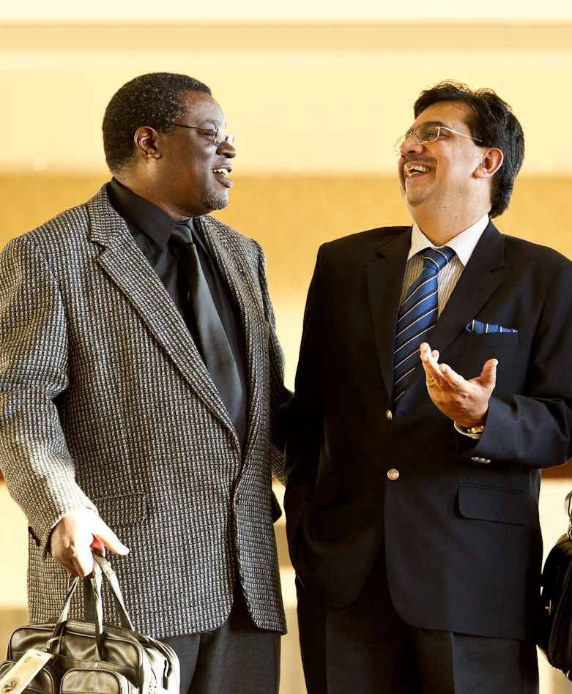
IMPLICATIONS
Rotarians are responsible leaders
  Define by mindset
Connecting always
will be a driving force behind Rotary
Rotary creates community impact
on a global scale
Notes:
JENNIFER
We have more than 200 pages of research…all of it interesting. Happily, I can distill it down to one slide for you…with three key implications.
First, Rotarians are responsible leaders, both socially and ethically.
In Rotary we define leadership by mindset, not title.
Of course, some of us hold senior titles, CEO…partner…business owner…school principal.
Others are leaders because we step forward to tackle some of our communities’ toughest challenges.
When people step forward as Rotarians, they ARE leaders.
Second. Connecting always will be a driving force behind Rotary
We are a membership organization.
Connecting celebrates our membership and the friendships and bonds we form.
Third. Rotary is not just about global impact. Rotary creates community impact on a global scale.

Slide 9

PUT THESE FACTS TO WORK
How do you:
Find leadership roles
for new members
right from the start?
Use service to create
opportunities for
prospects to connect?
Look beyond title to a prospect’s mindset for membership potential?
Notes:
JENNIFER
What can you do with this knowledge?
We know the top two reasons people join…and stay Rotarians...1) to give back to your community as responsible leaders…and 2) for the opportunity to connect and develop friendships.
While we have you all here…let’s share…tell us…How do you…
Create leadership opportunities for new members…right from the start…to recognize the knowledge and leadership skills these new members bring to Rotary…and get them active and involved immediately? Please step up to one of the microphones. [VAMP] I’m certain there are plenty of you who are putting new members right to work…right away in your clubs………………Yes…on the left. How do you engage new leaders right from the start…
[ALT., IF NO ONE STEPS FORWARD: JEN TELLS A PERSONAL EXAMPLE FROM HER CLUB.]
[OPEN THE FLOOR TO AUDIENCE RESPONSES.]
[END DISCUSSION ON THIS TOPIC AND CLICK TO BUILD]
Can anyone tell how they use their service projects as an opportunity to attract prospects to volunteer their time in service…and learn what it is to be a Rotarian? Do your clubs open up their service projects to people outside of Rotary several times a year? Tell us…the microphones are open…
[OPEN THE FLOOR TO AUDIENCE RESPONSES.]
[END DISCUSSION ON THIS TOPIC AND CLICK TO BUILD]
Do club members and leaders look beyond a prospect’s title to see if they have the mindset for leadership—and an especially strong desire for community service? Does someone in the audience have a story for us of how they “discovered” a new member with real potential…someone who is a leader, not because of their title, but because they step forward in their community as a Rotarian?
[OPEN THE FLOOR TO AUDIENCE RESPONSES.]

Slide 10
How do you answer?
What is Rotary?
Notes:
PAUL
Thank you Jennifer…thank you everyone. I have a question for you…
When someone asks you, “What is Rotary?” How do you answer?
Are you ready? Can you give your “elevator speech” at a moment’s notice?
In our research we found the number 1 response of Rotary members…even those who have been Rotarians for years…is…

Slide 11
Um…
Notes:
PAUL
UM.
There’s a pause. A hesitation. Uncertainty and a bit of unsteadiness.
We got answers like, “Rotary is different things to different people.” …“Rotary is what you make of it.” …and “Rotary is really, really great.” …I think you’ll agree that these are all really, really poor answers.
So let’s make a commitment today. You and me. Right now. That we are not going to be one of those people who answers…”UM.”
…that we’ll respond with confidence. Think about it…an elevator ride between floors lasts only a handful of seconds. So it should be easy to construct a statement that defines how you see Rotary.

Slide 12
JOIN LEADERS
EXCHANGE IDEAS
TAKE ACTION
Notes:
PAUL
And our research can help again…because it helped us define three core ideas about Rotary. And they’re perfect for creating our elevator speech. It’s our essence...our core. Rotary…
JOINS LEADERS…Rotary is a catalyst for improving our communities.
We EXCHANGE IDEAS…bringing our expertise and our diverse perspectives to bear on community problems.
Then…because ideas are only the first part of the solution…Rotarians TAKE ACTION.
And we do this community-by-community around the world.
Let me give you an example of how I constructed my own elevator speech…around the ideas: JOIN LEADERS…EXCHANGE IDEAS…TAKE ACTION. And perhaps I can inspire you to create your own…

Slide 13
Rotary brings together the kind of
people who step forward to
take on important issues for
local communities everywhere.
Notes:
PAUL
When someone asks me, “What is Rotary?” here’s what I tell them…
“Rotary brings together the kind of
people who step forward to
take on important issues for
local communities everywhere.
It’s crisp, short and clear. And I can an answer their question quickly and confidently.
…”Rotary brings together the kind of people who step forward.” We are a catalyst that JOINS LEADERS
We EXCHANGE IDEAS and TAKE ACTION…”we step forward to take on important issues.
And we do this in your community…in my community…”in communities everywhere.”

Slide 14
“What is Rotary?”
Notes:
PAUL
Think for a moment…how will you answer the question, “What is Rotary?”
Start today…Remember…our research shows that Rotary is about COMMUNITY…AND CONNECTION. At Rotary…we JOIN LEADERS…EXCHANGE IDEAS…TAKE ACTION. Use those core ideas to construct your answer.

Slide 15
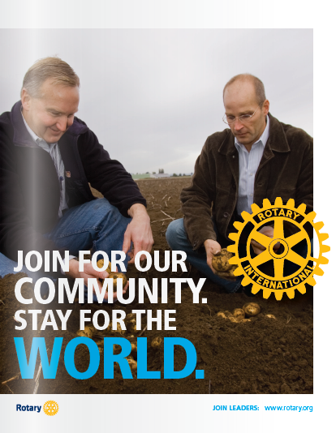

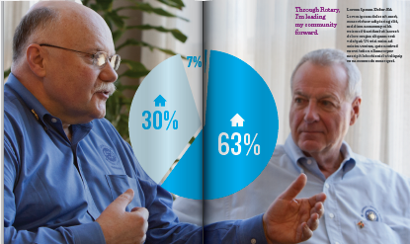
ROTARY’S COMMUNICATIONS
Notes:
Rotary’s communications materials will be affected as well. These are just rough concepts…but they suggest a direction born out of our research.
In the past, Rotary’s materials were often more concerned with the “Hows”…for example, the process and mechanics of becoming a member. As a result of our branding effort we are refocusing our communications on the “Whys”…the benefits of becoming a member…with action-oriented headlines and a compelling benefit story.
If we look inside that brochure we might find our story told with infographics—which communicate faster across languages than the long paragraphs of text we use today.

Slide 16
3 WAYS YOU CAN STRENGTHEN ROTARY
1. SHARE WHAT YOU LEARNED
2. LIVE THE BRAND…AND
INSPIRE YOUR CLUB TO
TRULY LIVE IT AS WELL
3. WORK TO IMPROVE
MEMBER ENGAGEMENT.
Notes:
JENNIFER
At the beginning of the workshop we said we would share three ways you can strengthen Rotary.

Slide 17
REMEMBER TWO WORDS
‘Community’
&
‘Connection’
This will help describe Rotary!
Notes:
If you remember only two words from our workshop today…remember…
COMMUNITY.
&
CONNECTION.
Then you can describe what Rotary is about in two words….”Community” and “Connection.”
Because we know this is why you join…and stay with Rotary.
Because we know that we CONNECT LEADERS.
We EXCHANGE IDEAS.
And we TAKE ACTION give back to our communities.
And we do this in every COMMUNITY everywhere in the world.

Slide 18

BE A
ROTARY
CHAMPION
Notes:
When you get back home…share what you’ve learned with your fellow Rotaractors…and your fellow Rotarians as well. Share it with your friends…people who are not Rotaractors…and do not yet know what you know…how amazing Rotary is…get out there and continue your mission…BE ROTARY CHAMPIONS!
Thank you.

