Slide 1
10 April 2015
HOW TO MAKE WEBINARS WORK FOR YOU

Slide 2
What has been your experience with webinars?

Slide 3
Interactive
Photo by Alyce Henson. © Rotary International.

Slide 4
Polls

Slide 5
Polls

Slide 6
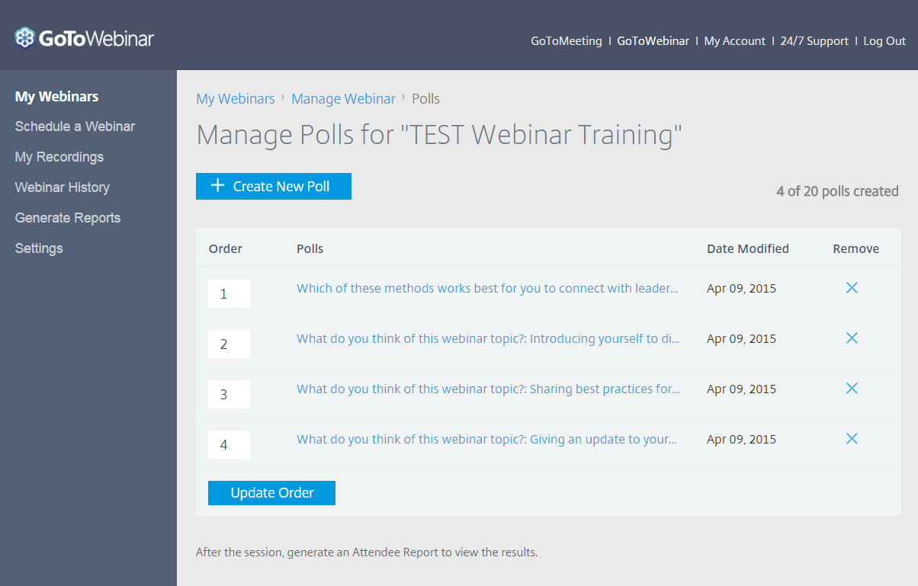
Poll Administration

Slide 7
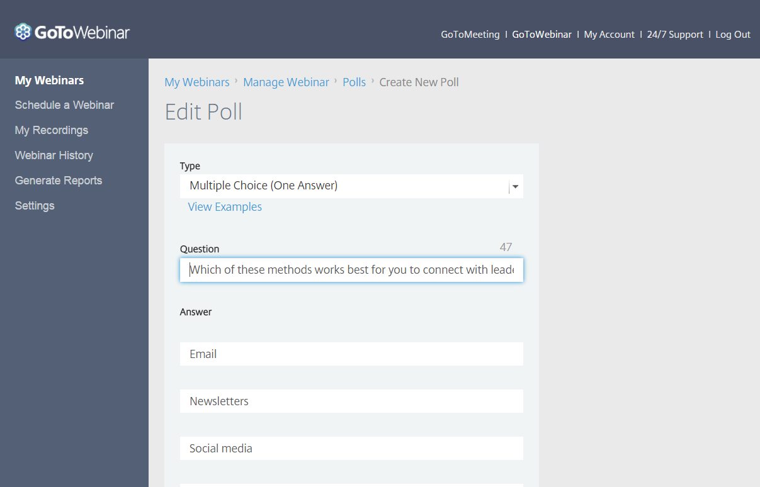
Poll Administration

Slide 8
Drawing Tools

Slide 9
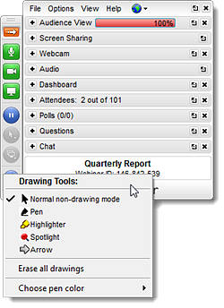
Drawing Tools

Slide 10
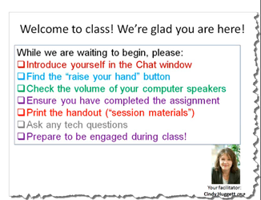
To-Do List

Slide 11
Webcams

Slide 12
What is a webinar topic that you think would be helpful for your region?

Slide 13
Webinar software

Slide 14
SOFTWARE OPTIONS
For Rotary Members: 60-Day Free Trial & 15% discount
GoToMeeting: $33/month for 25 attendees $48/month for 100
GoToWebinar: $67/month for 100 attendees
$271 for 500
$339 for 500

Slide 15
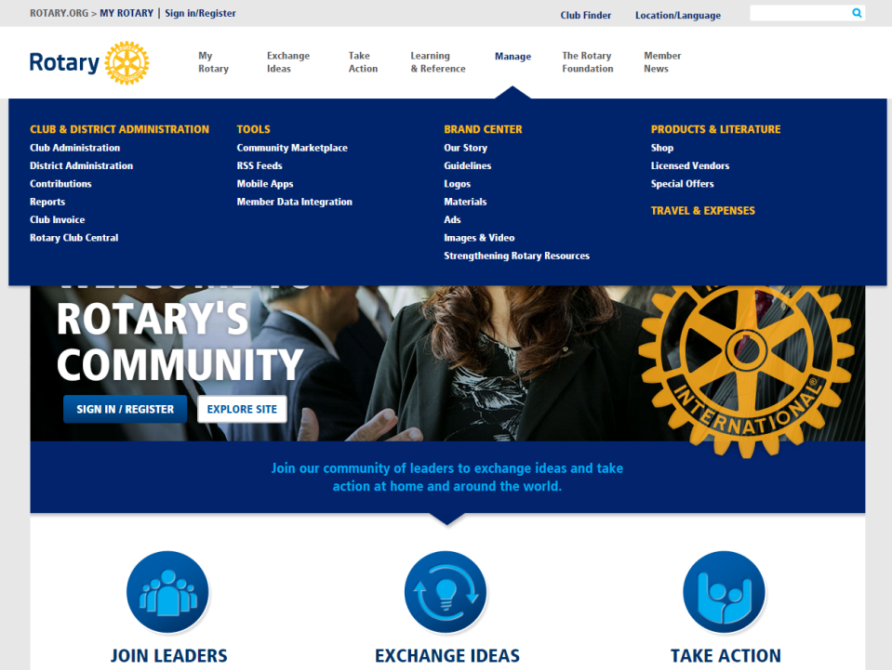

Slide 16
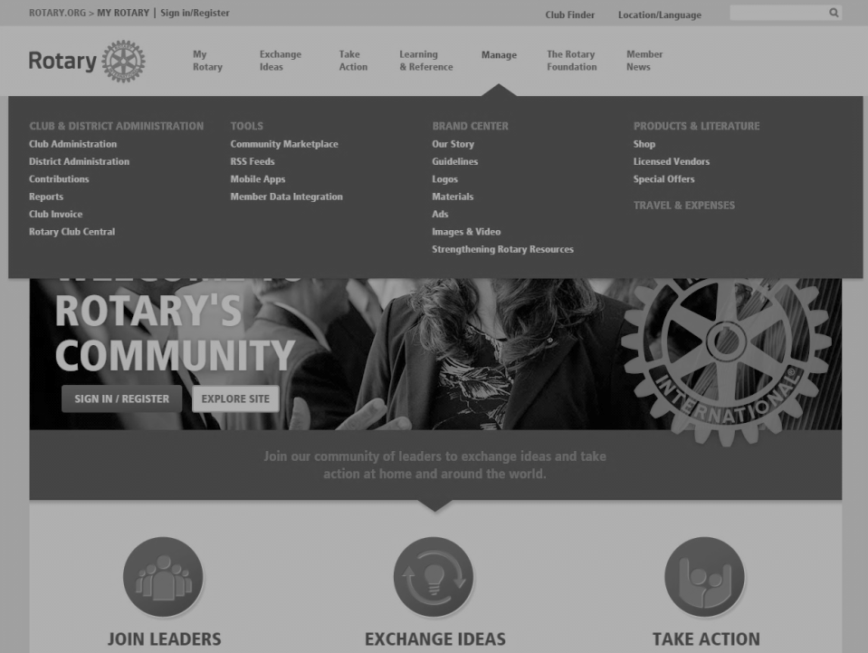

Slide 17
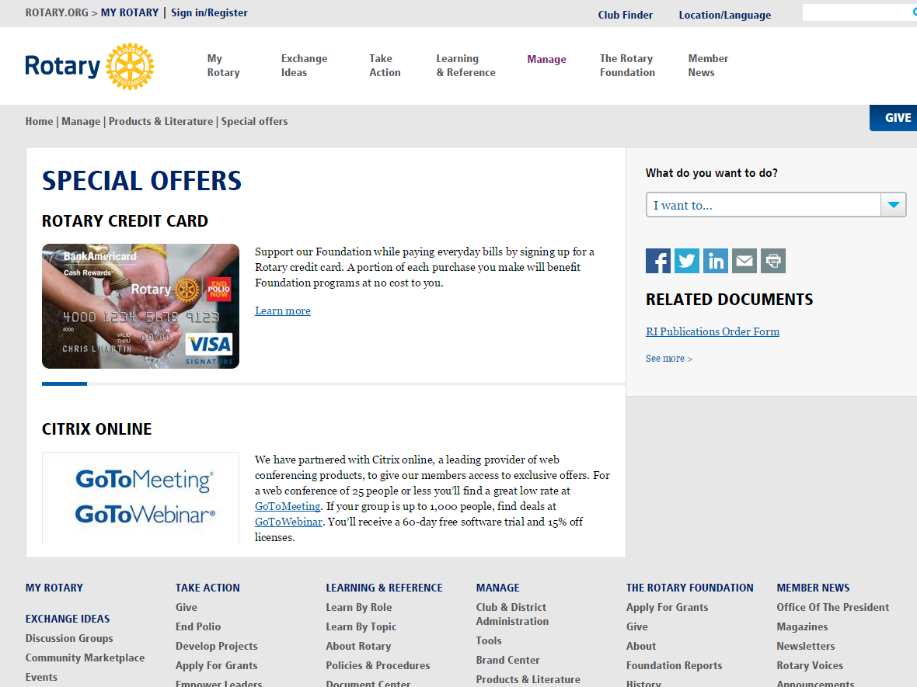

Slide 18
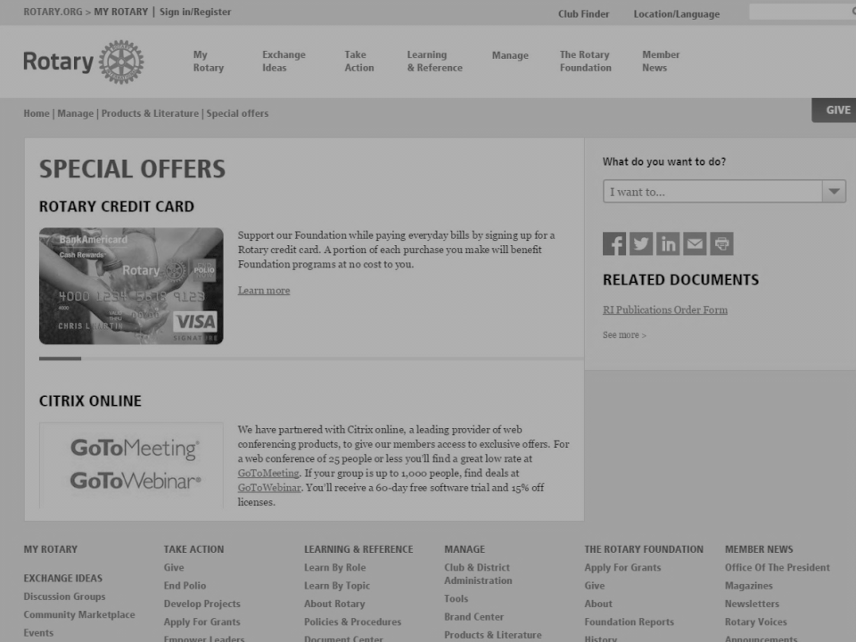

Slide 19
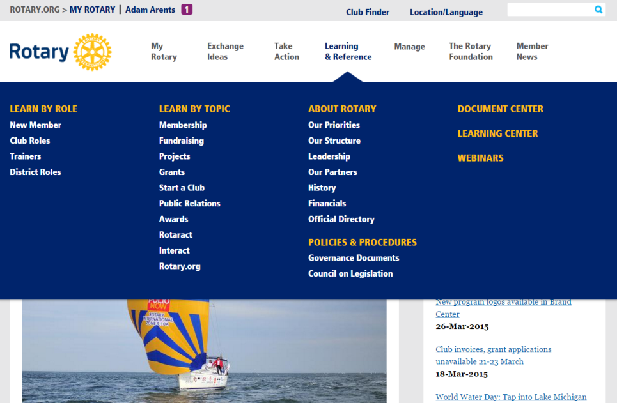
LEARNING CENTER

Slide 20
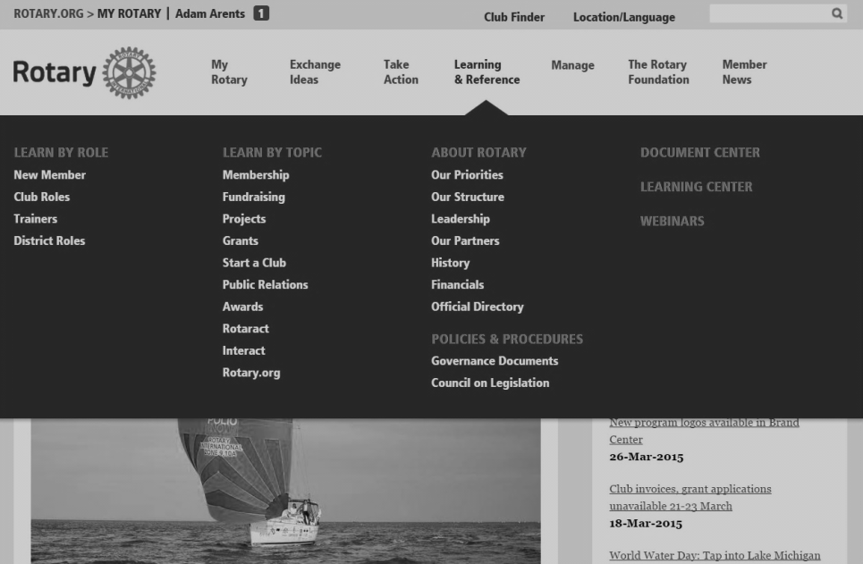
LEARNING CENTER

Slide 21
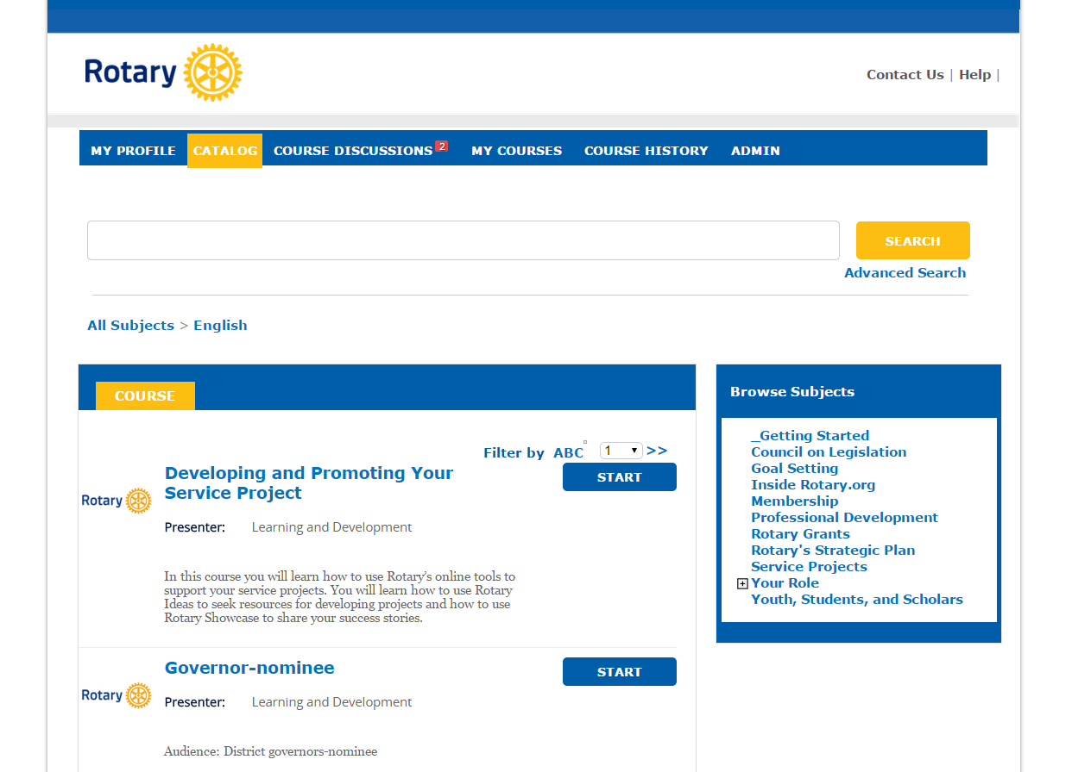
LEARNING CENTER

Slide 22
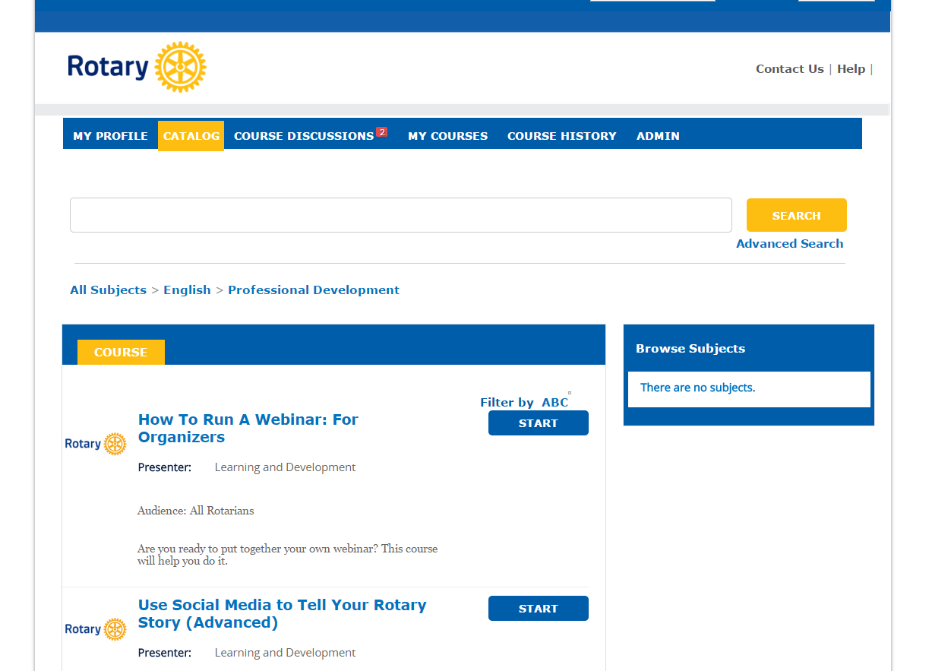
LEARNING CENTER

Slide 23
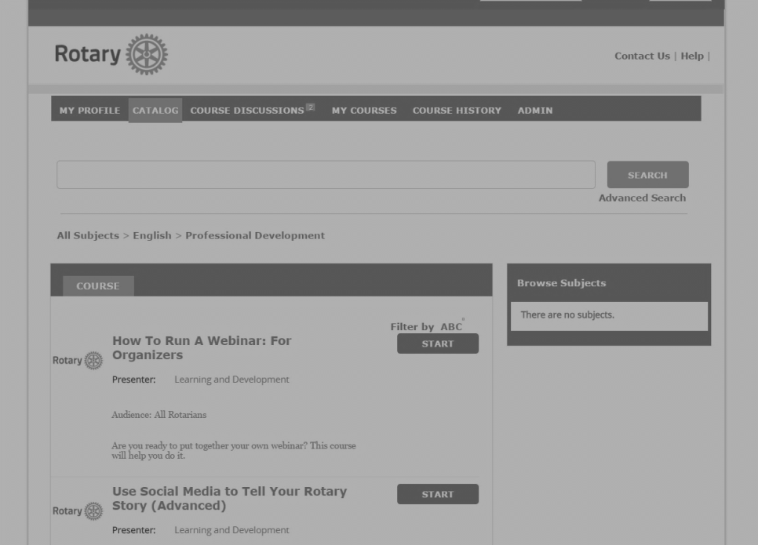
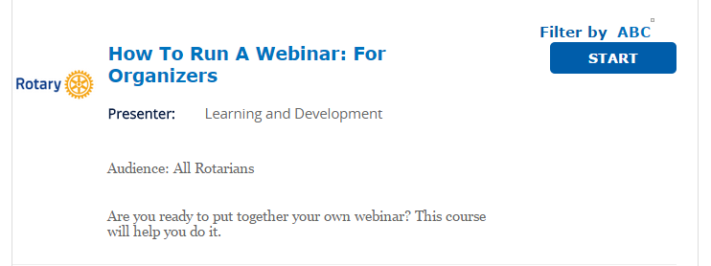
LEARNING CENTER

Slide 24
SOFTWARE OPTIONS
Video conference with up to 10 people
Anyone can watch the conference live on YouTube
Ron Burton did it!

Slide 25
SOFTWARE OPTIONS
Free (with ads) for up to 200 attendees

Slide 26
Questions

Slide 27
webinars@rotary.org

Slide 29
What should you avoid when choosing a webinar topic?

Slide 30
One-sided lecture
Photo by Kevin Dooley

Slide 31
Too much information
Photo by Russell Davies

Slide 32
Requires a hands-on activity
Photo by Gillicious

Slide 33
Designing webinar presentations

Slide 36
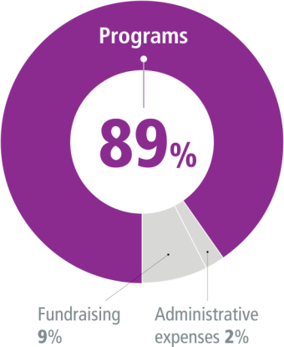
DOING GOOD IN THE WORLD

