Slide 1


District Grants Seminar
2025

Slide 2
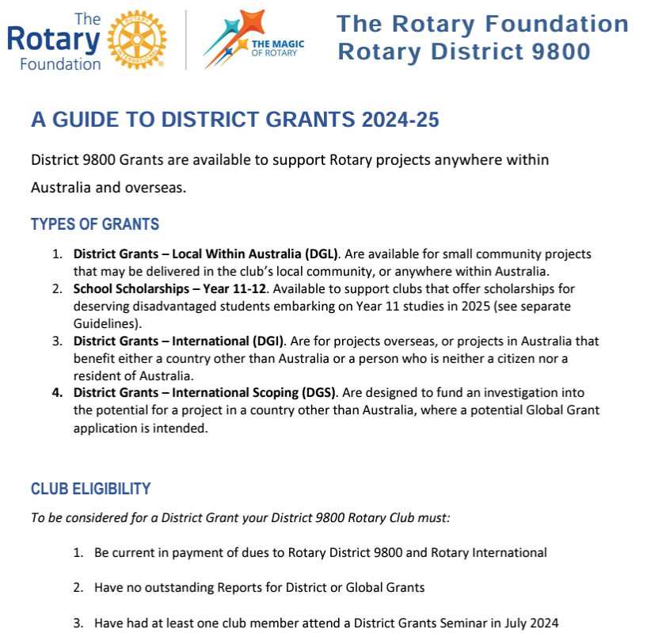
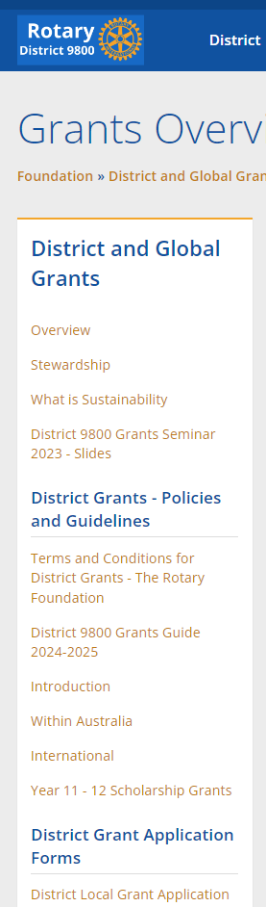

Where to Get More Information?
The District 9800 Website

Slide 3
Why Bother with A Foundation Grant?
Leverage club funding – Increase project impact
Encourage collaboration
  Greater skills bank
  Improved quality of projects
  Grow your Rotary network
  Strengthen member commitment
  Strengthen Rotary
Provide a robust project governance structure
  Increased trust and confidence in Rotary

Slide 4
Humanitarian Grants
The amount of funding available for Grants each year is dependent upon the volume of your club and individual donations three years prior
25% of the Annual Fund Share contributions available for
District Grants
25% of the Annual Fund Share for D9800 support for Global Grants
Balance available to the World Fund
District Designated Fund (DDF)

Slide 5
Types of Foundation Humanitarian Grants
The Three Types of District Grant in D9800
District Grants Local within Australia (DGL)
District International Grants (DGI)
District Youth Grants including Year 11-12 Scholarship Grants

Slide 6
District Grants
District Grants are administered by the District 9800 Grants Committee under the supervision of The Rotary Foundation in compliance with the Terms & Conditions of The Rotary Foundation and District 9800 Policy
For smaller, relatively short-term Rotary projects
Local With Australia or International
Easy application process
Clubs must be qualified

Slide 7
District Grants
Clubs Must Be Qualified to be Considered for a D9800 Foundation District Grant
Be current in payment of dues to Rotary District 9800 and Rotary International
Have no overdue reports on District or Global Grants
Have at least one club member attend the most recent Foundation Grants Seminar
Be a District 9800 Rotary Club

Slide 8
Types of Grants
District Grants
Managed by the lead club in accordance with the grant conditions
Minimum Grant A$1,000
Attract matching Foundation Grants from the District managed ‘Block Grant’
District 9800 can apply for ‘Block Grant’ funding only once per year (known as ‘The Spending Plan’)

Slide 9
District Grants
General Conditions
Compliance with The Rotary Foundation T&Cs
Support the Mission of The Rotary Foundation
  “To enable Rotarians to advance world understanding, goodwill, and peace through the improvement of health, the support of education, and the alleviation of poverty.”
Actively engage Rotarians in the Project
NOT Supporting donations to other organisations
Discrete project with a defined completion date.
Sustainable without ongoing Rotary Foundation funding.

Slide 10
District Grants
District Grants – General Conditions
Grant approval from The Rotary Foundation must be obtained before committing funds. This is sought through the D9800 Humanitarian Grants Committee
D9800 grant funding matches funding from D9800 clubs only
Rotarian, Rotary club or Rotary entity may not be the beneficiary of a grant.
Projects must commence within 12 months of grant approval by TRF and must be completed within 24 months of approval
Publicity plans must be included with the application

Slide 11
District Grants
District Grants – General Conditions
Funding is limited
Priority is given to grant applications or Grant Intention Forms received by September 30th and included in the ‘Block Grant’ application
Grant applications received after September 30th and not included in the Block Grant can be funded only if funds are available.
Grants are paid after final report received

Slide 12


District Grants
District Grants Local Within Australia (DGL)
For small community projects delivered anywhere within Australia
Active Rotarian engagement is essential.
Larger grants are available where more than one club is actively and financially engaged
MOU may be requested, when partnering with government or commercial entities
Grant funding is offered to match D9800 club funding on a $1:$1 basis. Limit $5,000 single club, $10,000 multi-club

Slide 13
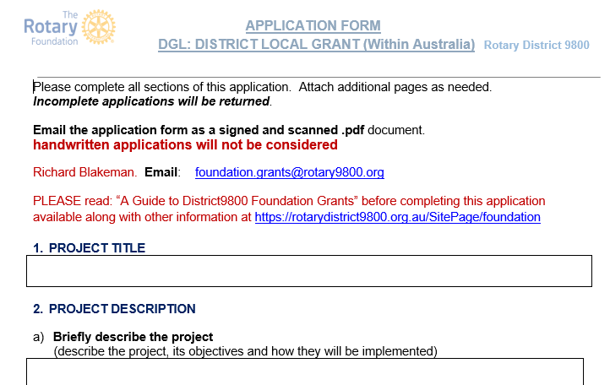
District Grants
District Grants Local Within Australia (DGL)
How to Apply
Read “A Guide to District Grants”
Complete an “Application Form DGL: District Local Grant (Within Australia)”
Have it signed and dated by the Club President
Scan the form and email it to the Chair of the Humanitarian Grants Committee

Slide 14
District Grants
District Grants Local Within Australia (DGL)
Your application must be accompanied by:
Budget worksheets in support of the total planned budget. quotes encouraged
Your Promotional Plan, internally and importantly, externally.
  Promoting Rotary, your club and The Rotary Foundation
  Promotion by Program Partners is especially valued
  TRF acknowledgement: “This project was/is being delivered with the assistance of a District Grant from The Rotary Foundation”.
  Posters to include The Rotary Foundation logo.
  Fixed assets must bear a plaque acknowledging the contribution of Rotary and The Rotary Foundation

Slide 15


District Grants
District International Grants (DGI)
For discrete projects
Australian citizens may not be a beneficiary
Require an international partner – Overseas Rotary District or Club preferred
within one of the seven Areas of Focus of The Rotary Foundation
Must be accompanied by a fully executed Letter of Participation (LOP) and quotes and budget worksheets
Grant funding is offered to match D9800 club funding on a $1:$1 basis. Grant limit A$5,000. Funding may be increased for multiple club involvement.

Slide 16
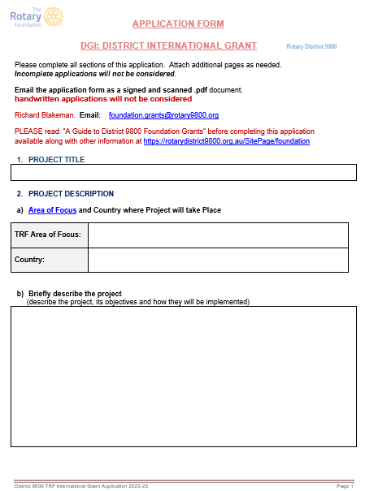
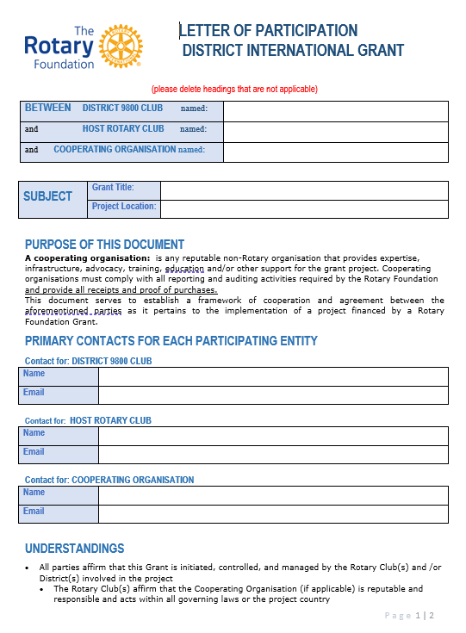
District Grants
District International Grants (DGI)
Areas of Focus
Promoting peace
Fighting disease
Providing clean water, sanitation and hygiene
Saving mothers and children
Supporting education
Growing local economies
Protecting the environment

Slide 17
District Grants
District International Grants (DGI)
How to Apply
Read ‘A Guide to District Grants’
Complete an ‘Application Form DGI: District International Grant ‘
Have it signed and dated by the Club President
Complete a Letter of Participation
Have it signed by the representatives of all partners in the project
Email them to the Chair of the Humanitarian Grants Committee

Slide 18
District Grants
District International Grants (DGI)
Your application must be accompanied by:
The International Letter of Participation (LOP)
Quotes and/or budget worksheets in support of the total planned budget
Your Promotional Plan, internally and importantly, externally.
  Promoting Rotary and your club
  Promoting the Rotary Foundation. “This project was/is being delivered with the assistance of a District Grant from The Rotary Foundation”.

Slide 19

District Grants
District Year 11-12 Scholarships
Purpose
To encourage talented and motivated young people facing financial barriers to successfully complete their Year 11 and Year 12 secondary education.
To build stronger relationships between clubs and their local schools.
THESE ARE UNDER REVIEW

Slide 20

District Grants
Youth Service
District Grants are available to match club contribution in support of:
RYLA
Sponsorship of MUNA teams
Rotary Youth Exchange
Rotaract Programs

Slide 21
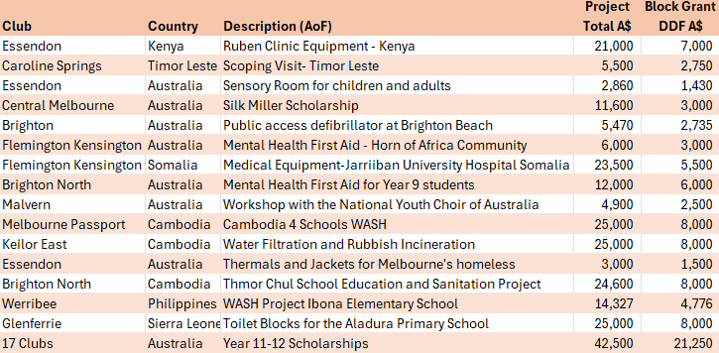
Grant Supported Projects
i

Slide 22
District Grants – Approval Timetable
Grant applications received between before September 30th
Reviewed by D9800 Grants Committee at monthly meeting
Will be funded from the Block Grant while funds last.
Otherwise, club will receive an acknowledgement that the Committee has accepted the application for inclusion in the ‘Block Grant’ (Spending Plan) for the next year.
Submitted with the Block Grant in November
Club advised of outcome by end of November together with Stewardship Requirements.

Slide 23
District Grants – Approval Timetable
Club considering a grant but not ready to apply by September 30th
Don’t have all the ducks in a row but are pretty certain it will go ahead this Rotary year
Submit a Grant Intention Form by September 30th
If your form is convincing, it will be included in the Block Grant submission in November to ‘reserve’ funds for you when you are ready to apply.
You must lodge a formal application by June 30th, or the funding will lapse.

Slide 24
District Grants – Approval Timetable
Grant applications received after November 1st
Reviewed by D9800 Grants Committee at monthly meeting
If accepted by the Grants Committee, they will be submitted to The Rotary Foundation for approval if ‘contingency’ funds are still available
If contingency funds are not available, they will be held back for submission in the next Rotary year

Slide 25
Applications for Grants
Grant Governance – The District Humanitarian Grants Committee
District Foundation Grants Chair
District Foundation Chair
District Foundation Stewardship Chair
  District Governor
  District Governor Elect
  District Governor Nominee
  District Governor Nominee Elect
Meet on the first Monday of every month to consider grant applications
Supervised by The Rotary Foundation in Evanston IL

Slide 26

Promotion a Key Project Deliverable

Slide 27
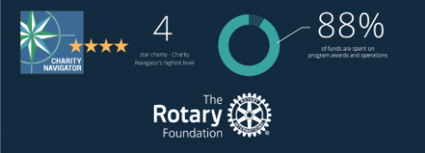
Stewardship
Of Grant Funds from The Rotary Foundation

Slide 28
What is Stewardship?
Stewardship is the responsible management and oversight of grant funds.
It ensures that funds are used properly and benefit the populations in need.
Stewardship involves:
  Report tracking
  Routine monitoring
  Ensuring guidelines followed
  Document retention
  Maintain TRF Seminar attendees' lists
  Ensuring Qualification of Clubs & Districts
  Maintaining trust
Notes:
Proper stewardship is the responsibility of each Rotarian.
Implementing good stewardship practices ensures that grants are well managed and that grant funds are used according to Foundation guidelines and benefit the populations in need.
Careful grant management sustains donor confidence in the Foundation and can increase donations.

Slide 29
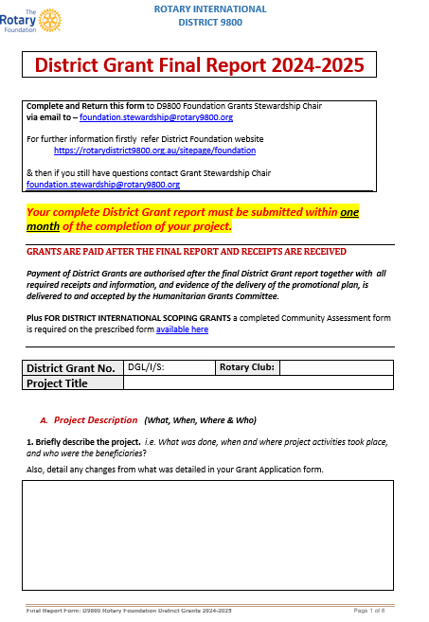
District Grant Report Form
On completion of your project,
complete and return the
District Grant Report Form to
D9800 Foundation Grants Stewardship
via email:
foundation.stewardship@rotary9800.org
Final reports must be submitted within one month of the scheduled completion date of your project

Slide 30
District Grant Report Form 2024 – 2025
In your report, describe:
And Funding:
Where the money came from.
How it was spent
The project
  what was done and how it was done?
Rotarian engagement
  how many Rotarians, what they did?
The benefit delivered to the recipients
  How many benefited and how?
  The long-term benefits of the project to the beneficiary community
Sustainability
  how will it be maintained without ongoing Rotary Foundation support?
The involvement of other partners
  what they did, how it contributed
Publicity
  what has been delivered internally and externally

Slide 31
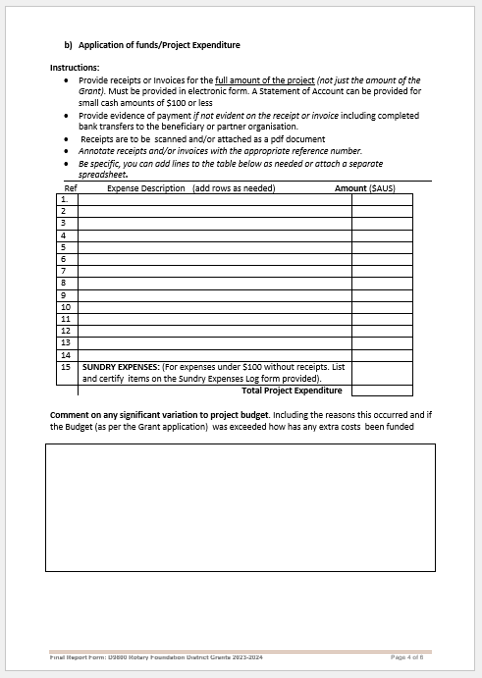
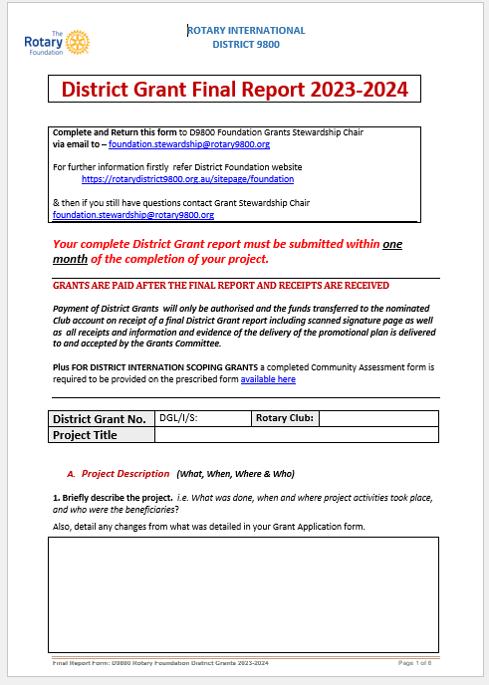
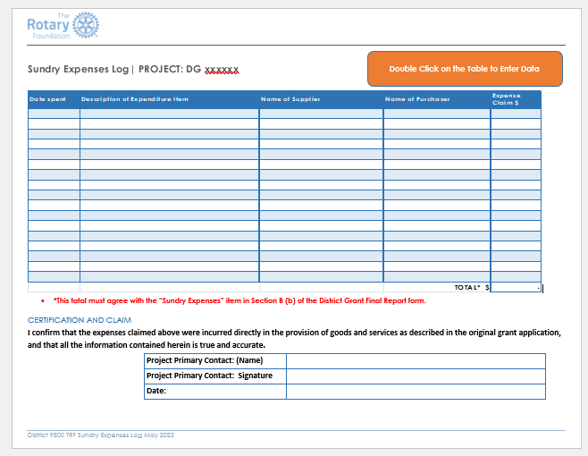

District Grant Report Form 2024 – 2025
On completion of your project,
complete and return the
District Grant Report Form to
D9800 Foundation Grants Stewardship
via email:
foundation.stewardship@rotary9800.org

Slide 32
District Grant Report Form
Include with your report:
All receipts (or invoices if accompanied by bank transfer as proof of payment)
  Addressed to the Rotary Club
  Describing what was provided
  Overseas projects funds may be dispersed by the overseas partner
    Receipts (or invoices with proof of payment) must be provided together with an additional receipt from the partner for the reimbursement of funds
Examples of internal and external publicity
  Describing the project and the role of Rotary and the Rotary Foundation
  Links to social media and website posts are acceptable.
  Include logos where possible – brand the project
    “This project was (is being) delivered with the assistance of a grant from The Rotary Foundation”
Signed declaration by the project lead

Slide 33
Grant Payments
Grant Governance – The District Foundation Stewardship Committee
District Foundation Stewardship Chair
District Foundation Grants Chair
District Foundation Chair
Review reports for compliance and approve grant payment within a few days of their submission
The files of the D9800 Humanitarian Grants Committee are audited annually to ensure compliance with the terms and conditions of The Rotary Foundation
ü

Slide 34
District Grants – The Grant Payment Process
- The
Club Completes Project
Club Submits Final Report
Reports Reviewed
Payment Approved
Payment of Grant
Completes project implementation and promotion of project
Final implementa-tion report
Final Project Promotion Report
Receipts
Submitted to Stewardship Chair
Reports reviewed and verified by Stewardship chair
Payment of Grant Recommended to Grants Committee
Grants Committee receives and reviews Stewardship Chair recommendation
Advises Club of imminent payment
Grants Committee Chair and District Foundation Chair process payment
Payment is made to Lead club
Projects must be completed within 24 months of the date grant is approved

Slide 35

Grant Intention Form
District Grant Workshop
Late August 2025
Via Zoom
How to lodge a successful District Grant Application
How to successfully acquit a District Grant without drama
Lodge by September 30th 2025
For grants to be included in the 2025-2026 Block Grant
Further details https://rotarydistrict9800.org.au/sitepage/foundation
REMEMBER: WE ARE HERE TO HELP YOU SUCEED
CONTACT Mark Stephens. Foundation.grants@rotary9800.org
Notes:
Speaking points
Thank participants for attending, and recognize the training leaders.
Highlight the importance of responsible grant management.
Review the requirements of club qualification, along with district-specific criteria for Rotary grant projects.
Provide information about local laws, district qualification requirements, and regional examples of successful projects.
Discuss how district grant funds will be used in the coming year.
Share how your district manages and allocates District Designated Funds.
Encourage attendees to get to know one another during the meeting so they can continue to work together during the year.
Review the seminar agenda and explain the next steps.
Ask participants to complete a survey to help improve future seminars.

