Slide 1
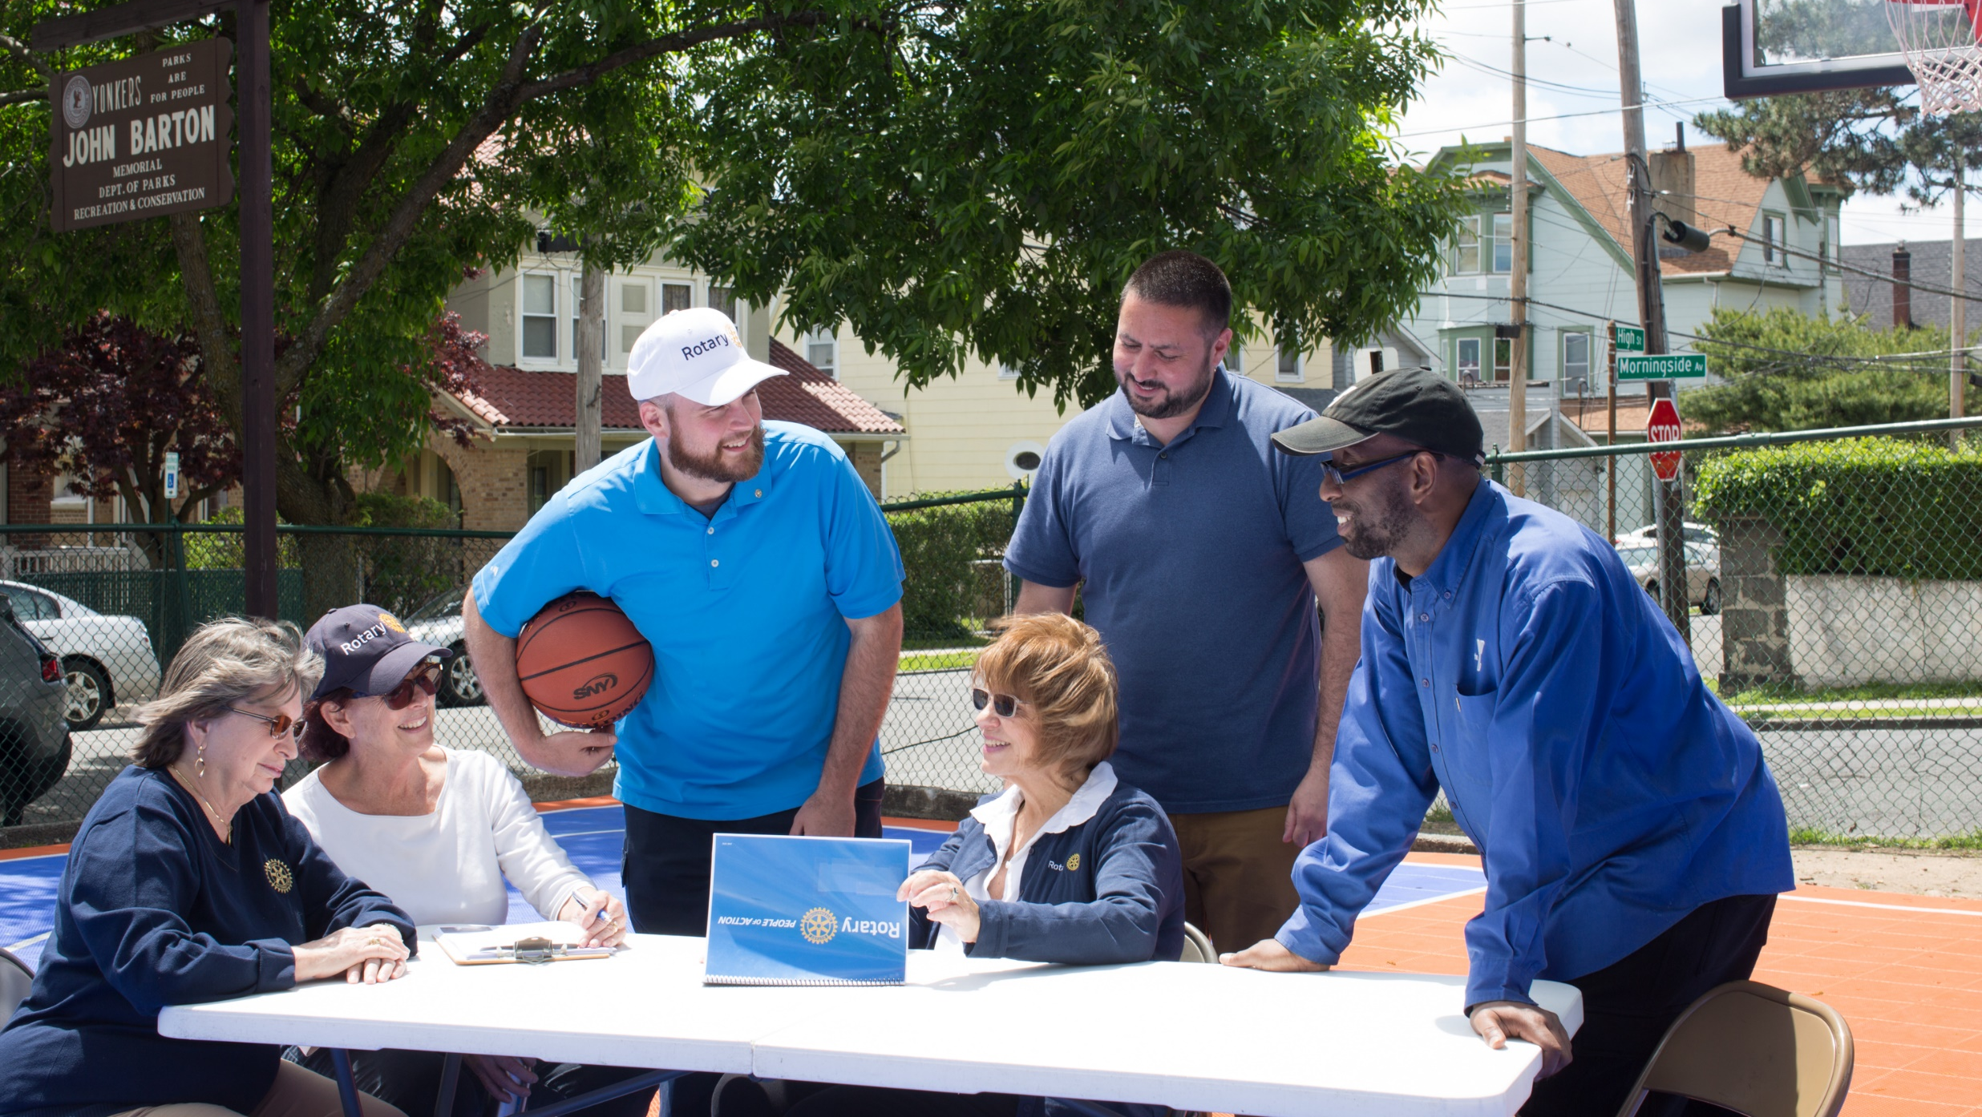

ROTARY FRIENDSHIP EXCHANGE

Slide 2
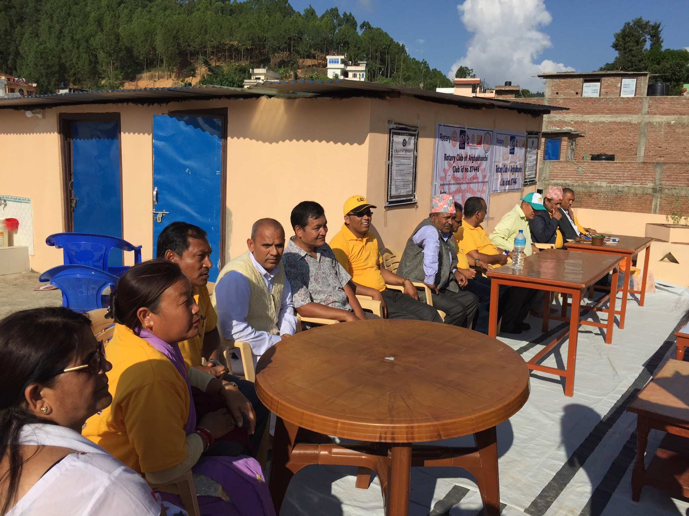
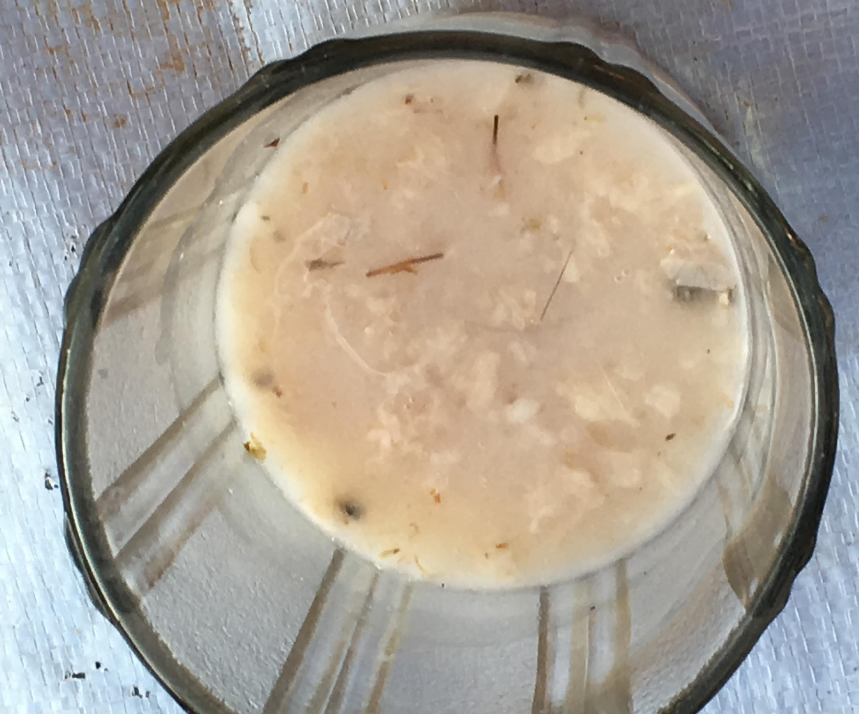
Purpose
Develop friendships
Create connections
Culture-oriented Exchanges
Service-oriented Exchanges
Vocation-oriented Exchanges
Notes:
Exchange participants work together to determine all aspects of an exchange. Participants:
- Determine all details, including exchange location and dates, travel & housing, and the schedule itself
- Assume all financial responsibilities associated with program participation. Check with your club or district if funding is available to help offset expenses.
Secure travel insurance
After an exchange, participants are encouraged to submit a report to Rotary with program reactions, suggestions for improving relationships between the two countries , and what was learned about Rotary’s work in a different part of the world to inspire other Rotary districts to plan their own exchanges.

Slide 3
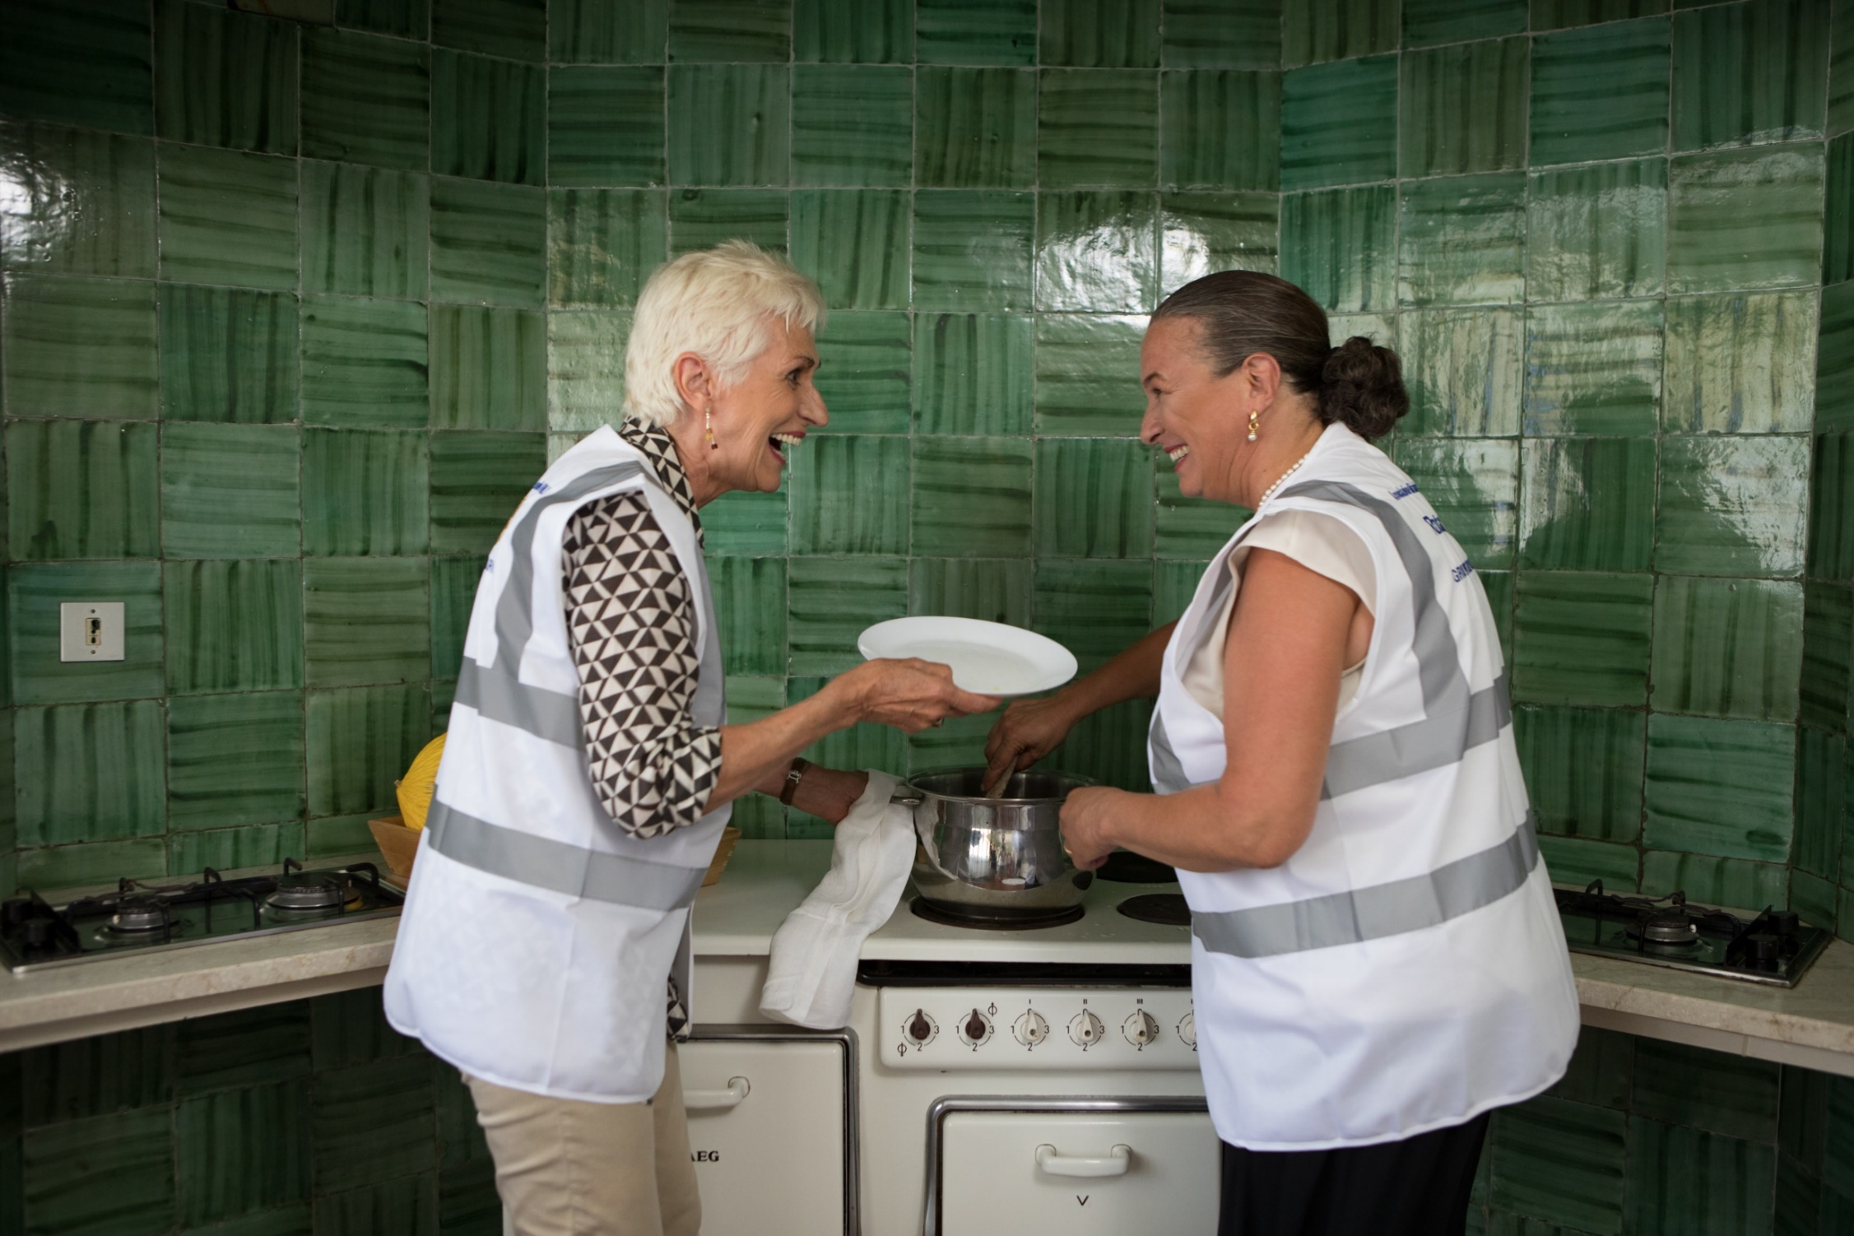
Rotary Friendship Exchanges
Rotary Friendship Exchanges: build goodwill, foster peace, strengthen international friendships, and create a more global community
Notes:
Rotary Friendship Exchange is an international program for Rotary members and friends that allows participants to take turns hosting one another in their homes and clubs. Exchanges allow Rotarians and non-Rotarians alike to
experience different cultures
broaden their international understanding
foster good will
explore their professions in a different context
build longstanding friendships
establish a foundation for peace and service

Slide 4
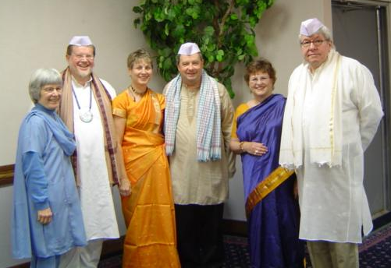
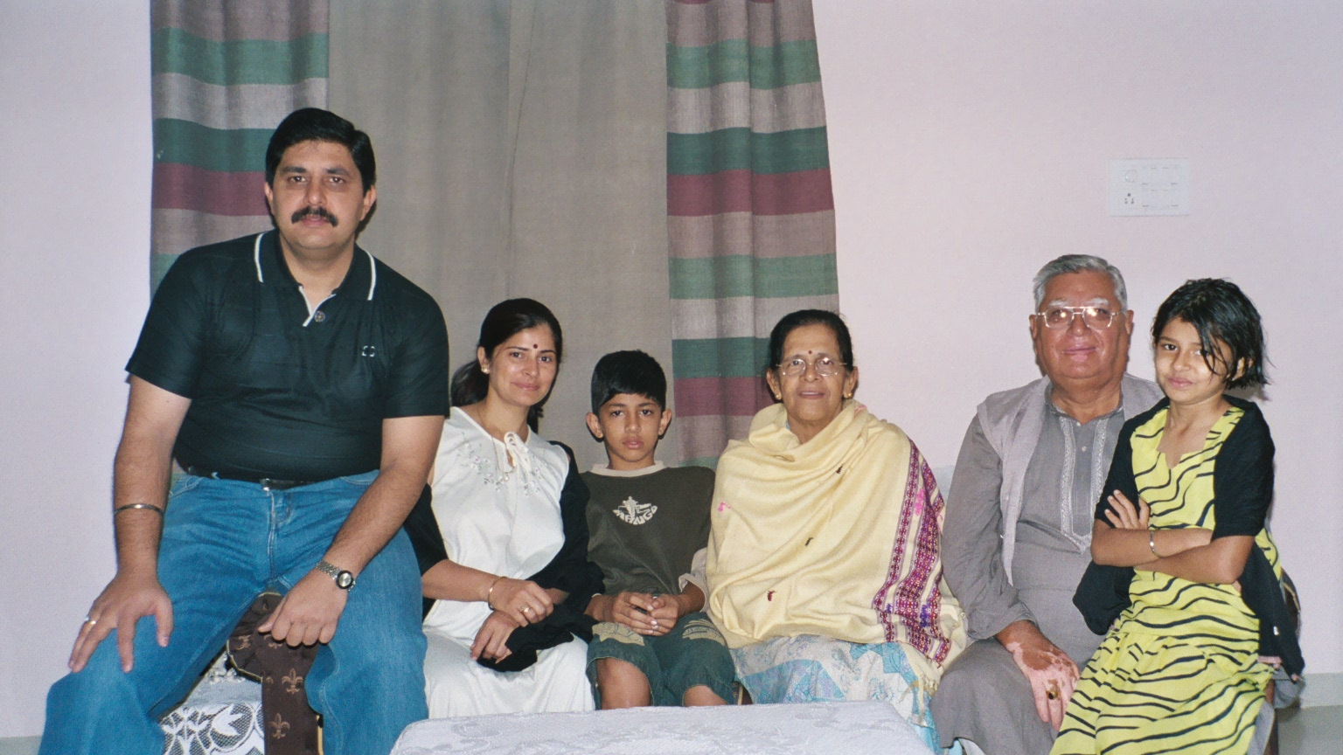
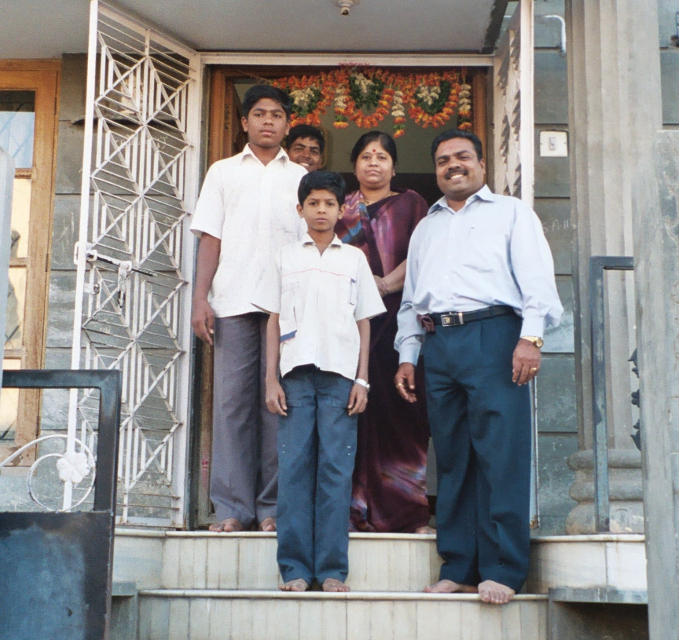
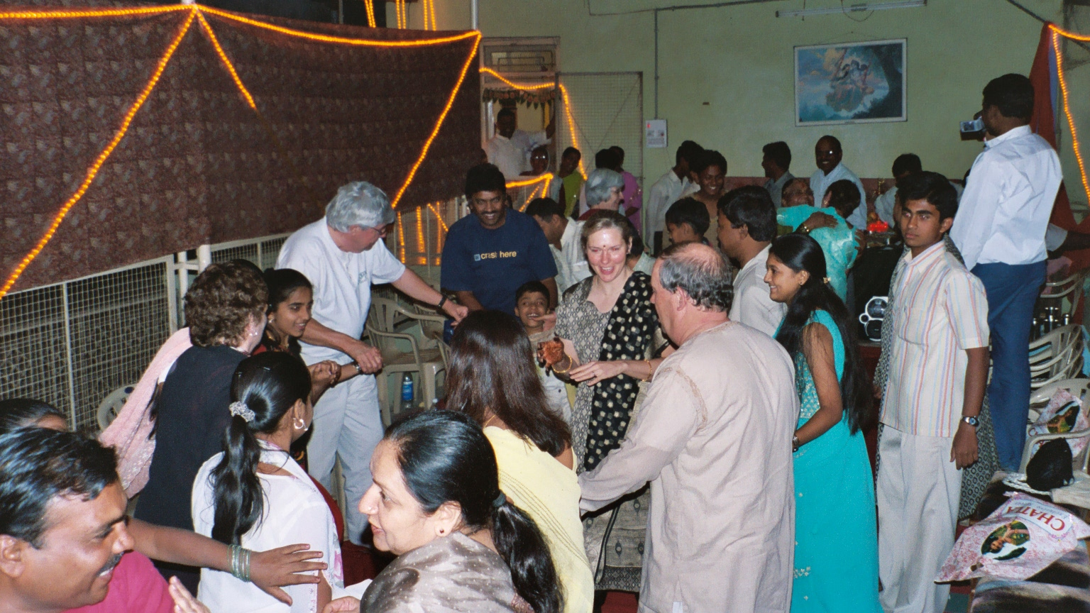
Make Friends

Slide 5
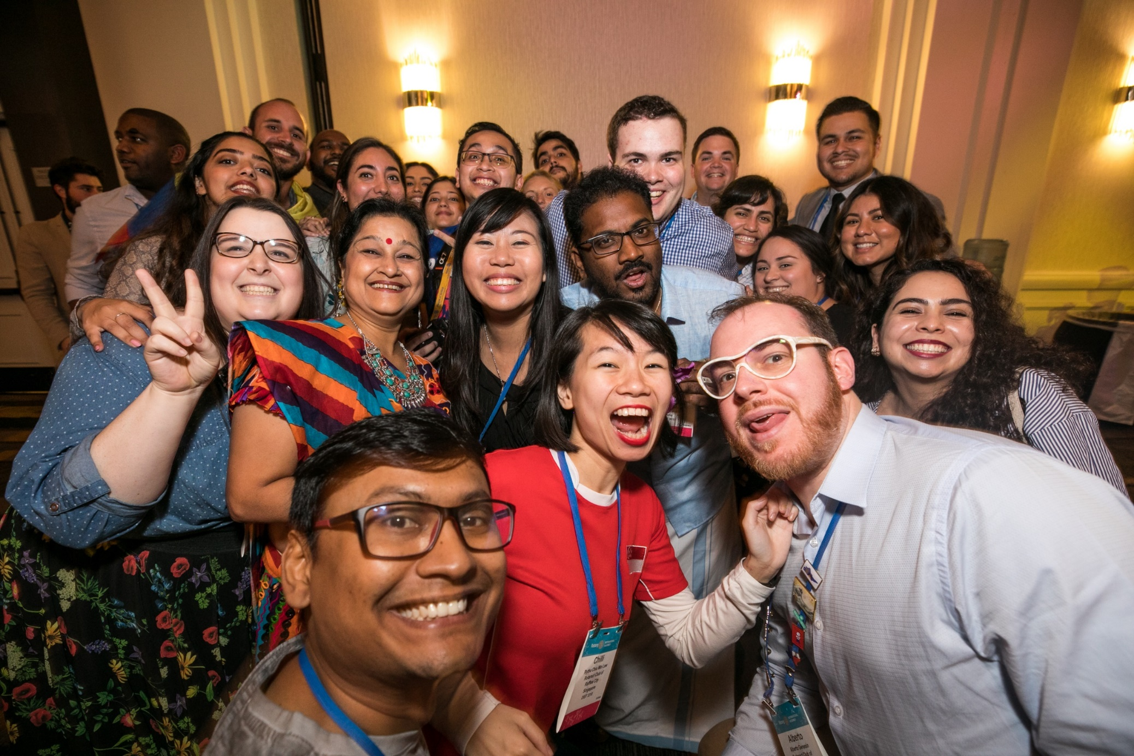
Exchange Guidelines
Exchanges are coordinated at the district and local level and reflect the interests and preferences of participants
Notes:
Exchange participants work together to determine all aspects of an exchange. Participants:
- Determine all details, including exchange location and dates, travel & housing, and the schedule itself
- Assume all financial responsibilities associated with program participation. Check with your club or district if funding is available to help offset expenses.
- Secure travel insurance
After an exchange, participants are encouraged to submit a report to Rotary with program reactions, suggestions for improving relationships between the two countries , and what was learned about Rotary’s work in a different part of the world to inspire other Rotary districts to plan their own exchanges.

Slide 6
Rotary Friendship Exchange Themes
Culture: Experiences that highlight a region’s ethnicity, food, language, history, and more
Service: Opportunities for hands-on project involvement and support
Vocation: Exploring specific professions or jobs in a different cultural context
Notes:
Districts should structure exchanges around one (or more) of the following themes:
Cultural Exchanges: Experiences that highlight a regions ethnicity, food, language, history, and more
Service Exchanges: Opportunities for hands-on project involvement and support
Vocational Exchanges: Exploring specific professions or jobs in a different cultural contest
Trips often lead to long-term relationships between the two partnering districts, and clubs often form twin club relationships or find partners for global grants with clubs participating on exchanges.

Slide 7
District 6250 RFE
Exchanges with Chile, India, Texas, New Mexico, Australia, Argentina, Peru, Netherlands, Sweden, Latvia, Nepal and more.
We were planning other exchanges, but Covid got in the way. Russia is now canceled. Chile still needs to be completed. The Chileans will come here. No others are in the schedule yet.
Anyone can start their own exchange. If you know a Rotarian from somewhere else, we can make it happen. We even had one with Texas and New Mexico.
Use your RFE district chair, or committee members, to get details and to find help in coordinating your exchange.

Slide 8
OVERVIEW
The district does not organize or pay for the exchange. Individuals and clubs do the work. The district helps and publicizes exchanges.
All costs are paid for by the participants or their clubs. Hosts provide lodging, travel in their area, and most meals. Travelers typically pay travel costs,which range from $400 to $1100 for airfare, plus $300-$500 for additional costs.
It normally starts with 2 Rotarians who connect and decide to arrange it. They set the dates and announce it to the District. This person, which might be the district chairperson or committee member, but anyone can coordinate the specifics.
Interested parties send in an application, with a $100 deposit. They must then do what is required to travel. If they can’t go for some reason not in their control, they may get a refund.
Outbound- You must get a passport and visa, buy your own airline tickets and prepare for travel.
Inbound- About 4 Rotary clubs agree to host a couple of travelers. The host team organizes the schedule and moves the group around. Include meals, tours, free time and social time. Each club hosts about 3-4 days, then helps transfer the group to the next Rotary club.

Slide 9
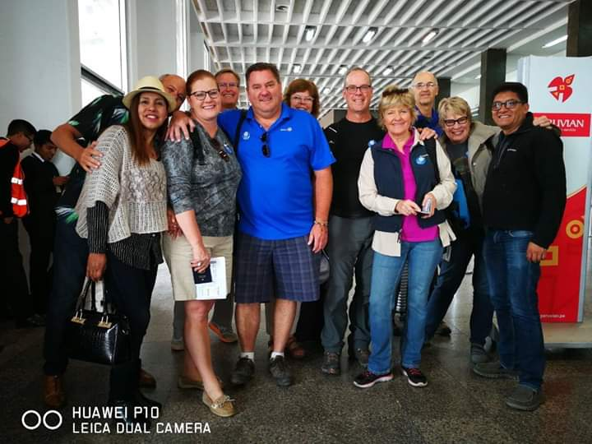
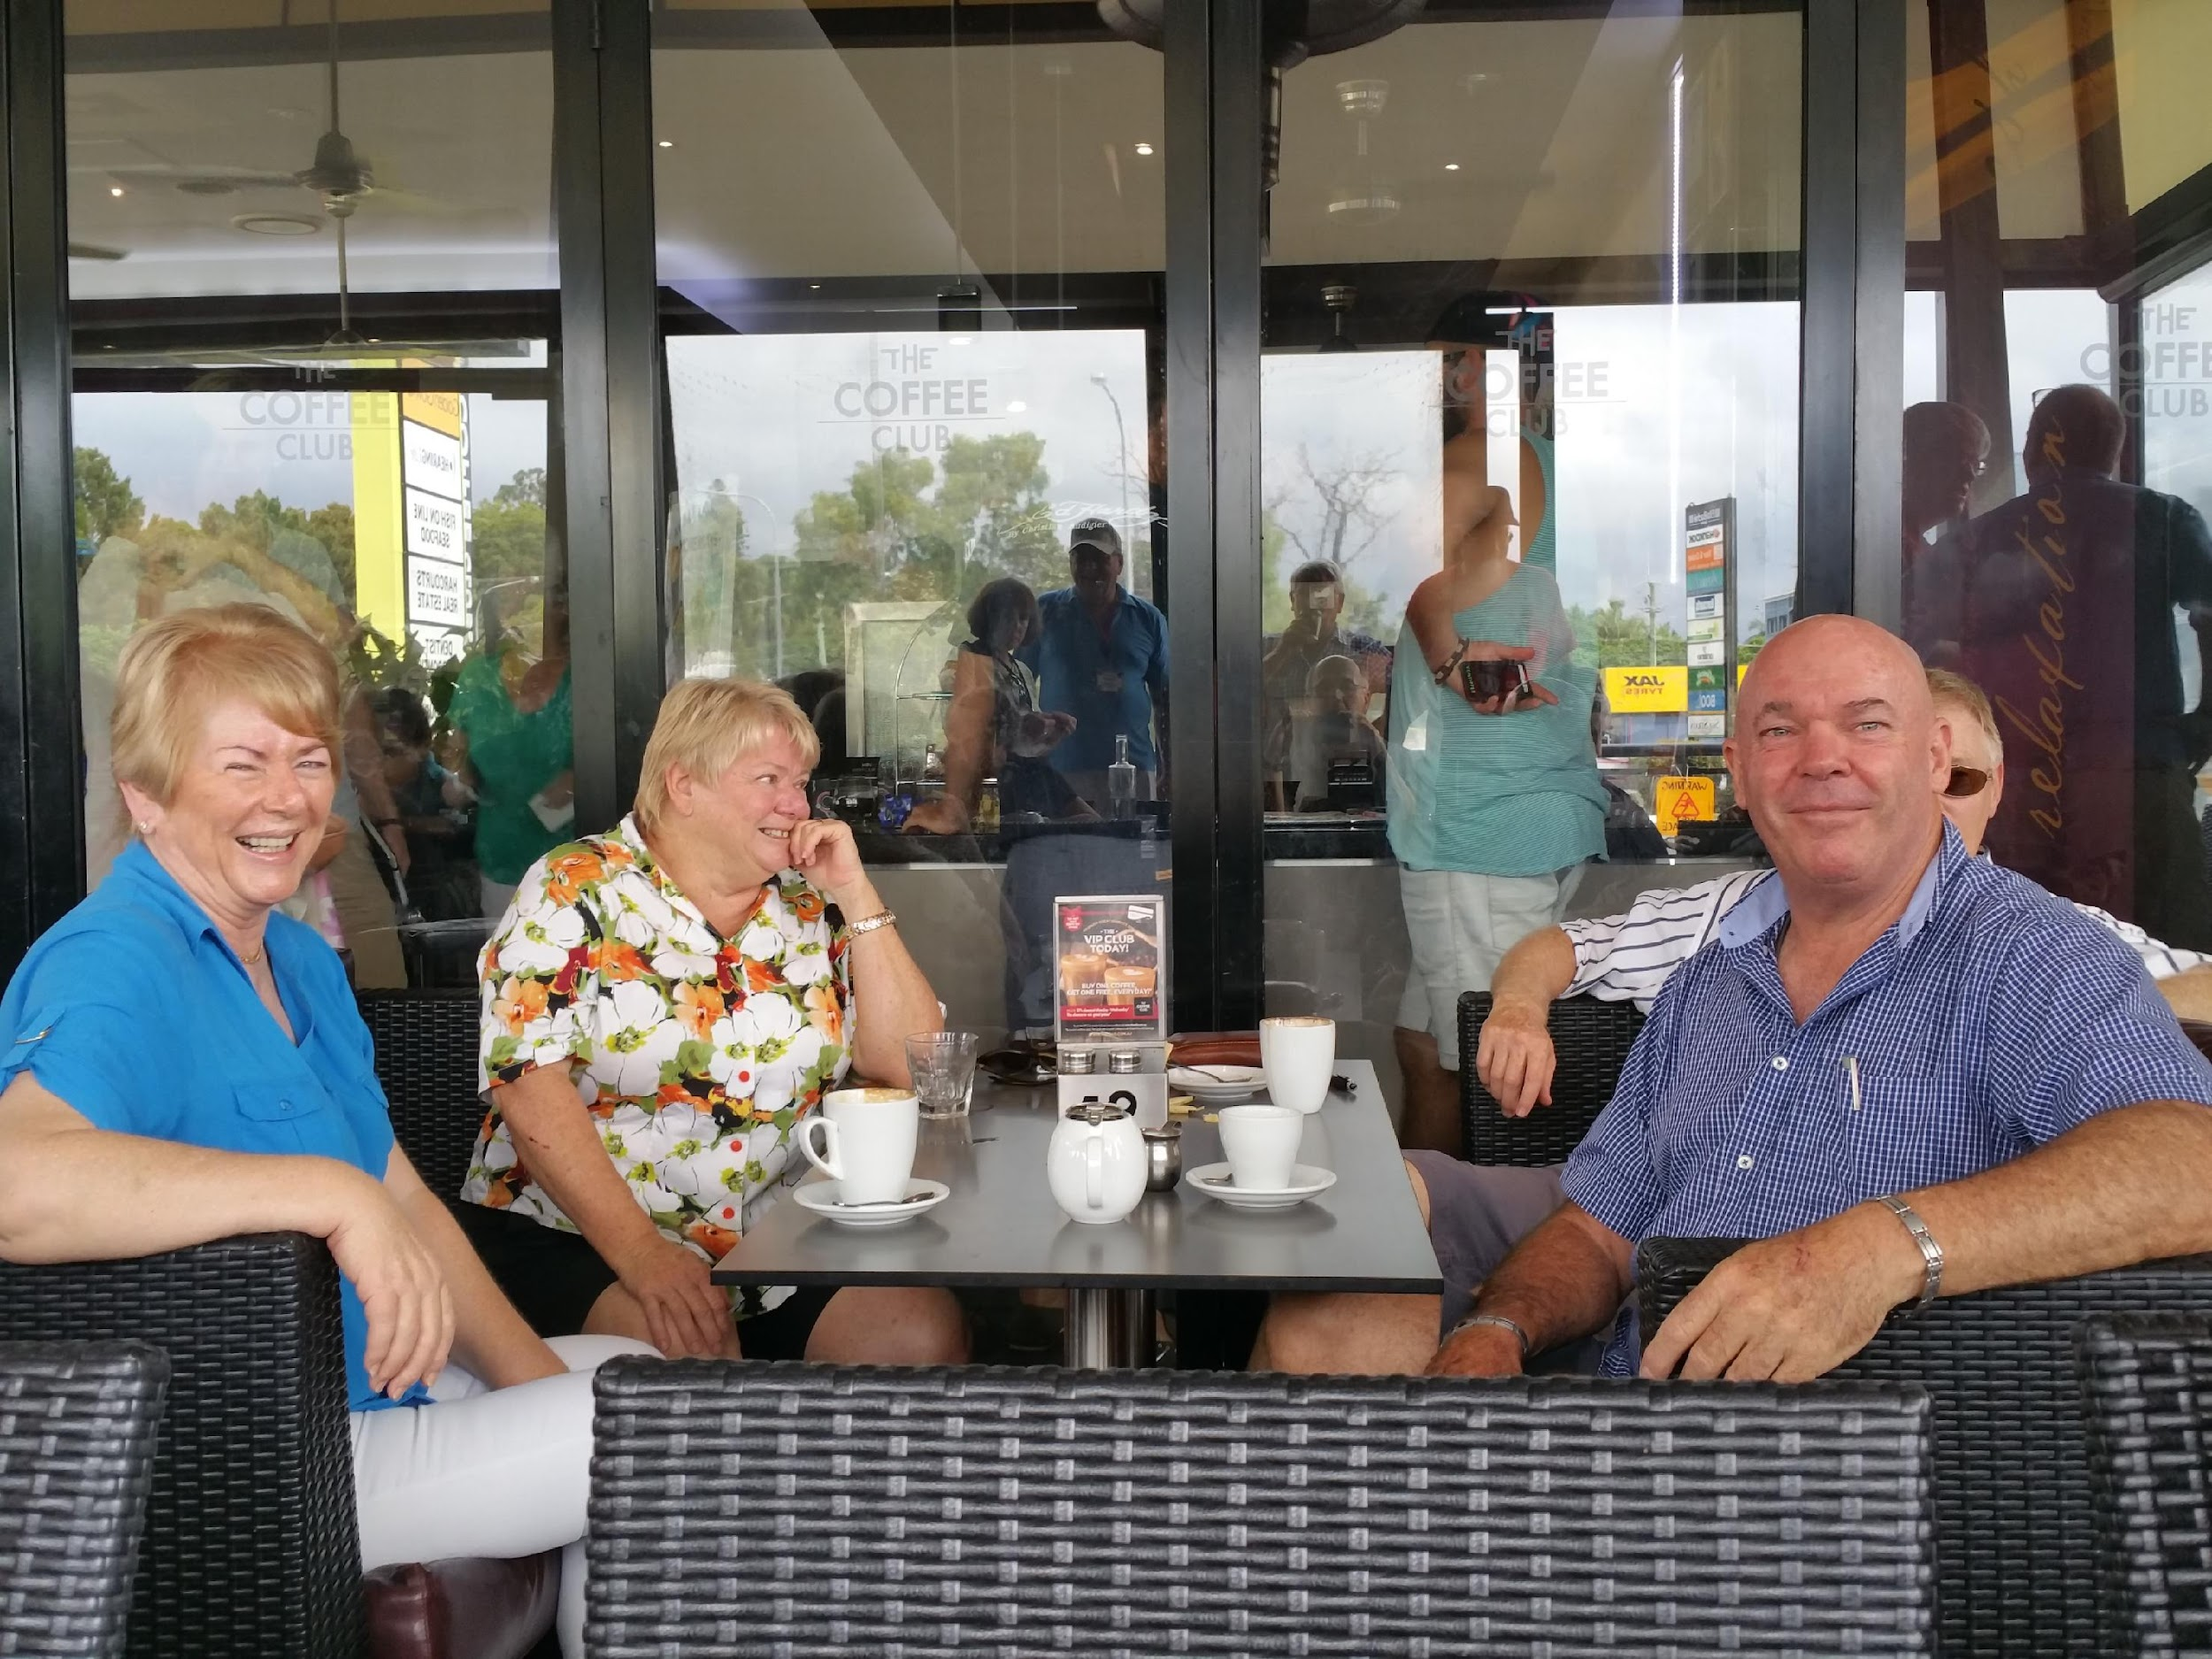
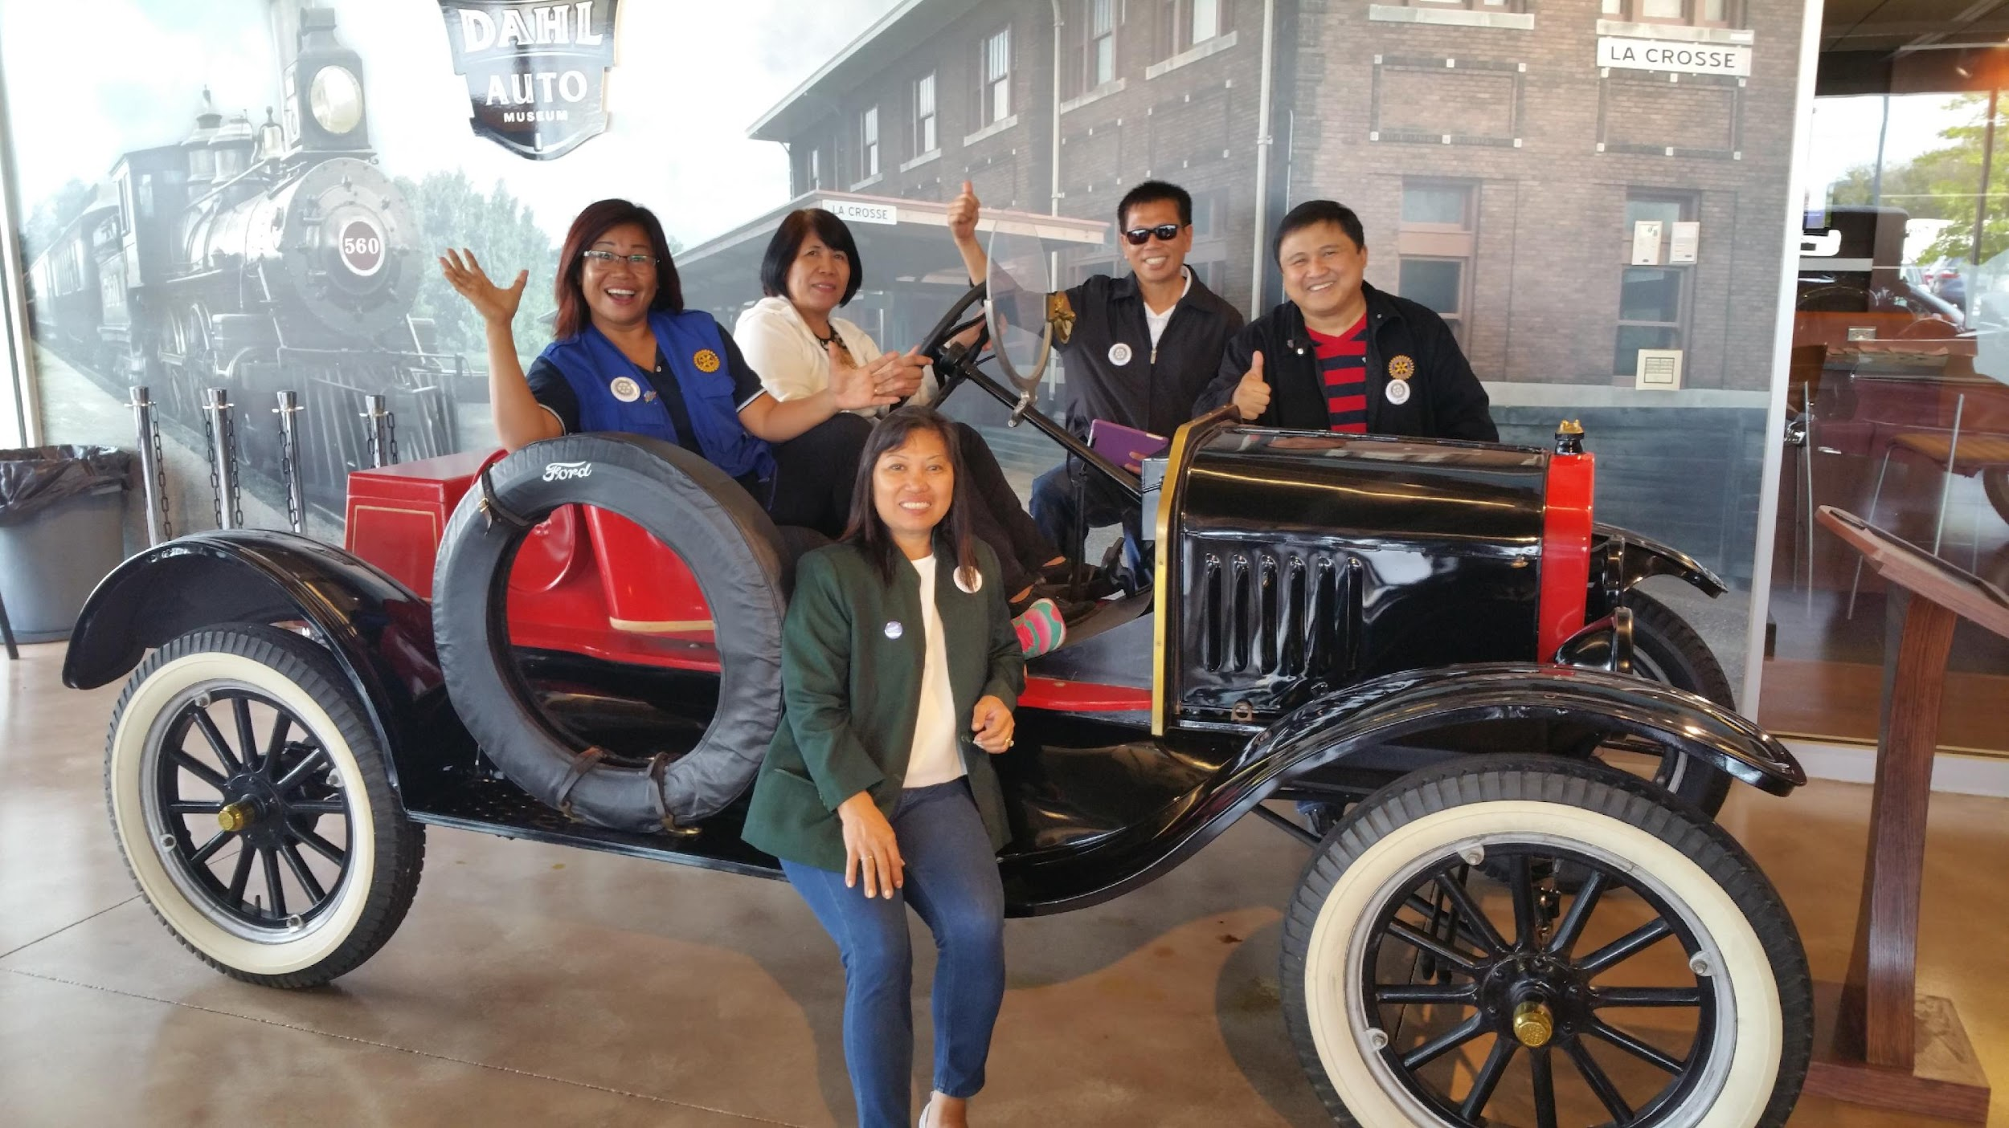
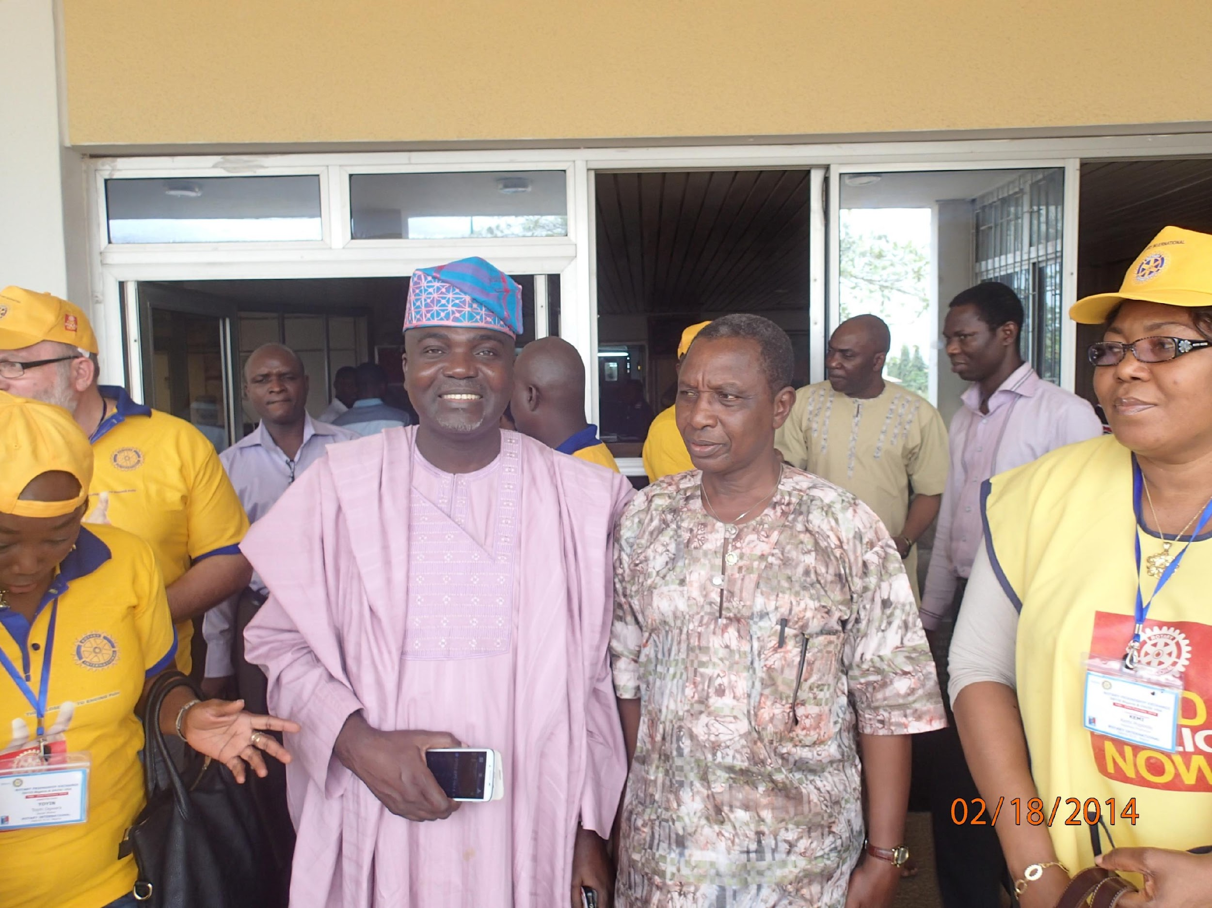
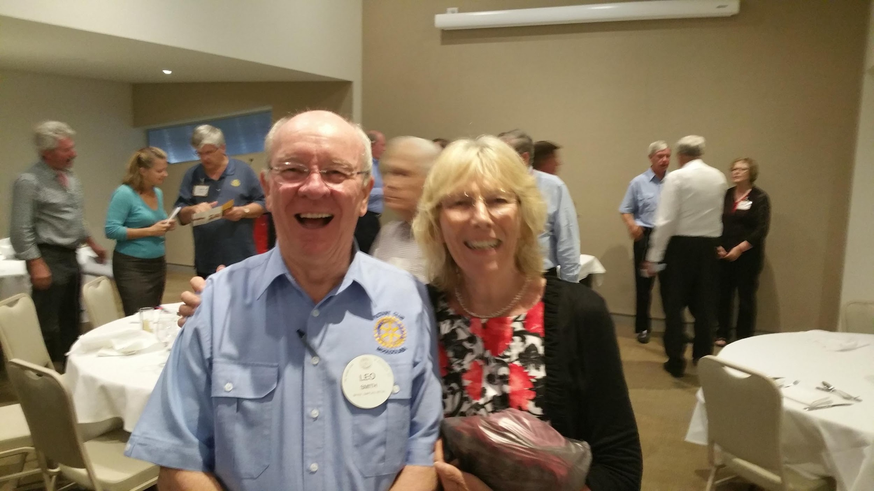
Nigeria, Nepal, India, Sweden, Netherlands, Australia, Latvia, Peru, Chile, Argentina
Why do a friendship exchange?
Friends from around the world!

Slide 10
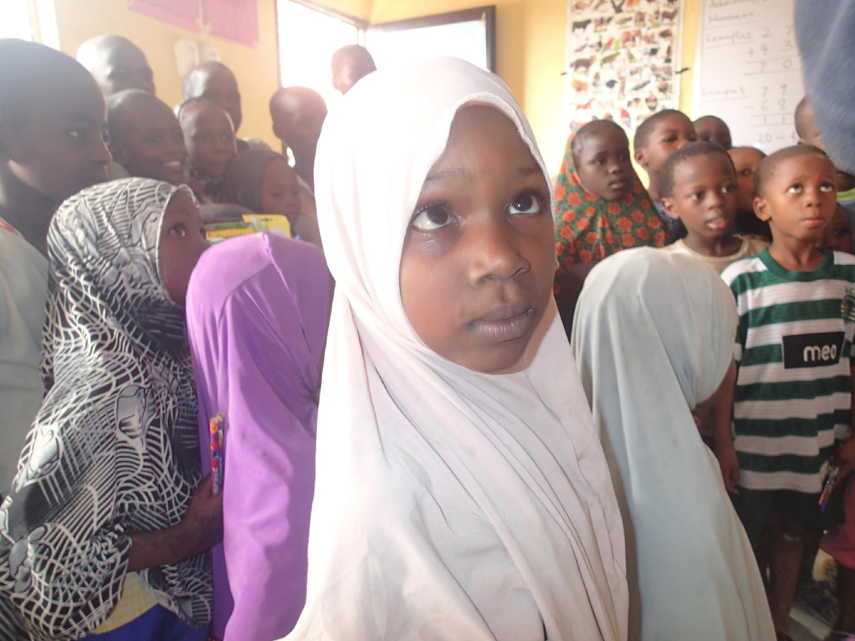
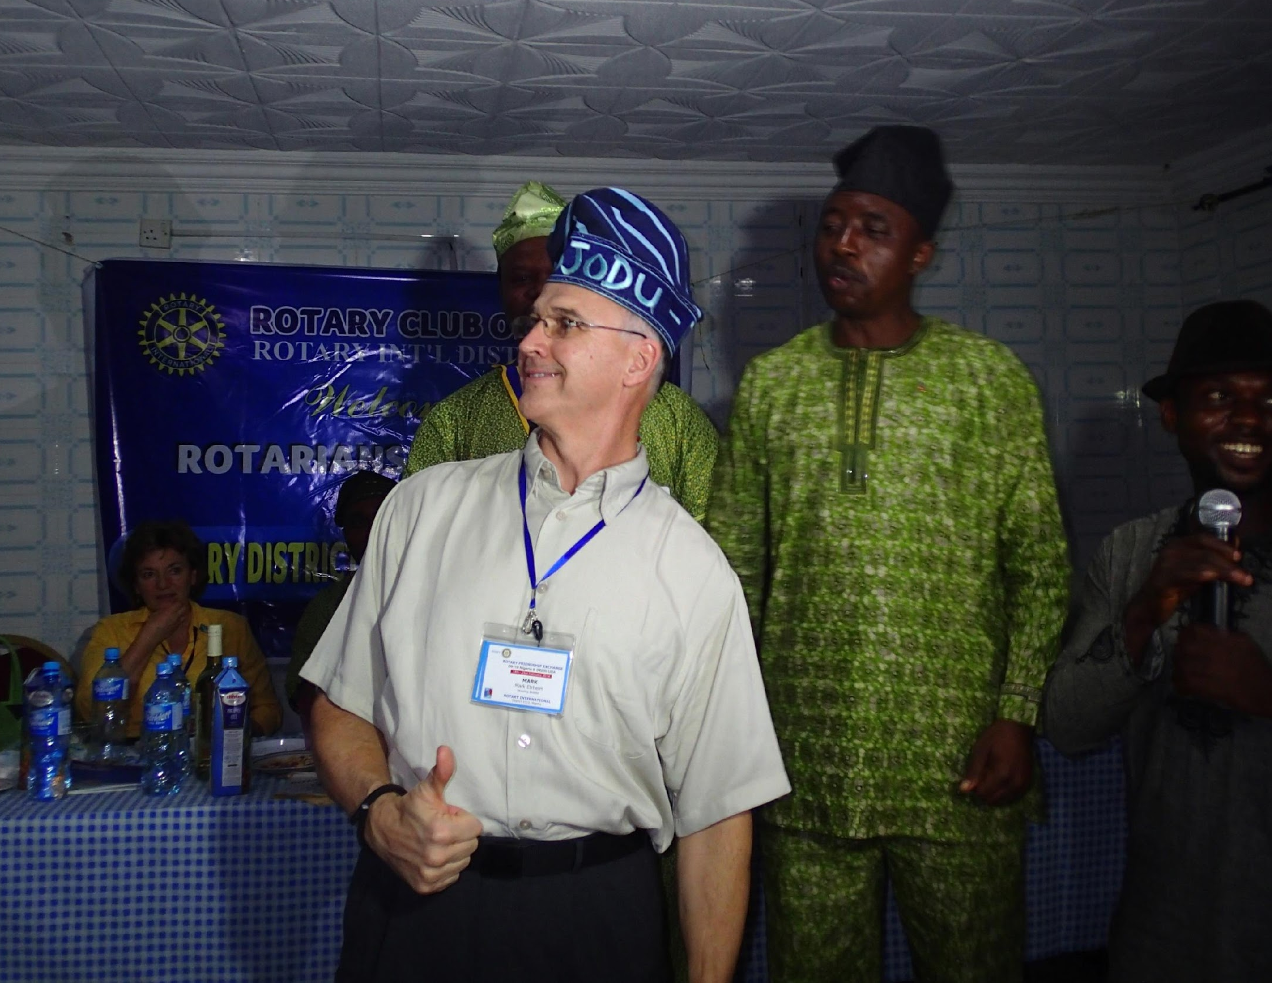
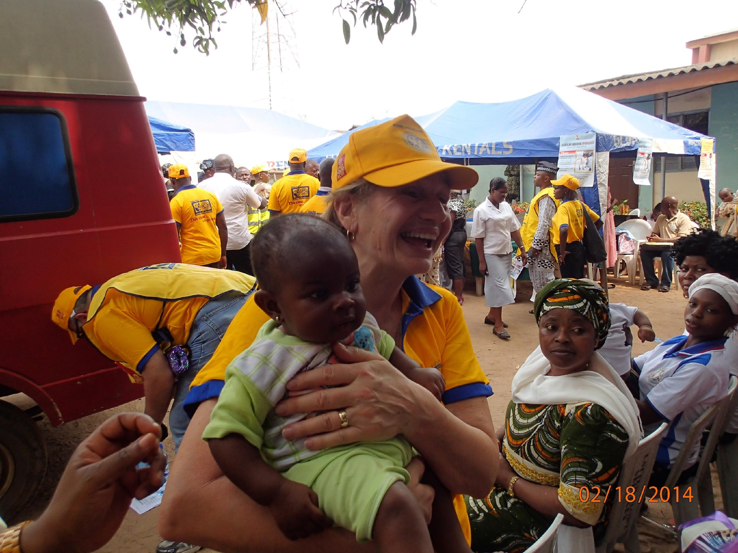
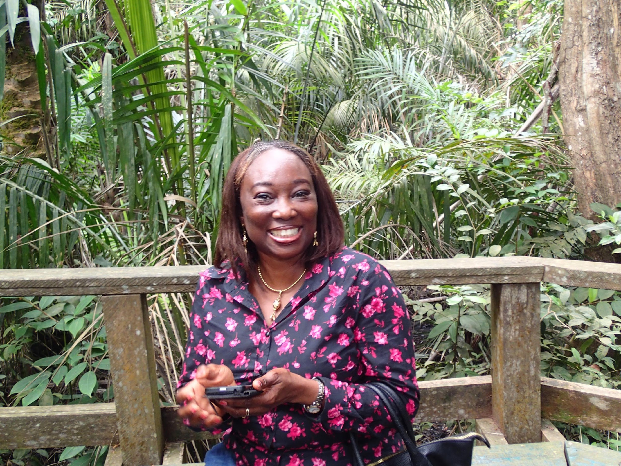
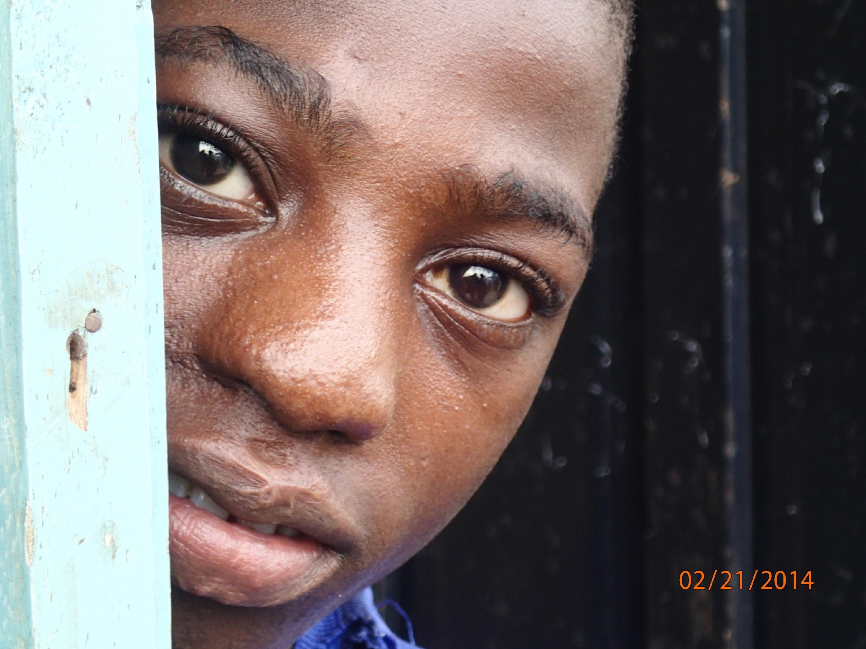
NIGERIA 2014
Polio Immunization
Wheel School
Rotary Meetings that are a bit different
Noisy, chaotic, Lagos 22 million people
Huge economic gap. Electricity works 14% of the time, Oil rich, ethnic tension, great Rotarians

Slide 11
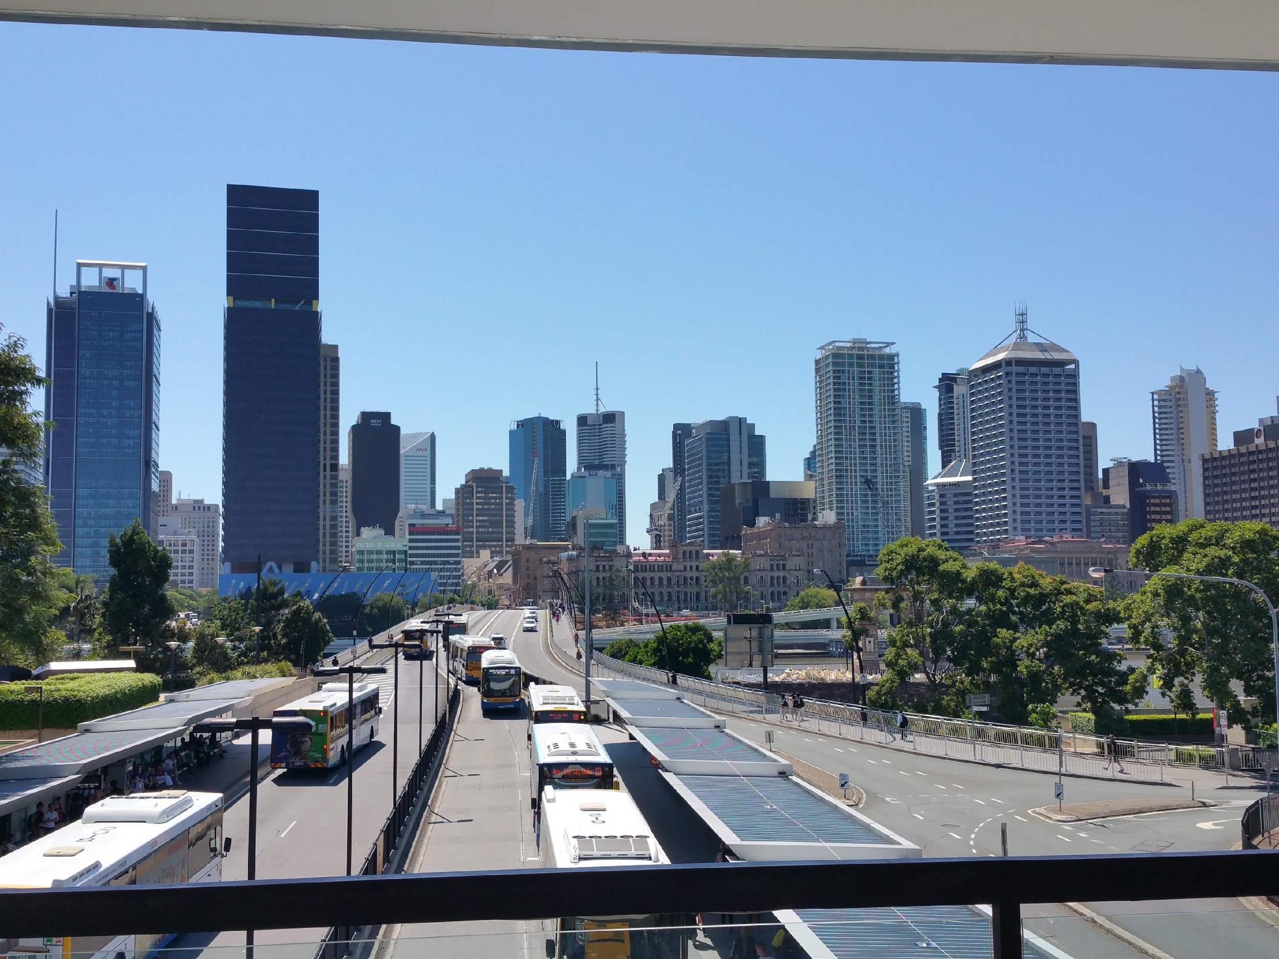


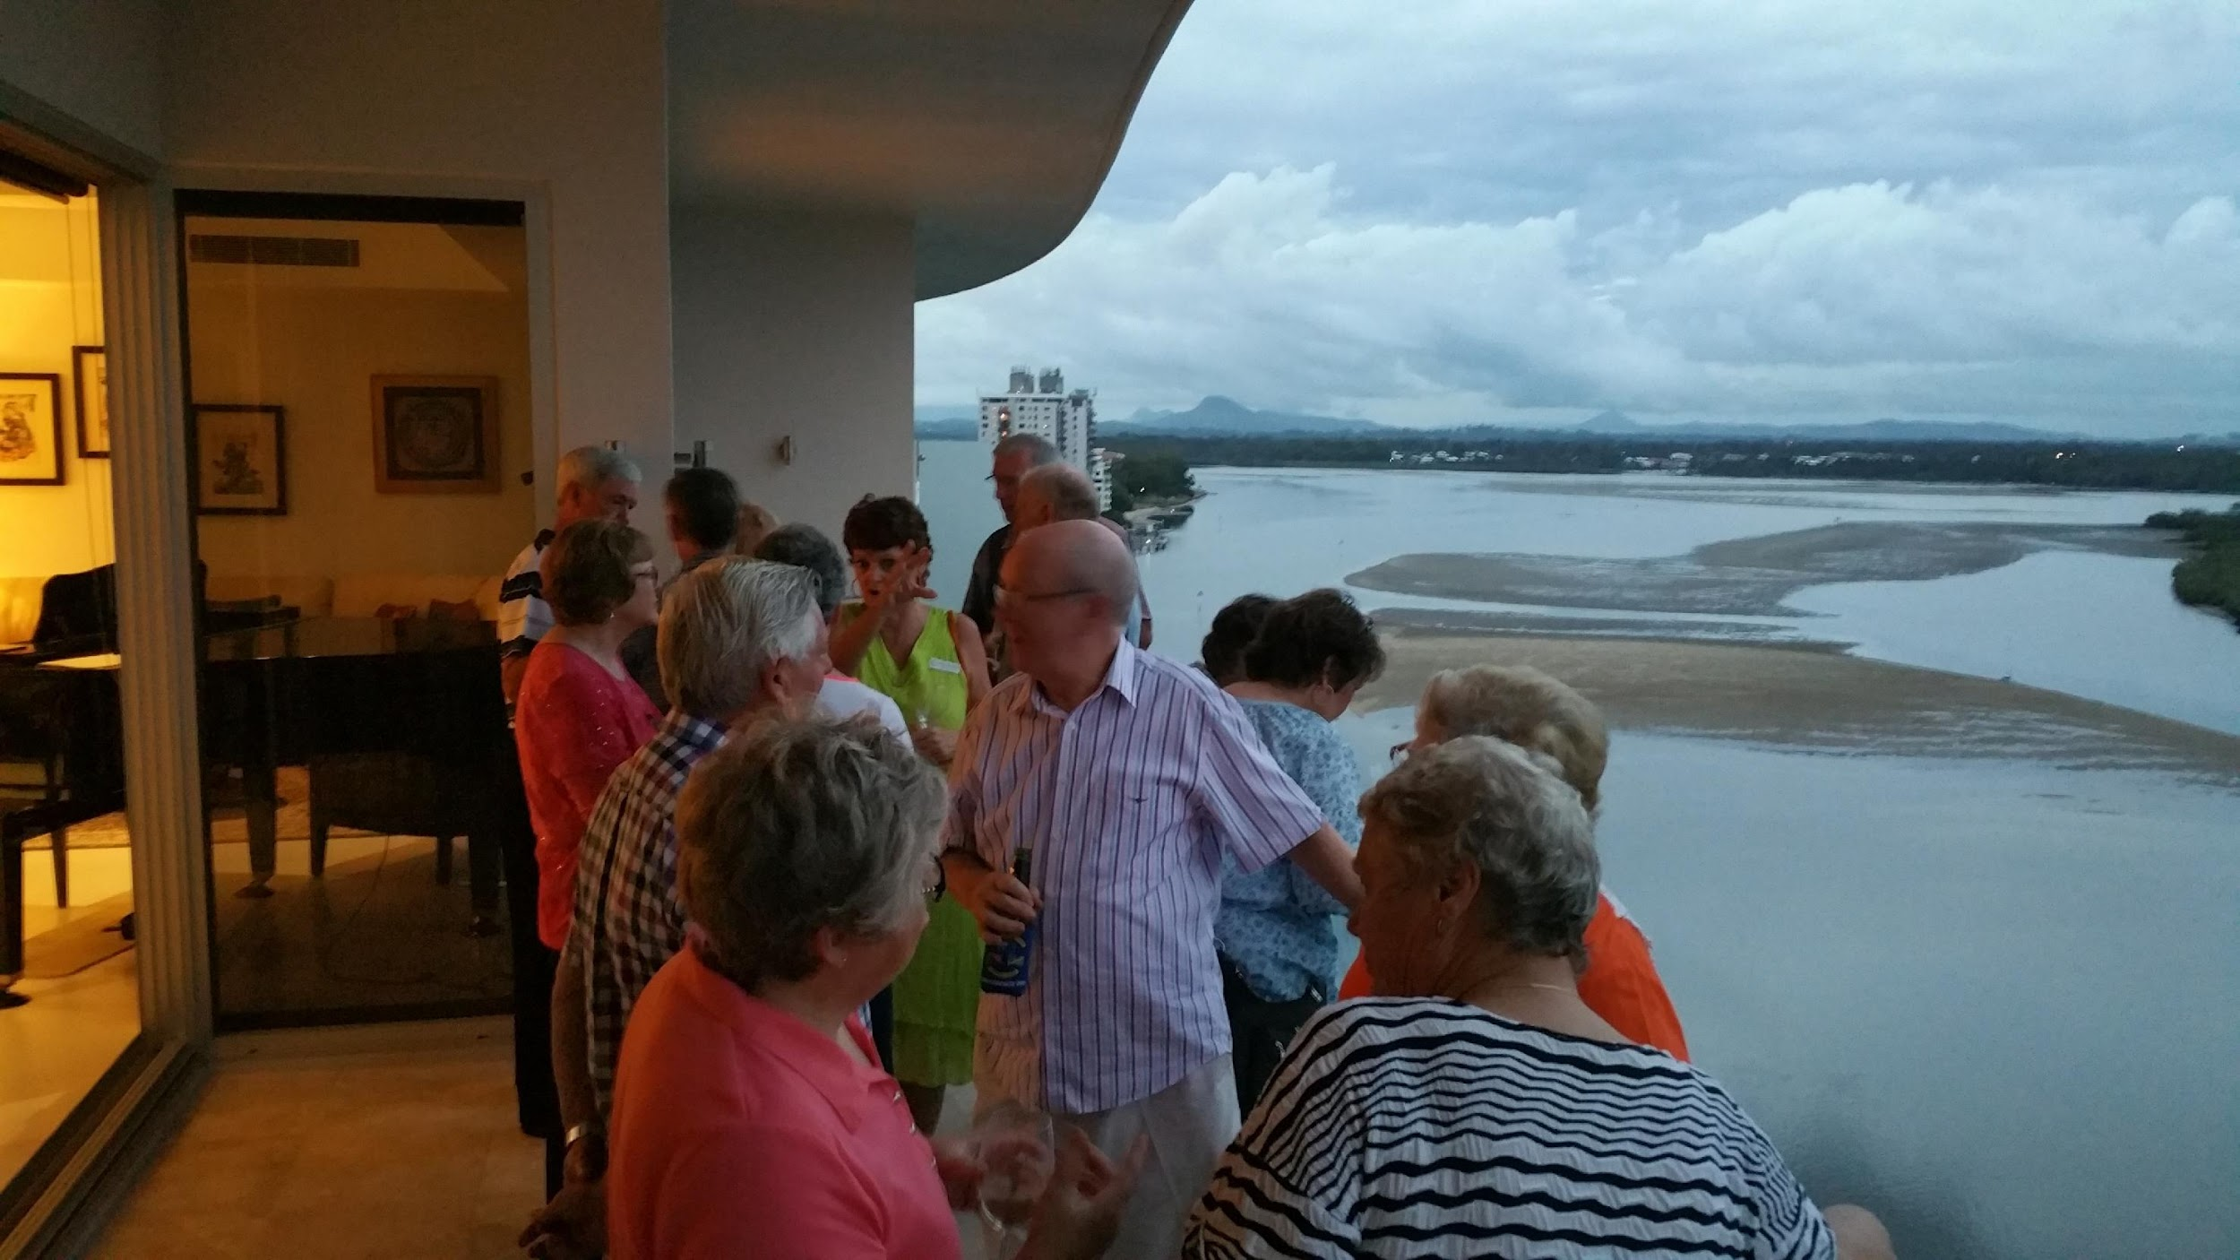
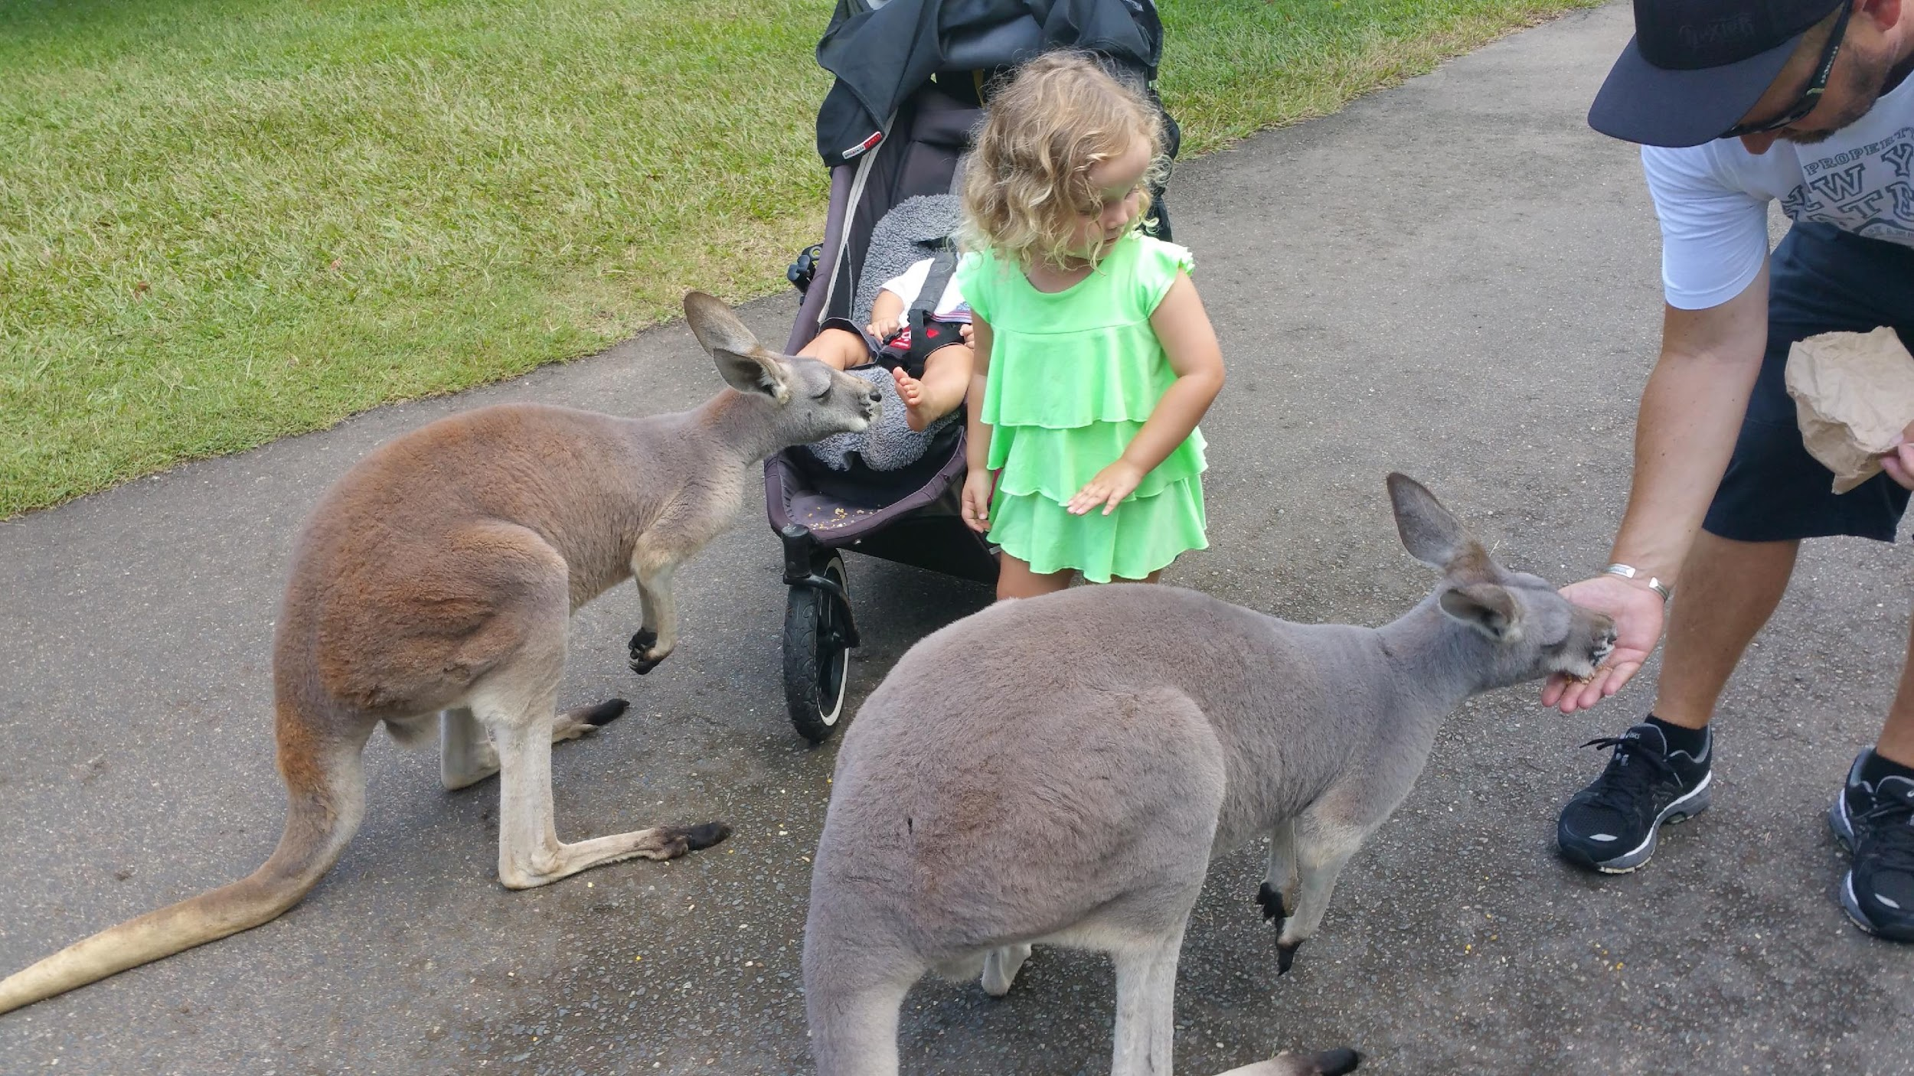
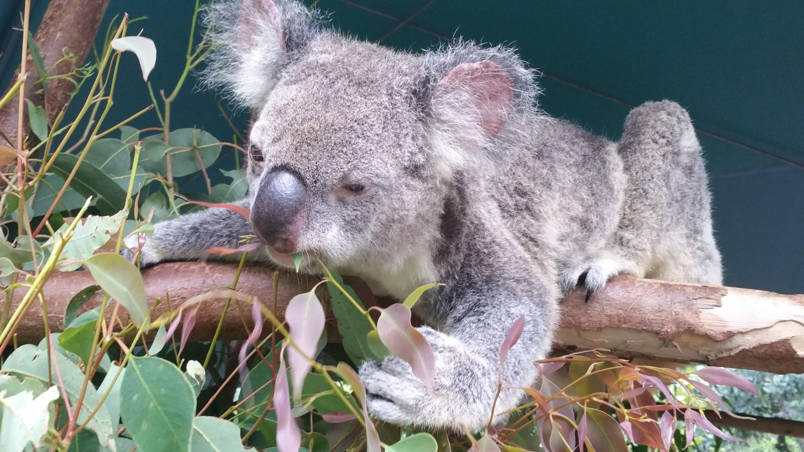
AUSTRALIA 2015
Party at the Penthouse!
20 hour flight to meet friendly people who talk funny. Basically the United States, but upside down with strange critters. Mark E. had a host that drank too much, tossed the keys to Mark and said “You’re driving Mate!” Wrong side in the dark, definitely a memorable experience.

Slide 12
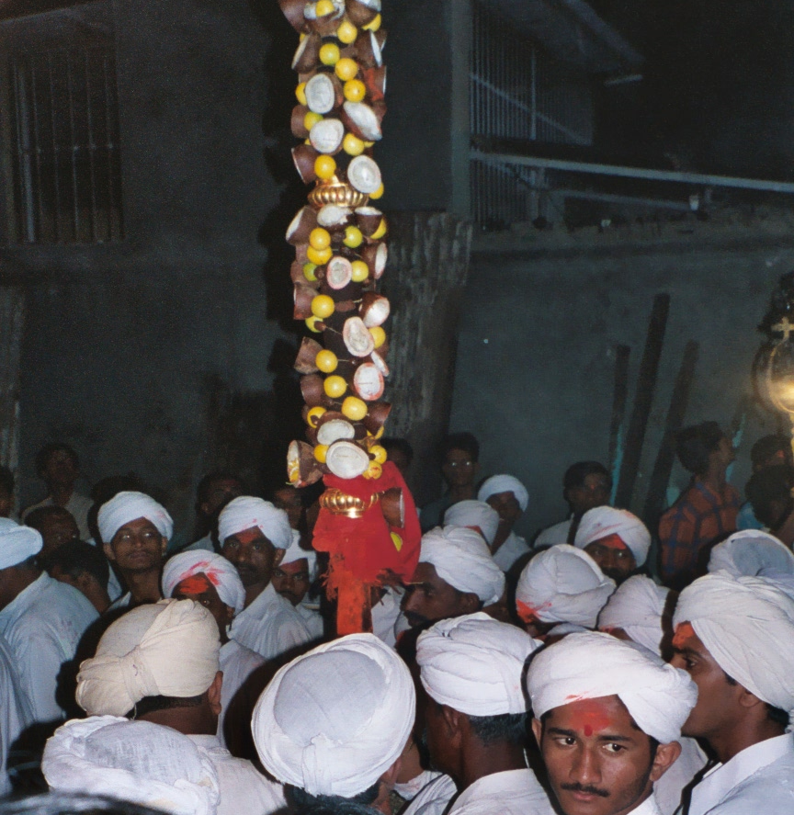
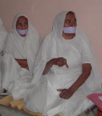
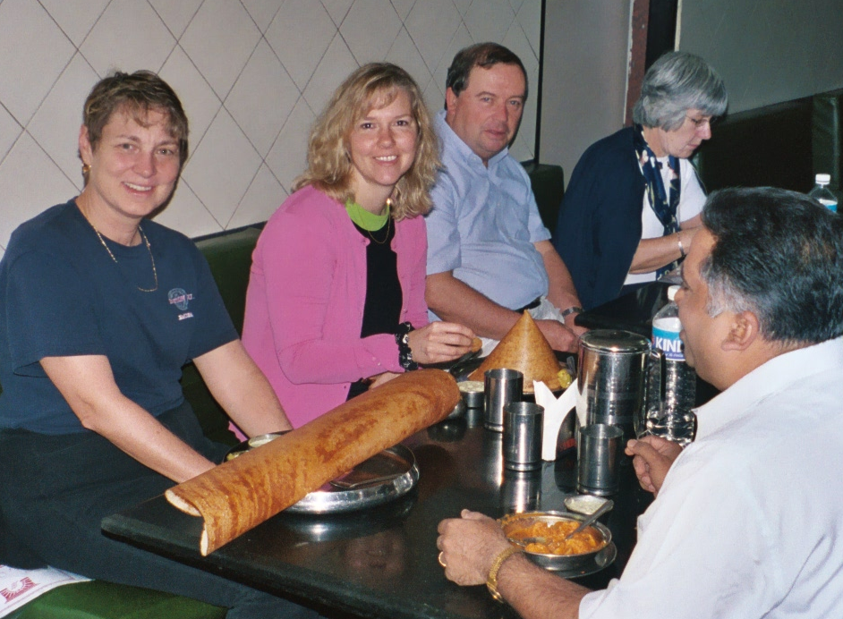
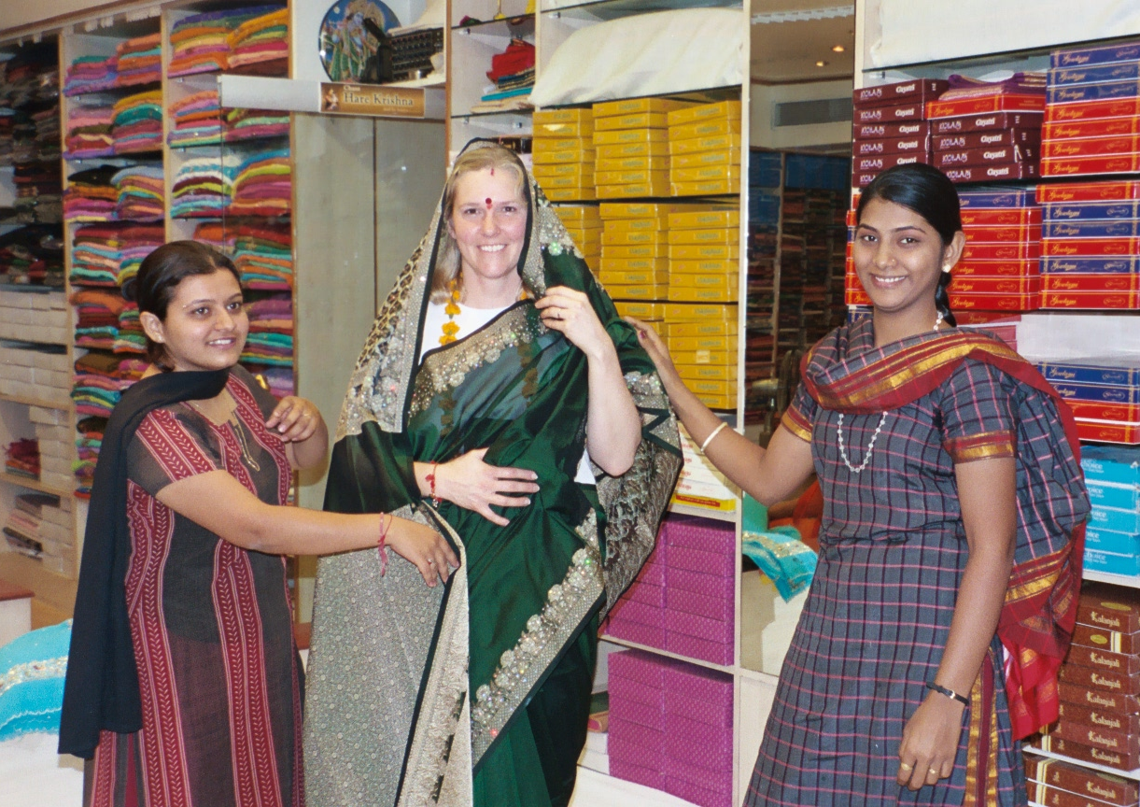
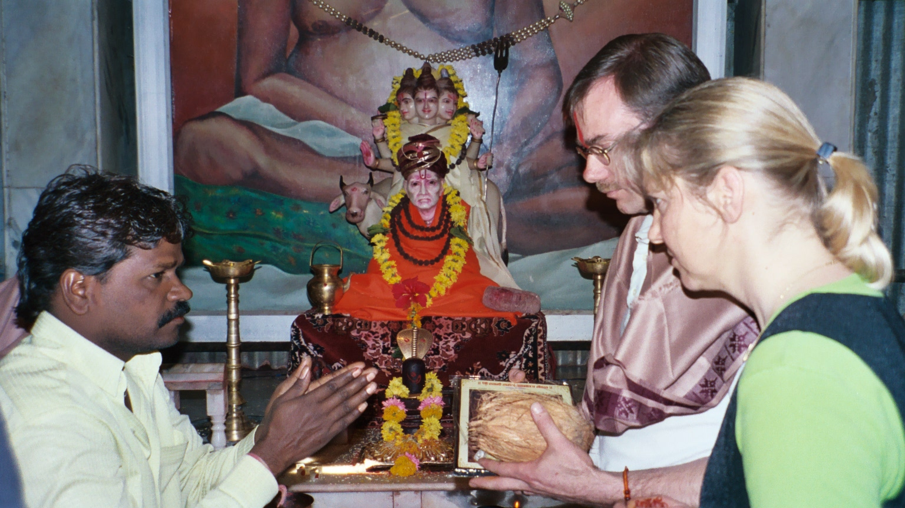

Experience Cultural Diversity

Slide 13
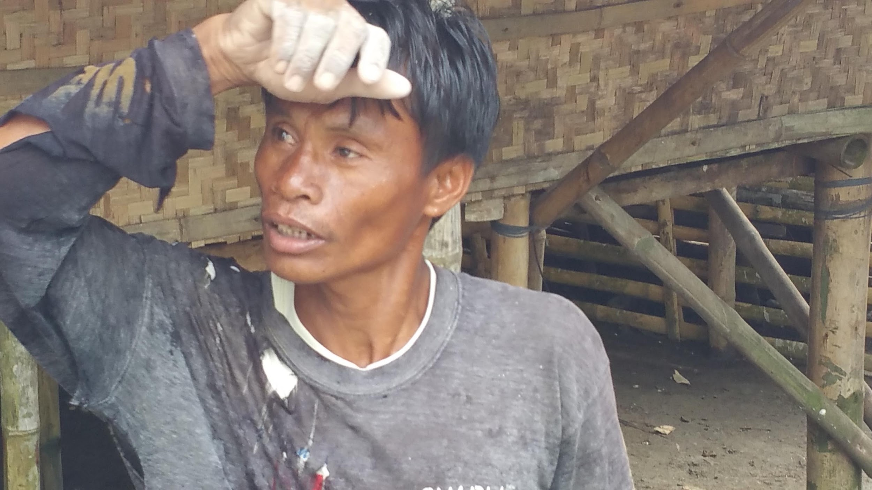
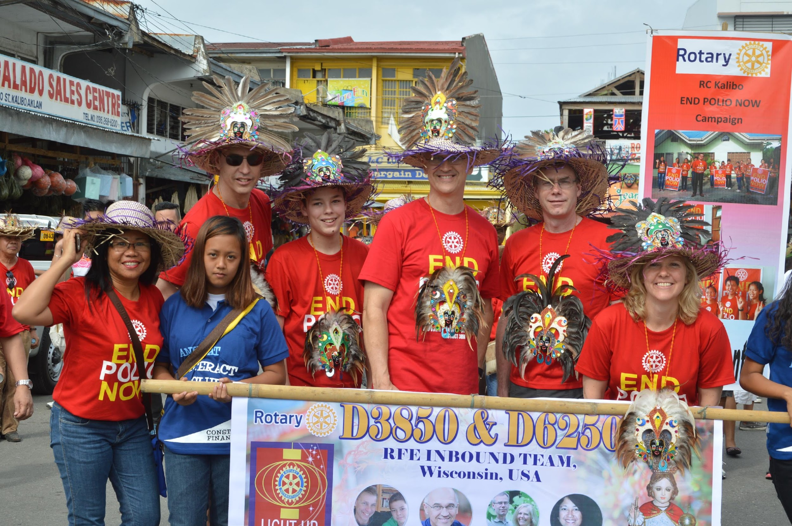
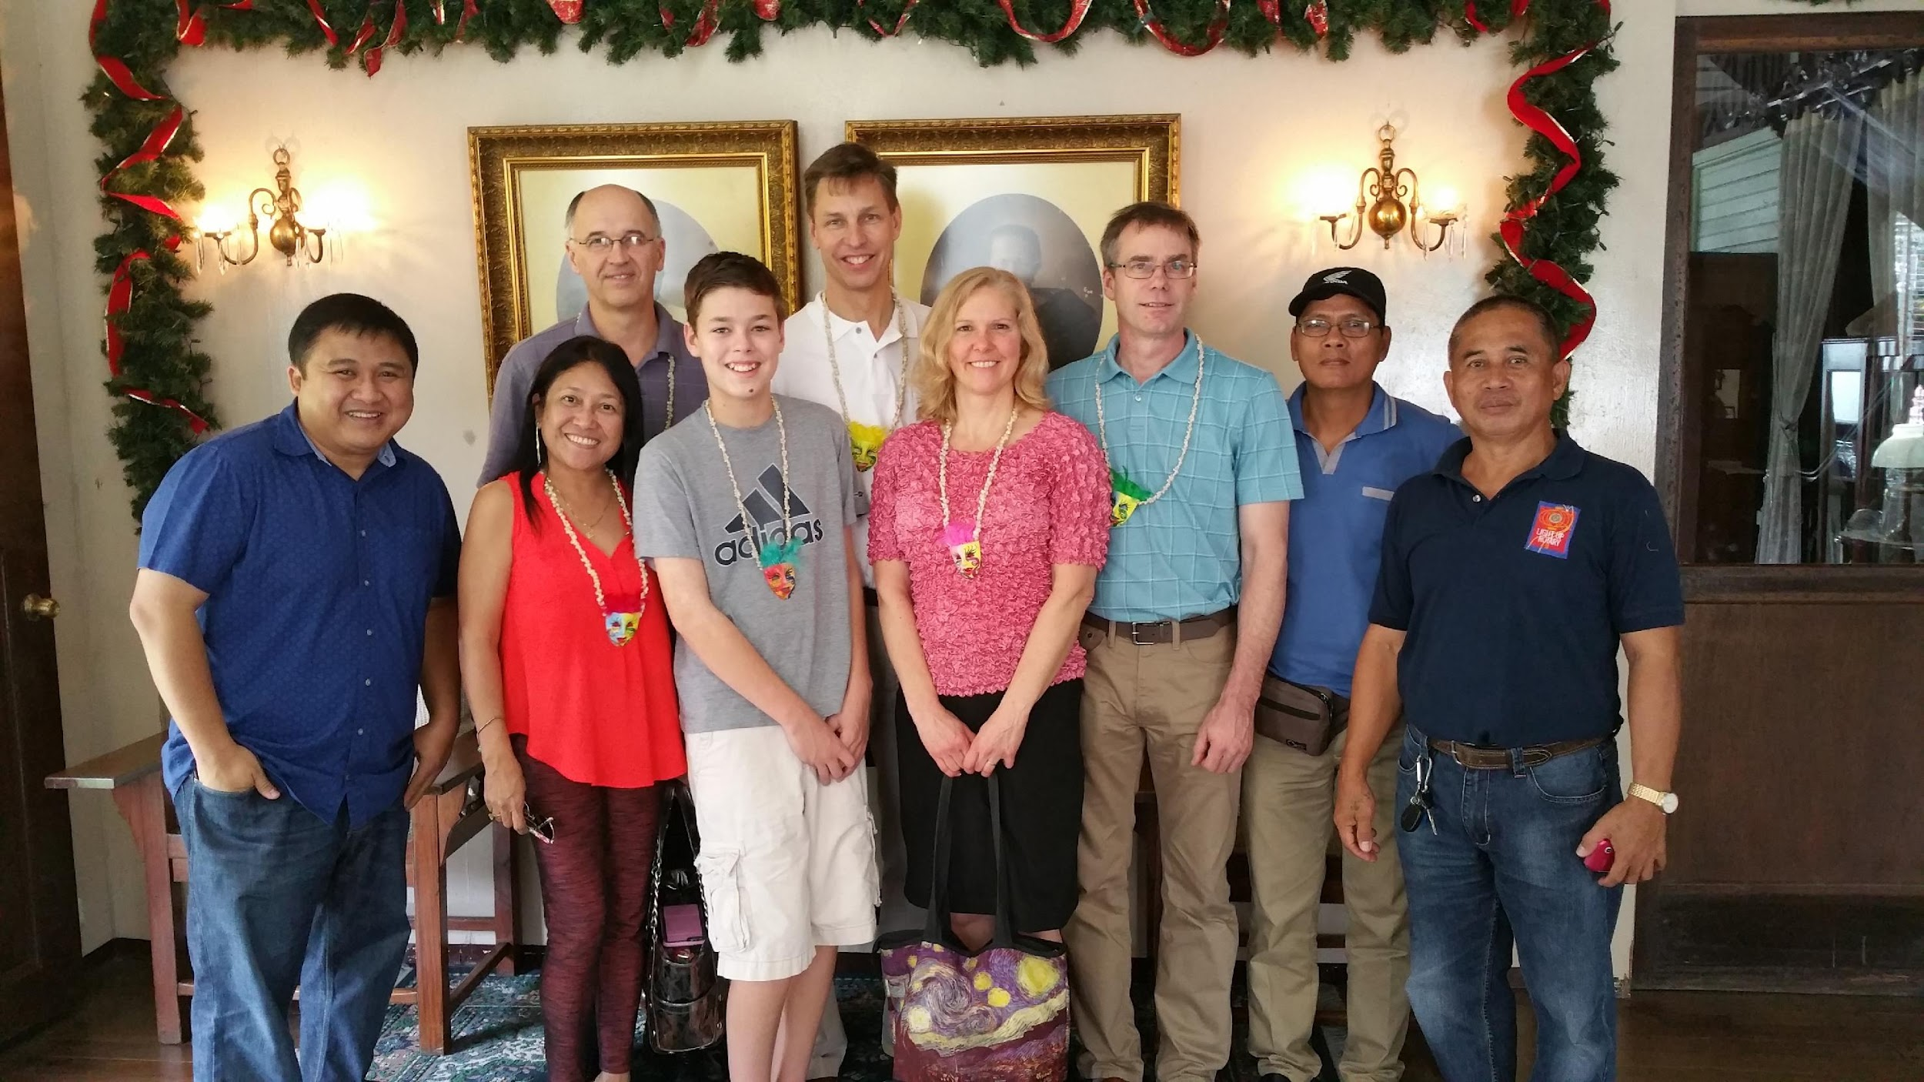
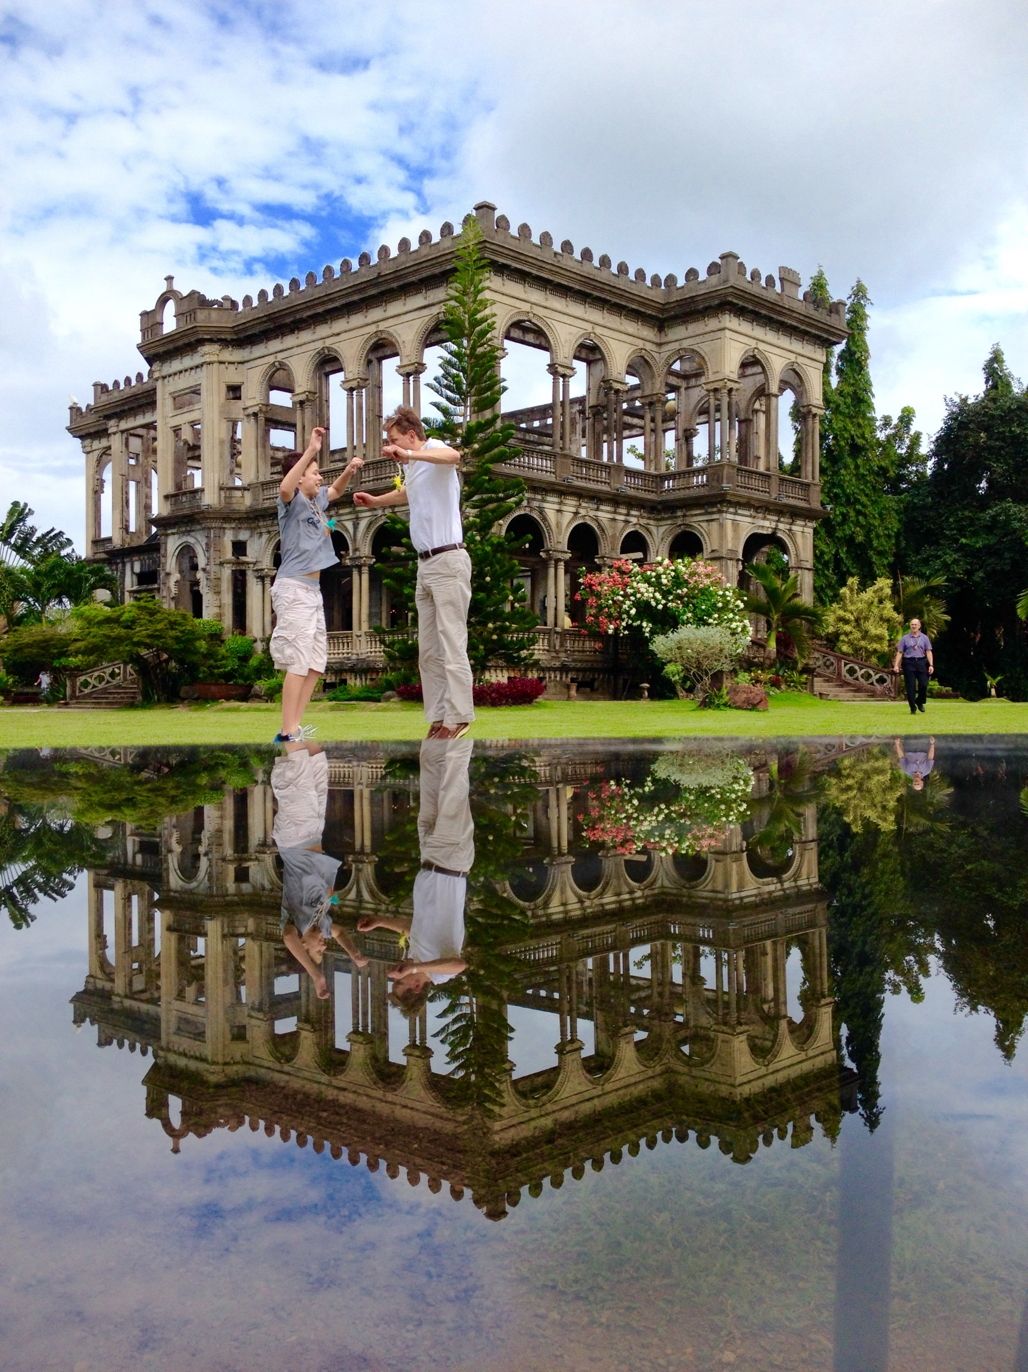
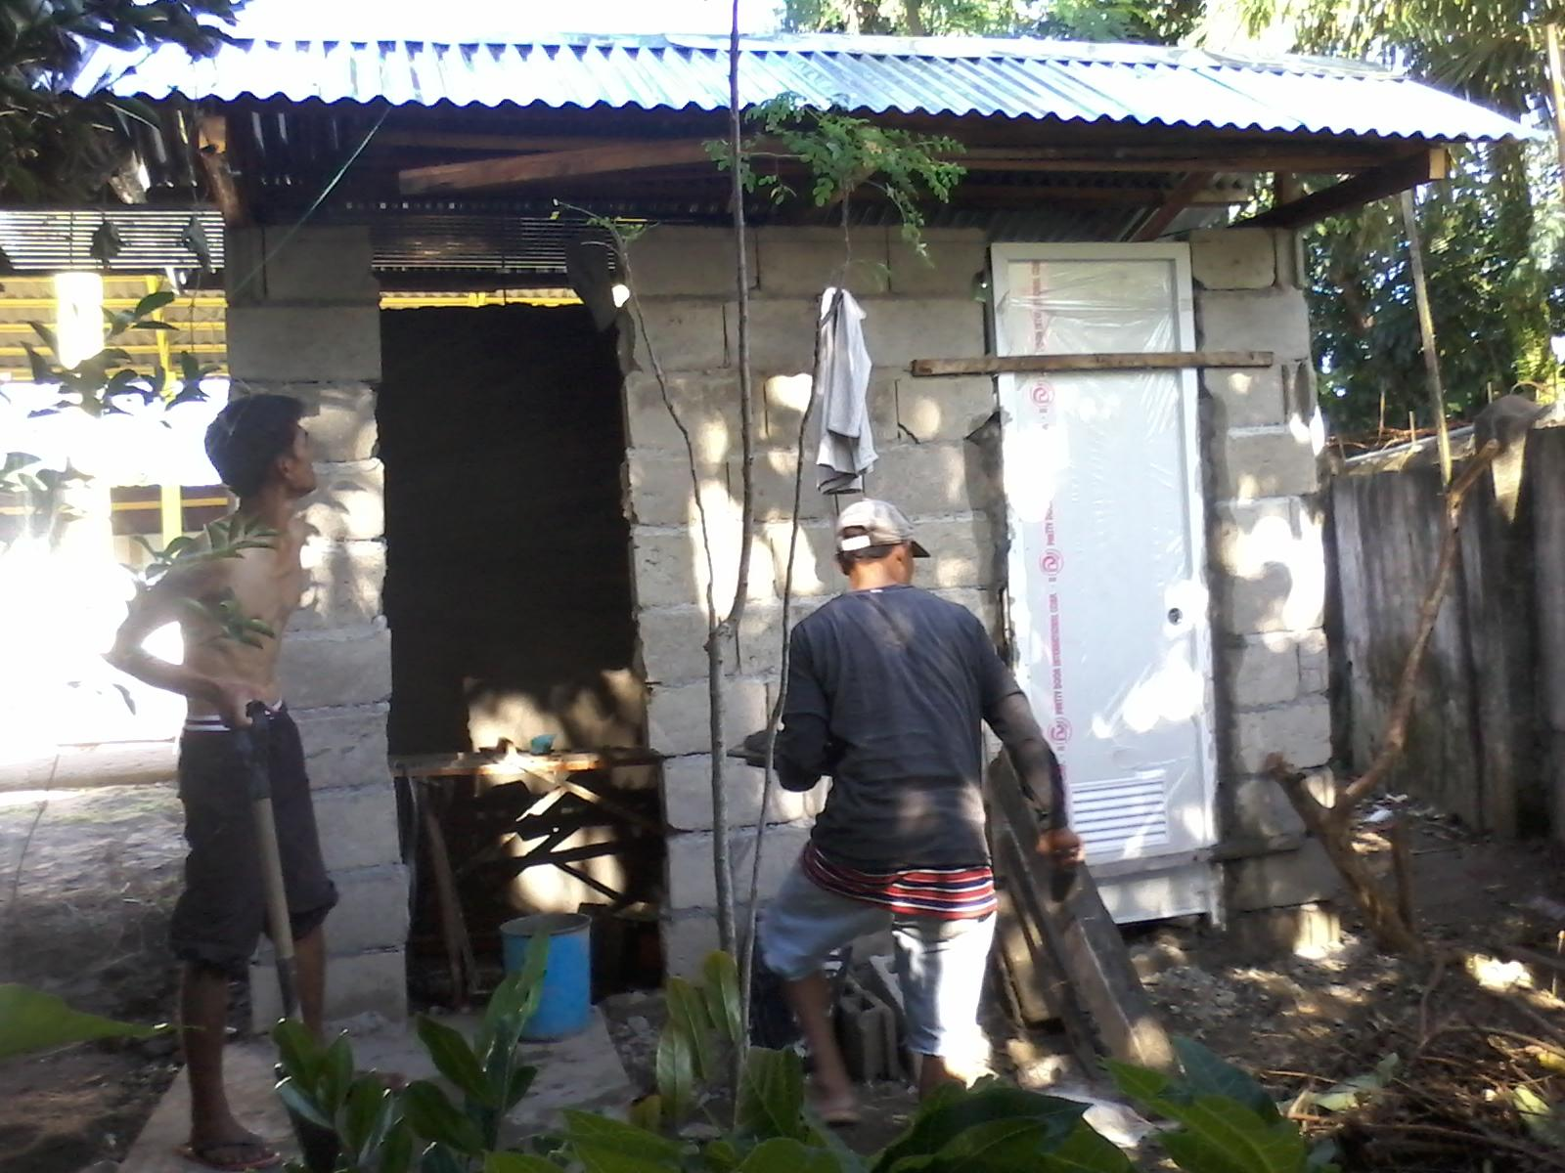
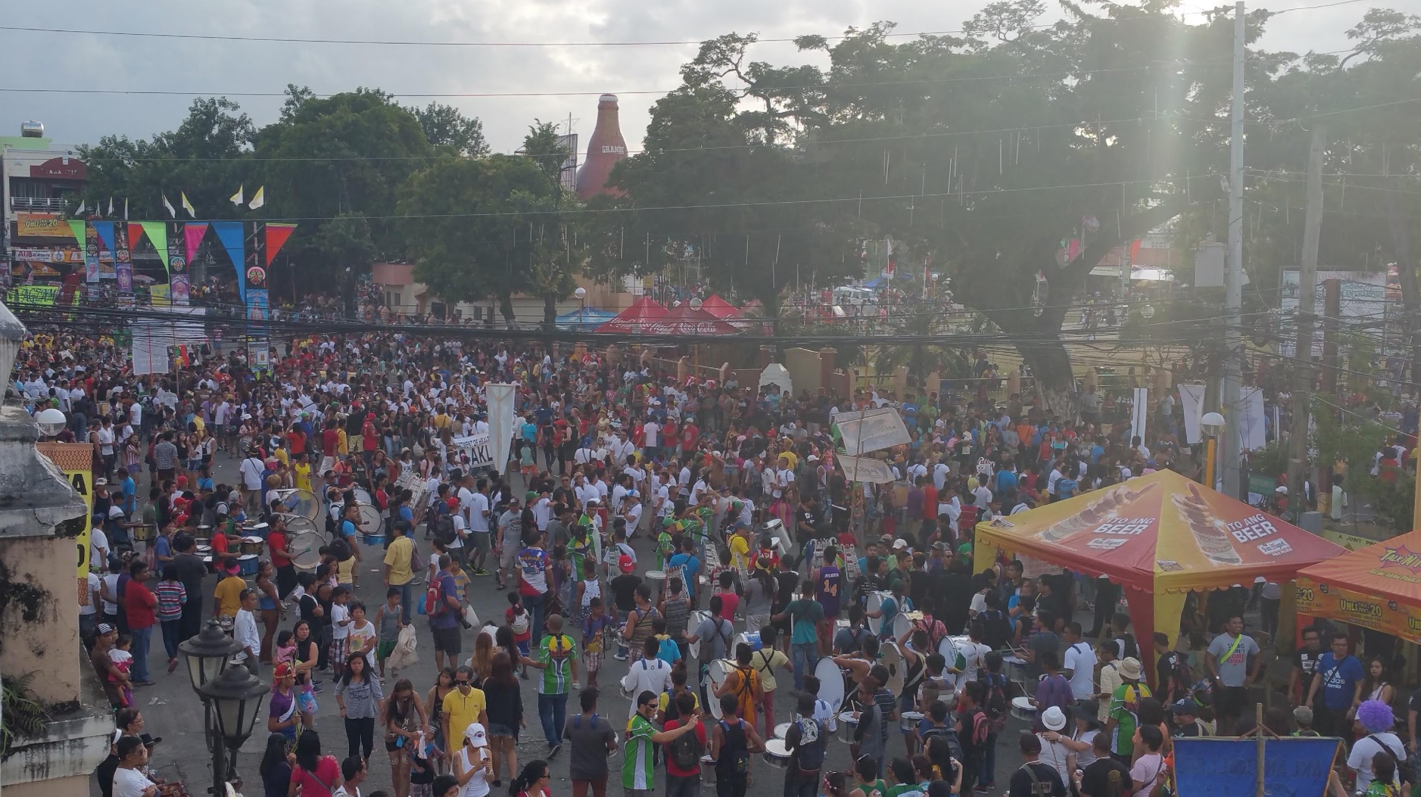
PHILLIPINES 2016
HUGE Parade, note banner!
Warm Friendly people who will go out of there way to take care of you, they don’t have much stuff, but I think they have more than we do?
Sanitation Project

Slide 14
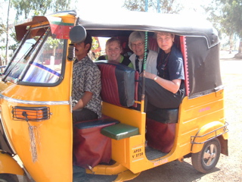
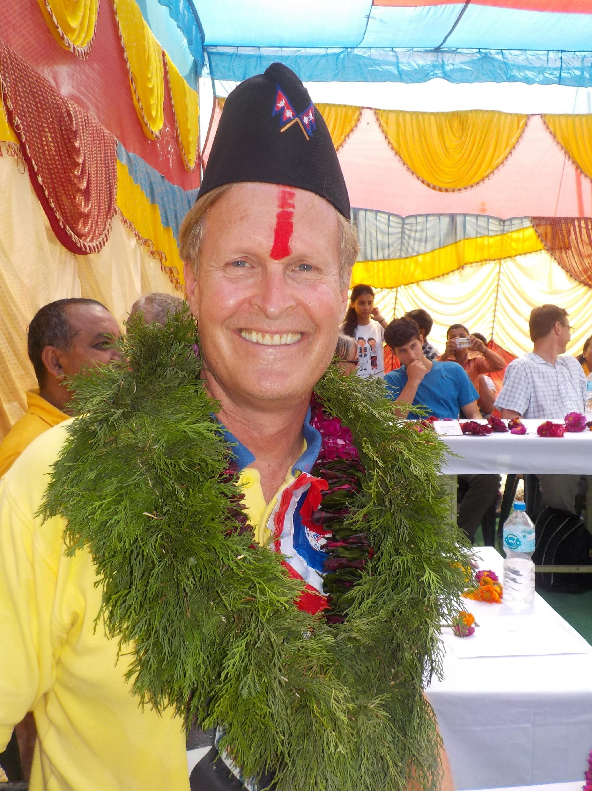
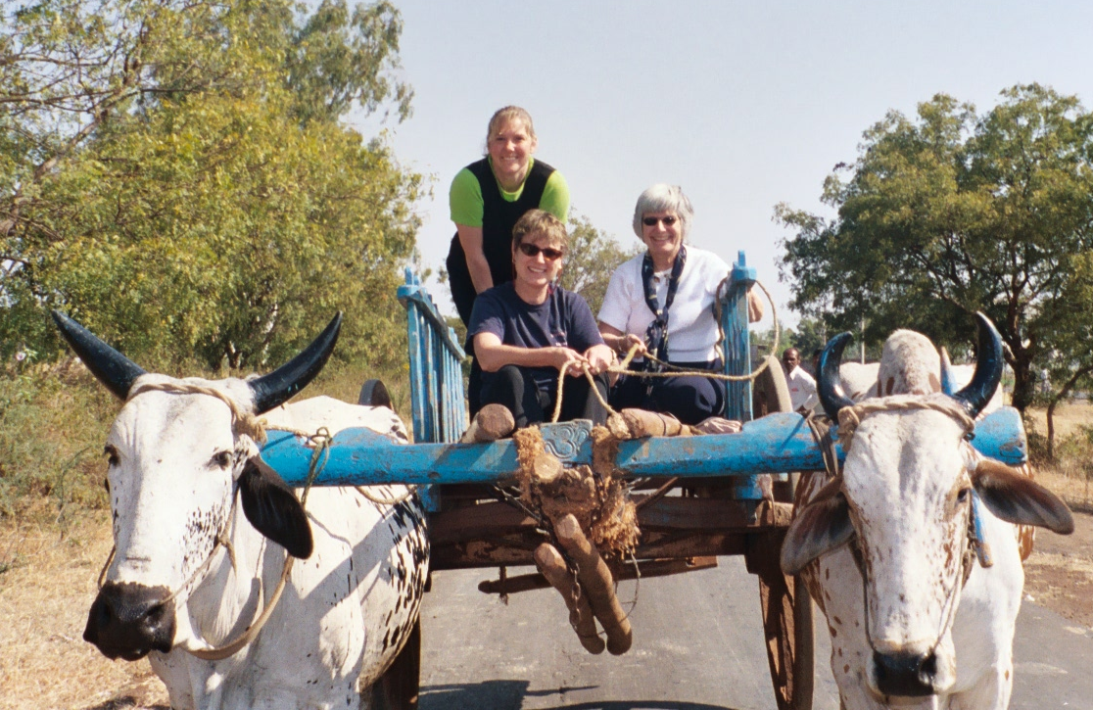
Adventure

Slide 15

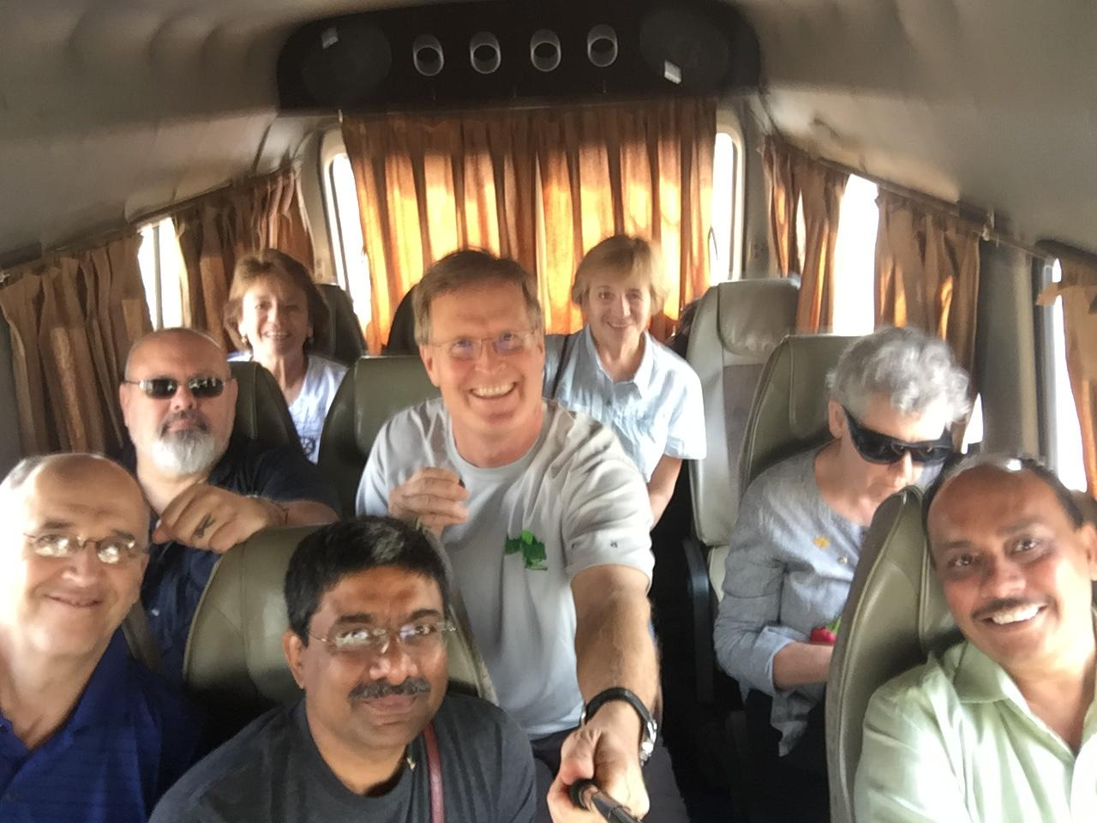
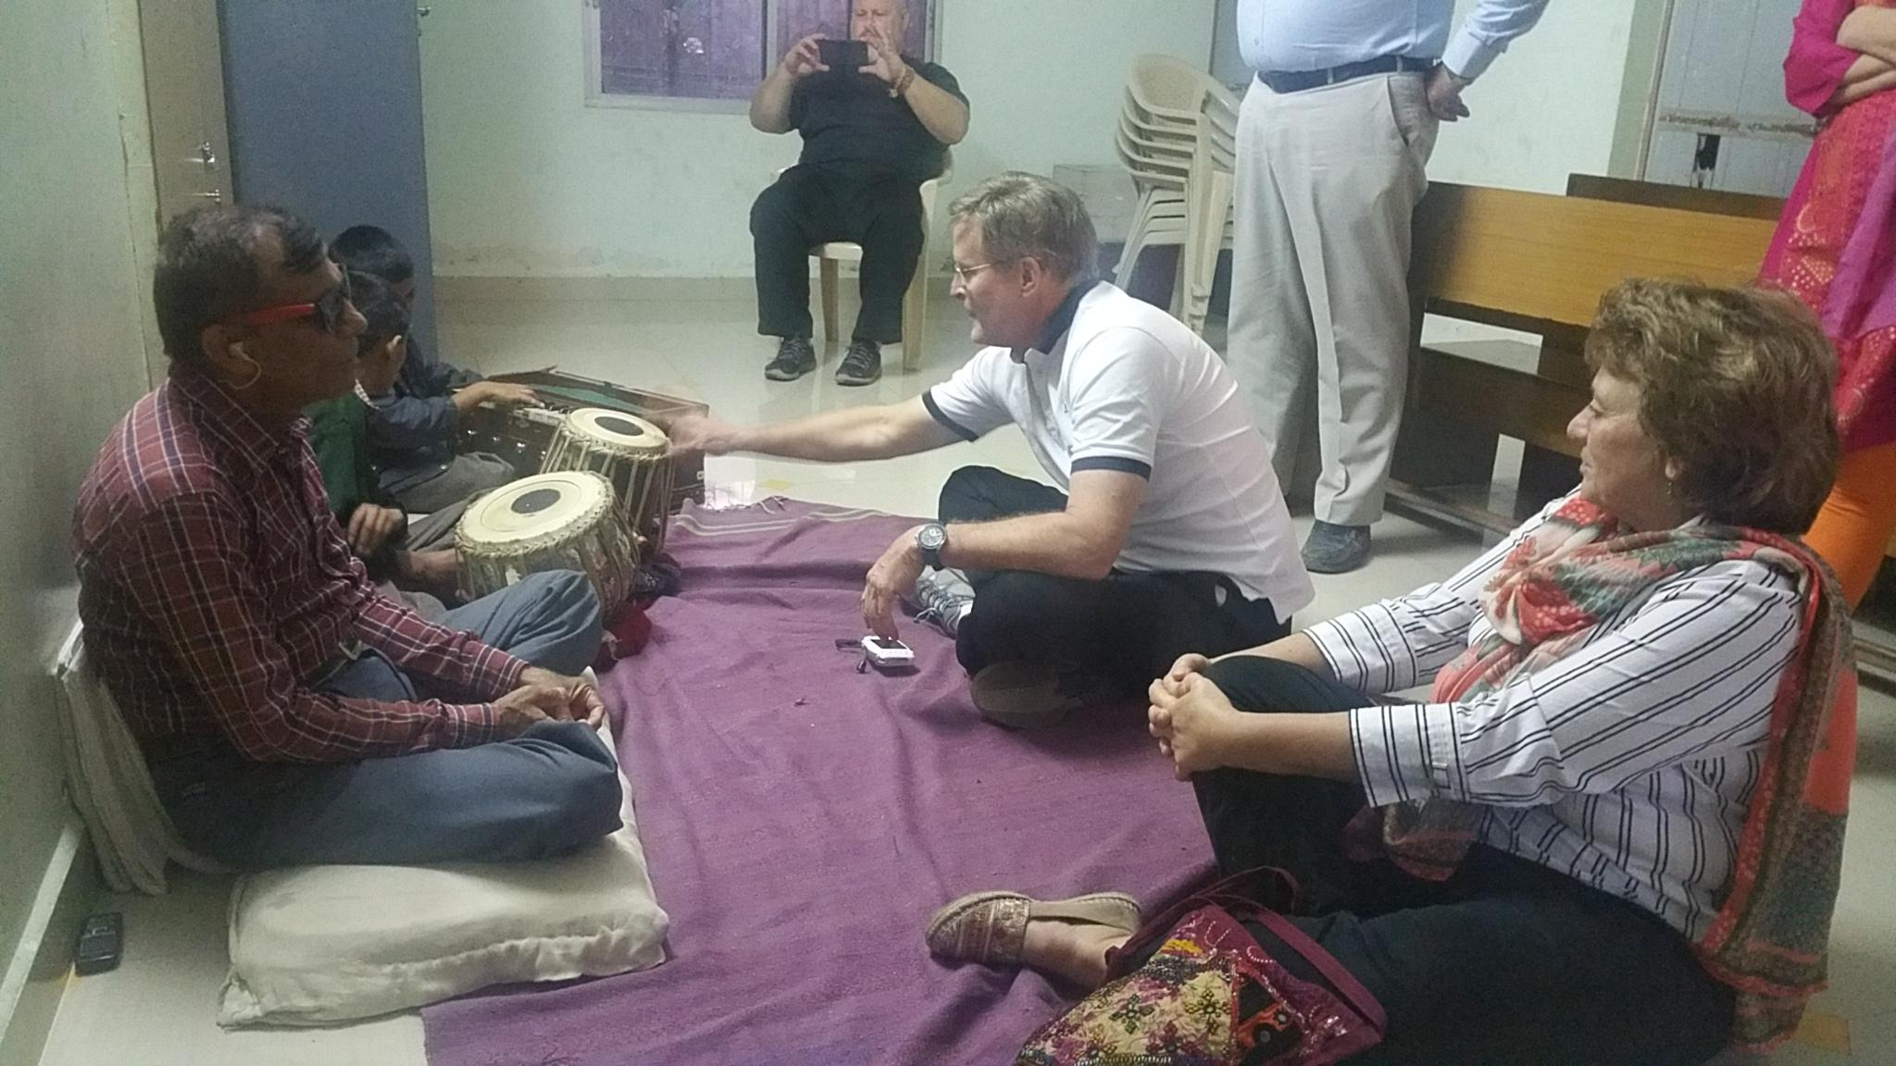
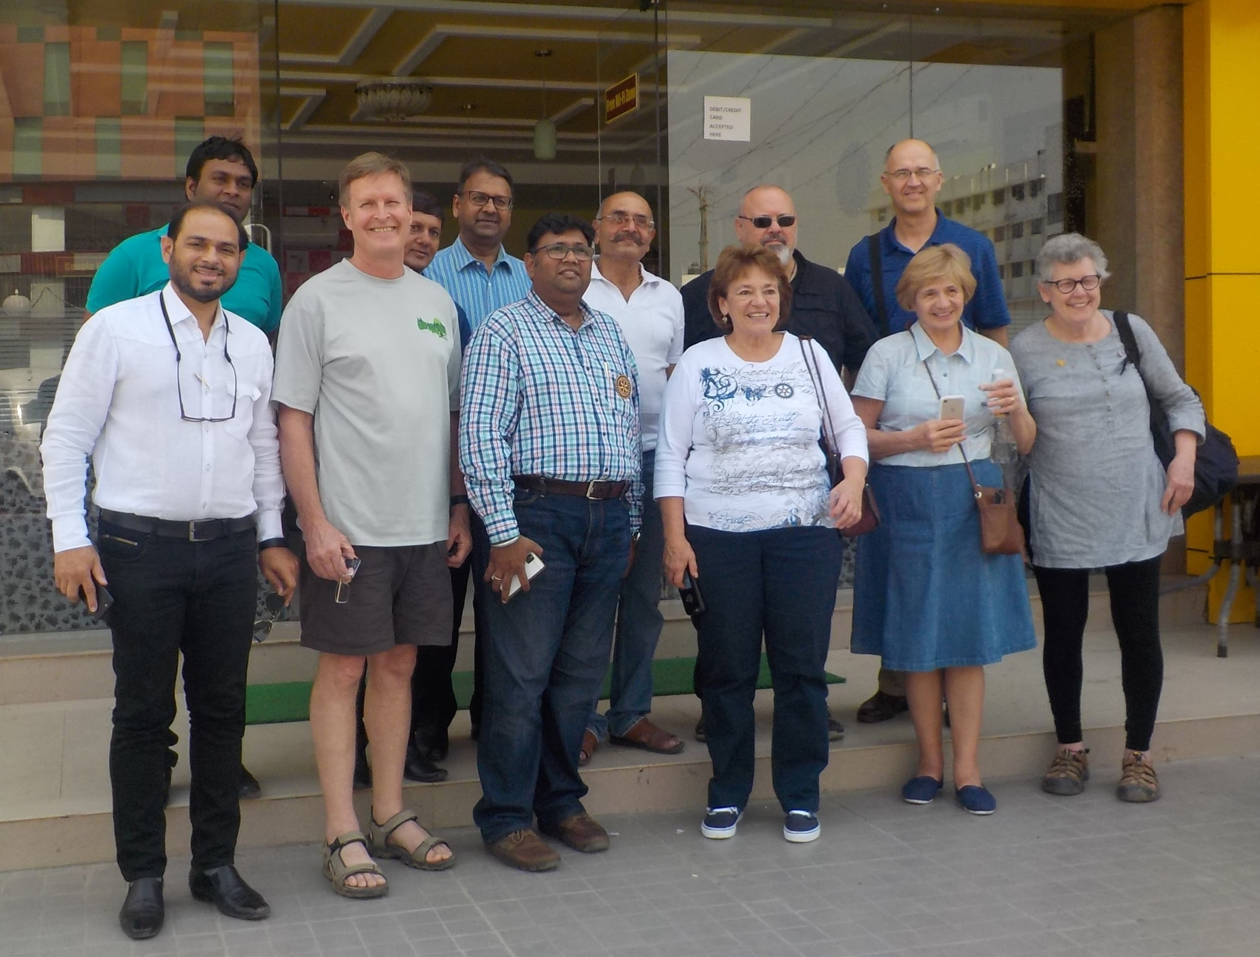
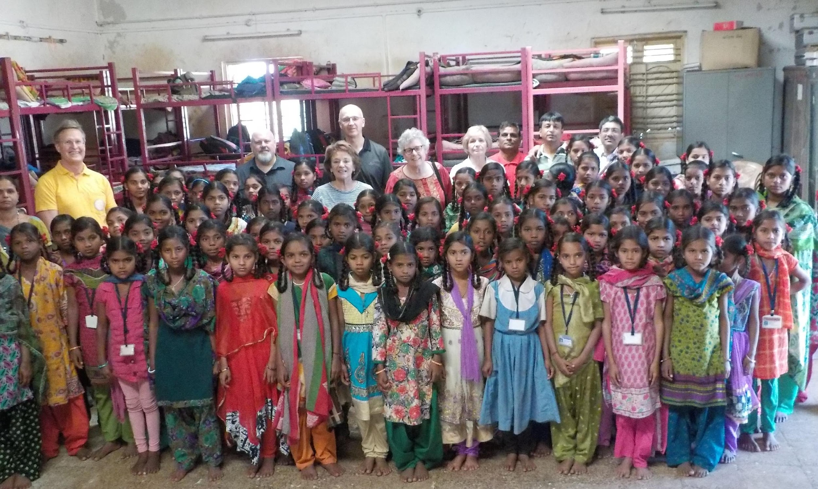
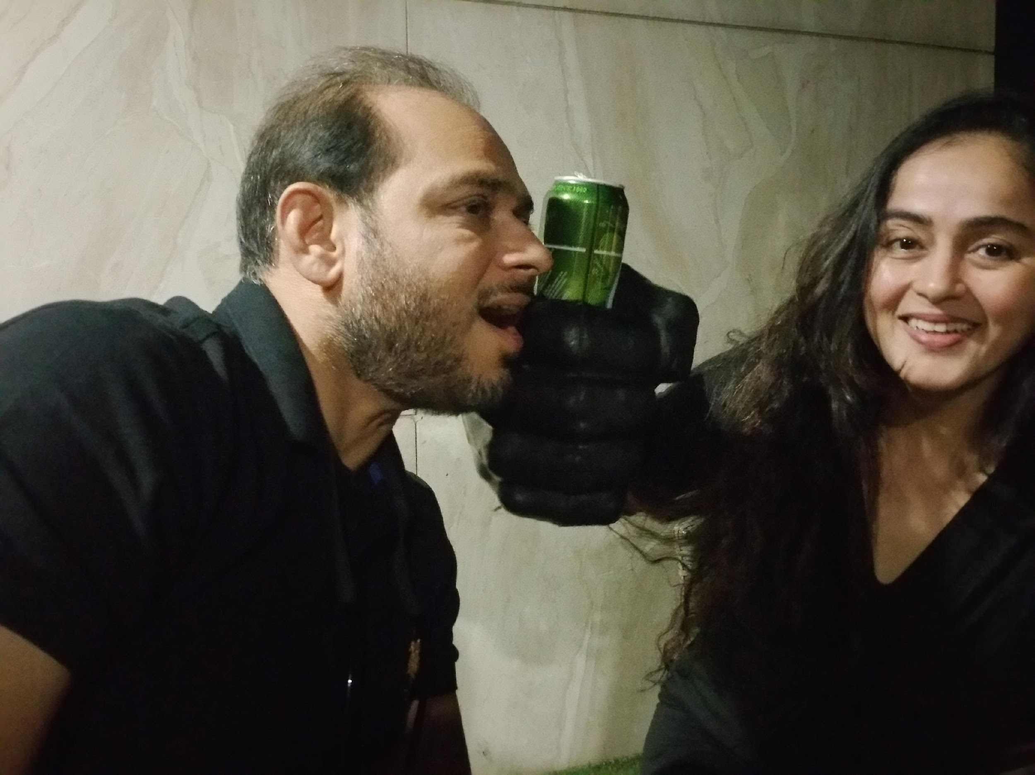
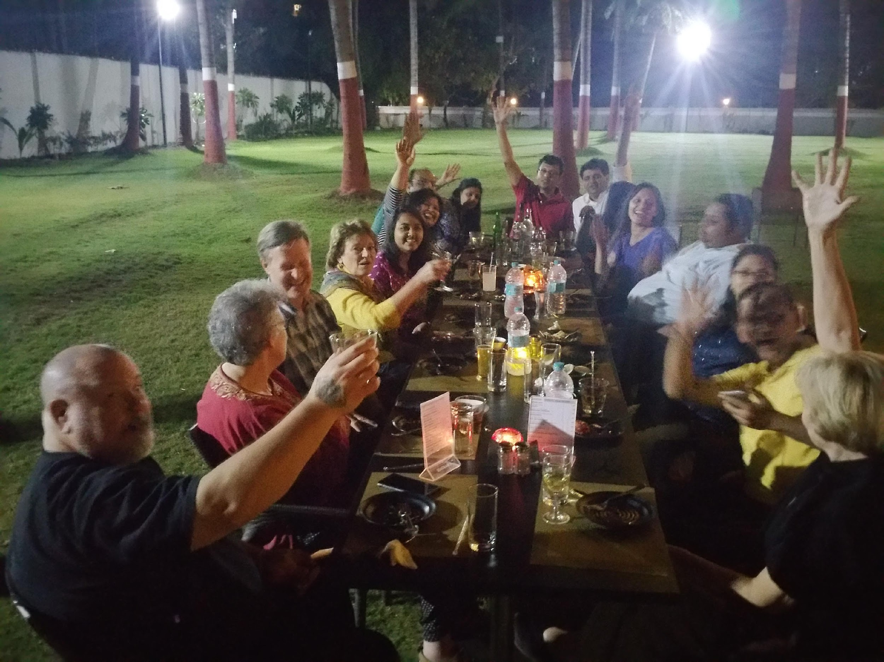
INDIA 2017
Outstanding trip with outstanding hosts and companions
Rotary Sponsored School for the Blind
Rotary Sponsored school for Migrant workers Girls

Slide 16

QUESTIONS?
Advantages of a Rotary Friendship Exchange
See the world from a better view point
Reasonable cost
Very safe, locals showing you their homes
Make Friends!
Get in the culture vs looking at stuff
Find meaningful projects to partner with local clubs

Slide 17
Resources and Support
For general program information, visit www.rotary.org/friendship-exchange
Interested in getting involved? Contact Your District. 6250 Dave Clemens dclemens541@gmail.com 6270 Julie Craig
Questions? Contact your District’s Friendship Exchange Chair or Rotary International rotary.service@rotary.org

