Slide 1

Who me?
The Club Treasurer?
Notes:
Welcome
Intro/credentials

Slide 2
Preparation
Notes:
Goals of session
Encourage all to cover all four steps independently – Today is one part of the second step/green

Slide 3



Club Treasurer
Job Description
Treasurer Resources
Notes:
Q: What do you THINK or BELIEVE is the Treasurers job?
(collect verbal replies) Might get these:
Tracking the flow of funds in and out of the club
Collecting and paying dues
Reporting to the board monthly
Preparing a budget,
After verbal answers, share the job description for Treasurers and for Secretaries/ Some clubs blend both positions

Slide 4

CLUB TREASURER JOB DESCRIPTION (10 bullets)
As club treasurer, you manage your club’s finances and ensure proper stewardship by following your club’s budget and tracking funds as they are received and spent. Here are some of your responsibilities:
Update the board about the club’s finances each month.
Share the results of fundraising efforts with the board each month.
Give other updates as needed at board and club meetings so that the minutes will include account balances and payments that match the club’s financial activity.
Save all financial records in case the club has to account for how any funds were used.
Present a financial report on the previous Rotary year at the annual meeting to elect officers before 31 December, and a midyear financial report for the first six months of the Rotary year at a meeting before 31 January.
Write a detailed annual report at the end of the Rotary year.
If it’s required by local or national law, hire a qualified accountant who isn’t affiliated with your club to review the club’s financial activity every year.
If your club has a satellite club, submit an audited or reviewed financial statement about it to your club’s board.
Divide the income and expenses into club operations and charitable funding or service projects and initiatives.
Establish a reserve fund if your club doesn’t have one.
As treasurer, you may also be responsible for filing taxes for the club. It’s important to know your country’s tax laws. Special requirements may apply if your club keeps a separate fund for scholarships or a foundation, or if the club is incorporated. Consult an expert in your club or community about specific tax questions.
Notes:
What software do you use?
Who signs on bank accounts? Watch the EIN! All accounts must be monitored and reported on a 990? Who can view online banking?
Is your club integrated and synced with RI? Club Runner or DacDb?
Deposit funds immediately, do not hold.
Separation of 501c3 and 501c4 is critical
Move to eliminate collecting TRF funds! Rotary direct is the way to go. Keeps integrity of tax deduction. MUCH cleaner!
Reconcile bank statements monthly, report to board monthly, no secrets from members
File with IRS by 11/15
Is your club a recognized entity with the Arizona Corporation Commission – who files the annual report?
Do you prepare or use Budget to actual reports??
Storing information – handoff and security. Qbooks online upload receipts when the check is written or bill is entered

Slide 5

Rotary International Dues
$44.50 per half year in 2026-27
$41.50 per half year in 2025-26.
$110.60 for RI total
Notes:
For 2026-27
Best guess is 110.60 for RI
$88 for district

Slide 6
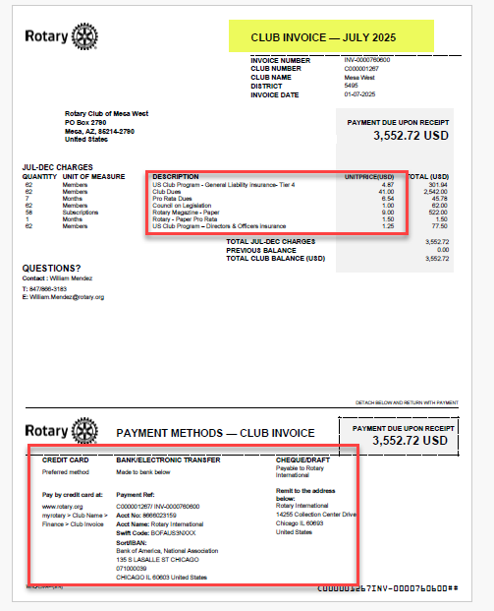
Notes:
41.00 in 2025-26 is the dues component only
July ends up $57.12 per member (base, plus magazine, plus insurance, plus pro rata items)
January is $50.00 per member
For the year 107.12 per member end result for RI
Pro Rata dues is for the mid period additions
District is a true $80 annual.

Slide 7
District 5495 Dues
2025-26 Dues per member $84 ($42 July and January )
2026-27 District per member $88
Same club member count as RI invoice
Sent by email to treasurer, secretary and president as shown
in Club Runner
Prefer e-payments. No fee from D5495
Notes:
Work with incoming board to plan next year’s budget (Current board must approve the new budget)
District dues will be $43.50 per member in July and again in January
With the RI dues remember that – In July clubs will be assessed:
$6.00 for each subscription to The Rotarian
$1.00 for Council on Legislation Assessment
Amount to be determined for General Liability Insurance –
Amount to be determined for Directors and Officers liability –

Slide 8

Club Treasurer
Monthly Duties
Notes:
What software do you use?
Who signs on bank accounts? Watch the EIN! All accounts must be monitored and reported on a 990? Who can view online banking?
Is your club integrated and synced with RI? Club Runner or DacDb?
Deposit funds immediately, do not hold.
Separation of 501c3 and 501c4 is critical
Move to eliminate collecting TRF funds! Rotary direct is the way to go. Keeps integrity of tax deduction. MUCH cleaner!
Reconcile bank statements monthly, report to board monthly, no secrets from members
File with IRS by 11/15
Is your club a recognized entity with the Arizona Corporation Commission – who files the annual report?
Do you prepare or use Budget to actual reports??
Storing information – handoff and security. Qbooks online upload receipts when the check is written or bill is entered

Slide 9





Slide 10
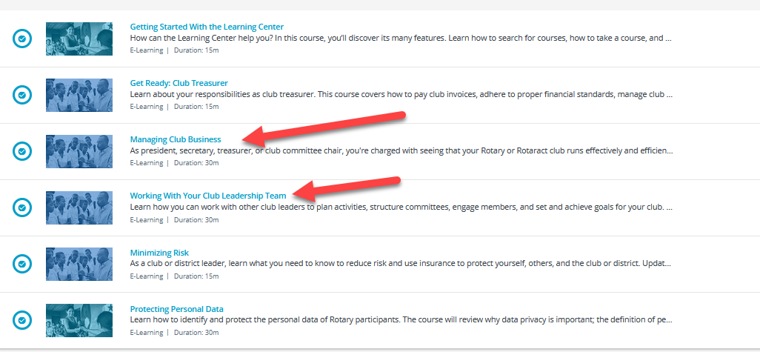
Club Treasurer Basics
The Learning Center

Slide 11
Links to Utilize
Track club goals and contributions in Rotary Club Central
with links on my.rotary.org
Club officer Resources
Take the classes!
Learning Center is Great!
Notes:
Blue arrow is hyperlink to get logged into my rotary
Then review Treasurer link in the class.
Suggest review of Secretary link to understand individual club’s division of labor

Slide 12

Contact
Lucinda General
District Treasurer
602-418-9598
treasurer@rotary5495.org

Slide 13
You are the new treasurer of the Rotary Club of Oakport. Your predecessor held the position for the past four years. The club has one bank account with $10,000 that has been transferred to your name. Yours is the only name on the account. The last financial review for the club was over five years ago.
What would your concerns be, if any? And what would you do to address those concerns?
What would you do to improve how the club’s finances are handled?
List Action Steps:
Who is responsible?
What is the timeline?
How to measure progress?
What resources are available?
Notes:
Case studies for thought and practice

Slide 14
The Rotary Club of Puerta Villa has always been a small club. One member has handled the responsibilities of the secretary and treasurer positions for several years. This member recently left the club for health reasons. The club is rarely open to change, but you see this as an opportunity to introduce innovation and new processes. You discussed automatic payments for membership dues and establishing suspension and termination procedures for nonpayment of dues with your club president-elect and other members. The president-elect is skeptical, but several club members agree with your proposals.
How can you convince your club president-elect to give your ideas a chance?
How can your innovative ideas benefit the club?
List Action Steps:
Who is responsible?
What is the timeline?
How to measure progress?
What resources are available?
Notes:
Case studies for thought and practice

Slide 15
You received the club invoice and would like to review it with the club secretary before paying the balance by 1 February. Since your club was previously almost terminated for not paying 120 days after the due date, you want to make sure your club remains in good standing. You feel that the secretary is not approaching the matter seriously, and is ignoring your requests for review.
How can you remedy this communication breakdown?
What would you do to avoid this predicament in the future?
List Action Steps:
Who is responsible?
What is the timeline?
How to measure progress?
What resources are available?
Notes:
Case studies for thought and practice

Slide 16
An independent accountant has just completed the annual financial review of your club. She found discrepancies between your club’s bank account and the club’s accounting records of payments made.
How should this be investigated?
How can club financial practices be overhauled to keep more accurate records and prevent financial mismanagement?
List Action Steps:
Who is responsible?
What is the timeline?
How to measure progress?
What resources are available?
Notes:
Case studies for thought and practice

