Slide 1


Global Grant Project: "Rainwater Harvesting for the Public Health Center and Low-Income Housing in Colonia Arroyo Blanco, Xalapa, Veracruz."
Area of Interest:
Water, Sanitation, and Hygiene

Slide 2
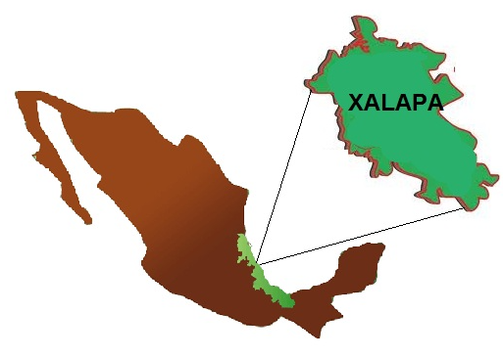
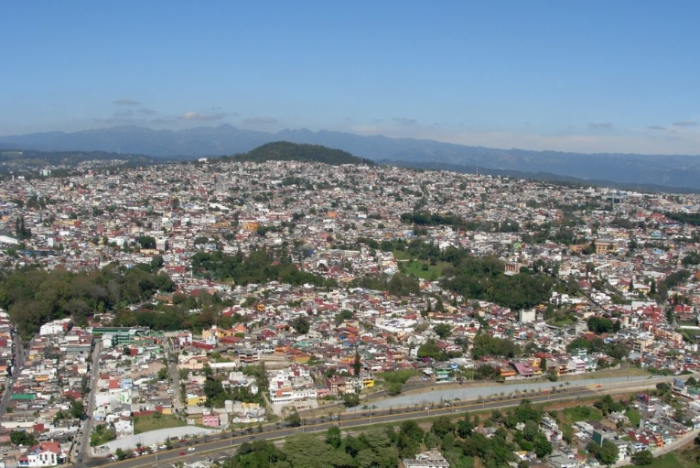
CITY OF XALAPA; STATE OF VERACRUZ; Country, Mexico, is located at 1,226 meters above sea level.
With a Population of 488,531 inhabitants*
Average Annual Rainfall: 1,600 mm
*"National Institute of Statistics, Geography, and Informatics (2020)"

Slide 3

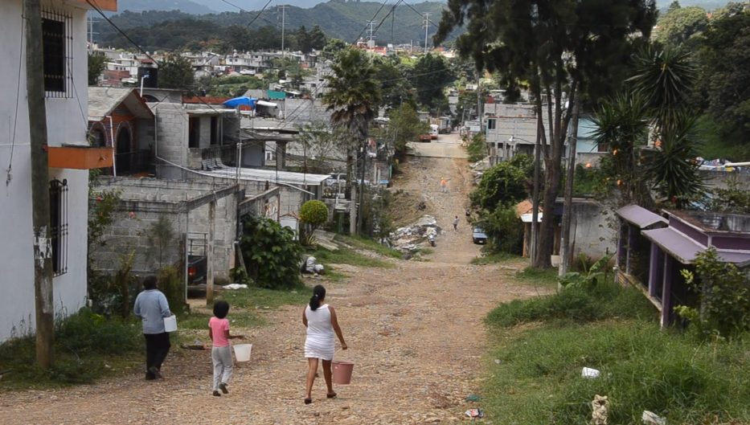
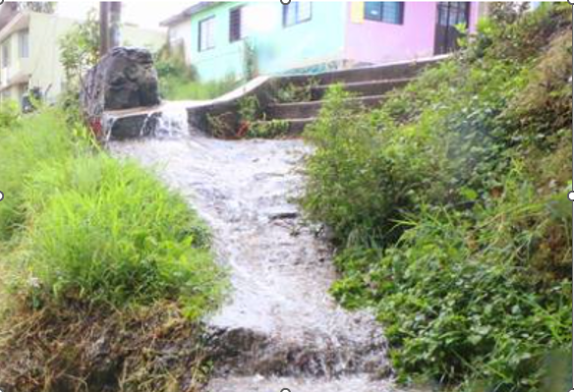
Project Overview
The project aims to improve access to clean drinking water for low-income families with a high population of children under 14 years old in Colonia Arroyo Blanco through the use of Innovative Rainwater Harvesting Systems (SCALL). This is the best option to enhance the quality of life for both children and adults.
Furthermore, by installing a Rainwater Harvesting System at the Health Center, the entire population seeking medical care will benefit.

Slide 4
Objectives Project Overview
To contribute to equitable access to water for human use, enabling conditions that enhance the quality of life for families.
To improve the community's knowledge, practices, and hygiene habits.
To improve the sanitary conditions of the Health Center that serves the community's population.
Promote a culture of water appreciation and care in order to foster attitude changes and the implementation of strategies, such as the establishment of "Urban Microforests" in the community.

Slide 5
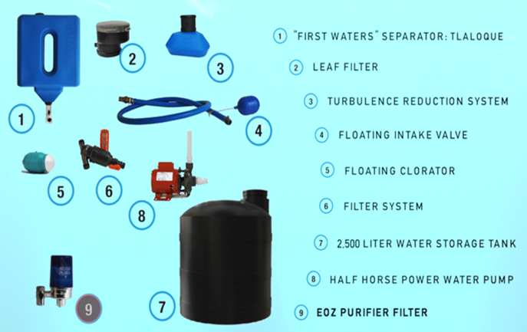
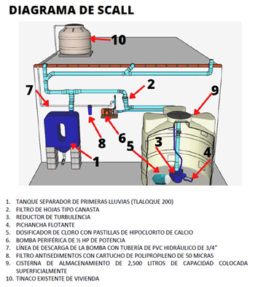
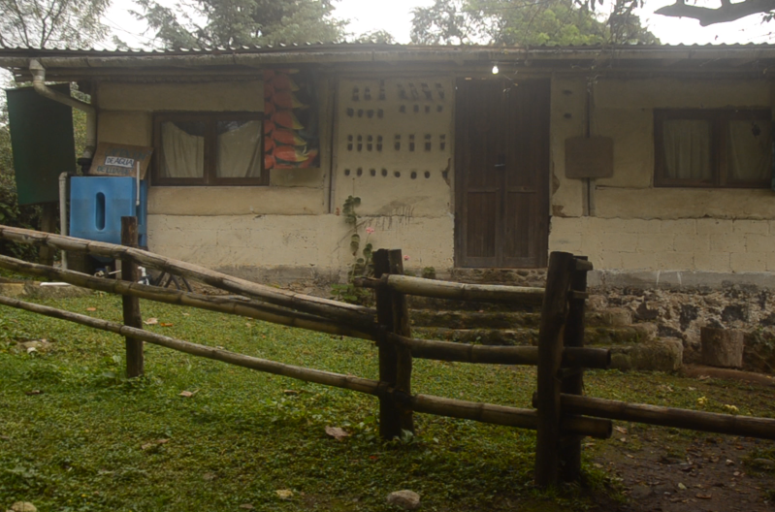
Beneficiaries
The direct beneficiaries are approximately 100 people residing in 20 households in Colonia Arroyo Blanco, Municipality of Xalapa, Veracruz. The benefit can extend to more than 200 people when there is excess captured rainwater.

Slide 6
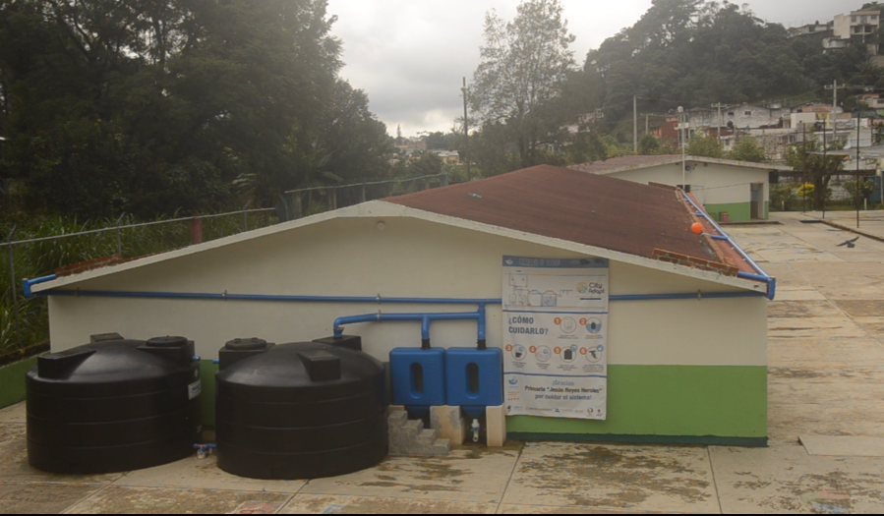
Beneficiaries
The Rainwater Harvesting System (SCALL) installed in the Health Center of Colonia Arroyo Blanco will benefit over 1,500 people receiving healthcare.
The provider will implement a training program and provide technical support to the beneficiaries regarding the use, operation, and maintenance of the SCALL to achieve effective and sustained adoption of rainwater harvesting practices.

Slide 7
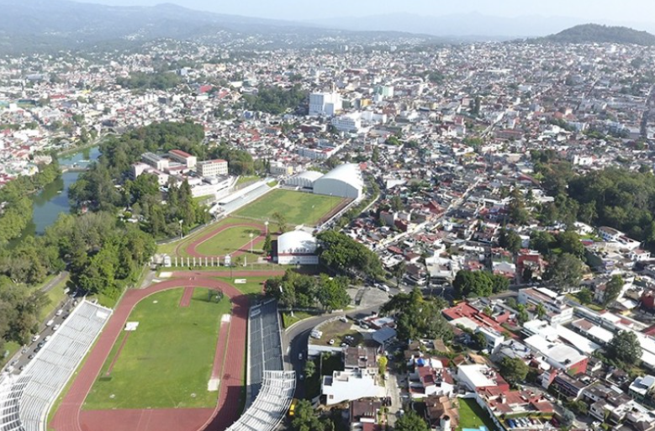
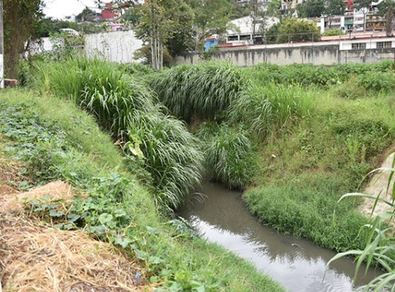
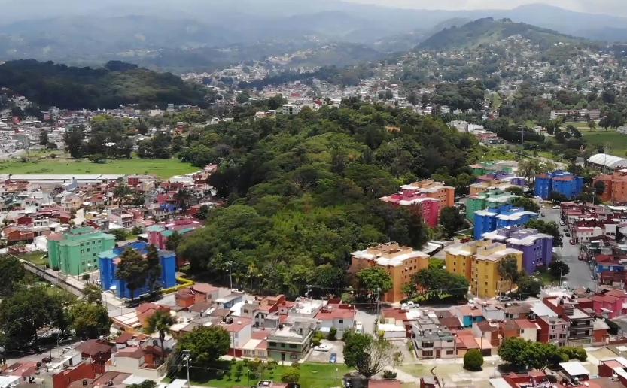
Community Needs
The acute water scarcity problem faced by the municipality of Xalapa, Veracruz, has its main causes in:
A constant increase in water demand due to the irregular growth of the population's settlements.
Pollution of water sources from urban drainage discharges.
Climate change, which has disrupted rainfall patterns, limiting the regular availability of clean water throughout the year, leading to increased economic and social costs for its distribution.

Slide 8
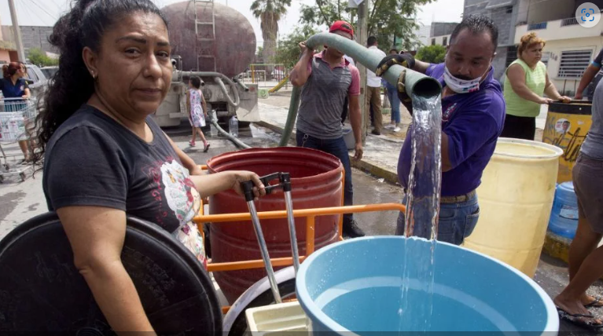
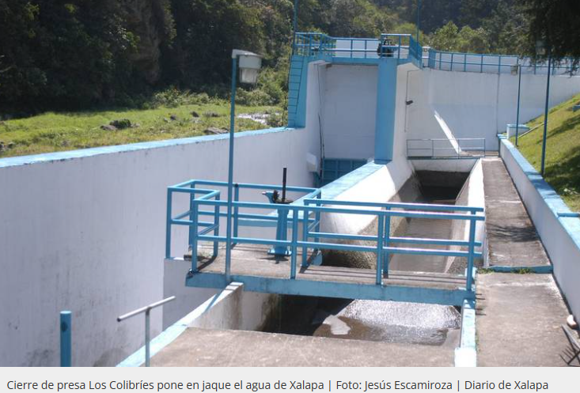
Community Needs
The distribution of clean water in the northeast area of the city, such as Colonia Arroyo Blanco, is affected by the topography and the high levels of marginalization caused by water rationing programs. Most families find it impossible to store water due to the lack of appropriate containers.
Another significant factor to mention is the social and political conflicts with some municipalities in the state of Puebla, from which Xalapa receives a portion of its water.
CMAS (Municipal Water and Sanitation Commission) reports that 10% of the city and its surrounding urban areas lack access to clean water, while 70% of the population experiences water rationing.

Slide 9
Community Needs
Finally, the identified needs in Colonia Arroyo Blanco are as follows:
Reducing the social inequality caused by water scarcity.
Promoting population awareness regarding water use and conservation to foster attitude changes and commitment to strategies such as the planting of Urban Microforests, under a comprehensive and participatory approach.
Promoting the training of the population for the adoption of new hygiene behaviors and practices within families and the community as a whole, motivating their commitment to collective actions.
Studies from the University of Veracruz indicate that over 70% of the population in Xalapa and its surrounding urban areas are unaware of the source of the water that reaches their homes and the issues related to the water catchment from watersheds and its return to the rivers once it has been used.
"The Rainwater Harvesting project is feasible and aligns with the sixth of the United Nations Sustainable Development Goals: to ensure the availability and sustainable management of water and sanitation for all by 2030."

Slide 10
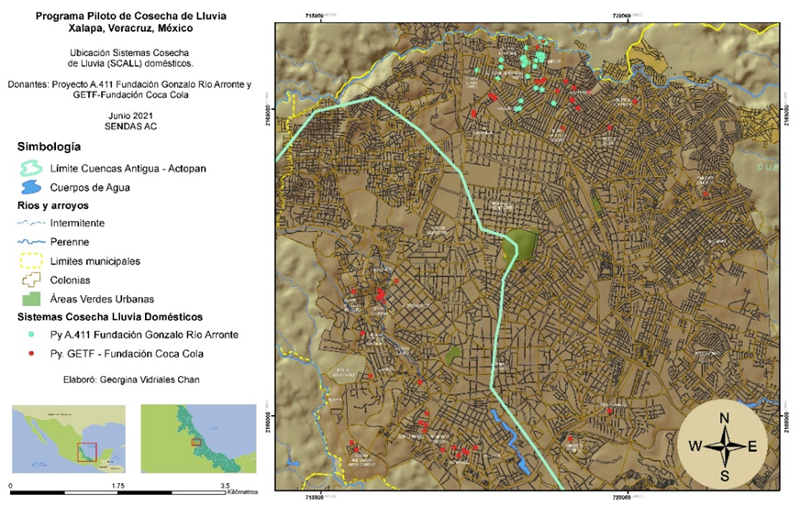
Sucessful Precedent
Experience gained from implementing a Pilot Project for Domestic and Public Rainwater Harvesting Systems (SCALL) in some neighborhoods of Xalapa, in coordination with: [Indicate the relevant coordinating entities or organizations.]
Municipality of Xalapa, Ver.
Municipal Commission for Potable Water and Sanitation of Xalapa (CMAS)
University of Veracruz
SENDAS A.C. Organization (Paths and Encounters for Autonomous and Sustainable Development)
City Adapt
And considering the actions and recommendations of EGIRHX (Integral Management Strategy for Water Resources in Xalapa).
In the project evaluation report, users from the El Naranjal and El Moral neighborhoods reported positive results in their economy and quality of life.

Slide 11
Budget
Funding
Includes:
20 Rainwater Harvesting Systems (domestic) in Colonia Arroyo Blanco1 Rainwater Harvesting System (public) at the Health Center in Colonia Arroyo Blanco.

Slide 12
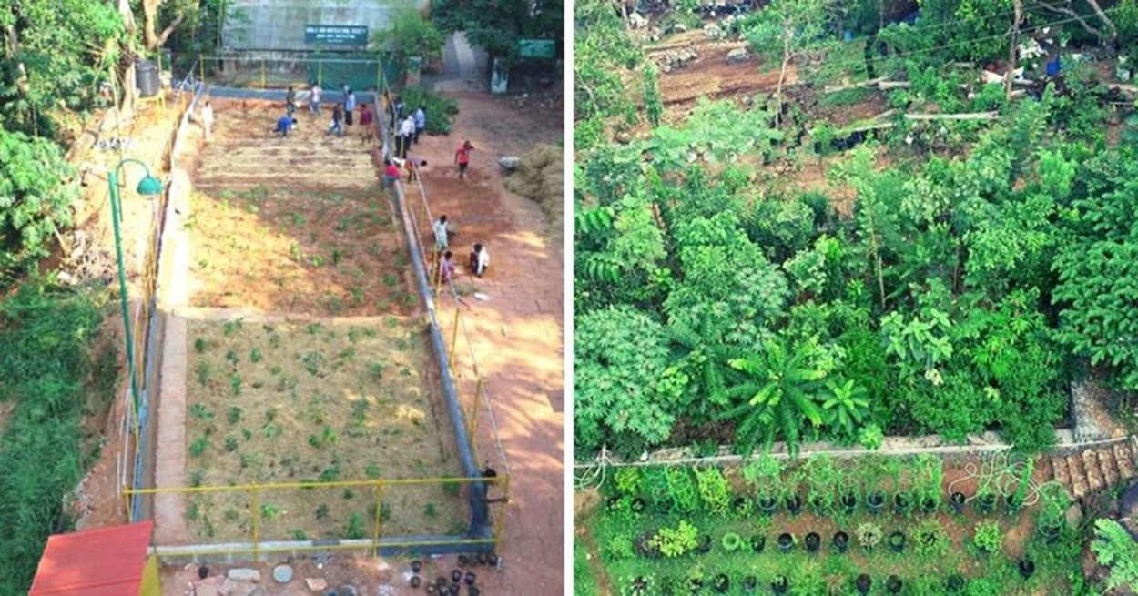
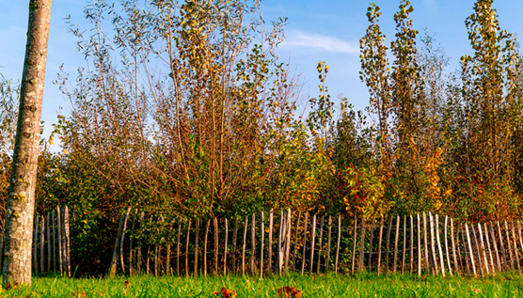
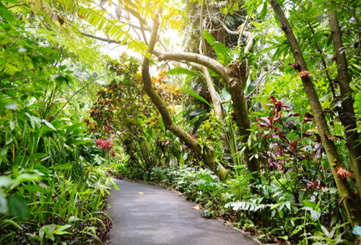
Sustainability
The measure of success for this project will be:
Fostering population awareness regarding water use and conservation to promote attitude changes and commitment.
Raising awareness in the population about the restoration of the city's ecosystems through the technique of Urban Reforestation or Urban Microforests.
The Benefits:
Capture carbon and rainwater.
Help retain forest moisture and participate in soil formation and nutrient cycling.
Filter water and purify the air.
Assist in the fight against heat islands.
Thrive in small spaces (approximately 15 square meters).
Provide shelter for biodiversity and promote the strengthening of community bonds.

Slide 13
Sustainability
The participation of allies is crucial to create and foster public awareness regarding water use and conservation, aiming to promote attitude changes and commitment to strategies such as the planting of "Urban Microforests"
SENDAS A.C. Organization
Municipality of Xalapa, Veracruz
Municipal Commission for Potable Water and Sanitation, Xalapa
Local Citizen Committee
Rotary members will also join the training to acquire knowledge to participate in monitoring and evaluation activities.

Slide 14
Collaborating Organizations
SENDAS A.C. Organization
Municipality of Xalapa, Veracruz
Municipal Commission for Water and Sanitation of Xalapa
University of Veracruz
Rotary Clubs of Xalapa and Coatepec
National Forestry Commission (CONAFOR)
Local Citizen Committee

Slide 15
Members of the Local Project Commitee
Principal Contact: Francisca Mendoza Sánchez E-mail: francis_zafa@ yahoo.com.mx Cel: +522281937776
Secondary Contacts:
  Eloína Olivares Bustillos
  Lucía León Tadeo
  Armando Cruz Enríquez

