Slide 1
Sanitation is Health
Global Grant #2235406
Wastewater Garden
Club Chapala Sunrise

Slide 2
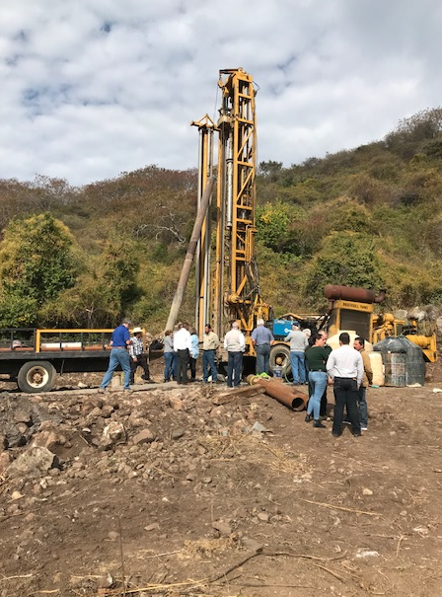
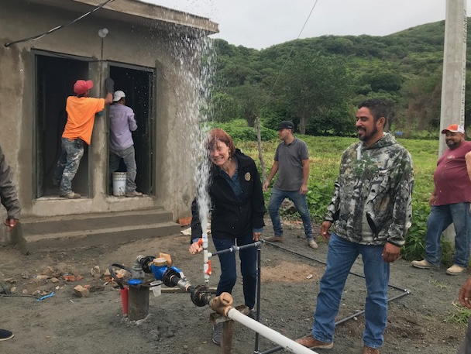
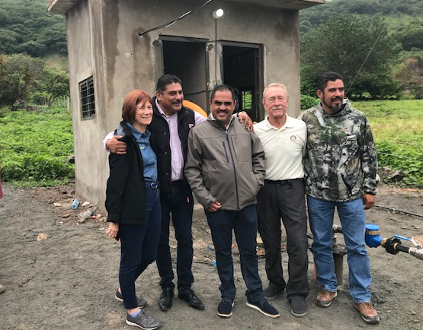
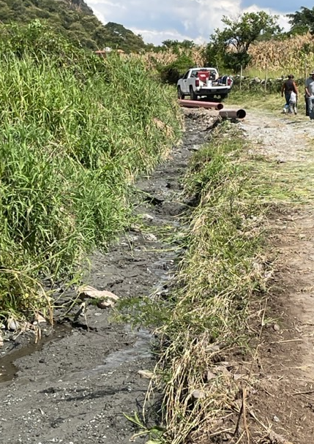
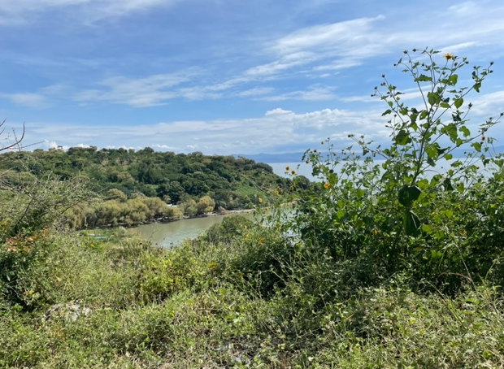
How we got here

Slide 4
Project Sponsors
Chapala Sunrise Rotary Club is the Host District 4140
The Rotary Club of South San Francisco is the International Sponsor District 5150

Slide 5
Project Description :
Construct a wetlands sewer treatment system for the village of Ojo de Agua, Poncitlán, Jalisco, MX
Raw sewage flows in a ditch directly from the village into Lake Chapala
300 citizens live in the village just above the ditch

Slide 6
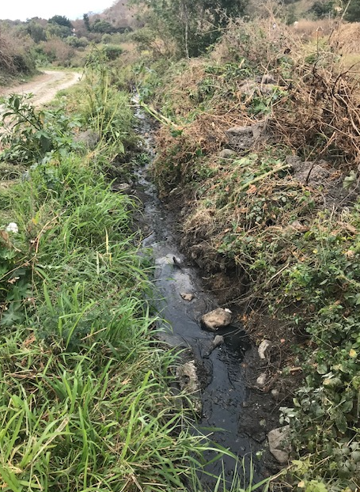
Effluent Directly into Lake Chapala

Slide 7
Project Objectives
Stop the flow of raw sewage directly into Lake Chapala
Eliminate the villagers exposure to coliform bacteria and other dangerous pollutants carried in the wastewater
Improve the health of the citizens by Reducing the abundant mosquito population and the potential exposure to Dengue Fever
End the odor coming from the drainage system

Slide 8
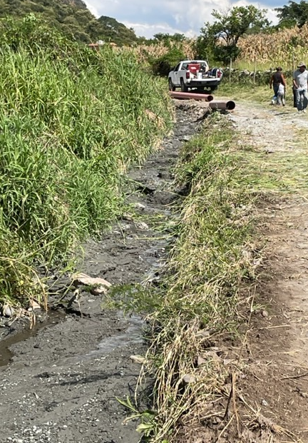
Water Samples

Slide 9
Level of wastewater Contaminants
The water is very dirty
The level of Coliform contamination is 1,300,000 NMP/100ml. The standard for wastewater allowed to flow into the lake is 1,000 NMP/100ml, in other words, it is 1,300 times worse than the standard.

Slide 10
Chapala Sunrise Rotary Club Project Partners
South San Francisco Rotary Club – International Sponsor
Ponciltlán Municipal Government, Ojo de Agua community
Local councils for land use approval
Aipromades
CIESAS – Centro de Investigaciones y Estudios Superiores en Antropologia Social Dr. Joshua Greene

Slide 11
Responsibilities
Rotary Club of So. SanFrancisco, as the international sponsor, will help financially and check project progression.
Rotary Club of Chapala will work with Poncitlán, the local community and regional council to obtain permission to use the property on which the wastewater system will be built. Poncitlán has also provided engineering support from the Director of Public Works, Rodrigo Amilcar Solis.

Slide 12
Responsibilities continued…
Aipromades helped us complete the “needs analysis” and has provided training, mentoring, education and assisted with public relations
CIESAS will provide technical and professional services. They will help design and construct the wetlands system
CIESAS will also conduct and educational curriculum with the community, specifically oriented around the designing and maintenance of the wetlands septic system and to gain community support and resources

Slide 13
Budget
Engineering design 93,286 pesos 5,217 USD
Pond Liner 477,375 26,698
Site preparation 91,800 5,134
Remove material 198,900 11,124
Build pond enclosure 53,550 2,995
Place septic tank connection 8,266 462
Construct septic tank 186,571 10,435
Plants for humedal 40,000 2,237
Signage 4,000 224
Taxes 56,403 3,155
Gravel 270,000 15,101
Gravel installation 45,000 2517
Total Budget 1,525,133 $85,299

Slide 14
Funding
Source USD
Richmond Sunrise 3,977
Chapala Sunrise 5,250
So. San Francisco 26,250
So. San Francisco DDF D5150 6,196
Peña Foundation 5,250
Bird Foundation 1,399
Ottawa-Sittsville 509.25
Vail Colorado 3,780
Vail D5470 DDF 4,500
Orland Park 2,625
Lincoln Rotary 1,995

Slide 15
Funding Summary
DDF Contributions 10,696.00
Cash Contributions 42,273.00
Subtotal matched contributions + World Fund 61,526.00
Non-Rotary contributions 6,333.00
Total funding 67,859.00
Total Budget 85,299.00

Slide 16
Constructed Wetlands Designs

Slide 18
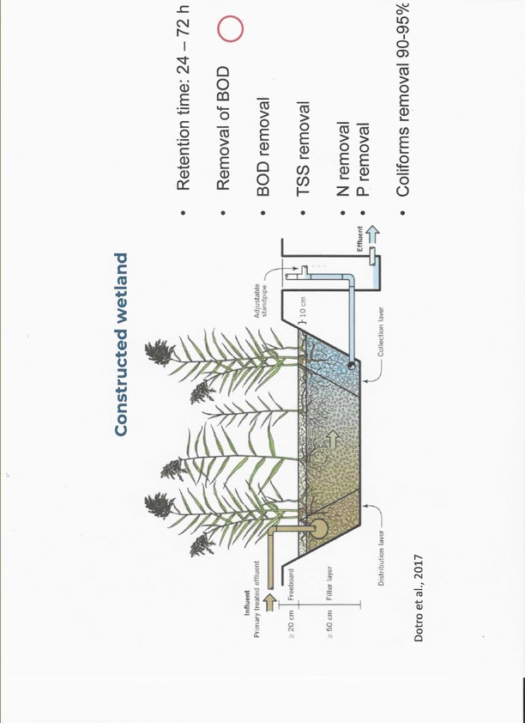

Slide 21
Unique Circumstances
The elevation angles are very good for the natural flow of effluent into the wetlands system we are proposing. The site is currently wet and swampy in the rainy season.
The location will require the wetlands holding area to be raised above the existing terrain

Slide 22
Funding
The project cost request will be established when:
The final design has been completed
The amount and cost of materials has been determined, gravel, sand and liner
The estimated length of time to complete the project has been approximated
Equipment rental estimated
Total labor cost forecast
Initial cost estimate is approximately $90,000 USD

Slide 23
Some Team Members

Slide 24
Project Explained to Council Leader

Slide 25
Contact Information
Karl Dyer, Past President
Chapala Sunrise Rotary Club
Chapala, Jalisco MX
w.karl.dyer@gmail.com
+52-333-475-6119 MX
+1-203-903-0604 USA
Tax deductible contributions to the Chapala Sunrise Rotary Club, A.C. can be made through the Fountain Hills Rotary Club, Fountain Hills, AZ

Slide 26
Tax Deductible Donations
Directions for U.S. donors who need a tax deduction letter to transfer money to Chapala Sunrise Rotary Club, A.C. through the Fountain Hills Rotary Club, Fountain Hills, Arizona
1. Make Check payable to:
Fountain Hills Rotary Club Foundation
P.O. Box 18188
Fountain Hills, AZ 85268
Attn: Treasurer
2. Include with check: Donor Mailing Address, Donor Email address
Donor phone number (only in case of verifying missing information)
Note the specific purpose for the donation(if any) to the Chapala Sunrise Rotary Club

Slide 27
Questions

