Slide 1



Technology for a better future
Investing in education is the most cost-effective way to boost economic development
A project of the Poza Rica Rotary Club
Notes:
Investing in education is one of the wisest decisions a society can make. Education is an essential factor for economic growth and social development in a country. According to a World Bank report, each additional schooling year can increase annual income by 10%. Moreover, education has a positive impact on health, gender equality, and poverty reduction.
We currently live in a digital age where technology is ubiquitous in our daily lives. Mastery of technology has become an urgent necessity to adapt to the demands of contemporary society. It is crucial that the new generations learn to use technology for educational purposes from an early age, preparing them for a future in a globalized world.
Consistent with this, the integration of educational technology in schools will always enhance the quality of education and foster digital skills development in students.
This provides access to a wide range of educational resources that support the teaching and learning process, reinforce the acquisition of new knowledge, and create meaningful learning experiences. Students can access digital books, educational programs, and didactic resources.
Lastly, a project like ours enables us to offer a more comprehensive and enriching education for children, ensuring equal opportunities for learning and reducing the likelihood of them becoming migrants or engaging in criminal activities.

Slide 2

The current educational challenge
"Technology for a better future" addresses a critical problem in an educational community with limited economic resources.
More than 1,700 primary school students at María Enriqueta School Center face difficulties in their access to technology and quality educational opportunities.
For economic reasons, they have not received classes using Information Technology for more than 5 years and they are missing opportunities for future development
Notes:
Project focused on improving the quality of education and the future of children at the Maria Enriqueta School Center in Poza Rica, Veracruz.
The Maria Enriqueta School Center operates 8 schools (4 in the morning and 4 in the afternoon).
Through 100 teachers and educational staff, it serves 1,700 primary school children aged 6 to 13.
The students at the Maria Enriqueta School Center primarily come from a low socio-economic background.
For the past 5 years, due to budget constraints, computer tools have not been used in education, causing students to miss out on the opportunities that technology offers and fall behind in future opportunities.

Slide 3
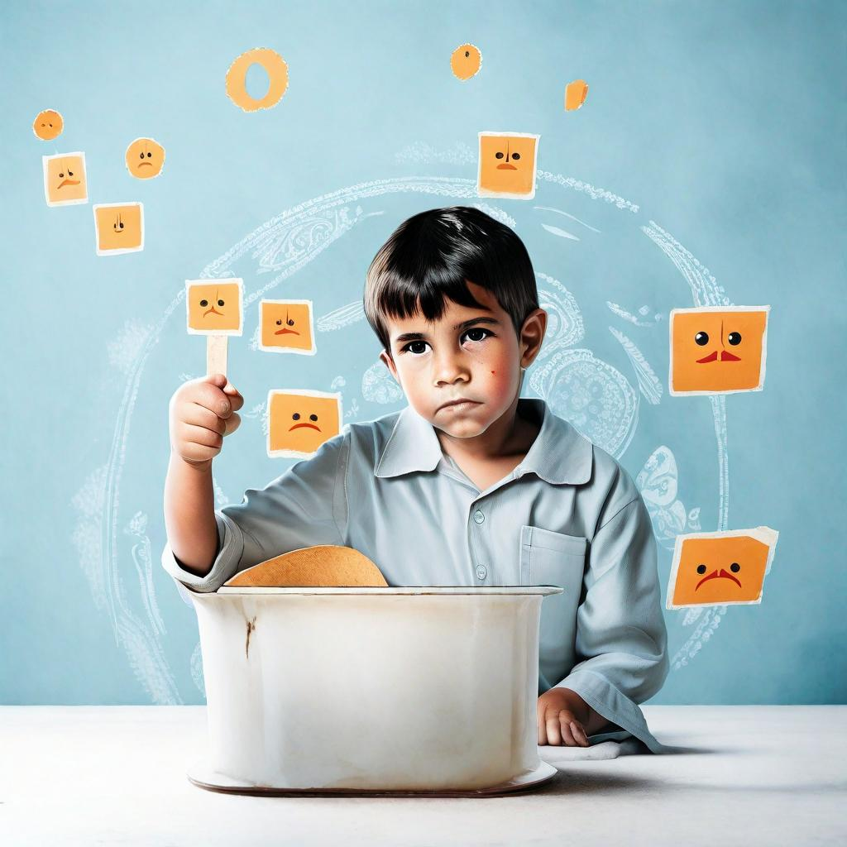

Our Mission. Transforming Education
We propose a project that will transform education in this community. If we don't act today, we give up on the future of these children and our own future.
The Project consists of:
Provide two classrooms with 60 computers so that students can get involved in the world of Information Technology and learn their subjects better.
Train the teachers of the María Enriqueta Educational Center so that, using technology, they can provide better classes to their students.
This ensures:
Quality education is provided to students in these schools to improve their educational performance and increase their chances of completing the next level of education.
Notes:
The project consists of:
Providing two computer classrooms with a total of 60 computers where students can receive at least 1 hour of their classes per week using technological tools to engage in the world of information technology and improve their understanding of the subjects taught.
Training (in collaboration with the Psychology and Pedagogy faculties of the Universidad Veracruzana) teachers from the 8 schools of the Maria Enriqueta Educational Center so that they can utilize the benefits of technology to develop these competencies and provide better classes to their students.
This ensures:
Quality educational services will be provided to students in these 8 public schools, many of whom have limited access to technology, reducing the digital gap and increasing their educational performance and chances of completing higher levels of education.

Slide 4

The Path to Educational Excellence
General Objective.
Support students to integrate Information Technologies into their learning process, allowing them to make the most of educational and future development opportunities
Specific objectives.
Strengthen the educational infrastructure of the schools by creating a computer-equipped learning environment, serving 1,700 students and 100 teachers needs.
Provide quality educational services to students to enhance their educational performance and increase their chances of completing the next level of education.
Improve teachers' competencies by providing training courses in the digital teaching methods.
Notes:
Project Objectives:
General Objective:
To guide, support, and assist the students of the new generations in integrating the use of Information Technologies into their learning framework so that they can better leverage the opportunities that education offers and do not miss out on the professional and personal benefits TI provide.
Specific Objectives:
Strengthen the educational infrastructure of the 8 public schools of Maria Enriqueta by creating a computer-equipped learning environment, serving the needs of 1,700 students and 100 teachers.
Provide quality educational services to students in 8 public schools with limited access to digital educational systems in the region, aiming to enhance their educational performance and increase their chances of completing the next educational level.
To enhance the competencies of teachers by offering training courses on digital teaching methods.

Slide 5

The Benefits We are Seeking
"Technology for a Better Future" primary goal is to enhance the education of children at the Maria Enriqueta School Center and prepare them for a digitally interconnected world.
The benefits and expected outcomes include
  Improved educational quality,
  Digital skills development,
  Digital Gap reduction,
  Employment opportunities, and
  Crime prevention
Notes:
Benefits and Expected Outcomes
At Rotary Club of Poza Rica, we are excited to be able to impact the future of children and teachers in our community through the "Technology for a Better Future" project. Our primary objective is to enhance the education of children at the Maria Enriqueta School Center and prepare them for a digitally interconnected world. This project will serve as a starting point to initiate similar projects in the community and strengthen collaboration between educational institutions and civil society.
The benefits and expected outcomes include improved educational quality, digital skills development, the reduction of the digital divide, employment opportunities, and crime prevention, all supported by ongoing assessments and a focus on sustainability.
Enhanced Educational Quality: The "Technology for a Better Future" project focuses on improving the quality of education at the Maria Enriqueta School Center in Poza Rica, Veracruz. By equipping schools with computer labs equipped with 60 computers, students can utilize technological tools to enhance their learning. This focus on technology will contribute to a higher level of education.
Digital Skills and Competencies: Through the training of teachers in the use of technological tools, students can develop essential digital skills and competencies. This will allow them to access better academic and employment opportunities, ultimately increasing their prospects for the future.
Reduction of the Digital Gap: By providing high-quality educational services to students in these 8 public schools, many of whom have limited access to technology, the project will help reduce the digital divide. Students will have the opportunity to improve their academic performance and increase their chances of completing higher levels of education.
Inclusion and Employment Opportunities: The project will enable students to learn how to use information technology from an early age, providing them with equal learning opportunities and access to job opportunities. This, in turn, reduces the likelihood of students seeking emigration to other countries for better employment prospects.
Crime Prevention: By providing a more comprehensive and enriching education for children, the project will contribute to reducing the likelihood of them becoming migrants or engaging in criminal activities. Quality education is a key factor in crime prevention and improving students' quality of life.
Assessment and Sustainability: Quarterly assessments will be conducted to monitor students' progress and the project's effectiveness. Furthermore, an annual fundraising campaign will be established to ensure the long-term sustainability of this educational initiative.

Slide 6



Strategic Collaboration. Universidad Veracruzana
"Technology for a Better Future", greatly benefits from the collaboration and support of the Universidad Veracruzana, the most renowned public university in the Gulf of Mexico region.
This collaboration not only support the feasibility of the project but also add an extra dimension of prestige and community commitment.
Notes:
Collaborations and Support
Our project, "Technology for a Better Future", greatly benefits from the collaboration and support of the Universidad Veracruzana, the most renowned public university in the Gulf of Mexico region.
We highlight their essential and motivating participation:
Prestige and Reputation: The Universidad Veracruzana is the most prestigious public university in the Gulf of Mexico region. Its recognition extends beyond the regional level, bolstering the quality and credibility of this project. Evaluators can place trust in the integrity of an institution with such renown.
Relevant Faculties: Among the various faculties of the Universidad Veracruzana, Pedagogy, Social Work, and Psychology stand out. These faculties are integral to the implementation of our project, specializing in education, social development, and mental health. The involvement of these faculties will strengthen the quality and effectiveness of teacher training and the use of technology in education.
Commitment to Community Service: The Universidad Veracruzana demonstrates a strong commitment to community service. This collaboration is not a one-time effort but an extension of their ongoing dedication to the well-being of the communities in which they operate. Their focus on benefiting the community aligns with the values and goals of the project.
History of Successful Collaboration: The Universidad Veracruzana has enthusiastically collaborated in previous programs organized by Rotary Club Poza Rica, such as "Enchúlame la Silla," "Hope Haven," and visual and dental health campaigns. This history of successful collaboration demonstrates their consistent commitment to humanitarian projects that make a difference in the community.
Trained Human Resources: The university has a team of trained human resources that can oversee, promote, and execute various project-related activities and others. The experience and expertise of their staff are valuable assets to ensure the success of the initiative.
The collaboration and support of the Universidad Veracruzana not only support the feasibility of the project but also add an extra dimension of prestige and community commitment. Their participation is a testimony to the positive impact this project will have on the education of children at the Maria Enriqueta School Center and the community as a whole.

Slide 7

Overcoming the Financial Challenge.
The cost of the investment is very low compared to the expected benefits.

Slide 8
Overcoming the Financial Challenge.
To carry out the project, we need the following Budget.

Slide 9
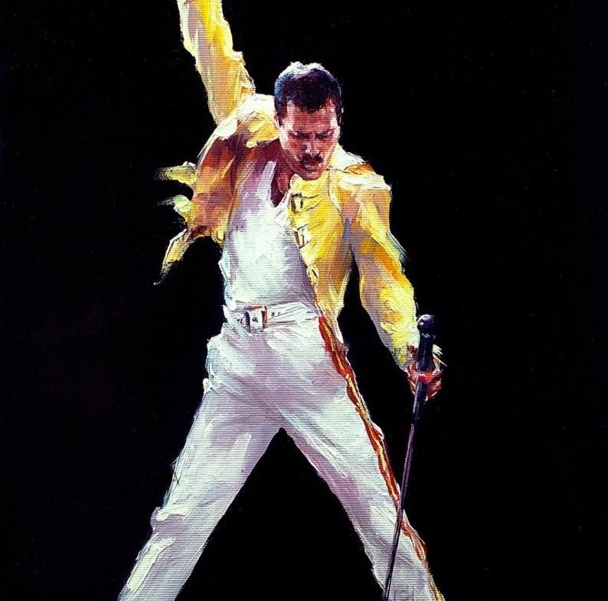
Help make a better future a reality
Every dollar invested in this project means a child receiving a more enriching education, a teacher enhancing their skills, and, most important, a community moving toward a brighter future.
Be part of this project that not only changes lives but also paves the way for a brighter future for all.
Thank you for considering support for our "Technology for a Better Future" project.
Together, we can shape the future of our community.
Notes:
Dear members of the evaluation committee,
Today, we have presented a project that transcends the classrooms and reaches the heart of our community at the Maria Enriqueta School Center in Poza Rica, Veracruz. "Technology for a Better Future" is more than an educational project; it is an investment in hope, progress, and equal opportunities.
We have emphasized the importance of education as a driver of economic growth and social development, and it is imperative that we leave no child behind. Our project focuses on 1,700 children from low economic backgrounds who have been deprived of the advantages of technology in their education for the past 5 years due to budget limitations.
Today, we call on you to change the course of their lives and our community. Technology is not just a tool; it is a great opportunity.
It is an opportunity to empower these children, provide them with better job prospects, prevent them from falling into organized crime, and, ultimately, propel their overall development.
We need your support to make this project a reality and make a tangible difference. We urge you to consider the importance of investing in the early education of these children and the opportunities it will provide them throughout their lives.
The requested budget and the expected impact are detailed in the following table:
Every dollar invested in this project translates means a child receiving a more enriching education, a teacher enhancing their skills, and, most important, a community moving toward a brighter future.
We ask you to join us on this journey toward a better future. Your support is vital, and together, we can make a difference.
We invite you to be part of this project that not only changes lives but also paves the way for a brighter future for all.
Thank you for considering support for our "Technology for a Better Future" project.
Together, we can shape the future of our community.
Sincerely,

Slide 10
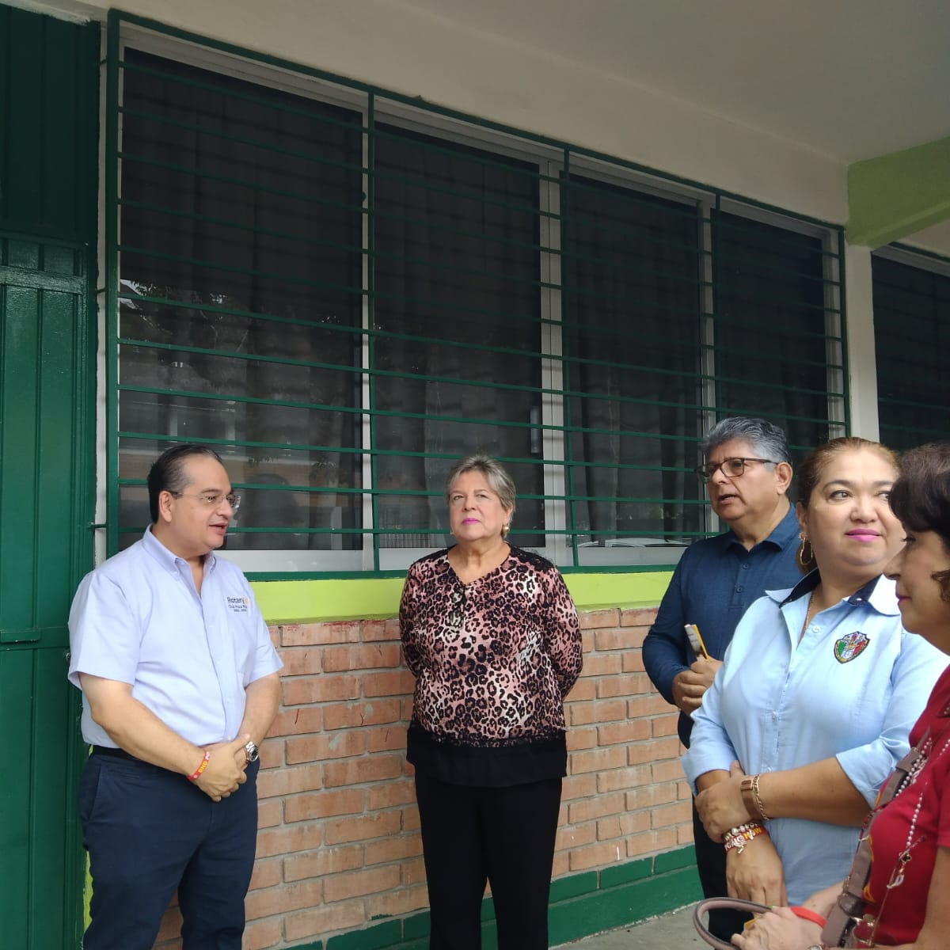
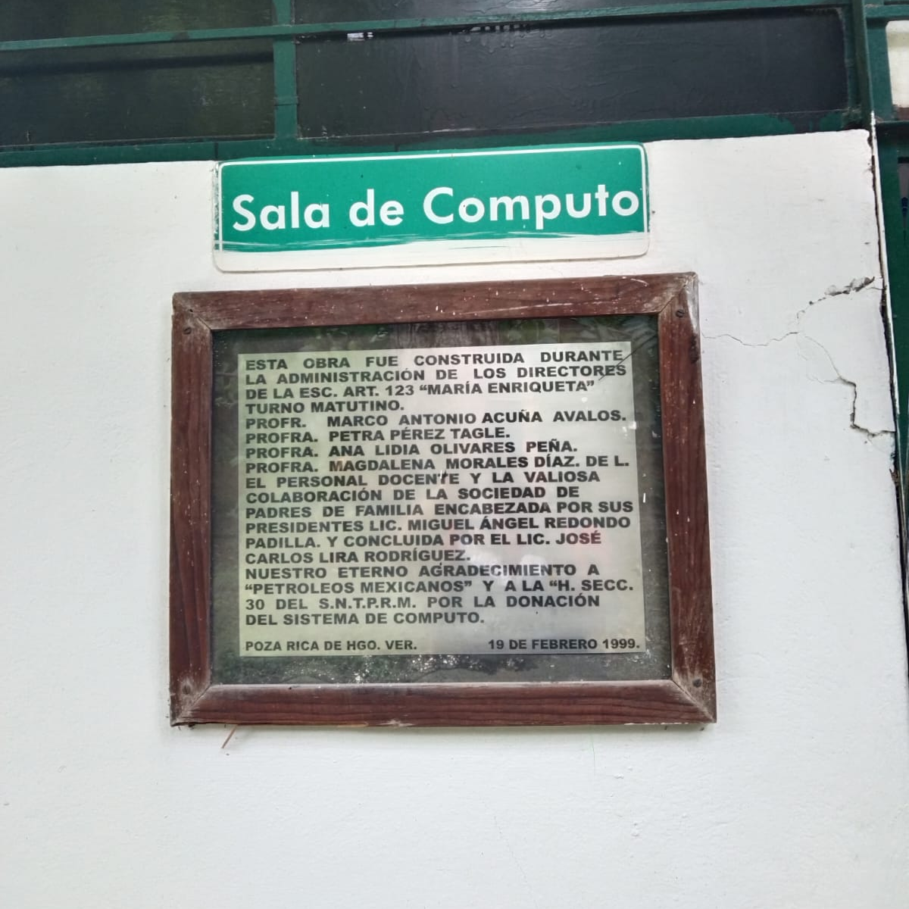
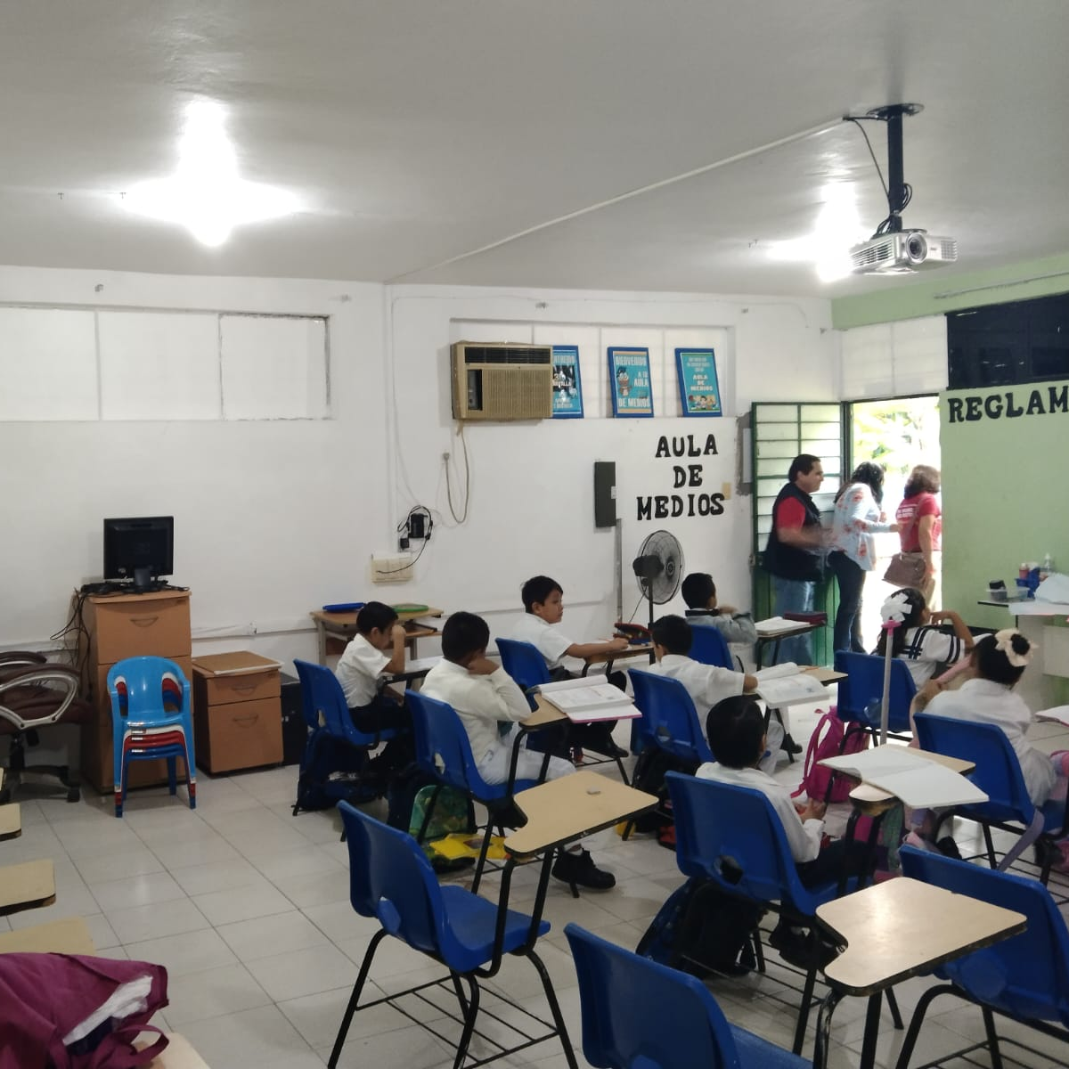
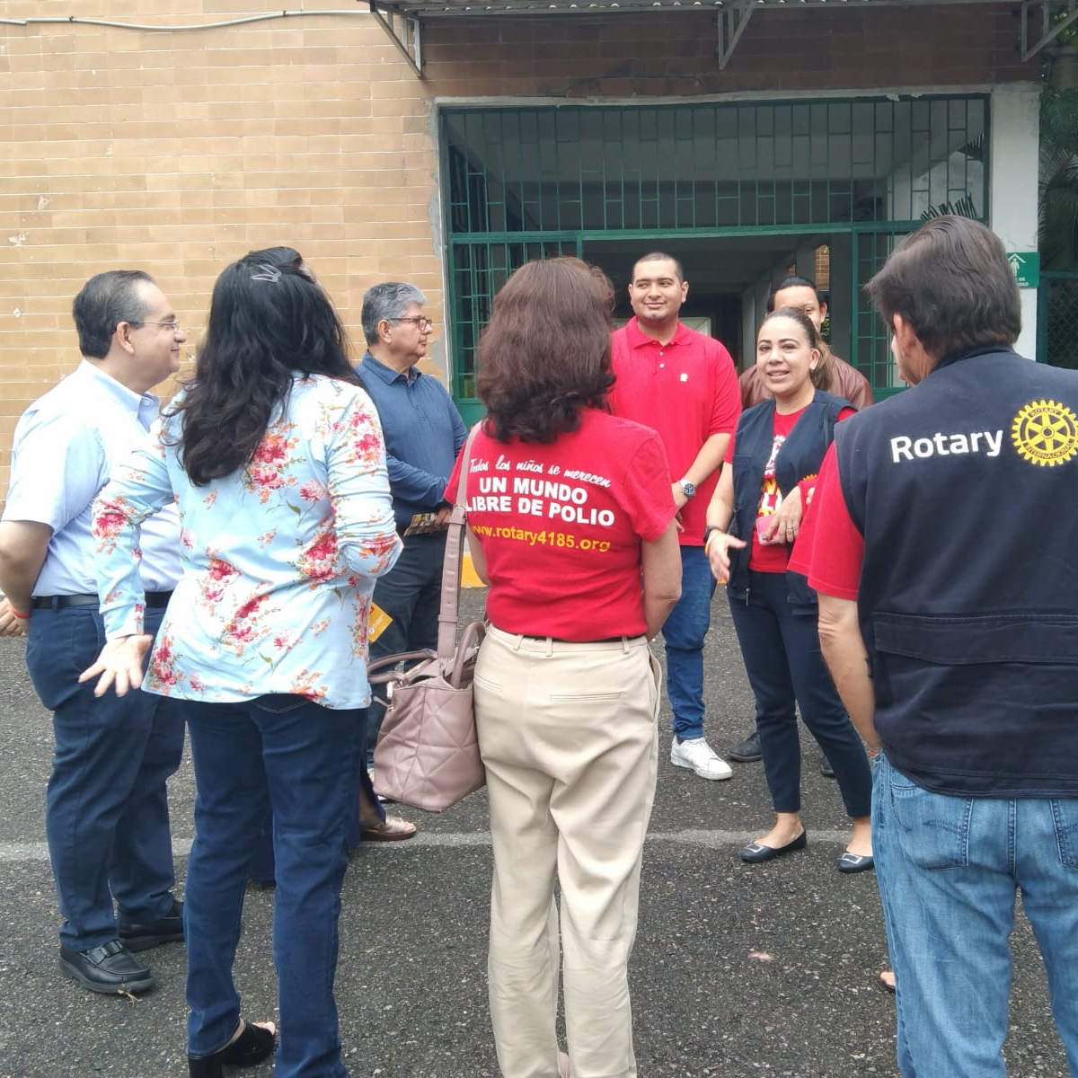
Knowing Maria Enriqueta School

Slide 11
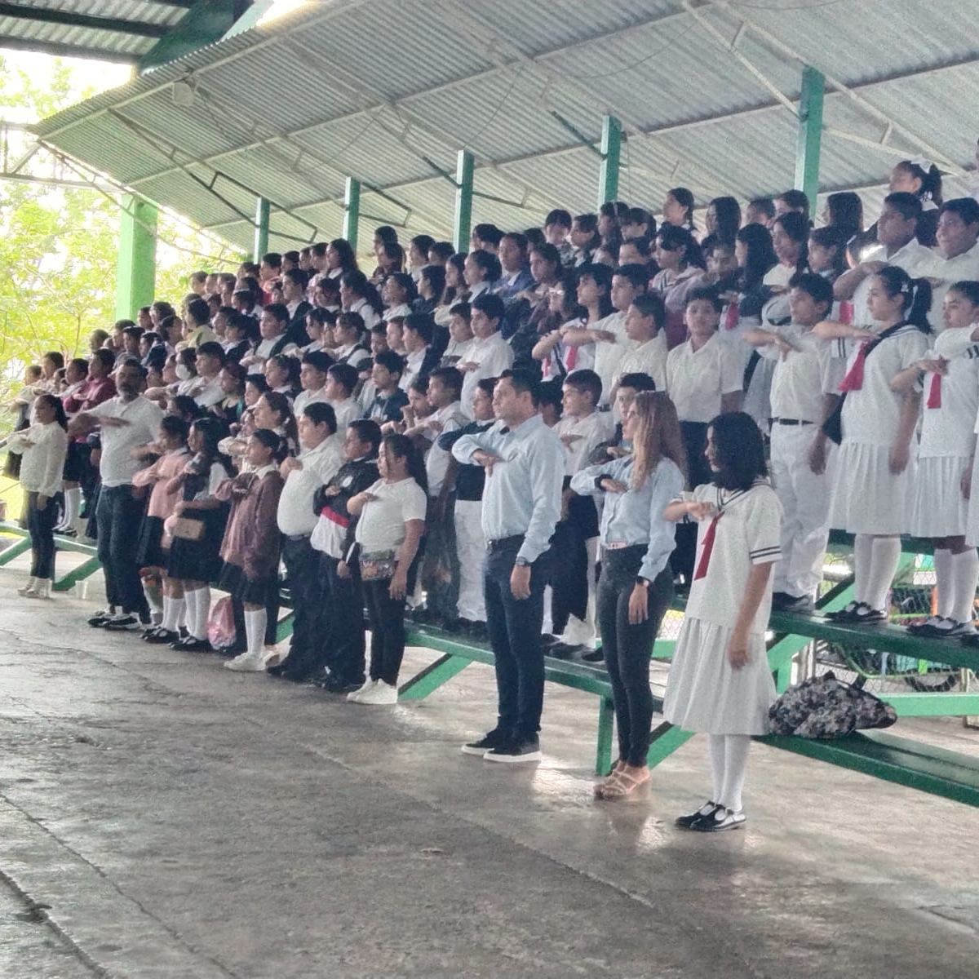
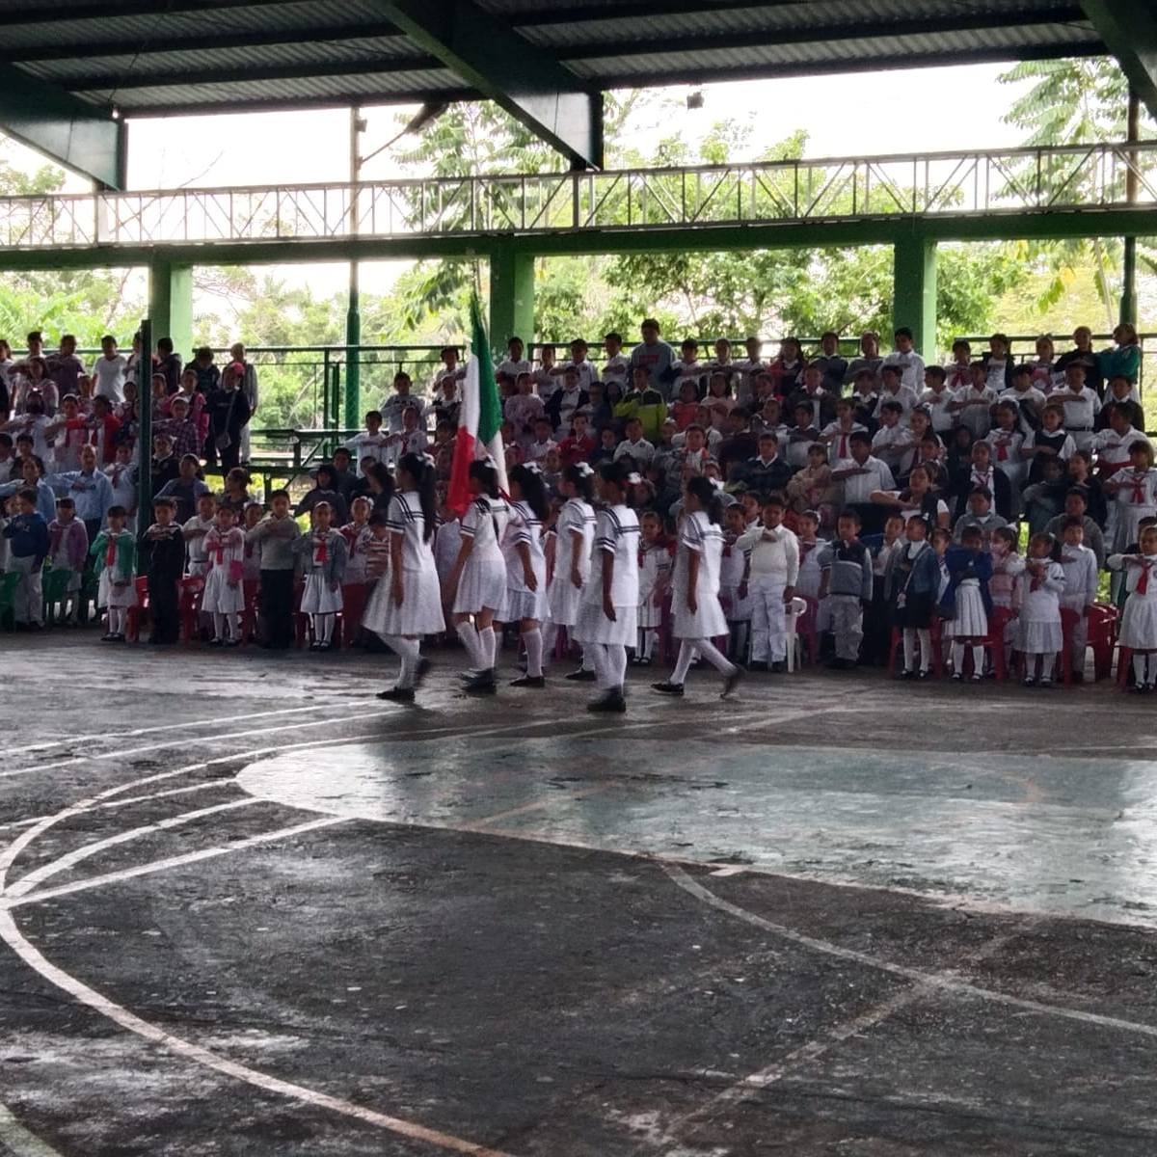
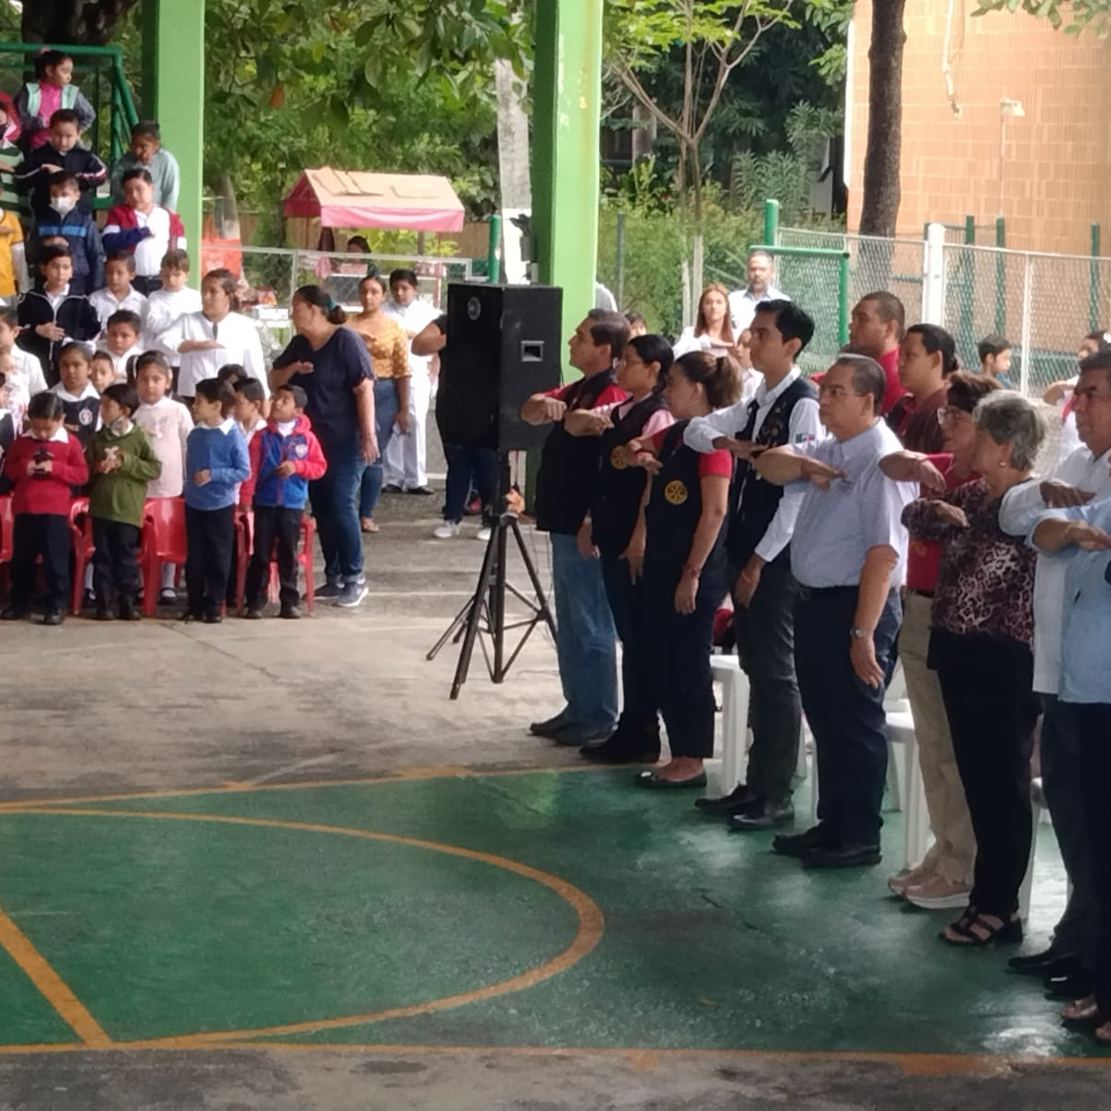
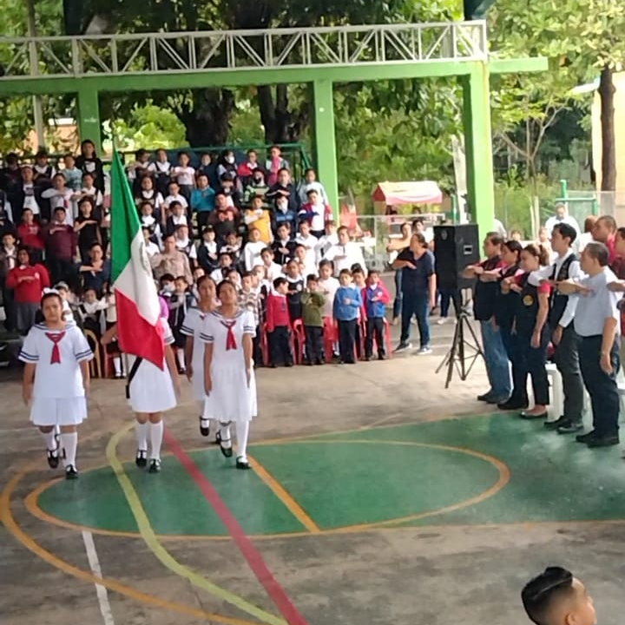
Knowing Maria Enriqueta School

