Slide 1
MANAGING CONFLICT IN YOUR CLUB
PDG Wendy Gaborit District 9510
May 2024

Slide 2
AIMS FOR SESSION

Slide 3
POTENTIAL FOR CONFLICT

Slide 4
SCENARIOS
FOOD
VENUE
CLIQUES
FINANCE
OWNERSHIP PF PROJECT OF JOB
BULLYING

Slide 5
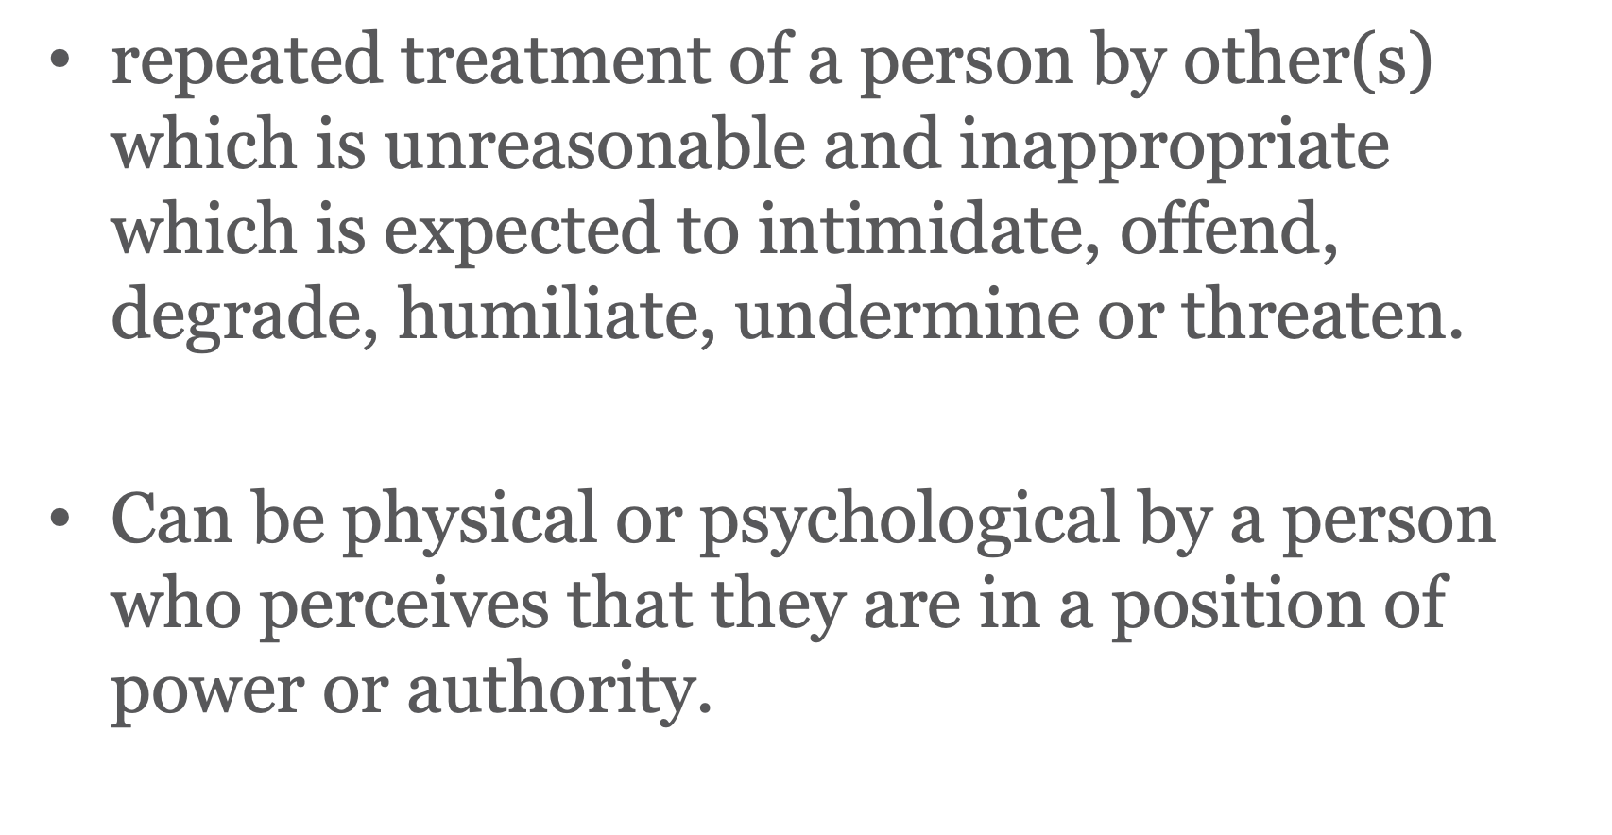
WHAT IS BULLYING

Slide 6
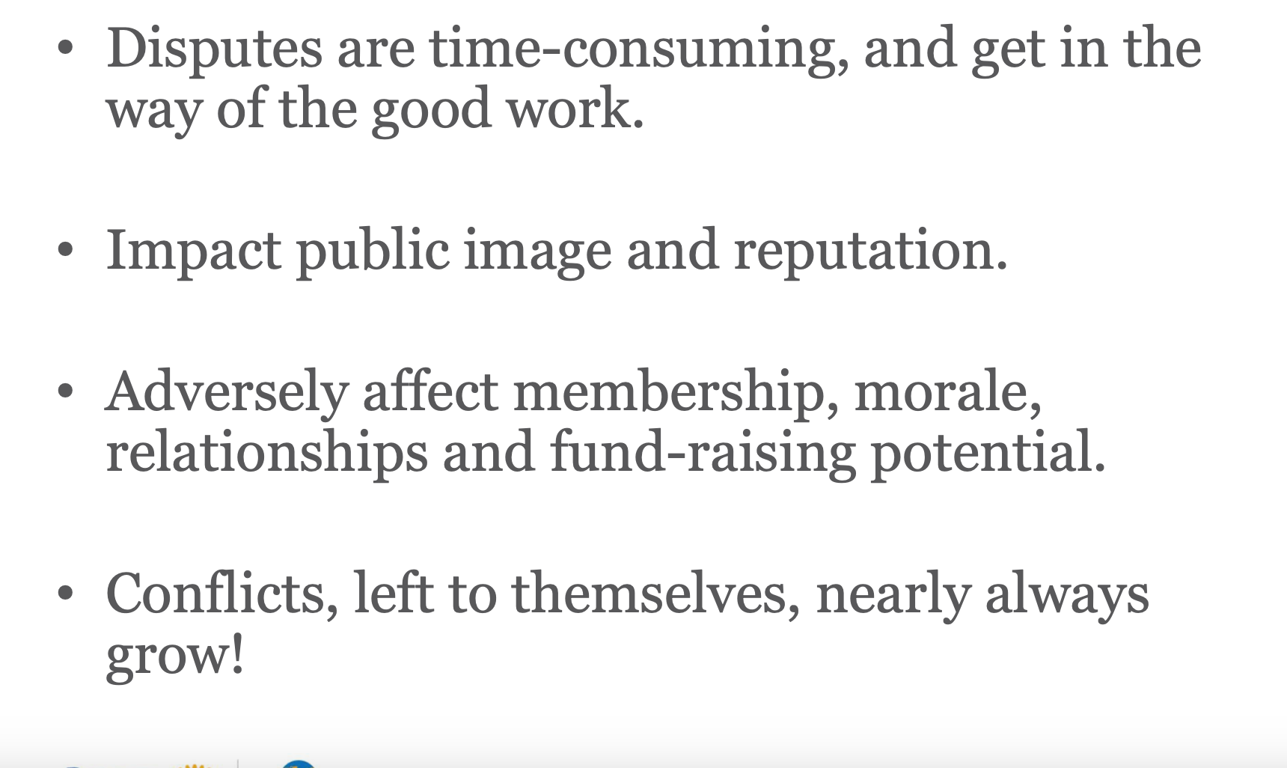
THE IMPACT OF CONFLICT

Slide 7
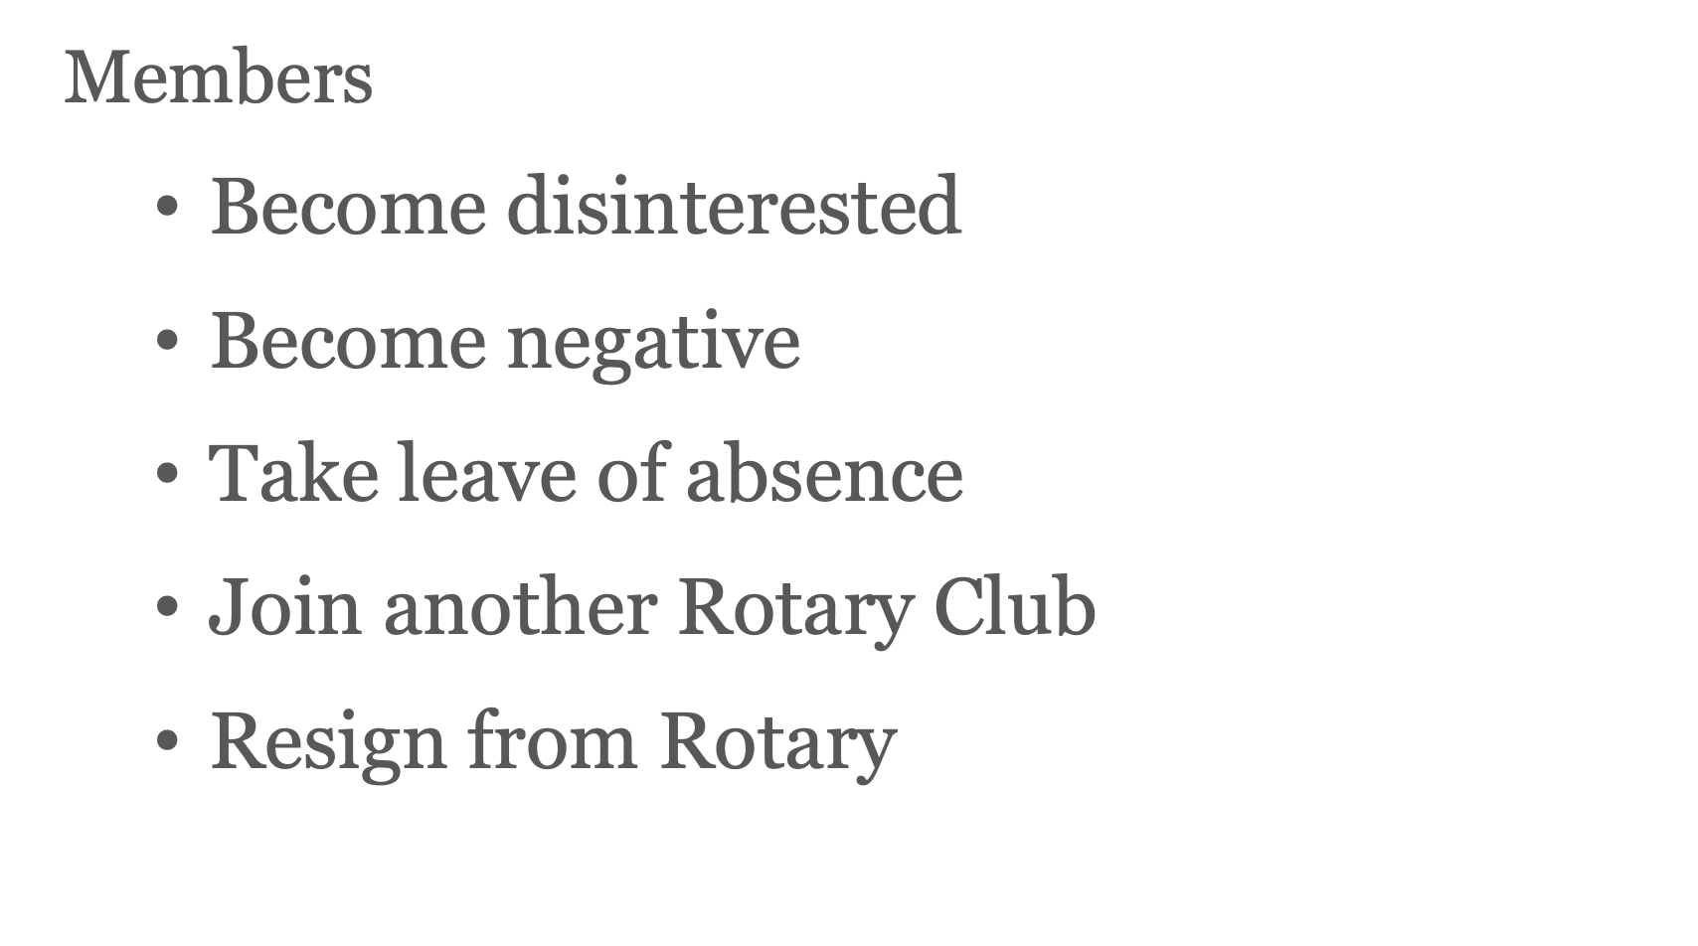
THE IMPACT TO MEMBERS

Slide 8
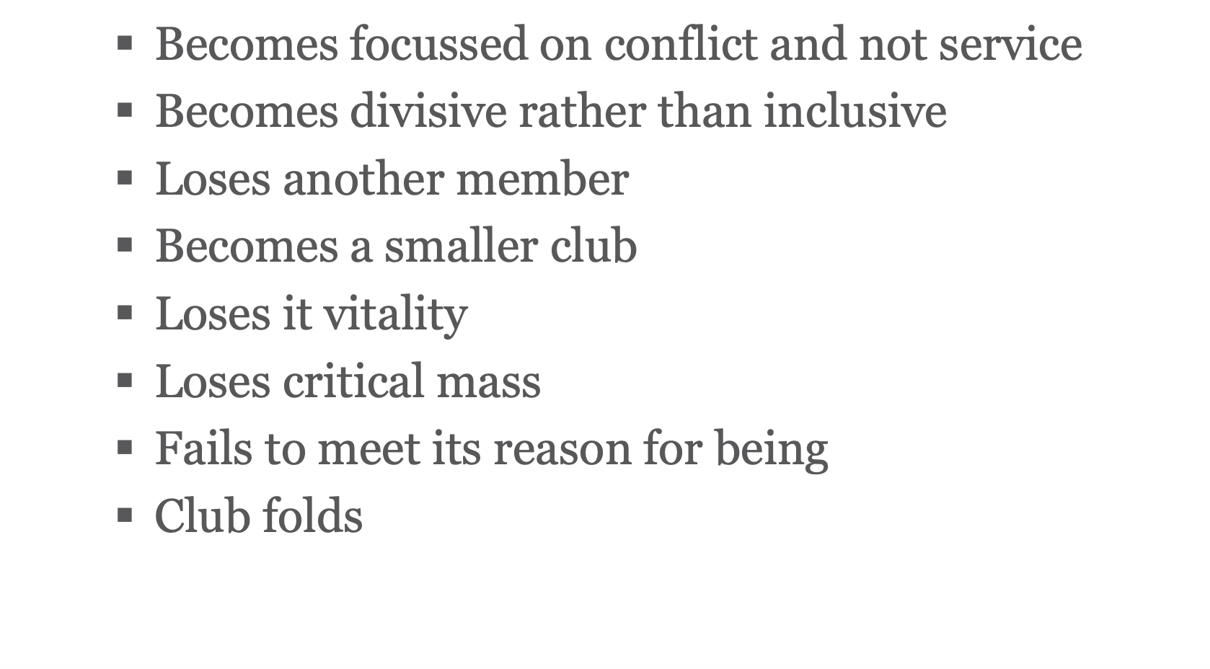
THE IMPACT ON THE CLUB

Slide 9
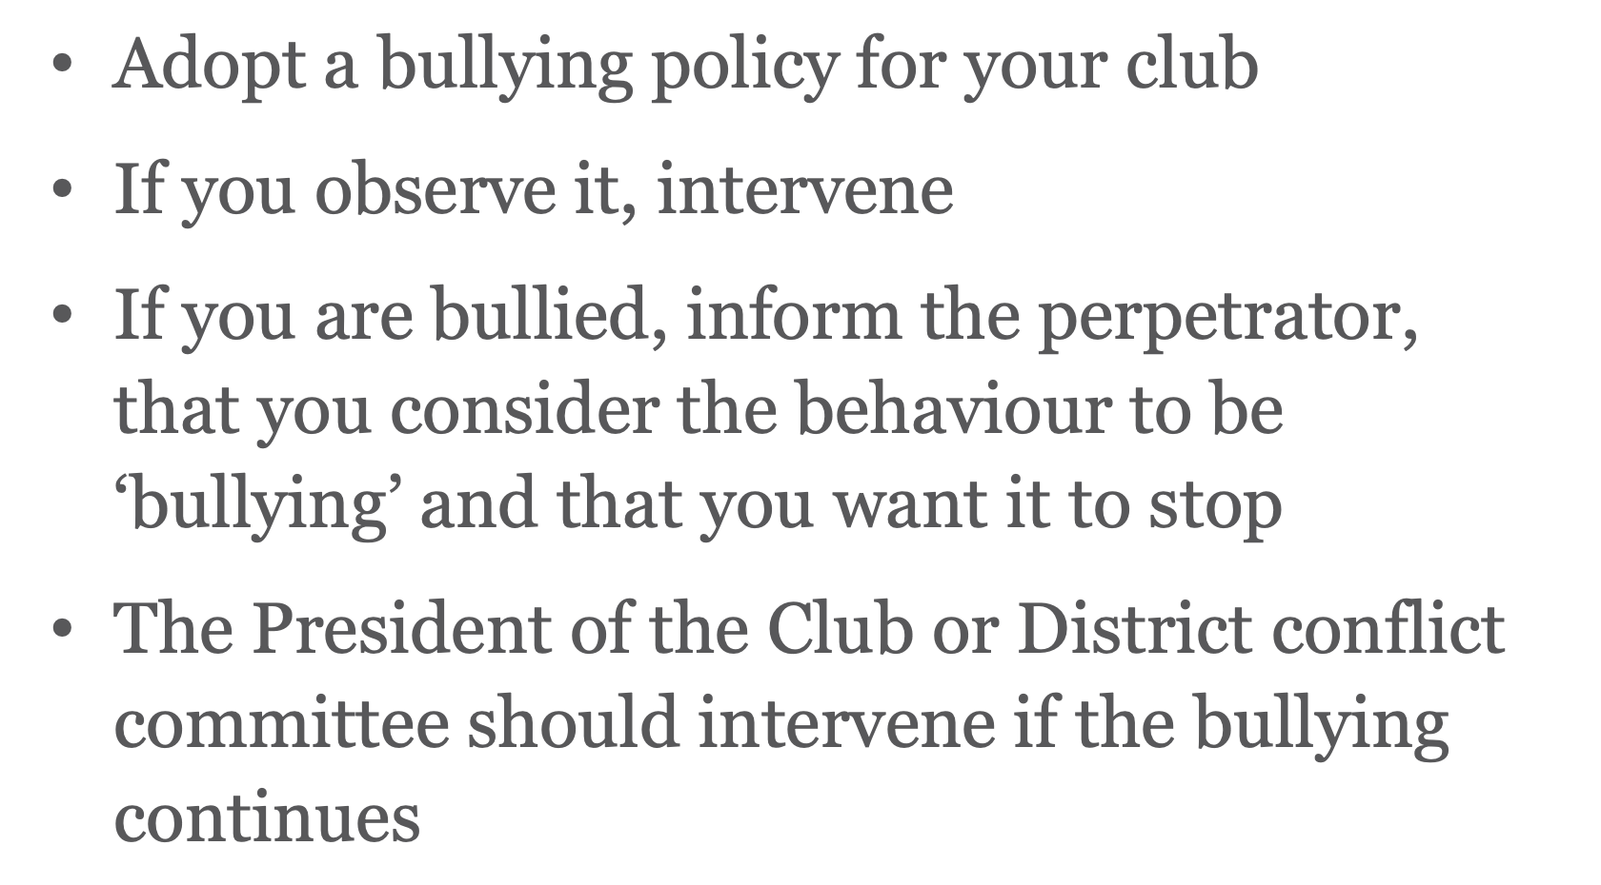
MANAGING BULLYING

Slide 10
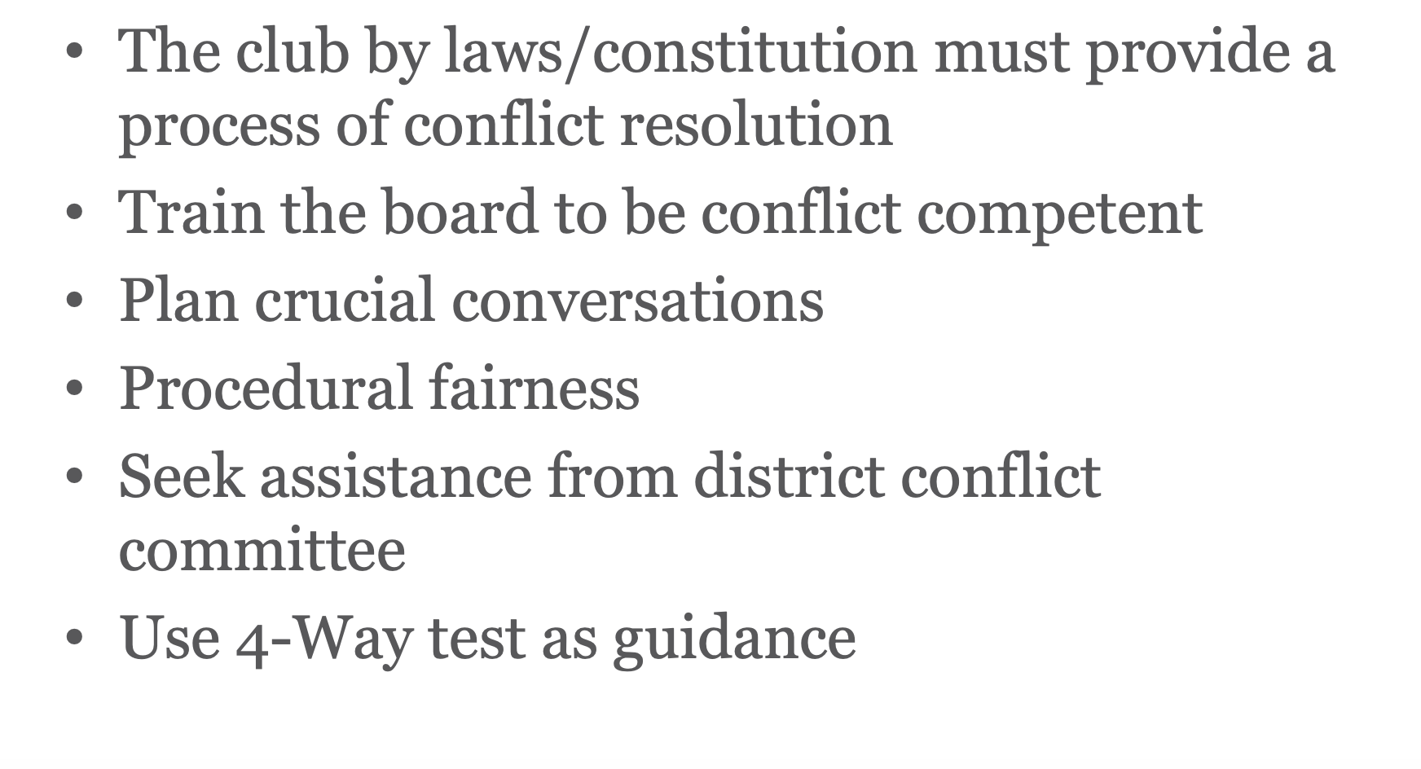
MANAGING CONFLICT

Slide 11
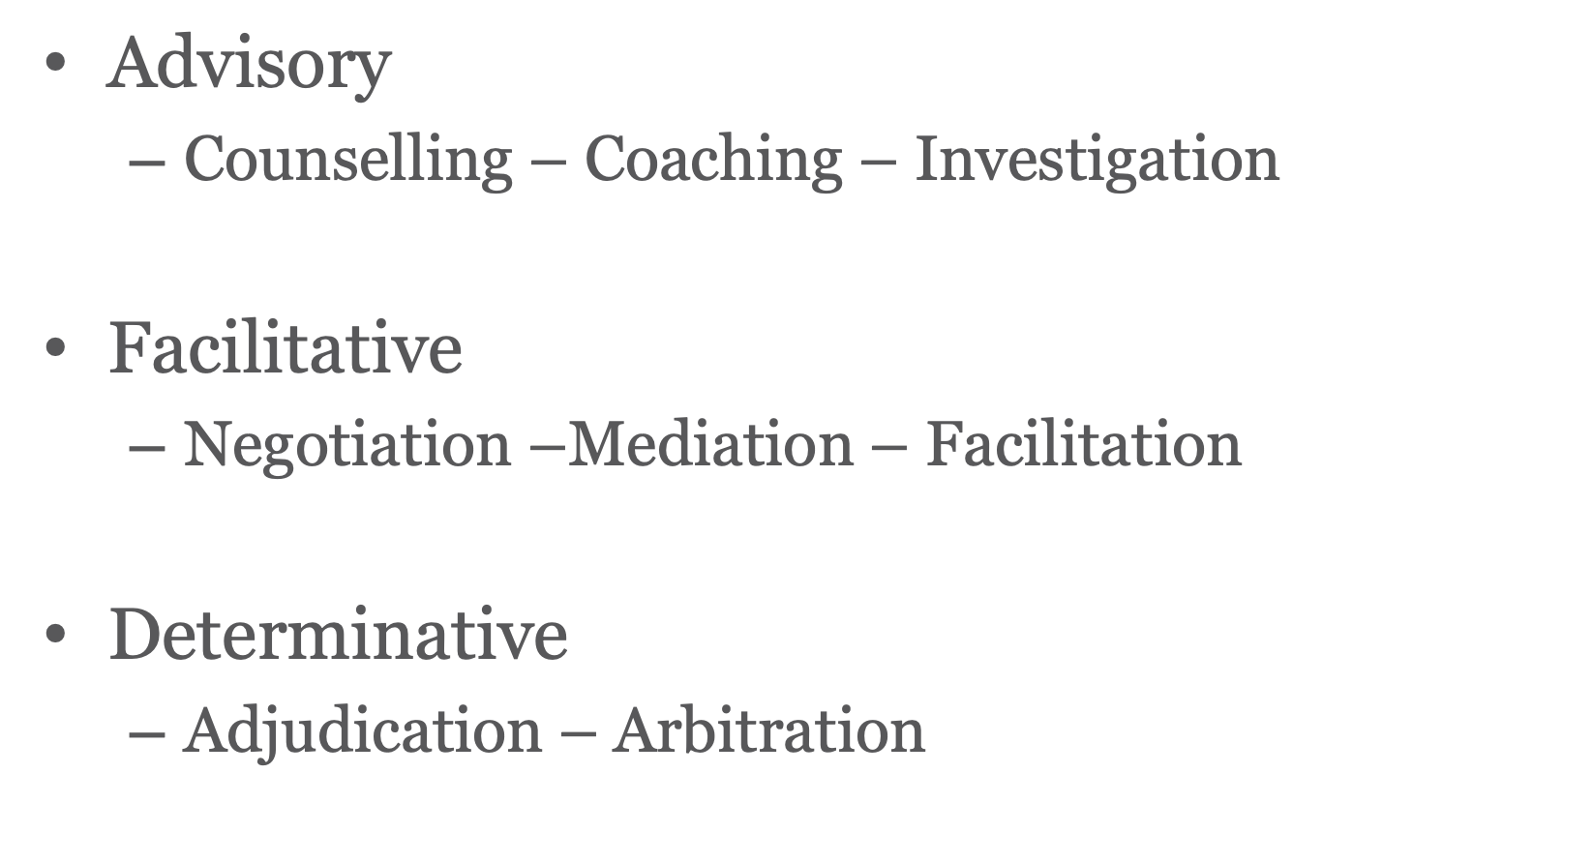
TYPES OF INTERVENTION

Slide 12
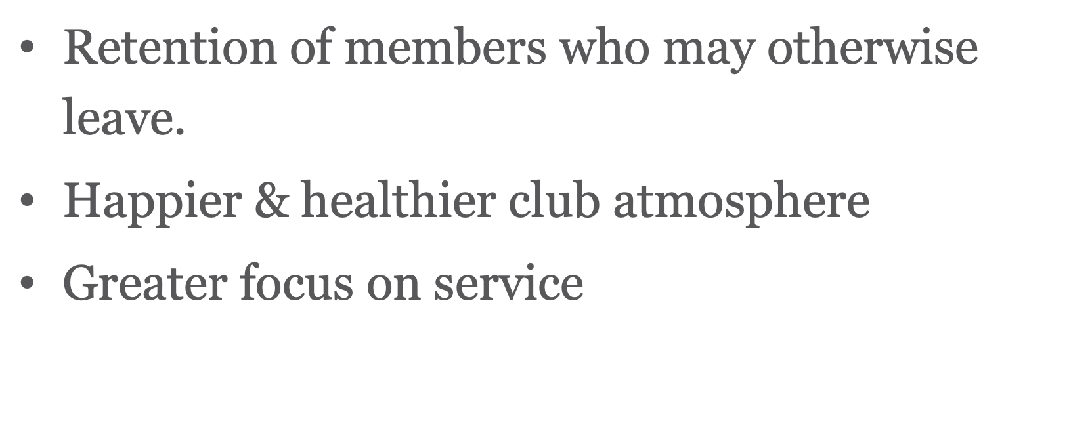
OUTCOMES FOR CLUB

Slide 13
HOW TO RESOLVE CONFLICT
Acknowledge the conflict
Ignoring an issue could lead to further arguments, disagreements and potentially even hurt feelings.
Avoid this by acknowledging the issue out loud and letting the concerned parties know what is happening.
It may not be pleasant but getting it out in the open can then allow everyone to work on a solution.
Be RESPECTFUL

Slide 14
COMMUNICATE
It is important that all parties can have their say when a conflict arises.
Open and honest communication will help the group know exactly where everyone is at and help the group understand where a grievance might be coming from.
Be respectful and clearly state the issue and how you’re feeling, but also make sure that you listen and are prepared to consider that people are allowed to see things differently.

Slide 15
LISTEN AND FIND A SOLUTION
When listening to others, make sure you listen attentively and try to understand where they are coming from with empathy.
Not everyone is the same – we all have different upbringings and experiences which can shape our understanding of what it means to communicate, what can upset one person may not upset another; give people space, yourself included, listen and do your best to bring understanding.
This allows the parties to then start working towards a solution

Slide 16
REFLECT ON WHAT YOUR PART IS
It’s important to be honest with ourselves as to how we have been with the group as well.
Have we stepped up to what’s need or pulled away and withdrawn from the opportunity?
Have we been reactive and shut people down or have we been open, clear and considerate? No one’s perfect but reflecting on the part we’ve played and taking responsibility for it can be a great growth opportunity and can often help the others in the groups to do the same – but not always! Be aware, take responsibly and move on, let others come to understand their part in their own way – you don’t have to force it down their throat! That never gets anyone anywhere anyway.

Slide 17
REMEMBER THE IMPORTANCE OF RELATIONSHIPS
At the end of the day, a conflict is usually a smaller blip in a bigger picture.
You don’t have to be friends, but it’s probably more useful if you aren’t butting heads
In life, you have to be able to work with all sorts of people.
Keep the bigger picture in mind and be respectful, composed and decent to everyone

Slide 19
A reminder to reflect on our own leadership skills

Slide 20
CONFLICT MANAGEMENT SYSTEM

Slide 21
ACKNOWLEDGEMENTS
PDG. Jennifer Scott. D Jennifer has held positions as RI Trainer, Peace Builder at Zone & International levels. Convenor – Singapore Convention 2024
Vocation: Environmental Lawyer. Arbitration
LaTrobe University – Conflict Management
PDG Wendy Gaborit. D 9510 Conflict Management 2022-23
Contact: E. wendygaborit@gmail.com. M. 0418 858 717

