Slide 1
Understanding Conflict Why it’s so important to work together!

Slide 2
How do your club members get along?
Are folks respectful of one another?
Do folks always agree?
Of course not--- but when they disagree
how do they handle it?
Notes:
Ask each question, get some feedback from the group

Slide 3
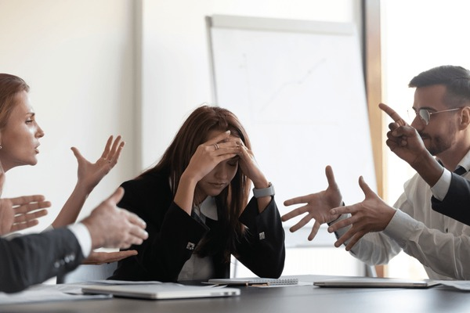
How do you define conflict?
Notes:
ΓΕΤ ΦΕΕΔΒΑΧΚ ΦΡΟΜ ΑΥΔΙΕΝΧΕ ΦΙΡΣΤ…. ΣΕΕ ΩΗΑΤ ΤΗΕΡΕ ΔΕΦΙΝΙΤΙΟΝΣ ΑΡΕ:
A disagreement or argument
• Something that happens between or within people or groups
• A perceived threat to needs or interests
• A choice between multiple needs, interests, or concerns

Slide 4
Is conflict positive or negative?
Notes:
We often think of conflict as negative, especially if it made us feel uncomfortable or it becomes tense or violent.
But conflict can be positive. Debates, brainstorms, and competitions can lead us to better ideas and better outcomes.

Slide 5
Causes of conflict
Poor communication and misunderstandings
Unclear expectations
Real or perceived unfairness
Manipulative behavior
Harassment or bullying

Slide 6
There are also different types of conflict
Four major types of conflict are:
Task conflict (also known as conflict in understanding) differences in viewpoints, ideas, and opinions between people or groups
Relationship conflict (also known as emotional conflict) differences in personality, incompatibility between people. Involves Tension and animosity
Process conflict difference in the method of how tasks are accomplished
Inner conflict differences in opposing demands or impulses within a single person
Notes:
If you can identify the type of conflict, you understand it better.
Conflict management is how people handle conflict
The goal is to reduce the negative aspects of conflict

Slide 7
What's your style?
Most people regularly use one or two of these styles:
Accommodating is unassertive and cooperative. The person neglects their own concerns to satisfy the concerns of the other person.
Avoiding is unassertive and uncooperative. The person pursues neither their own concerns nor those of others. They simply don't deal with the conflict.
Collaborating is assertive and cooperative. The parties attempt to work together to find a solution that satisfies everyone's concerns.
Competing is assertive and uncooperative. A person pursues their own concerns without regard for others' concerns. The person may use their position of power to get their way.
Compromising is moderate in both assertiveness and cooperativeness. The objective is to find some mutually acceptable solution that partially satisfies all parties.
Notes:
After reviewing above mention:
Factors in conflict
In an ideal world, we would collaborate to resolve every conflict. But we don't live in an ideal world, and certain factors affect how we deal with conflict.
The significance of the issue The extent to which priorities, principles, or values are at stake in the conflict
The importance of the relationship How important it is to maintain respect and a supportive relationship with others The relative power of those involved How much power the parties involved in the conflict hold compared with each other.
Time constraints How much actual or perceived time the parties have to resolve the conflict

Slide 8
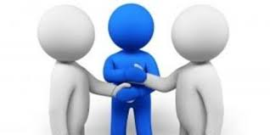
What types of behaviors and skills do you think are beneficial in resolving conflict?
Staying Calm
Managing your emotions
Listening
Speaking up
Being Tactful
Focusing on the problem not the person
Thinking about the present and the future not the past.
Notes:
Listening Don't assume that you know what the other person is upset about. Listen to what they say, and ask questions to understand their perspective better. You may still disagree, but you'll be better equipped to find a resolution that works for both of you.
Thinking about the present and the future not the past. You can't change what has already happened. Instead, think about how to make the relationship more positive and how to avoid similar situations in the future.

Slide 9
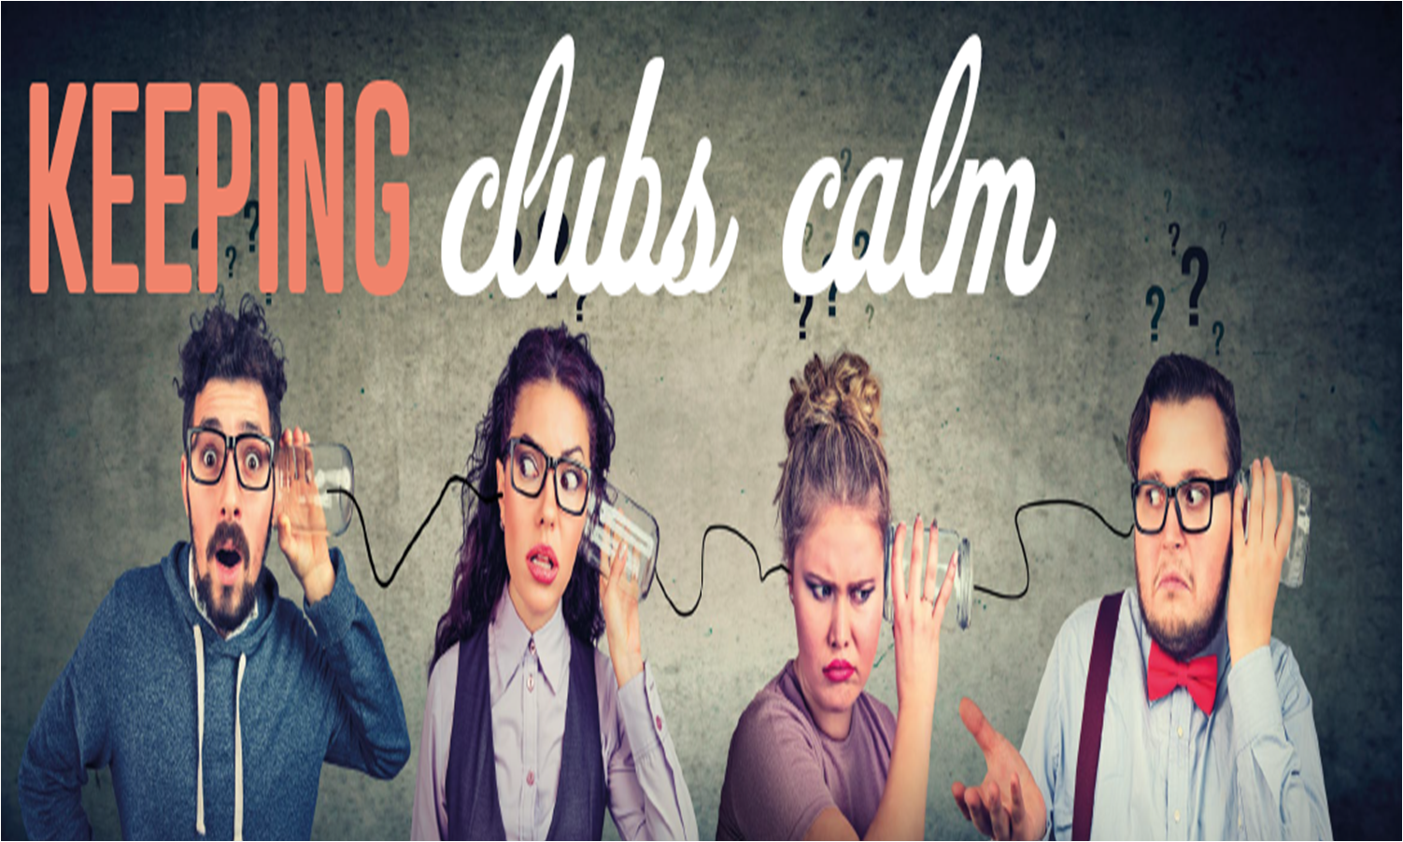
Notes:
Internal Club Dispute
The club rules or constitution must provide a
process of conflict resolution
Train the board to be conflict competent
Consider crucial conversations and plan them
Consider The 4 Way Test
of things we think, say or do:
□ is it the truth
□ is it fair to all concerned
□ Will it build goodwill and better friendships
□ Will it be beneficial to all concerned

Slide 10
Leaders and members must work together for an effective club
Key to getting along is building trust
Acknowledge success and efforts
Communicate well and regularly
“Deal with conflict one on one: praise in public, criticize in private.”
Notes:
I strongly feel both the club leadership and its members are responsible for creating a bond of love and affection, an atmosphere of togetherness, and all-around camaraderie. Everyone has to make an effort in order to create an effective Rotary club.
“Deal with conflict one on one: praise in public, criticize in private.” “Use the 3 C method: compliment, criticize, compliment.” “Separate the person from the position.” Who you are is not what you do. You may be a great member and get elected to a leadership position

Slide 11
SO WE’VE TALKED A LOT ABOUT CONFLICT
ANYTHING YOU WANT TO SHARE OR DISCUSS IN THIS FORUM?
ANY THOUGHTS OR ADDITIONS YOU WANT TO TALK ABOUT?

Slide 12
THANK YOU AND ENJOY THE MAGIC OF THE 2024-2025 ROTARY YEAR!

